Slide 1
Next Recommended Action
01 - Events
02 – Triggers – Flags + Actions
03 - Matched
04 - Repurchase

Slide 2
Agenda:
01
Anatomy Of A Recommender System
02
Triggers And Actions
03
Modeling Process
04
Performance And Validation

Slide 3
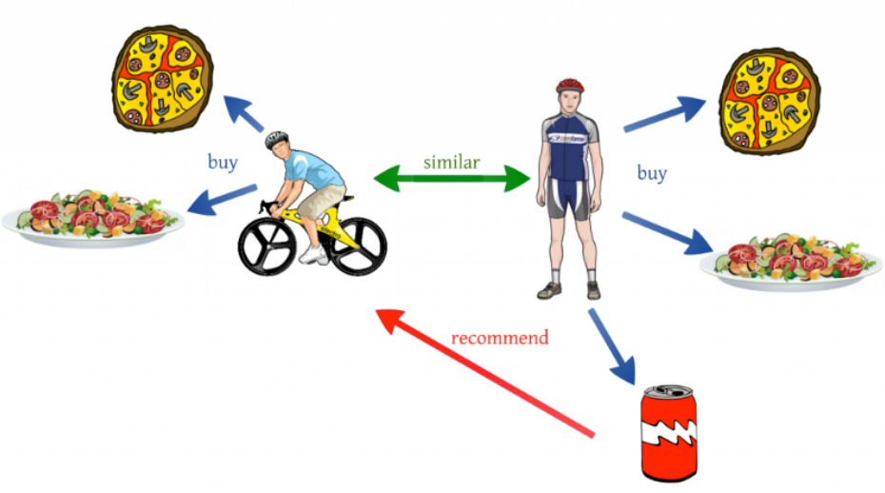
Anatomy Of A Recommender System

Slide 4





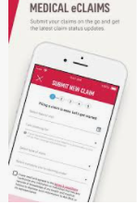


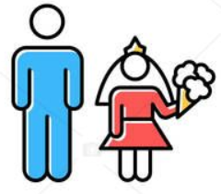
Triggers And Actions
Actions
Triggers

Slide 5
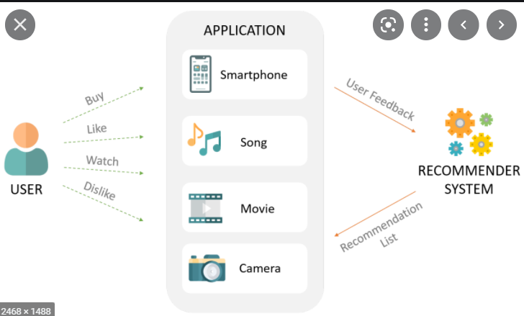
Modeling Process

Slide 6
Flags and conversion rate

Slide 7





Triggered to Repurchase
marriage
Income change
Nest builder 30 yr old
Young single from big city
child
fam claims
birthday

Slide 8
RELEVANT To Repurchase
birthday
2
Income change
marriage
child
fam claims
21
maturing
Age 17
Young Single
Mature Single
Mature Couple
Est Family
marriage
call

Slide 9
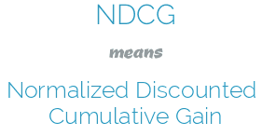
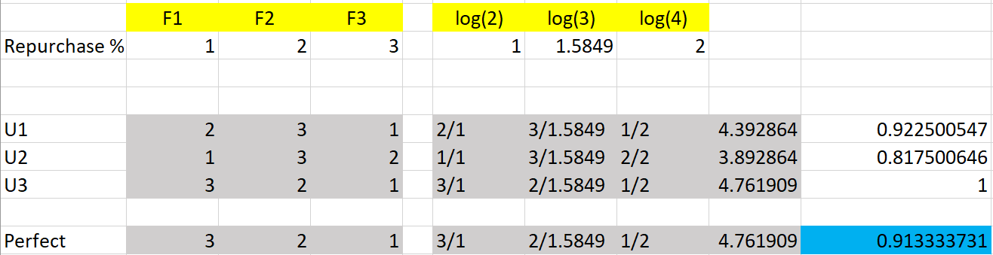
Performance and Validation

Slide 10
Young Single
Income change
mariage
Age 17
Golden Ager
child
Mature Couple

Slide 11
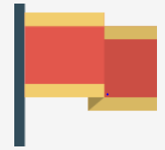



ALPA

Slide 12



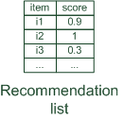
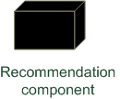



Overview of recommender systems
Hybrid: combinations of various inputs and/or composition of different mechanism

Slide 13
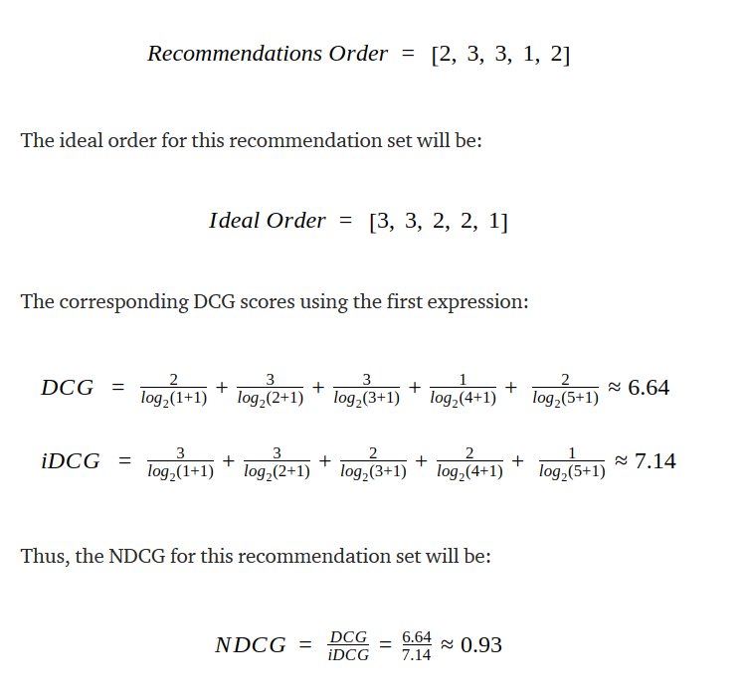
How to measure model performance - NDCG

Slide 14
User profile 1 - Flag ranking – 20, single, 0 kid (21, …
User profile 2 - Flag ranking – 25, single,
https://towardsdatascience.com/an-exhaustive-list-of-methods-to-evaluate-recommender-systems-a70c05e121de

Slide 15
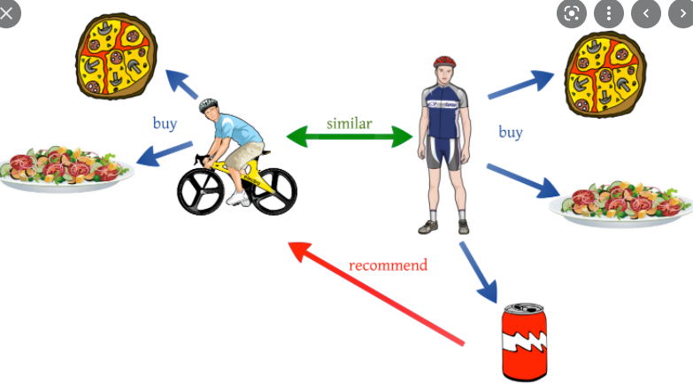
Flags + user profile

