Slide 1



BSP User Training
BSP EC Upgrade 14.1

Slide 2
Agenda
EC Standard Features
01
02
03
Introduction to EC 14
Upgraded Business Features/Process in EC14.1

Slide 3

EC14 Introduction
EC Basic Concept

Slide 4
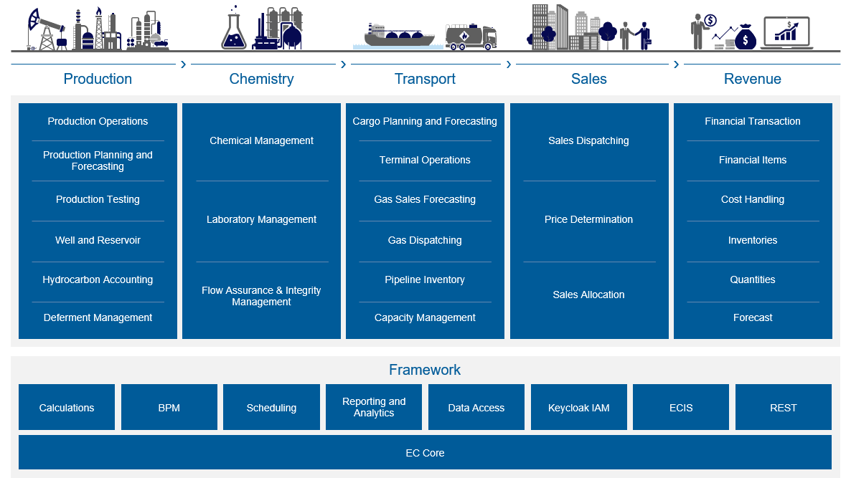
EC14 Core and sub-modules

Slide 5
Stepping up framework & technology
Easier Installation and upgrade of EC with docker images
Improved user experience and efficient system configuration
Up-to-date technology and security enhancements
^{Enhanced Rest API support}
EC upgrade
Better configurability and extensibility through the EC Extension framework
New tools for class & data configuration
New reporting and analytics, providing advanced capabilities
Improved integration capabilities

Slide 6


Security Enhancements
Keycloak
EC now leverages Keycloak, a third party, standardized tool to handle authentication and authorization.
With Keycloak, the process of authentication and authorization has been fully delegated out of EC.
Keycloak gives EC great flexibility in authentication method. EC still supports log-in using a regular username and password but Keycloak provides several other options, including Federated Authentication and Multi/Two-factor Authentication.
Some key authentication methods (not exhaustive list):
LDAP and Microsoft Active Directory SSO
SAML 2.0 – Security Assertion Markup Language. XML based protocol for exchanging authentication information between security domains. This allows for cross-domain SSO.
OAuth 2.0 – Industry-standard protocol for authorization
OpenID Connect 1.0 – Simple identity layer on top of OAuth

Slide 7

Integrations
Data transmission (I/O)
From EC version 12.0, a new RESTful API is made available. This REST API will serve as the basis entry point for new integrations and clients.
Focus for this initial version of REST API has been to enable import and export of data, to and from external resources.
EC provides a REST service endpoint for using GraphQL as the query language towards EC APIs. This serves as an alternative entry point for clients and integrations alongside the REST API itself. GraphQL empowers clients to ask for exactly what they need and no more by providing an intuitive and flexible syntax for describing data requirements and interactions.
In EC14, EC have also added support for external webhooks, allowing you to automatically let external systems know when an event happens. Example: Let a third-party system know that the allocation is done, and that the results can be fetched from EC.

Slide 8


Upgrading/Flyway
Introduction of "Flyway", a delta-based upgrade tool. This is used for all development efforts and is also available for use by customers.
Upgrading EC has always been complicated, and many customers choose to upgrade in large increments. We have started with delta-based upgrades, a new way of creating and managing going from one version to another. This lets us have more control over what is being done, reducing the risk and time for doing upgrades.

Slide 9


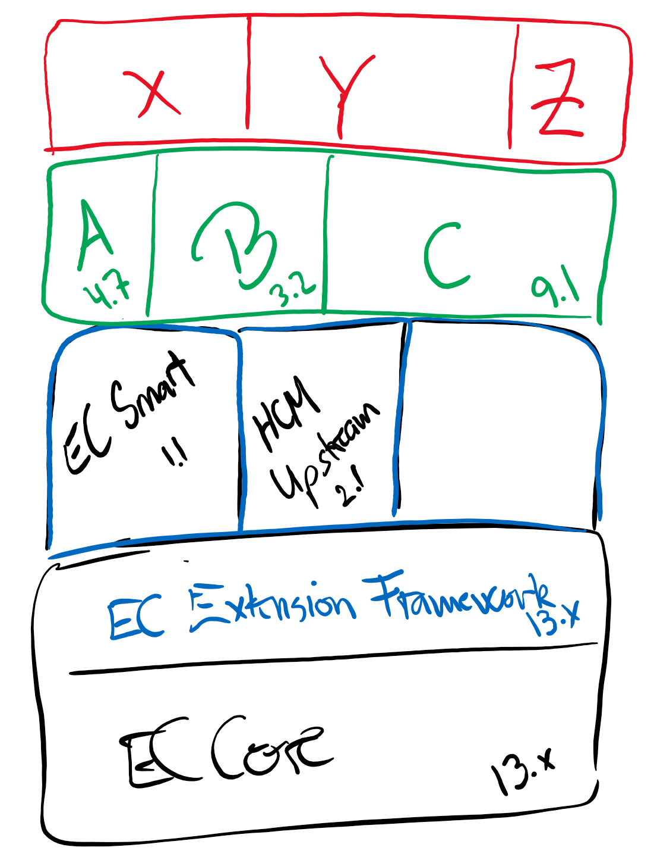
EC Extensions Concept
The extension concept is a new and controlled way of extending functionality in EC. Modifications will not be done as modifying core functionality, but rather to extend it. This will greatly enhance upgradability of EC and also speed up development and deployment time for modifications.
Introduction of the Extension concept, a standardized way of extending the functionality in EC. Historically, modifications to EC have been done by modifying the source code directly, injecting Java code through assemblies, or to create User Exit packages. This, in turn, makes it even harder to upgrade EC.
With Extensions, we take these features and separate them from the core functionality, enabling stricter rules on how to expand the functionality in EC, and provide a standardized way of doing it.

Slide 10

Calculation enhancements
Calculation Editor
Possible to edit library calculation from the main calculation.
Convert a calculation sub process to a library calculation. This makes it easier to split a large calculation into calculation library that are easier to maintain.
Calculation Engine
Make the run no available to the calculation engine. This make it possible to write data for one calculation run.
Improve data write by making it possible to have tables without triggers. Audit trail / journaling must be done by the project. This can be used to write temporary calculation results.
Stream Node Diagram
Make it configurable which attribute should be used for stream colour.
Make it possible to filter stream based on allocation period (e.g. only show daily, monthly or yearly streams).

Slide 11

EC Standard Features
Screen Structure | Screen layout | Treeview

Slide 12

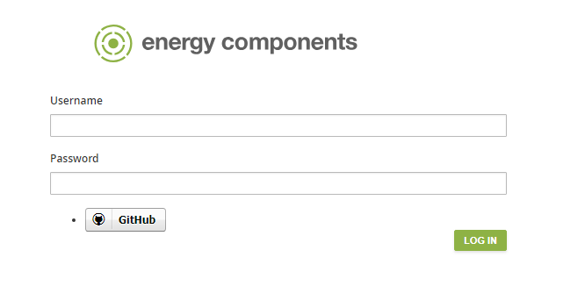
Login Page
All users must be registered in EC and given a password before first login.
Depending on the local IT environment, the password can be specific for the user and EC, it may just be the same as the Windows password or it can even be automatically set for the user – if single sign on is implemented.

Slide 13
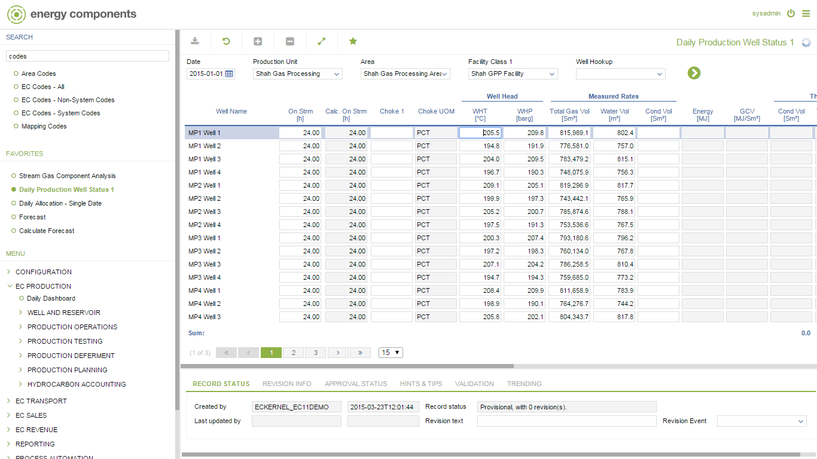
Screen Areas
Add to Favourite Menu
Columns can be hidden or new included
Access to objects can be configured
Navigator can be configured
Screen navigation
Search
Favorites
Pre configured
Units can be configured
Input data can be validated
New lines appear automatically
when new objects are created
Calculated numbers can be
Included in reporting layer
And hidden or displayed in
client
Access is configured By role/user and record status
The application can be
Configured in multiple
languages
Audit tracking rules
can be configured
Check rules can
be configured
Record status processes
Can be configured

Slide 14


Screen Bar
The screen bar shows who is logged on
It has the log off button
Most screens also have a three lines icon. Click this to get some appropriate help regarding the screen you are in

Slide 15

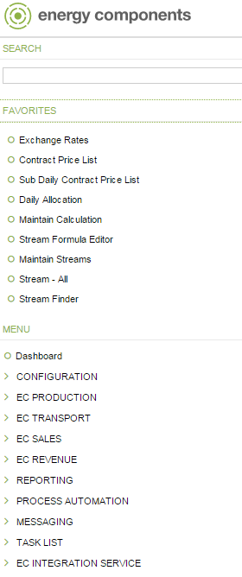
Treeview
The treeview is the menu tool you use to select your next screen to visit.
It has a hierarchical structure with folders and subfolders where the functional area folders are all on the highest level.
It offers a search feature for locating menu items, and a Favorites zone for each user to populate.
The functional area folders are all on the highest level
The treeview will appear according to the specific system setup and also the logged in user’s access privileges. If a user hasn’t access to any screens under a given folder, then even the folder will be hidden in the treeview.

Slide 16


Tool Bar
From left to right:
Save, Refresh, New, Mark for deletion, Fullscreen on/off and Add to Favorites

Slide 17


‘New’ button will insert a blank line in screens where this is allowed
Refresh will read again from database
Mark for deletion will do just that, you will need to press ‘Save’
Save to store changes
Fullscreen – get more data window space by hiding treeview and status area
Add to Favorites will copy the active menu item to Favorites

Slide 18
Navigator
Filter
In the navigator we filter what data we will read from the database
Navigator dropdowns will only list items that are configured for the screen in question
Default Settings
Navigator has default settings for users or user groups
Memory
It ‘remembers’ the choices made earlier in the same session
Dependencies
It ‘remembers’ the choices made earlier in the same session
Go button
Hit the ‘>’ button to start the data retrieval. If you change anything in the navigator, this button must be pressed again. Trying to save changes in data that was not refreshed will give an error message and nothing gets saved.

Slide 19
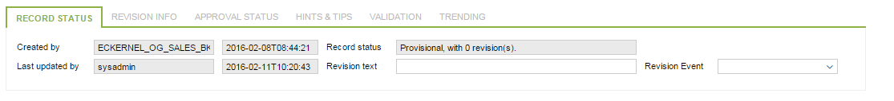
Status Area
Record Status
tells who created this record, when it was created and info about updates and revisions.
Revision Info
shows all previous revisions from the journal files.
Approval Status
Is used for approval of specific data records according to configuration.
Hints &Tips
is a blank field for users to write what they may find appropriate.
Validation
is for the execution of defined validation rules.
Trending
can be used to draw a graph or get a pdf report with selected data trended.
Notes:
Standard
In the status area you will find information about the data record you have marked by placing the cursor.

Slide 20
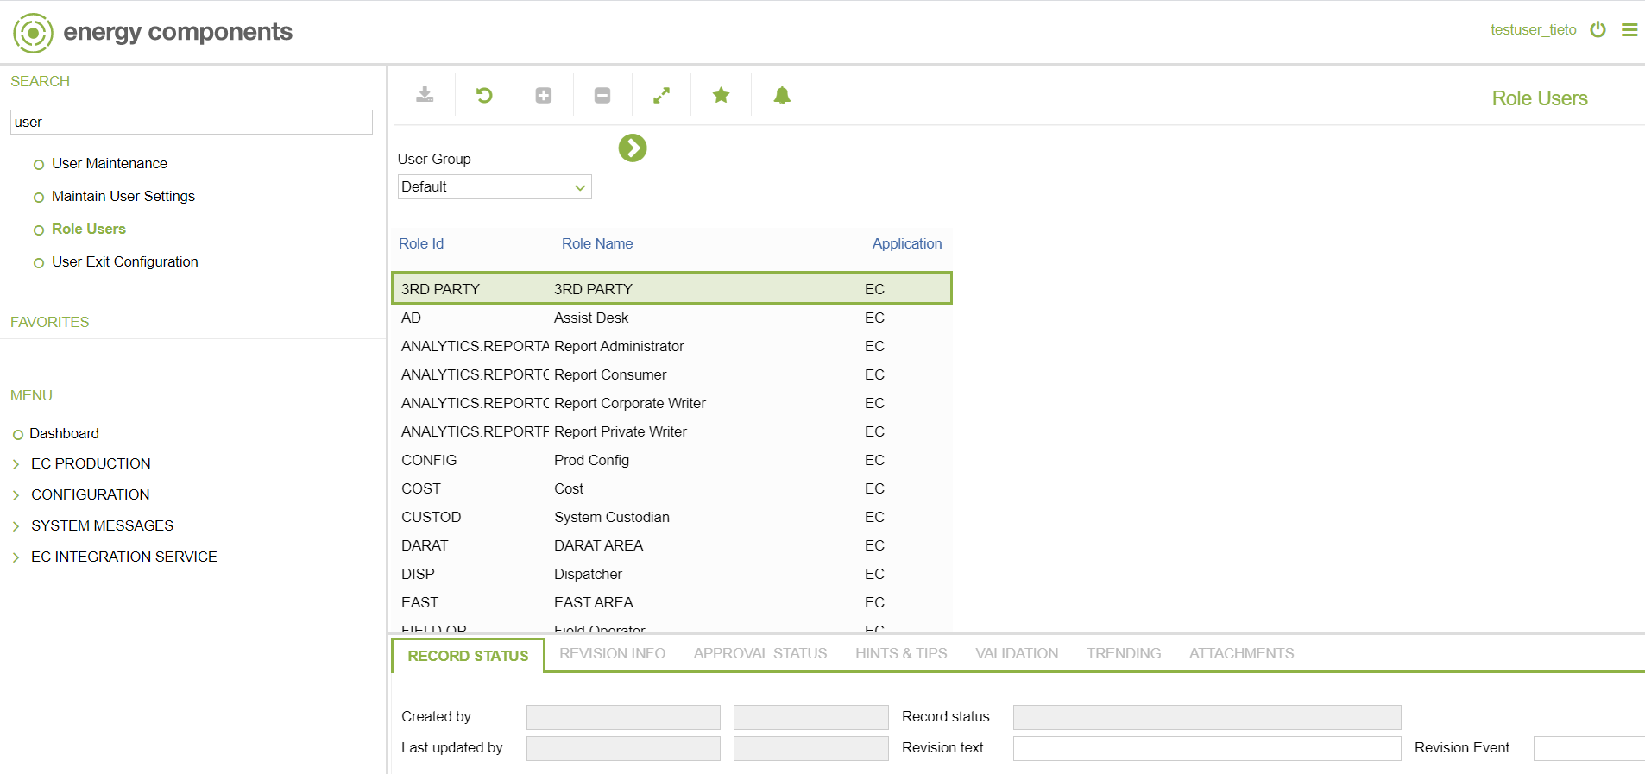
Business Function Search

Slide 21
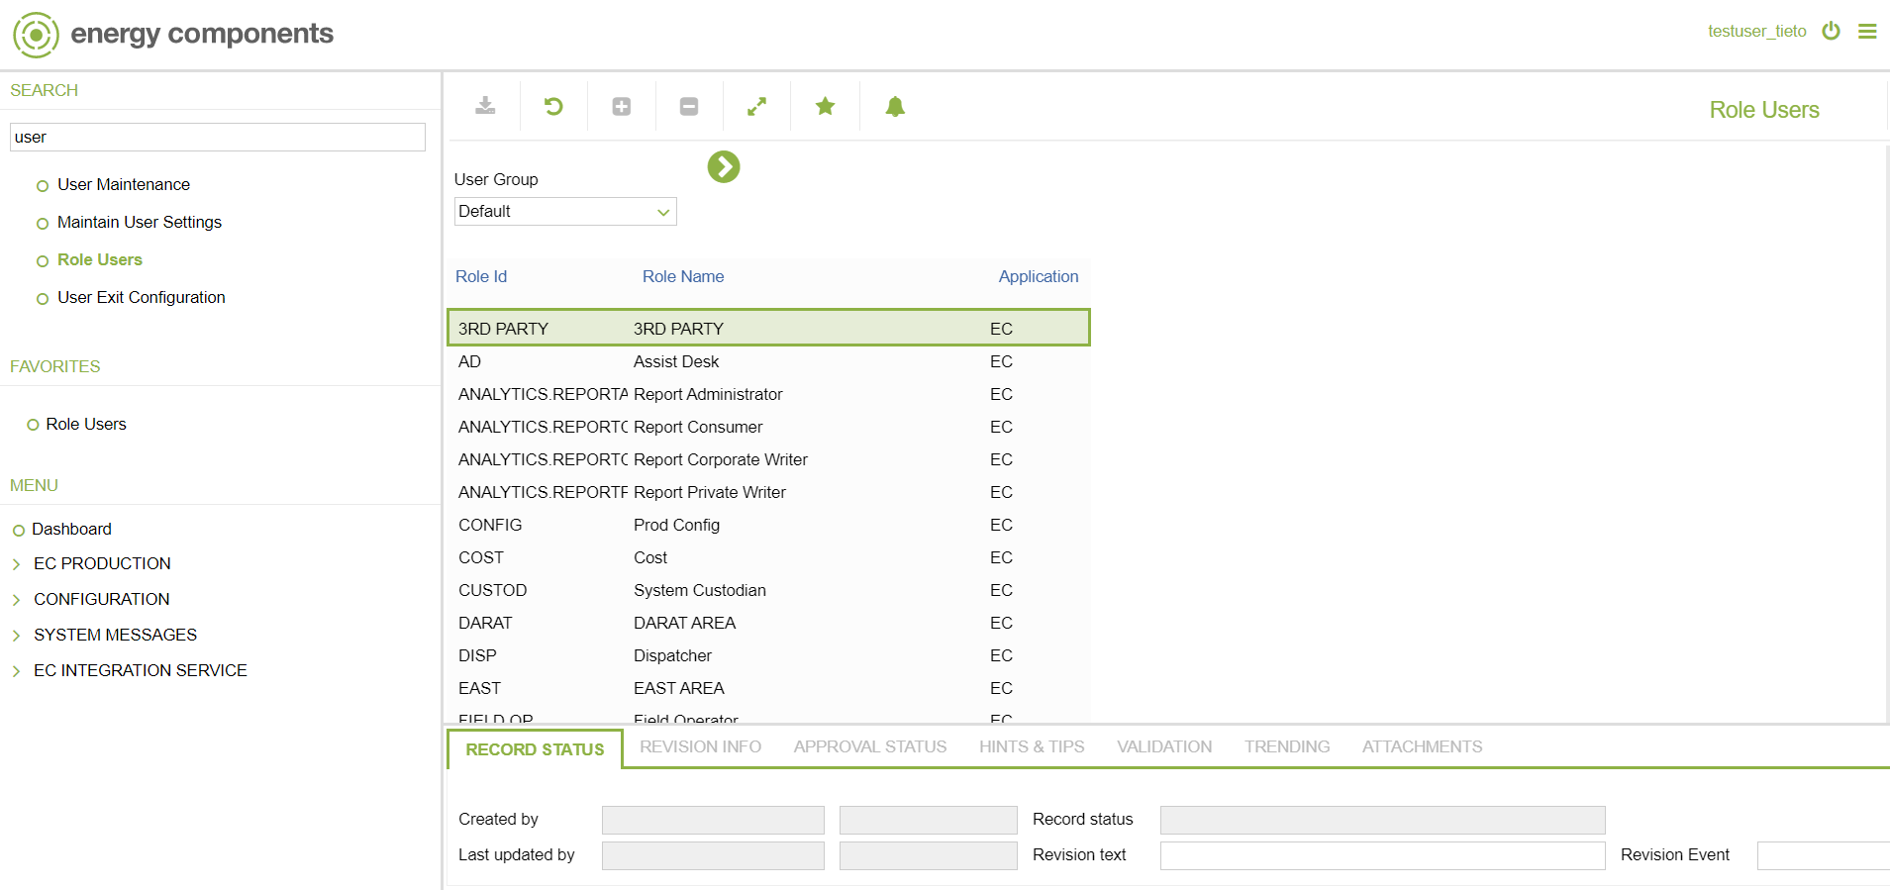
Add Favorite

Slide 22
Data Window - 1
Field colours
Grey – read only
White – editable
Yellow – mandatory
Numeric field colour code
Can be configured
E.g.: yellow/red for values outside ranges as warning/error
System prevents user from saving value outside the error range

Slide 23
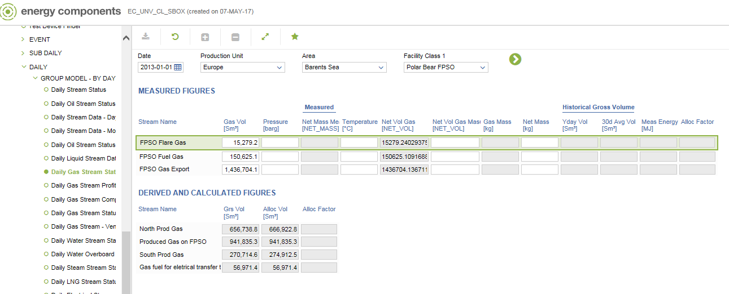
Data Window - 2
Show Data
Protect Data
Edit Data (Priviledges)
Edit Mandatory Data
Editable data
Non-editable data
Notes:
Standard
The data window is where we check the actual data and do our work.
Screens have different layout, but a common thing is that only data we can change are editable. There are several reasons for showing data in a protected way. One is that the data item is derived and displayed in the screen but not stored in the database, another that the user has not the necessary priviledges.
Typically for stream screens we have the measured stream in the upper part and the derived and calculated streams below.

Slide 24

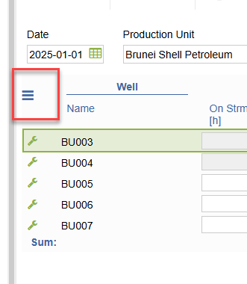
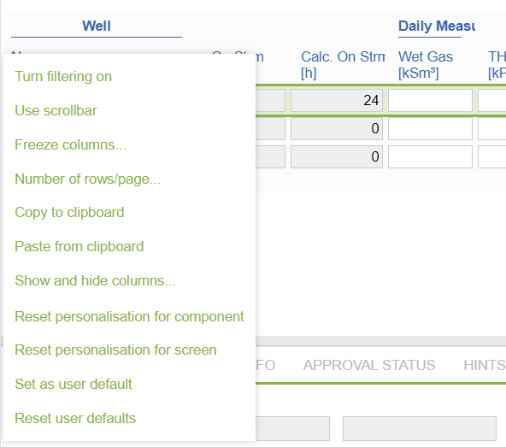
Data Table Menu
Enable the filtering to search
Enable scrollbar to combine all the data in one page
Freeze selected columns for efficient column view
Set number of rows to show per page
Copy the entire rows of data in clipboard to edit in excel
Copy from excel and apply in EC screen
Show and hide the columns
Reset capability
Reset capability for screen only
Set as default

Slide 25
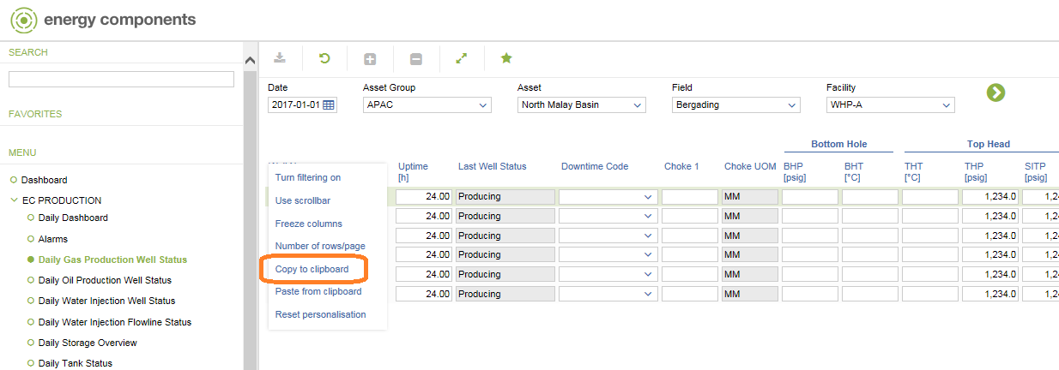
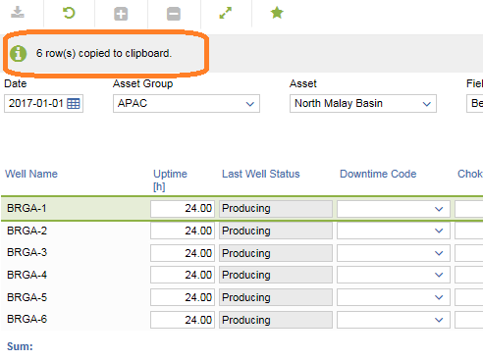
Excel copy and paste - 1
Data in screen can be edit in bulk using the “Copy to clipboard” function

Slide 26
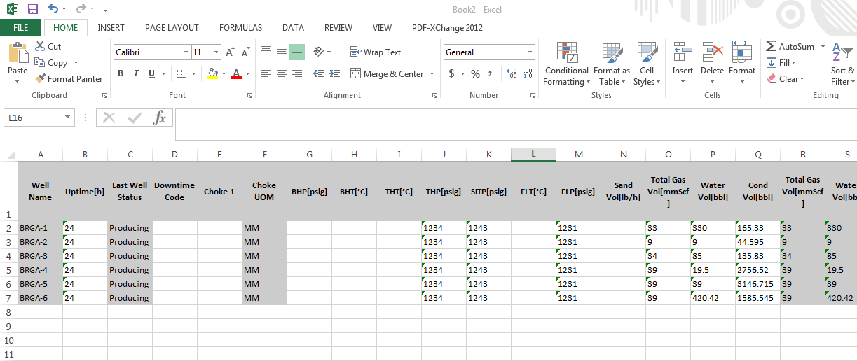
Excel copy and paste - 2
Open a blank excel sheet, click paste

Slide 27
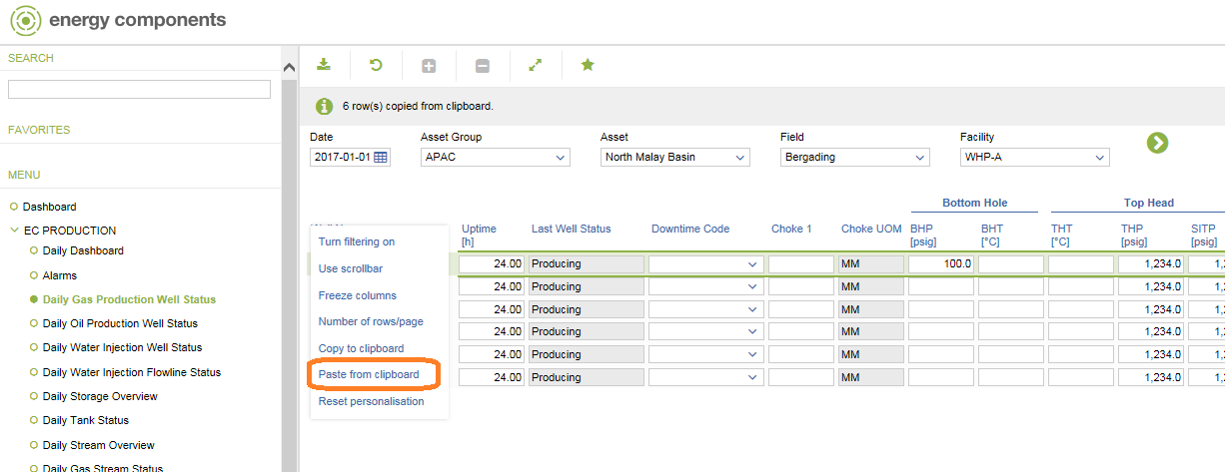
Excel copy and paste - 3
Data can be edited in excel and to be pasted back to the screen using “Paste from clipboard”

Slide 28


Upgraded Business Features/Process in EC 14.1

Slide 29

1. Manage Object
2. Deferment
3. Tooltips on EC codes
4. ECIS Agent
What’s new in EC14.1?

Slide 30
1. Manage Object

Slide 31
Manage Object – Overview
New one-stop screens for simplified object configuration.
Reduces separate screen navigation.
Enter the most relevant information for an object.
Includes:
Manage Facility
Manage Stream
Manage Well

Slide 32
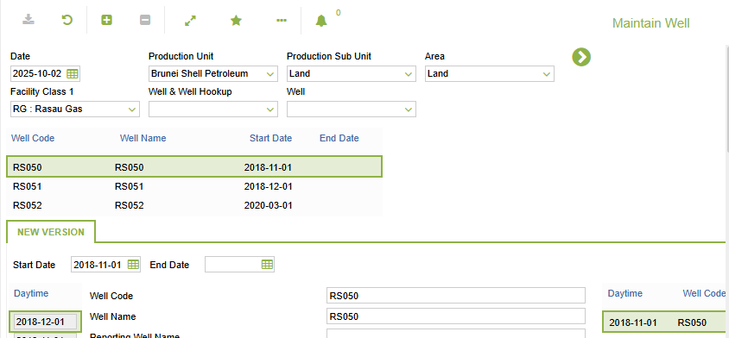
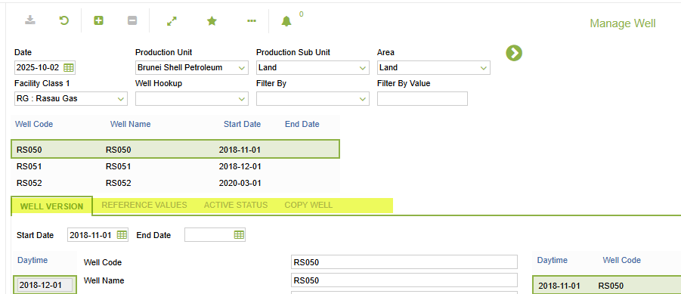
Manage Well
EC12
EC14

Slide 33
2. Deferment

Slide 34
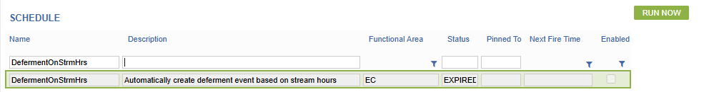
Deferment
Automatically creates a deferment record based on minimum on stream hours settings
A scheduler job can be executed to insert the wells automatically in Deferment Day

Slide 35
3. Tooltips on EC Codes

Slide 36
Tooltips on EC Codes
More descriptive dropdown selections are now available.
Tooltip on dropdown that uses EC Codes for most screens are now supported.
Configuration is required for the tooltip to be displayed on screen.

Slide 37
4. ECIS Agent

Slide 38
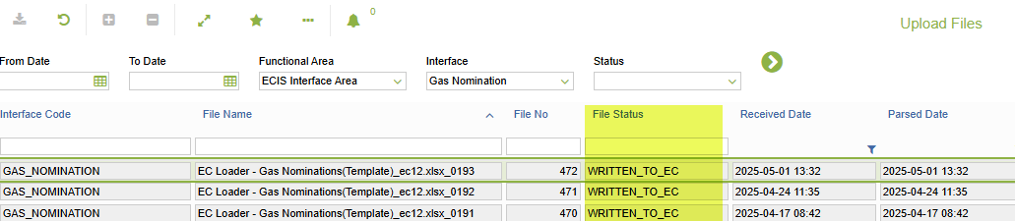
File Upload – Gas Nomination / IPP
EC12
EC14
Users upload files to the 'Drop' folder on the server: \\bspsvmp50.bsp.shell.bn.
IT support copies the files and uploads them manually to the EC server.
User manually trigger the EC scheduled job (BSP_ImportGasNominations / BSP_ImportIPP) to import data into EC.
User upload files to ‘Drop” folder on the server : \\servmo-s-11549 (Production ECIS server)
At ECIS server, a windows task scheduler will trigger a batch file every 5 minutes to upload the file in the 'Drop' folder into EC.
User verify in the EC screen "File Uploads" whether the file has been uploaded successfully.
User manually trigger the EC scheduled job (BSP_ImportGasNominations / BSP_ImportIPP) to import data into EC, and the file status in ‘Upload Files” screen should mark as “WRITTEN_TO_EC”
38

Slide 39


Current EC12 PI configuration in BSP
EC BSP
Web Server
(OPC Client)
OPC Server
EC
ECIS
DCOM
EC Database

Slide 40




Upgraded EC14 PI Configuration in BSP
EC BSP
ECIS Agent server
PI Web
EC
ECIS Agent
EC Database

Slide 41
PI - BSP_ECIS_DAY (scheduled)
EC12
EC14
PI job is scheduled in EC to run everyday at midnight 00:10
The PI tag is configured to map to EC column through the Maintain Mapping screen.
Data imported from PI will be stamped as Created By / Last Updated By: sched, under Record Status.
PI job is scheduled in ECIS server task scheduler to run everyday at midnight 00:10
The PI tag is configured to map to EC column through the Maintain Mapping screen.
Data imported from PI will be stamped as Created By / Last Updated By: ecisagent, under Record Status.
41

Slide 42
PI - BSP_ECIS_PISAMPLE (scheduled)
EC12
EC14
PI job is scheduled in EC to run everyday at midnight 00:02
The PI tag is configured to map to EC column through the Maintain Mapping screen.
Data imported from PI will be stamped as Created By / Last Updated By: sched, under Record Status.
PI job is scheduled in ECIS server task scheduler to run everyday at midnight 00:02
The PI tag is configured to map to EC column through the Maintain Mapping screen.
Data imported from PI will be stamped as Created By / Last Updated By: ecisagent, under Record Status.
42

Slide 43
PI - BSP_ECIS_PIRERUN (manual)
EC12
EC14
User identify the PI tag to rerun.
User update Source Id and Last Transfer date through the Maintain Mapping screen.
User trigger scheduler BSP_ECIS_PIRERUN in EC manually
User identify the PI tag to rerun.
User update Source Id and Last Transfer date through the Maintain Mapping screen.
User to inform IT support to run task scheduler PIRerun in ECIS server manually
43

Slide 44

Discussion

Slide 45


