Slide 1
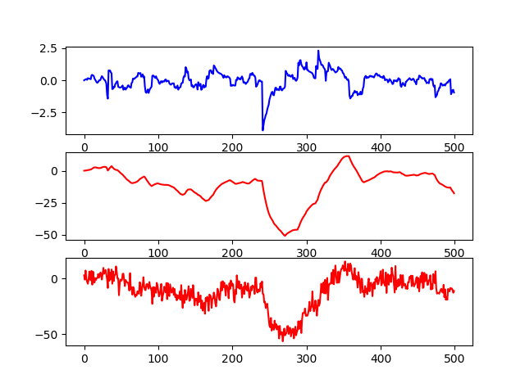



Simulated Price / Return series
Returns ($x_{2,k}$)
Price ($x_{1,k}$)
Observed Price ($y_{k}$)

