Slide 1
Concepts of Android Programming using kotlin
Shou-Chih Lo
National dong hwa university
2021

Slide 2
Outline
APP Fundamentals /Components
Data Binding
Intent
Fragment
ViewModel/ViewModel.Factory
LiveData

Slide 3
APP Fundamentals
Android apps can be written using Kotlin, Java, and C++ languages
Android SDK tools compile your code along with any data and resource files into an APK
By default, every app runs in its own Linux process, and each process has its own virtual machine (VM)

Slide 4
APP Components
The essential building blocks of an Android app
Four different types of app components
Activities
Services
Broadcast receivers
Content providers
Each component is an entry point through which the system or a user can enter your app (there is no main function as the single entry point)

Slide 5
Activities
Represents a single screen with a user interface
An APP can contain several activities that work together but independently

Slide 6
Services
Runs in the background to perform long-running operations or to perform work for remote processes
Does not provide a user interface

Slide 7
Broadcast Receivers
Allow the app to respond to system-wide broadcast announcements
Many broadcasts originate from the system such as the screen has turned off, the battery is low, etc.
Apps can also initiate broadcasts to let other apps know some events, for example, some data has been downloaded

Slide 8
Content Providers
Manage a shared set of app data that you can store in the file system, in a SQLite database, on the web, or on any other persistent storage location
Other apps can query or modify the data if the content provider allows it
For example, the Android system provides a content provider that manages the user's contact information

Slide 9
Data Binding vs. View Binding
Data binding
Support layout variables to declare dynamic UI content
View binding
Don’t support layout variables
Need not use the <layout> tag
https://developer.android.com/topic/libraries/view-binding
https://betterprogramming.pub/exploring-viewbinding-in-depth-598925821e41
Notes:
View binding
android { ... buildFeatures { viewBinding true } }
Data binding
android { ... buildFeatures { dataBinding true } }

Slide 10
Data Binding vs. View Binding
View binding
android { ... buildFeatures { viewBinding true } }
Data binding
android { ... buildFeatures { dataBinding true } }

Slide 11
Data Binding in Activities
Data binding (activity_main.xml for example)
private lateinit var binding: ActivityMainBinding
override fun onCreate(savedInstanceState: Bundle?) {
super.onCreate(savedInstanceState)
binding = DataBindingUtil.setContnetView(this, R.layout.activity_main)
}

Slide 12
View Binding in Activities
View binding (activity_main.xml for example)
private lateinit var binding: ActivityMainBinding
override fun onCreate(savedInstanceState: Bundle?) {
super.onCreate(savedInstanceState)
binding = ActivityMainBinding.inflate(layoutInflater)
setContentView(binding.root)
}

Slide 13
Data Binding in Fragments
Data Binding (fragment_title.xml for example)
override fun onCreateView(inflater: LayoutInflater, container: ViewGroup?,
savedInstanceState: Bundle?): View? {
val binding = DataBindingUtil.inflate<FragmentTitleBinding>(inflater,
R.layout.fragment_title, container, false)
return binding.root
}

Slide 14
View Binding in Fragments
View Binding (fragment_title.xml for example)
override fun onCreateView(inflater: LayoutInflater, container: ViewGroup?,
savedInstanceState: Bundle?): View? {
val binding = FragmentTitleBinding.inflate(inflater, container, false)
return binding.root
}

Slide 15
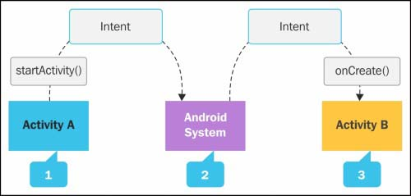
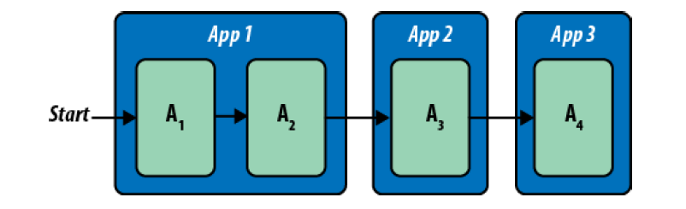
Activating Components
To activate another component in the same or different app, deliver a message to the system that specifies your intent to start a particular component

Slide 16
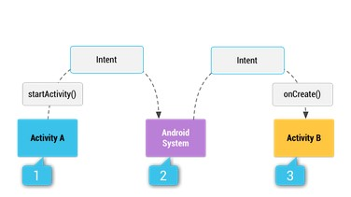
Intent
A messaging object you can use to request an action from another app component

Slide 17
Intent Type
Explicit intents specify which application will satisfy the intent, by supplying either the target app's package name or a fully-qualified component class name
Implicit intents do not name a specific component, but instead declare a general action to perform, which allows a component from another app to handle it

Slide 18
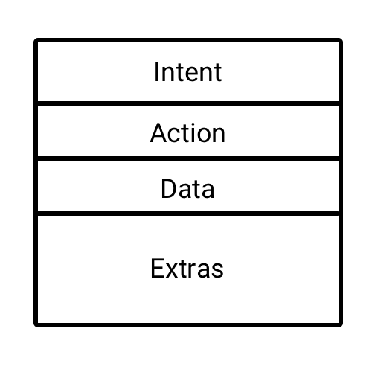
Intent Structure
Action: a string that specifies the generic action to perform (ACTION_VIEW, ACTION_SEND, etc.)
Data: The URI (a Uri object) that references the data to be acted on and/or the MIME type of that data
Extras: Key-value pairs that carry additional information required to accomplish the requested action

Slide 19
Intent Example
Star another activity using an explicit intent
Scenario: MainActivity → SecondActivity
Codes:
val intent = Intent(this, SecondMainActivity::class.java)
startActivity(intent)

Slide 20
AndroidManifest.xml
<application …
…
<activity android:name=".SecondMainActivity"></activity> <activity android:name=".MainActivity"> <intent-filter> <action android:name="android.intent.action.MAIN" /> <category android:name="android.intent.category.LAUNCHER" /> </intent-filter> </activity> </application>

Slide 21
Intent Example
Star another activity using an implicit intent
Codes:
Customized action name
val intent = Intent("com.example.intentexample.ACTION_START")
startActivity(intent)

Slide 22
AndroidManifest.xml
<application …
…
<activity android:name=".SecondMainActivity">
<intent-filter> <action android:name="com.example.intentexample.ACTION_START" /> <category android:name="android.intent.category.DEFAULT" /> </intent-filter>
</activity> …
…
</application>

Slide 23
More Implicit Intent Examples
Open a web page
Dial a phone number
val intent = Intent(Intent.ACTION_VIEW) intent.data = Uri.parse("https://www.yahoo.com.tw")
val intent = Intent(Intent.ACTION_DIAL) intent.data = Uri.parse("tel:0800123456")

Slide 24
Passing Data Using Intents
Put each data item into the intent using PutExtra()
Get each data item from the intent using different GetXXExtra()
val intent = Intent(this, SecondMainActivity::class.java).apply { putExtra("Name", "Robert") putExtra("Age", 40) }
val name = intent.getStringExtra("Name") val age = intent.getIntExtra("Age", 0)
Default Value

Slide 25
Passing Data Using Intents
Enclose all data items into a bundle
Put the bundle into the intent using PutExtras()
May be null
val bundle = Bundle().apply { putString("Name", "Robert") putInt("Age", 40) } intent.putExtras(bundle)
val bundle = intent.extras val name = bundle?.getString("Name") val age = bundle?.getInt("Age")

Slide 26
Passing Objects Using Intent
//Person.kt
import android.os.Parcelable import kotlinx.parcelize.Parcelize @Parcelize //object serialization data class Person(val name: String, val age: Int): Parcelable
Add plugin id 'kotlin-parcelize’
kotlin_gradle_plugin at least 1.4.20
//MainActivity.kt
val person = Person(“Robert”, 40)
val bundle = Bundle().apply {
putParcelable("Person", person)
}
//SecondMainActivity.kt
val person = bundle?.getParcelable<Person>("Person")
Notes:
//kotlin-parcelize ships with Kotlin Plugin 1.4.20
plugins { ... id 'kotlin-parcelize’ }
//passing list of objects
putParcelableArrayList()

Slide 27
Return Data Back using Intents
MainActivity
Override onActivityResult() to get the returned data
startActivityForResult(intent, 1) //any requestCode number
override fun onActivityResult(requestCode: Int, resultCode: Int, data: Intent?) { super.onActivityResult(requestCode, resultCode, data) when (requestCode) { 1 -> if (resultCode == Activity.RESULT_OK) { val returnedData = data?.getStringExtra("Message") Log.d("Main", returnedData.toString()) } } }

Slide 28
Return Data Back using Intents
SecondActivity
binding.button2.setOnClickListener { val intent = Intent() intent.putExtra("Message", "No problem") setResult(Activity.RESULT_OK, intent) finish() }

Slide 29
Fragment
Fragment basic
Fragment navigation (Using navigation graphs)
Data passing between fragments (Using SafeArgs)

Slide 30
Basic: Fragment
Multi-pane applications

Slide 31
What is a Fragment
A reusable sub Activity
Must be attached to an Activity
Have its own UI (layout) or no UI
Can be loaded into an Activity statically
Can be added into or removed from an Activity dynamically
Have a unique ID or tag

Slide 32
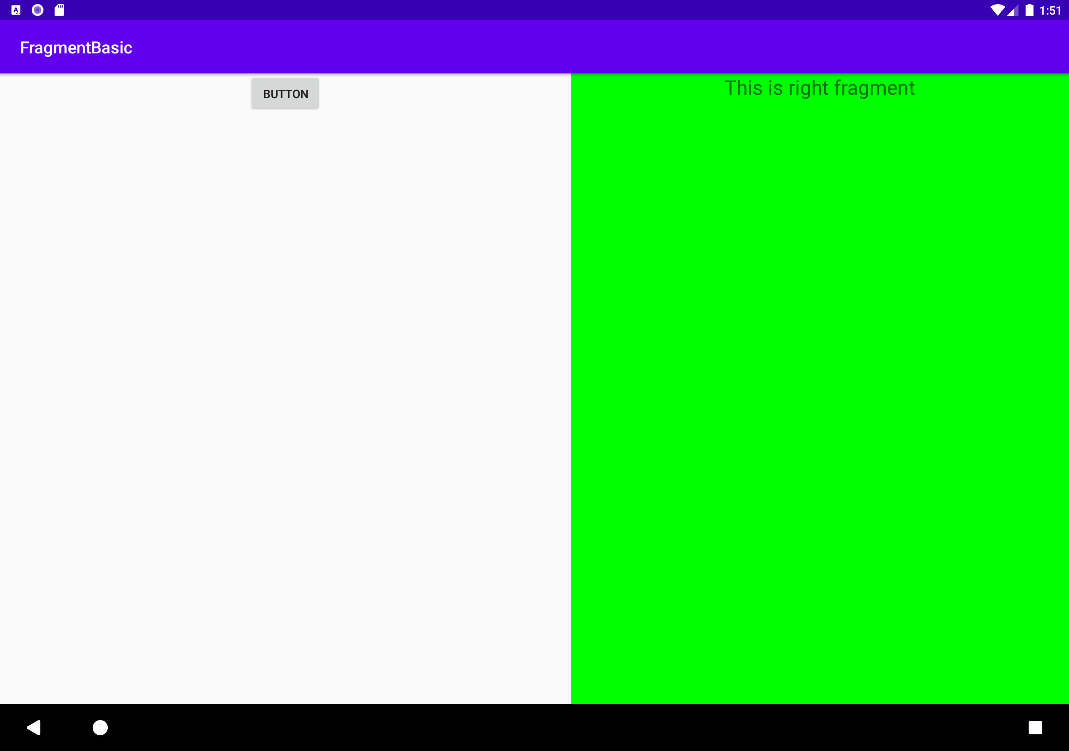
Static Loading
MainActivity includes two fragments: RightFragment and LeftFragment
In the activity_main.xml, use the fragment tag to load the fragment by giving the android:name

Slide 33
Fragment’s Layout
<LinearLayout xmlns:android="http://schemas.android.com/apk/res/android"
android:orientation="vertical"
android:layout_width="match_parent"
android:layout_height="match_parent">
<Button
android:id="@+id/button"
android:layout_width="wrap_content"
android:layout_height="wrap_content"
android:layout_gravity="center_horizontal"
android:text="Button"
/>
</LinearLayout>
<LinearLayout xmlns:android="http://schemas.android.com/apk/res/android"
android:orientation="vertical"
android:background="#00ff00"
android:layout_width="match_parent"
android:layout_height="match_parent">
<TextView
android:layout_width="wrap_content"
android:layout_height="wrap_content"
android:layout_gravity="center_horizontal"
android:textSize="24sp"
android:text="This is right fragment"
/>
</LinearLayout>

Slide 34
Main Layout
<LinearLayout xmlns:android="http://schemas.android.com/apk/res/android"
android:orientation="horizontal"
android:layout_width="match_parent"
android:layout_height="match_parent" >
<fragment
android:id="@+id/leftFrag"
android:name="com.example.fragmenttest.LeftFragment"
android:layout_width="0dp"
android:layout_height="match_parent"
android:layout_weight="1" />
<fragment
android:id="@+id/rightFrag"
android:name="com.example.fragmenttest.RightFragment"
android:layout_width="0dp"
android:layout_height="match_parent"
android:layout_weight="1" />
</LinearLayout>
Using <fragment> to load a fragment

Slide 35
Dynamic Adding
In the activity_main.xml, use the FrameLayout tag to reserve the space of the fragment
<FrameLayout android:id="@+id/rightLayout" android:layout_width="0dp" android:layout_height="match_parent" android:layout_weight="1" > </FrameLayout>

Slide 36
MainActivity’s Code
override fun onCreate(savedInstanceState: Bundle?) { super.onCreate(savedInstanceState) setContentView(R.layout.activity_main) button.setOnClickListener { replaceFragment(RightFragment()) } } private fun replaceFragment(fragment: Fragment) { val fragmentManager = supportFragmentManager val transaction = fragmentManager.beginTransaction() transaction.replace(R.id.rightLayout, fragment)
//transaction.addToBackStack(null) transaction.commit() }

Slide 37
Fragment Management
Manage fragments by getting a FragmentManager
The edit operations are processed in a transaction way
Transactions are enclosed by BeginTransaction and Commit
Transactions includes the add, remove, replace and query fragments
Transactions can be recorded into the back stack for the user’s undo by pressing the back button

Slide 38

Explain: FrameLayout
All UI views are placed at the left top corner
A former UI is covered by a latter UI
Used to hold substitutable fragments
Red < Green < Yellow

Slide 39
Navigation Architecture Component
Add NavHostFragment into the main layout
Create a navigation graph
The related dependencies will be added automatically
Perform a navigation action
view.findNavController().navigate(R.id.actionXXXXX)

Slide 40
Passing Data Between Fragments
Using Safe Args (add classpath and plugin)
Add arguments on the receiver-side fragment (int, int array, custom parcelable, etc.)
Perform a navigation action (sender-side fragment)
view.findNavController().navigate(XXXDirections.actionXXXXX(arguments))
Receive the data (receiver-side fragment)
val args = XXXArgs.fromBundle(requireArguments())
Notes:
classpath "androidx.navigation:navigation-safe-args-gradle-plugin:$navigationVersion“
apply plugin: 'androidx.navigation.safeargs'

Slide 41
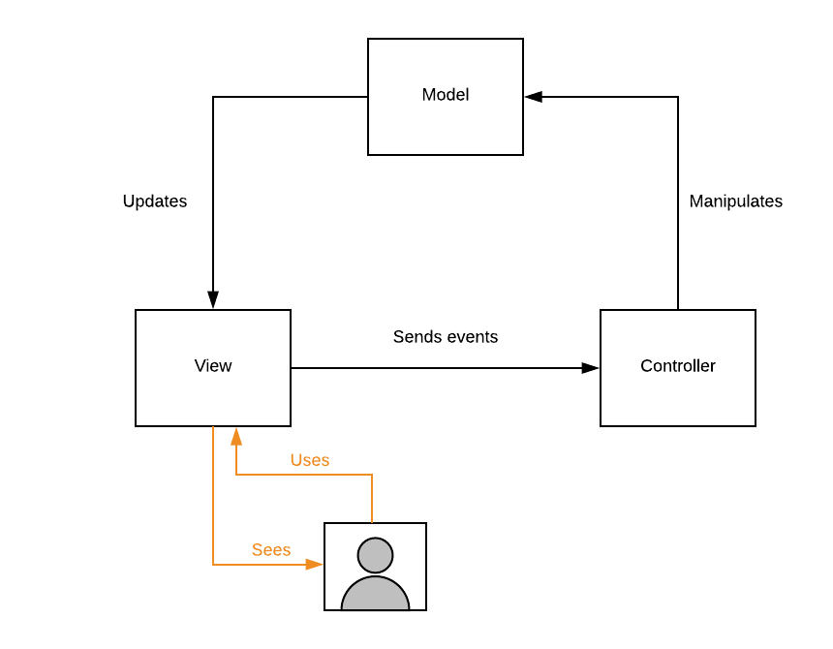
MVC (Model-View-Control)
The View displays the state of the Model,
The Controller handles the View input.
The Model stores the result that comes out of the Controller
Problem: massive view controller

Slide 42
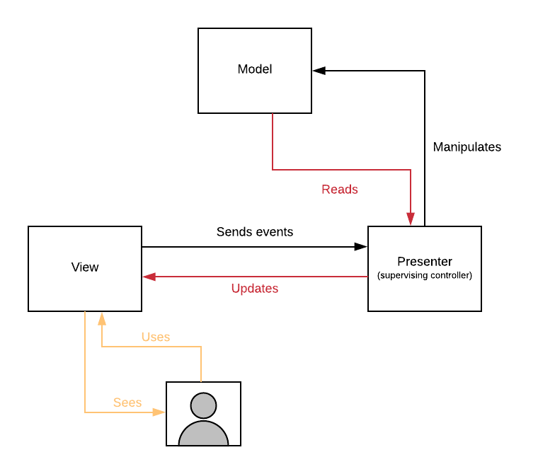
MVP (Model-View-Presenter)
Decoupling the Model from the View
Offers easier UI and Unit Testing

Slide 43
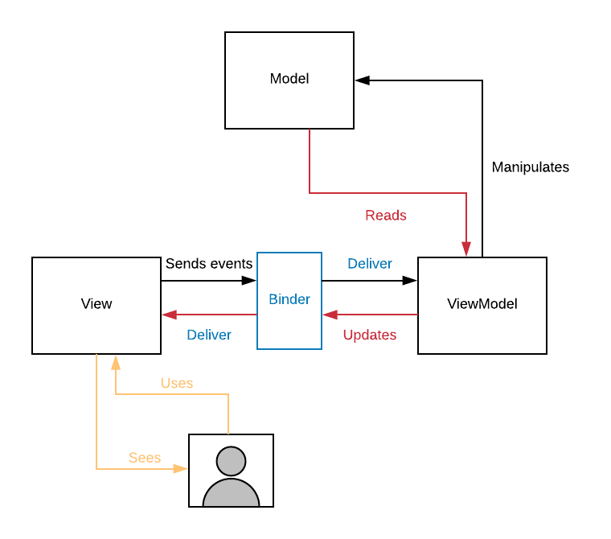
MVVM (Model-View-ViewModel)
View is very lightweight without logic in it
Model is a lightweight component without knowing other components
ViewModel has all the business logic

Slide 44
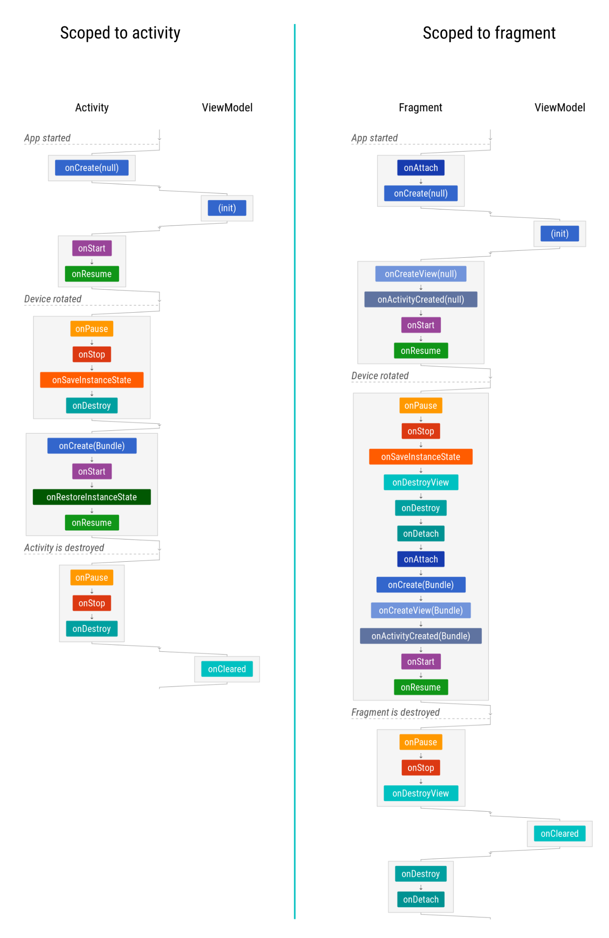
ViewModel Lifecycle
The ViewModel allows data to survive configuration changes such as screen rotations

Slide 45
Summary
A UI controller is UI-based class like Activity or Fragment.
UI controllers should only contain logic that handles UI and operating system interactions
The ViewModel class stores and manages UI-related data
The ViewModel is lifecycle-aware
ViewModelProvider.Factory is an interface you can use to create a ViewModel object with parameter passing

Slide 46
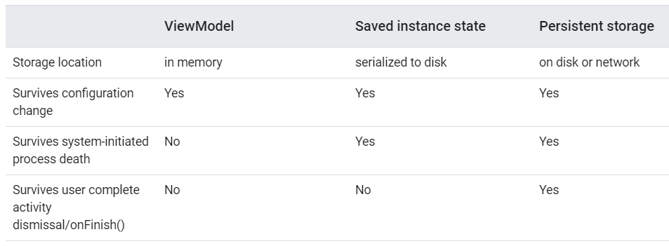
Summary

Slide 47
ViewModel
Module-level gradle
implementation ‘androidx.lifecycle:lifecycle-viewmodel-ktx:2.3.1 ’
Create a ViewModel class file
Creae a ViewModel in the MainActivity
class MainViewModel : ViewModel() { var counter = 0 }
viewModel = ViewModelProvider(this).get(MainViewModel::class.java)

Slide 48
ViewModel.Factory
Pass parameters to the ViewModel’s constructor
Create a ViewModelFactory class file
class MainViewModel(lastValue: Int) : ViewModel() { var counter = lastValue }
class MainViewModelFactory(private val lastValue: Int): ViewModelProvider.Factory { override fun <T : ViewModel?> create(modelClass: Class<T>): T { return MainViewModel(lastValue) as T } }

Slide 49
ViewModel.Factory
Create a ViewModel in the MainActivity
val lastValue = 100 viewModel = ViewModelProvider(this, MainViewModelFactory(lastValue))
.get(MainViewModel::class.java)

Slide 50
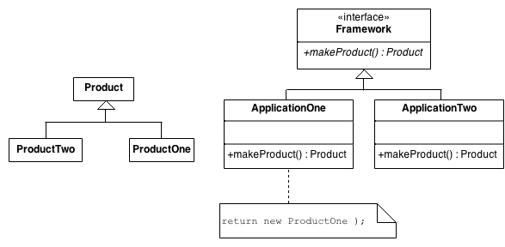
Factory Method Design
Define an interface (Factory) for creating an object, but let subclasses decide which class to instantiate
Factory Method is to creating objects as Template Method

Slide 51
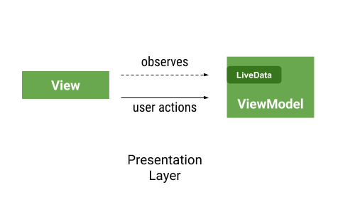
LiveData and LiveData observers
LiveData is a data holder class that can be observed within a given lifecycle
(observers)
The observers should be bound to the fragment view’s lifecycle not the fragment itself

Slide 52
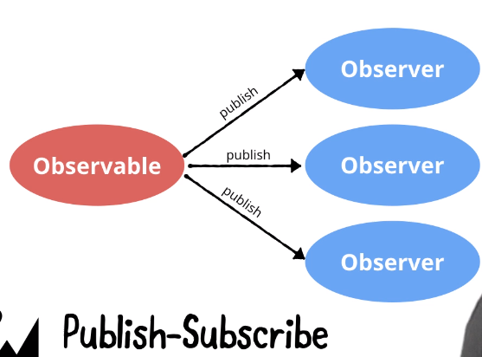
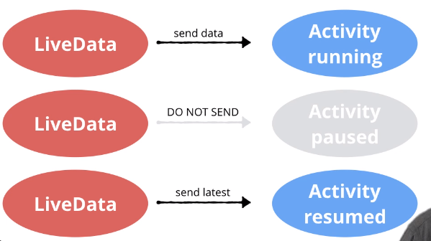
LiveData
Observer pattern

Slide 53
Summary
Use LiveData to enable your UI to update automatically when the data updates
LiveData is observable from an activity or a fragment
LiveData is lifecycle-aware, meaning that it only updates observers that are in an active lifecycle state
To change or reference the value of the data held by the LiveData, use the value property

Slide 54
LiveData Example
Module-level gradle
implementation ‘androidx.lifecycle:lifecycle-livedata-ktx:2.3.1 ’
counter: public mutable LiveData object (nullable)
class MainViewModel(lastValue: Int) : ViewModel() { val counter = MutableLiveData<Int>() init { counter.value = lastValue } fun plusOne() { val count = counter.value ?: 0 counter.value = count + 1 } fun reset() { counter.value = 0 } }

Slide 55
LiveData Example
Add an observer in an activity or fragment
MainActivity does not contain any logic about the counter
binding.add_button.setOnClickListener { viewModel.plusOne() } binding.reset_button.setOnClickListener { viewModel.reset() }
//add a LiveData observer to refresh the UI viewModel.counter.observe(this, Observer {
count -> binding.textView.text = count.toString()
})
This code can be removed by using data binding in layout

Slide 56
LiveData Example (Improve)
counter: public immutable LiveData object
class MainViewModel(lastValue: Int) : ViewModel() { private val _counter = MutableLiveData<Int>() val counter: LiveData<Int> get() = _counter init { _counter.value = lastValue } fun plusOne() { val count = counter.value ?: 0 _counter.value = count + 1 } fun reset() { _counter.value = 0 } }

Slide 57
Combine LiveData and DataBinding
MainActivity
val binding = DataBindingUtil.setContentView<ActivityMainBinding>
(this, R.layout.activity_main)
binding.viewModel = viewModel binding.lifecycleOwner = this //binding can observe the LiveData’s changes
// binding.lifecycleOwner = viewLifeCycleOwner //in fragments typically
//binding.addButton.setOnClickListener { viewModel.plusOne() } //binding.resetButton.setOnClickListener { viewModel.reset() }

Slide 58
Combine LiveData and DataBinding
Layout (directly observe the livedata)
<data> <variable name="viewModel" type="com.example.viewmodelexample.MainViewModel"> </variable> </data>
Binding expression
android:text="@{String.valueOf(viewModel.counter)}"
android:onClick="@{() -> viewModel.plusOne()}"
Listener binding

Slide 59
Explain: Binding Expression language
https://developer.android.com/topic/libraries/data-binding/expressions
Samples
android:text="@{String.valueOf(index + 1)}"
android:visibility="@{age > 13 ? View.GONE : View.VISIBLE}"
android:transitionName='@{"image_" + id}’
android:text="@{user.displayName ?? user.lastName}"

Slide 60
Shared ViewModel among Fragments
When getting the ViewModel in a fragment
viewModel = ViewModelProvider(requireActivity()).get(XXXX::class.java)
//this means the main activity is the owner of the view model
Fragments
Main ViewModel
Share common data
Main Activity

