Slide 1
Data Persistence
Shou-Chih Lo
National dong hwa university
2021

Slide 2
Outline
SharedPreferences
Java File I/O
Room Database

Slide 3
SharedPreferences
Store data in key-value pair into an XML file
The XML file is stored at the device directory: data/data/<package name>/shared_prefs
Start from getting a SharedPreferences object first by the following two ways
1: getSharedPreferences(file_name, Context.MODE_PRIVATE) //no filename extension
2: getPreferences(Context.Mode_PRIVATE)
Notes:
getSharedPreferences() — Use this if you need multiple shared preference files identified by name, which you specify with the first parameter. You can call this from any Context in your app.
getPreferences() — Use this from an Activity if you need to use only one shared preference file for the activity. Because this retrieves a default shared preference file that belongs to the activity, you don't need to supply a name.

Slide 4
Write Data into SharedPreferences
Get the Editor object first
val editor = getSharedPreferences(file_name, Context.MODE_PRIVATE) .edit()
Put data into the editor by calling different putXXX() (such as putInt, putString, putFloat, putBoolean, etc)
Finally, call the apply() to commit the data writing

Slide 5
Writing Example
val editor = getSharedPreferences(“my_data”, Context.MODE_PRIVATE) .edit()
.putString(“name”, “Robert”)
.putInt(“age”, 30)
.putBoolean(“married”, true)
.apply()
Chaining method calls

Slide 6
Read Data from SharedPreferences
Get the SharedPreferences object first
Call different getXXX() to retrieve data associated with a specified key
Reading example
val sprefs = getSharedPreferences(“my_data”, Context.MODE_PRIVATE)
val name = sprefs.getString(“name”, “”) //second parameter: default value
val age = sprefs.getInt(“age”, 0)

Slide 7

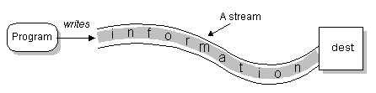
Java File I/O
Input stream
Output stream

Slide 8
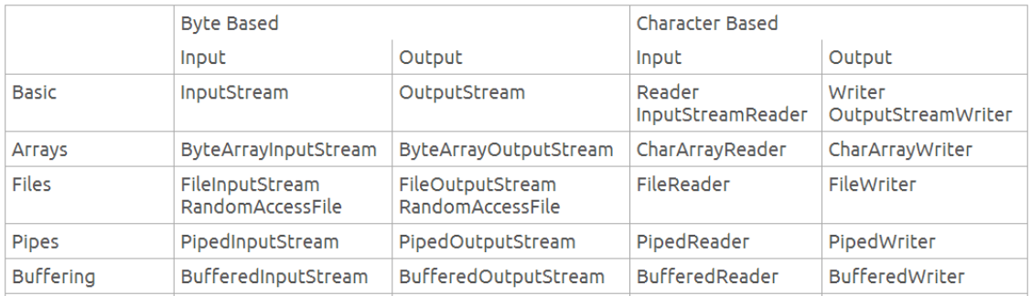
Java I/O Classes

Slide 9
File Directories
Internal private directory
data/data/<package name>/files
Retrieve the filesDir variable
External private directory
/storage/emulated/0/Android/data/<package_name>/files/
Call getExternalFilesDir(null) //root
Call getExternalFilesDir(Environment.DIRECTORY_PICTURES) //photo
External public directory //can not direct access any more
/storage/emulated/0/

Slide 10
Text File I/O Example
try { val fileIn = resources.openRawResource(R.raw.text_source) val fileOut = openFileOutput("text_dest.txt", Context.MODE_PRIVATE) val reader = BufferedReader(InputStreamReader(fileIn)) val writer = BufferedWriter(OutputStreamWriter(fileOut)) reader.use { reader.forEachLine { inBuffer.append(it) } } writer.use { writer.write(inBuffer.toString()) } } catch (e: IOException) { e.printStackTrace() }

Slide 11
Binary File I/O Example
try { val fileIn = resources.openRawResource(+R.drawable.binary_source) // or val fileIn = resources.openRawResource(R.raw.binary_source) val fileOut = openFileOutput("binary_dest.png", Context.MODE_PRIVATE) val reader = BufferedInputStream(fileIn) val writer = BufferedOutputStream(fileOut) var inBuffer = ByteArray(fileIn.available()) //estimate the file size in bytes reader.use { reader.read(inBuffer) } writer.use { writer.write(inBuffer) } } catch (e: IOException) { e.printStackTrace() }

Slide 12
SQL Database
SQL databases store data in tables of rows and columns:
Each row contains one entity. The entity is identified by a unique ID (primary key)
Each column is identified by a name (field name) that is unique per table
SQLite is a lightweight SQL database
Database
Table
Table
Row
Field

Slide 13
SQL Query Language
Inserting rows
Deleting rows
Updating values in rows
Retrieving rows that meet given criteria
Query syntax
select field1, field2, …
from table1, table 2, …
where condition1 (and/or other conditions)

Slide 14
Room Database
A database library that supports object relational mapping (ORM)
3 major components
Database: Contains the database holder and serves as the main access point for the underlying connection to your app's relational data
Entity: Represents a table within the database (defined as data classes in the app)
DAO: Contains the methods used for accessing the database (SQL queries → method functions)
https://developer.android.com/training/data-storage/room

Slide 15
Room Example
Add dependencies
Apply plugin: ‘Kotlin-kapt’
Implement “android.room:room-runtime:2.2.5
Kapt “android.room:room.compiler:2.2.5
Define Entity class
or @Entity(tableName = “user_table")
Table name is User
@Entity data class User ( @ColumnInfo(name = "user_name") //customized column field name var name: String, var age: Int ) { @PrimaryKey(autoGenerate = true) var id: Long = 0L }
Notes:
no arguments to @Entity, the table name will be the same as the class.
@Entity data class User (
@PrimaryKey(autoGenerate = true) //construct one user by specifying three data members var id: Long = 0L, @ColumnInfo(name = "user_name") //customized column field name var name: String, var age: Int )

Slide 16
Room Example
Define DAO interface
@Dao interface UserDao { @Insert fun insertUser(user: User): Long //insert the user specified by the parameter @Update fun updateUser(newUser: User) //update the data for the user given by the parameter @Query("select * from User") //load all user data fun loadAllUsers(): List<User> @Query("select user_name from User where age > :age") //Show the user names that are qualified fun loadUserOlderThan(age: Int): List<String> @Delete fun deleteUser(user: User) // //delete the user specified by the parameter }
Notes:
@Insert fun insertUser(user: User) //without specifying the return value (rawId)
@Insert fun insertBothUsers(user1: User, user2: User) @Insert fun insertListOfUsers(users: List<User>)
@Query(“delete from User") fun deleteAllUser()

Slide 17
@Database(version = 1, entities = [User::class]) abstract class UserDatabase : RoomDatabase() { abstract val userDao: UserDao companion object { //for providing class methods and class variables @Volatile private var INSTANCE: UserDatabase? = null fun getInstance(context: Context): UserDatabase { //return the database synchronized(this) { var instance = INSTANCE if (instance == null) { instance = Room.databaseBuilder( context.applicationContext, UserDatabase::class.java, "user_database" ) .fallbackToDestructiveMigration() //destroy the database when the schema changes .build() INSTANCE = instance } return instance } } } }
Database name
Notes:
The value of a volatile variable will never be cached, and all writes and reads will be done to and from the main memory
Copy the current value of INSTANCE to a local variable instance. This is to take advantage of smart cast, which is only available to local variables

Slide 18
lateinit var userDao: UserDao override fun onCreate(savedInstanceState: Bundle?) { super.onCreate(savedInstanceState) setContentView(R.layout.activity_main) userDao = UserDatabase.getInstance(this).userDao //typically, this.application //generate test data val user1 = User("Tom", 30) val user2 = User("Robert", 40) //database test1 thread { user1.id = userDao.insertUser(user1) user2.id = userDao.insertUser(user2) displayAll() } //database test2 thread { user1.age = 42 userDao.updateUser(user1) displayAll() } } private fun displayAll() { for (user in userDao.loadAllUsers()) { Log.d("Main", user.toString()) } }
Database operations should be run in background

Slide 19
(Method 1) Using Coroutines
private val mainScope = MainScope() override fun onCreate(savedInstanceState: Bundle?) { ...
binding.button1.setOnClickListener { mainScope.launch { user1.id = insertUser(user1) user2.id = insertUser(user2) } } suspend private fun insertUser(user: User): Long { return withContext(Dispatchers.IO) { userDao.insertUser(user) } }
viewModelScope, typically
Switch to the I/O scope
Notes:
MainScope: main thread

Slide 20
(Method 2) Using KTX Extensions to Room
Add dependency
implementation "androidx.room:room-ktx:2.2.5“
Update @Dao
Add “suspend” to each Dao function
@Insert suspend fun insertUser(user: User): Long //insert the user specified by the parameter @Update suspend fun updateUser(newUser: User) //update the data for the user given by the parameter @Query("select * from User") //load all user data suspend fun loadAllUsers(): List<User>
Notes:
If the return value is LiveData, suspend can be omitted (since the roomdatabase run jobs in background)

Slide 21
Using KTX Extensions to Room
Binding.button1.setOnClickListener { mainScope.launch { user1.id = userDao.insertUser(user1) user2.id = userDao.insertUser(user2) } }
Run on an I/O thread automatically

Slide 22
Domain-Driven Design (DDD)
DDD is an approach to software development that centers the development on programming a domain model that has a rich understanding of the processes and rules of a domain.
Domain Models: involve data and processes, and their structure is the most suitable for the app

Slide 23
DAO vs. DTO
DAO (Data Access Object): a class that usually has the CRUD operations like save, update, delete.
DTO (Data Transfer Object): an object that holds data.
DTO will be passed as value object to DAO layer and DAO layer will use this object to persist data using its CRUD operation methods

Slide 24
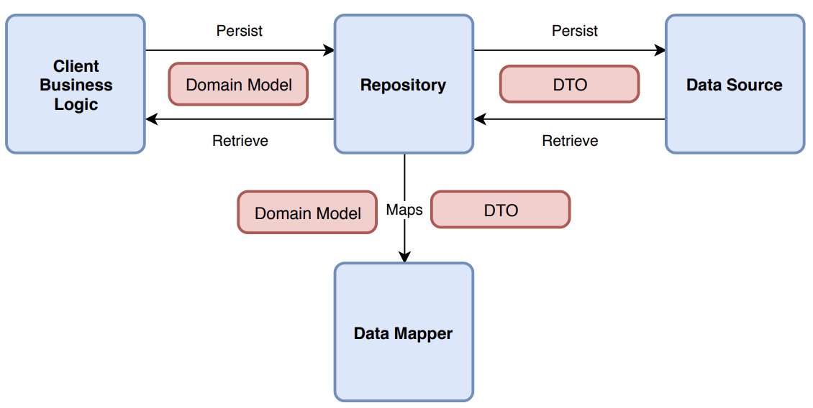
Repository Pattern

