Slide 1
Work with HTTP
Shou-Chih Lo
National dong hwa university
2020

Slide 2
Outline
WebView
Retrieve webpages
Parsing HTML/JSON/XML
Callback
Retrofit Library

Slide 3
Widget: WebView
Display web content as part of your activity layout, but lack some of the features of fully-developed browser
Enable the Internet connection permission
<manifest xmlns:android="http://schemas.android.com/apk/res/android"
… >
<uses-permission android:name="android.permission.INTERNET" />
<application
…
</application>
</manifest>

Slide 4
HTTP Cleartext Support
Starting with Android 9.0 (API level 28), cleartext support is disabled by default.
AndroidMainifest.xml
android:usesCleartextTraffic="true"

Slide 5
WebView Operation Codes
//Suppose the WebView’s id is webView
// Enable the JavaScript interpretation function
binding.webView.settings.JavaScriptEnabled = true
/ Confine to the same WebView when clicking URL links
binding.webView.webViewClient = WebViewClient()
//Load the web page specified by an URL
binding.webView.loadUrl("http://www.google.com")

Slide 6
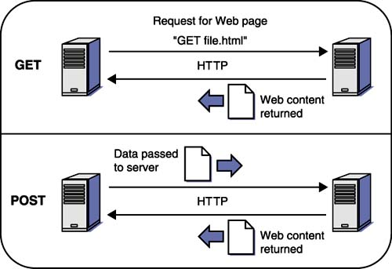
Retrieve Webpages
The service protocol operating between a web browser and a web server is HTTP

Slide 7
Retrieve Webpages
(Official) HttpURLConnection
(3rd party) OkHttp: more efficient
implementation ‘com.squareup.okhttp3:okhttp:4.8.0’
Noted: any network access operations should be run in background (using threads)

Slide 8
private fun sendRequestWithHttpURLConnection() { // open a background thread thread { var connection: HttpURLConnection? = null try { val url = URL(GIVEN_HTTP_URL) connection = url.openConnection() as HttpURLConnection with(connection) { requestMethod = "GET" connectTimeout = 8000 readTimeout = 8000 } // read data from the inputstream val input = connection.inputStream val reader = BufferedReader(InputStreamReader(input))
val response = StringBuilder() reader.use { reader.forEachLine { response.append(it) } } showResponse(response.toString()) //need to switch to the main thread } catch (e: Exception) { e.printStackTrace() } finally { connection?.disconnect() } } }

Slide 9
private fun showResponse(response: String) { runOnUiThread { // display results on the main/UI thread binding.textView.text = response } }
private fun sendRequestWithOkHttp() { thread { try { val client = OkHttpClient() val request = Request.Builder() .url(GIVEN_URL) .build() val response = client.newCall(request).execute() val responseData = response.body?.string() responseData?.let {showResponse(it)} } catch (e: Exception) { e.printStackTrace() } } }

Slide 10
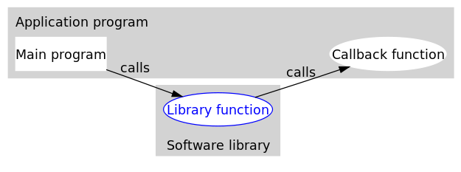
Callback Functions
Also known as a "call-after" function, is any executable code that is passed as an argument to other code
Common in asynchronous programming to notify the completion of one background job

Slide 11
Using okhttp3.Callback
Create HttpUtil class
object HttpUtil { fun sendOkHttpRequest(address: String, callback: okhttp3.Callback) { val client = OkHttpClient() val request = Request.Builder() .url(address) .build() client.newCall(request).enqueue(callback)
//internally open a background thread } }

Slide 12
Using okhttp3.Callback
binding.button.setOnClickListener { HttpUtil.sendOkHttpRequest(GIVEN_URL, object : Callback { override fun onResponse(call: Call, response: Response) { val responseData = response.body?.string() showResponse(responseData!!) } override fun onFailure(call: Call, e: IOException) { } } ) }
Callback functions still run in background

Slide 13
Parsing HTML
3rd party library: Jsoup
Scrape and parse HTML from a URL, file, or string
Find and extract data, using DOM traversal or CSS selectors
Manipulate the HTML elements, attributes, and text
Add dependency
implementation 'org.jsoup:jsoup:1.13.1'

Slide 14

Parsing HTML
HTML DOM(Document Object Model) Tree

Slide 15
Using Jsoup
Load the HTML document
via an URL
via a string value
val doc = Jsoup.connect(“http://...").get()
val doc = Jsoup.parse(responseData)

Slide 16
Using Jsoup
Select elements using the Selector CSS query
For example
https://www.w3schools.com/cssref/css_selectors.asp
val elements = doc.select(“CSSquery)
doc.select(“h1”) //return all elements with tag <h1>
coc.select(“a”) //return all elements with tag <a>

Slide 17
Jsoup Example
private fun parseHTMLWithJsoup(responseData: String) { val doc = Jsoup.parse(responseData) val result = StringBuilder() doc.select("a") //with tag <a> .forEach { elm -> result.append(elm.text() + " " + elm.attr("href")) result.append("\n") } doc.select("th") //with tag <th> .forEach { elm -> result.append(elm.text() + "\n") } showResponse(result.toString()) }

Slide 18
Parsing XML
XML example
<?xml version="1.0" encoding="UTF-8"?>
<!-- Edited by XMLSpy -->
<note>
<to>Tove</to>
<from>Jani</from>
<heading>Reminder</heading>
<body>Don't forget me this weekend!</body>
</note>

Slide 19
Using XmlPullParser
Create a new parser
val factory = XmlPullParserFactory.newInstance()
val parser = factory.newPullParser()
Read an XML document
val webpage = URL(“URL_ADDRESS”)
parser.setInput(webpage.openStream(), null) //from a web site
//parser.setInput(webpage.openStream(), “utf-8”) //specify the encoding
//parser.setInput(StringReader(responseData)); //from a string value

Slide 20
Using XmlPullParser
Token-by-Token parsing
Get text
START_DOCUMENT
TEXT
END_TAG
<note>
<to>Tove</to>
<from>Jani</from>
<heading>Reminder</heading>
<body>Don't forget me this weekend!</body>
</note>
Get name
START_TAG
START_TAG
END_DOCUMENT

Slide 21
Using XmlPullParser
Parsing code structure
val eventType = pullParser.getEventType()
while (eventType != XmlPullParser.END_DOCUMENT) {
if (eventType == XmlPullParser.START_TAG) {
….
} else if (eventType == XmlPullParser.TEXT) {
….
}
….
eventType = pullParser.next(); //read the next token
}

Slide 22
private fun parseXMLWithPull(xmlData: String) { try { val factory = XmlPullParserFactory.newInstance() val xmlPullParser = factory.newPullParser() xmlPullParser.setInput(StringReader(xmlData)) var eventType = xmlPullParser.eventType var note = Note() while (eventType != XmlPullParser.END_DOCUMENT) { val nodeName = xmlPullParser.name when (eventType) { XmlPullParser.START_TAG -> { when (nodeName) { "to" -> note.to = xmlPullParser.nextText() "from" -> note.from = xmlPullParser.nextText() "heading" -> note.heading = xmlPullParser.nextText() "body" -> note.body = xmlPullParser.nextText() } } } eventType = xmlPullParser.next() } Log.d("Main", note.toString()) } catch (e: Exception) { e.printStackTrace() } }
data class Note (var to: String="", var from: String="", var heading: String="", var body: String="")

Slide 23
JSON Data
JavaScript Object Notation
Open standard file format, and data interchange format
Uses human-readable text to store and transmit data objects consisting of attribute–value pairs and array data types

Slide 24
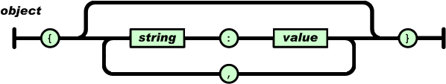
JSON Structure
Object: A collection of name/value pairs
Example:
{
"firstName": "John",
"lastName": "Smith",
"age": 27
}

Slide 25
JSON Nested Objects
{
”name”: {
"firstName": "John",
"lastName": "Smith”
}
"age": 27
}

Slide 26
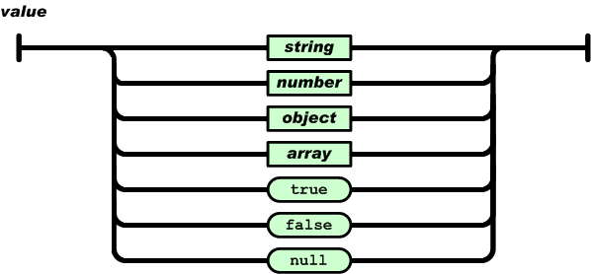
JSON Structure
Value: can be a string in double quotes, or a number, or true or false or null, or an object or an array

Slide 27
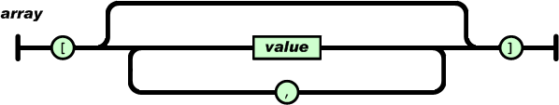
JSON Structure
Array: An ordered list of values

Slide 28
JSON Array Example
{ "name":"John", "age":30, "cars":[ "Ford", "BMW", "Fiat" ] //string array }
{
"eBooks":[ //object array
{ "language":"Pascal", "edition":"third" },
{ "language":"Python", "edition":"four" }
]
}

Slide 29
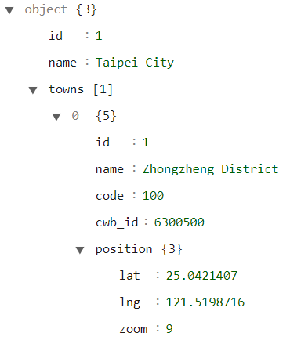
JSON Data Example
{
"id": "1",
"name": “Taipei City",
"towns": [
{
"id": "1",
"name": "Zhongzheng District",
"code": "100",
"cwb_id": "6300500",
"position": {
"lat": "25.0421407",
"lng": "121.5198716",
"zoom": "9"
}
}
]
}
Json Editor Online

Slide 30
Parsing JSON
Using Google’s GSON
Get objects
e.g., {“name”:”Tom”, “age”:20}
Define Person Class including data members name and age (should be the same as the key name in JSON)
implementation ‘com.google.code.gson:gson:2.8.6’
val gson = Gson()
val person = gson.fromJson(jsonData, Person::class.java)

Slide 31
Parsing JSON
Get an array of objects
e.g., [{“name”:”Tom”, “age”:20}, {“name”:”Joy”, “age”:10}]
val gson = Gson()
val typeOf = object: TypeToken <List<Person>>().type
val people = gson.fromJson(jsonData, typeOf);

Slide 32
Parsing JSON Example
private fun parseJSONWithGSON(jsonData: String) { val gson = Gson() val taipeiCity = gson.fromJson(jsonData, City::class.java) Log.d("Main", taipeiCity.toString()) }
data class Location(val lat: String, val lng: String, val zoom: Int) data class Town(val id: Int, val name: String, val code: Int, val cwb_id: String, val position: Location) data class City(val id: Int, val name: String, val towns: List<Town>)

Slide 33
Retrofit Library
Type-safe REST client library for Android and Java which aims to make it easier to consume RESTful web services
Leverage OkHttp as the networking layer and is built on top of it
Automatically serialize the JSON response using a converter to data objects
Retrofit APIs
URL(base_address+endpoint)
RESTful Web Services
Android
Service interface
JSON or XML
Converter
Object or String
Notes:
Solution to the compile error: [CIRCULAR REFERENCE:…]
Android {
…
compileOptions { sourceCompatibility JavaVersion.VERSION_1_8 targetCompatibility JavaVersion.VERSION_1_8 }
}

Slide 34
Supported Converters
Gson: com.squareup.retrofit2:converter-gson
Jackson: com.squareup.retrofit2:converter-jackson
Moshi: com.squareup.retrofit2:converter-moshi
Protobuf: com.squareup.retrofit2:converter-protobuf
Wire: com.squareup.retrofit2:converter-wire
Simple XML: com.squareup.retrofit2:converter-simplexml
JAXB: com.squareup.retrofit2:converter-jaxb
Scalars (primitives, boxed, and String): com.squareup.retrofit2:converter-scalars

Slide 35
Retrofit API
Add dependency (Module:app)
implementation 'com.squareup.retrofit2:retrofit:2.9.0’
implementation ‘com.squareup.retrofit2:converter-gson:2.9.0’
Add support for Java 8 language features (Module:app)
Can specify other converters
android {
...
compileOptions {
sourceCompatibility JavaVersion.VERSION_1_8
targetCompatibility JavaVersion.VERSION_1_8
}
kotlinOptions {
jvmTarget = JavaVersion.VERSION_1_8.toString()
}
}

Slide 36
Retrofit API
Define service interface (defines how Retrofit talks to the web server using HTTP requests)
interface AppService {
@GET("taipei_towns.json") fun getAppData(): Call<City> //Call<List<City>> if having an array of cities
//Call object is used to start the request
//add more annotation such as @POST, @DELETE }

Slide 37
Singleton Retrofit object
Get a singleton Retrofit object that implements AppService
object GetService { val retrofitService : AppService by lazy { retrofit.create(AppService::class.java) } }

Slide 38
fun sendRetrofitRequest() { val retrofit = Retrofit.Builder() .baseUrl("http://web.csie.ndhu.edu.tw/sclo/programming/")
//specify the converter .addConverterFactory(GsonConverterFactory.create()) .build()
GetService.retrofitService.getAppData().enqueue(object: Callback<City> {
// run getAppData in the background thread override fun onResponse(call: Call<City>, response: Response<City>) { // in the main thread
binding.textView.text = response.body().toString() } override fun onFailure(call: Call<City>, t: Throwable) { } }) } }

Slide 39
Using Coroutine
Add coroutine support implementation "org.jetbrains.kotlinx:kotlinx-coroutines-core:1.4.1" implementation "org.jetbrains.kotlinx:kotlinx-coroutines-android:1.4.1”
interface AppService { @GET("taipei_towns.json") suspend fun getAppData(): City //coroutine version }

Slide 40
Using Coroutine
//coroutine version fun sendRetrofitRequest() { val job = Job() //create a coroutine scope val scope = CoroutineScope(Dispatchers.IO+job) scope.launch { try { val result = GetService.retrofitService.getAppData() withContext(Dispatchers.Main) { //switch to the UI thread binding.textView.text = result.toString() } Log.d("Main", result.toString()) } catch (e: Exception) { Log.d("Main", "Fail to access: ${e.message}") } } }

Slide 41
Customized Data Field Names
Example: data class Town(val id: Int, val name: String, val code: Int, val cwb_id: String, val position: Location)
Using Gson
@SerializedName(“cwbId") val cwb_id: String
Using Moshi
@Json(name=“cwbId") val cwb_id: String

