Slide 1
Real CHOP Patient Portal
This is the patient portal for my kids care at CHOP
I’m sharing this as a private citizen, parent, and not as a CHOP employee.

Slide 2
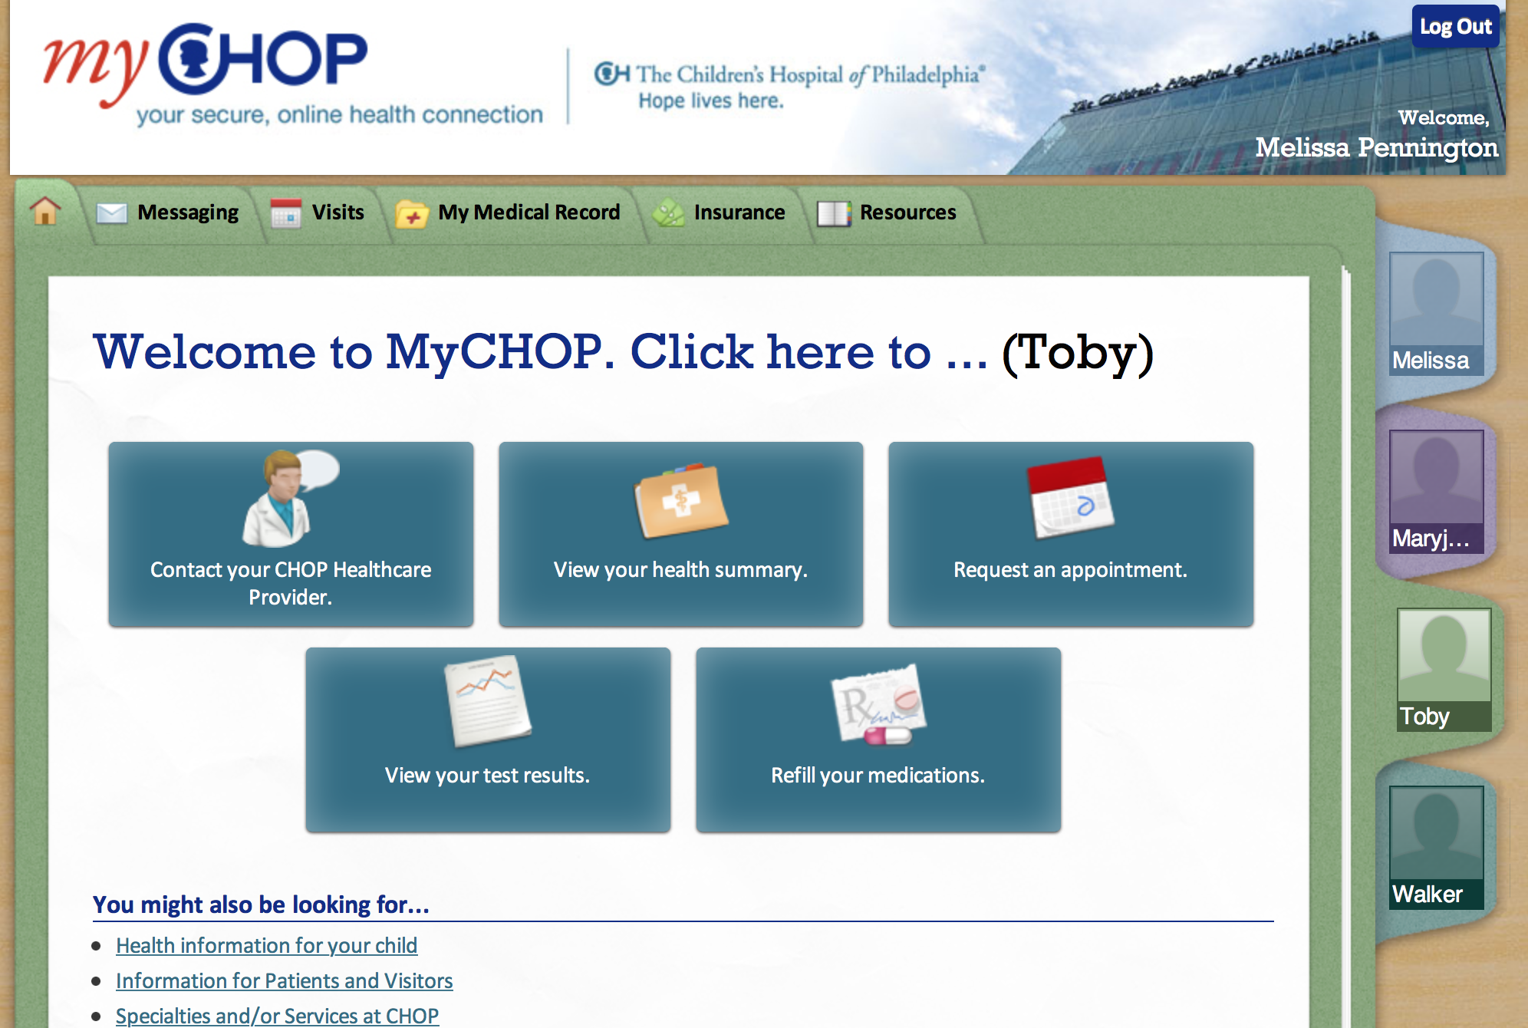

Slide 3
