Slide 1
Syllabus
Access modifiers(public, private, protected and default) Packages and import statements Static imports Constructor chaining (with and without packages) Accessing protected variables and methods outside the package
Garbage collection in java, Requesting JVM to run garbage collection,Different ways to make object eligible for garbage collection: (Nulling a reference variable, Re-assigning a reference variable & island of isolation) ,Finalize method
Lab: Create a demo application to understand the role of access modifiers. Implement multilevel inheritance using different packages. Access/invoke protected members/methods of a class outside the package.
Override finalize method to understand the behavior of JVM garbage collector.

Slide 2
Access modifiers
Access modifiers in Java helps to restrict the scope of a class, constructor, variable, method, or data member. There are four types of access modifiers available in java:
Default – No keyword required
Private
Protected
Public

Slide 3
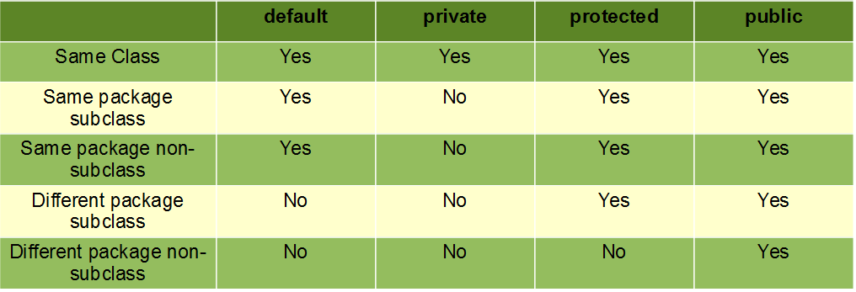
Continue….

Slide 4
Package
Package is a collection of related classes. Java uses package to group related classes, interfaces and sub-packages in any Java project.
We can assume package as a folder or a directory that is used to store similar files.
In Java, packages are used to avoid name conflicts and to control access of class, interface and enumeration etc. Using package it becomes easier to locate the related classes and it also provides a good structure for projects with hundreds of classes and other files.

Slide 5
Continue….
package com;
class Demo {
void main()
{ System.out.println("Second main function");
}
public static void main(String[] args) {
Demo d=new Demo();
d.main();
System.out.println("Hello world");
}
}

Slide 6
C:\Users\kiran>cd Desktop
C:\Users\kiran\Desktop>javac -d . Demo.java //compile using this command
C:\Users\kiran\Desktop>java Demo
Second main function
Hello world
C:\Users\kiran\Desktop>

Slide 7
Types Of Java Package
Package can be built-in and user-defined, Java provides rich set of built-in packages in form of API that stores related classes and sub-packages.
Built-in Package: math, util, lang, i/o etc are the example of built-in packages.
User-defined-package: Java package created by user to categorize their project's classes and interface are known as user-defined packages.
Note:Package statement must be first statement in the program even before the import statement.

Slide 8
javac -d . Demo.java // compile using this command

Slide 9
How to import Java Package
To import java package into a class, we need to use java import keyword which is used to access package and its classes into the java program.
There are 3 different ways to refer to any class that is present in a different package:
without import the package
import package with specified class
import package with all classes

Slide 10
With the help of static import, we can access the static members of a class directly without class name or any object.
For Example: we always use sqrt() method of Math class by using Math class i.e. Math.sqrt(), but by using static import we can access sqrt() method directly.

Slide 11
class A {
public static void main(String[] args)
{
System.out.println(Math.sqrt(4));
System.out.println(Math.pow(2, 2));
System.out.println(Math.abs(6.3));
}
}

Slide 12
import static java.lang.Math.*;
import static java.lang.System.*;
class TestModifier {
public static void main(String[] args)
{
out.println(sqrt(4));
System.out.println(pow(2, 2));
System.out.println(abs(6.3));
}
}

Slide 13
Garbage collection in java:
Garbage collection in Java is the process by which Java programs perform automatic memory management.
Java programs compile to bytecode that can be run on a Java Virtual Machine, or JVM for short. When Java programs run on the JVM, objects are created on the heap, which is a portion of memory dedicated to the program.
Eventually, some objects will no longer be needed. The garbage collector finds these unused objects and deletes them to free up memory.
In C/C++, a programmer is responsible for both the creation and destruction of objects.
Usually, programmer neglects the destruction of useless objects. Due to this negligence, at a certain point, sufficient memory may not be available to create new objects, and the entire program will terminate abnormally, causing OutOfMemoryErrors.
But in Java, the programmer need not care for all those objects which are no longer in use. Garbage collector destroys these objects. The main objective of Garbage Collector is to free heap memory by destroying unreachable objects.

Slide 14
How Does Garbage Collection in Java works?
Java garbage collection is an automatic process.
Automatic garbage collection is the process of looking at heap memory, identifying which objects are in use and which are not, and deleting the unused objects.
An in-use object, or a referenced object, means that some part of your program still maintains a pointer to that object.
An unused or unreferenced object is no longer referenced by any part of your program.
So the memory used by an unreferenced object can be reclaimed. The programmer does not need to mark objects to be deleted explicitly.
The garbage collection implementation lives in the JVM.

Slide 15
Different ways to make object eligible for garbage collection:
Even though the programmer is not responsible for destroying useless objects but it is highly recommended to make an object unreachable(thus eligible for GC) if it is no longer required.
There are generally four ways to make an object eligible for garbage collection.
Nullifying the reference variable
Re-assigning the reference variable
An object created inside the method
Island of Isolation

Slide 16
Continue..
Nullifying the reference variable: A Reference variable always points to an address of the actual copy of an object.If this particular address is replaced by null value ,the object can no longer be accessed through that variable.
Thererfore assigning null value would break the link between the object and reference variable, making it eligible for garbage collection.
Object1 1029
Obj 1029
Obj null
Object1
1029

Slide 17
Continue….
Re-assigning the reference variable:
In this if an object is not required and at the same time there is need to work on another object,we simply shift reference of the variable from useless object to a new object.
As a result the old one becomes eligible for garbage collection.
Obj1 1029
Obj11029 obj21030
Obj2 1030
obj11029
Obj11029
obj21030
obj21029

Slide 18
continue
An object created inside the method: When an object is created in a local method ,it acts like a local variable. and when that particular method finishes its execution,it goes out of scope,the reference variable pointing to the object automatically gets destroyed but not the actual object.
As a result, the reference to the object breaks and the object becomes ureachable.
However if a method returns an object and its reference is assigned to a variable, then the object would no longer be eligible for garbage collection.

Slide 19
Continue….
Island of Isolation:
When there is a group of objects that are internally referencing to each other and if no root object reference to them ,then these group of objects collectively eligible for garbage collection.
Ob1
1028
Ob1 1028
Ob2 1030
Ob2
1030
Ob3 1032
Ob3
1032

Slide 20


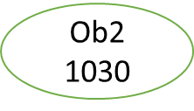
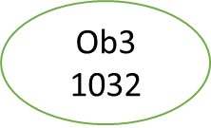
Continue…
Ob1=null
Ob1
102
Ob2=null
Ob3=null

Slide 21
Requesting JVM to run Garbage Collector
Once we make an object eligible for garbage collection, it may not destroy immediately by the garbage collector. Whenever JVM runs the Garbage Collector program, then only the object will be destroyed. But when JVM runs Garbage Collector, we can not expect.
We can also request JVM to run Garbage Collector. There are two ways to do it :
Using System.gc() method: System class contain static method gc() for requesting JVM to run Garbage Collector.
Using Runtime.getRuntime().gc() method: Runtime class allows the application to interface with the JVM in which the application is running. Hence by using its gc() method, we can request JVM to run Garbage Collector.
There is no guarantee that any of the above two methods will run Garbage Collector.
The call System.gc() is effectively equivalent to the call : Runtime.getRuntime().gc()

Slide 22
Advantages of Garbage Collection in Java
The advantages of Garbage Collection in Java are:
It makes java memory-efficient because the garbage collector removes the unreferenced objects from heap memory.
It is automatically done by the garbage collector(a part of JVM), so we don’t need extra effort.

Slide 23
Finalization
Just before destroying an object, Garbage Collector calls finalize() method on the object to perform cleanup activities. Once finalize() method completes, Garbage Collector destroys that object.
finalize() method is present in Object class with the following prototype.
protected void finalize() throws Throwable
Based on our requirement, we can override finalize() method for performing our cleanup activities like closing connection from the database.
The finalize() method is called by Garbage Collector, not JVM. However, Garbage Collector is one of the modules of JVM.
Object class finalize() method has an empty implementation. Thus, it is recommended to override the finalize() method to dispose of system resources or perform other cleanups.
The finalize() method is never invoked more than once for any object.
If an uncaught exception is thrown by the finalize() method, the exception is ignored, and the finalization of that object terminates.

Slide 24
Question: Suppose you go for the internship and you were told to write a program to count the number of employees working in the company(excluding interns). To make this program, you have to use the concept of a garbage collector.
This is the actual task you were given at the company:
Write a program to create a class called Employee having the following data members.
1. An ID for storing unique id allocated to every employee.
2. Name of employee.
3. age of an employee.
Also, provide the following methods:
A parameterized constructor to initialize name and age. The ID should be initialized in this constructor.
A method show() to display ID, name, and age.
A method showNextId() to display the ID of the next employee.

Slide 25
class Employee {
private int ID;
private String name;
private int age;
private static int nextId = 1;
public Employee(String name, int age)
{
this.name = name;
this.age = age;
this.ID = nextId++;
}
public void show()
{
System.out.println("Id=" + ID + "\nName=" + name
+ "\nAge=" + age);
}
public void showNextId()
{
System.out.println("Next employee id will be="
+ nextId);
}
protected void finalize()
{
--nextId;
// In this case,
// gc will call finalize()
// for 2 times for 2 objects.
}
}

Slide 26
public class TestEmployee{
public static void main(String[] args)
{
Employee E = new Employee(“emp1", 56);
Employee F = new Employee(“emp2", 45);
Employee G = new Employee(“emp3", 25);
E.show();
F.show();
G.show();
E.showNextId();
F.showNextId();
G.showNextId();
{
// It is sub block to keep
// all those interns.
Employee X = new Employee(“emp4", 23);
Employee Y = new Employee(“emp5", 21);
X.show();
Y.show();
X.showNextId();
Y.showNextId();
X = Y = null;
System.gc();
System.runFinalization();
}
E.showNextId();
}
}

