Slide 1
Fine-tuning setup
Start from the official WiLoR checkpoint; adapt to Gaussian Hand Display glove videos.
Data and training budget
What we updated
12 videos, split by recording: 8 train / 2 val / 2 test
Hand samples: 1,672 train / 384 val / 517 test
Batch size: 16 total; one GPU (GPU 5)
10 epochs / 1,050 optimizer updates
Selected: epoch 9 / step 945, by validation MPJPE
Trainable: backbone + RefineNet
Learning rates: backbone 1e-6; RefineNet 1e-5
AdamW; weight decay 1e-4; gradient clip 1.0
Supervised losses only; discriminator frozen
Left-hand shape (betas) supervision disabled
Augmentation: scale 0.15, rotation 15°, color 0.10; no random horizontal flip.
DropPath 0.10; FP32; no gradient accumulation.
Crop geometry: square box ×1.25 → 256×256. Formal fine-tuning restarted from official weights after the smoke test.

Slide 2
Mean 2D Joint Reprojection Error (px)
Fine-tuned with “Gaussian Hand Display“, on same validation
Official WiLoR
Fine-tuned WiLoR
Decrease
35.3 px
26.4 px
25.1%
Fine-tuning->better Average, but still has degression and failure
Data：1,672 samples, 10 epoch, choose 9th epoch
Validation：384samples，351 success； 33 failure not counted into error calculation
2
Notes:
Mean 2D Joint Reprojection Error (px)
We project the predicted and reference 3D hand joints into the image, then calculate the Euclidean distance between corresponding joints. We average these distances
不是检测准确率；指标为21关节平均原图投影误差，参考为拟合MANO。验证集曾用于选模，不是新独立测试结论。训练/验证按完整录像划分。检测同手性+IoU>=0.3。两模型输入一致，1.25倍正方形，无额外宽高比扩张。来源：evaluation/hand_display_unified_crop/per_sample.csv。
辅助指标｜手腕对齐后的 3D 关节误差：20.1 → 9.8 mm

Slide 3
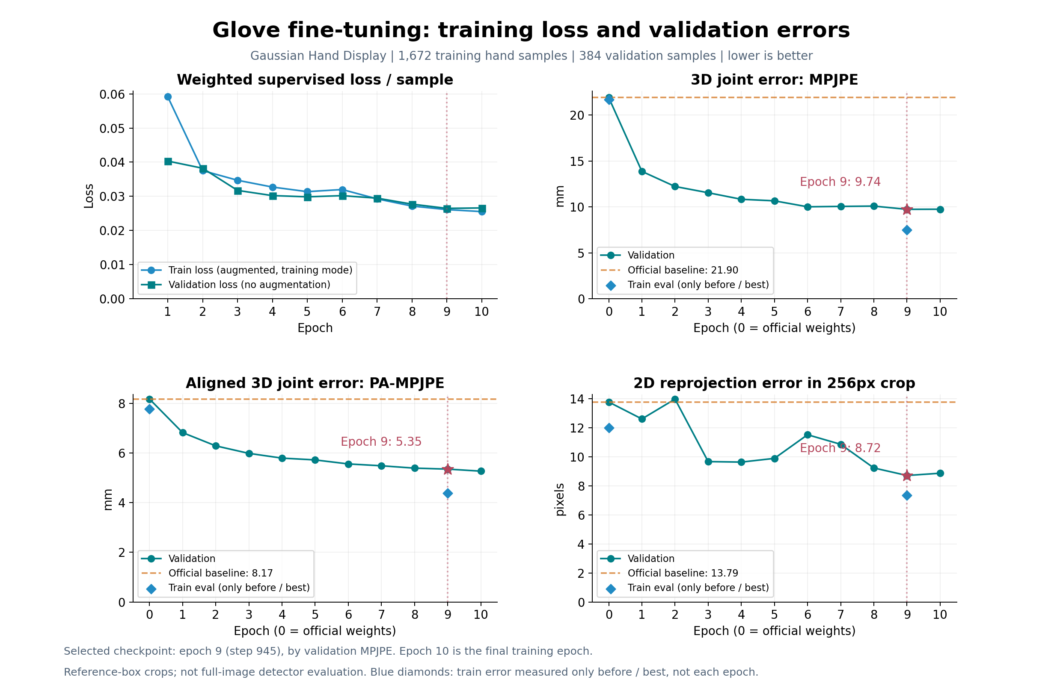
Training loss and pose-estimation performance
Lower is better. Pose-estimation errors replace classification accuracy for this task.
Train error: measured before training and at the selected checkpoint only. Validation error: recorded every epoch.

Slide 4
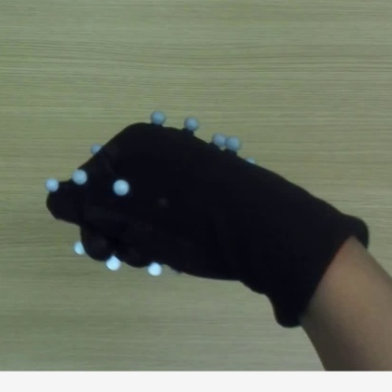
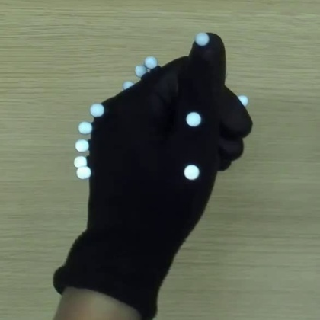
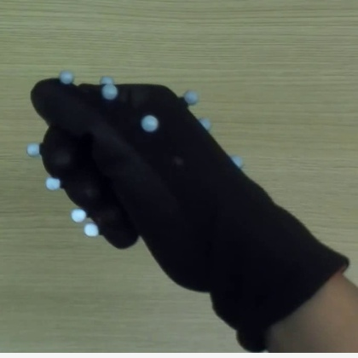
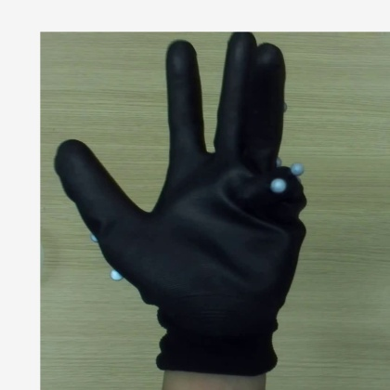
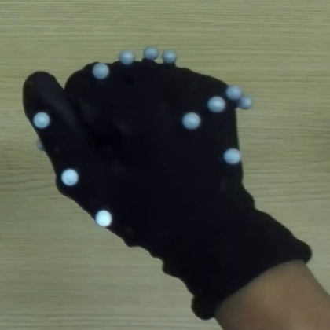
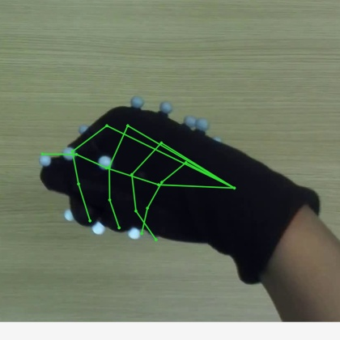
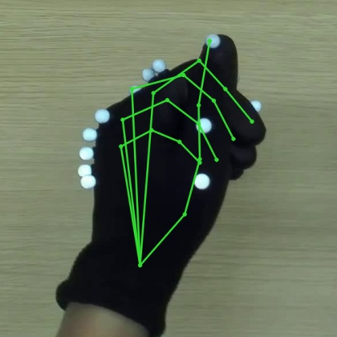
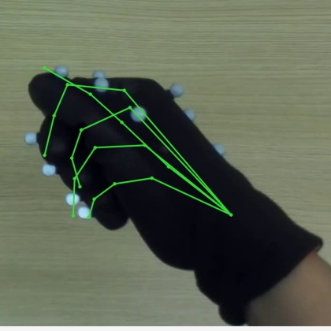
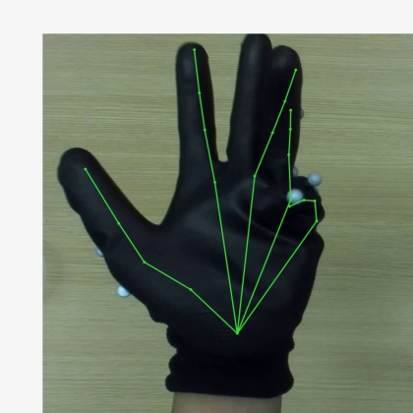
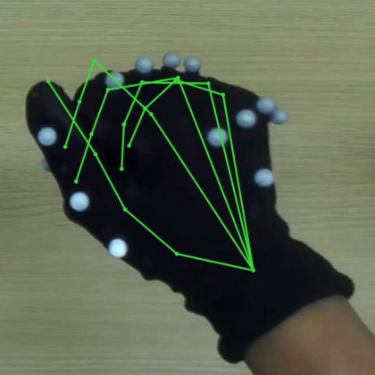
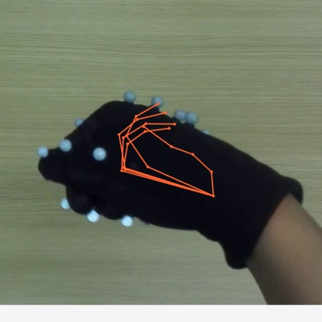
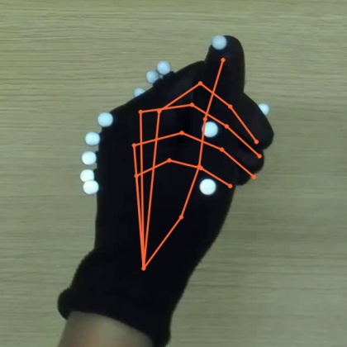
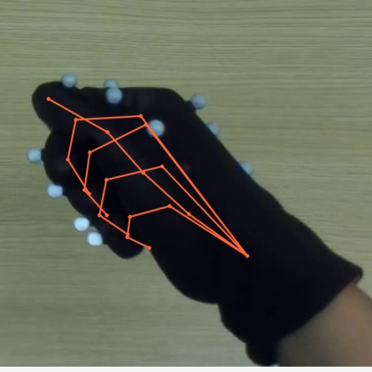
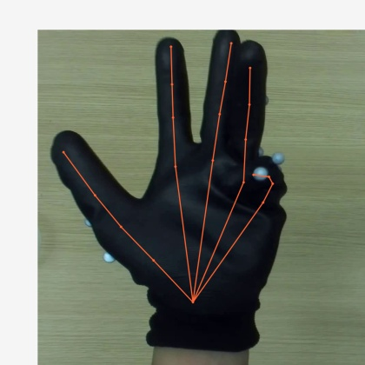
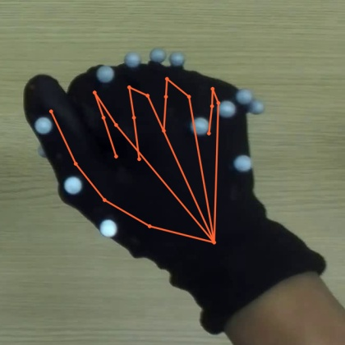
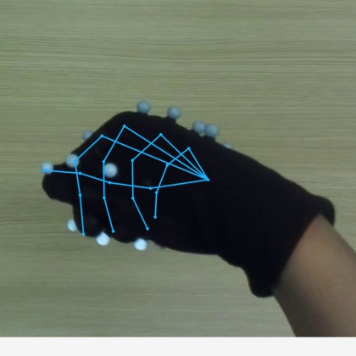
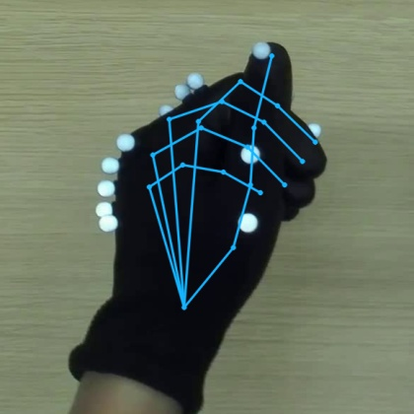
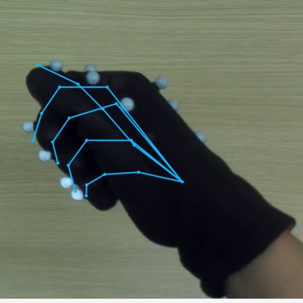
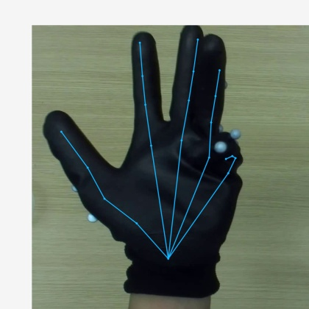
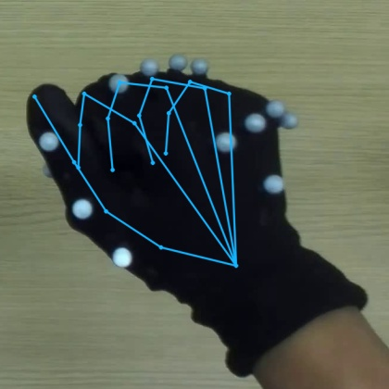
Random Validation 1-5
S019 | F276 | R
S036 | F540 | L
S019 | F282 | R
S036 | F420 | L
S036 | F180 | R
Raw image
Dataset
annotation
Official
WiLoR
184.4 px
35.7 px
41.0 px
41.2 px
78.8 px
Fine-tuned
WiLoR
40.5 px
15.0 px
21.8 px
36.3 px
35.9 px
Dataset annotation: 21 joints projected from the provided MANO parameters. Identical frame and display crop for all rows.
4
Notes:
验证集 · 统一检测框紧裁剪 · 误差以数据集 MANO 拟合标注为参考；图片不显示标注骨架
从有效验证样本中随机抽取 10 个，不按结果挑选；固定随机种子 42。数字为对应手的二维误差，越低越好。
{
"group": "random",
"sample_indices": [
41,
298,
42,
258,
181
],
"sample_mean_px": {
"official": 76.19261620929981,
"finetuned": 29.922698204236134
},
"display": "All three panels use identical hand-region crop for display; input inference used detected boxes. Source reference overlays excluded.",
"selection": "Uniform over 351 matched validation hand samples, without replacement; no selection by outcome."
}

Slide 5
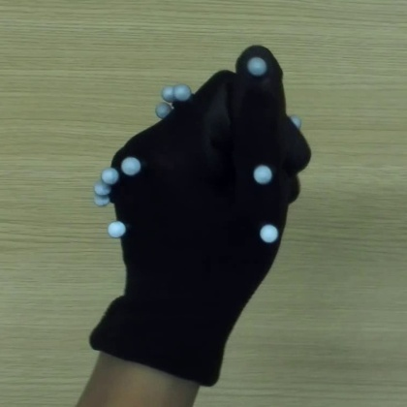
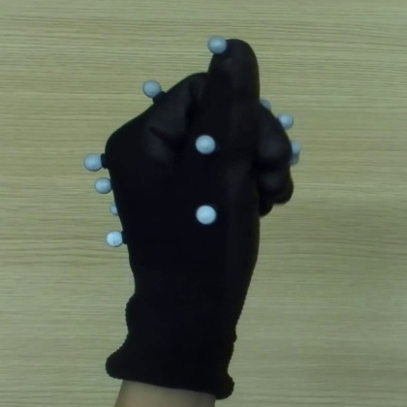
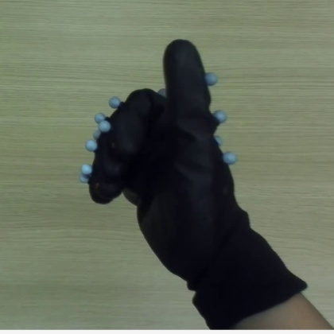
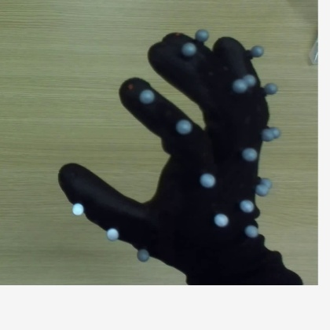
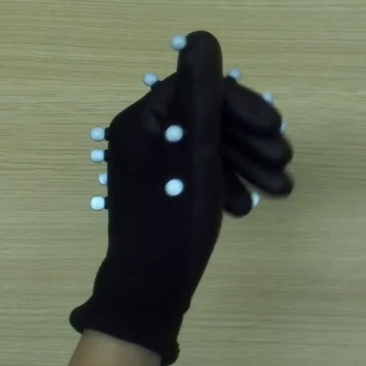
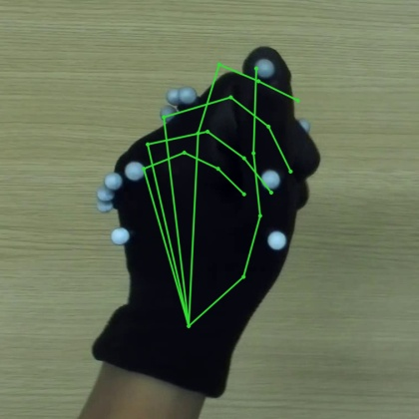
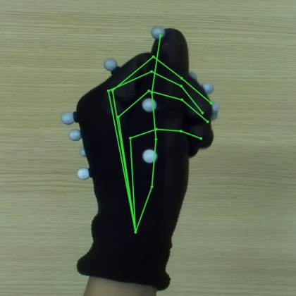
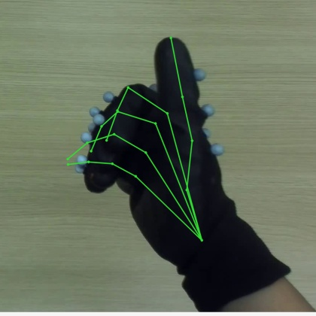
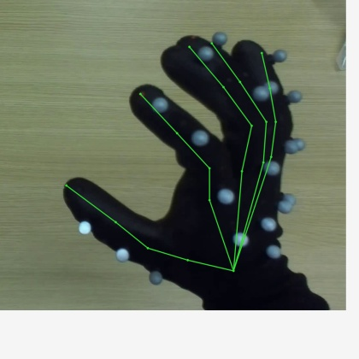
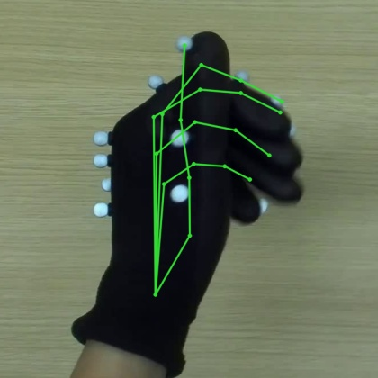
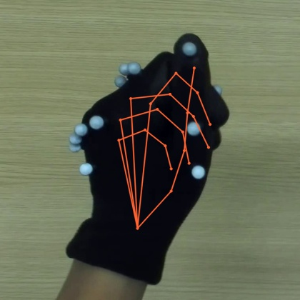
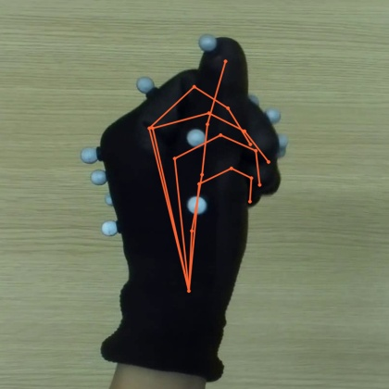
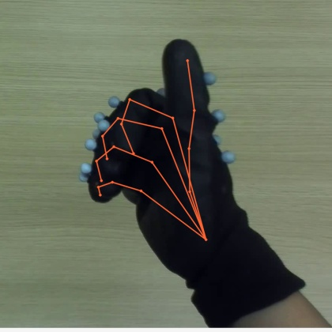
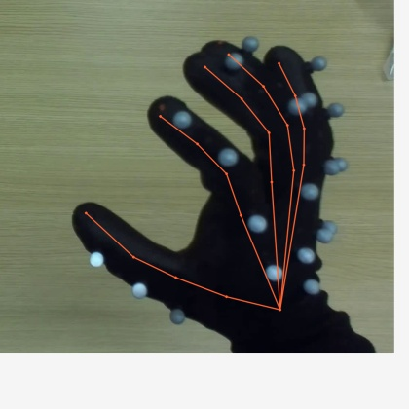
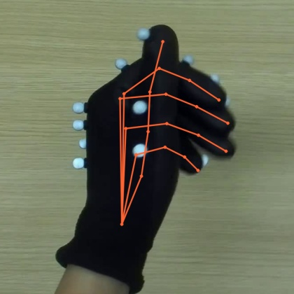
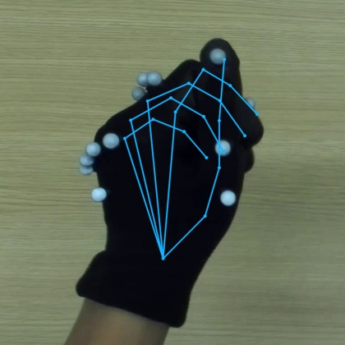
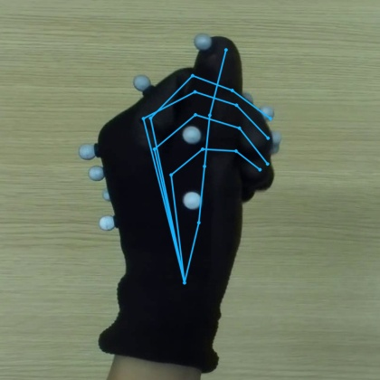
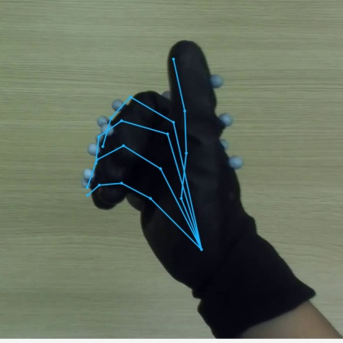
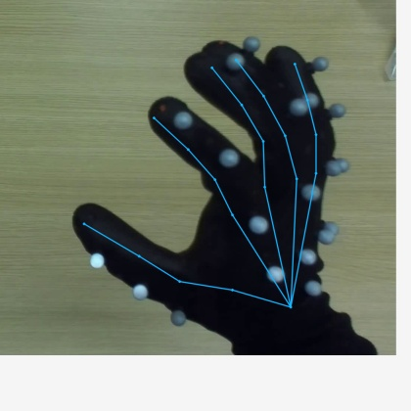
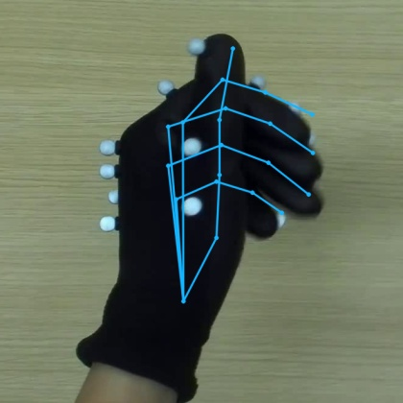
Random Validation 6-10
S036 | F174 | L
S036 | F474 | L
S019 | F300 | R
S019 | F612 | R
S036 | F636 | L
Raw image
Dataset
annotation
Official
WiLoR
56.1 px
38.9 px
33.3 px
37.4 px
46.2 px
Fine-tuned
WiLoR
26.9 px
21.0 px
29.9 px
37.0 px
31.9 px
Dataset annotation: 21 joints projected from the provided MANO parameters. Identical frame and display crop for all rows.
5
Notes:
{
"group": "random",
"sample_indices": [
178,
276,
45,
94,
330
],
"sample_mean_px": {
"official": 42.37943626861882,
"finetuned": 29.344938689380843
},
"display": "All three panels use identical hand-region crop for display; input inference used detected boxes. Source reference overlays excluded.",
"selection": "Uniform over 351 matched validation hand samples, without replacement; no selection by outcome."
}

Slide 6
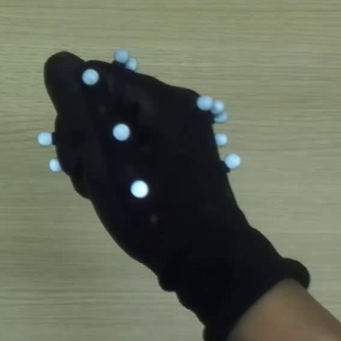
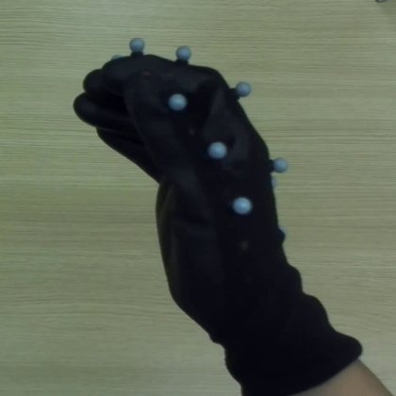
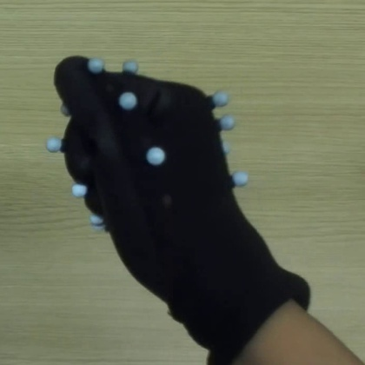
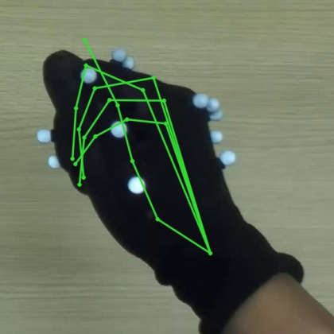
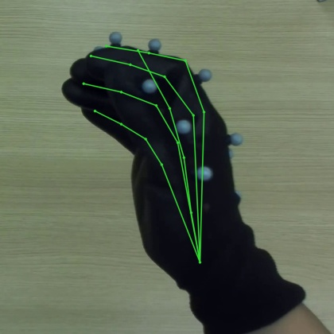
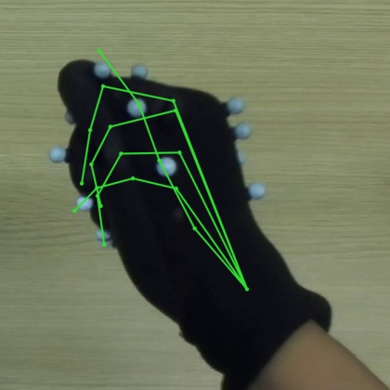
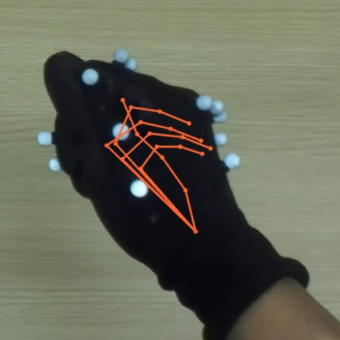
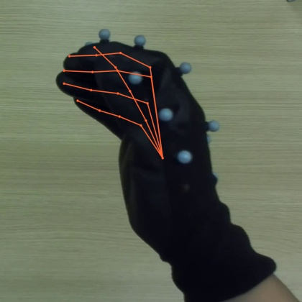
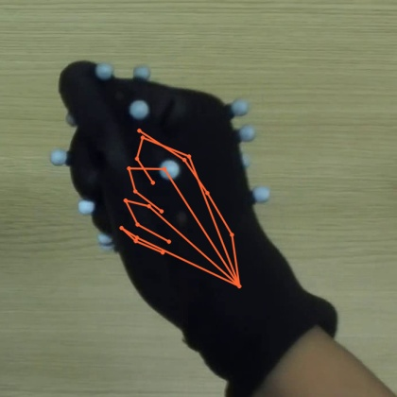



Worst case of Official Wilor | Improvement of fine-tuning
S019 | F276 | R
S036 | F504 | R
S019 | F786 | R
S036 | F210 | R
Raw image
Dataset
annotation
Official
WiLoR
184.4 px
121.8 px
105.8 px
99.0 px
Fine-tuned
WiLoR
40.5 px
28.0 px
43.4 px
36.1 px
Dataset annotation: 21 joints projected from the provided MANO parameters. Identical frame and display crop for all rows.
6
Notes:
按官方二维误差降序，选取 4 个不同时间点展示（同录像间隔至少 1 秒），避免相邻帧重复。
{
"group": "official_worst",
"sample_indices": [
41,
287,
123,
191
],
"sample_mean_px": {
"official": 127.75550131280298,
"finetuned": 37.01491714876549
},
"display": "All three panels use identical hand-region crop for display; input inference used detected boxes. Source reference overlays excluded.",
"selection": "Rank by original-image 2D error; greedily choose 4 examples at least 30 source frames apart within each session, to avoid adjacent duplicates."
}

Slide 7
















Worst case of Fine-tuned Wilor
S036 | F450 | L
S036 | F282 | L
S036 | F324 | L
S036 | F354 | L
Raw image
Dataset
annotation
Official
WiLoR
98.1 px
90.1 px
75.6 px
74.8 px
Fine-tuned
WiLoR
97.6 px
73.4 px
70.3 px
67.0 px
Dataset annotation: 21 joints projected from the provided MANO parameters. Identical frame and display crop for all rows.
7
Notes:
{
"group": "finetuned_worst",
"sample_indices": [
268,
212,
226,
236
],
"sample_mean_px": {
"official": 84.63165664367004,
"finetuned": 77.0996337194388
},
"display": "All three panels use identical hand-region crop for display; input inference used detected boxes. Source reference overlays excluded.",
"selection": "Rank by original-image 2D error; greedily choose 4 examples at least 30 source frames apart within each session, to avoid adjacent duplicates."
}

Slide 8
当前结论与下一步
已完成裁剪统一；继续围绕手套场景的实际效果验证改进。
1
已完成：统一训练与推理裁剪
正方形框 ×1.25；两模型使用同一检测框，平均二维误差下降约25%。
2
下一步：改善定位与框变化适应性
在后续微调中加入检测框中心、尺度扰动，同时监测原图投影和手腕偏差。
3
最后：用新的留出录像确认收益
检查未见过的手套姿态和裸手表现，再决定是否替换官方模型。
当前限制：平均改善不代表每帧更好；手腕定位与裸手表现仍有退化，参考标注也存在误差。
验证集 · 统一检测框紧裁剪 · 误差以数据集 MANO 拟合标注为参考；图片不显示标注骨架
8
Notes:
合并旧结论版中的下一步计划，并将裁剪统一更新为已完成。其余旧裁剪诊断留在实验记录，不放入面向观众的汇报。第二轮微调尚未启动。

