Slide 1
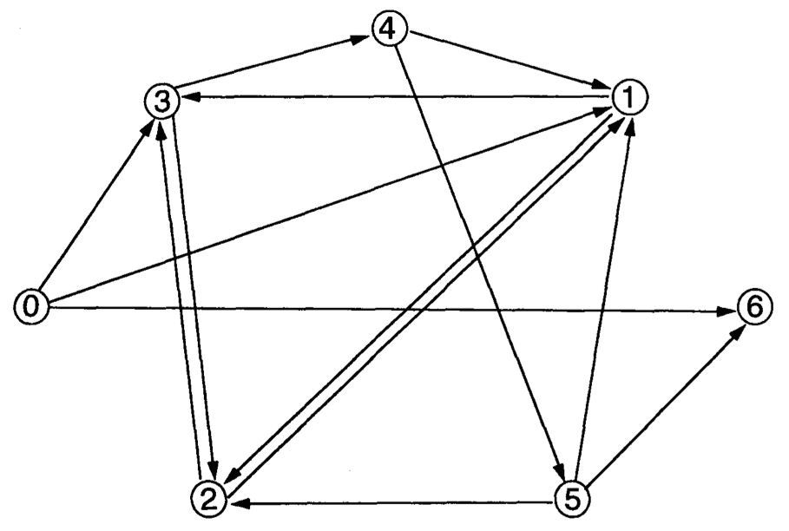
Biological networks can be represented as a directed graph:
Nodes = genes
Directed edges = interactions

Slide 2
Biological networks can be represented as a directed graph:
Nodes = genes
Directed edges = interactions
An interaction can be promotional (+) or inhibitory (-) in nature

Slide 3
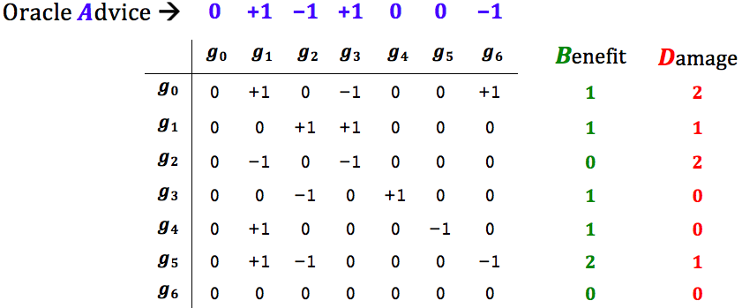
The above graph represented as an adjacency matrix:

Slide 4
+ or – to signify the nature of the interaction: promotional (+)
or
inhibitory (-)

Slide 5
(hypothetical)

Slide 6
Oracle says:
g₁ and g₃ should be up (+)
g₂ and g₆ should be down (-)
Indifferent to g₀ g₄ g₅

Slide 7
Oracle says:
g₁ and g₃ should be up (+)
g₂ and g₆ should be down (-)
Indifferent to g₀ g₄ g₅

Slide 8
Projection
(counting along rows)

Slide 9
Attraction
(counting along columns)
0 0
3 1
2 1
1 2
0 0
0 0
0 2

Slide 10
Both
(counting along rows & columns)
1 2
4 2
2 3
2 2
1 0
2 1
0 2

Slide 11
Q: What genes should one turn on/off (by external intervention) so as to
maximize the total Benefit ?
Projection
(counting along rows)

Slide 12
Q: What genes should one turn on/off (by external intervention) so as to
maximize the total Benefit ?
A: Faithfully follow the Oracle advice and get the all the Benefits = 1+1+0+1+1+2+0 = 6
Projection
(counting along rows)

Slide 13
Q: What genes should one turn on/off (by external intervention) so as to
maximize the total Benefit ?
A: Faithfully follow the Oracle advice and get the all the Benefits = 1+1+0+1+1+2+0 = 6
But ... you also get all the Damages = 2+1+2+0+0+1+0 = 6
Projection
(counting along rows)

Slide 14
Q: What genes should one turn on/off (by external intervention) so as to
maximize the total Benefit while keeping the total Damages <= 3?
Projection
(counting along rows)

Slide 15
Q: What genes should one turn on/off (by external intervention) so as to
maximize the total Benefit while keeping the total Damages <= 3?
A: Turn on g₀ & g₃ & g₄ & g₅
Turn off g₁ & g₂
Projection
(counting along rows)

Slide 16
Q: What genes should one turn on/off (by external intervention) so as to
maximize the total Benefit while keeping the total Damages <= 3?
A: Turn on g₀ & g₃ & g₄ & g₅
Turn off g₁ & g₂
Optimal solution (projection variant):
Total B = 5 , Total D = 3

Slide 17
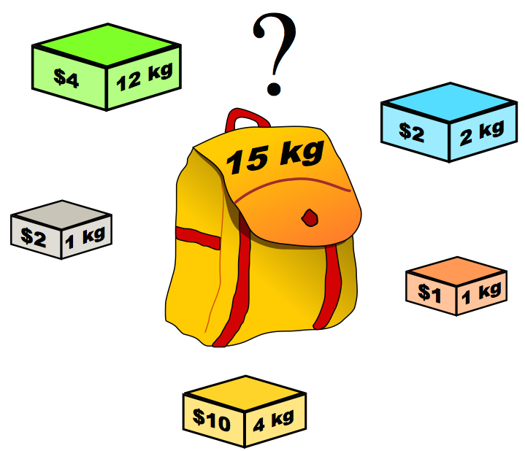
Which genes would you turn on/off to achieve maximal total Benefit while total
Damage <= T ?
Problem Definition
This problem is NP-hard by reduction from the Knapsack optimization problem
Holds for all three variants:
Projection, Attraction, and Both (proj. + att.)
M. A. Shamrani, J. Waldispühl, F. Major. "Evolution by Computational Selection." arXiv preprint arXiv:1505.02348 (2015).

