Slide 1
Pneumonia Detection in lung X-Rays
Mayur Kurup and Niyati Chopra

Slide 2
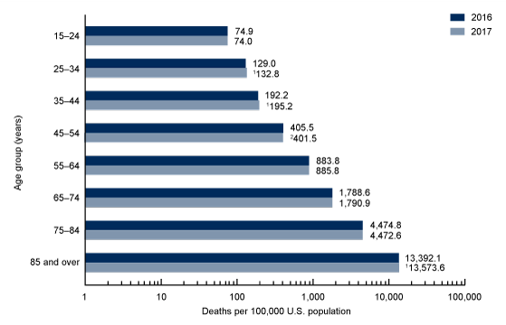
Introduction
Pneumonia is responsible for 15% of deaths. Recently, under the circumstances of the global pandemic, pneumonia cases have risen manifold as the virus attacks the respiratory system.
This is why having an algorithm that inputs chest X-ray dicom images and detects whether pneumonia exists in the lungs is important and very useful.
Our dataset is hosted as a competition on Kaggle in association with the Radiology Society of North America(RSNA). It consists of X-ray dicom images of multiple patients.

Slide 3
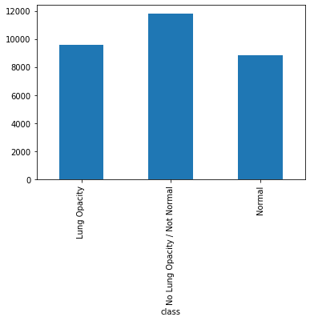
Exploratory Data Analysis
There are three types of patient records: Normal, Opacity, No Lung Opacity / Not Normal. The No Lung Opacity / Not Normal patients, have target variable value as 0. This means that they are treated as having no pneumonia. Our main focus is on the patients with Lung Opacity. They have target variable value as 1.

Slide 4
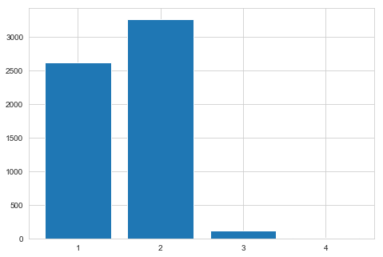
Exploratory Data Analysis
Our dataset comprises of a number of patients having 0-4 lung opacity instances. We are given x-min, y-min, width and height of the bounding boxes by which we can detect pneumonia of the patient based on their X-ray image

Slide 5
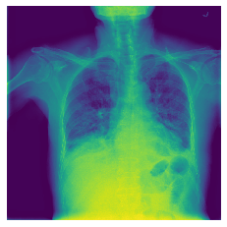
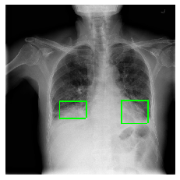
Exploratory Data Analysis
As mentioned, we are given X-ray dicom images as well as box co-ordinates. We can simply plot the boxes on X-ray images to visualize where the opacity in the lungs occurs. This is an example of the just the patient X-ray and one with the bounding boxes.

Slide 6
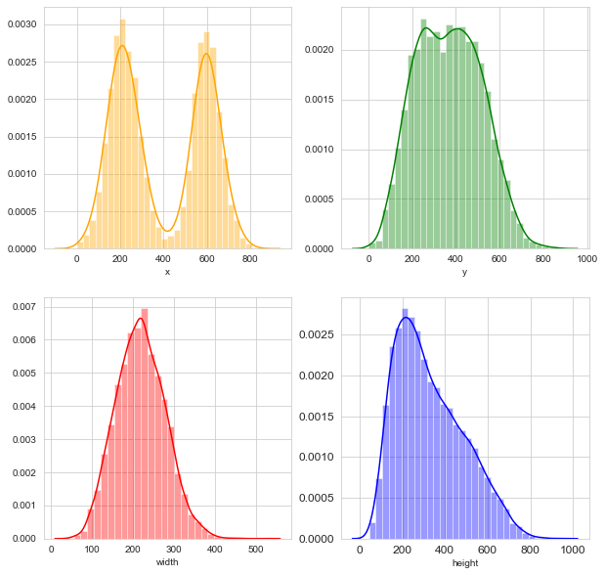
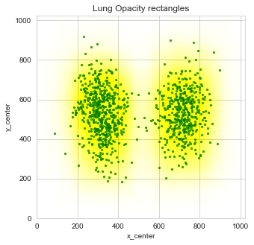
Exploratory Data Analysis
The boxes are used to show the location in the lungs where pneumonia like symptoms are present. As you can see in the plot, symptoms are not bounded to any particular location in the lungs. The boxes also have a distribution similar to a gaussian distribution in terms of width and height.

Slide 7
Modelling
We have used the following models to predict the presence of pneumonia on our dataset:
CNN – Convolutional Neural Networks
SVM – Support Vector Machines
Bonus: Logistic Regression

Slide 8
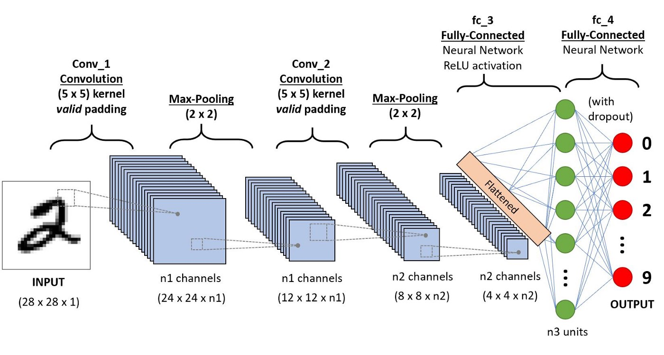
Convolutional neural networks (CNN)
A CNN, takes an image as input and assigns certain aspects of the image a level of importance. It uses these aspects to differentiate between images. The level of pre-processing required in CNNs is significantly lower than any other classification algorithms.
A CNN can successfully capture the spatial and temporal dependencies in an image through the application of relevant filters. The image shows the various stages of filters used in a CNN.

Slide 9
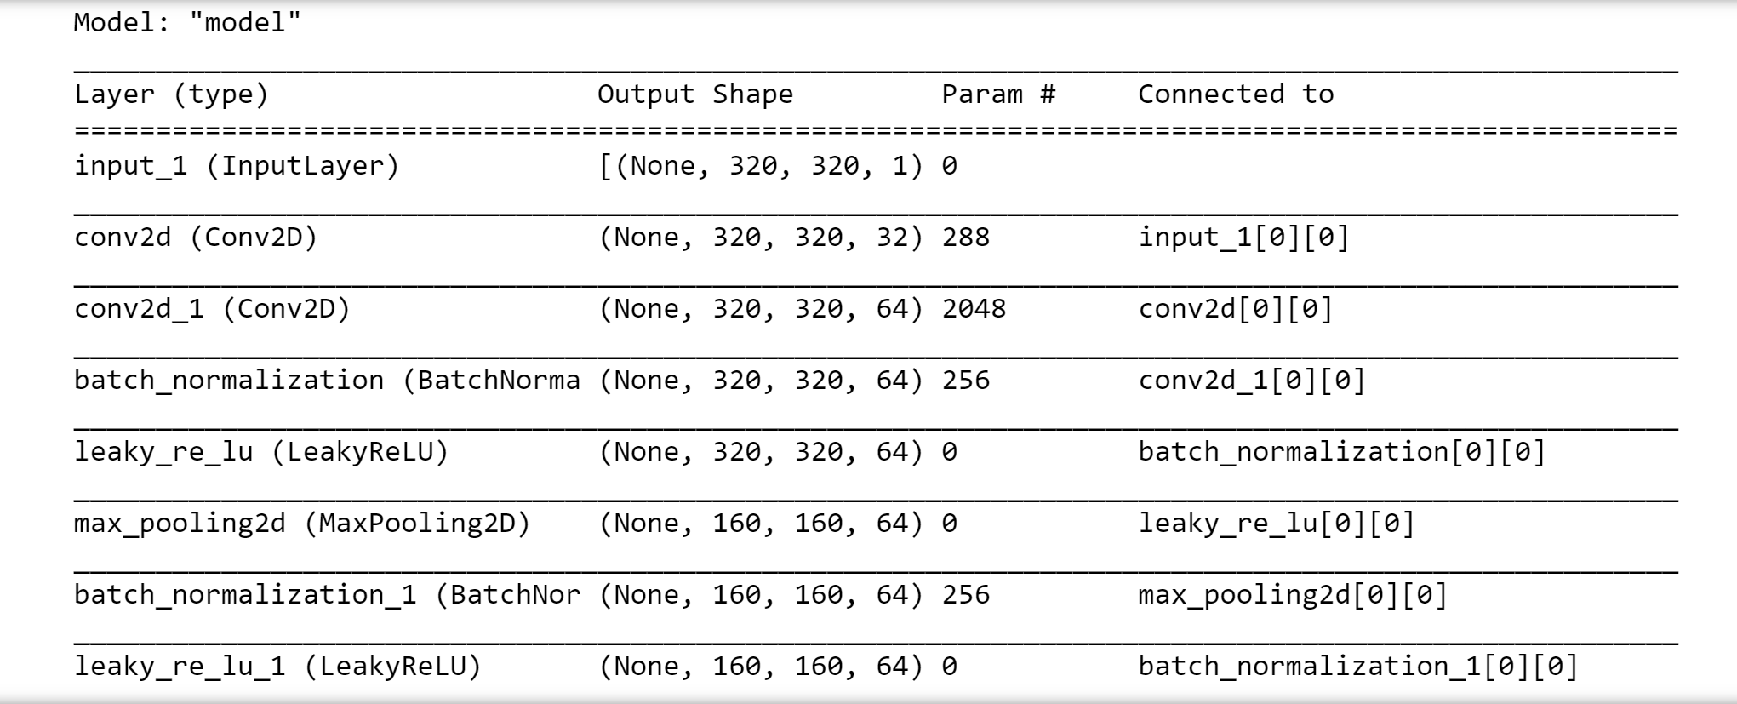
Convolutional neural networks (CNN)
Our CNN model has 50 layers. It has returned an training accuracy of 97.60% and a testing accuracy of 96.01%.

Slide 10
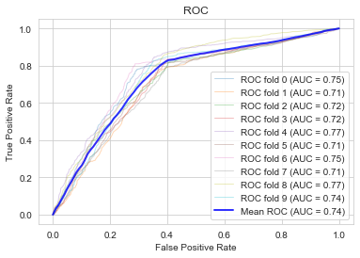
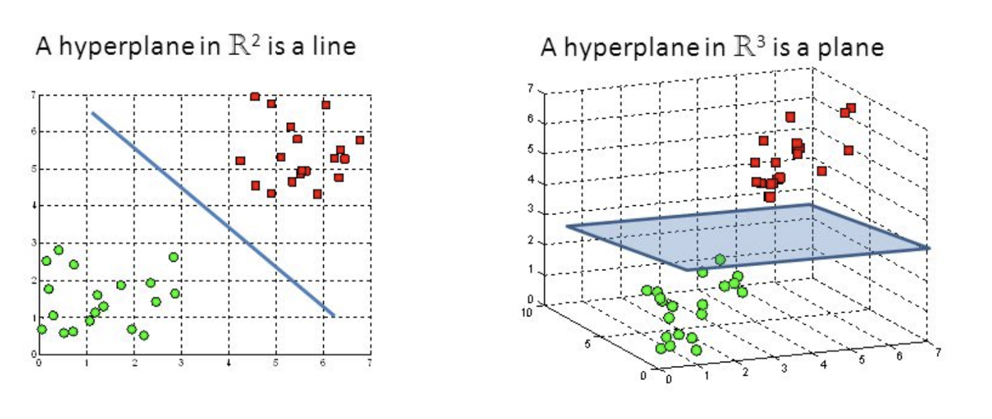
Support Vector Machine
The objective of an SVM is to find a hyperplane in an N dimensional space to help classify data points into classes. Here N is the number of predictors. We used SVM to classify our images into two categories based on the value of the target variable, i.e. has pneumonia or doesn’t have pneumonia. We achieved a training accuracy of 74.59 and a testing accuracy of 71.01%

Slide 11
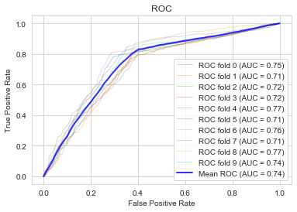
Bonus: Logistic Regression
Logistic regression is a classification algorithm used to segregate data based on categorical target variables. We performed logistic regression to check how a simple algorithm like logistic regression performs on an image dataset. We got a training accuracy of 72.25% and a testing accuracy of 70.40%.

Slide 12
conclusion
Future developments: we can use a Residual Neural Network to get a more accurate model, however, due to computational limitations, we were not able to implement the same. A residual neural network uses double or triple layer skips that contain non-linearities and batch normalizations in between.
Model Comparison: SVM got a lower accuracy as we could not extract much metadata from the images. We found only 3 useful parameters from the 39 given parameters. If we would have found more useful parameters, SVM would have performed better.
CNN on the other, in spite of being slower than SVM, gives a much higher accuracy rate.

Slide 13

THANK YOU

