Slide 1



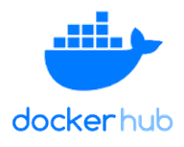

CI/CD Pipeline to Deploy Snowflake Data Warehouse Using dbt
Git/GitLab/Bit Bucket
Tech Stack
Source Code Management
Code Build
DBT Cloud
Snowflake
GIT
Docker Hub
Visual Studio
Validations Scans
Unit Tests
CI Pipelines
Pull the Docker image and Deploy
Create docker image and push
Strategy
Set up Local development environment
Set up GIT repository
Set up dbt
Set up dbt yaml file
Initialize Docker Image
Create Project and code in DBT
Push the code to GIT
Set up Git in dbt Cloud
Set up CI pipeline in dbt cloud with Snowflake Credentials
Create Pull request and deploy
yaml
Developer’s
Environment

Slide 2

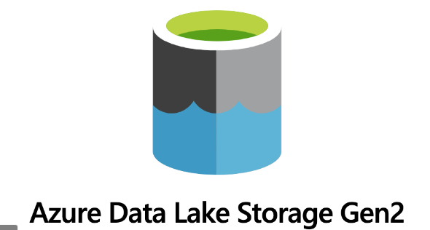



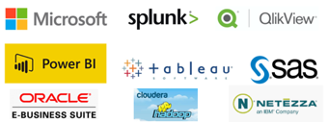
Identify PII Data and Restrict Access using Azure Purview
Strategy
Data Insights
Data Classification
Lineage
Access Control
Connect to the Azure Data Lake through Purview inbuilt Integration runtime feature
Scan the data assets using Data map scan by defining the desired scan rule set
We can schedule the scan to run at desired frequency
Identify the data category through built in rules and also custom business rules
Connect to Azure Data Factory pipelines to discover the data lineage
Classify the data as confidential, sensitive
Configure ADF to write the PII data into a separate Storage account
Provide read access only to the auditors using Identity Management in Synapse
Data Catalog
Business Glossary and Data Ownership
Unified Experience
Data Map
Automated Scanning & Classification
Data Discovery and Scans
Azure Data Factory
On Prem DBMS
On-prem & Multi-Cloud Operational, Analytical, SaaS

Slide 3
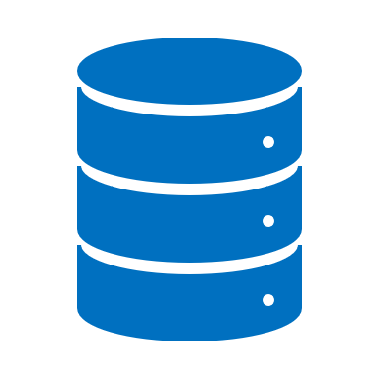

Data Discovery: Implementation Stages
STAGE1: DATA MGMT.
STAGE2: DATA QUALITY
STAGE3: DATA LINEAGE
BUSINESS METADATA: Executed workshops with Data Stewards and Data Owners to identify and document Business metadata (e.g. description, priority, sensitivity etc.), for all ingested data sets. This data will be uploaded and maintained with Azure Purview
TECHNICAL METADATA MANAGEMENT: Utilize Purview to discover, manage, and maintain technical metadata.
BUSINESS GLOSSARY: Document Business Glossary for the identified Data Domains. This data will be uploaded and maintained with Purview in the Master Data Mart within the Data Lake.
DQ CHECKS: Configure data quality checks to validate the attributes’ data completeness, data validity and data consistency
COMPLEX DQ VALIDATION: Design and develop complex data quality validations based on identified business rules and requirements, which can span across multiple attributes. These complex validations will be designed and developed for select data sets from the Various domains
DQ DASHBOARD & SCORECARD: Configure data quality dashboards to display results of DQ checks. Design and develop DQ scorecards to display results of the complex DQ validations
DATA DOMAINS: Identify and document the Data Domains associated to the ingested datasets (e.g. Digital). Also document and load the True Source information related to Data Assets.
DATA LINEAGE*: Relationships between data from various sources can be identified using Purview with Data Maps providing a visual representation of the lineage.
MDM Mart Creation : Load the Master Data, Lineage Data and Technical and Business Glossary to the MDM Mart. This data will be loaded after complex DQ checks and will be encrypted and masked wherever needed.
DATA GOVERNANCE OPERATIONS
ROLES & RESPONSIBILITIES: Outline and document roles and responsibilities for Data Owners and Data Stewards. These roles, responsibilities, and associated groups will be configured and maintained within EDC tool.
PROCESS MANAGEMENT: Outline and document processes to manage data governance operations. A process will be configured as a workflow within the Purview

