Slide 1
MACHINE LEARNING PROJECT
Deepfake Detection
Using Deep Learning
Image classification with EfficientNetB0
Presented by
Purvi Chopra
B.Tech CSE — Artificial Intelligence & Data Science
CT University | Subject: Machine Learning
REAL vs FAKE • Deep learning
Notes:
Opening: Introduce the project as an image-based deepfake classifier. Explain that it predicts whether an uploaded image resembles the REAL or FAKE examples learned during training. It is a decision-support tool, not a guarantee of authenticity.

Slide 2

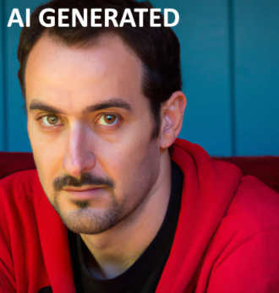
What are deepfakes?
AI can create or alter visual content so that it appears authentic.
AI-generated images
Manipulated images
Why it matters
Images created largely by generative models rather than captured directly by a camera.
Existing images altered by face swapping, editing, compositing, or other techniques.
Can enable misinformation, impersonation, fraud, and misuse of someone's identity.
AUTHENTIC-LOOKING IMAGE
SYNTHETIC / MANIPULATED IMAGE
Captured
image
Generated or
edited image
02
Notes:
Explain that the term deepfake is commonly used for AI-generated or manipulated media. This project focuses on still images, not video. Avoid suggesting that every AI-generated image is malicious.

Slide 3
Problem statement
Visual realism makes manual verification difficult.
The challenge
Why manual checks fall short
Our project goal
Synthetic images can look convincing. Visual clues may be subtle, inconsistent, or absent.
Human judgment is subjective and may not scale to large numbers of images.
Build a model that analyzes an uploaded image and predicts REAL or FAKE.
Input image → learned visual features → binary classification
REAL
FAKE
The prediction is an estimate based on training data—not definitive forensic proof.
03
Notes:
State the problem precisely: given a still image, predict one of two trained labels. The model cannot independently establish the image's origin or prove that a person or event is real.

Slide 4
Project objectives
A practical end-to-end image classification workflow.
01
Classify images
02
Learn visual patterns
Predict one of two labels: REAL or FAKE.
Use a deep CNN to learn image representations.
03
Measure performance
04
Build a usable demo
Evaluate with accuracy, precision, recall, F1-score, and confusion matrix.
Let a user upload an image and view a prediction.
04
Notes:
Walk through the four objectives: classification, learned feature extraction, measurable evaluation, and an interface for testing. Mention that the model's scope is image-level binary classification.

Slide 5
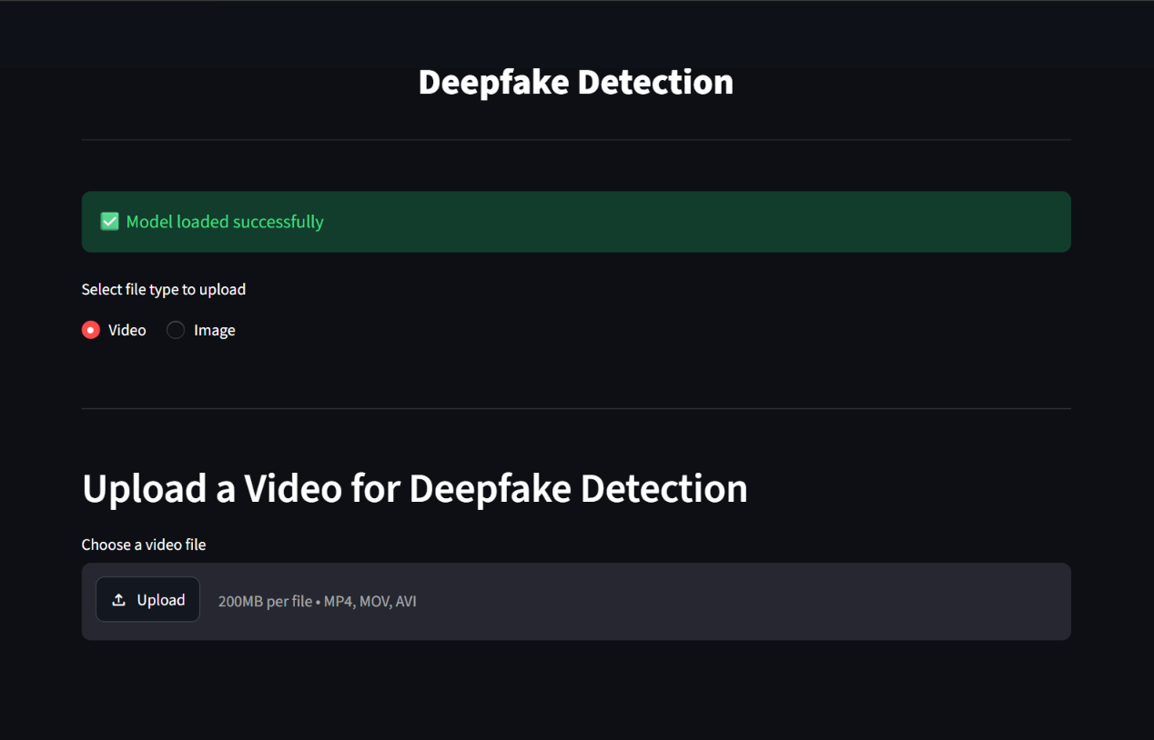
Streamlit application and demo
A simple interface makes the model testable without running training code.
1. Upload
Select an image from your device.
2. Preprocess
Prepare it in the format expected by the model.
3. Interpret
Display the predicted class and score, if supported.
14
Notes:
Use this slide to demonstrate the actual Streamlit app if available. This is a mockup, not a screenshot. Explain that the app should load the trained model, preprocess an uploaded image consistently, and display the prediction. Avoid calling the displayed score a calibrated probability unless verified.

Slide 6
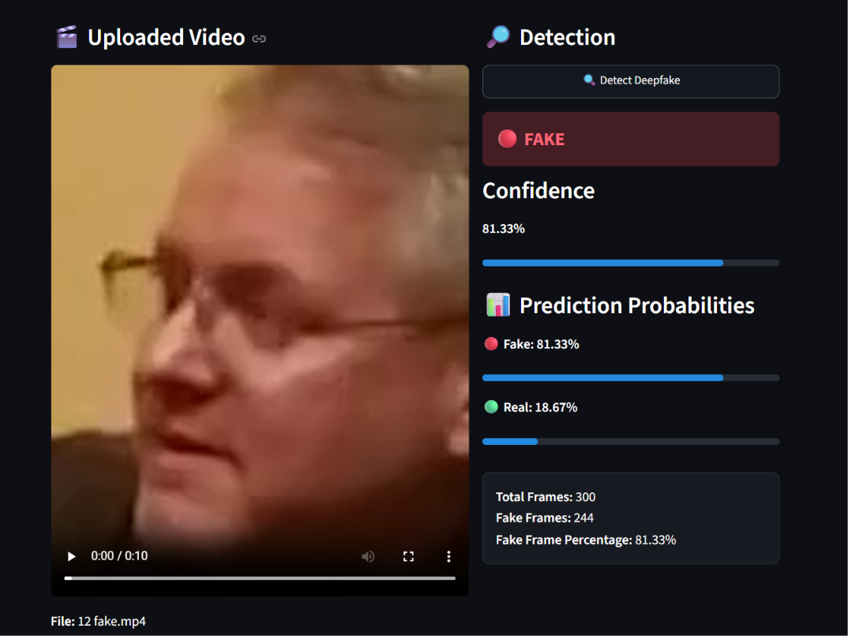
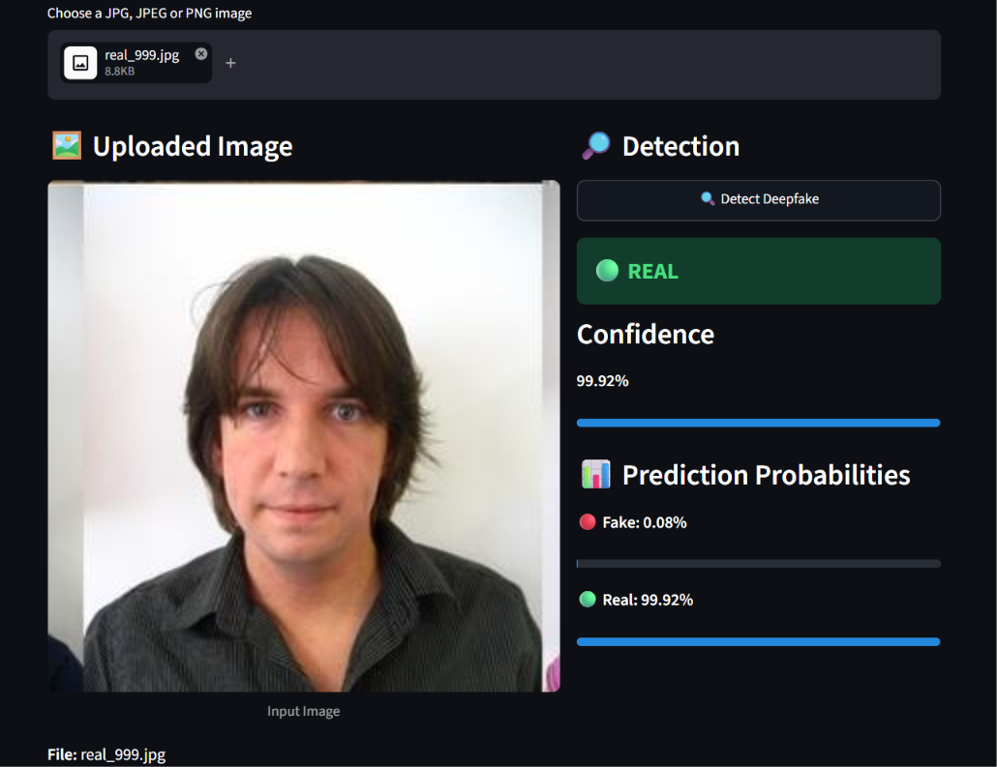
Streamlit Interface
Fake image detected
Real image detected
14
Notes:
Use this slide to demonstrate the actual Streamlit app if available. This is a mockup, not a screenshot. Explain that the app should load the trained model, preprocess an uploaded image consistently, and display the prediction. Avoid calling the displayed score a calibrated probability unless verified.

Slide 7
Existing approaches vs our solution
The project automates a repeatable first-pass classification.
Manual inspection
Proposed deep learning approach
• A person looks for visual inconsistencies
• Results can vary by observer
• Difficult to apply consistently at scale
• Skilled forensic analysis may still be needed
• Preprocess an image consistently
• Extract learned features with EfficientNetB0
• Produce a REAL/FAKE score or label
• Reuse the same inference pipeline for each image
Important: automated prediction supports review; it does not replace forensic verification.
05
Notes:
Avoid claiming that this model outperforms every existing method. The comparison is conceptual: the project makes the classification process automated and repeatable.

Slide 8
Dataset and preprocessing
Consistent inputs help the model learn comparable visual patterns.
Image folders
Load & label
Resize
Batch
Split
REAL / FAKE
Binary labels
224 × 224
Mini-batches
Train / validation
Why resize and batch?
Why split the data?
Fixed dimensions fit the model input; batches make training and inference manageable.
Training updates model weights; validation checks performance on held-out examples.
Project note: one recorded loader run contained 12,902 images (10,322 train / 2,580 validation). Verify these counts against the final dataset before presenting.
06
Notes:
The project loader has previously reported 12,902 images, with 10,322 training and 2,580 validation examples. Because dataset versions may change, verify the current run before treating this as final. Mention model-specific preprocessing only as implemented in the final code.

Slide 9
How deep learning analyzes an image
CNNs learn useful patterns from pixels during training.
Input
pixels
Early features
edges / texture
Deeper features
shapes / patterns
Feature
representation
Classifier
REAL / FAKE
Training
Inference
The model adjusts weights to reduce prediction error on labelled examples.
A new image passes through the trained network to generate a prediction.
07
Notes:
Explain the difference between training and inference. During training, labelled examples guide weight updates. At inference, the weights are fixed and the network processes a new image.

Slide 10
Why EfficientNetB0?
A compact CNN architecture commonly used for image classification.
Transfer learning
Efficiency
Adaptation
Start from features learned on a large image dataset, if pretrained weights are used.
EfficientNet scales network depth, width, and input resolution in a balanced way.
A task-specific classification head can adapt features to REAL/FAKE labels.
Pretrained features → project-specific training → image-level prediction
The exact layers, frozen/unfrozen blocks, and output activation must match the final model code.
08
Notes:
EfficientNetB0 is a CNN architecture designed for a strong accuracy-efficiency balance. Transfer learning means reusing weights learned on another dataset. Only describe a pretrained setup if the final code actually loads pretrained weights.

Slide 11
Proposed model architecture
Conceptual pipeline—confirm the classifier head and preprocessing against the saved model.
Uploaded image
Preprocessing
EfficientNetB0
Classification head
Prediction
JPG / PNG
Resize + model-specific input prep
Convolutional feature extractor
Task-specific layers
REAL / FAKE
Input consistency
Output interpretation
Training and app inference should use compatible preprocessing and image dimensions.
Map the model output to the correct class order; calibrate thresholds only with held-out data.
09
Notes:
This diagram describes the expected high-level pipeline, not every layer. Verify whether the model uses sigmoid or softmax, and check class ordering in the saved model and application code before the viva.

Slide 12
Model training
The model learns by comparing its predictions with known labels.
1. Forward pass
Image moves through the network and produces a score.
2. Loss calculation
Loss measures disagreement between prediction and true label.
3. Backpropagation
Gradients indicate how model weights should change.
4. Optimizer update
Weights are adjusted to reduce loss.
5. Validation
Performance is checked on examples not used for weight updates.
Key settings to report from the final run: optimizer • learning rate • batch size • epochs • loss function
10
Notes:
Explain the training loop in sequence. Avoid reading every hyperparameter unless asked. The exact optimizer and settings should be read from the final training script, because configurations changed during experimentation.

Slide 13
How do we evaluate the model?
Different metrics reveal different types of mistakes.
Accuracy
Precision
Correct predictions ÷ all predictions
Of predicted FAKE images, how many were FAKE?
Recall
F1-score
Of actual FAKE images, how many did we detect?
Harmonic mean of precision and recall
For deepfake detection, Fake-class recall matters because missed fakes are false negatives.
Always state which dataset and evaluation run produced each metric.
11
Notes:
Define the metrics with the FAKE class explicitly. Precision tells us how trustworthy FAKE predictions are; recall tells us how many actual fake examples were caught. Which metric matters most depends on the use case.

Slide 14
Project results
Reported runs from project experiments; validation and test figures are different.
Validation accuracy
Separate test run
Fake recall
91.2% in a reported fine-tuned validation run.
89.5% accuracy on a reported 1,000-image evaluation.
83% in that reported 1,000-image test run.
Reported confusion matrix (1,000 images)
Interpretation
• 417 fake images were correctly detected.
• 83 fake images were missed (false negatives).
• 22 real images were flagged as fake.
• 478 real images were correctly classified.
Pred. FAKE
417
Pred. REAL
83
Pred. FAKE
22
Pred. REAL
478
Verify these numbers against the final saved model and test script before presenting; results can change between runs.
12
Notes:
These figures reflect previously reported project runs: 91.2% validation accuracy in a fine-tuned run and 89.5% on a separate 1,000-image test run. The reported test confusion matrix is [[417, 83], [22, 478]] with FAKE first and REAL second. Confirm the exact model checkpoint and class order before final submission.

Slide 15
Challenges and improvements
Better results require reliable data, testing, and careful error analysis.
Challenge: limited compute and storage
Challenge: missed fake images
Large image datasets take space; CPU training can be slow.
A strong overall accuracy can hide weaker recall for the FAKE class.
Improvement: data quality
Improvement: evaluation
Use diverse, correctly labelled examples; prevent duplicates and data leakage.
Test on independent sources; tune thresholds on validation data; inspect errors.
Augmentation can improve robustness, but should not create unrealistic artifacts or replace independent testing.
13
Notes:
Mention practical constraints without presenting them as excuses. Data leakage, duplicate images across splits, and dataset-specific artifacts can inflate metrics. Any augmentation or threshold change must be re-evaluated.

Slide 16
Streamlit application and demo
A simple interface makes the model testable without running training code.
1. Upload
Deepfake Detection
Select an image from your device.
Upload an image to classify it
2. Preprocess
Choose image file • JPG / PNG
Prepare it in the format expected by the model.
PREDICT
REAL / FAKE
3. Interpret
Display the predicted class and score, if supported.
Illustrative mockup — replace with a screenshot of the actual app.
14
Notes:
Use this slide to demonstrate the actual Streamlit app if available. This is a mockup, not a screenshot. Explain that the app should load the trained model, preprocess an uploaded image consistently, and display the prediction. Avoid calling the displayed score a calibrated probability unless verified.

Slide 17
Future scope
Potential extensions beyond the current image classifier.
Video analysis
Robustness testing
Sample frames and study temporal inconsistencies.
Evaluate on unseen datasets and new generation methods.
Forensic signals
Deployment
Combine visual model output with metadata and provenance checks.
Package inference for a reliable web or cloud service.
These are future possibilities—not features claimed to exist in the current version.
15
Notes:
Clearly separate future work from implemented functionality. Video detection requires additional temporal modelling and evaluation; it is not achieved merely by classifying one frame.

Slide 18
Conclusion
Our project applies deep learning to classify still images as REAL or FAKE using an EfficientNetB0-based pipeline.
KEY TAKEAWAYS
Preprocessing and class labels must be consistent.
Evaluation should include fake-class recall and error analysis.
Predictions are not definitive proof of authenticity.
Thank You !
Notes:
Close by summarizing the project and its limitations. References should be finalized with the exact dataset source and documentation versions used. Invite questions about model architecture, training, and evaluation.

