Slide 1
CHURN MODELING
BILJANA JOVANOVA, RAJESH CHODAVARAPU

Slide 2
What is Churn and Why is it important?
Acquiring new customers is expensive than retaining existing customers.
How can predictive modeling help companies in their retention efforts?
Retention or churn models use historic customer behavior measured in different variables with the goal to assign a risk profile or probability of churn
In churn models it is important not only to predict whether a customer will churn or not, but also what drives churn. Understanding the key drivers can help management focus on creating operational strategies change the defection pattern and mitigate churn
The GOAL is to a build model which is both ACCURATE and INTERPRETABLE

Slide 3
Our goals for this project
Open source dataset to answer a real-world business problem
Dealing with imbalanced classes in the response
Impact on the accuracy of predicting the event (churn | yes) and the overall accuracy of the model

Slide 4
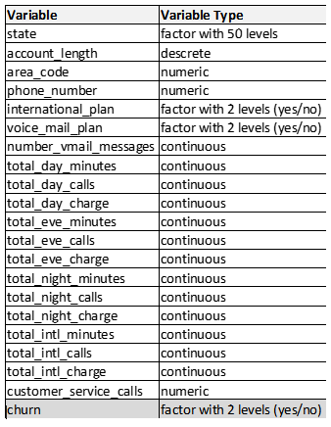
Telcom Churn Dataset
Source: Kaggle
Dimensions:
20 predictors
1 response
Churn | yes = 14%
Churn | no = 86%
5,000 observations

Slide 5
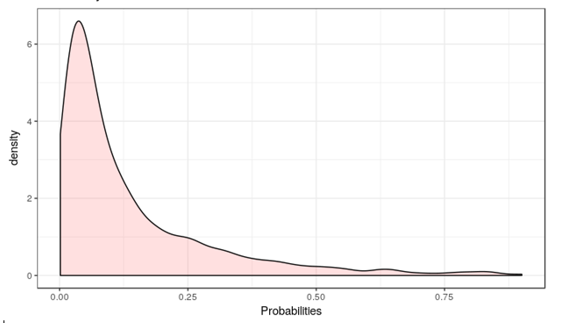
The Accuracy Paradox: Choosing the performance metric
Predictive power relates to the power of the model to accurately predict for the problem of interest we want to model, in our case probability of positive churn event.
Predictive models with a given level of Sensitivity or Specificity may have greater predictive power than models with higher overall accuracy.
performance is generally very biased against the class with the smallest frequencies
Predicted probabilities distribution for Churn | yes
COMPARE MODELS BASED ON SENSITIVITY and Kappa

Slide 6
Modeling Methodology
Methodology:
Start with a more complex model
Investigate simpler, more interpretable models
Choose simplest model which reasonably approximates the accuracy of complex model
For each model we will calculate:
Area Under the Curve (AUC), Sensitivity, Specificity, Kappa, Variable Importance
To study the effect of class imbalance:
Build all models with out-of-box probability threshold of 0.5
Use sampling techniques such as Up-sampling and SMOTE
For logistic regression, classify based on best Youden’s J index which maximizes the Sensitivity metric

Slide 7
Data Splitting and Resampling
Data Splitting:
75% to Training set
25% to Test set
Resampling on the Training set :
10 fold cross validation with 5 repeats
For model fitting and tuning: provides good control over bias and variance and was computationally efficient

Slide 8
Exploratory Analysis on Training Set
High pairwise correlations
Ex: Total Day Charge vs Total Day Minutes, Total Intl Minutes vs Total Intl Charge…
Zero Variance Predictors
Ex: Number of Vmail Messages
Imbalanced classes
Predictors: Intl Plan (no-91% |yes -9%), Voicemail Plan (no-74% | yes- 26%)
Response: Churn (no-86% | yes – 14%)
Uninformative variables
Ex: phone number, area code
Feature engineering:
Pricing component: calculate call rates for day, evening, and night calls
Total charges / Total minutes

Slide 9
Training Datasets
Full Training: original dataset
2. Reduced Training: removed zero variance and highly correlated predictors
3. Upsampled Training: reduced dataset Upsampled
4. SMOTE Training: reduced dataset resampled using SMOTE

Slide 10
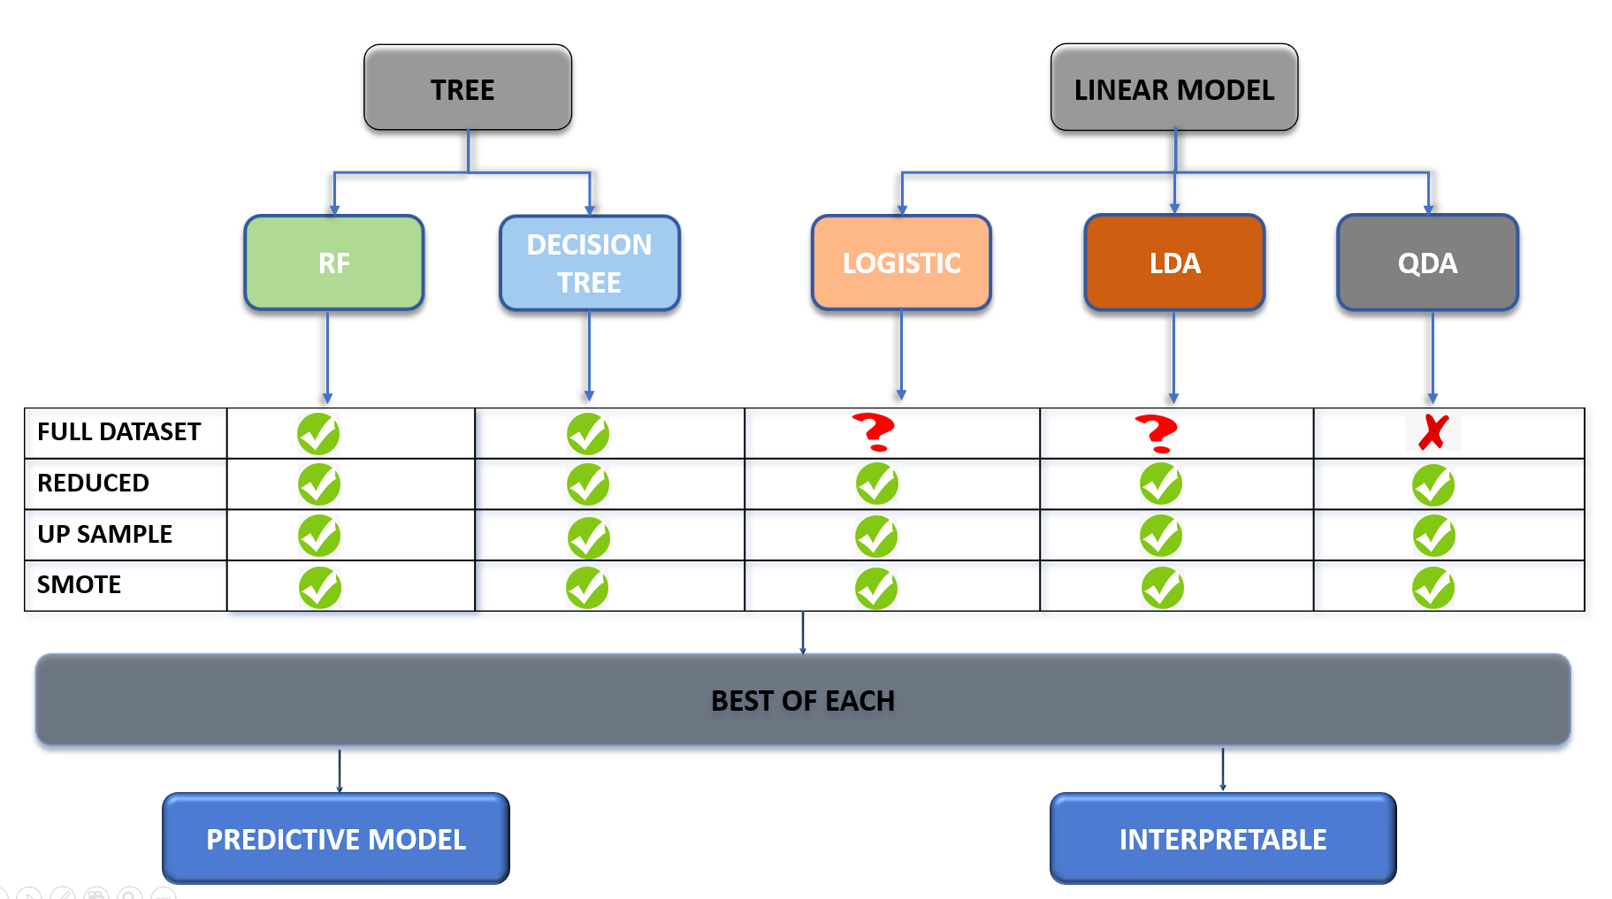
MODELING DIAGRAM

Slide 11
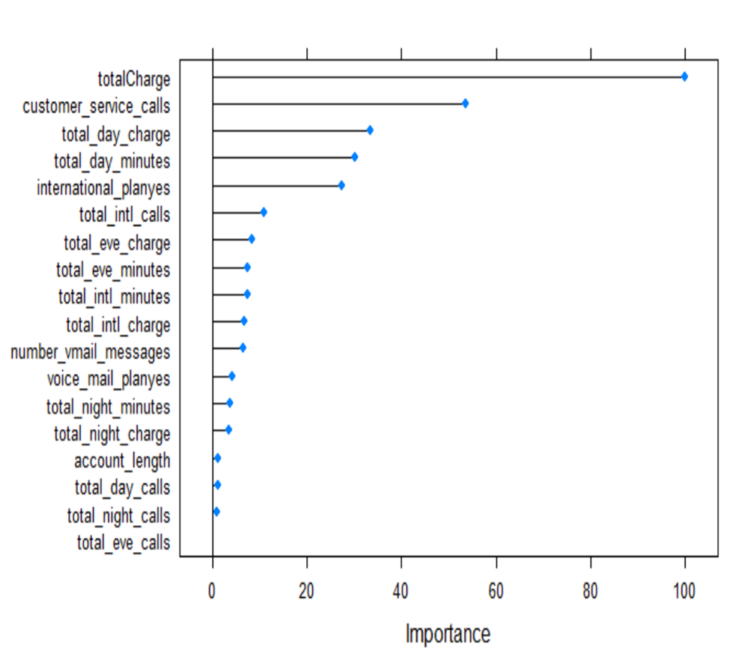
Random Forrest Models
Predictive Power:
Interpretability
Findings
Best Model : Training Full
Model insensitive to class imbalance
Different thresholds no significant improvement
Upsampling and Smote did not improve sensitivity
Most important variables for Best Model: Total Charge, Number of Service Calls, and Total Day Charge, but no directional insight

Slide 12
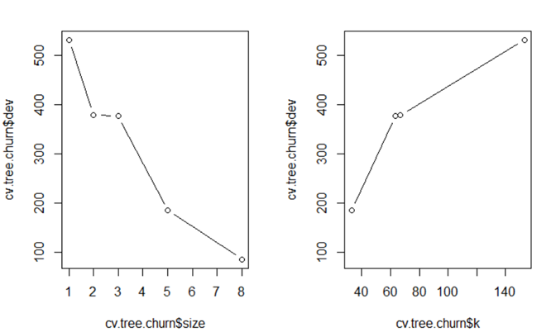
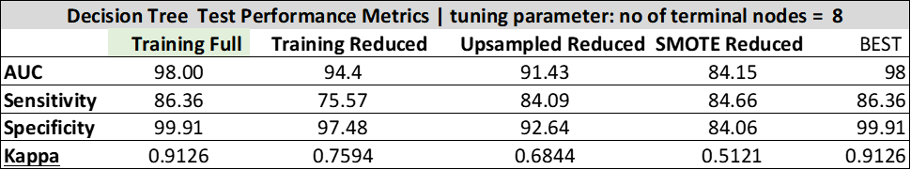
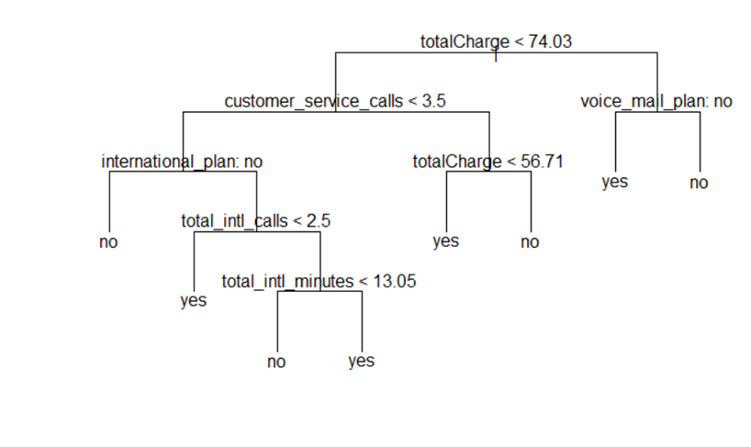
Decision Tree Models
Predictive Power:
Interpretability
Findings
Best Model : Training Full
Model insensitive to class imbalance
Different thresholds no significant improvement
Upsampling and Smote did not improve sensitivity
Useful interpretability

Slide 13
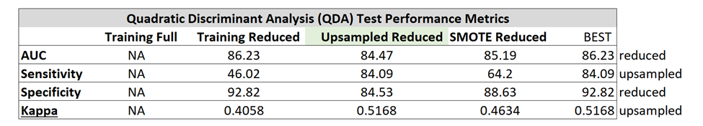
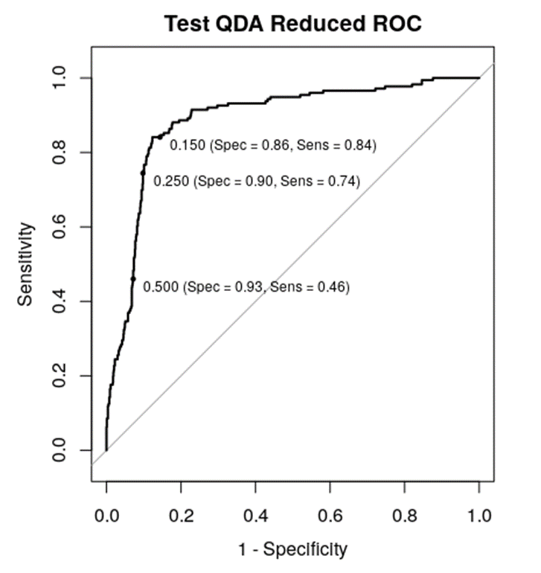
Quadratic Discriminant Analysis (QDA)
Predictive Power:
Findings
Best Model : Upsampled Reduced
Out of Box very sensitive to class imbalance
Upsampling was better than SMOTE
Not good interpretability: QDA algorithm provides only group means

Slide 14
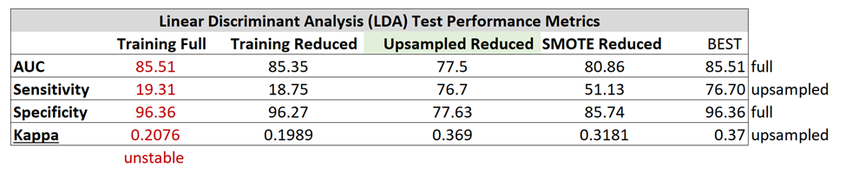
Linear Discriminant Analysis (LDA)
Predictive Power:
Interpretability
Findings
Best Model : Upsampled Reduced
Out of Box very sensitive to class imbalance
Upsampling was better than SMOTE
Not good interpretability

Slide 15
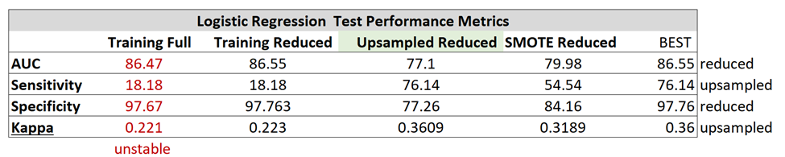
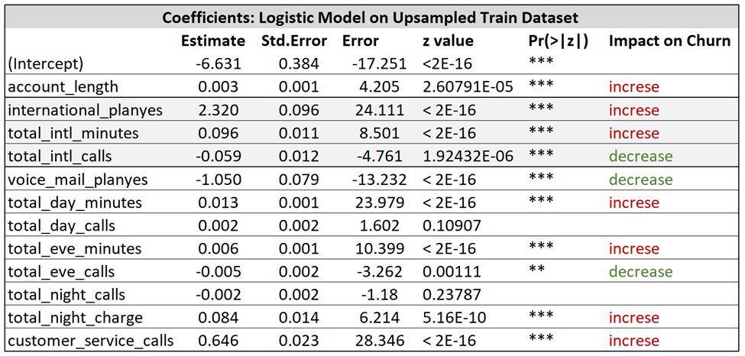
Logistic Regression
Predictive Power:
Interpretability
Findings
Best Model : Upsampled Reduced
Out of Box very sensitive to class imbalance
Upsampling was better than SMOTE
Very good interpretability

Slide 16
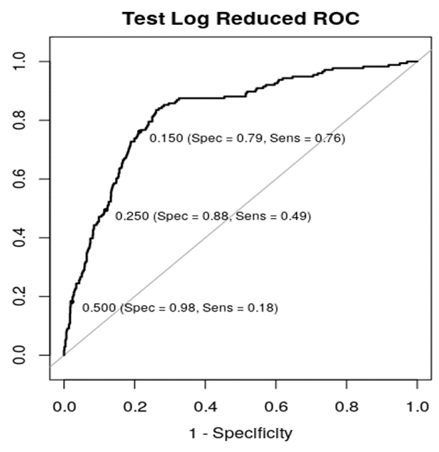

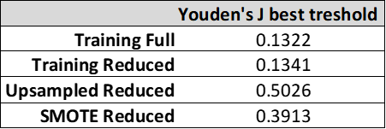
Adjusting Probability Threshold

Slide 17
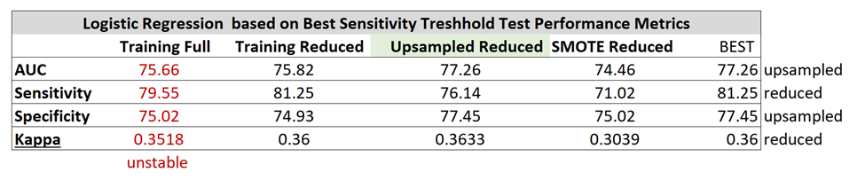
Logistic Regression based on Youden’s J
Predictive Power:
Interpretability
Findings
Best Model : Upsampled Reduced
Out of Box very sensitive to class imbalance
Upsampling was better than SMOTE
Very good interpretability

Slide 18
Summary on Classification Models
Accuracy (Area Under the Curve) is not a good performance metric when we have imbalanced classes, we should use sensitivity and kappa for model selection purposes
For linear models:
running the models with a default threshold of 0.5 results in poor sensitivity
Sensitivity increased when upsampling and SMOTE techniques were used
Collinearity produced unstable parameter estimates
Removing highly correlated variables based on pairwise correlations can result in loss of predictive power (total charge variable)
Random Forrest performed very well regardless of the imbalance of the classes

Slide 19



CARET ENSEMBLE
INTERVIEWER 1 (MODEL 1)
INTERVIEWER 2 (MODEL 2)
CANDIDATE(INPUT)
MANAGER
(STACK OF MODELS)
RESULT (OUTPUT)
INTERVIEWER 3 (MODEL 3)
LIST OF MODELS

Slide 20
CARET ENSENMBLE
Ensembling
Combining two or more algorithms
Types of Ensembling
Averaging
Majority Vote
Weighted Average

Slide 21
CARET ENSEMBLE
SENSITIVITY STATISTICS
DATA SET | RF MODEL | ENSEMBLE RF MODEL
REDUCED SET | 76.7 | 80.11
UPSAMPLED SET | 79.54 | 86.93
CARET ENSEMBLE UP SAMPLE SET PREDICTION SUMMARY
RF | LOGISTIC | LDA | QDA | DT | EMSEMBLE(RF) | ACTUAL
0 | 0 | 0 | 0 | 0 | 0 | 0
0 | 1 | 1 | 0 | 0 | 0 | 0
0 | 0 | 0 | 0 | 0 | 0 | 0
0 | 1 | 1 | 1 | 0 | 0 | 1
1 | 1 | 0 | 0 | 1 | 1 | 1

Slide 22
CARET ENSEMBLE
Advantages
Improves accuracy
More robust and stable
Builds simple as well complex models
Disadvantages
Reduces Interpretability
Lack of business insights
Time consuming
Hard to master the model selection

