Slide 1


Gpt-3
Elon Musk
Sam Altman
Ilya Sutskever
Greg Brockman
Wojciech Zaremba
John Schulman

Slide 2
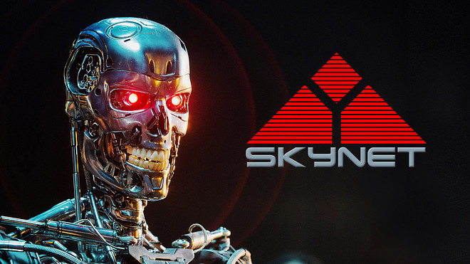
Intelligence Explosion Threat to Human Extinction Reduce Risk Surpass Human Intelligence Fake News/ Blogs/Articles/Academic Assignments
MOTIVES

Slide 3
HISTORY
GPT (June 2018)
GPT-2 (February 2019)
GPT-3 (May 2020)

Slide 4
Generative Pre-trained Transformer 3 (GPT-3)
Open AI’s latest Language model
175 billion parameters from 1.5 billion(GPT2)
Just in early stages

Slide 5
USE CASES
Generates text/articles
Chat Bots (Of course lacks bit of common sense)
Music
Business Memos
Writes the code
Text Predictor

