Slide 1



Towards a Conversion of the Prague Dependency Treebank Data to the Uniform Meaning Representation
Markéta Lopatková, Eva Fučíková, Federica Gamba,
Jan Štěpánek, Daniel Zeman and Šárka Zikánová
Charles University, Faculty of Mathematics and Physics
Institute of Formal and Applied Linguistics
Supported by the LUSyD project (GAČR, no. 20-16819X) and the LINDAT/CLARIAH-CZ project (MŠMT, no. LM2023062); partially supported by CUNI (GAUK, project no. 104924, and SVV, project no. 260 698).

Slide 2
Motivation and Goal
Meaning representation
intriguing theoretical problem
its practical implications for applications
interlingua for machine translation
a basis for knowledge representation and
knowledge systems
a sound and reliable basis for logical inference
+
LLM dominates the field, BUT
problems with hallucinating
tend to fabricate information
WAFNL ITAT 2024, Drienica, Čergovské vrchy September 23rd, 2024

Slide 3
Motivation and Goal
Meaning representation
intriguing theoretical problem
its practical implications for applications
interlingua for machine translation
a basis for knowledge representation and
knowledge systems
a sound and reliable basis for logical inference
+
LLM dominates the field, BUT
problems with hallucinating
tend to fabricate information
Goal:
compare 2 meaning representations
based on different theoretical assumptions, with different linguistic traditions, with different focuses
a substantially deeper understanding of language semantics
WAFNL ITAT 2024, Drienica, Čergovské vrchy September 23rd, 2024

Slide 4
Two Meaning Representations at a Glance
PDT-MR
theory: Functional Generative Description (esp. Sgall et al, 1967; 1986; 2020)
data and tools: treebank (esp. Hajič et al., 2020)
Czech (∼130k sentences); English (∼55k); Latin (∼5k)
dependency-oriented formalism
covers:
– deep and surface syntax (argument structure)
– meaning-relevant morphology (tense, modality)
– coreference annotation
– information structure and discourse relations
focus on meaning as structured by the given language
more-or-less directly reflects the text
UMR
semantics, abstracting away from syntax (esp. van Gysel et al, 2018; Bonn et al, 2013)
typological perspective
limited data, no supporting infrastructure 6 languages (∼ 2k sentences)
(directed) (acyclic) graphs
covers:
– argument structure
– multiword expressions, named entities
– enhanced info on aspect, modality, temporality
– coreference
broad sem. interpretation of the text
for cross-lingual applications
WAFNL ITAT 2024, Drienica, Čergovské vrchy September 23rd, 2024

Slide 5
Two Meaning Representations at a Glance
PDT-MR
theory: Functional Generative Description (esp. Sgall et al, 1967; 1986; 2020)
data and tools: treebank (esp. Hajič et al., 2020)
Czech (∼130k sentences); English (∼55k); Latin (∼5k)
dependency-oriented formalism
covers:
– deep and surface syntax (argument structure)
– meaning-relevant morphology (tense, modality)
– coreference annotation
– information structure and discourse relations
focus on meaning as structured by the given language
more-or-less directly reflects the text
UMR
semantics, abstracting away from syntax (esp. van Gysel et al, 2018; Bonn et al, 2013)
typological perspective
limited data, no supporting infrastructure 6 languages (∼ 2k sentences)
(directed) (acyclic) graphs
covers:
– argument structure
– multiword expressions, named entities
– enhanced info on aspect, modality, temporality
– coreference
broad sem. interpretation of the text
for cross-lingual applications
WAFNL ITAT 2024, Drienica, Čergovské vrchy September 23rd, 2024

Slide 6
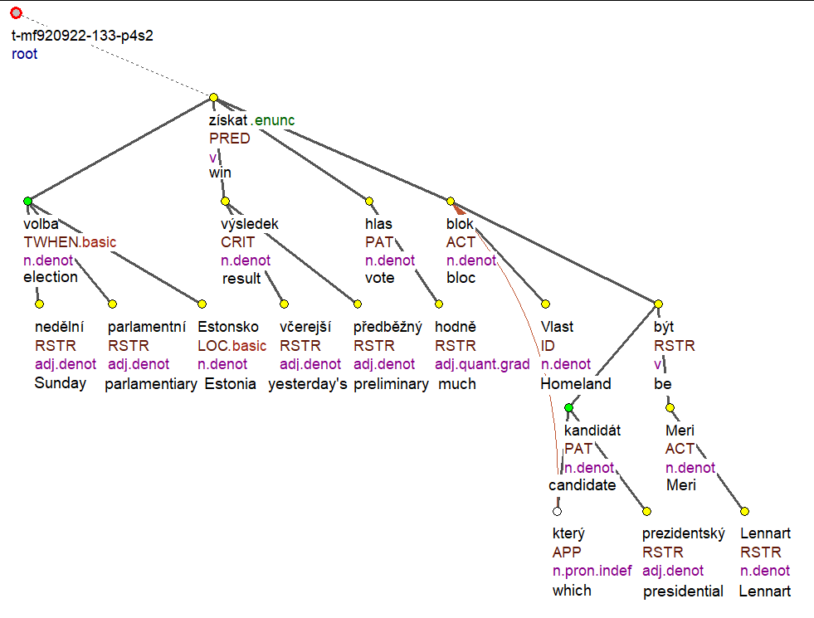
PDT-MR
V nedělních parlamentních volbách v Estonsku získal podle včerejších předběžných výsledků nejvíce hlasů blok Vlast, jehož prezidentským kandidátem byl Lennart Meri.
'In Sunday’s parliamentary elections in Estonia, according to yesterday’s preliminary results,
the Homeland bloc, whose presidential candidate was Lennart Meri, won the most votes.'
(borrowed from the PDiT-EDA 1.0 corpus; English glosses added).

Slide 7
PDT-MR
V nedělních parlamentních volbách v Estonsku získal podle včerejších předběžných výsledků nejvíce hlasů blok Vlast, jehož prezidentským kandidátem byl Lennart Meri.
'In Sunday’s parliamentary elections in Estonia, according to yesterday’s preliminary results,
the Homeland bloc, whose presidential candidate was Lennart Meri, won the most votes.'
(borrowed from the PDiT-EDA 1.0 corpus; English glosses added).

Slide 8
PDT-MR
V nedělních parlamentních volbách v Estonsku získal podle včerejších předběžných výsledků nejvíce hlasů blok Vlast, jehož prezidentským kandidátem byl Lennart Meri.
'In Sunday’s parliamentary elections in Estonia, according to yesterday’s preliminary results,
the Homeland bloc, whose presidential candidate was Lennart Meri, won the most votes.'
(borrowed from the PDiT-EDA 1.0 corpus; English glosses added).

Slide 9
UMR: sentence level scheme
V nedělních parlamentních volbách v Estonsku získal podle včerejších předběžných
výsledků nejvíce hlasů blok Vlast, jehož prezidentským kandidátem byl Lennart Meri.
'In Sunday’s parliamentary elections in Estonia, according to yesterday’s preliminary
results, the Homeland bloc, whose presidential candidate was Lennart Meri, won the most votes.'

Slide 10
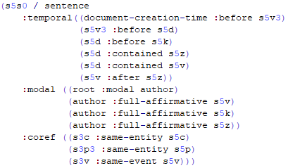
UMR: document level scheme
včera 'yesterday'
neděle 'Sunday' (date-entity)
kandidovat-001
'nominate as a candidate'
získat-001 'get'
volit-001 'vote'
V nedělních parlamentních volbách v Estonsku získal podle včerejších předběžných
výsledků nejvíce hlasů blok Vlast, jehož prezidentským kandidátem byl Lennart Meri.
'In Sunday’s parliamentary elections in Estonia, according to yesterday’s preliminary
results, the Homeland bloc, whose presidential candidate was Lennart Meri, won the most votes.'

Slide 11
Towards PDT-MR to UMR Conversion
Selected deep syntactic phenomena
change of the graph structure
coreference relation: re-entrancies, inverse roles, listing
coordination (and re-entrancies)
events vs. entities
graph labeling:
valency frames → argument structure
verb specific mapping of arguments
default mapping of arguments
default mappings of adjuncts
WAFNL ITAT 2024, Drienica, Čergovské vrchy September 23rd, 2024

Slide 12
I. Change of the Graph Structure: Coreference
coreference ≈ relation between two or more expressions that refer to the same concept
such expressions typically form coreferential chains → text coherence
"words"
"mental concept"
of a real-world
entity/event
Mary lives in Prague. She likes ice-cream. The girl decided ∅ to go for a trip.
WAFNL ITAT 2024, Drienica, Čergovské vrchy September 23rd, 2024

Slide 13
I. Change of the Graph Structure: Coreference
coreference ≈ relation between two or more expressions that refer to the same concept
such expressions typically form coreferential chains → text coherence
"words"
"mental concept"
of a real-world
entity/event
Mary lives in Prague. She likes ice-cream. The girl decided ∅ to go for a trip.
antecedent
anaphor
WAFNL ITAT 2024, Drienica, Čergovské vrchy September 23rd, 2024

Slide 14
I. Change of the Graph Structure: Coreference
coreference ≈ relation between two or more expressions that refer to the same concept
such expressions typically form coreferential chains → text coherence
PDT-MR: all types the same representation
(the node for) the anaphor bears attributes for ID of its antecedent(s), type of relation
UMR different treatment
"words"
"mental concept"
of a real-world
entity/event
Mary lives in Prague. She likes ice-cream. The girl decided ∅ to go for a trip.
antecedent
anaphor
WAFNL ITAT 2024, Drienica, Čergovské vrchy September 23rd, 2024

Slide 15
Ia. PDT-MR Coreference → UMR "Re-entrancy"
Coreference of 2 nodes in PDT-MR
taste-01
temporal
ARG0
ARG1
today
Edmund Pope
free-04
ARG1
#Cor
Edmund Pope tasted freedom today.
(taken from the released UMR data, simplified;
also used as an example sentence in the UMR 0.9 Specification)
WAFNL ITAT 2024, Drienica, Čergovské vrchy September 23rd, 2024

Slide 16
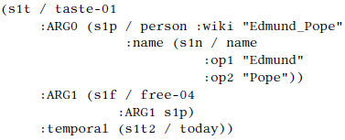
Ia. PDT-MR Coreference → UMR "Re-entrancy"
Concept of re-entrancy in UMR
taste-01
instance
s1t
today
temporal
instance
ARG0
ARG1
s1t2
instance
ARG1
instance
s1p
s1f
free-04
Edmund Pope
Edmund Pope tasted freedom today.
(taken from the released UMR data, simplified;
also used as an example sentence in the UMR 0.9 Specification)
WAFNL ITAT 2024, Drienica, Čergovské vrchy September 23rd, 2024

Slide 17
Ia. PDT-MR Coreference → UMR "Re-entrancy"
Conversion: Merging 2 nodes in PDT
taste-01
taste-01
temporal
temporal
ARG0
ARG0
ARG1
today
ARG1
today
ARG1
Edmund Pope
free-04
Edmund Pope
free-04
ARG1
#Cor
Edmund Pope tasted freedom today.
(taken from the released UMR data, simplified;
also used as an example sentence in the UMR 0.9 Specification)
WAFNL ITAT 2024, Drienica, Čergovské vrchy September 23rd, 2024

Slide 18
Ia. PDT-MR Coreference → UMR "Re-entrancy"
Conversion: Merging 2 nodes in PDT
taste-01
taste-01
taste-01
instance
s1t
today
temporal
temporal
temporal
instance
ARG0
ARG0
ARG0
ARG1
today
ARG1
today
ARG1
s1t2
ARG1
instance
ARG1
instance
Edmund Pope
free-04
Edmund Pope
free-04
s1f
s1p
free-04
ARG1
Edmund Pope
#Cor
Edmund Pope tasted freedom today.
(taken from the released UMR data, simplified;
also used as an example sentence in the UMR 0.9 Specification)
WAFNL ITAT 2024, Drienica, Čergovské vrchy September 23rd, 2024

Slide 19
Ib. PDT-MR Coreference → UMR Inverse Role
Coreference of 2 nodes in PDT-MR
stěžovat_si
'complain'
ACT
PAT
člověk
'person'
potíž
'problem'
RSTR
RSTR
bydlet
'live'
zdravotní
'health'
ACT
LOC
který
'who'
závod
'factory'
Lidé, kteří bydlí v blízkosti závodu, si stěžují na zdravotní potíže.
‘People who live near the factory have been complaining of health problems’.
WAFNL ITAT 2024, Drienica, Čergovské vrchy September 23rd, 2024

Slide 20
Ib. PDT-MR Coreference → UMR Inverse Role
Coreference of 2 nodes in PDT-MR Merging 2 nodes in PDT
Inverse role (= inverse relation) in UMR
stěžovat_si
'complain'
stěžovat_si
'complain'
ACT
PAT
ACT
PAT
člověk
'person'
potíž
'problem'
člověk
'person'
potíž
'problem'
RSTR
RSTR
ACT-of
RSTR
bydlet
'live'
bydlet
'live'
zdravotní
'health'
zdravotní
'health'
ACT
LOC
LOC
který
'who'
závod
'factory'
závod
'factory'
Lidé, kteří bydlí v blízkosti závodu, si stěžují na zdravotní potíže.
‘People who live near the factory have been complaining of health problems’.
WAFNL ITAT 2024, Drienica, Čergovské vrchy September 23rd, 2024

Slide 21
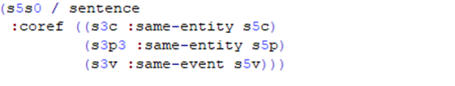
Ic. PDT-MR Coreference → UMR Pairing
Inter-sentence coreference relation
PDT-MR
the node for the anaphor bears attributes for
ID of its antecedent(s)
type of relation
type of reference (specific vs. generic)
UMR
lists pairs of coreferring concepts
ID of both concepts
event or entity … entities
identity or subset … identity
WAFNL ITAT 2024, Drienica, Čergovské vrchy September 23rd, 2024

Slide 22
Id. Coordination
PDT-MR
special node for coordinating expression
coordinated expressions as children
allows for common arguments/adjuncts
#root
CONJ
and
ACT
PRED
PRED
#PersPron
listen-001
read-001
PAT
PAT
book music
I read a book and listened to music. /
I read a book while listening to music. /
I read a book while I listened to music.
WAFNL ITAT 2024, Drienica, Čergovské vrchy September 23rd, 2024

Slide 23
Id. Coordination
PDT-MR
special node for coordinating expression
coordinated expressions as children
allows for common arguments/adjuncts
UMR
special keyword for "discourse" relation
coordinated expressions as children
allows for common arguments/adjuncts
#root
and
op1
CONJ
op2
and
read-001
listen-001
ACT
PAT
ACT
PRED
ACT
PRED
PAT
#PersPron
listen-001
book #PersPron music
read-001
PAT
PAT
book music
I read a book and listened to music. /
I read a book while listening to music. /
I read a book while I listened to music.
WAFNL ITAT 2024, Drienica, Čergovské vrchy September 23rd, 2024

Slide 24
II. Events vs. Entities
UMR
conceptual distinction:
entities (objects) man, cat
states (properties) tall, (to) love
events (processes) cry, storm, elections
no clear definition, no testable criteria
skewed towards English (e.g., statives)
big impact on annotation
modal, temporal, aspectual for events
fuzzy boundary btw. entities and events
big space for different interpretations
intuitive decisions
☹
WAFNL ITAT 2024, Drienica, Čergovské vrchy September 23rd, 2024

Slide 25
II. Events vs. Entities
PDT-MR
only small degree of abstraction
e.g., matčin 'mother's' → matka 'mother' + possesive
"normalization", e.g., jehož → který 'who'
lack of information
even for most systematic changes
e.g., bojování 'fighting' → bojovat '(to) fight'
(příjezd) přijíždění 'coming' → přijet '(to) come'
conversion:
first steps using additional resources
UMR
conceptual distinction:
entities (objects) man, cat
states (properties) tall, (to) love
events (processes) cry, storm, elections
no clear definition, no testable criteria
skewed towards English (e.g., statives)
big impact on annotation
modal, temporal, aspectual for events
fuzzy boundary btw. entities and events
big space for different interpretations
intuitive decisions
☹
WAFNL ITAT 2024, Drienica, Čergovské vrchy September 23rd, 2024

Slide 26
III. Graph labeling
PDT-MR
arguments:
PDT-Vallex valency lexicon (Hajič et al., 2003)
verbs, nouns (adjectives)
elaborated valency theory
5 "arguments": ACT, PAT, ADDR, ORIG, EFF
UMR
arguments:
PropBank lexicon (Palmer at al 2005, Pradhan et al., 2022)
verbs, nouns (adjectives)
coarse-grained semantic roles
ARG0, ARG1, … ARG5, ARGM
WAFNL ITAT 2024, Drienica, Čergovské vrchy September 23rd, 2024

Slide 27
III. Graph labeling
PDT-MR
arguments:
PDT-Vallex valency lexicon (Hajič et al., 2003)
verbs, nouns (adjectives)
elaborated valency theory
5 "arguments": ACT, PAT, ADDR, ORIG, EFF
UMR
arguments:
PropBank lexicon (Palmer at al 2005, Pradhan et al., 2022)
verbs, nouns (adjectives)
coarse-grained semantic roles
ARG0, ARG1, … ARG5, ARGM
partial verb-specific mapping
∼ 43% of PDT-Vallex labels (out of 42,116) (Hajič et al, 2024)
default mapping for the rest verb senses
most frequent argument mappings from the previous
WAFNL ITAT 2024, Drienica, Čergovské vrchy September 23rd, 2024

Slide 28
III. Graph labeling
PDT-MR
arguments:
PDT-Vallex valency lexicon (Hajič et al., 2003)
verbs, nouns (adjectives)
elaborated valency theory
5 "arguments": ACT, PAT, ADDR, ORIG, EFF
UMR
arguments:
PropBank lexicon (Palmer at al 2005, Pradhan et al., 2022)
verbs, nouns (adjectives)
coarse-grained semantic roles
ARG0, ARG1, … ARG5, ARGM
partial verb-specific mapping
∼ 43% of PDT-Vallex labels (out of 42,116) (Hajič et al, 2024)
default mapping for the rest verb senses
most frequent argument mappings from the previous
adjuncts:
default mapping based on their semantics
further refined where necessary
WAFNL ITAT 2024, Drienica, Čergovské vrchy September 23rd, 2024

Slide 29
What We Have Learned
PDT-MR
theory:
meaning as structured by the particular language
→ How different for various language?
→ consequence: too close to the text
data annotation:
refined criteria how to annotate
many "running text" examples
stress on consistency of annotation
(→ consequences for ML)
"technology":
massive consistency checking
well-defined data format
formal validation
many tools (editing, visualization)
UMR
theory:
meaning representation as a basis for logical inference
(BUT not much investigated so far)
→ Should be language independent (theory)!
→ consequence: broad interpretation
data annotation:
vague description
small number of examples (to illustrate the theory)
interest in the annotator's understanding
(→consequences for logical inference ?)
"technology":
NO consistency checking
NO formal specification
NO data validation
NO usable tools
WAFNL ITAT 2024, Drienica, Čergovské vrchy September 23rd, 2024

Slide 30
What We Have Learned
PDT-MR
theory:
meaning as structured by the particular language
→ How different for various language?
→ consequence: too close to the text
data annotation:
refined criteria how to annotate
many "running text" examples
stress on consistency of annotation
(→ consequences for ML)
"technology":
massive consistency checking
well-defined data format
formal validation
many tools (editing, visualization)
UMR
theory:
meaning representation as a basis for logical inference
(BUT not much investigated so far)
→ Should be language independent (theory)!
→ consequence: broad interpretation
data annotation:
vague description
small number of examples (to illustrate the theory)
interest in the annotator's understanding
(→ consequences for logical inference ?)
"technology":
NO consistency checking
NO formal specification
NO data validation
NO usable tools
WAFNL ITAT 2024, Drienica, Čergovské vrchy September 23rd, 2024

Slide 31
What We Have Learned
PDT-MR
theory:
meaning as structured by the particular language
→ How different for various language?
→ consequence: too close to the text
data annotation:
refined criteria how to annotate
many "running text" examples
stress on consistency of annotation
(→ consequences for ML)
"technology":
massive consistency checking
well-defined data format
formal validation
many tools (editing, visualization)
UMR
theory:
meaning representation as a basis for logical inference
(BUT not much investigated so far)
→ Should be language independent (theory)!
→ consequence: broad interpretation
data annotation:
vague description
small number of examples (to illustrate the theory)
interest in the annotator's understanding
(→ consequences for logical inference ?)
"technology":
NO consistency checking
NO formal specification
NO data validation
NO usable tools
☹
WAFNL ITAT 2024, Drienica, Čergovské vrchy September 23rd, 2024

Slide 32
Future Work
Refining the conversion of illustrated phenomena
focus on abstract predicates and rolesets (language-independent predicates)
nouns/adjectives to predicative verbs
PDT-MR grammatemes to UMR attributes
tense, modality, gender, animateness, negation, degree, aspect (not in UMR for the time being), …
Named Entities, their anchoring in Wikidata
Structured data – addresses, sport scores, weather forecast, tables, …. (whatever appears in texts)
Czech/Latin evaluation data !!!
WAFNL ITAT 2024, Drienica, Čergovské vrchy September 23rd, 2024

Slide 33
Thank you for your attention! Questions?
Supported by the LUSyD project (GAČR, no. 20-16819X) and the LINDAT/CLARIAH-CZ project (MŠMT, no. LM2023062); partially supported by CUNI (GAUK, project no. 104924, and SVV, project no. 260 698).

