Slide 1



Towards a Conversion of the Prague Dependency Treebank Data to the Uniform Meaning Representation
Markéta Lopatková, Eva Fučíková, Federica Gamba,
Jan Štěpánek, Daniel Zeman and Šárka Zikánová
Charles University, Faculty of Mathematics and Physics
Institute of Formal and Applied Linguistics
(based on ITAT 2024 paper, slightly adapted for UMR meeting at Brandeis Univ. by J. Hajič)
Supported by the LUSyD project (GAČR, no. 20-16819X) and the LINDAT/CLARIAH-CZ project (MŠMT, no. LM2023062); partially supported by CUNI (GAUK, project no. 104924, and SVV, project no. 260 698).

Slide 2
Two Meaning Representations at a Glance
PDT-TR
theory: Functional Generative Description (esp. Sgall et al, 1967; 1986; Hajičová, 2020)
data and tools: treebank (esp. Hajič et al., 2020)
Czech (∼130k sentences); English (∼55k); Latin (∼5k)
dependency-oriented formalism
covers:
– deep and surface syntax (argument structure)
– meaning-relevant morphology (tense, modality)
– coreference annotation
– information structure and discourse relations
focus on meaning as structured by the given language
more-or-less directly reflects the text
UMR
semantics, abstracting away from syntax (esp. van Gysel et al, 2021; Bonn et al, 2013)
typological perspective
limited data, no supporting infrastructure 6 languages (∼ 2k sentences)
(directed) (acyclic) graphs
covers:
– argument structure
– multiword expressions, named entities
– enhanced info on aspect, modality, temporality
– coreference
broad sem. interpretation of the text
for cross-lingual applications

Slide 3
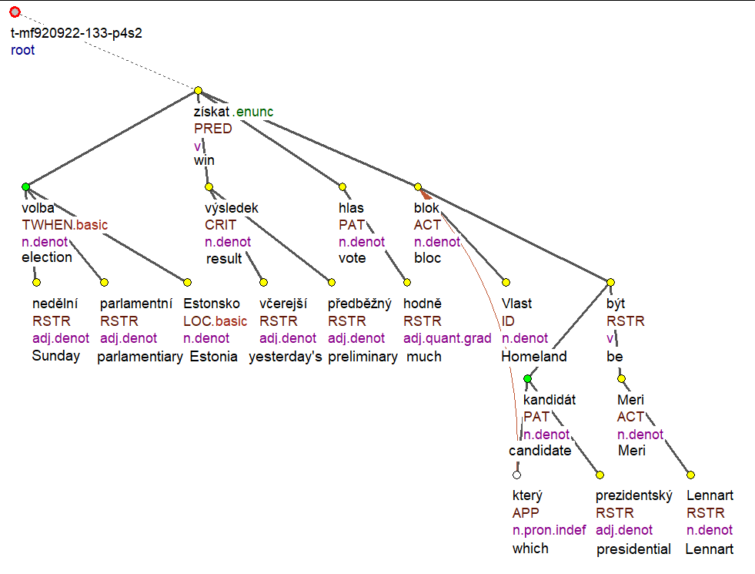
PDT-TR
V nedělních parlamentních volbách v Estonsku získal podle včerejších předběžných výsledků nejvíce hlasů blok Vlast, jehož prezidentským kandidátem byl Lennart Meri.
'In Sunday’s parliamentary elections in Estonia, according to yesterday’s preliminary results,
the Homeland bloc, whose presidential candidate was Lennart Meri, won the most votes.'
(borrowed from the PDiT-EDA 1.0 corpus; English glosses added).

Slide 4
UMR: sentence level scheme
V nedělních parlamentních volbách v Estonsku získal podle včerejších předběžných
výsledků nejvíce hlasů blok Vlast, jehož prezidentským kandidátem byl Lennart Meri.
'In Sunday’s parliamentary elections in Estonia, according to yesterday’s preliminary
results, the Homeland bloc, whose presidential candidate was Lennart Meri, won the most votes.'

Slide 5
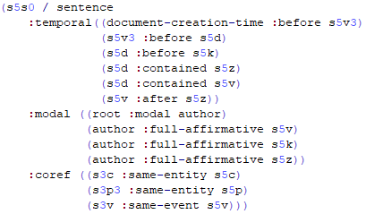
UMR: document level scheme
včera 'yesterday'
neděle 'Sunday' (date-entity)
kandidovat-001
'nominate as a candidate'
získat-001 'get'
volit-001 'vote'
V nedělních parlamentních volbách v Estonsku získal podle včerejších předběžných
výsledků nejvíce hlasů blok Vlast, jehož prezidentským kandidátem byl Lennart Meri.
'In Sunday’s parliamentary elections in Estonia, according to yesterday’s preliminary
results, the Homeland bloc, whose presidential candidate was Lennart Meri, won the most votes.'

Slide 6
Towards PDT-TR to UMR Conversion
Selected deep syntactic phenomena
change of the graph structure
coreference relation: re-entrancies, inverse roles, listing
coordination (and re-entrancies)
events vs. entities
graph labeling:
valency frames → argument structure
verb specific mapping of arguments
default mapping of arguments
default mappings of adjuncts

Slide 7
I. Coreference
coreference ≈ relation between two or more expressions that refer to the same concept
such expressions typically form coreferential chains → text coherence
PDT-TR: all types the same representation
(the node for) the anaphor bears attributes for ID of its antecedent(s), type of relation
UMR different treatment
"words"
"mental concept"
of a real-world
entity/event
Mary lives in Prague. She likes ice-cream. The girl decided ∅ to go for a trip.
antecedent
anaphor

Slide 8
Ia. PDT-TR Coreference → UMR "Re-entrancy"
Coreference of 2 nodes in PDT-TR
taste-01
temporal
ARG0
ARG1
today
Edmund Pope
free-04
ARG1
#Cor
Edmund Pope tasted freedom today.
(taken from the released UMR data, simplified;
also used as an example sentence in the UMR 0.9 Specification)

Slide 9
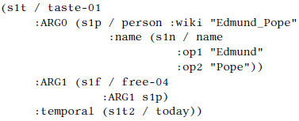
Ia. PDT-TR Coreference → UMR "Re-entrancy"
Concept of re-entrancy in UMR
taste-01
instance
s1t
today
temporal
instance
ARG0
ARG1
s1t2
instance
ARG1
instance
s1p
s1f
free-04
Edmund Pope
Edmund Pope tasted freedom today.
(taken from the released UMR data, simplified;
also used as an example sentence in the UMR 0.9 Specification)

Slide 10
Ia. PDT-TR Coreference → UMR "Re-entrancy"
Conversion: Merging 2 nodes in PDT
taste-01
taste-01
taste-01
instance
s1t
today
temporal
temporal
temporal
instance
ARG0
ARG0
ARG0
ARG1
today
ARG1
today
ARG1
s1t2
ARG1
instance
ARG1
instance
Edmund Pope
free-04
Edmund Pope
free-04
s1f
s1p
free-04
ARG1
Edmund Pope
#Cor
Edmund Pope tasted freedom today.
(taken from the released UMR data, simplified;
also used as an example sentence in the UMR 0.9 Specification)

Slide 11
Ib. PDT-TR Coreference → UMR Inverse Role
Coreference of 2 nodes in PDT-TR Merging 2 nodes in PDT
Inverse role (= inverse relation) in UMR
stěžovat_si
'complain'
stěžovat_si
'complain'
ACT
PAT
ACT
PAT
člověk
'person'
potíž
'problem'
člověk
'person'
potíž
'problem'
RSTR
RSTR
ACT-of
RSTR
bydlet
'live'
bydlet
'live'
zdravotní
'health'
zdravotní
'health'
ACT
LOC
LOC
který
'who'
závod
'factory'
závod
'factory'
Lidé, kteří bydlí v blízkosti závodu, si stěžují na zdravotní potíže.
‘People who live near the factory have been complaining of health problems’.

Slide 12
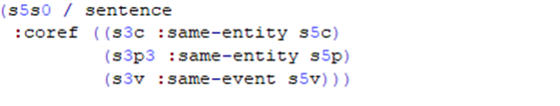
Ic. PDT-TR Coreference → UMR Pairing
Inter-sentence coreference relation
PDT-TR
the node for the anaphor bears attributes for
ID of its antecedent(s)
type of relation
type of reference (specific vs. generic)
UMR
lists pairs of coreferring concepts
ID of both concepts
event or entity … entities
identity or subset … identity

Slide 13
Id. Coordination
PDT-TR
special node for coordinating expression
coordinated expressions as children
allows for common arguments/adjuncts
UMR
special keyword for "discourse" relation
coordinated expressions as children
allows for common arguments/adjuncts
#root
and
op1
CONJ
op2
and
read-001
listen-001
ACT
PAT
ACT
PRED
ACT
PRED
PAT
#PersPron
listen-001
book #PersPron music
read-001
PAT
PAT
book music
I read a book and listened to music. /
I read a book while listening to music. /
I read a book while I listened to music.

Slide 14
II. Events vs. Entities
PDT-TR
verbs ≈ events and states → event annotation
other nodes → entities or keywords
with some degree of abstraction
e.g., matčin 'mother's' → matka 'mother' + possesive
"normalization", e.g., jehož → který 'who'
refinement: lack of information
even for most systematic changes
e.g., bojování 'fighting' → bojovat '(to) fight'
(příjezd) přijíždění 'coming' → přijíždět '(to) come'
conversion:
first steps using additional resources
UMR
conceptual distinction:
entities (objects) man, cat
states (properties) tall, (to) love
events (processes) cry, storm, elections
no clear definition, no testable criteria
skewed towards English (e.g., statives)
big impact on annotation
modal, temporal, aspectual for events
fuzzy boundary btw. entities and events
big space for different interpretations
intuitive decisions
☹

Slide 15
III. Graph labeling
PDT-TR
arguments:
PDT-Vallex valency lexicon (Hajič et al., 2003, Urešová et al., 2021))
verbs, nouns (adjectives)
elaborated valency theory
5 "arguments": ACT, PAT, ADDR, ORIG, EFF
UMR
arguments:
PropBank lexicon (Palmer at al 2005, Pradhan et al., 2022)
verbs, nouns (adjectives)
coarse-grained semantic roles
ARG0, ARG1, … ARG5, ARGM
partial verb-specific mapping
∼ 43% of PDT-Vallex labels (out of 42,116) (Hajič et al, 2024)
default mapping for the rest of verb senses
most frequent argument mappings
adjuncts:
default mapping based on their semantics
further refined where necessary

Slide 16
What We Have Learned
PDT-TR
theory:
meaning as structured by the particular language
THUS: too close to the text?
→ How different for various languages?
data annotation:
refined criteria how to annotate
many "running text" examples
stress on consistency of annotation
(→ consequences for ML)
"LR technology":
massive consistency checking
well-defined data format
formal validation
many tools (editing, visualization)
UMR
theory:
meaning representation as language independent
THUS: broad interpretation
→ should serve as a basis for logical inference
BUT not much investigated so far
data annotation:
vague description
small number of examples (to illustrate the theory)
interest in the annotator's understanding
(→ consequences for logical inference ?)
"LR technology":
Weaker consistency checking, data validation

Slide 17
Future Work
Refining the conversion of illustrated phenomena
focus on abstract predicates and rolesets (language-independent predicates)
nouns/adjectives to predicative verbs
PDT-TR grammatemes to UMR attributes
tense, modality, gender, animateness, negation, degree, aspect (not in UMR for the time being), …
Named Entities, their anchoring in Wikidata
Structured data – addresses, sport scores, weather forecast, tables, …. (whatever appears in texts)
Czech/Latin evaluation data !!!

Slide 18
References
Bonn, J. et al (2023): Uniform meaning representation, LINDAT/CLARIAH-CZ Digital Library, ÚFAL, MFF UK, Prague, Czechia.
Uniform Meaning Representation (UMR) 0.9 Specification (dated August 8, 2022)
van Gysel, J. et al. (2021): Designing a uniform meaning representation for natural language processing, KI - Künstliche Intelligenz, 35, p. 343-360.
Hajič J. et al. (2003): PDT-VALLEX: Creating a large-coverage valency lexicon for treebank annotation, in: Proceedings of The Second Workshop on Treebanks and Linguistic Theories, volume 9 of Mathematical Modeling in Physics, Engineering and Cognitive Sciences, Vaxjo University Press, Vaxjo, Sweden, p. 57-68.
Hajič, J. et al. (2020): Prague Dependency Treebank - Consolidated 1.0 (PDT-C 1.0), LINDAT/CLARIAH-CZ Digital Library, ÚFAL, MFF UK, Prague, Czechia (project URL )
Hajič, J. et al. (2024): Mapping Czech Verbal Valency to PropBank Argument Labels, in: Proceedings of the Fifth International Workshop on Designing Meaning Representations (DMR 2024), ELRA and ICCL, Torino, Italia, p. 88-100.
Hajičová, E. (2020): Dependency-Based Underlying-Structure Tagging of a Very Large Czech Corpus, Special Issue of TAL Journal, Grammaires De Dépendence / Dependency Grammars, p. 57-78.
Lopatková, M. et al. (2024): Towards a Conversion of the Prague Dependency Treebank Data to the Uniform Meaning Representation. in: Proceedings of the 24th Conference Information Technologies – Applications and Theory (ITAT 2024), CEUR-WS.org, Košice, Slovakia, p. 62-76.
Palmer, M. and Gildea, D. and Kingsbury, P. (2005): The Proposition Bank: An Annotated Corpus of Semantic Roles, Computational Linguistics, 31, p. 71-106.
Pradhan, S. et al. (2022): PropBank comes of age—larger, smarter, and more diverse, in: Proceedings of the 11th Joint Conference on Lexical and Computational Semantics, ACL, Seattle, Washington, p. 278-288.
Sgall, P. (1967): Generativní popis jazyka a česká deklinace (Generative Description of a Language and the Czech Declension), Academia, Praha.
Sgall, P. and Hajičová, E. and Panevová, J. (1986): The Meaning of the Sentence in Its Semantic and Pragmatic Aspects, Reidel, Dordrecht.
Synková, P. et al. (2022): Prague Discourse Treebank 3.0 (PDiT 3.0), LINDAT/CLARIAHCZ Digital Library, ÚFAL, MFF UK, Prague, Czechia.
Urešová, Z. et al. (2021): PDT-Vallex: Czech Valency lexicon linked to treebanks 4.0 (PDT-Vallex 4.0), LINDAT/CLARIAH-CZ Digital Library, ÚFAL, MFF UK, Prague, Czechia.

Slide 19
Thank you for your attention! Questions?
Supported by the LUSyD project (GAČR, no. 20-16819X) and the LINDAT/CLARIAH-CZ project (MŠMT, no. LM2023062); partially supported by CUNI (GAUK, project no. 104924, and SVV, project no. 260 698).

