Slide 1
Tectogrammatical to AMR conversion: current status
Jan Hajič
with
Ondřej Bojar, Silvie Cinková, Roman Sudarikov
Zdeňka Urešová, Martin Popel, Ondřej Dušek
Institute of Formal and Applied Linguistics
Computer Science School
Faculty of Mathematics and Physics
Charles University in Prague
Malostranské náměstí 25
11800 Prague 1
http://ufal.mff.cuni.cz

Slide 2
The Goal
JHU Summer Workshop 2014 project
Machine Translation using AMRs
Well, maybe some steps to get there:
Graph transformation algorithms, ML
Parsing and Generation using AMRs as the target/source representation
...
We need Data
Monolingual (being annotated for English)
Parallel (CzEng 1.0, 200MW) – needs (auto) annotation
Now auto annotated up to tectogrammatical trees (simplified)

Slide 3
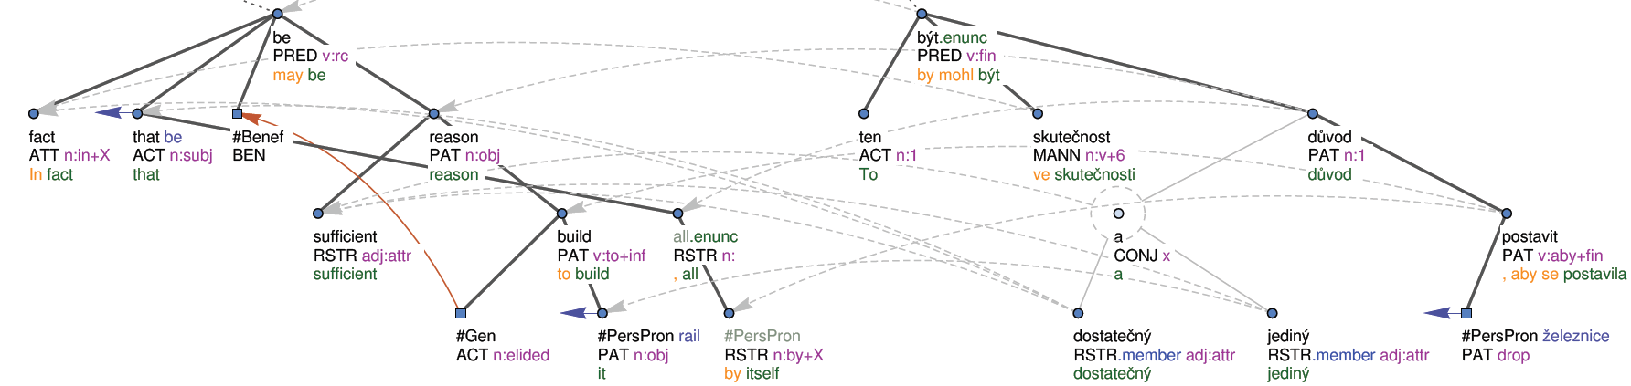
To Do
Write algorithms/code for conversion from tectogrammatical trees to AMR
Why should it work?
Tectogrammatical trees ~ “dependency” Ontonotes
Semantic relations/labels, EngVallex(~Propbank)-linked
In fact that may be sufficient reason to build it, all by itself.

Slide 4
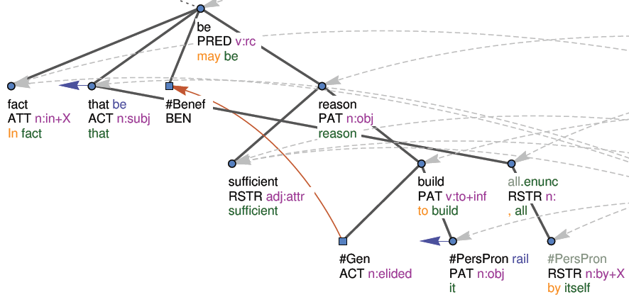
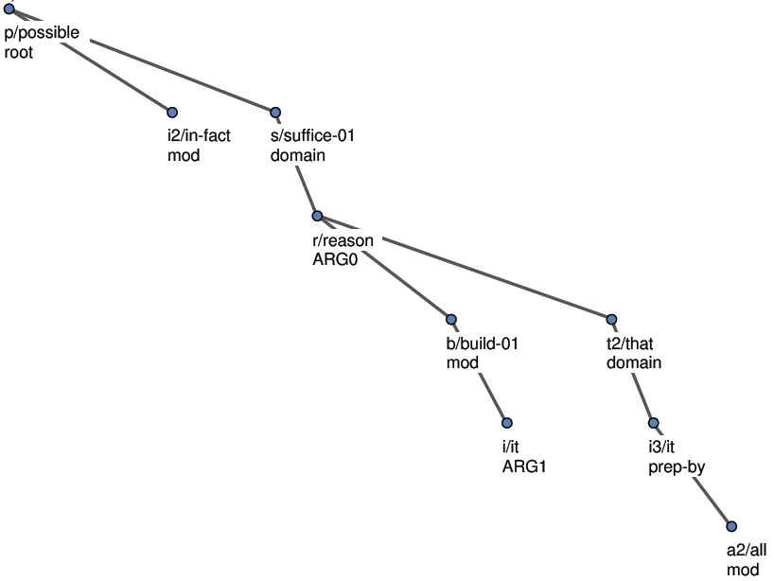
TR to AMR example: what we want
Ex. WB Sent. 74
In fact that may be sufficient
reason to build it, all by itself.

Slide 5
The process
Get all AMR examples from the AMR manual (SC)
259 in total; have been ID-ed (three digit number, 001 - 259)
in some cases, “intermediate” AMR created for all examples (less abstract)
Get all phrases (segments) for these (n:1 mapping, SC)
401 of them; related to the AMR subtrees by ID (001a, 001b, ...)
Imagine the t-(sub)tree for those phrases (SC)
Formulate it as a query to a t-tree (there will be 401 of them, now 183 done)
Run the queries on a treebank (CzEng, En side) (RS)
Results in nodes being marked by a AMR rule ID (works, sort of)
Rule disambiguation (to solve conflicting rule matches)
manual on a subset, later ML-ed (if refinement of rules impossible)
Clone the t-tree, replace subtrees marked by AMR trees
Restructure the result get a full AMR tree (RS)

Slide 6
AMR Guidelines Examples extracted
AMR tree + all expression forms
002 >AMR (a / adjust-01
002 >AMR :ARG0 (b / girl)
002 >AMR :ARG1 (m / machine))
002 >AMR
002 > The girl **made** adjustments **to** the machine.
002 > The girl adjusted the machine.
002 > The machine **was** adjusted **by** the girl.
003 >AMR (k / kill-01
003 >AMR :time (y / yesterday))
003 >AMR
003 > The killing **happened** yesterday.
003 > The killing **took place** yesterday.

Slide 7
PML-TQ Search Rules
#080a-the_man_is_attractive
t-node $be := [t_lemma in {"be", "become", "remain"}, t-node $man := [gram/sempos="n.denot", functor="ACT"],
t-node $attractive := [gram/sempos="adj.denot", functor="PAT", formeme="adj:compl"]]
#080b-the_man_attracts
t-node $attract := [gram/sempos="v", t_lemma !in {"be", "become", "remain"}, t-node $man := [functor="ACT",
gram/sempos~"n."]]
#081a-1-the_man_is_attractive_to_women
t-node $be := [t_lemma in {"be", "become", "remain"}, t-node $man:= [gram/sempos="n.denot", functor="ACT"],
t-node $attractive:= [formeme="adj:compl", gram/sempos="adj.denot", t-node $woman := [gram/sempos=
"n.denot", functor in{"BEN", "PAT"}, a/aux.rf a-node $to:= [lemma="to", ord<$woman.ord, sons()=0]]]]
#081a-2-the_man_is_attractive_to_woment
t-node $be := [t_lemma in {"be", "become", "remain"}, t-node $man:= [gram/sempos="n.denot", functor="ACT"],
t-node $attractive:= [formeme="adj:compl", gram/sempos="adj.denot"],t-node $woman := [gram/sempos=
"n.denot", functor in{"BEN", "PAT"}, a/aux.rf a-node $to:= [lemma="to", ord<$woman.ord, sons()=0]]]
#081b-the_man_attracts_women
t-node $attract := [gram/sempos="v", t_lemma !in {"be", "become", "remain"}, t-node $man := [functor="ACT",
gram/sempos~"n."], t-node $woman := [functor="PAT", gram/sempos~"n."]]

Slide 8
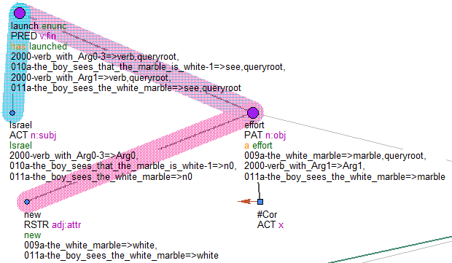
Processed t-trees
PML-TQ “rules” mark nodes where matched
Thick color bars: nodes matching
nnnl+the-boy_sees...: rule name(s)
PAT n.obj
a effort
: t-node attributes
Israel has launched a new effort to prove...

Slide 9
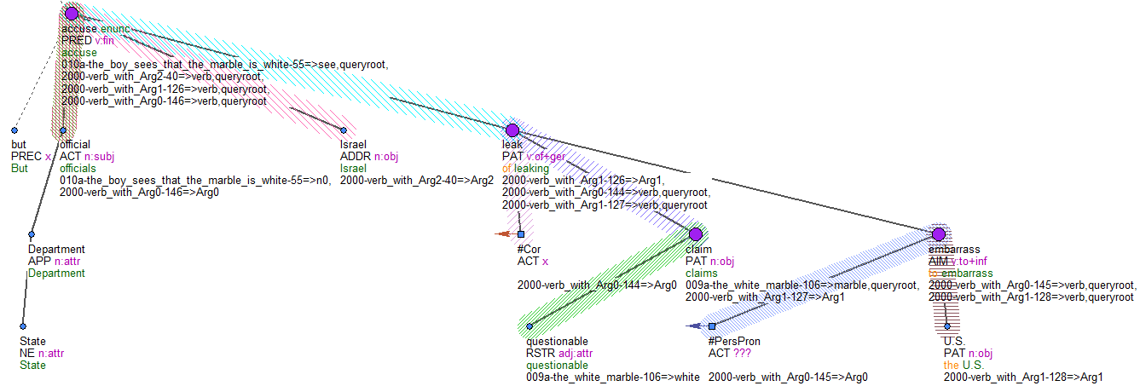
Full t-tree, matched nodes
( s / see-01
:ARG0 ( b / boy
)
:ARG1 ( w / white
:domain ( m / marble
)
)
)
But State Department officials accuse Israel of leaking questionable claims to embarrass the U.S.

Slide 10
Intermediate AMR (SC-AMR)
SC-AMR:003a (h/happen :ARG0 (k/killing) :time (y / yesterday) ) 003a > The killing **happened** yesterday. SC-AMR:003b (t/take.LV :ARG0 (k/killing) :ARG1 (p/place) :time (y / yesterday) ) 003b > The killing **took place** yesterday.

