Slide 1


From the Prague Dependency Treebank to the Uniform Meaning Representation: Gold-Standard Czech UMR Data and Partial Automatic Conversion
From PDT to UMR
Markéta Lopatková, Hana Hledíková, Jan Štěpánek, Daniel Zeman
ITAT 2025, WAFNL, Sept. 2029, Telgárt, Slovakia
Charles University
Faculty of Mathematics and Physics
Institute of Formal and Applied Linguistics

Slide 2
Motivation
goal: Uniform Meaning Representation for Czech
semantics, abstracting away from syntax
cross-linguistic applicability
broad sem. interpretation of the text for cross-lingual applications
annotation from scratch:
time consuming
expertise and training
re-use existing corpus:
automatic conversion from Prague Dependency Treebank
rich annotation already there
the same procedure for all languages with PDT annotation
expertise and training still needed
evaluation: manually annotated data
From PDT to UMR

Slide 3
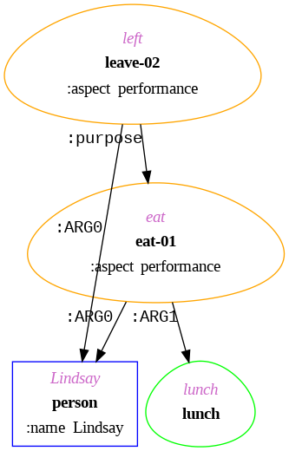
Uniform Meaning Representation
###########################################################
# meta-info :: sent_id = u_tree-cs-s1-root
# :: snt1
Index: 1 2 3 4 5 6 7 8
Words: Lindsay left in order to eat lunch .
# sentence level graph:
(s1l / leave-02
:ARG0 (s1p / person
:name (s1n / name :op1 "Lindsay"))
:aspect performance
:purpose (s1e / eat-01
:ARG0 s1p
:ARG1 (s1l2 / lunch)
:aspect performance))
# alignment:
s1l: 2-2 s1p: 1-1 s1n: 0-0 s1e: 6-6 s1l2: 7-7
# document level annotation:
(s1s0 / sentence
:temporal ((document-creation-time :before s1l)
(s1l :after s1e))
:modal ((root :modal author)
(author :full-affirmative s1l)
(author :full-negative s1e)))
From PDT to UMR
download UMR 2.0 http://hdl.handle.net/11234/1-5902

Slide 4
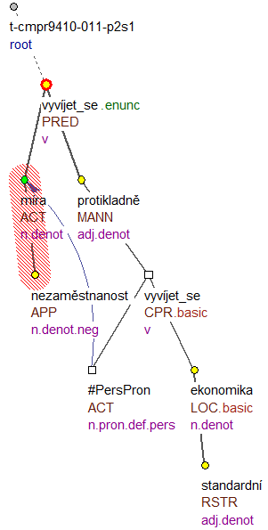
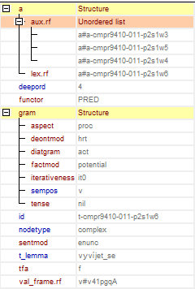
Prague Dependency Treebank
Míra nezaměstnanosti by se měla vyvíjet protikladně než ve standardní ekonomice.
The unemployment rate should develop in the opposite direction to that in a standard economy.
From PDT to UMR
download PDT-C 2.0 http://hdl.handle.net/11234/1-5813

Slide 5
UMR vs. PDT
UMR
represents meaning
PDT
represents linguistically structured meaning (vs. situational meaning)
topic-focus articulation

Slide 6
UMR vs. PDT
UMR
represents meaning
encodes the frame-based predicate-argument structure of all eventive concepts
PDT
represents linguistically structured meaning (vs. situational meaning)
topic-focus articulation
predicate-argument structure (valency) and dependency relations

Slide 7
UMR vs. PDT
UMR
represents meaning
encodes the frame-based predicate-argument structure of all eventive concepts
for each event, complex information
aspect
temporal chains
epistemic modality
PDT
represents linguistically structured meaning (vs. situational meaning)
topic-focus articulation
predicate-argument structure (valency) and dependency relations
meaning of individual morphological categories

Slide 8
UMR vs. PDT
UMR
represents meaning
encodes the frame-based predicate-argument structure of all eventive concepts
for each event, complex information
aspect
temporal chains
epistemic modality
coreference
PDT
represents linguistically structured meaning (vs. situational meaning)
topic-focus articulation
predicate-argument structure (valency) and dependency relations
meaning of individual morphological categories
coreference

Slide 9
Towards Gold-Standard UMR Data for Czech
From PDT to UMR

Slide 10
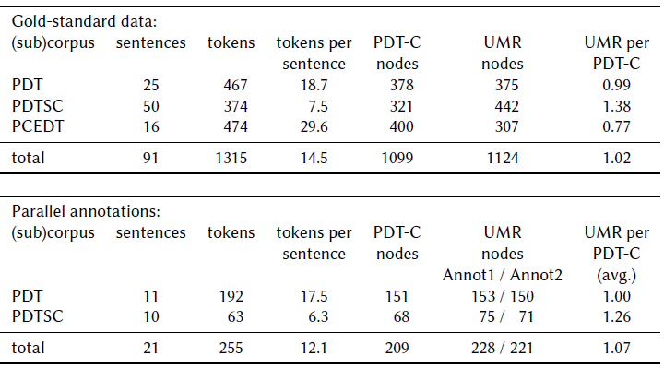

Towards Gold-Standard UMR Data for Czech
From PDT to UMR
Download the data: http://hdl.handle.net/11234/1-5951

Slide 11
Towards Gold-Standard UMR Data for Czech
From PDT to UMR
Download the data: http://hdl.handle.net/11234/1-5951

Slide 12
Inter-Annotator Agreement (IAA)
UMR graphs = as a set of triples (𝑥,𝑦,𝑧):
(node, relation, node)
(node, attribute, value)
Metric for graph comparison:
Match nodes:
different number of nodes
different alignment (nodes to words)
juːmæʧ
maps nodes primarily by word alignment
for nodes without alignment, requires concept identity
forces 1:1 mapping (selected the "best" node from 1:N)
Similarity is measured as the F₁-score of the triples
From PDT to UMR

Slide 13
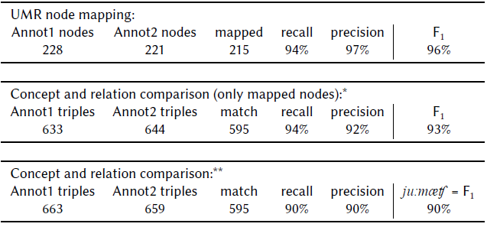
Towards Gold-Standard UMR Data for Czech
final IAA (after reconciliation; table taken from Štěpánek et al., 2025)
analysis of main mismatches in the paper (events and argument structure, ellipses, granularity of NE classification, relations vs. attributes, attributes and their values)
UMR allows for multiple valid annotations of the same meaning
!!!
From PDT to UMR

Slide 14
Automatic (Partial) Conversion
From PDT to UMR

Slide 15
Automatic (Partial) Conversion
based on the tectogrammatical structure:
structural transformations
coordination
coreference
relative clauses
raising and control verbs
node labels
t_lemma → concept
edge labeling
valency lexicon → PropBank
default table
selected attributes
aspect
refer-person, refer-number
degree, polarity, quant
node alignment
From PDT to UMR
Download the data: http://hdl.handle.net/11234/1-5951

Slide 16
Automatic (Partial) Conversion
based on the tectogrammatical structure:
structural transformations
coordination
coreference
relative clauses
raising and control verbs
node labels
t_lemma → concept
edge labeling
valency lexicon → PropBank
default table
selected attributes
aspect
refer-person, refer-number
degree, polarity, quant
node alignment
often interact further increases
the conversion complexity
From PDT to UMR
Download the data: http://hdl.handle.net/11234/1-5951

Slide 17
Automatic (Partial) Conversion
based on the tectogrammatical structure:
structural transformations
coordination
coreference
relative clauses
raising and control verbs
node labels
t_lemma → concept
edge labeling
valency lexicon → PropBank
default table
selected attributes
aspect
refer-person, refer-number
degree, polarity, quant
node alignment
often interact further increases
the conversion complexity
ignored (so far)
attributes:
mode, polite
quote, modal-strength
wiki
most of the document level annotation
temporal
modal
From PDT to UMR
Download the data: http://hdl.handle.net/11234/1-5951

Slide 18
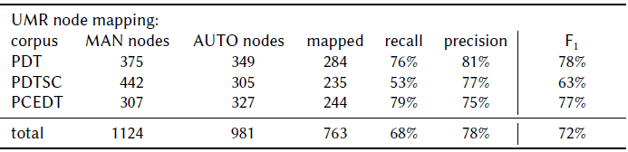

Automatic (Partial) Conversion – Quantitative Comparison
(tables taken from Štěpánek et al., 2025)
Automatic conversion:
Manual annotation (inter-annotator agreement):
From PDT to UMR
Download the data: http://hdl.handle.net/11234/1-5951

Slide 19
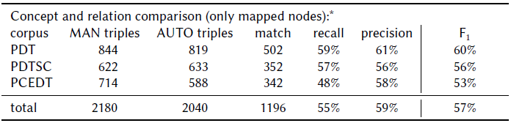

Automatic (Partial) Conversion – Quantitative Comparison
(tables taken from Štěpánek et al., 2025)
Automatic conversion:
Manual annotation (inter-annotator agreement):
From PDT to UMR
Download the data: http://hdl.handle.net/11234/1-5951

Slide 20
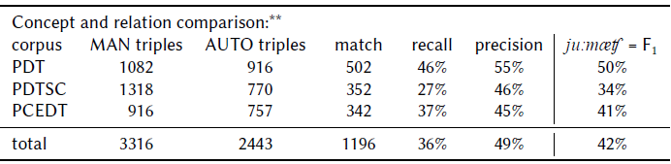

Automatic (Partial) Conversion – Quantitative Comparison
(tables taken from Štěpánek et al., 2025)
Automatic conversion:
Manual annotation (inter-annotator agreement):
From PDT to UMR
Download the data: http://hdl.handle.net/11234/1-5951

Slide 21
From PDT to UMR:
Gold-Standard Czech UMR Data and Partial Automatic Conversion
two different meaning representations
manually annotated Czech UMR gold-standard data
IAA 90 %
evaluation of the automatic (partial) conversion
transforms selected language phenomena from PDT to UMR
53-60% accuracy on the aligned nodes
plan: cover more phenomena in the (near) future
automatic conversion as an essential first step to reduce costs for full manual annotation
Download the data: http://hdl.handle.net/11234/1-5951

Slide 22
Acknowledgements
The work described herein has been supported by the following grants:
Czech Science Foundation, Language Understanding: from Syntax to Discourse (Project No. 20-16819X)
Ministry of Education, Youth, and Sports of the Czech Republic, LINDAT/CLARIAH-CZ (Project No. LM2023062)
The project has been using data and tools provided by the LINDAT/CLARIAH-CZ Research Infrastructure (https://lindat.cz), supported by the Ministry of Education, Youth and Sports of the Czech Republic (Project No. LM2023062).
From PDT to UMR

