Slide 1
The PHI Data Scan Tool
Luyao Chen, Kai Zhang, Xiaoqian Jiang
McWilliams School of Biomedical Informatics
UTHealth Houston

Slide 2
User Instructions
The workflow
Start
Define source data
Select tables from Source Data
Read source data sample and generate profile
View data profile
Save Project
Scan PHI Data
View PHI Scan Result
Load Project
End

Slide 3
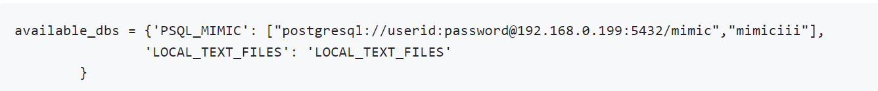
User Instructions
Configurations : config.py
Source databases
Sample size
Don’t change this line

Slide 4
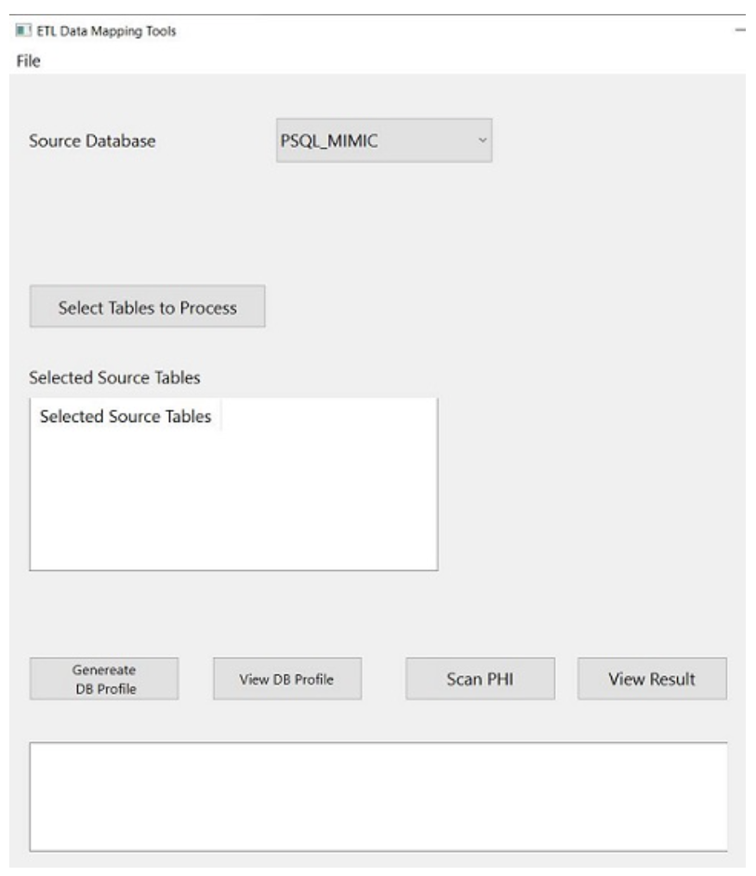
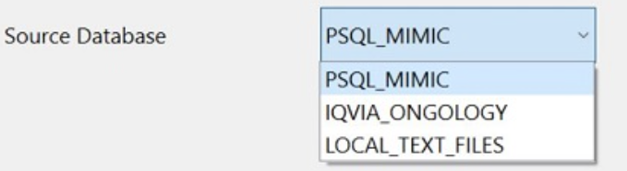
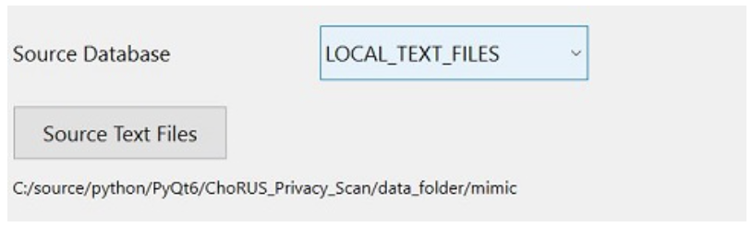
User Instructions
Select source data

Slide 5
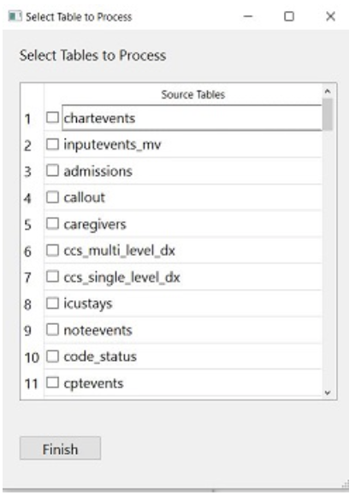
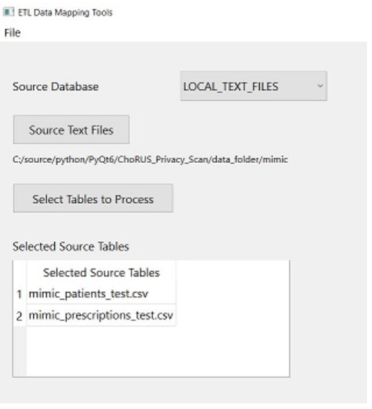
User Instructions
Select Tables to scan

Slide 6
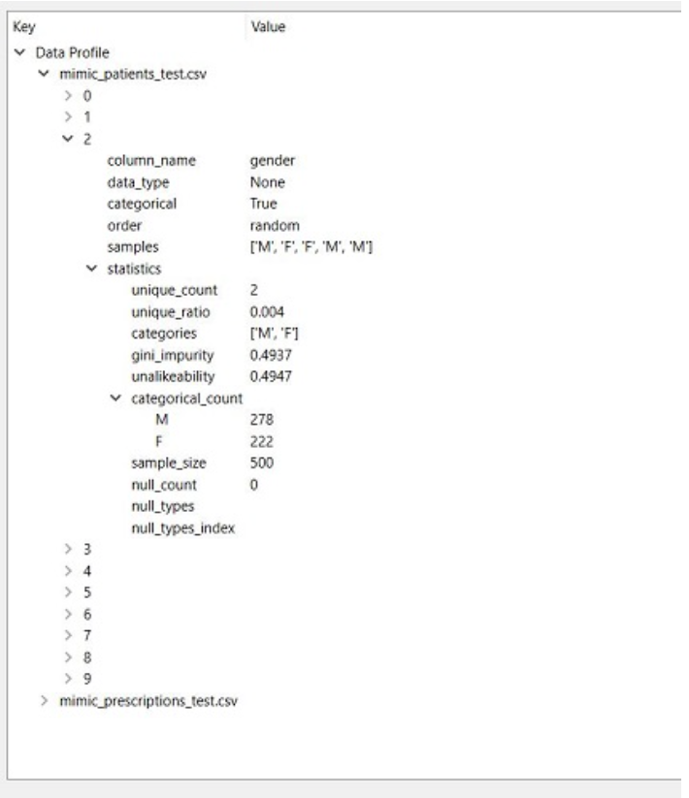
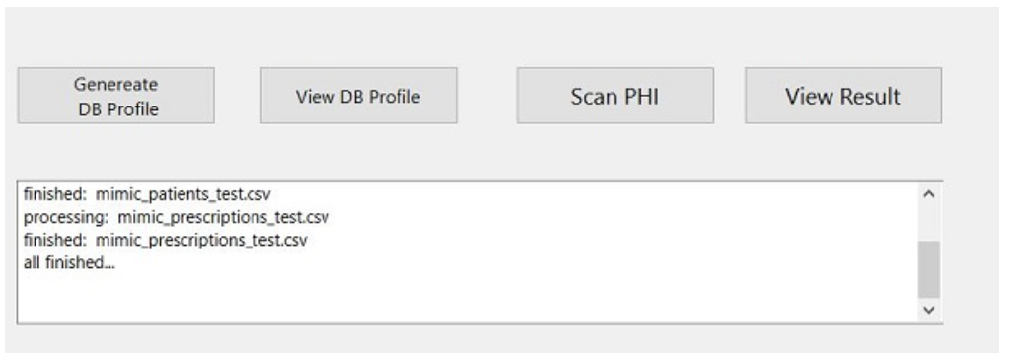
User Instructions
Data profiling

Slide 7
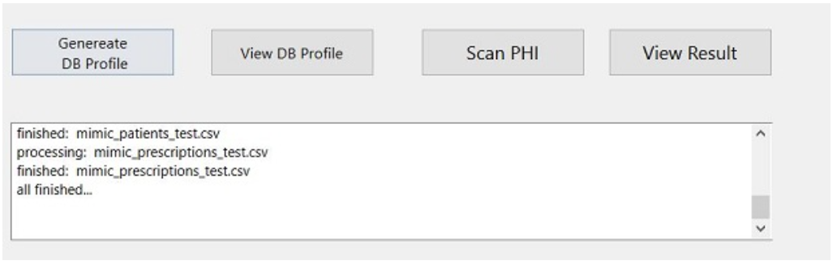
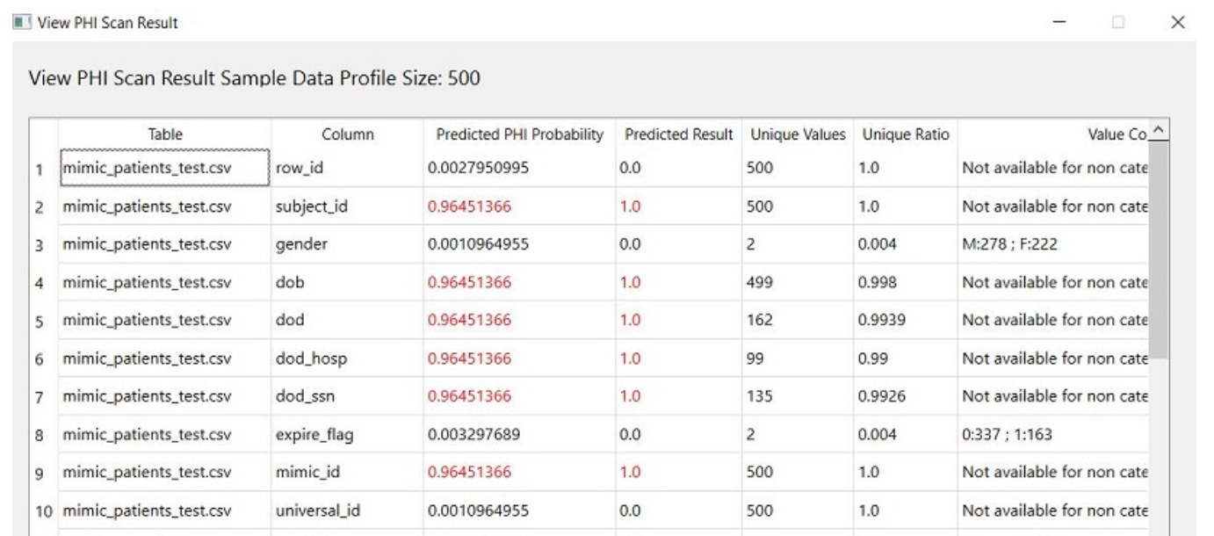
User Instructions
PHI Scan
The result can be saved to a spreadsheet file.

Slide 8
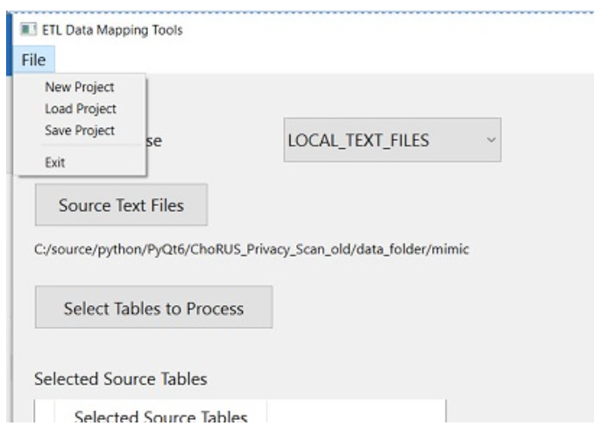
User Instructions
Save / Load the works

