Slide 1

Job Quality, Political Attitudes, and New Evidence on Old Questions
Christian Hosam
Assistant Professor
Wellesley College

Slide 2
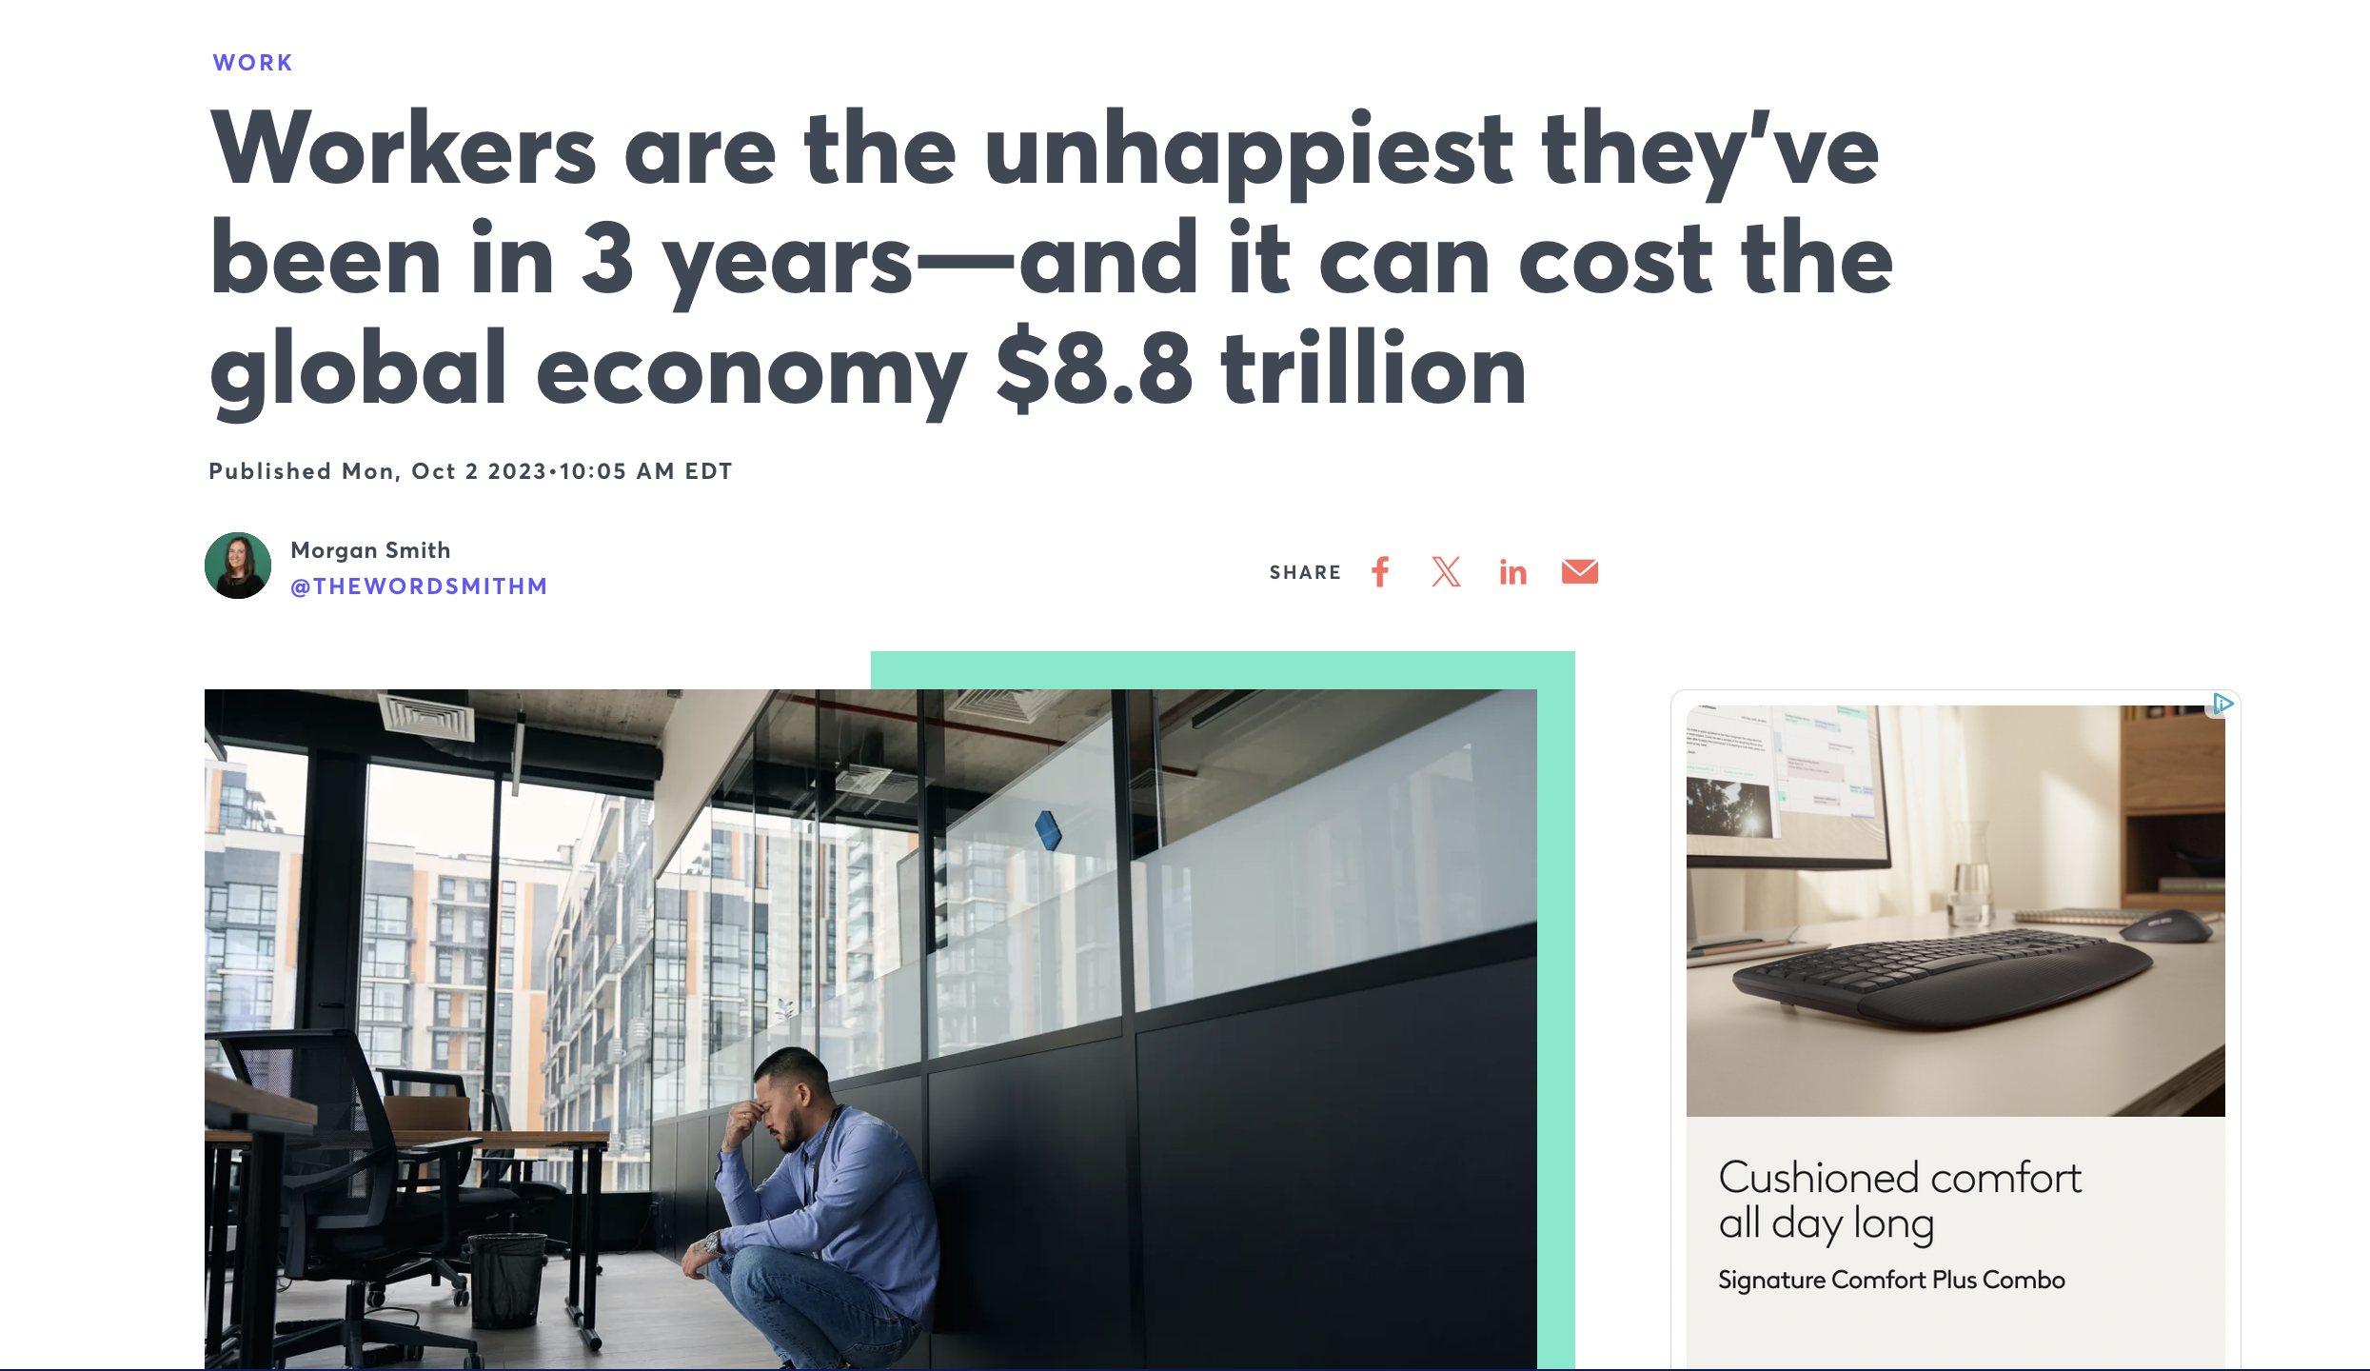
What is a Good Job? And Why Does it Matter for Political Attitudes?

Slide 3
Existing literature on the link between employment and political behavior tends to focus principally on exploiting the variation between the two parties as a pathway to understand how having a job shapes vote share and/or partisan attachment (Grafstein 2005; Wright 2012)
Recent work in Economics has looked at different ways of disaggregating parts of a job to understand its benefits for workers but most of that work is focused on understanding how to integrate objective factors that might accentuate the importance of income with subjective factors that help give workers a sense of meaning (Nikolova and Cnossen 2020; Mira 2021). Because of collinearity concerns, this becomes less tractable for understanding political behavior
Closer to home, Kathleen Thelen’s assertion that unemployment as a metric of macroeconomic health makes less sense in the context of higher rates of contingent labor identifies a need to more fluidly understand the ways that people’s work shapes their political attitude
So my idea is that by separating the component parts of a job, we can more holistically understand the ways that different parts of work matter in different ways for different people

Slide 4
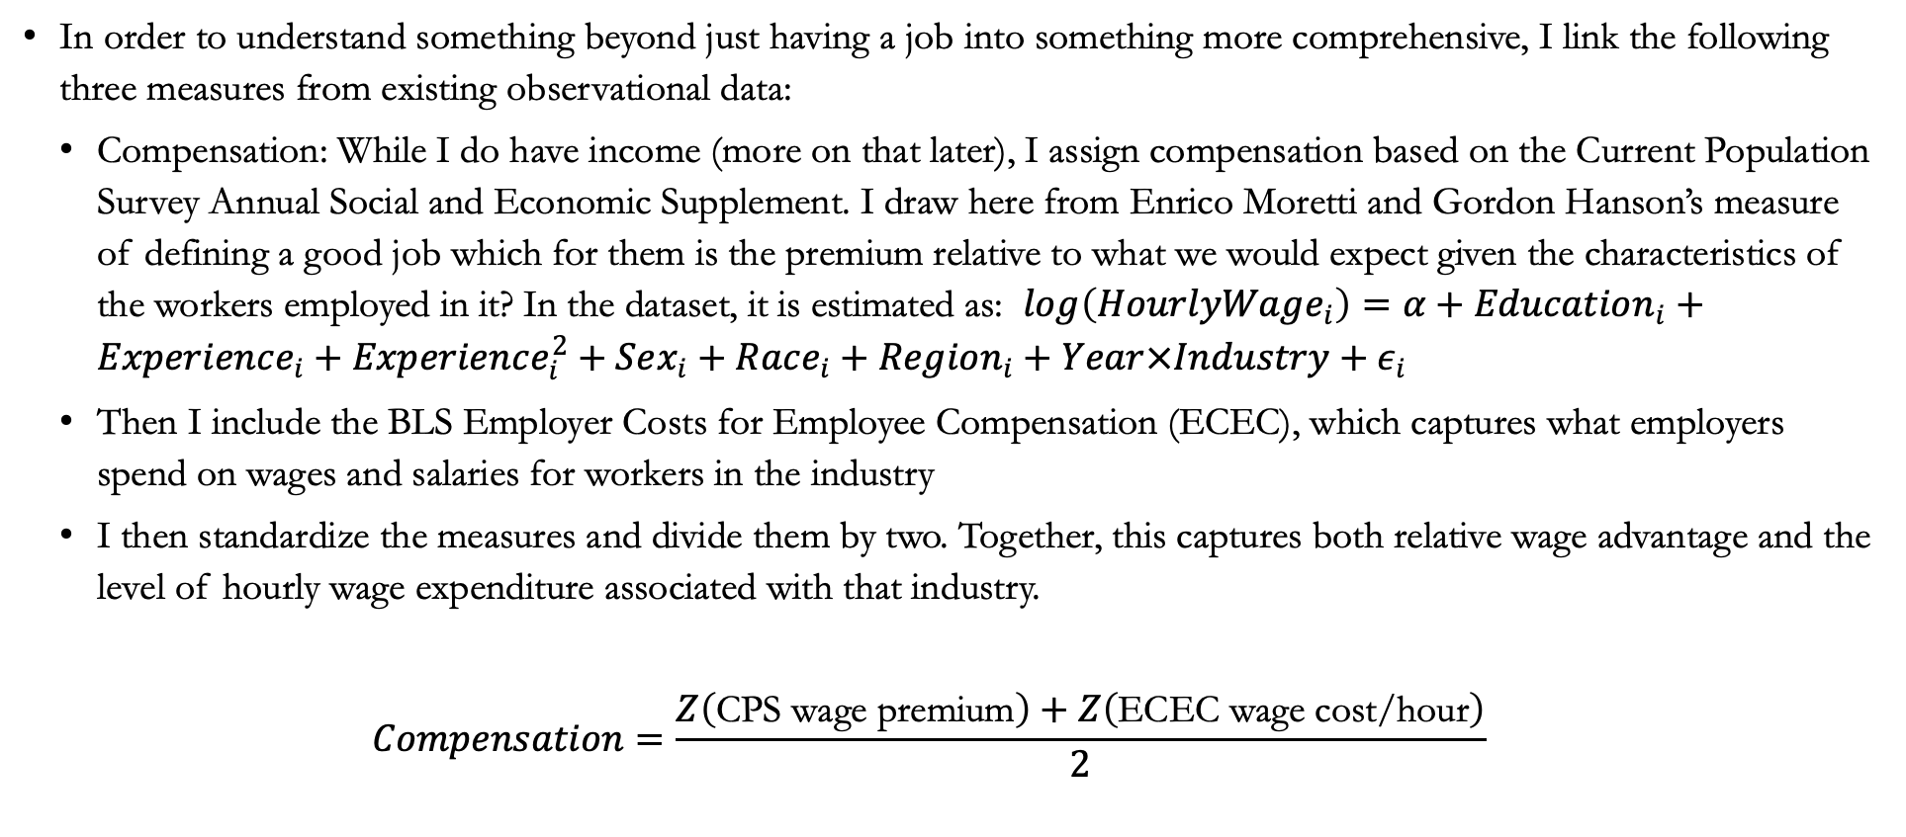
Data - Compensation
In order to understand something beyond just having a job into something more comprehensive, I link the following three measures from existing observational data:
  Compensation: While I do have income (more on that later), I assign compensation based on the Current Population Survey Annual Social and Economic Supplement. I draw here from Enrico Moretti and Gordon Hanson’s measure of defining a good job which for them is the premium relative to what we would expect given the characteristics of the workers employed in it? In the dataset, it is estimated as: $\log\left(HourlyWage_{i}\right)=α+Education_{i}+Experience_{i}+Experience_{i}^{2}+Sex_{i}+Race_{i}+Region_{i}+Year×Industry+ε_{i}$
  Then I include the BLS Employer Costs for Employee Compensation (ECEC), which captures what employers spend on wages and salaries for workers in the industry
  I then standardize the measures and divide them by two. Together, this captures both relative wage advantage and the level of hourly wage expenditure associated with that industry.
  $$Compensation=\frac{Z\left(\text{CPS wage premium}\right)+Z\left(\text{ECEC wage cost/hour}\right)}{2}$$

Slide 5

Data – Benefits
Separately, also from the ECEC, I construct the employer cost per hour for paid leave, insurance, and retirement costs (I choose not to include the benefits that they are legally mandated to pay at the same level so as to not artificially inflate the measure)
$$Benefits_{jt}=Z\left(PaidLeave_{jt}+Insurance_{jt}+Retirement_{jt}\right)$$

Slide 6
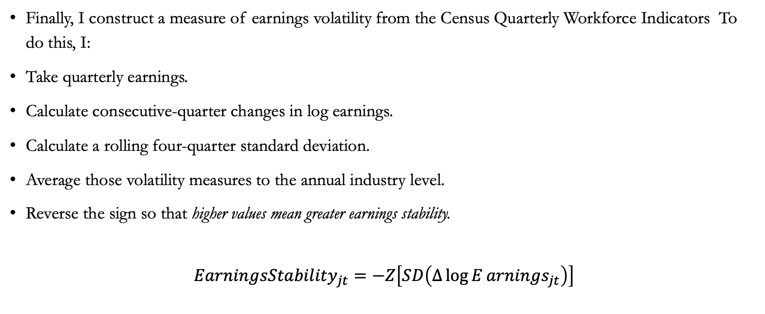
Data – Earnings Stability
Finally, I construct a measure of earnings volatility from the Census Quarterly Workforce Indicators To do this, I:
Take quarterly earnings.
Calculate consecutive-quarter changes in log earnings.
Calculate a rolling four-quarter standard deviation.
Average those volatility measures to the annual industry level.
Reverse the sign so that higher values mean greater earnings stability.
$$EarningsStability_{jt}=−Z\left[SD\left(Δ\log{E}arnings_{jt}\right)\right]$$

Slide 7
JQI
In many of the models, I standardize these components into what I call a JQI (Job Quality Index)
While for the purposes of the presentation I do disaggregate these components, conceptually I’m separating how much a job pays, the relative security it provides, and its earnings predictability for its workers.

Slide 8
Outline for the Rest of the Talk
Does this index capture things that other dimensions of objective and subjective financial quality don’t?
Does this have additional descriptive power for important questions around political attitudes?
Are those questions and the potential additional information that it gives us distinct for different populations, particularly African Americans?

Slide 9
What Does Job Quality Tell Us that Other Measures Don’t?

