Slide 1

Job Quality, Political Attitudes, and New Evidence on Old Questions
Christian Hosam
Assistant Professor
Wellesley College

Slide 2
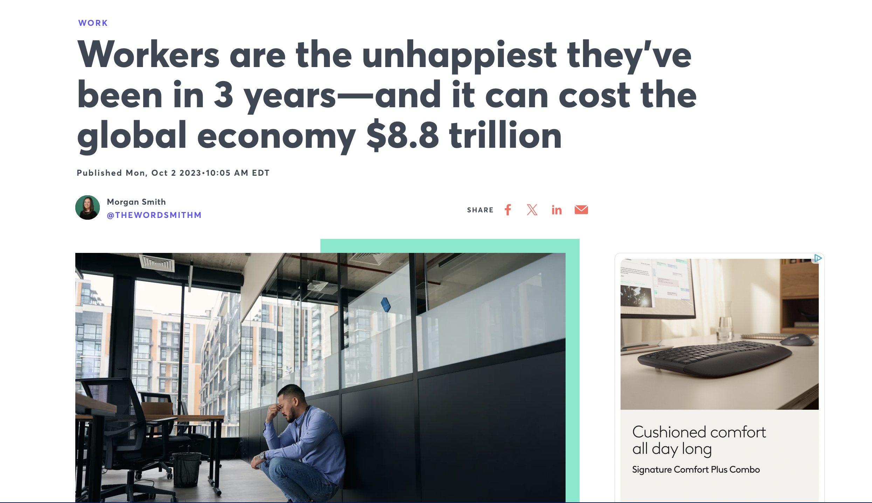
What is a Good Job? And Why Does it Matter for Political Attitudes?

Slide 3
Existing literature on the link between employment and political behavior tends to focus principally on exploiting the variation between the two parties as a pathway to understand how having a job shapes vote share and/or partisan attachment (Grafstein 2005; Wright 2012)
Recent work in Economics has looked at different ways of disaggregating parts of a job to understand its benefits for workers but most of that work is focused on understanding how to integrate objective factors that might accentuate the importance of income with subjective factors that help give workers a sense of meaning (Nikolova and Cnossen 2020; Mira 2021). Because of collinearity concerns, this becomes less tractable for understanding political behavior
Closer to home, Kathleen Thelen’s assertion that unemployment as a metric of macroeconomic health makes less sense in the context of higher rates of contingent labor identifies a need to more fluidly understand the ways that people’s work shapes their political attitude
So my idea is that by separating the component parts of a job, we can more holistically understand the ways that different parts of work matter in different ways for different people

Slide 4
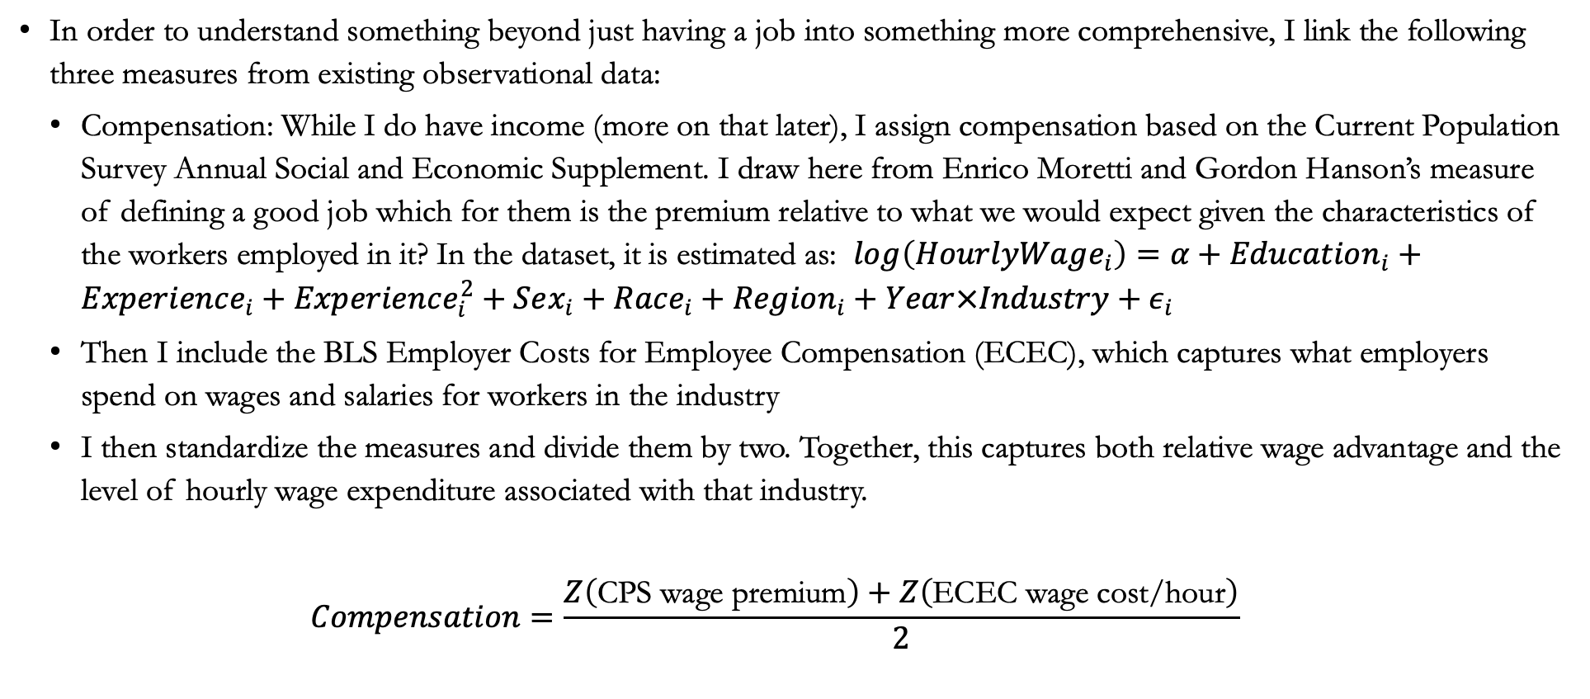
Data - Compensation
In order to understand something beyond just having a job into something more comprehensive, I link the following three measures from existing observational data:
  Compensation: While I do have income (more on that later), I assign compensation based on the Current Population Survey Annual Social and Economic Supplement. I draw here from Enrico Moretti and Gordon Hanson’s measure of defining a good job which for them is the premium relative to what we would expect given the characteristics of the workers employed in it? In the dataset, it is estimated as: $\log\left(HourlyWage_{i}\right)=α+Education_{i}+Experience_{i}+Experience_{i}^{2}+Sex_{i}+Race_{i}+Region_{i}+Year×Industry+ε_{i}$
  Then I include the BLS Employer Costs for Employee Compensation (ECEC), which captures what employers spend on wages and salaries for workers in the industry
  I then standardize the measures and divide them by two. Together, this captures both relative wage advantage and the level of hourly wage expenditure associated with that industry.
  $$Compensation=\frac{Z\left(\text{CPS wage premium}\right)+Z\left(\text{ECEC wage cost/hour}\right)}{2}$$

Slide 5

Data – Benefits
Separately, also from the ECEC, I construct the employer cost per hour for paid leave, insurance, and retirement costs (I choose not to include the benefits that they are legally mandated to pay at the same level so as to not artificially inflate the measure)
$$Benefits_{jt}=Z\left(PaidLeave_{jt}+Insurance_{jt}+Retirement_{jt}\right)$$

Slide 6
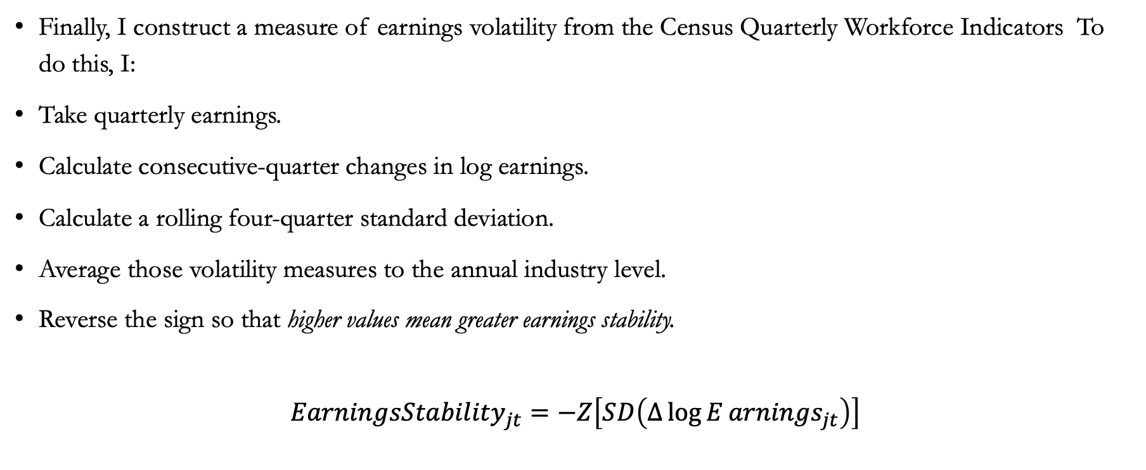
Data – Earnings Stability
Finally, I construct a measure of earnings volatility from the Census Quarterly Workforce Indicators To do this, I:
Take quarterly earnings.
Calculate consecutive-quarter changes in log earnings.
Calculate a rolling four-quarter standard deviation.
Average those volatility measures to the annual industry level.
Reverse the sign so that higher values mean greater earnings stability.
$$EarningsStability_{jt}=−Z\left[SD\left(Δ\log{E}arnings_{jt}\right)\right]$$

Slide 7
JQI
In many of the models, I standardize these components into what I call a JQI (Job Quality Index)
While for the purposes of the presentation I do disaggregate these components, conceptually I’m separating how much a job pays, the relative security it provides, and its earnings predictability for its workers.

Slide 8
Outline for the Rest of the Talk
Does this index capture things that other dimensions of objective and subjective financial quality don’t?
Does this have additional descriptive power for important questions around political attitudes?
Are those questions and the potential additional information that it gives us distinct for different populations, particularly African Americans?

Slide 9
What Does Job Quality Tell Us that Other Measures Don’t?

Slide 10
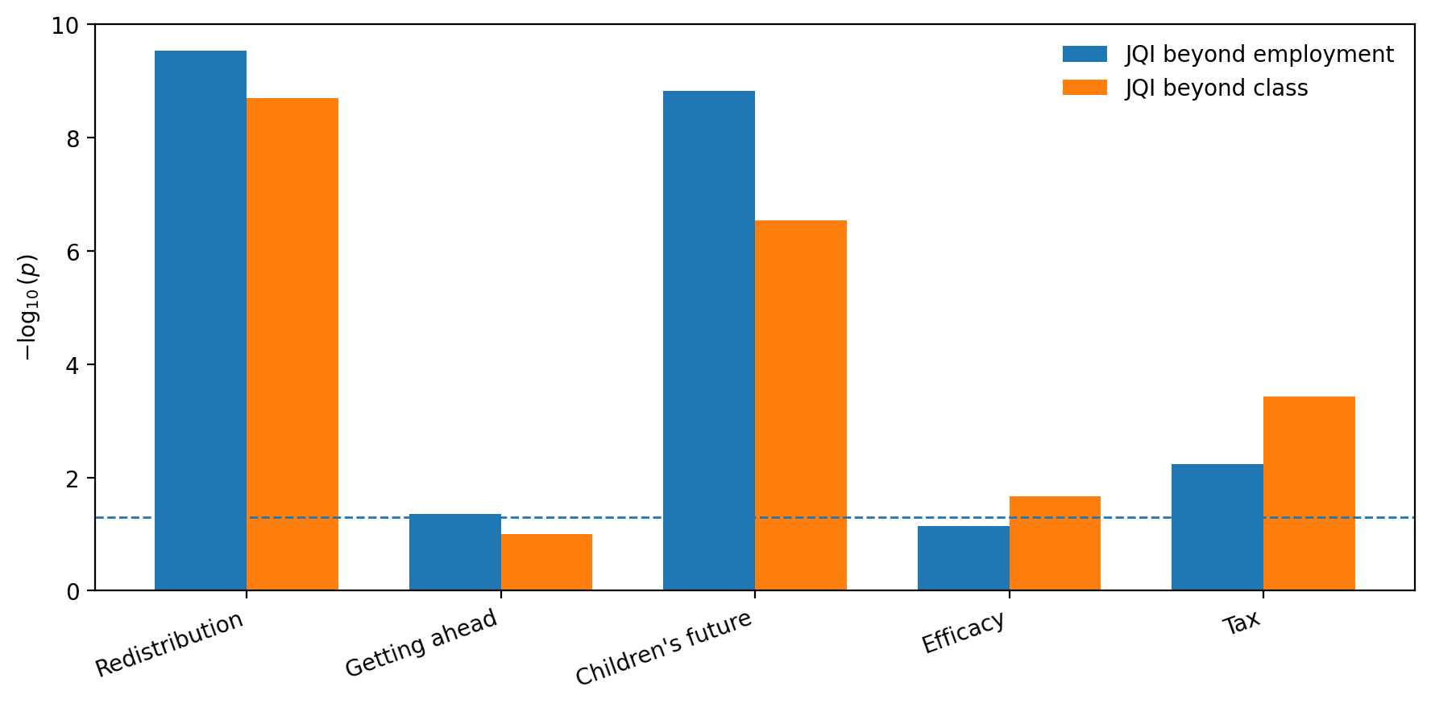
Diagnostic 1: Does JQI Add Information Beyond Employment?
• Employment status is a very coarse measure of economic position.
• JQI adds significant information within employment-status categories for several political attitudes.
• The same pattern appears in subjective economic outcomes: workers in the same employment category can occupy very different job-quality environments.
LR tests comparing nested ordered-logit models

Slide 11
Diagnostic 2: JQI Is Not Simply Another Measure of Class
• Social class remains a powerful predictor of political attitudes.
• But JQI adds information beyond class for redistribution, children's future, political efficacy, and tax attitudes.
• The point is not that JQI replaces class: it captures a different dimension of economic position.
Outcome | JQI beyond class | Class beyond employment
Redistribution | p < 0.001 | p < 0.001
Getting ahead | p = 0.101 | p < 0.001
Children's future | p < 0.001 | p < 0.001
Political efficacy | p = 0.021 | p < 0.001
Tax attitudes | p < 0.001 | p < 0.001
Nested model likelihood-ratio tests

Slide 12
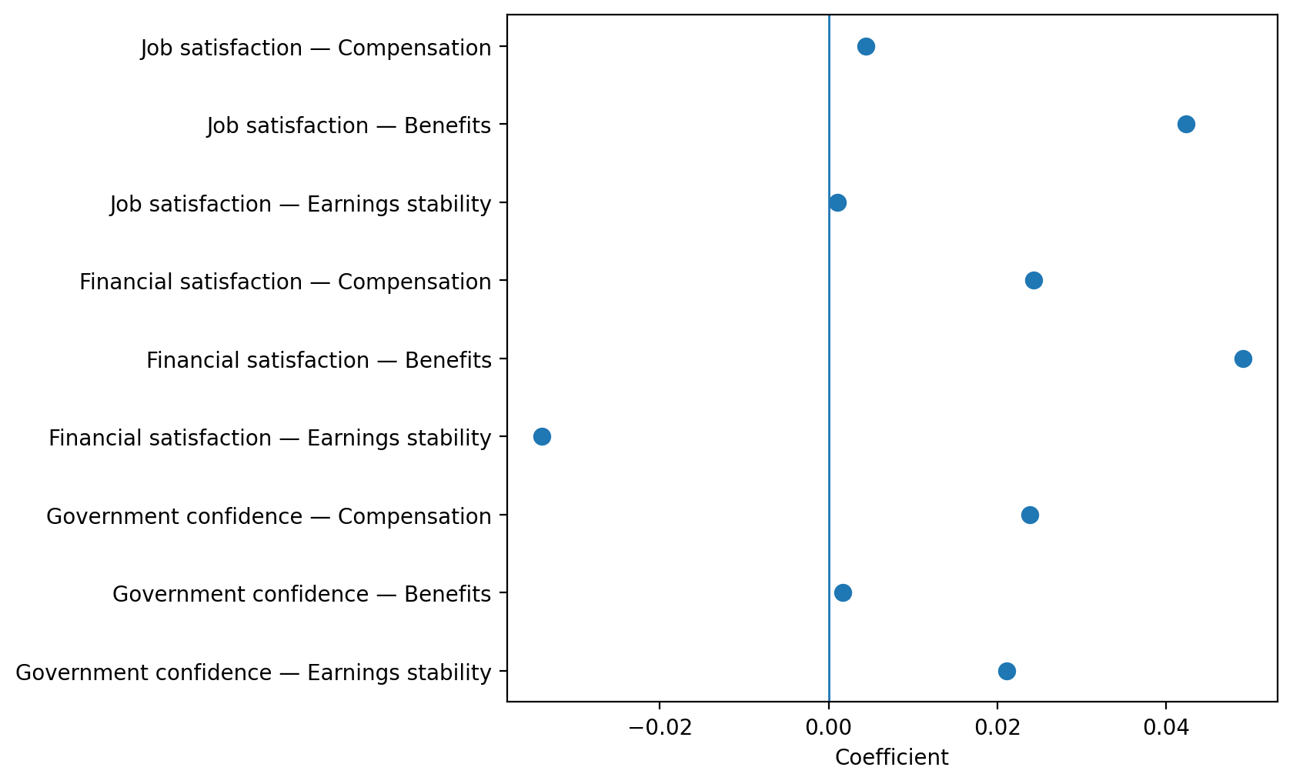
Diagnostic 3: The Components Are Not Interchangeable

Slide 13
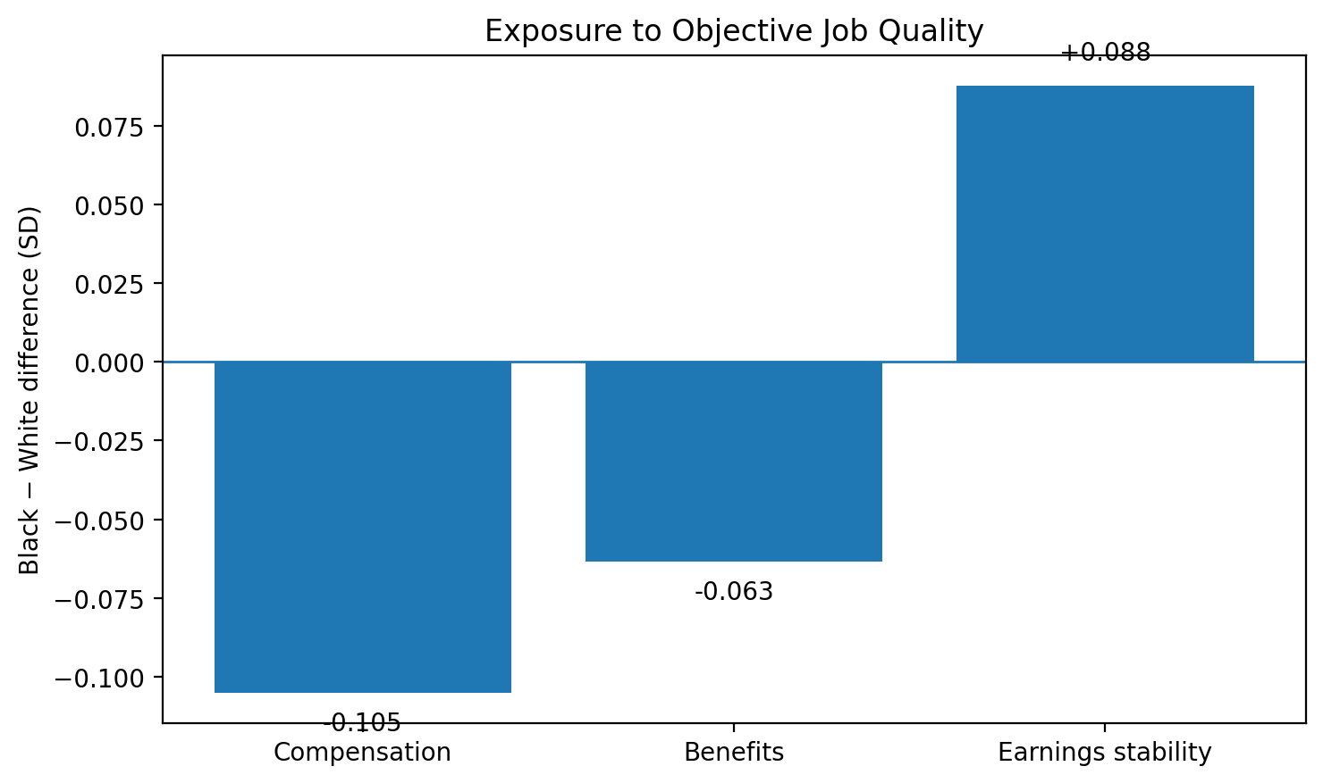
Race Reveals Why Disaggregation Matters
• Black respondents are exposed to lower compensation and benefits.
• But they are exposed to higher measured earnings stability.
• A single composite would compress these substantively different patterns into one number.
Black − White standardized differences: compensation −0.105; benefits −0.063; earnings stability +0.088

Slide 14
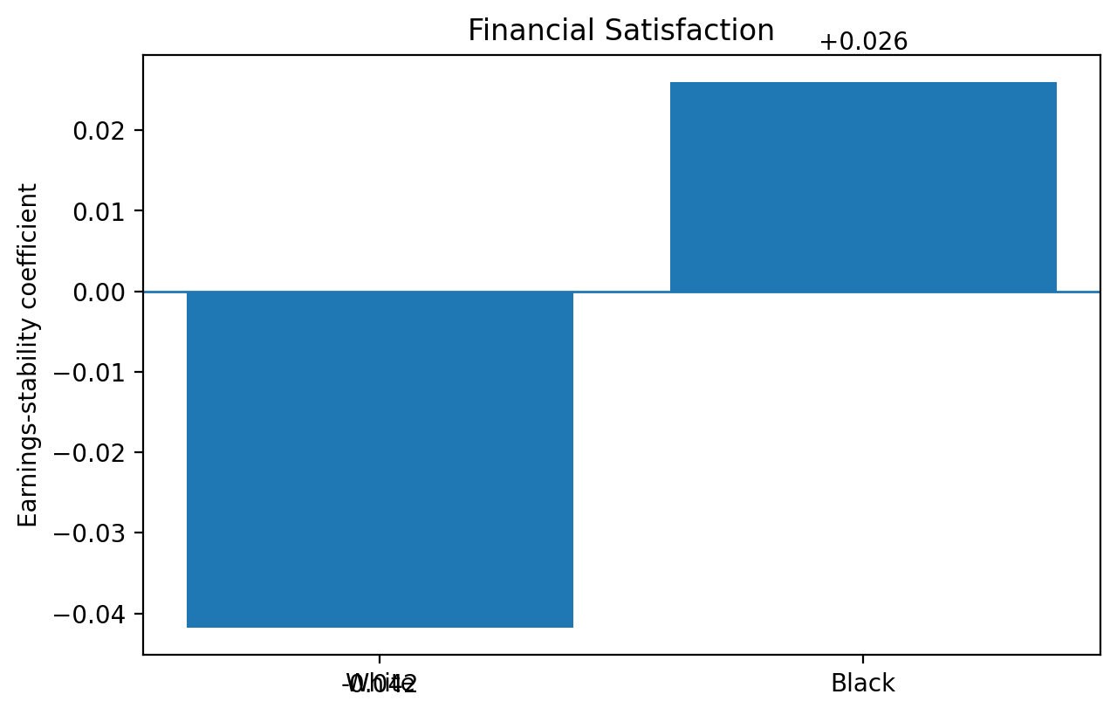
Race Also Conditions What Job Quality Means for Financial Well-Being
• The joint race interaction is significant: F(3, 22220) = 15.09, p < 0.001.
• The earnings-stability × Black interaction is β = 0.068, p < 0.001.
• Implied slopes: White = −0.042; Black = +0.026.
Personal financial satisfaction model

Slide 15
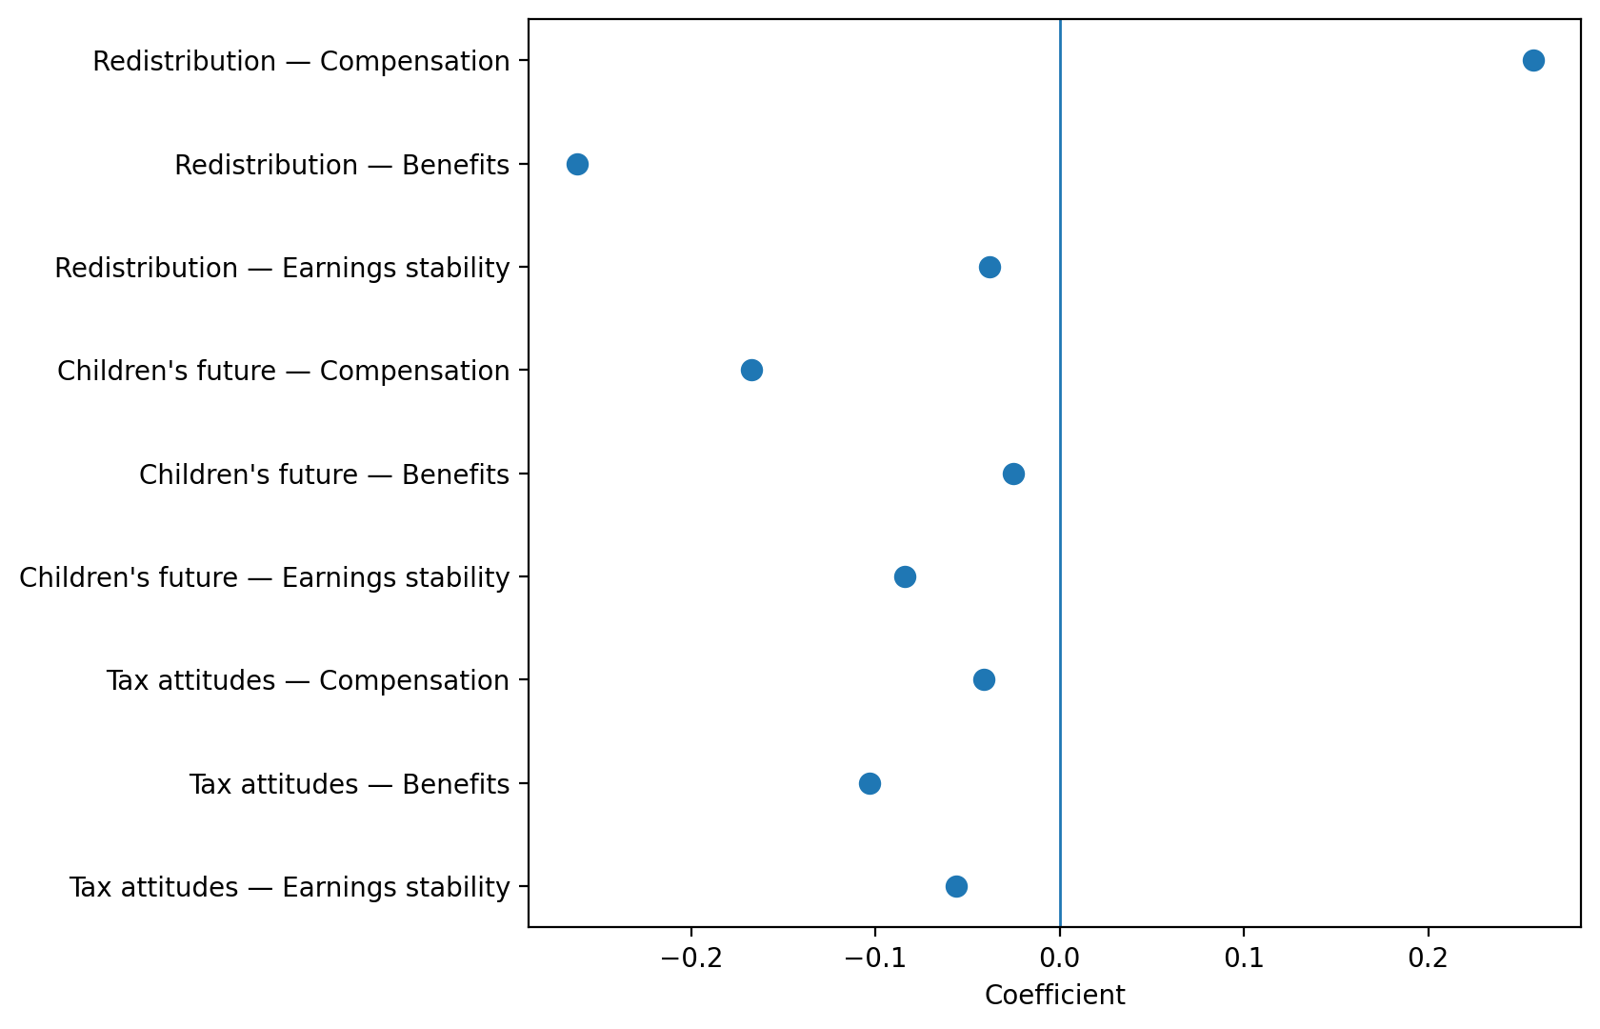
Political Attitudes: Different Dimensions, Different Associations
Joint JQI-component models; coefficients shown for selected outcomes

Slide 16
What About Confidence in Government?
• The political-attitude story is not uniformly about compensation or benefits.
• In the joint model, earnings stability is the clearest job-quality predictor of confidence in government: β = 0.021, p = 0.001.
• Compensation is weaker (β = 0.024, p = 0.085); benefits are essentially null (β = 0.002, p = 0.893).
• There is no significant evidence that these relationships differ by race.

Slide 17
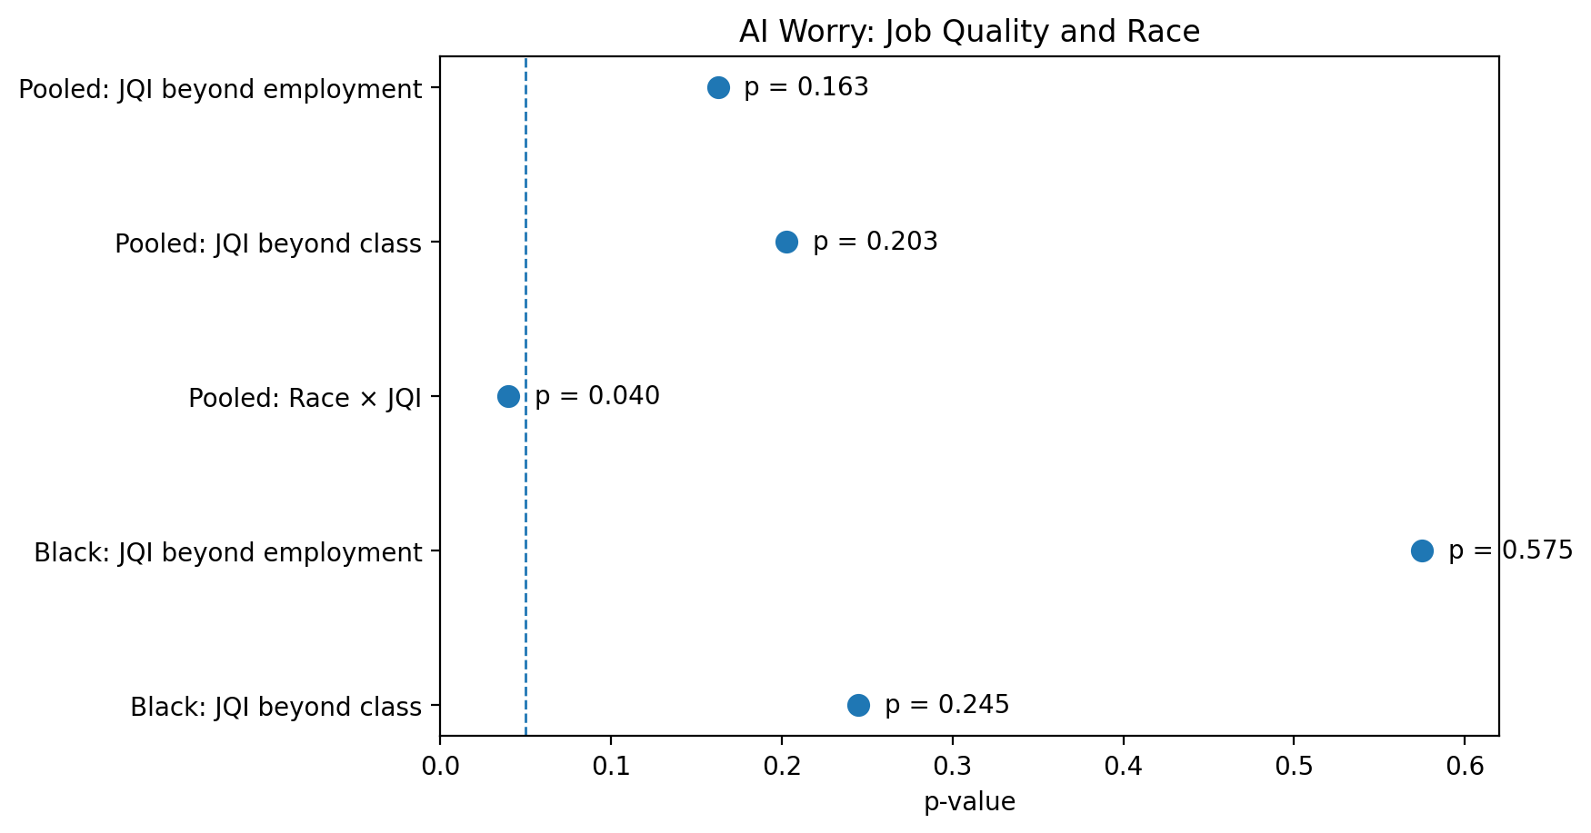
2024: AI Worry Shows a Different Racial Pattern
• For the full 2024 sample, JQI does not add significant information about AI worry beyond employment or class.
• But the race × JQI interaction is significant: p = .040.
• The interaction is driven by benefits × Black: β = −0.682, p = .020.
• Among Black respondents alone, JQI does not significantly improve the model (p = .575 beyond employment; p = .245 beyond class).
2024-only outcome; AI worry is a contemporary political/economic attitude

