Slide 1

Employment Quality and Political Attitudes. New Evidence for Canonical Questions
Christian Hosam
Assistant Professor
Wellesley College

Slide 2
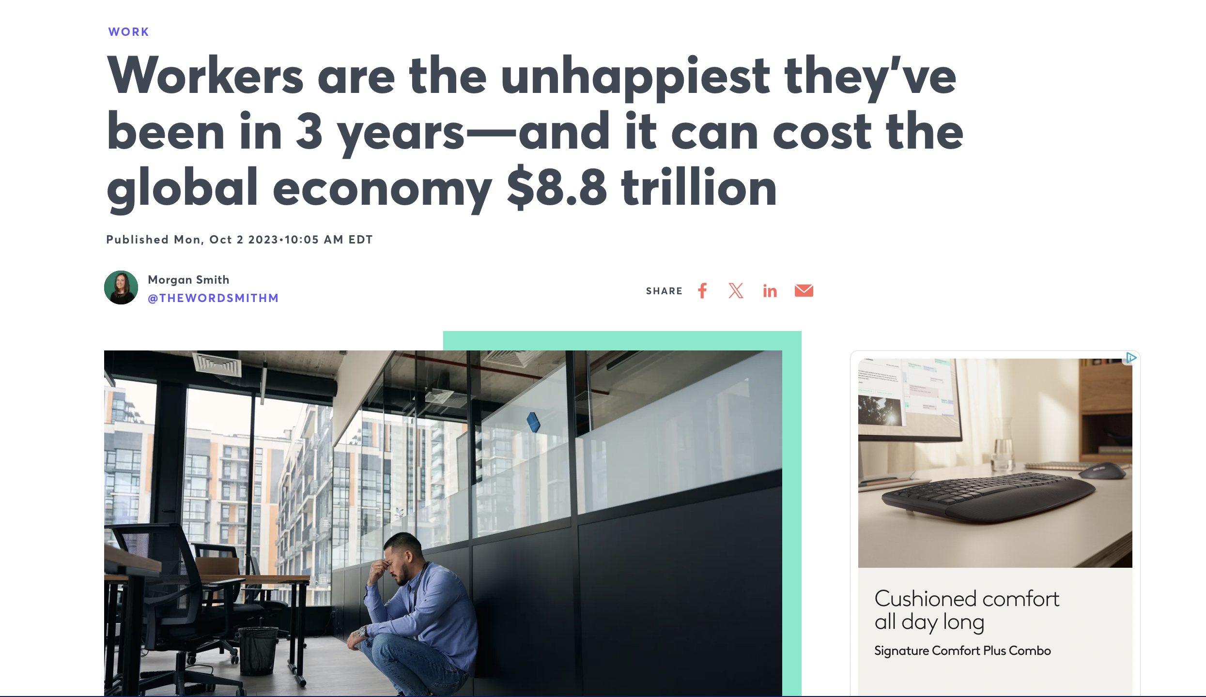
What is a Good Job? And Why Does it Matter for Political Attitudes?

Slide 3
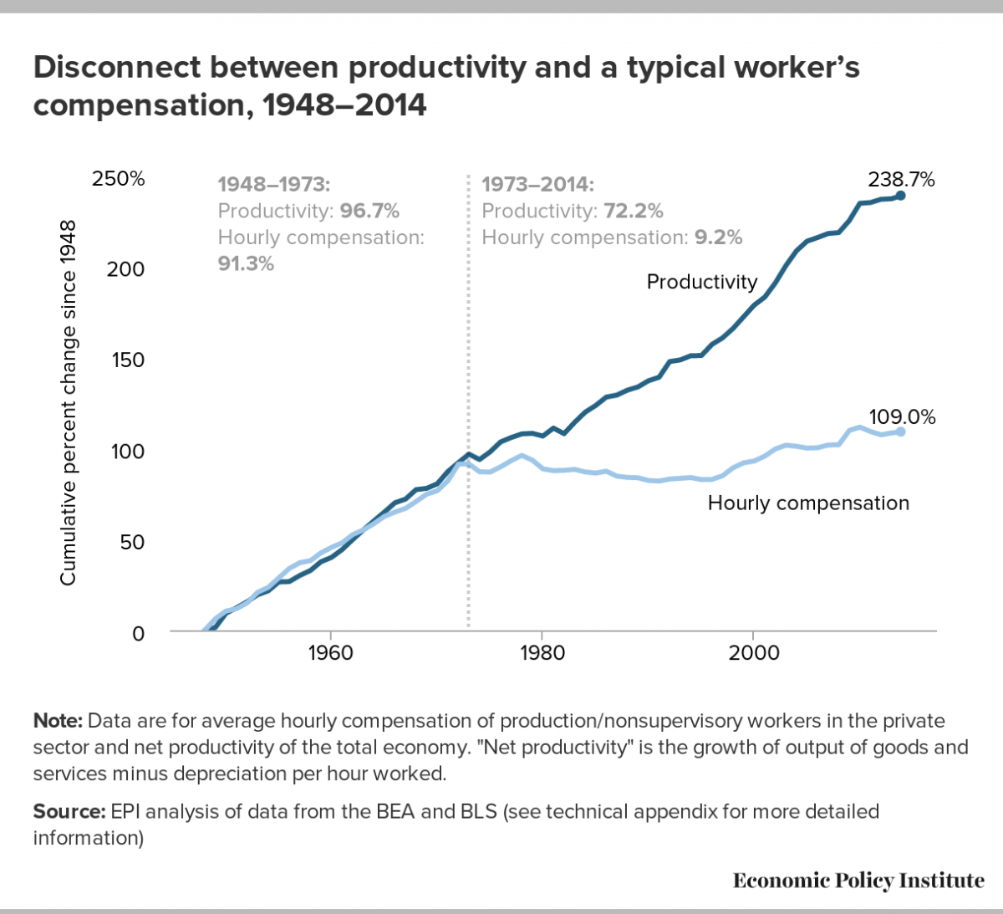

Slide 4
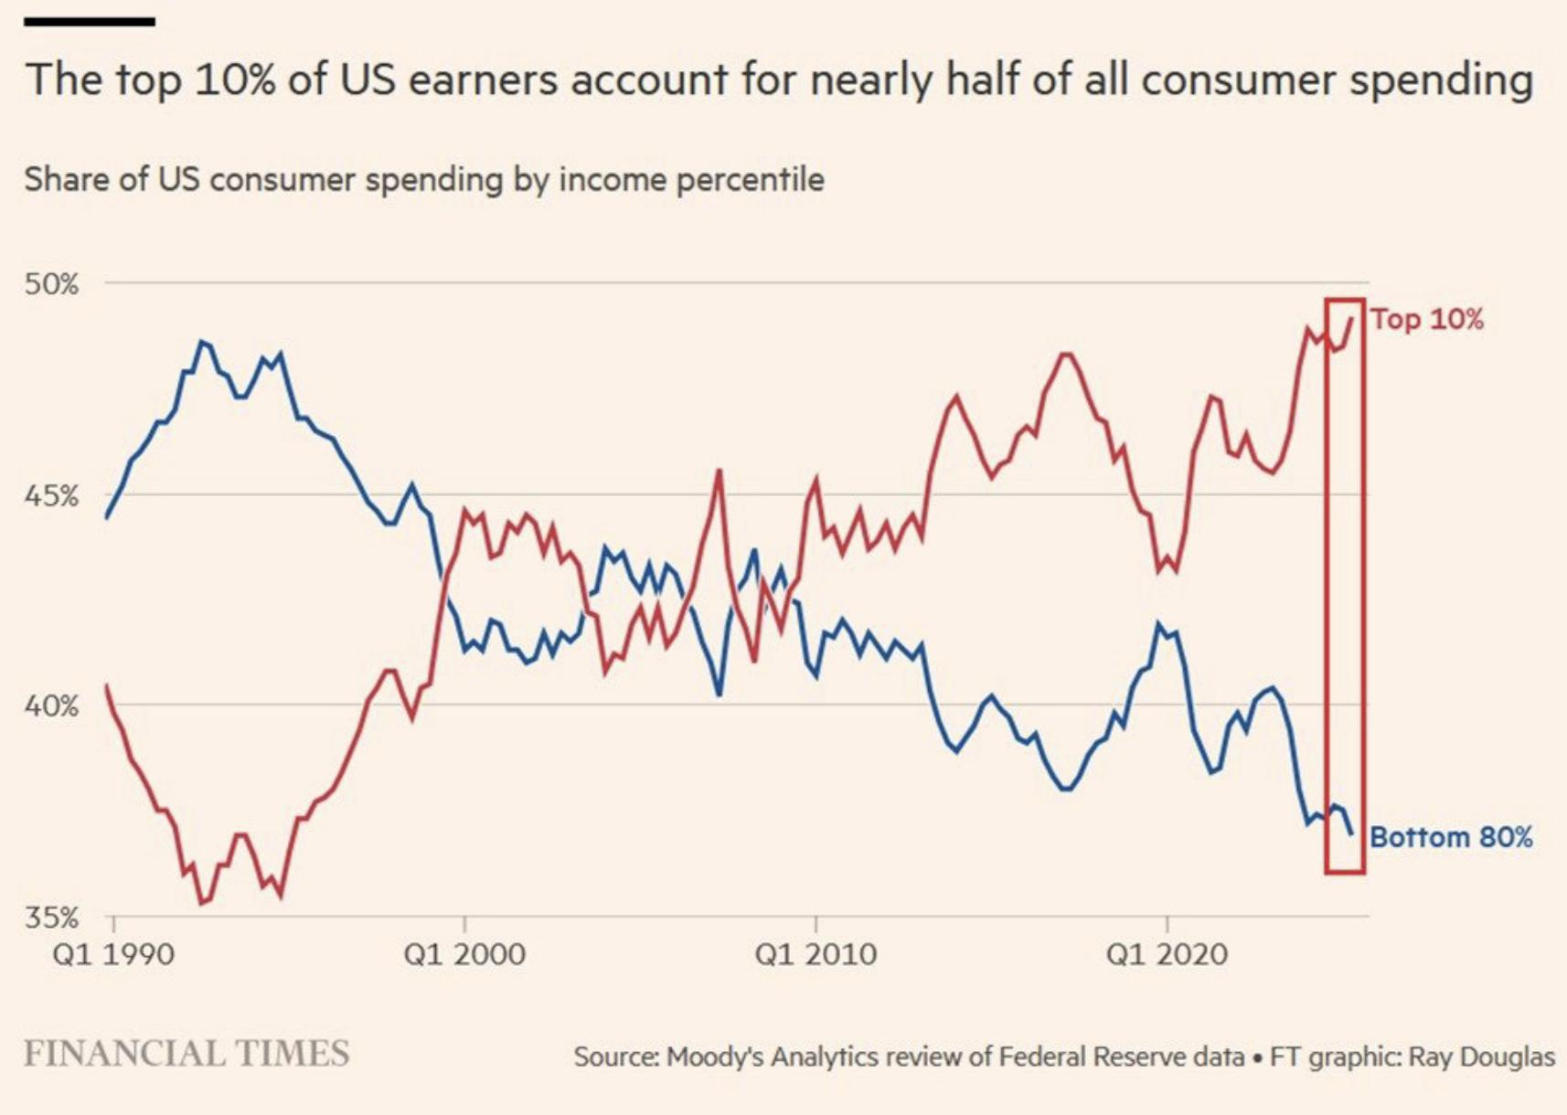

Slide 5
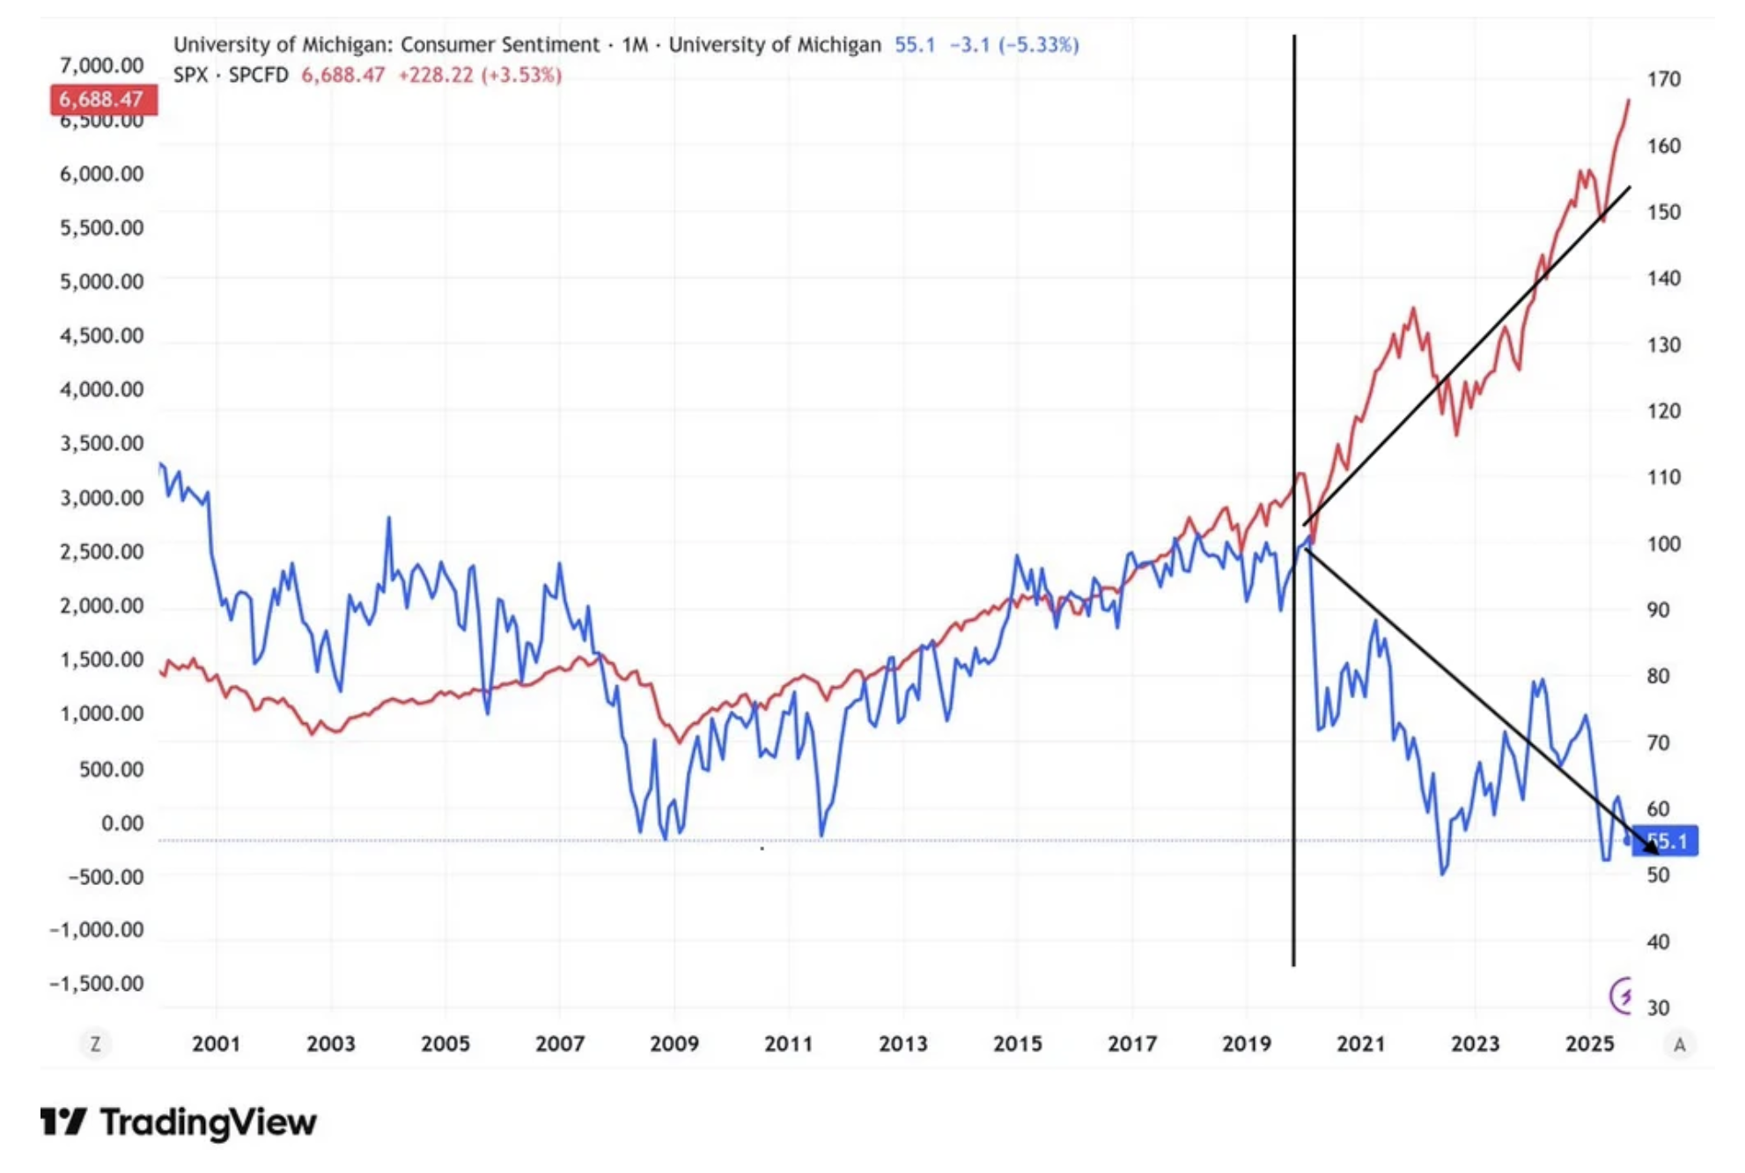

Slide 6
The decline of worker power expands the set of reasons that workers will feel unhappy and with it, the reasons to think of work as shaping political meaning

Slide 7
Existing literature on the link between employment and political behavior tends to focus principally on exploiting the variation between the two parties as a pathway to understand how having a job shapes vote share and/or partisan attachment (Grafstein 2005; Wright 2012)
Recent work in Economics has looked at different ways of disaggregating parts of a job to understand its benefits for workers but most of that work is focused on understanding how to integrate objective factors that might accentuate the importance of income with subjective factors that help give workers a sense of meaning (Nikolova and Cnossen 2020; Mira 2021). Because of collinearity concerns, this becomes less tractable for understanding political behavior
Closer to home, Kathleen Thelen’s assertion that unemployment as a metric of macroeconomic health makes less sense in the context of higher rates of contingent labor identifies a need to more fluidly understand the ways that people’s work shapes their political attitude
My idea is that by separating the component parts of a job, we can more holistically understand the ways that different parts of work matter in different ways for different people

Slide 8
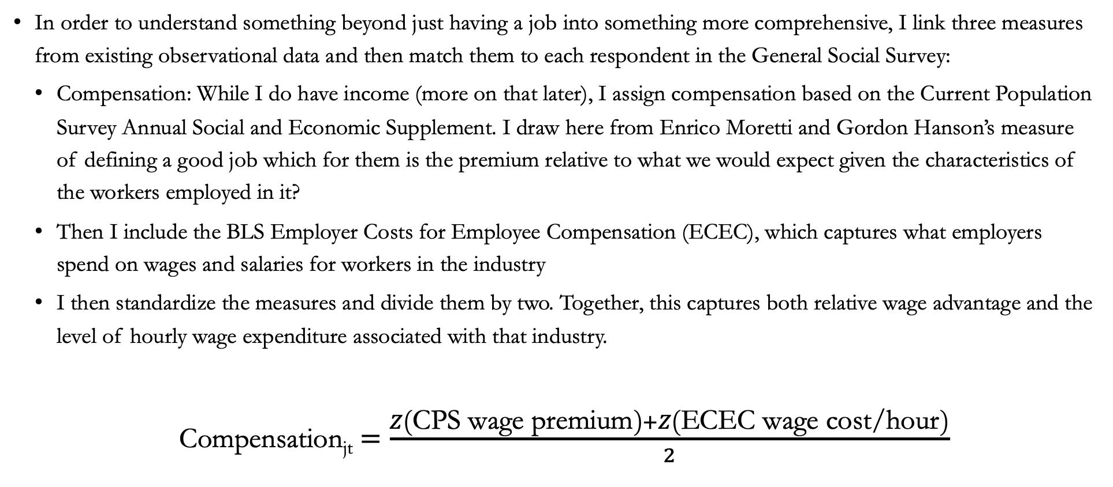
Data - Compensation
In order to understand something beyond just having a job into something more comprehensive, I link three measures from existing observational data and then match them to each respondent in the General Social Survey:
  Compensation: While I do have income (more on that later), I assign compensation based on the Current Population Survey Annual Social and Economic Supplement. I draw here from Enrico Moretti and Gordon Hanson’s measure of defining a good job which for them is the premium relative to what we would expect given the characteristics of the workers employed in it?
  Then I include the BLS Employer Costs for Employee Compensation (ECEC), which captures what employers spend on wages and salaries for workers in the industry
  I then standardize the measures and divide them by two. Together, this captures both relative wage advantage and the level of hourly wage expenditure associated with that industry.
  Compensation_{jt} $=\frac{Z\left(\text{CPS} \text{wage} \text{premium}\right)+Z\left(\text{ECEC} \text{wage} \text{cost}\text{/}\text{hour}\right)}{2}$
Notes:
In the dataset, the CPS wage premium is estimated as: $\log\left(HourlyWage_{i}\right)=α+Education_{i}+Experience_{i}+Experience_{i}^{2}+Sex_{i}+Race_{i}+Region_{i}+Year×Industry+ε_{i}$

Slide 9
Data – Benefits
Separately, also from the ECEC, I construct the employer cost per hour for paid leave, insurance, and retirement costs (I choose not to include the benefits that they are legally mandated to pay at the same level so as to not artificially inflate the measure)
Benefits_{jt} = Z(PaidLeave_{jt}+ Insurance_{jt} + Retirement_{jt})

Slide 10
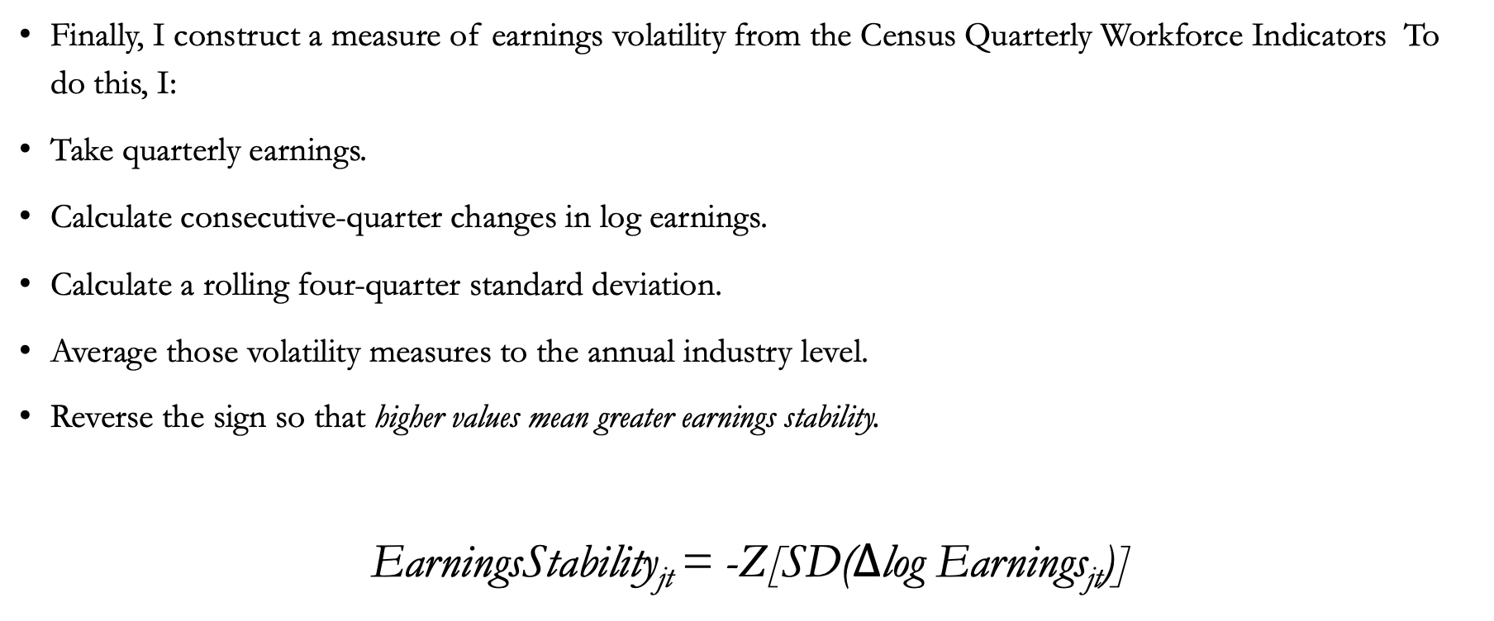
Data – Earnings Stability
Finally, I construct a measure of earnings volatility from the Census Quarterly Workforce Indicators To do this, I:
Take quarterly earnings.
Calculate consecutive-quarter changes in log earnings.
Calculate a rolling four-quarter standard deviation.
Average those volatility measures to the annual industry level.
Reverse the sign so that higher values mean greater earnings stability.
EarningsStability_{jt} = -Z[SD($Δ$log Earnings_{jt})]

Slide 11
JQI
I standardize these components into what I call a JQI (Job Quality Index)
While for the purposes of the presentation I do disaggregate these components, conceptually I’m separating how much a job pays, the relative security it provides, and its earnings predictability for its workers to understand what each component does politically relative to the others.
Connecting each measure to the General Social Survey (GSS) Cumulative File from 2000-2024 at the industry-year level, I have about 200 different combinations to work with in a survey that has n = 37,563 respondents across waves.

Slide 12
Research Question
Does disaggregating the effects of compensation, benefits, and earnings stability highlight different aspects of political attitudes than are captured by work status alone?

Slide 13
Outline for the Rest of the Talk
At the model level, does separating out different forms of employment quality give us more information than employment status and social class alone can’t?
Do these measures capture things that other dimensions of objective and subjective financial quality don’t?
Does this have additional descriptive power for important questions around political attitudes?
Are those questions and the potential additional information that it gives us distinct for different populations, particularly African Americans?

Slide 14
JQI Accentuates but doesn’t replace Class
• Social class (here meaning respondent self-reported class status) remains a powerful predictor of political attitudes.
• But JQI adds information beyond class for all attitudinal measures that I study.
Outcome | JQI beyond class | Class beyond employment
Redistribution | p < 0.001 | p < 0.001
Getting ahead | p = 0.101 | p < 0.001
Children's future | p < 0.001 | p < 0.001
Political efficacy | p = 0.021 | p < 0.001
Tax attitudes | p < 0.001 | p < 0.001
Nested model likelihood-ratio tests

Slide 15
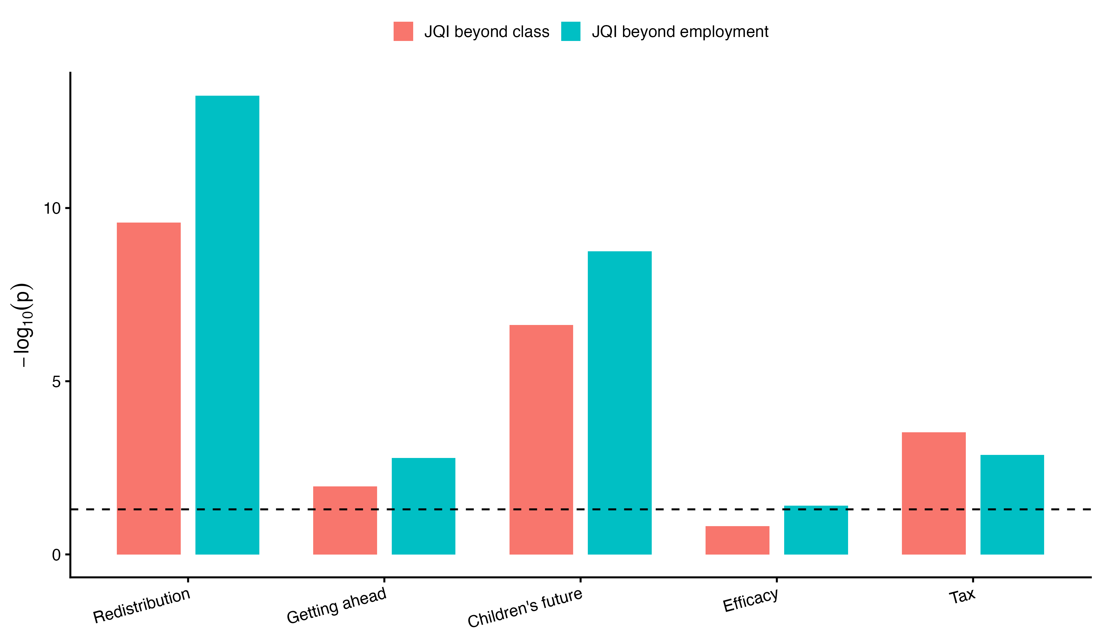
Does JQI Add Information Beyond Employment?
• JQI adds significant information within employment-status categories for all political attitudes measured in the study.
LR tests comparing nested ordered-logit models

Slide 16
Objective and Subjective Forms of Employment Quality
Job satisfaction:
  Compensation: β = 0.045983, p = 3.09×10⁻¹²
  Benefits: β = 0.045709, p < 0.001
  Earnings stability: β = −0.018845, p = .00342
Compensation and benefits are positive when considered separately, but once entered jointly, benefits is the only component that remains clearly associated with satisfaction.
Personal financial satisfaction:
  Compensation: β = 0.08822, p= 0.005357
  Benefits: β = 0.08083, p=0.004773
  Earnings stability: β = −0.06420, p=0.005162
All three components are associated separately; jointly, benefits remains strongly positive and earnings stability is strongly negative, while compensation is only marginally positive (p = .0484).

Slide 17
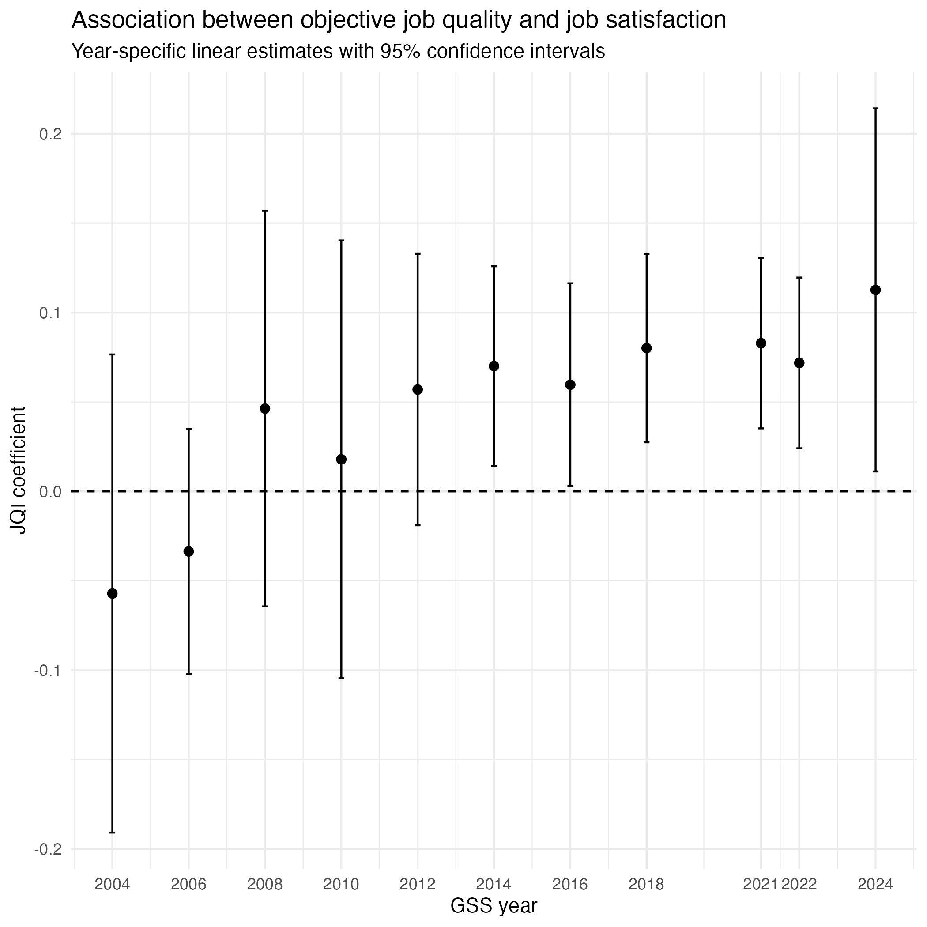

Slide 18
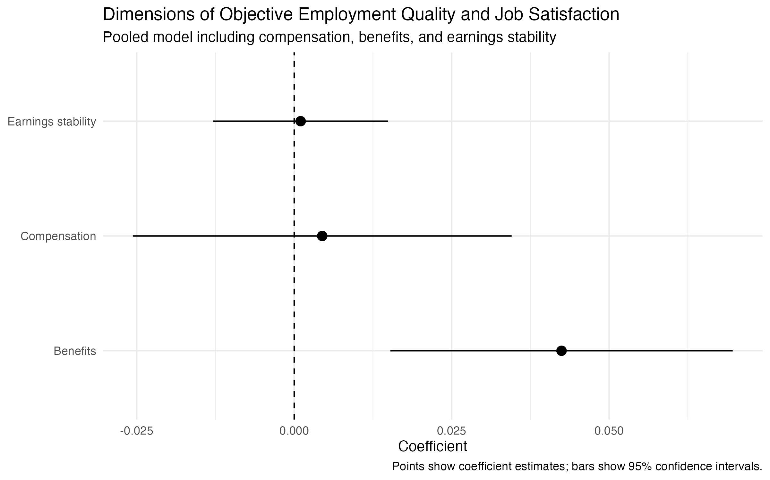

Slide 19
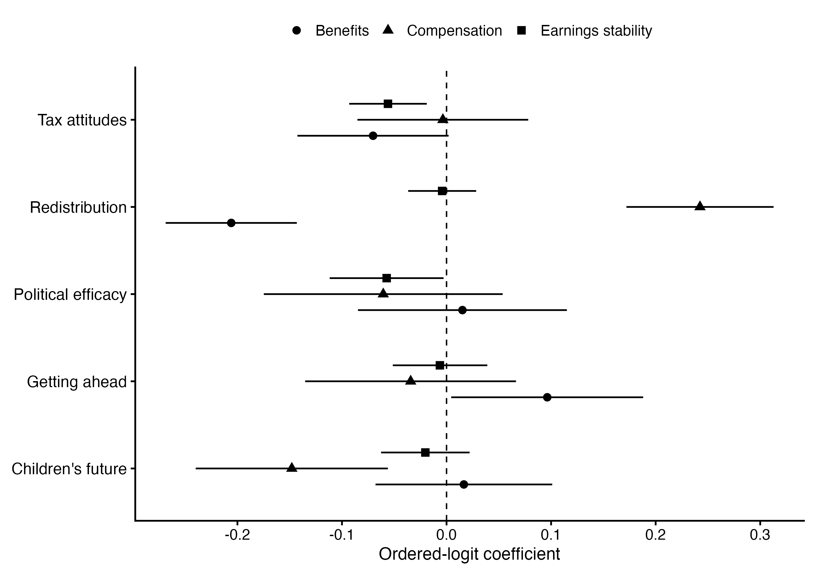

Slide 20
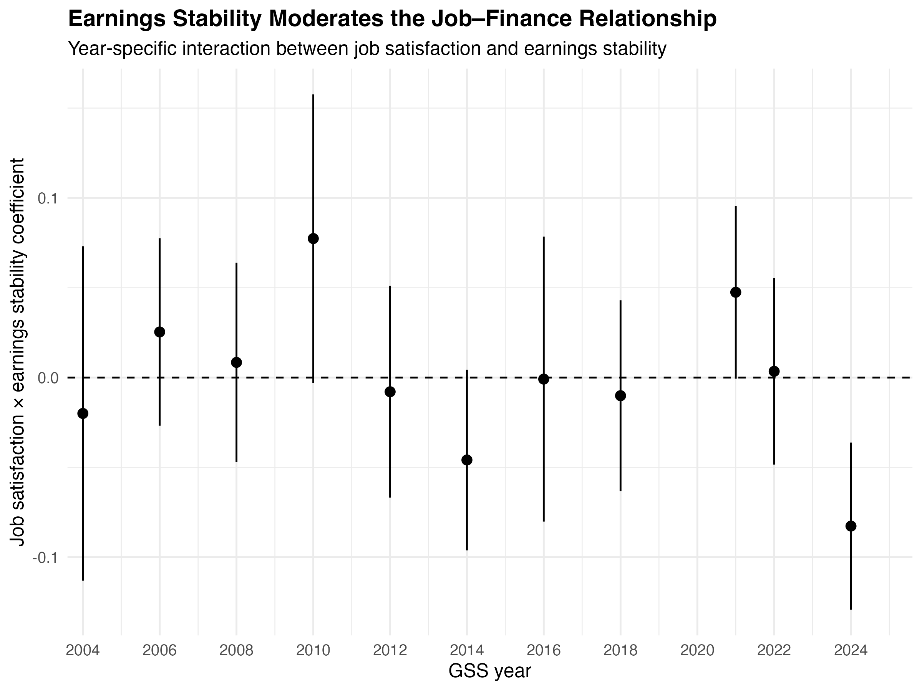

Slide 21
What About Confidence in Government?
• The political-attitude story is not uniformly about compensation or benefits.
• In the joint model, earnings stability is the clearest job-quality predictor of confidence in government: β = 0.021, p = 0.001.
• Compensation is weaker (β = 0.024, p = 0.085); benefits are essentially null (β = 0.002, p = 0.893).
• There is no significant evidence that these relationships differ by race.

Slide 22
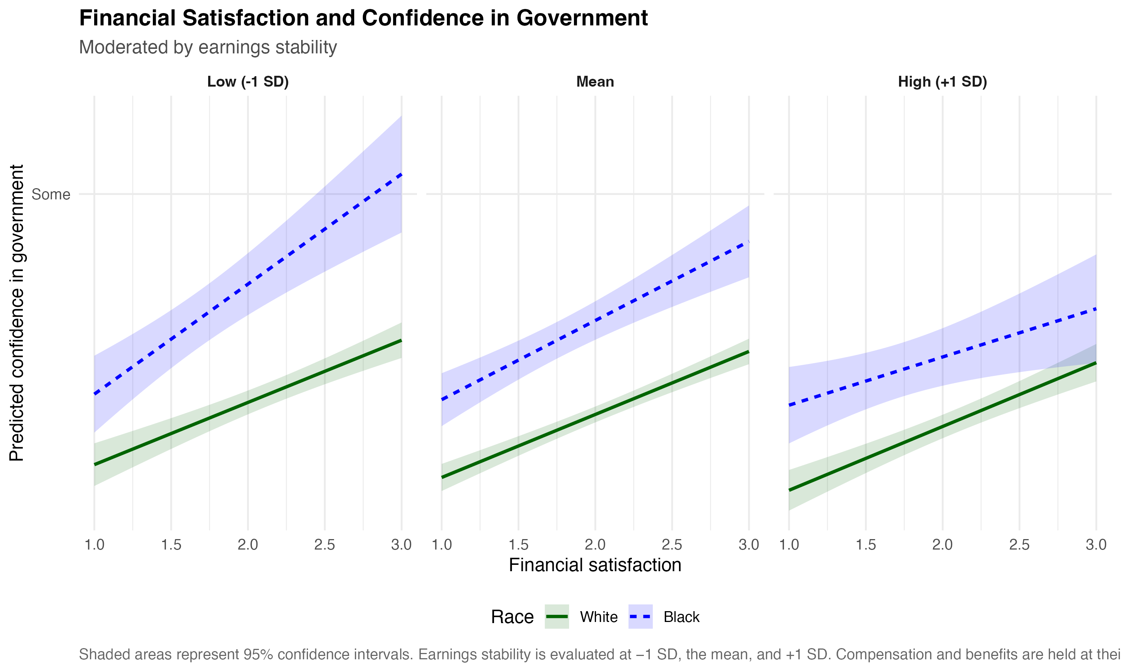

Slide 23
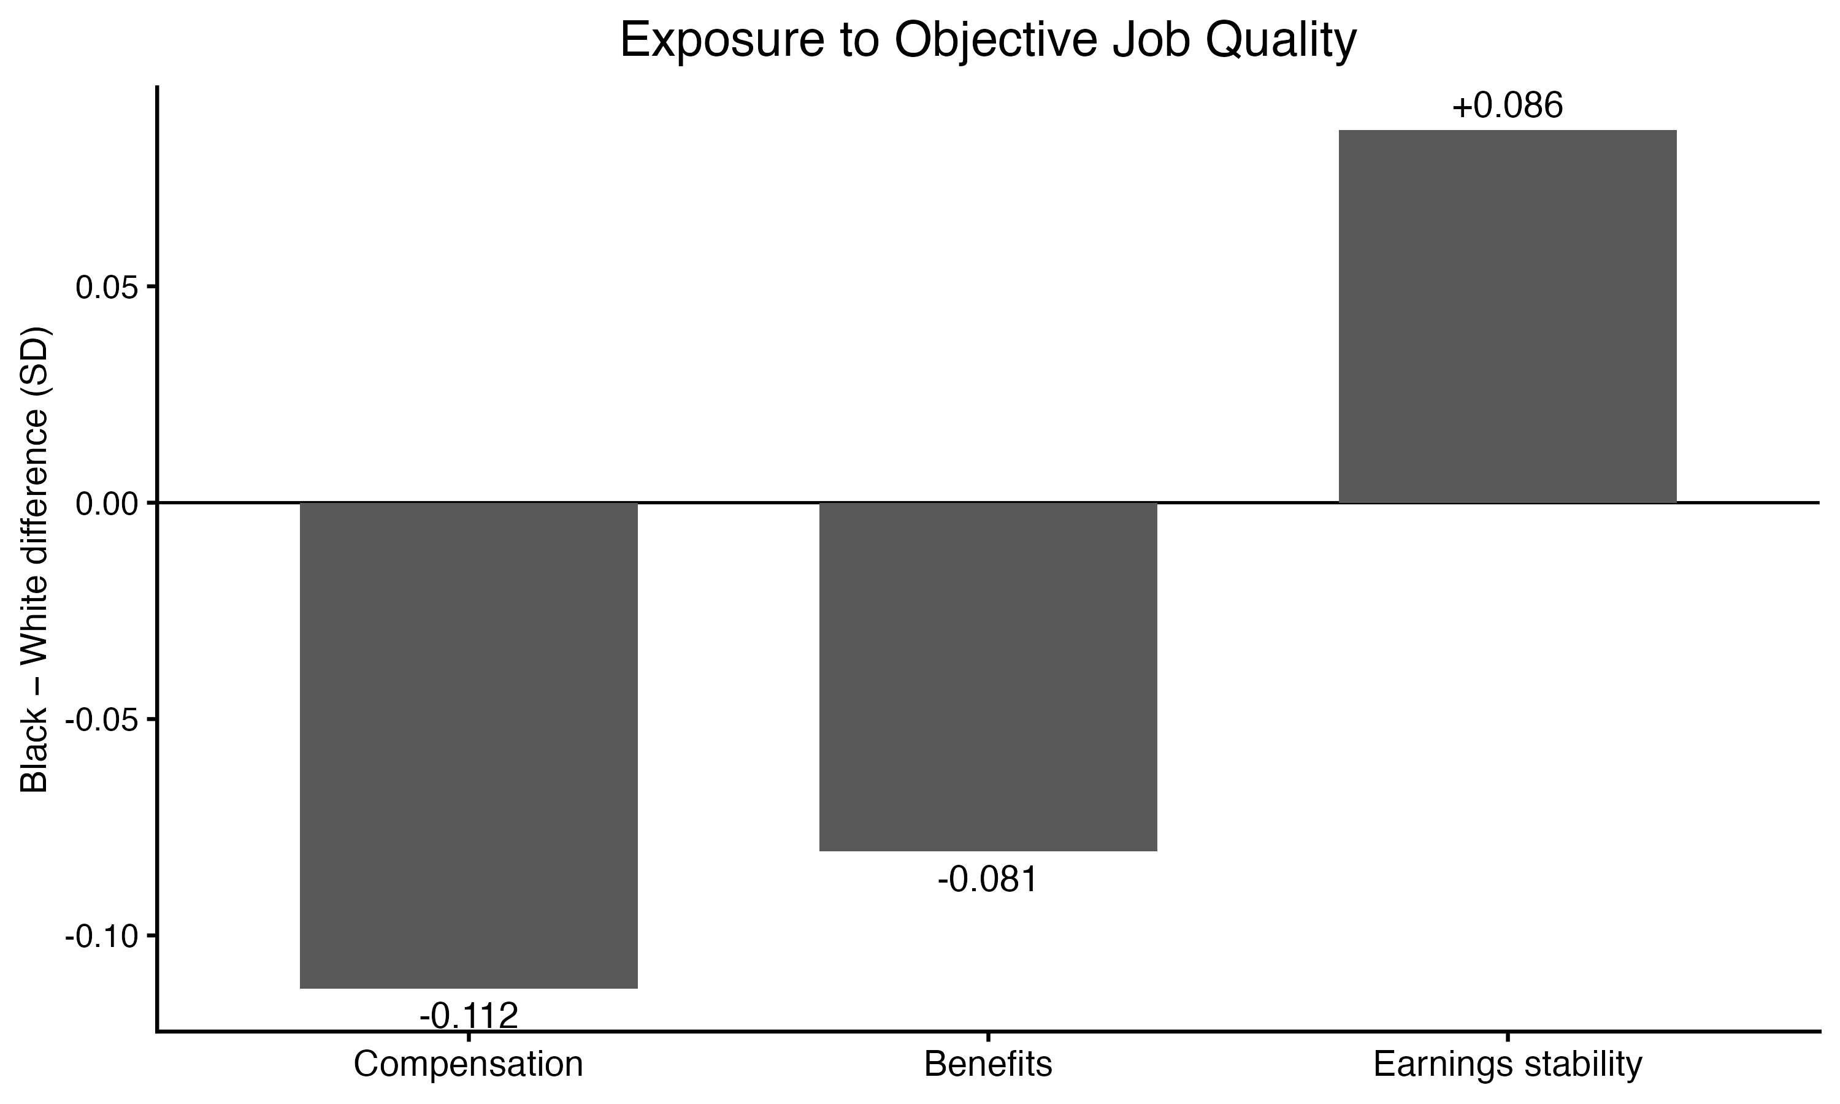
Race and Employment Quality
• Black respondents are concentrated in industries with lower compensation and benefits.
• But they are exposed to higher measured earnings stability.
• A single composite would compress these substantively different patterns into one number.

Slide 24
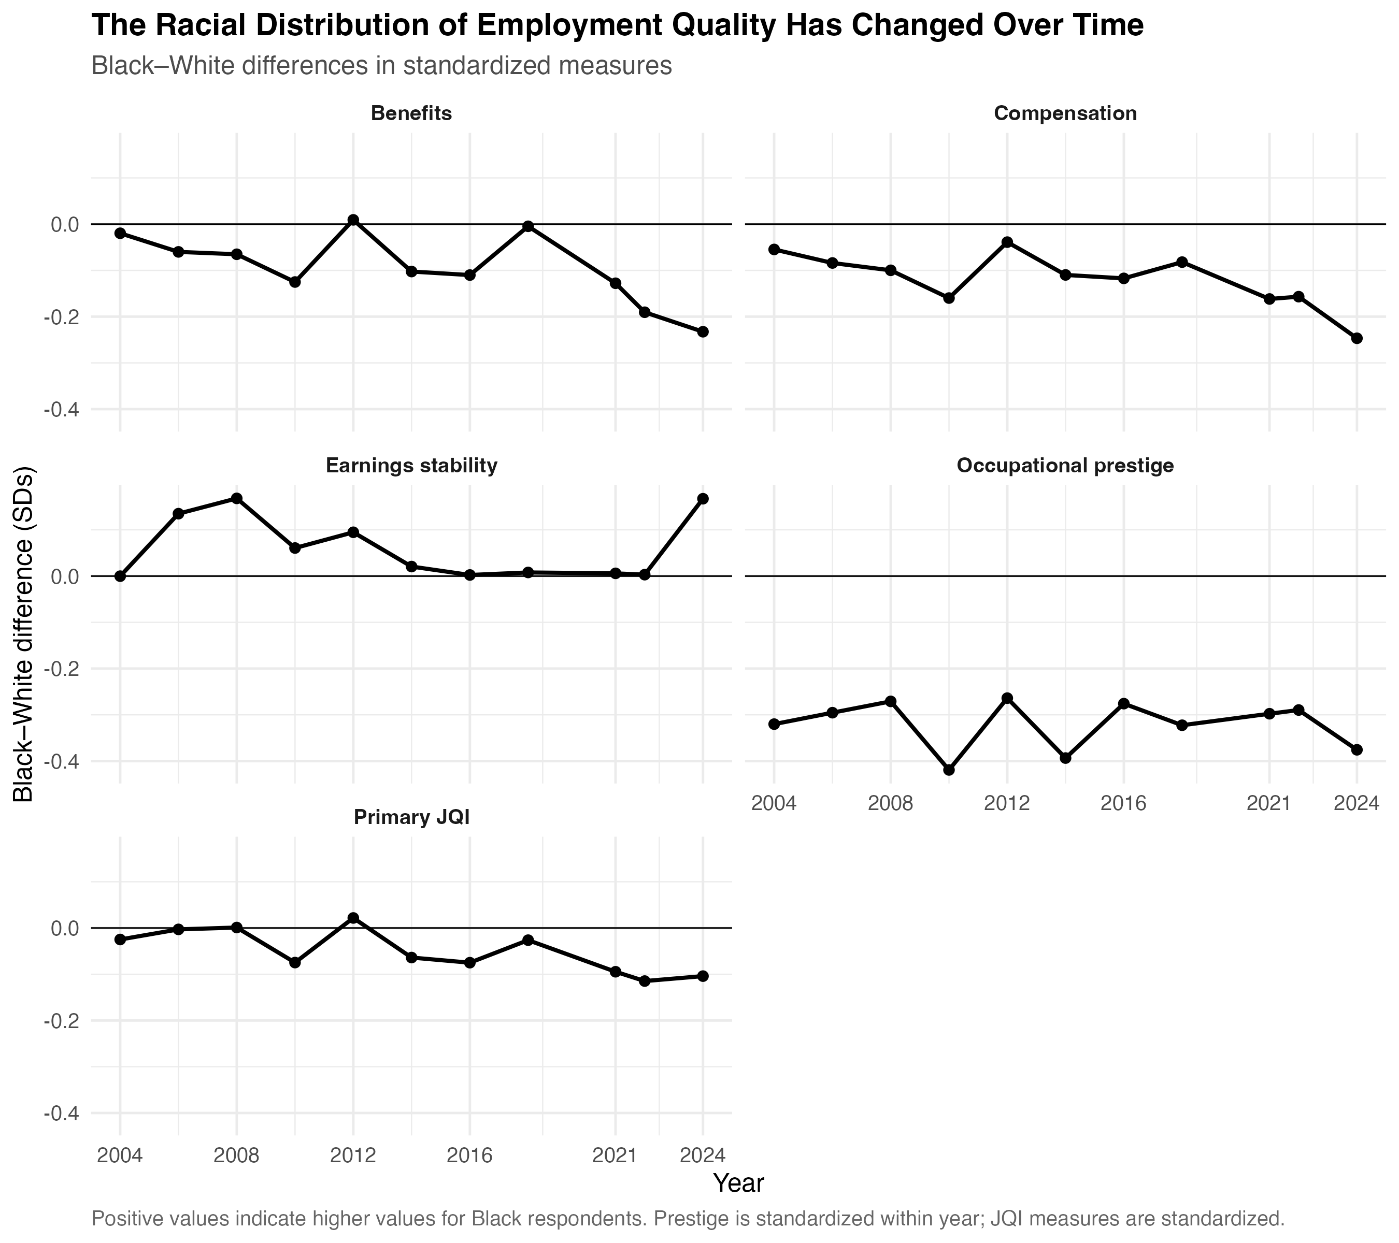

Slide 25
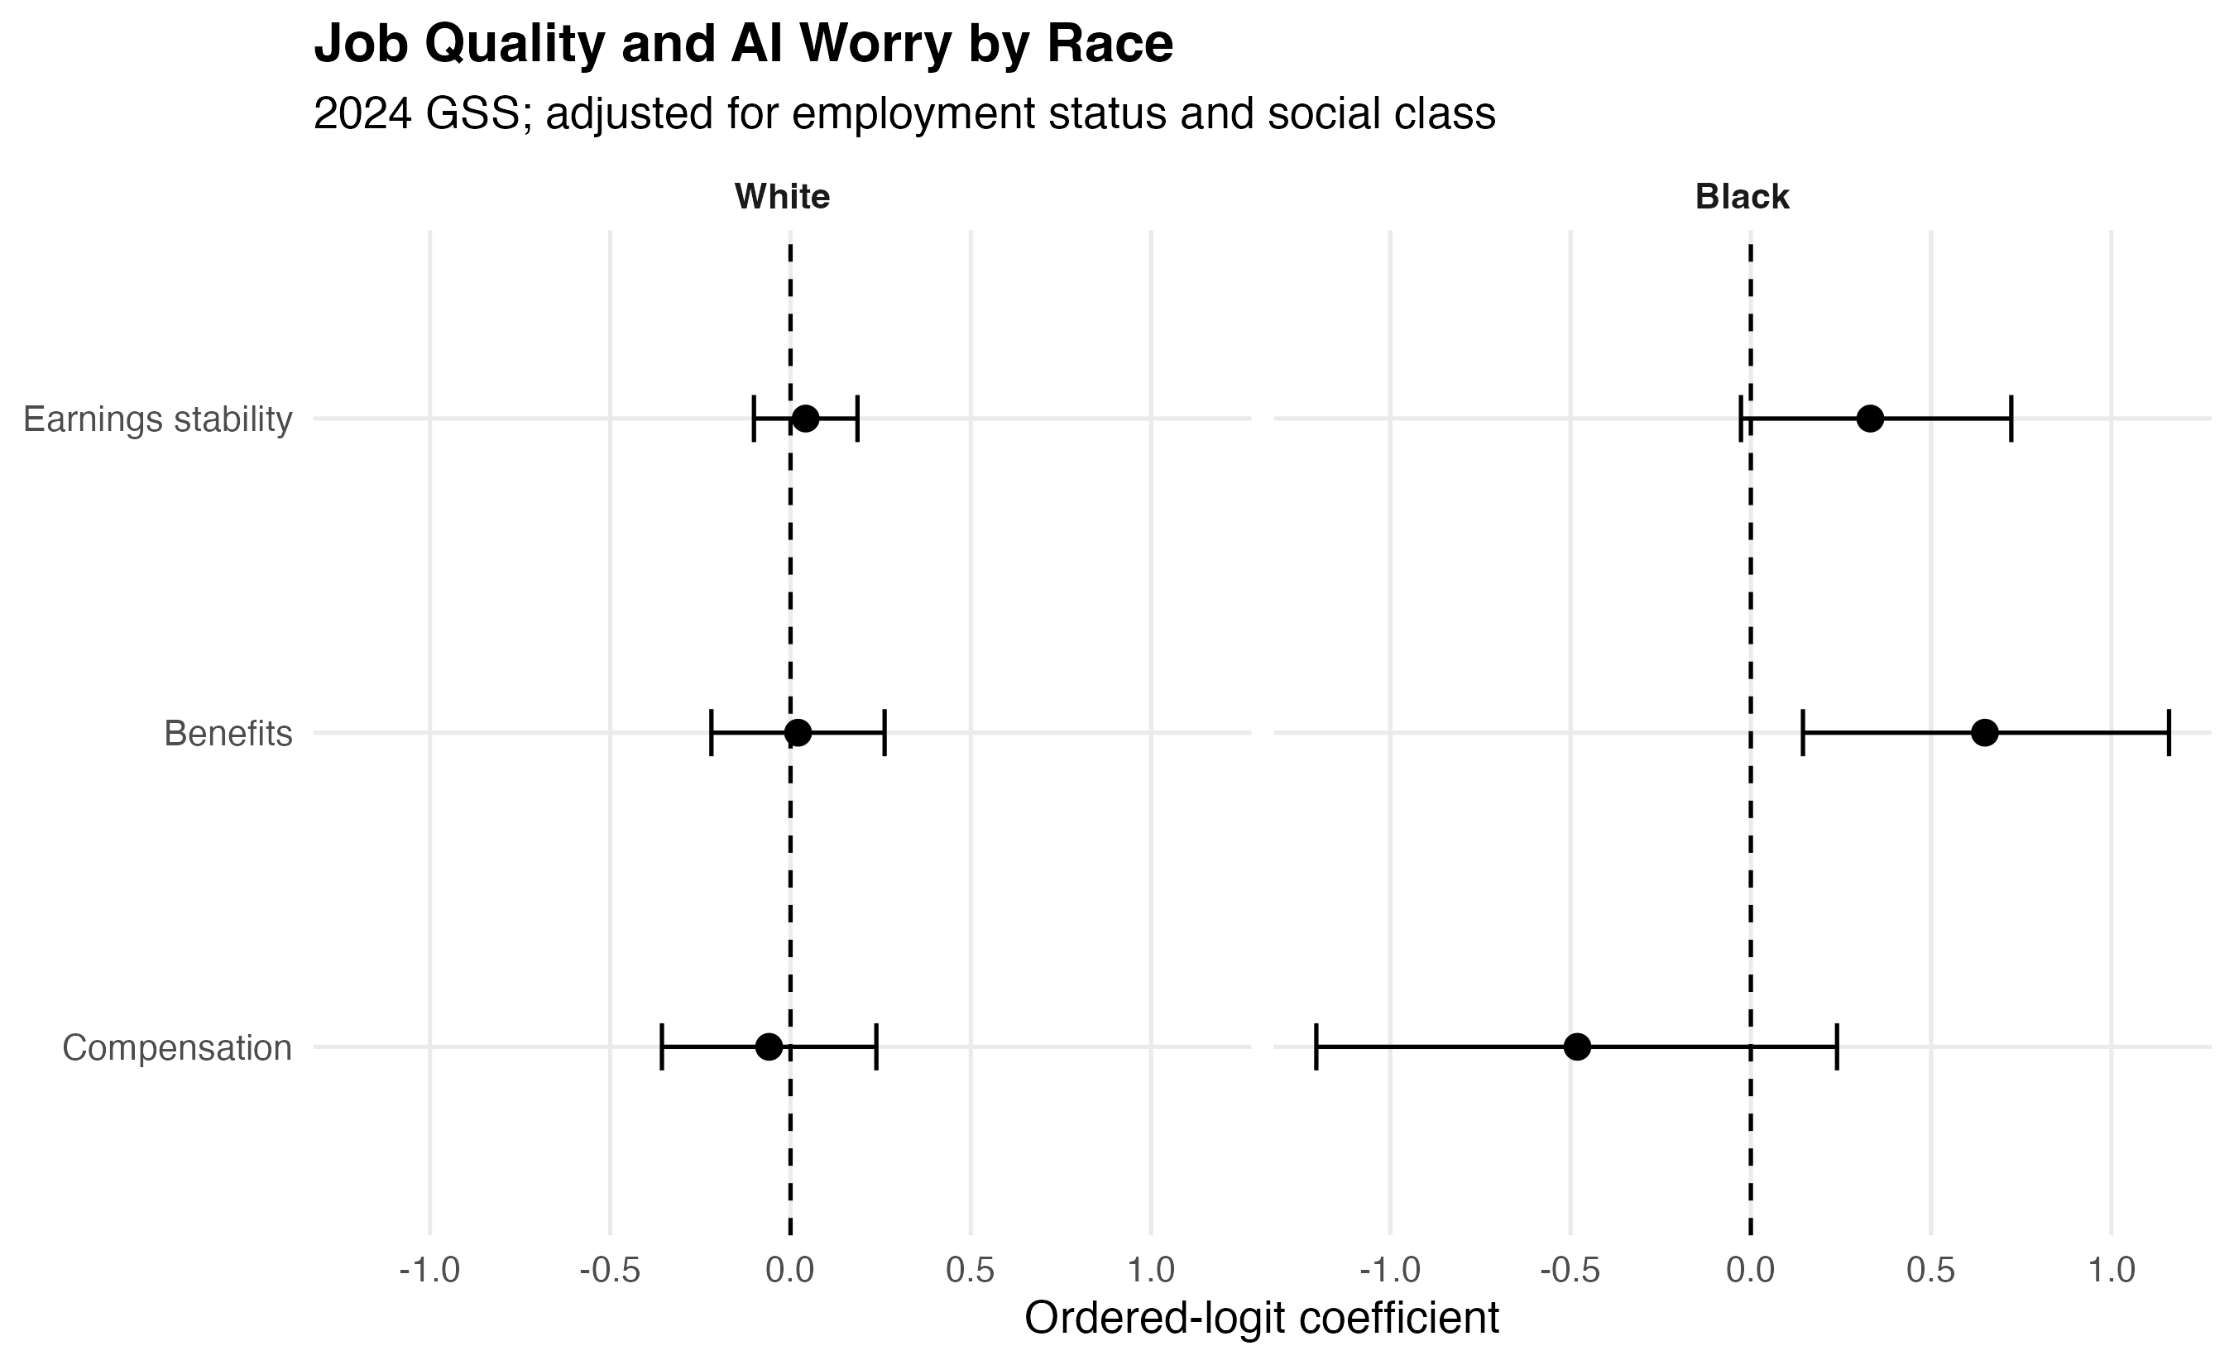

Slide 26
Takeaways
The political contours of a job are more dynamic than we’ve fully realized and have implication for political attitudes that we’ve yet to fully detect
Compensation, benefits, and earnings stability are distinct political phenomenon that are wrapped up within the broader concept of work status.
Moreover, distinguishing these concepts from one another also provides insights into the ways that race and class are interlinked within the American Political Economy
While this project was limited in terms of the granularity of assignment given the coarsening of industry rather than occupation, that so much was still present highlights the need for this type of analysis even more
Future work should look into sensitivity to job loss and the probability of layoffs in these terms as well

Slide 27
Thank You!
ch128@wellesley.edu
christianhosam.com

