Slide 1
Spark ML main guide
조다슬

Slide 2
Contents
Recent Spark Mllib
Pipeline
Extraction, Transformation, Selection …
Popular Algorithms : Multilayer perceptron classifier, ALS
Model selection and tuning : Train-Validation Split

Slide 3

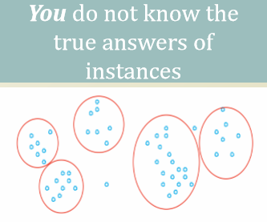
Types of the Spark ML
Machine Learning
Supervised Learning
Unsupervised Learning
Classification, Regression
Clustering, Collaborative filtering

Slide 4
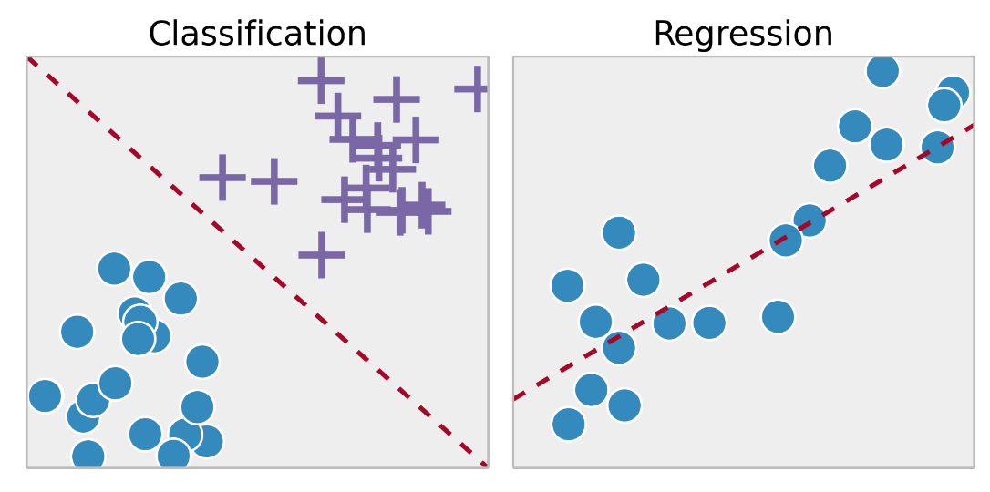
Examples of Supervised learning : Classification and Regression
Classification : You train with images/labels. Then on the future when you give a new image expecting that the computer will recognise the new object
-> Logistic regression, Decision tree classifier, Random forest classifier, Gradient-boosted tree classifier, Multilayer perceptron classifier, One-vs-Rest classifier (a.k.a. One-vs-All), Naive Bayes
Regression : You train the computer with historical market data, and ask the computer to predict the new price on the future
-> Linear regression, Generalized linear regression, Decision tree regression, Random forest regression, Gradient-boosted tree regression, Survival regression, Isotonic regression
Hospital
Stock market

Slide 5
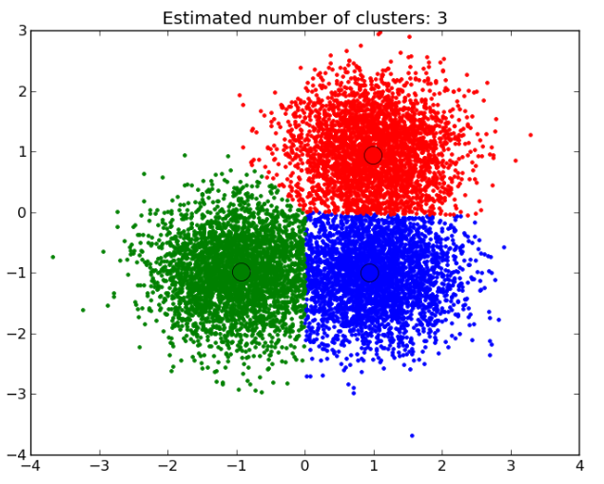
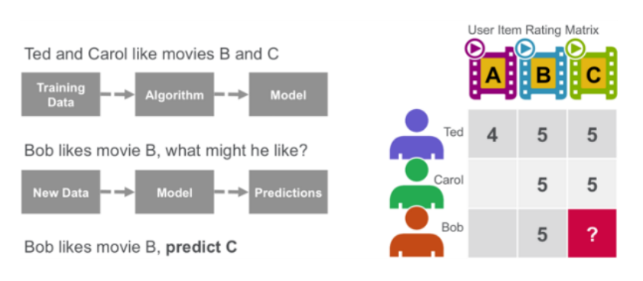
Examples of Unsupervised learning : Clustering and Collaborative filtering
Clustering : You ask the computer to separate similar data on clusters, this is essential in research and science.
-> k-means, gaussian mixture, power iteration clustering(PIC), latent dirichlet allocation(LDA), streaming k-means
Collaborative filtering : Amazon uses a machine learning technique called collaborative filtering (commonly referred to as recommendation), to determine which products users will like based on their history and similarity to other users.
-> alternating least squares (ALS)
Clustering
Collaborative Filtering

Slide 6
Recent Spark MLlib
From Spark 2.0
From Spark 3.0
RDD-based API
DataFrame-based API
Spark 2.1.0
- A DataFrame : A Dataset organized into named columns like RDB
- A Dataset : A Distributed collection of data
Q. Why is MLlib switching to the DataFrame-based API?
1. DataFrames provide a more user-friendly API than RDDs. The many benefits of DataFrames include Tungsten and Catalyst optimizations, and uniform APIs across languages.
2. DataFrames facilitate practical ML Pipelines, particularly feature transformations.
Pipeline : Spark Mllib represents such a workflow as a Pipeline, which consists of a sequence of Pipelinestages to be run in a specific order.
1. Split each document’s text into words
2. Convert each document’s words into a numerical feature vector
3. Learn a prediction model using the feature vectors and labels
4. Predict

Slide 7
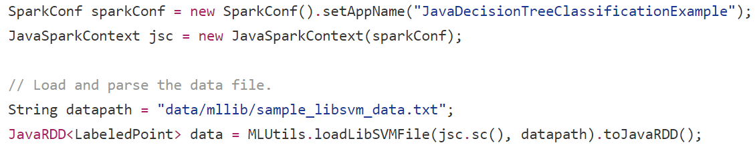
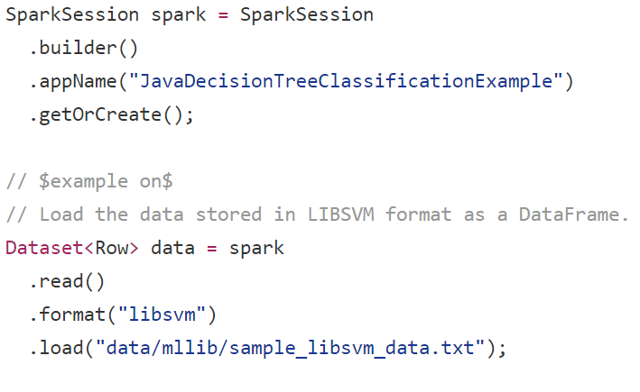
RDD-based API vs Dataframe-based API
RDD-based API
DataFrame-based API
Loading data
Loading data

Slide 8
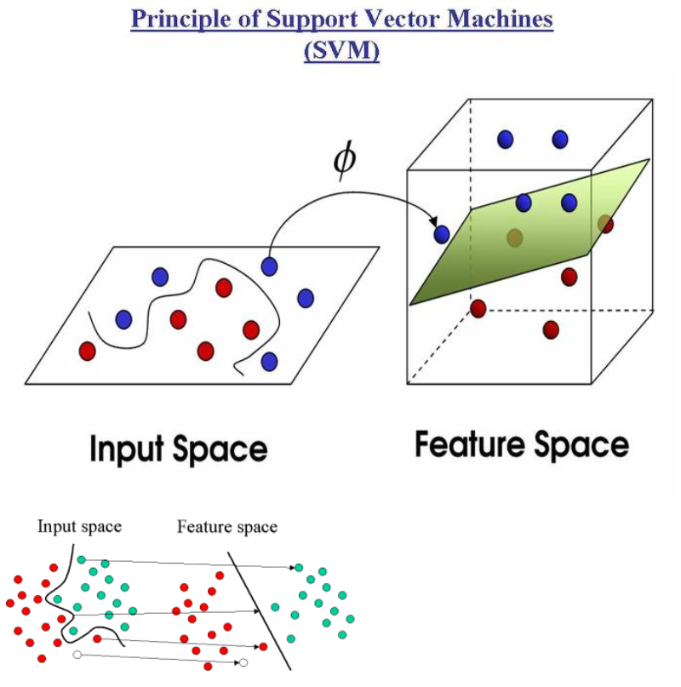
SVM(Support Vector Machines)
Features를 공간상에서 가장 잘 구분할 수 있게 하는 pre-processing

Slide 9
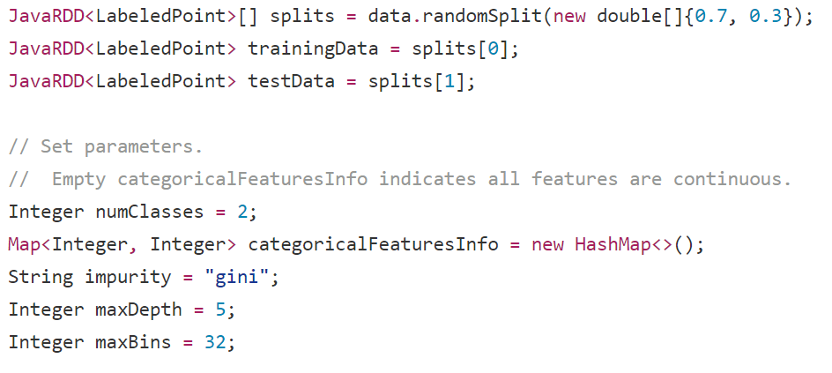
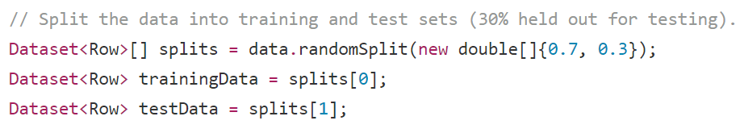
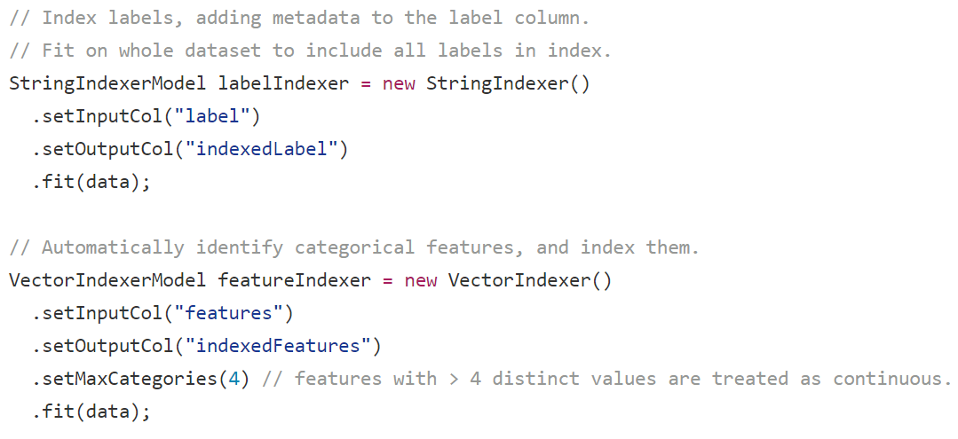
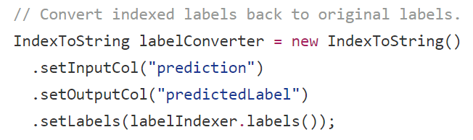
RDD-based API vs Dataframe-based API
RDD-based API
DataFrame-based API
1
data for ML
data for ML
1
Parameters for ML
2
Parameters for ML
2

Slide 10
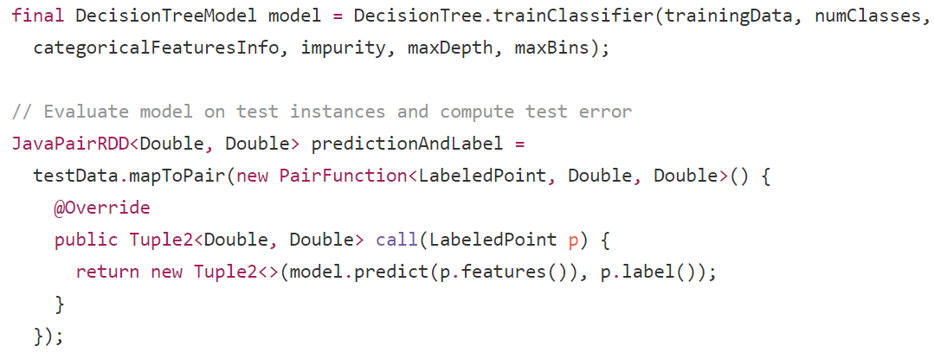
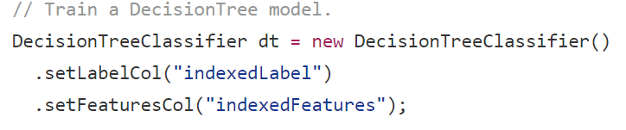
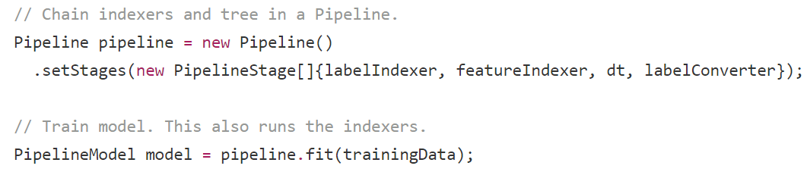
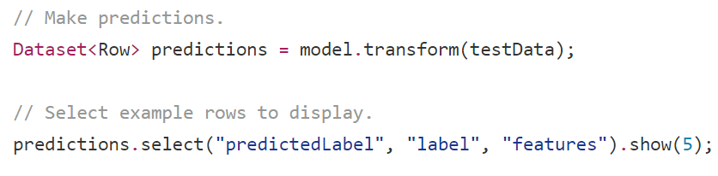

RDD-based API vs Dataframe-based API
RDD-based API
DataFrame-based API
Model
2
1
Algorithm
Algorithm
1
Prediction
3
Model
2
Prediction
3
4
4
Result
Result

Slide 11
Recent Spark Mllib
Pipeline
Extraction, Transformation, Selection …
Popular Algorithms : Multilayer perceptron classifier, ALS
Model selection and tuning : Train-Validation Split

Slide 12
Pipeline
DataFrame: A Dataset is a distributed collection of data. A DataFrame is a Dataset organized into named columns. In Scala and Java, a DataFrame is represented by a Dataset of Rows. It is conceptually equivalent to a table in a relational database.
Transformer: A Transformer is an algorithm which can transform one DataFrame into another DataFrame. E.g., an ML model is a Transformer which transforms a DataFrame with features into a DataFrame with predictions.
Estimator: An Estimator is an algorithm which can be fit on a DataFrame to produce a Transformer. E.g., a learning algorithm(logistic regression) is an Estimator which trains on a DataFrame and produces a model.
Pipeline: A Pipeline chains multiple Transformers and Estimators together to specify an ML workflow.

Slide 13
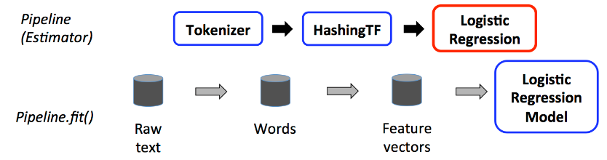
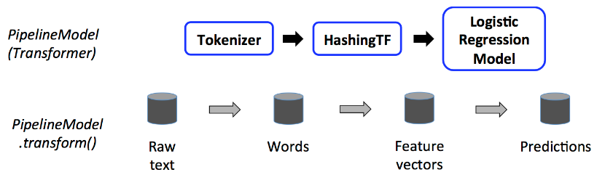
Pipeline
Training time usage of a Pipeline(for the model)
Test time usage of a PipelineModel(for predictions)
Transformer
Transformer
Estimator
Transformer
Transformer
Transformer

Slide 14
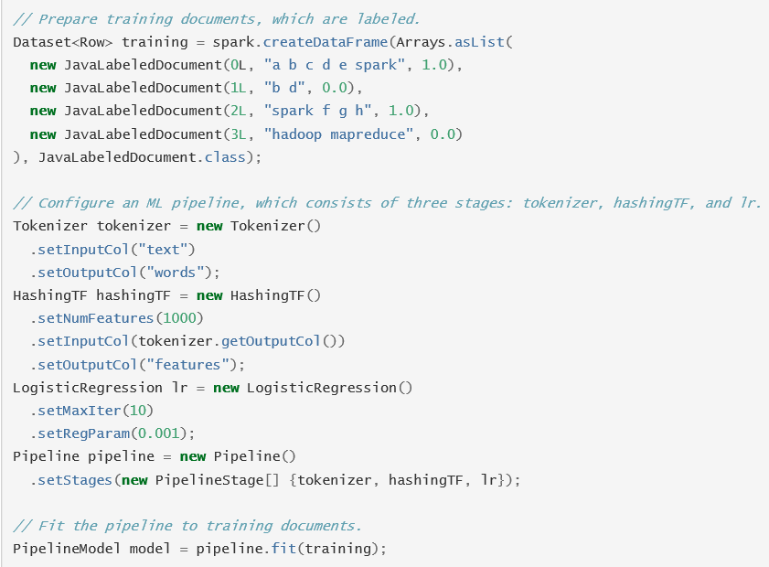
Pipeline
Training time usage of a Pipeline(for the model)
Raw text
Split each document’s text into words
Convert the words into a numerical feature vector

Slide 15
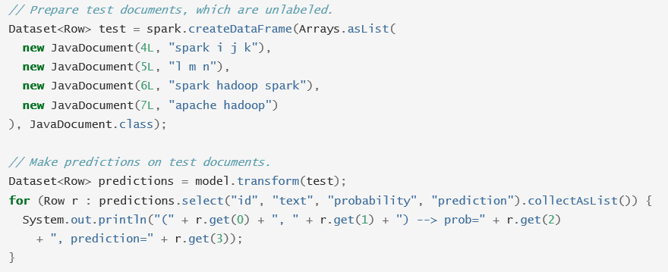
Pipeline
Test time usage of a PipelineModel(for predictions)
Raw text
From pipeline.fit(training data)

Slide 16
Recent Spark Mllib
Pipeline
Extraction, Transformation, Selection
Popular Algorithms : Multilayer perceptron classifier, ALS
Model selection and tuning : Train-Validation Split

Slide 17
Extraction, Transformation, Selection
Extraction : Extracting features from “raw” data
Transformation : Scaling, converting, or modifying features
Selection : Selecting a subset from a larger set of features

Slide 18
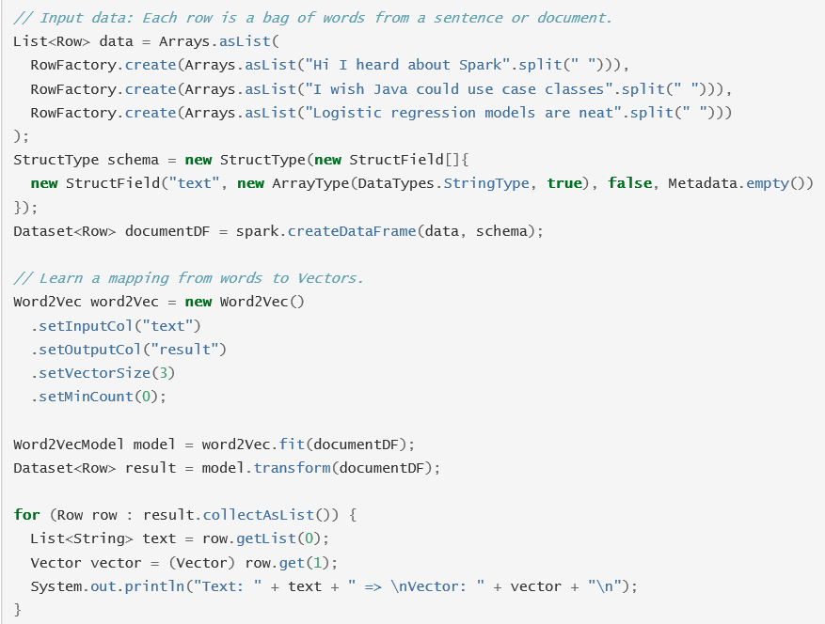
Extraction : Extracting features from “raw” data
Feature extractor : Word2Vec(words -> vectors)
Raw text
These vectors can then be used as features for prediction, etc

Slide 19
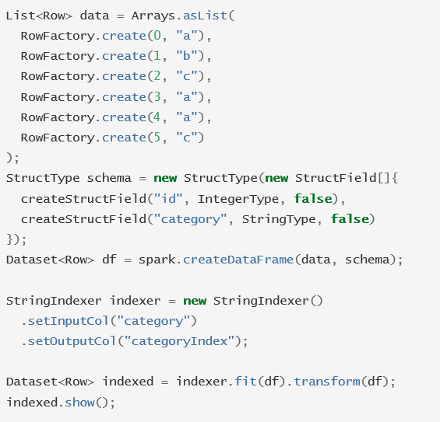
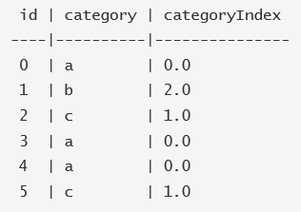
Transformation : Scaling, converting, or modifying features
Feature Transformers : StringIndexer for pipeline process(estimator, transformer)

Slide 20
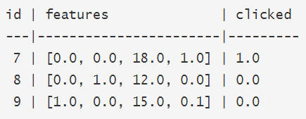
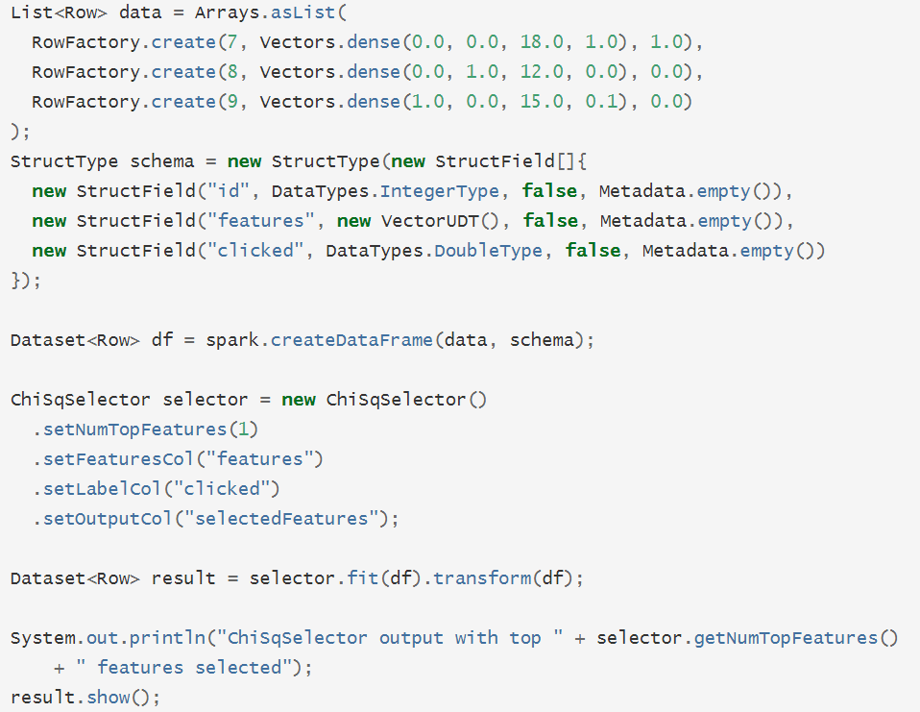
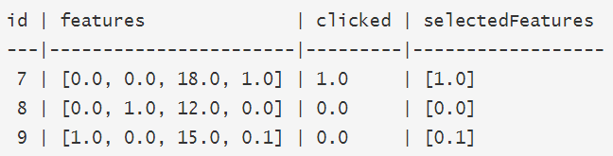
Selection : Selecting a subset from a larger set of features
Feature Selector : ChiSqSelector for the most useful feature

Slide 21
Recent Spark Mllib
Pipeline
Extraction, Transformation, Selection …
Popular Algorithms : Multilayer perceptron classifier, ALS
Model selection and tuning : Train-Validation Split

Slide 22
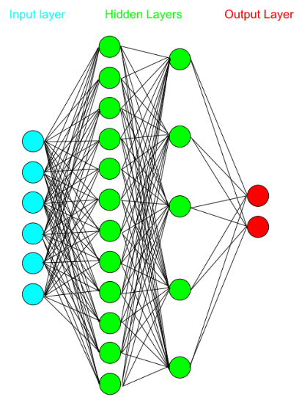
Multilayer perceptron classifier
A multilayer perceptron (MLP) is a feedforward artificial neural network model that maps sets of input data onto a set of appropriate outputs. An MLP consists of multiple layers of nodes in a directed graph, with each layer fully connected to the next one. Except for the input nodes, each node is a neuron (or processing element) with a nonlinear activation function.
MLP utilizes a supervised learning technique called backpropagation for training the network. MLP is a modification of the standard linear perceptron and can distinguish data that are not linearly separable.
Input Layer
Hidden Layer
Output Layer
사용 예 : Speech recognition

Slide 23
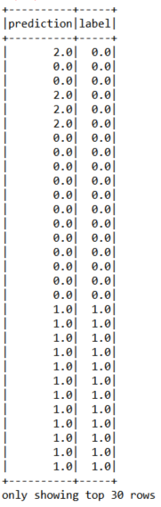
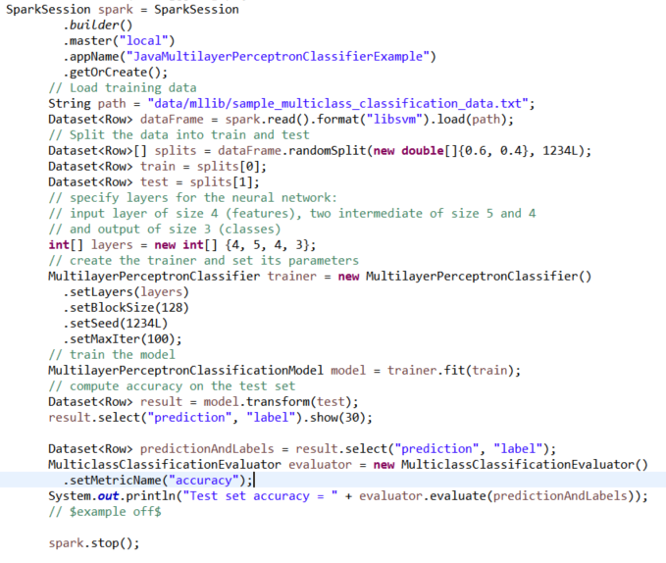
Multilayer perceptron classifier
Raw text
Train and test data
Set layers’ size

Slide 24
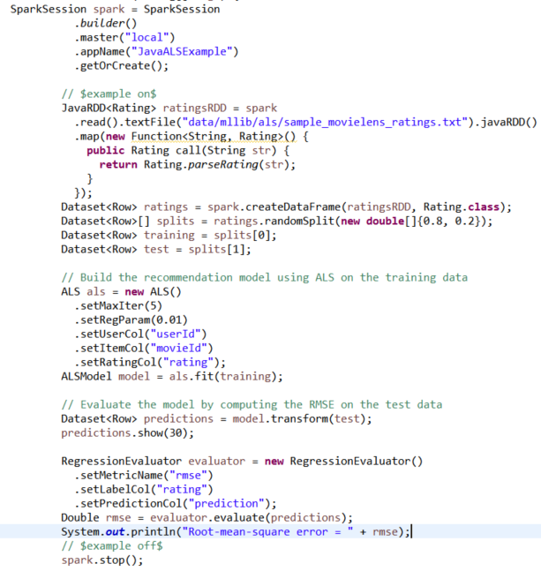

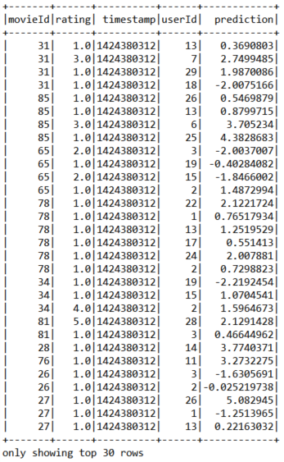
ALS(Alternating Least Squares)

Slide 25
Recent Spark Mllib
Pipeline
Extraction, Transformation, Selection …
Popular Algorithms : Multilayer perceptron classifier, ALS
Model selection and tuning : Train-Validation Split

Slide 26
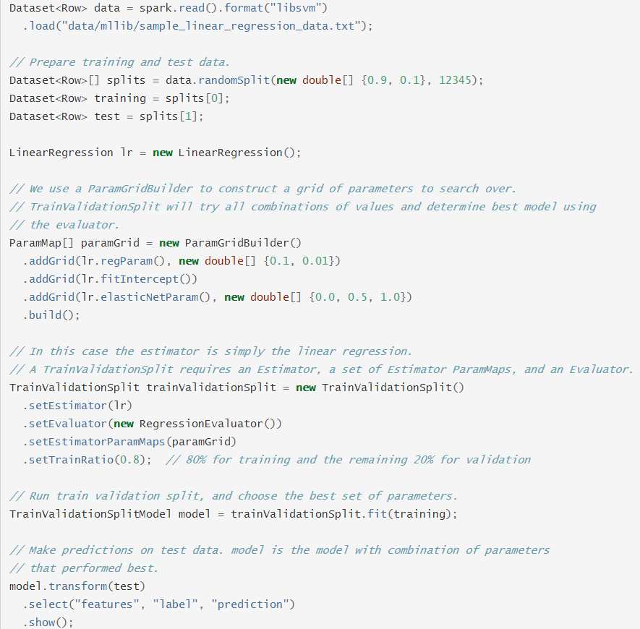
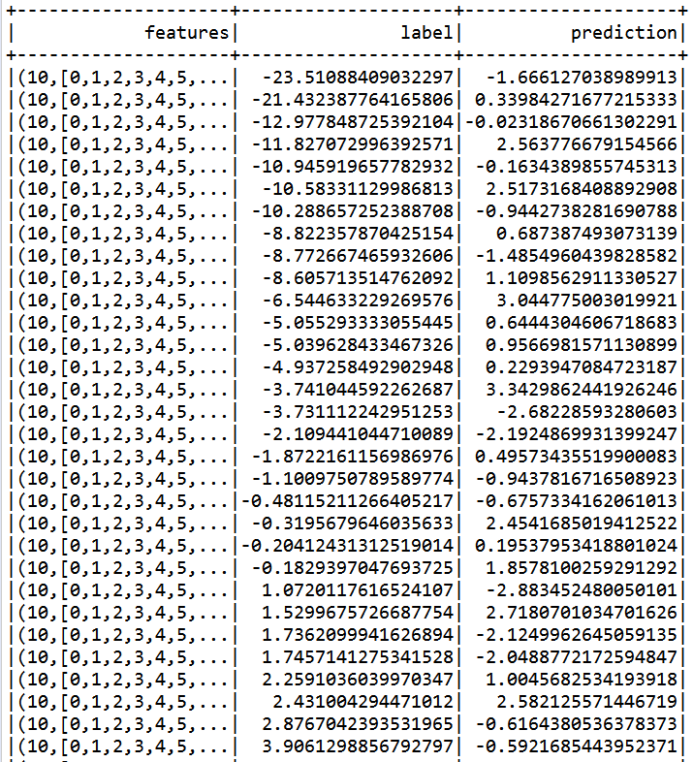
Model selection and tuning
Train-Validation Split

Slide 27

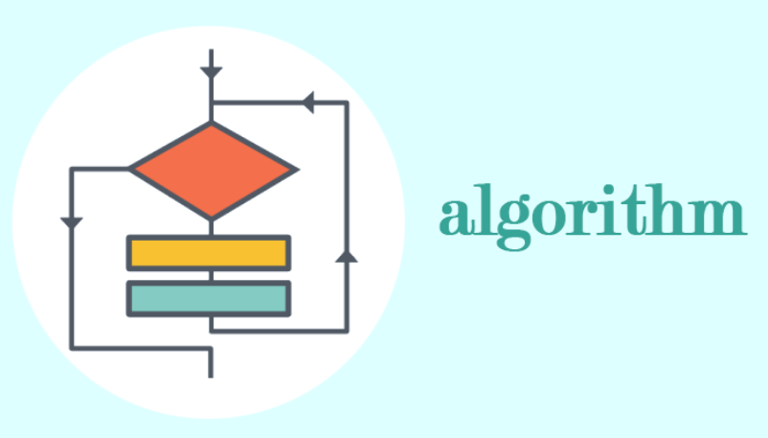
In my opinion
Specific training data & test data & features & label / unsupervised or supervised ?
More important!

Slide 28
Reference
https://github.com/apache/spark - Spark repository
http://spark.apache.org/docs/latest/ml-guide.html - Spark ML
http://jangjy.tistory.com/96 - libsvm

Slide 29
Thank you

