Slide 1
Chapter 13
13.5 Resonant Circuits

Slide 2

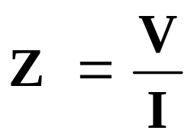

Resonant Circuits
Input = current Response = voltage
Network Function =
In this case =
An RLC circuit with
a sinusoidal input
some frequency
response data

Slide 3
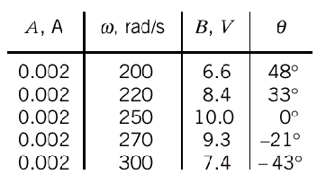
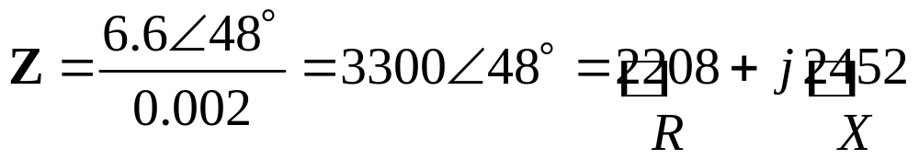


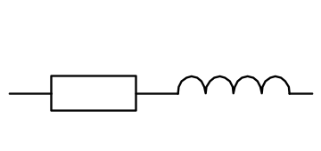

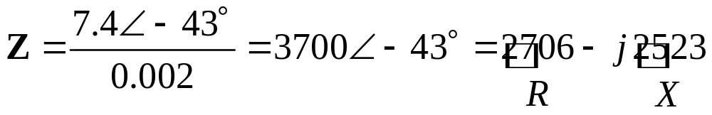
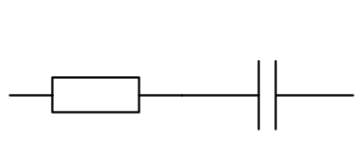

Resonant Circuits
R
L
R
C

Slide 4
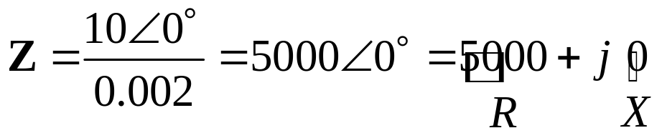
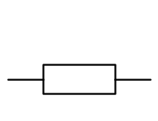
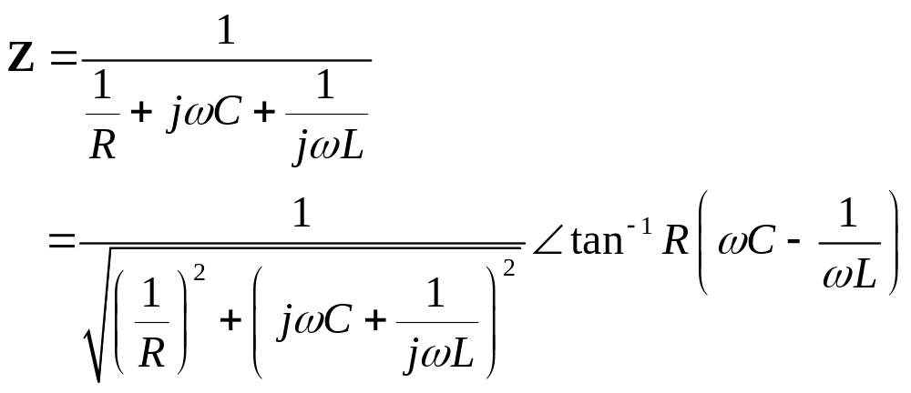
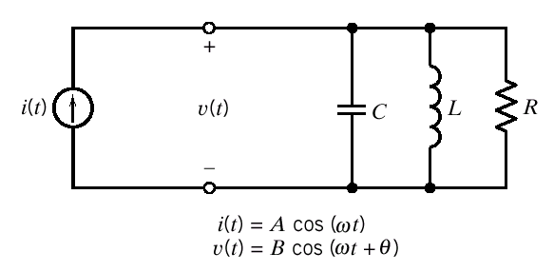
Resonant Circuits
Resonant Frequency
R
The magnitude of the impedance is maximum at this
frequency.
The parallel resonant circuit

Slide 5
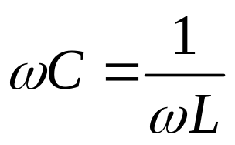
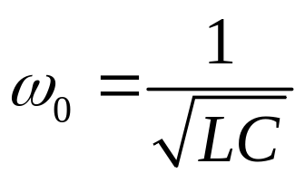
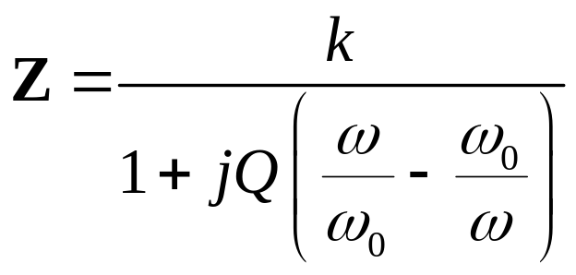
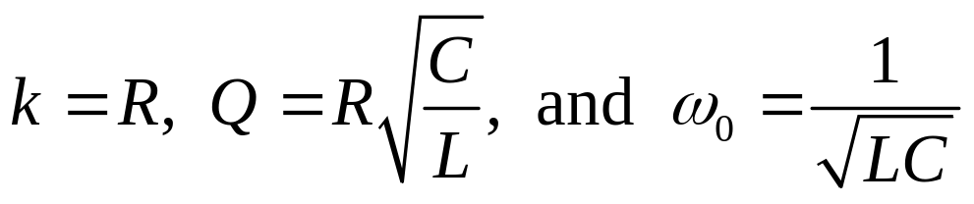
Resonant Circuits
The reactance will be zero when
Or the resonant frequency is
The impedance can be put in the form
where

Slide 6

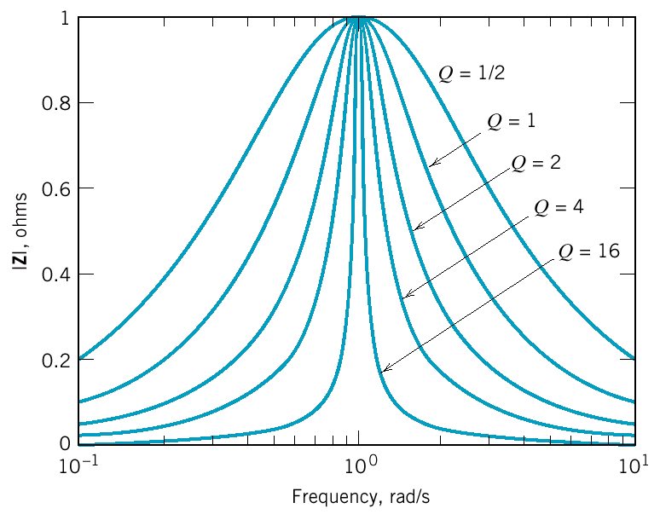
Resonant Circuits
The effect of Q on the frequency response of a resonant circuit

Slide 7
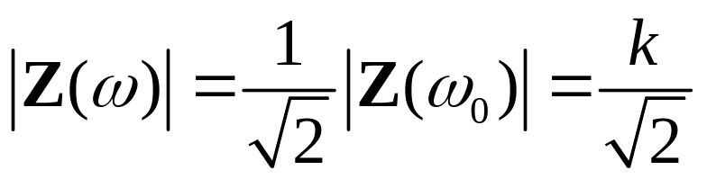

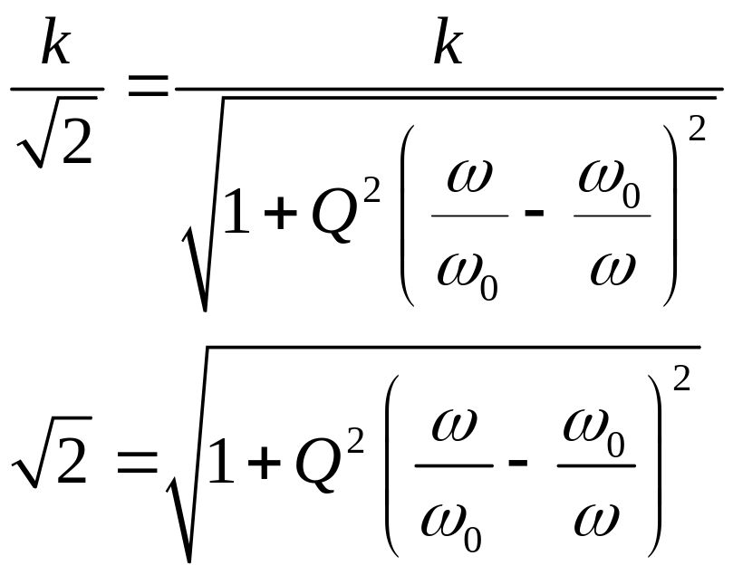
Resonant Circuits
Let ω₁ and ω₂ denote the frequencies where
We define bandwidth, BW
Find ω₁ and ω₂

Slide 8
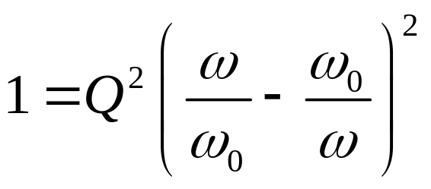
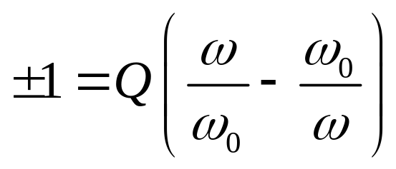
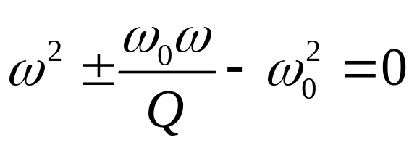
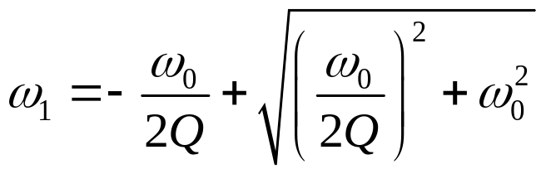
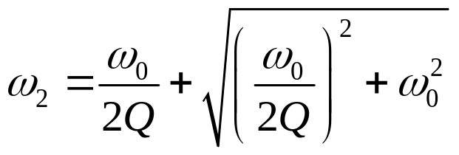
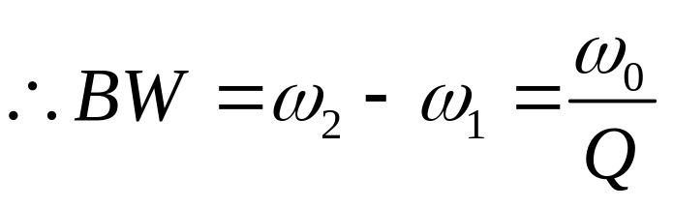
Resonant Circuits
Squaring both sides
Taking Square root of both sides
Rearranging
The positive solutions are
and

Slide 9
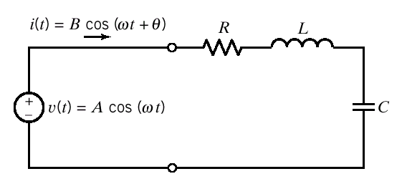
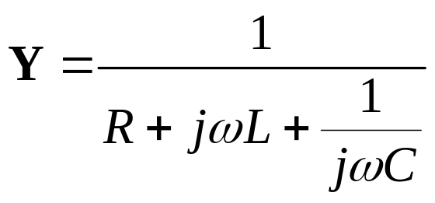
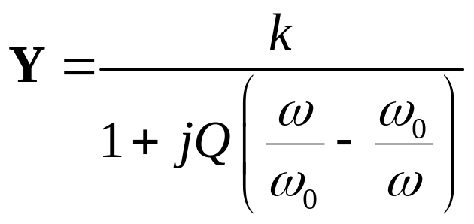
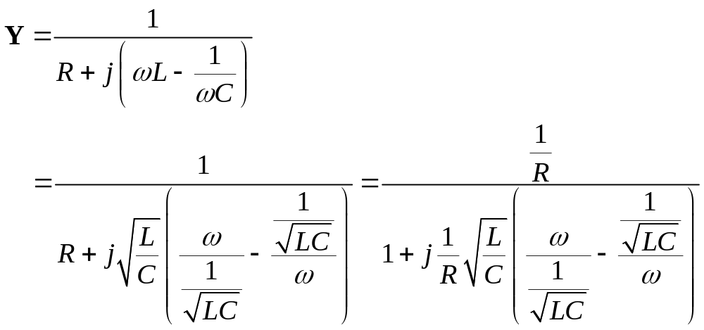
Example 13.5-1 Relationship = ?
The series resonant circuit

Slide 10
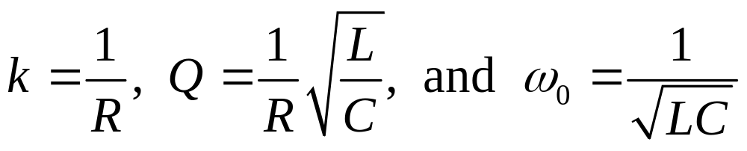
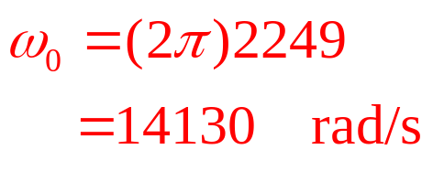
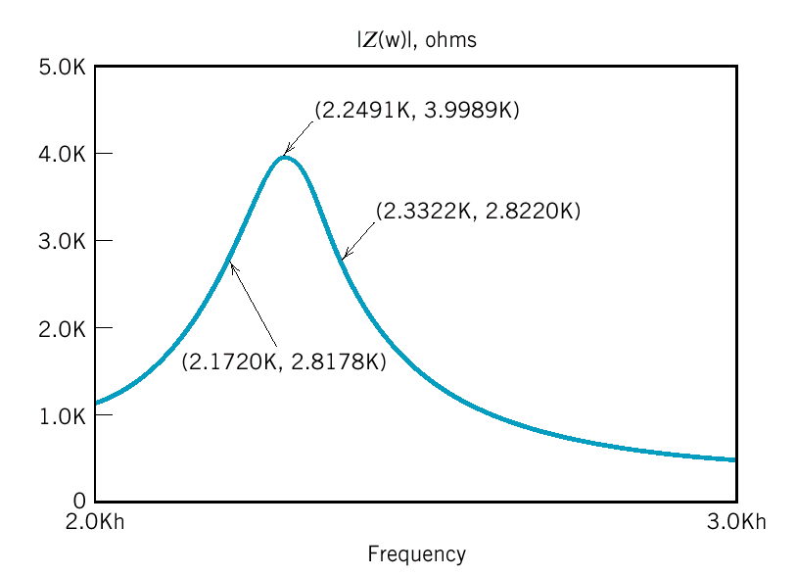

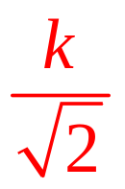
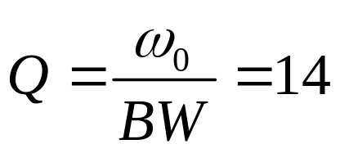
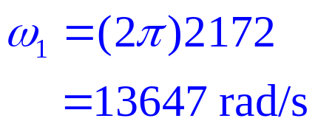
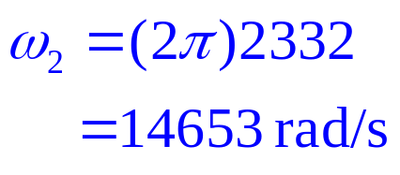

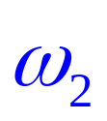
Example 13.5-1(cont.)
Example 13.5-2 k, Q, ω₀ = ?
The magnitude frequency response of a resonant circuit

Slide 11
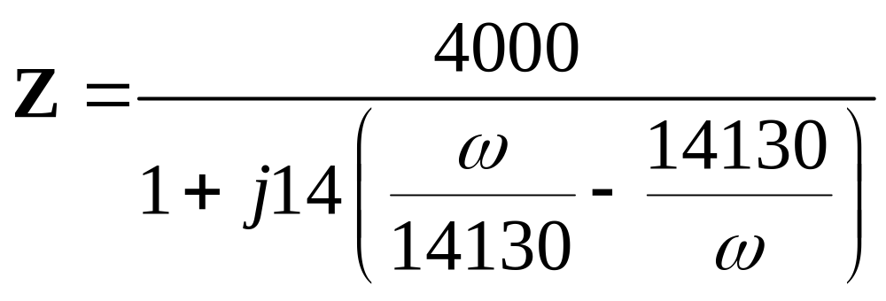
Example 13.5-2(cont.)
When the parameters k, Q, ω₀ are known, the network function can be express as
k
Q
ω₀

Slide 12
Summary
Parallel resonant circuits
Series resonant circuits

