Slide 1
Chapter 15
Fourier Series and Fourier Transform
15.3 - 15.8

Slide 2


The Fourier Series
I/P
Linear Circuit
O/P
Sinusoidal Inputs
OK
Nonsinusoidal Inputs
Nonsinusoidal Inputs
Sinusoidal Inputs
Fourier Series

Slide 3
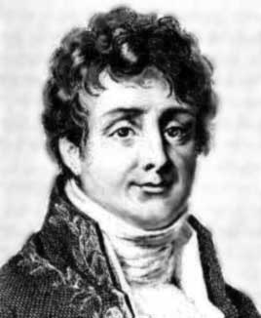
The Fourier Series
Joseph Fourier
1768 to 1830
Fourier studied the mathematical theory of heat
conduction. He established the partial differential
equation governing heat diffusion and solved it by
using infinite series of trigonometric functions.

Slide 4
The Fourier Series
Fourier proposed in 1807
A periodic waveform f(t) could be broken down into an
infinite series of simple sinusoids which, when added
together, would construct the exact form of the original
waveform.
Consider the periodic function
T = Period, the smallest value of T that satisfies the above
Equation.

Slide 5
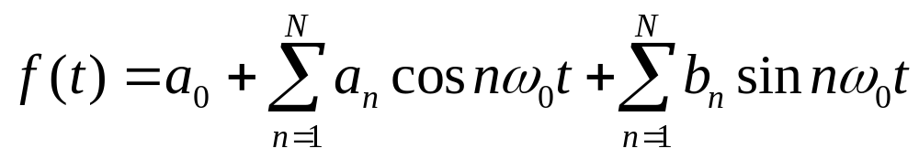
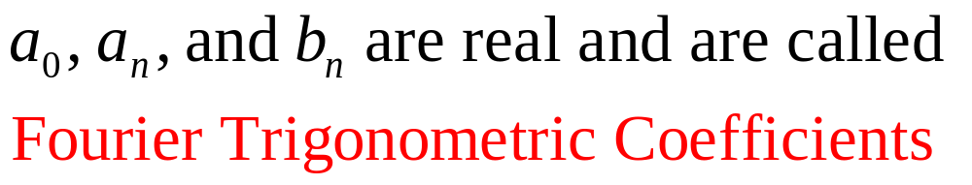
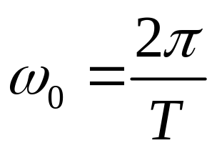
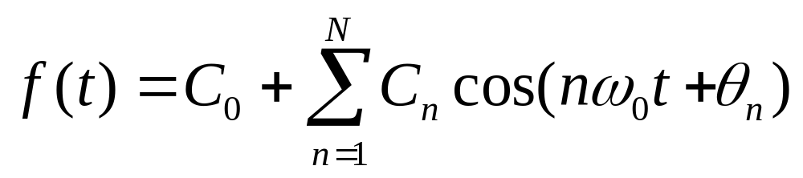
The Fourier Series
The expression for a Fourier Series is
and
Or, alternative form
Fourier Series = a finite sum of harmonically related sinusoids

Slide 6
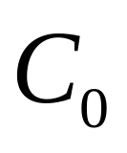
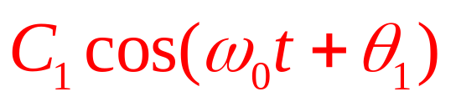
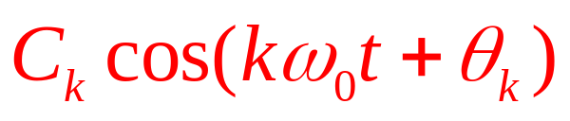
The Fourier Series
is the average (or DC) value of f(t)
For n = 1 the corresponding sinusoid
is called the fundamental
For n = k the corresponding sinusoid
is called the k^{th} harmonic term
Similarly, ω₀ is call the fundamental frequency
kω₀ is called the k^{th} harmonic frequency

Slide 7

The Fourier Series
Definition
A Fourier Series is an accurate representation of a
periodic signal and consists of the sum of sinusoids at
the fundamental and harmonic frequencies.
The waveform f(t) depends on the amplitude and phase
of every harmonic components, and we can generate any
non-sinusoidal waveform by an appropriate combination
of sinusoidal functions.
http://archives.math.utk.edu/topics/fourierAnalysis.html

Slide 8
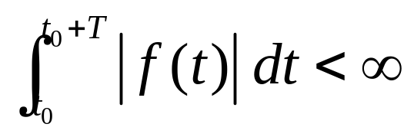
The Fourier Series
To be described by the Fourier Series the waveform f(t)
must satisfy the following mathematical properties:
1. f(t) is a single-value function except at possibly a finite number of points.
2. The integral for any t₀.
3. f(t) has a finite number of discontinuities within the period T.
4. f(t) has a finite number of maxima and minima within the period T.
In practice, f(t) = v(t) or i(t) so the above 4 conditions are
always satisfied.

Slide 9
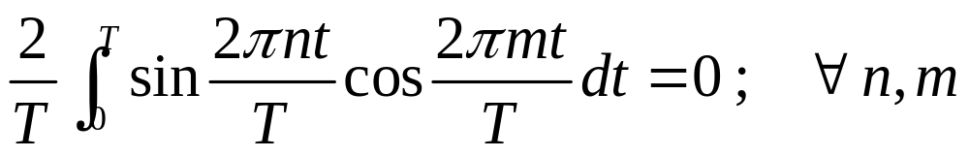
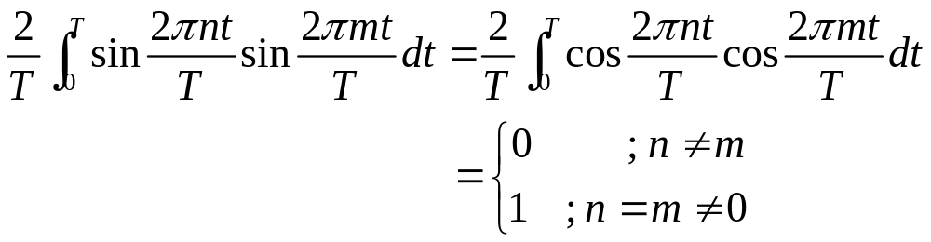
The Fourier Series
Recall from calculus that sinusoids whose frequencies are
integer multiples of some fundamental frequency f₀ = 1/T
form an orthogonal set of functions.
and

Slide 10
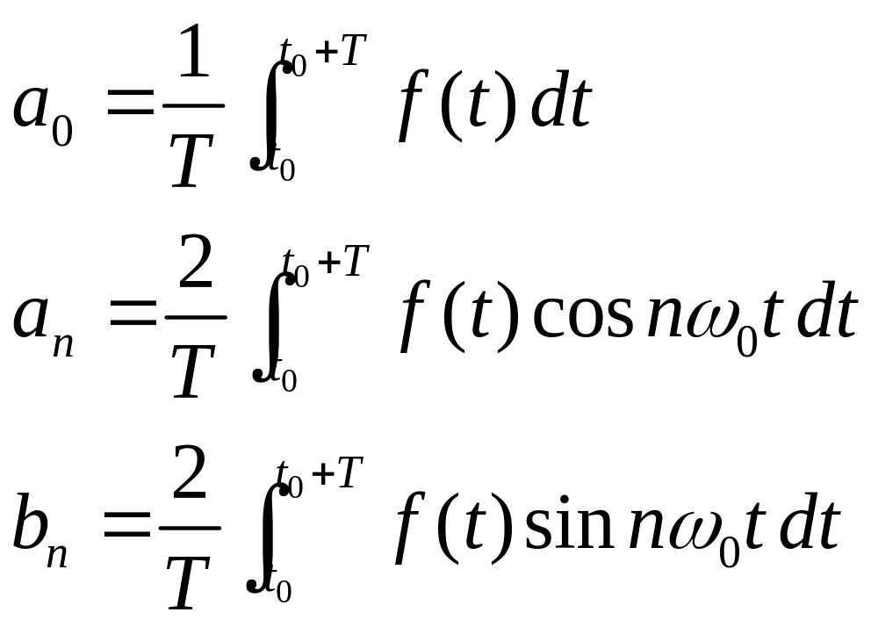
The Fourier Series
The Fourier Trigonometric Coefficients can be obtained
from
average value over one period
n > 0
n > 0

Slide 11
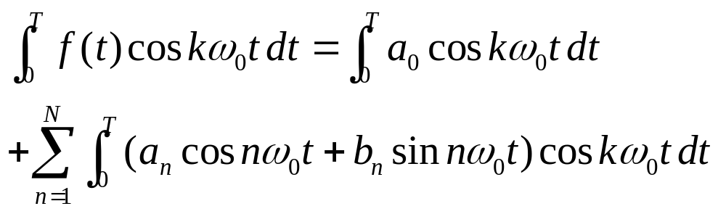
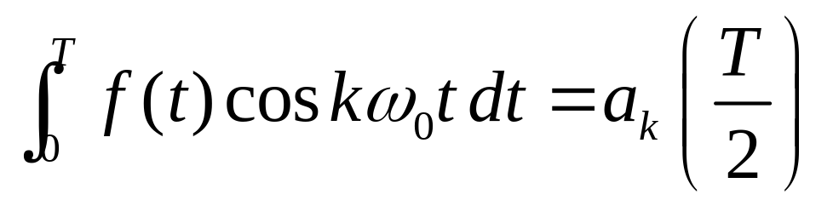
The Fourier Series
To obtain a_{k}
The only nonzero term is for n = k
Similar approach can be used to obtain b_{k}

Slide 12
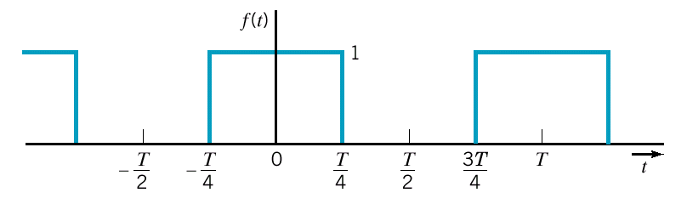
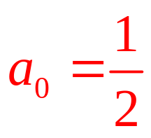
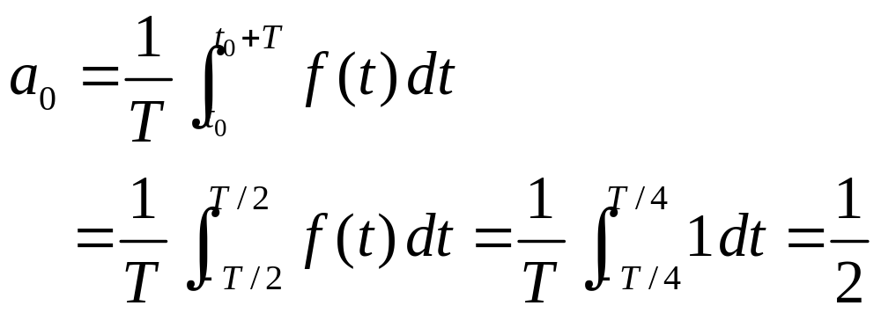
Example 15.3-1 determine Fourier Series and plot for N = 7
average or DC value

Slide 13
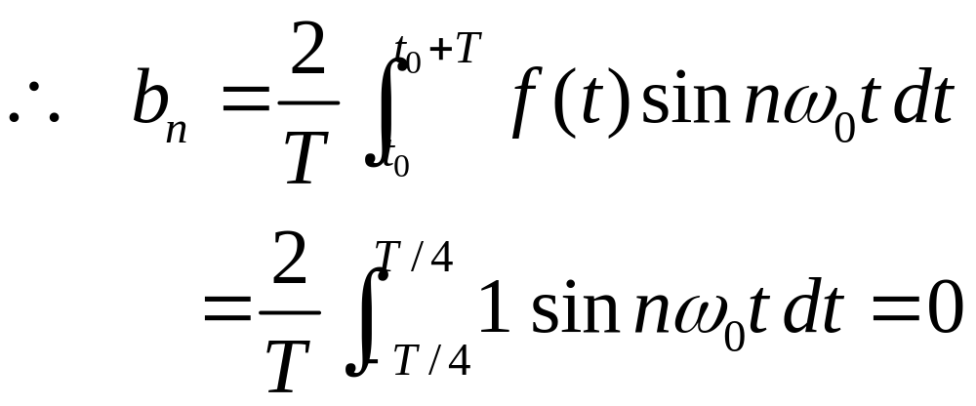
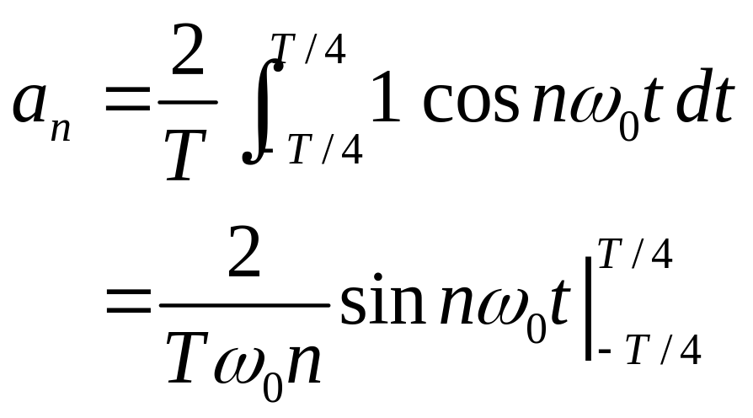
Example 15.3-1(cont.)
An even function exhibits symmetry around the vertical axis
at t = 0 so that f(t) = f(-t).
Determine only a_{n}

Slide 14
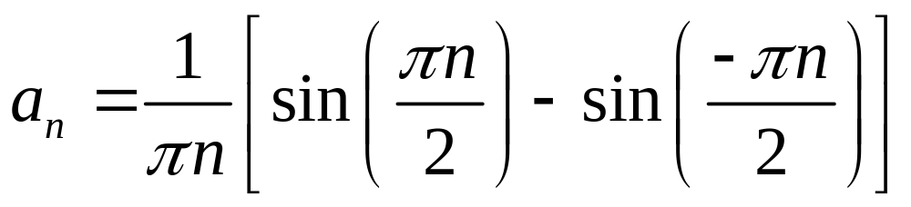
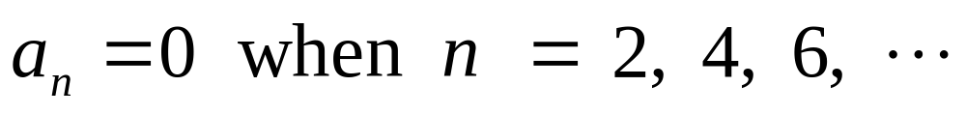
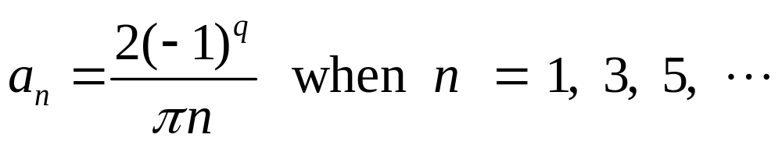
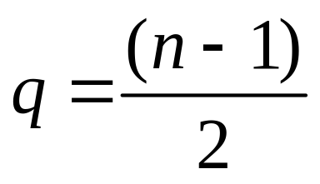
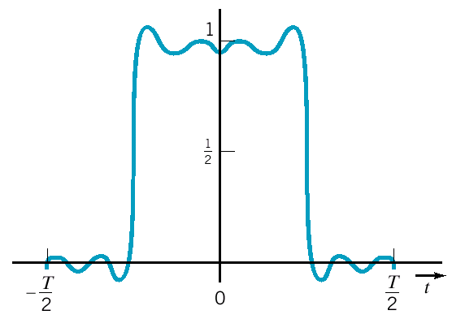
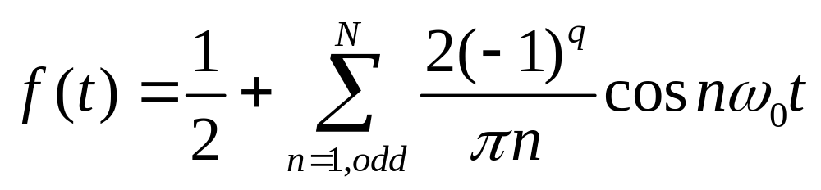
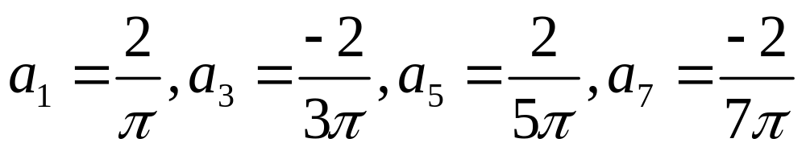
Example 15.3-1(cont.)
and
where

Slide 15
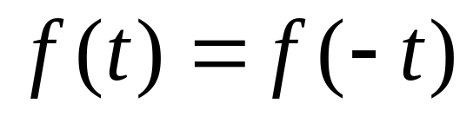
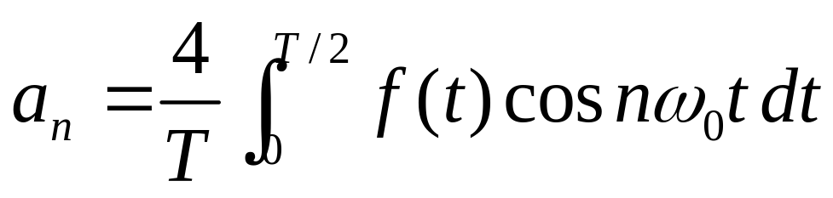
Symmetry of the Function
Four types
Even-function symmetry
Odd-function symmetry
Half-wave symmetry
Quarter-wave symmetry
Even function
All b_{n} = 0

Slide 16
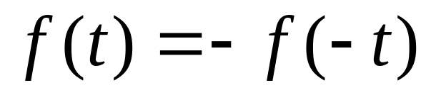
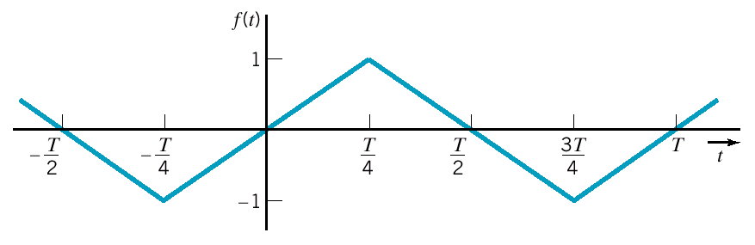
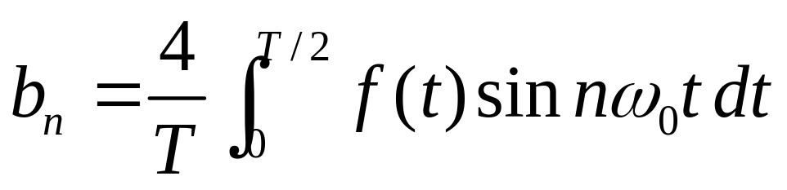
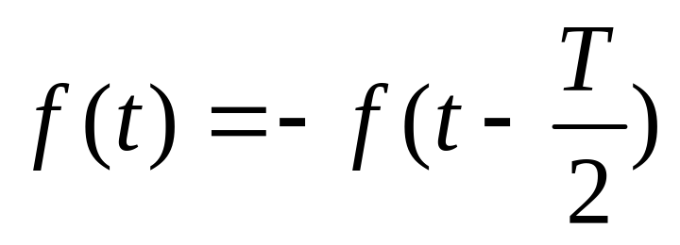
Symmetry of the Function
Odd function
All a_{n} = 0
Half-wave symmetry
a_{n} and b_{n} = 0 for even values of n and a₀ = 0

Slide 17
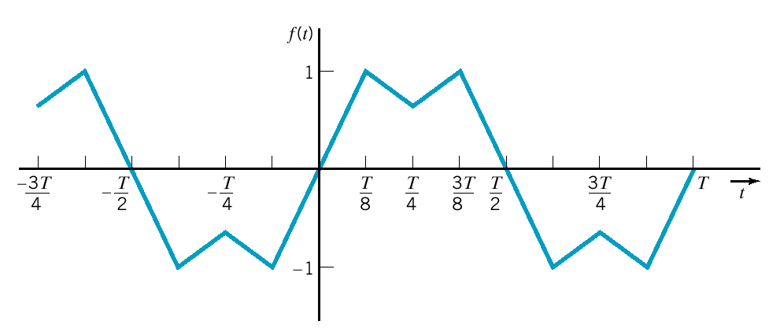
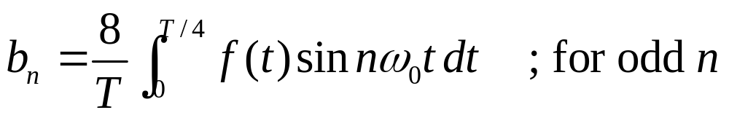
Symmetry of the Function
Quarter-wave symmetry
Odd & Quarter-wave
All a_{n} = 0 and b_{n} = 0 for even values of n and a₀ = 0

Slide 18
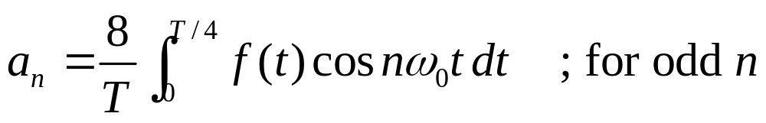
Symmetry of the Function
For Even & Quarter-wave
All b_{n} = 0 and a_{n} = 0 for even values of n and a₀ = 0
Table 15.4-1 gives a summary of Fourier coefficients
and symmetry.

Slide 19
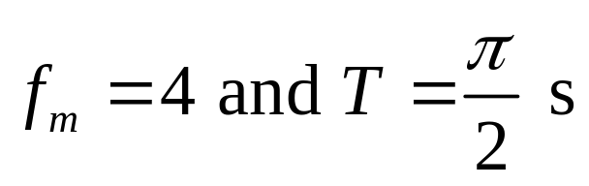
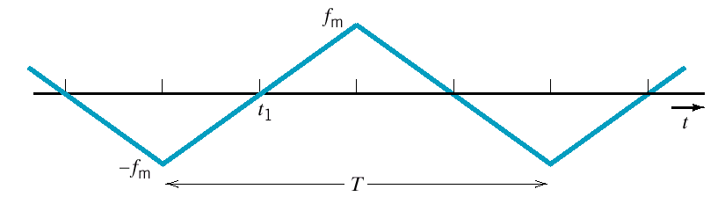
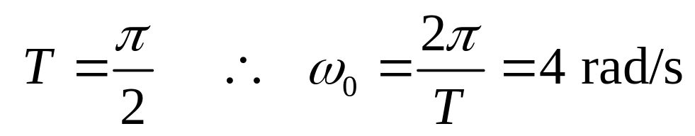

Example 15.4-1 determine Fourier Series and N = ?
0
To obtain the most advantages form of symmetry,
we choose t₁ = 0 s
Odd & Quarter-wave
All a_{n} = 0 and b_{n} = 0 for even values of n and a₀ = 0

Slide 20

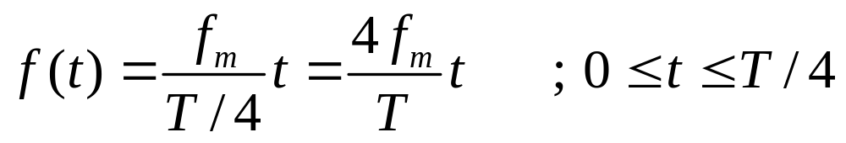

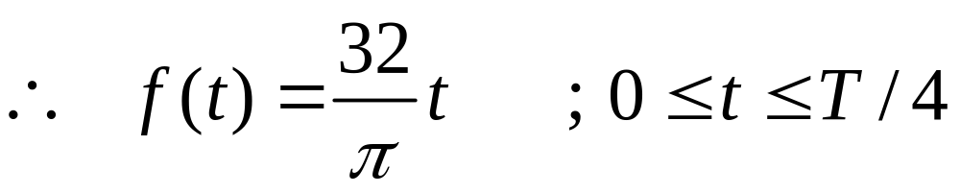
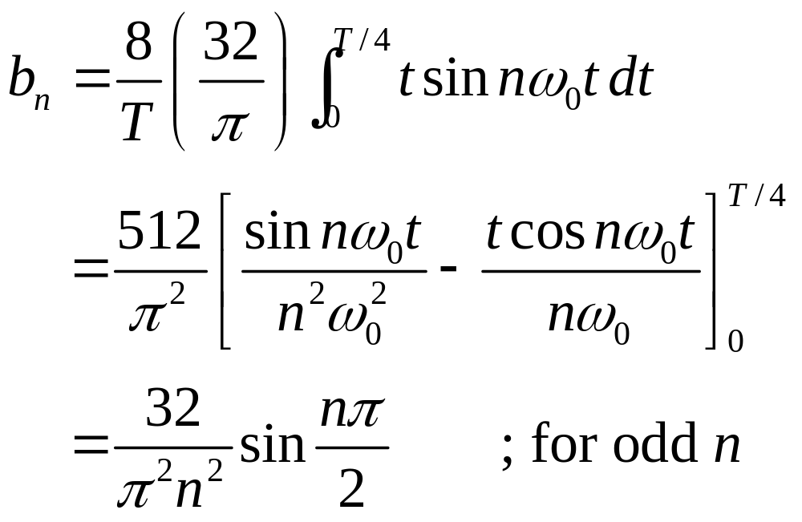
Example 15.4-1(cont.)

Slide 21
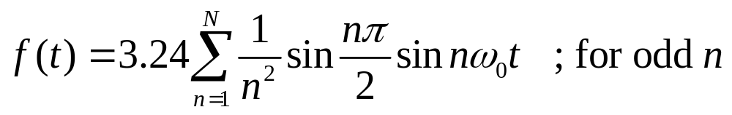
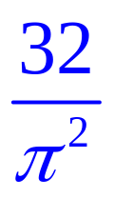
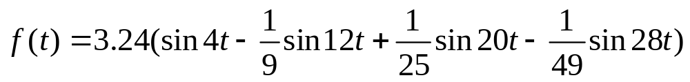
Example 15.4-1(cont.)
The Fourier Series is
The first 4 terms (upto and including N = 7)
Next harmonic is for N = 9 which has magnitude
3.24/81 = 0.04 < 2 % of b₁ ( = 3.24)
Therefore the first 4 terms (including N = 7) is enough for
the desired approximation

Slide 22
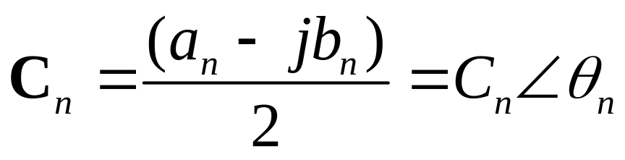
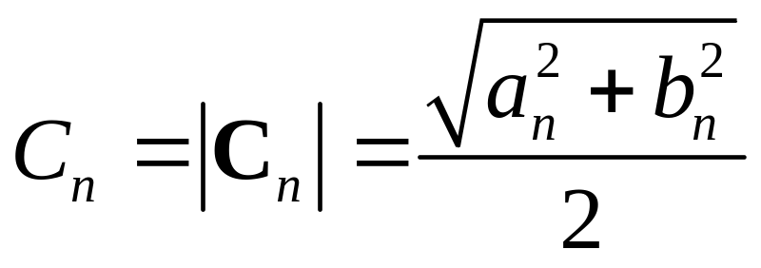
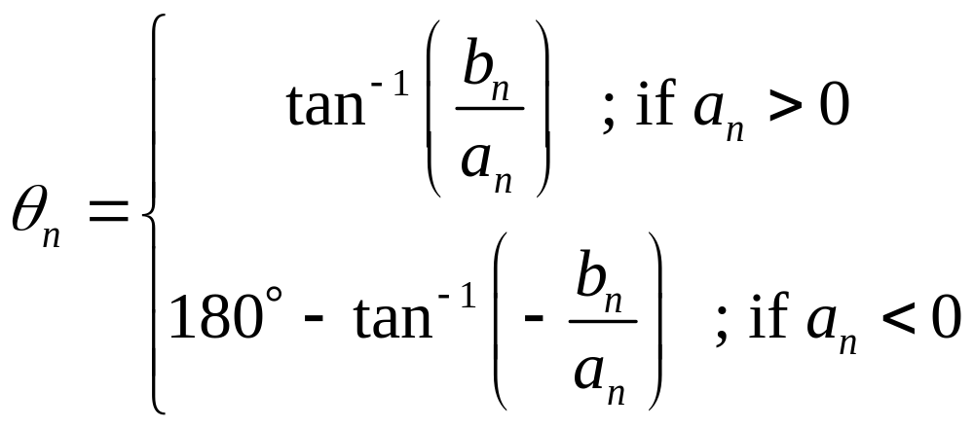
Exponential Form of the Fourier Series
is the average (or DC) value of f(t) and
where
and

Slide 23
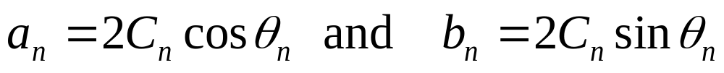
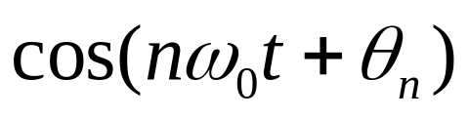

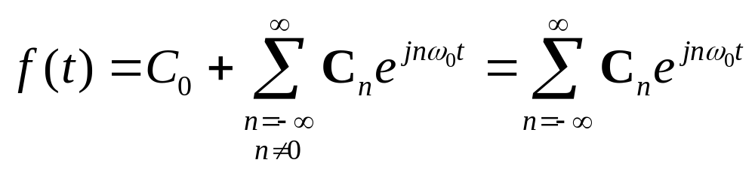


Exponential Form of the Fourier Series
or
Writing in exponential form using
Euler’s identity with
where the complex coefficients are defined as
And ; the coefficients for negative n are the
complex conjugates of the coefficients for positive n

Slide 24





Example 15.5-1 determine complex Fourier Series
Even function
The average value of f(t) is zero
We select and define

Slide 25

Example 15.5-1(cont.)

Slide 26



Example 15.5-1(cont.)
Since f(t) is even function, all C_{n} are real and = 0 for n even
For n = 1
For n = 2
For n = 3

Slide 27




Example 15.5-1(cont.)
The complex Fourier Series is
where
For real f(t)

Slide 28


Example 15.5-2 determine complex Fourier Series
Even function
Use

Slide 29


Example 15.5-2(cont.)
To find C₀

Slide 30




The Fourier Spectrum
The complex Fourier coefficients
Amplitude spectrum
Phase spectrum

Slide 31

The Fourier Spectrum
The Fourier Spectrum is a graphical display of the
amplitude and phase of the complex Fourier coeff.
at the fundamental and harmonic frequencies.
Example
A periodic sequence of pulses each of width δ

Slide 32



The Fourier Spectrum
The Fourier coefficients are
For

Slide 33




The Fourier Spectrum
where
For

Slide 34






The Fourier Spectrum

Slide 35



The Truncated Fourier Series
A practical calculation of the Fourier series requires that
we truncate the series to a finite number of terms.
The error for N terms is
We use the mean-square error (MSE) defined as
MSE is minimum when C_{n} = Fourier series’ coefficients

Slide 36


The Truncated Fourier Series
overshoot

Slide 37


Circuits and Fourier Series
It is often desired to determine the response of a circuit
excited by a periodic signal v_{S}(t).
Example 15.8-1 An RC Circuit v_{O}(t) = ?
Example 15.3-1
An RC circuit excited by a periodic voltage v_{S}(t).

Slide 38

Circuits and Fourier Series
Each voltage source
is a term of the
Fourier series of v_{s}(f).
An equivalent circuit.

Slide 39


Example 15.8-1
(cont.)
Each
input
is a
Sinusoid.
Using
phasors
to find
steady-state
responses
to the
sinusoids.

Slide 40




Example 15.8-1 (cont.)
where
The first 4 terms of v_{S}(t) is
The steady state response v_{O}(t) can then be found using
superposition.

Slide 41


Example 15.8-1 (cont.)
The impedance of the capacitor is
We can find

Slide 42


Example 15.8-1 (cont.)
The steady-state response can be written as
In this example we have

Slide 43



Example 15.8-1 (cont.)

Slide 44
Summary
The Fourier Series
Symmetry of the Function
Exponential Form of the Fourier Series
The Fourier Spectrum
The Truncated Fourier Series
Circuits and Fourier Series

