Slide 1
Using HLS IP in IP integrator fft – use block to integrate IP
107061107 周沛毅

Slide 2
Outline
Introduction of Algorithm and System
Explanation of HLS Codes
Performance Analysis
Discussion

Slide 3
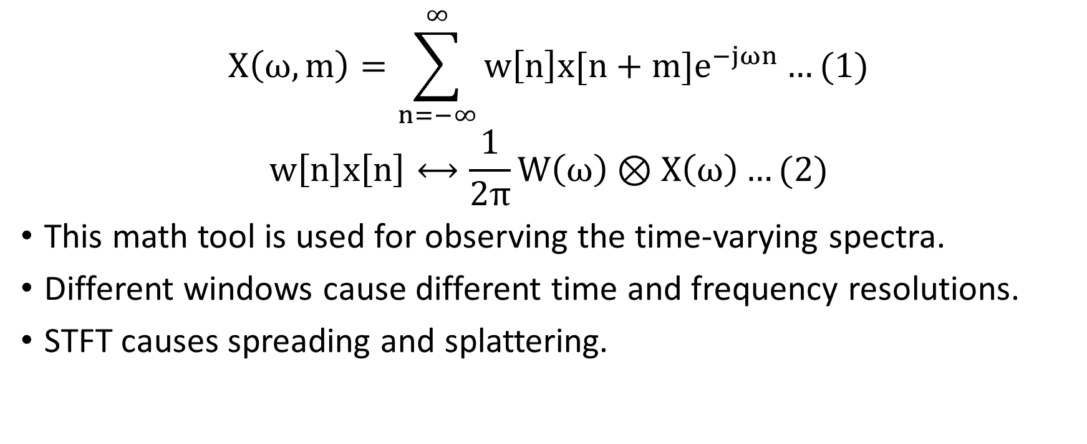
Short-Time Fourier Transform
$$X\left(ω,m\right)=\sum_{n=−∞}^{∞}{w\left[n\right]x[n+m]e^{−jωn}}…(1)$$
$$w\left[n\right]x\left[n\right]⟷\frac{1}{2π}W\left(ω\right)⊗X\left(ω\right)…(2)$$
This math tool is used for observing the time-varying spectra.
Different windows cause different time and frequency resolutions.
STFT causes spreading and splattering.

Slide 4
Window
We adopt Hamming window in this lab, whose window size is 1024.

Slide 5
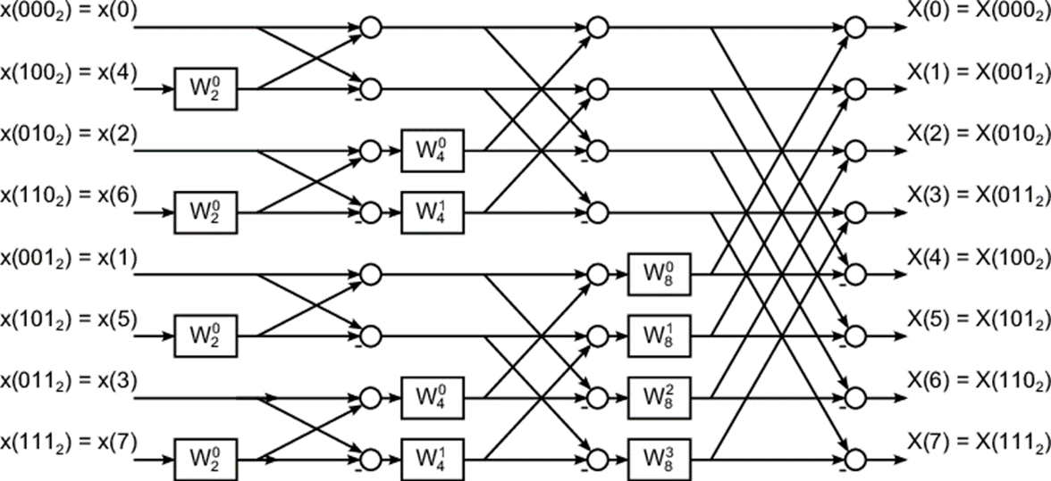

Fast Fourier Transform
$$\left\{\begin{aligned}\left[\begin{matrix}X[0] \\ \begin{matrix}X[1] \\ ⋮ \\ X[\frac{N}{2}−1]\end{matrix}\end{matrix}\right]=\left[\begin{matrix}Y[0] \\ \begin{matrix}Y[1] \\ ⋮ \\ Y[\frac{N}{2}−1]\end{matrix}\end{matrix}\right]+\left[\begin{matrix}1 & e^{−j\frac{2π}{N}×1} & \begin{matrix}… & e^{−j\frac{2π}{N}×(\frac{N}{2}−1)}\end{matrix}\end{matrix}\right]\left[\begin{matrix}Z[0] \\ \begin{matrix}Z[1] \\ ⋮ \\ Z[\frac{N}{2}−1]\end{matrix}\end{matrix}\right] \\ \left[\begin{matrix}X[\frac{N}{2}] \\ X[\frac{N}{2}+1] \\ \begin{matrix}⋮ \\ X[N−1]\end{matrix}\end{matrix}\right]=\left[\begin{matrix}Y[0] \\ \begin{matrix}Y[1] \\ ⋮ \\ Y[\frac{N}{2}−1]\end{matrix}\end{matrix}\right]−\left[\begin{matrix}1 & e^{−j\frac{2π}{N}×1} & \begin{matrix}… & e^{−j\frac{2π}{N}×(\frac{N}{2}−1)}\end{matrix}\end{matrix}\right]\left[\begin{matrix}Z[0] \\ \begin{matrix}Z[1] \\ ⋮ \\ Z[\frac{N}{2}−1]\end{matrix}\end{matrix}\right]\end{aligned}\right.…(3)$$
Twiddle factor
+/-
Bit-reverse
Notes:
<提點重點>
1.Twiddle factor
2.+/-
3.Bit-reverse

Slide 6
System Architecture

Slide 7
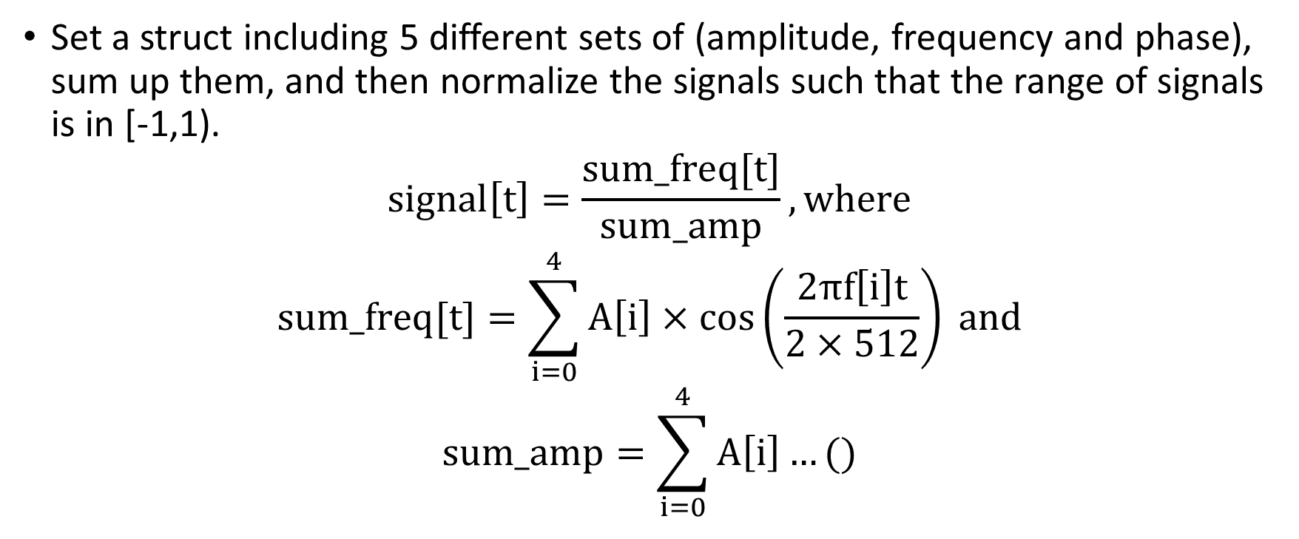
Generate Signals
Set a struct including 5 different sets of (amplitude, frequency and phase), sum up them, and then normalize the signals such that the range of signals is in [-1,1).
$$signal\left[t\right]=\frac{sum_freq[t]}{sum_amp}, where$$
$$sum_freq[t]=\sum_{i=0}^{4}{A\left[i\right]×\cos\left(\frac{2πf\left[i\right]t}{2×512}\right)} and$$
$$sum_amp=\sum_{i=0}^{4}{A\left[i\right]…()}$$

Slide 8
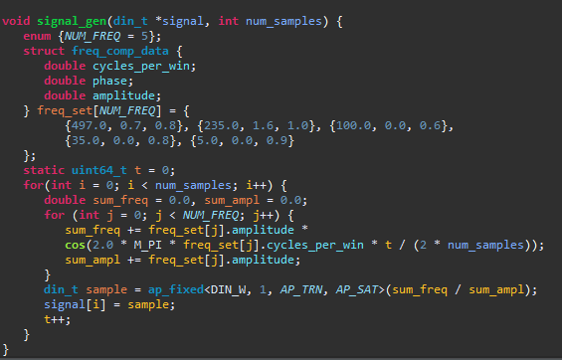

Slide 9
FFT in HLS Testbench

