Slide 2
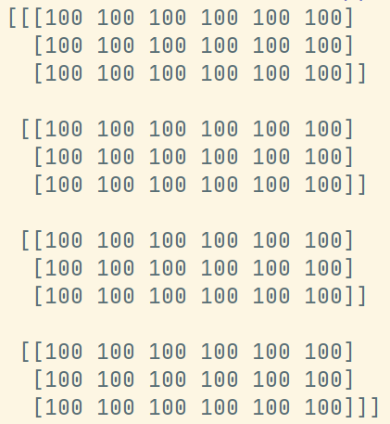
[2, 3, 4, None, None, None], [None, 3, None, 2, 4, None], [1, 4, 5, None, None, None] [3, None, 5, None, 2, None], [4, 3, None, 6, None, None], [None, None, 4, None, 7, 11] [5, 6, None, None, None, None], [None, 4, None, 3, 5, None], [None, None, 13, None, 9, 12]
[9, None, 7, 9, None, None], [None, 6, None, 4, None, 5], [1, None, 3, None, None, 3]
Lot1 lot2 lot3 lot4
Available EQP
100 | 100 | 100 | 100
100 | 100 | 100 | 100
100 | 100 | 100 | 100
100 | 100 | 100 | 100
100 | 100 | 100 | 100
100 | 100 | 100 | 100
100 | 100 | 100 | 100
100 | 100 | 100 | 100
100 | 100 | 100 | 100
100 | 100 | 100 | 100
100 | 100 | 100 | 100
100 | 100 | 100 | 100
1 2 3
1 3 4
1 2
1 3 5
2 4 5
2 4 5
2 4 6
1 2 3
1 2 4
1 3 6
3 5 6
3 5 6
12道工序
6
1
2
3
4
5
每列需要出现三次
工序list
各 矩 阵 对 应 关 系 ？

