Slide 1
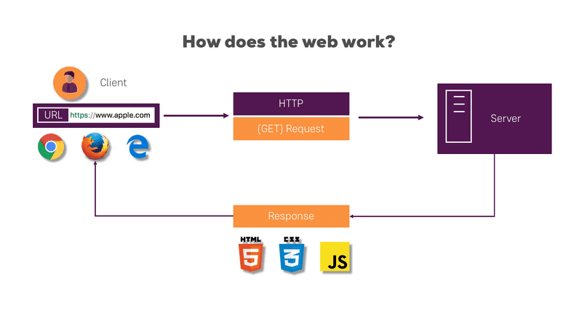
How does the web works
Web - How it Works ?
Your personal computer This is the PC at which you sit to see the web.
A Web browser A software installed on your PC which helps you to browse the Web.
An internet connection This is provided by an ISP and connects you to the internet to reach to any Website.
A Web server This is the computer on which a website is hosted.

Slide 2
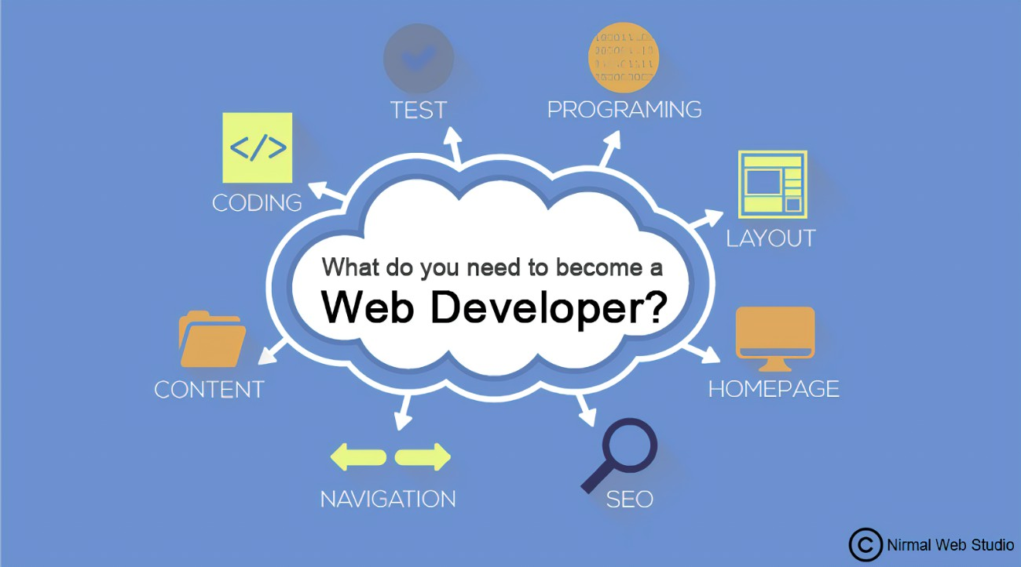
What do you need to be a web developer ?
Web developers usually need to demonstrate skill with learning programming languages and other computer-based applications. To succeed, many web developers also need professional training or education, plus the hard and soft skills described above.

Slide 3
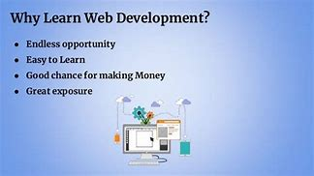
Why did you choose to learn web development?
Freedom is the most important reason to learn web development course. The internet is everywhere. The laptop is a portable device and you can use it anywhere. Websites can be reached from all over the world.

