Slide 1
Chapter 12
Chi-Square Tests

Slide 2
Chi-Square Tests
12.1 Chi-Square Goodness of Fit Tests
12.2 A Chi-Square Test for Independence

Slide 3
12.1 Chi-Square Goodness of Fit Tests
LO 12-1: Test hypotheses about multinomial probabilities by using a chi-square goodness-of-fit test.
Collect count data to study how counts are distributed among cells
Often use categorical data for statistical inference
May use a multinomial experiment
Similar to a binomial experiment only more than two outcomes are possible

Slide 4
The Multinomial Experiment
LO12-1
Carry out n identical trials with k possible outcomes of each trial
Probabilities are denoted p₁, p₂, … , _{pk} where p₁ + p₂ + … + p_{k} = 1
The trials are independent
The results are observed frequencies of the number of trials that result in each of k possible outcomes, denoted f₁, f₂, …, f_{k}
Binomial experiment is multinormal experiment with k=2

Slide 5
Chi-Square Goodness of Fit Tests
LO12-1
Consider the outcome of a multinomial experiment where each of n randomly selected items is classified into one of k groups
Let f_{i} = number of items classified into group i (i^{th} observed frequency)
E_{i} = np_{i} = expected number in i^{th} group if p_{i} is probability of being in group i (i^{th} expected frequency)

Slide 6
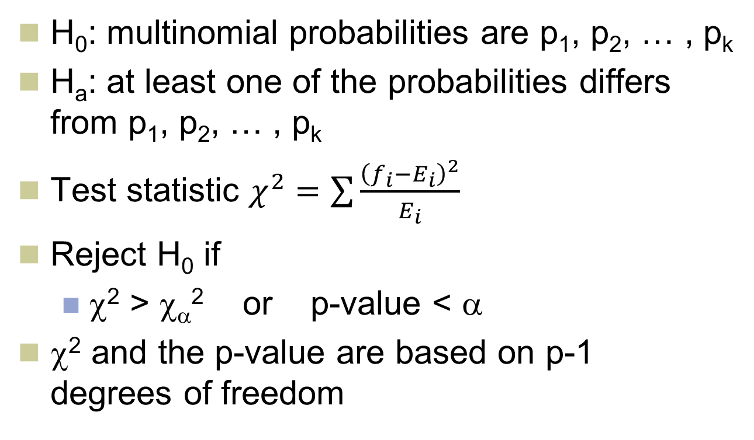
A Goodness of Fit Test for Multinomial Probabilities
LO12-1
H₀: multinomial probabilities are p₁, p₂, … , p_{k}
H_{a}: at least one of the probabilities differs from p₁, p₂, … , p_{k}
Test statistic $χ^{2}=\sum{\frac{{\left(f_{i}−E_{i}\right)}^{2}}{E_{i}}}$
Reject H₀ if
χ² > χ_{α}² or p-value < α
χ² and the p-value are based on p-1 degrees of freedom

Slide 7
Example 12.1: The Microwave Oven Preference Case
LO12-1
Market shares in Cleveland
Brand 1 20%
Brand 2 35%
Brand 3 30%
Brand 4 15%
Observed Frequency in Milwaukee
Brand 1 102
Brand 2 121
Brand 3 120
Brand 4 57

Slide 8
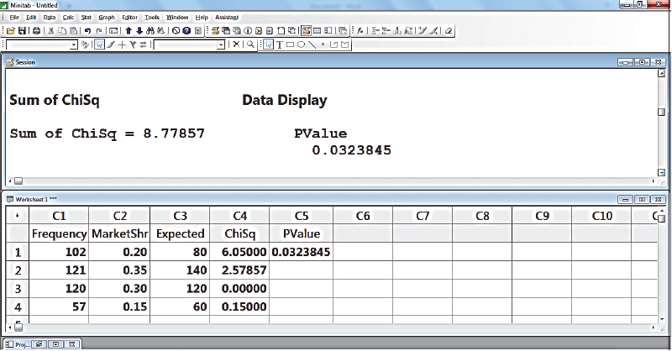
Output of a Minitab Session That computes the Chi-Square Statistics for the Microwave Oven Case
LO12-1
Figure 12.1

Slide 9
Example 12.1: The Microwave Oven Preference Case
LO12-1
H₀: p₁ = .20, p₂ = .35, p₃ = .30, p₄ = .15
H_{a}: H₀ fails to hold

Slide 10
Normal Distribution
LO 12-2: Perform a goodness of fit test for normality.
Have seen many statistical methods based on the assumption of a normal distribution
Can check the validity of this assumption using frequency distributions, stem-and-leaf displays, histograms, and normal plots
Another approach is to use a chi-square goodness of fit test

Slide 11
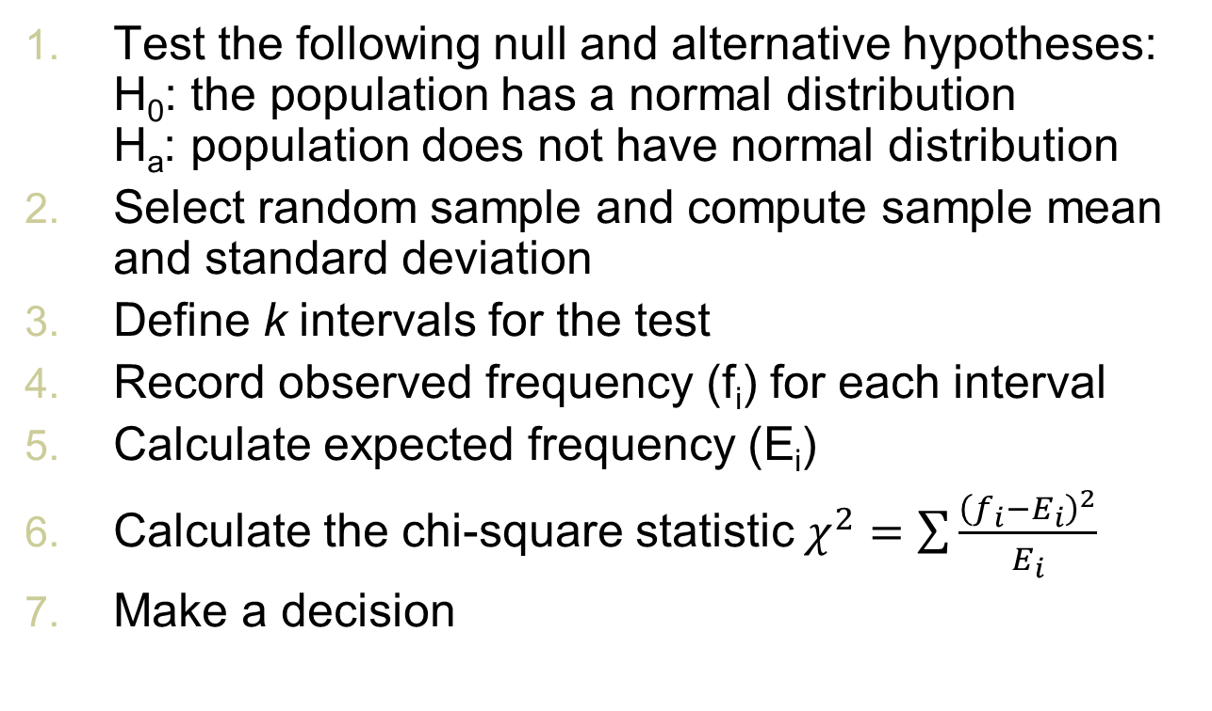
A Goodness of Fit Test for a Normal Distribution
LO12-2
Test the following null and alternative hypotheses: H₀: the population has a normal distribution H_{a}: population does not have normal distribution
Select random sample and compute sample mean and standard deviation
Define k intervals for the test
Record observed frequency (f_{i}) for each interval
Calculate expected frequency (E_{i})
Calculate the chi-square statistic $χ^{2}=\sum{\frac{{\left(f_{i}−E_{i}\right)}^{2}}{E_{i}}}$
Make a decision

Slide 12
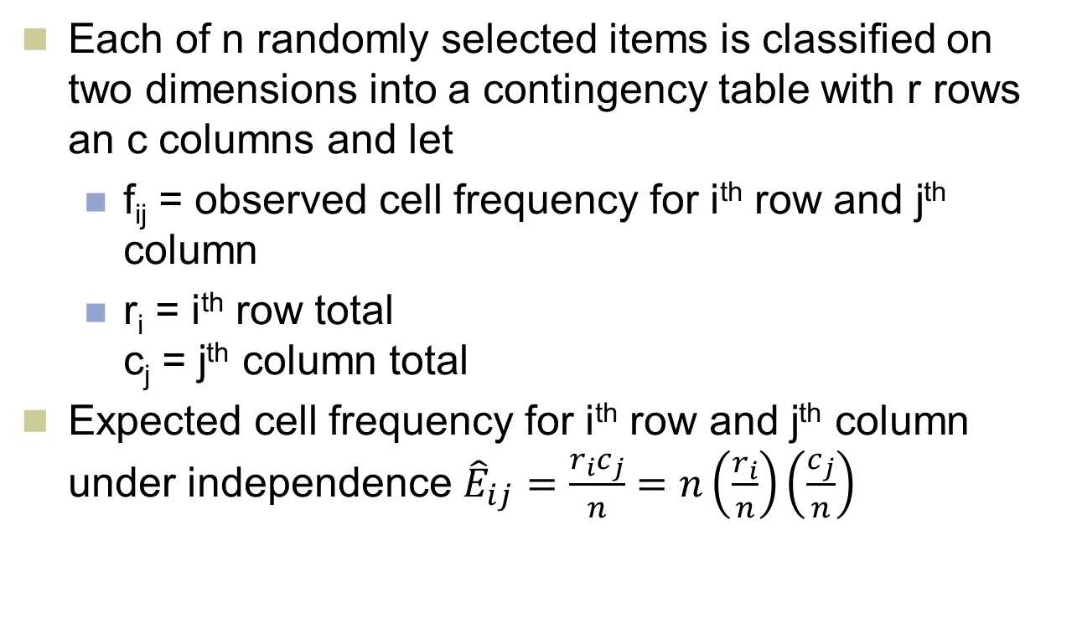
12.2 A Chi-Square Test for Independence
LO 12-3: Decide whether two qualitative variables are independent by using a chi-square test for independence.
Each of n randomly selected items is classified on two dimensions into a contingency table with r rows an c columns and let
f_{ij} = observed cell frequency for i^{th} row and j^{th} column
r_{i} = i^{th} row total c_{j} = j^{th} column total
Expected cell frequency for i^{th} row and j^{th} column under independence ${\hat{E}}_{ij}=\frac{r_{i}c_{j}}{n}=n\left(\frac{r_{i}}{n}\right)\left(\frac{c_{j}}{n}\right)$

Slide 13
Example 12.3 The Brokerage Firm Case: Studying Client Satisfaction
LO12-3
Brokerage firm sells several kinds of products
A stock fund
A bond fund
A tax-deferred annuity
Wish to know if customer satisfaction depends on time of product purchased
A sample of 100 clients are surveyed

Slide 14
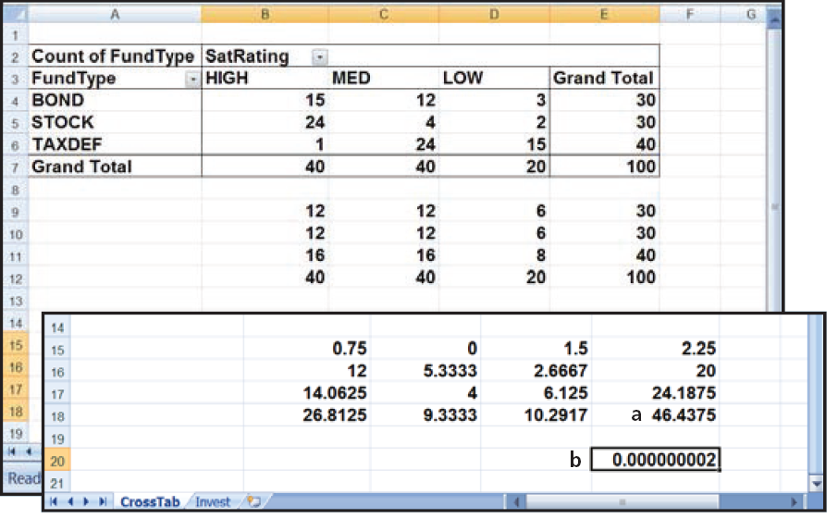
Example 12.3 Contingency Table
LO12-3
Figure 12.2 (b) Partial

Slide 15
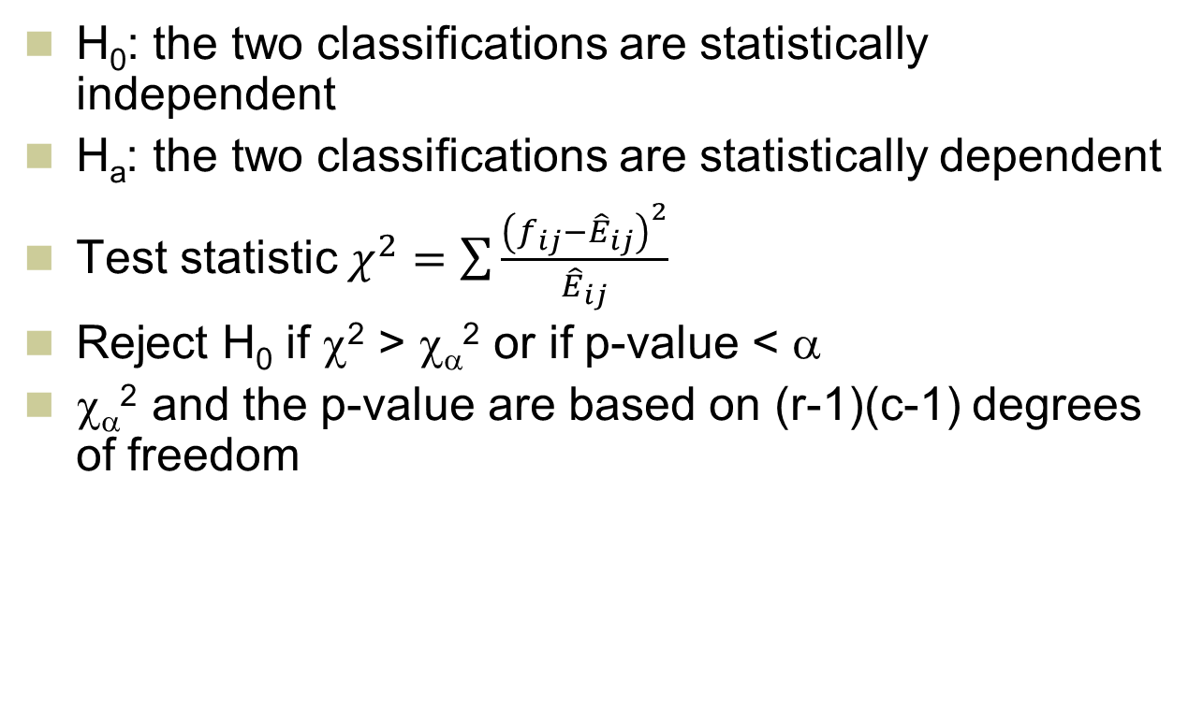
A Chi-Square Test for Independence Continued
LO12-3
H₀: the two classifications are statistically independent
H_{a}: the two classifications are statistically dependent
Test statistic $χ^{2}=\sum{\frac{{\left(f_{ij}−{\hat{E}}_{ij}\right)}^{2}}{{\hat{E}}_{ij}}}$
Reject H₀ if χ² > χ_{α}² or if p-value < α
χ_{α}² and the p-value are based on (r-1)(c-1) degrees of freedom

Slide 16
Example 12.3 The Chi-Square Test
LO12-3

