Slide 1
Chapter 8
Confidence Intervals

Slide 2
Chapter Outline
8.1 z-Based Confidence Intervals for a Population Mean: σ Known
8.2 t-Based Confidence Intervals for a Population Mean: σ Unknown
8.3 Sample Size Determination
8.4 Confidence Intervals for a Population Proportion
8.5 Confidence Intervals for Parameters of Finite Populations (Optional)

Slide 3
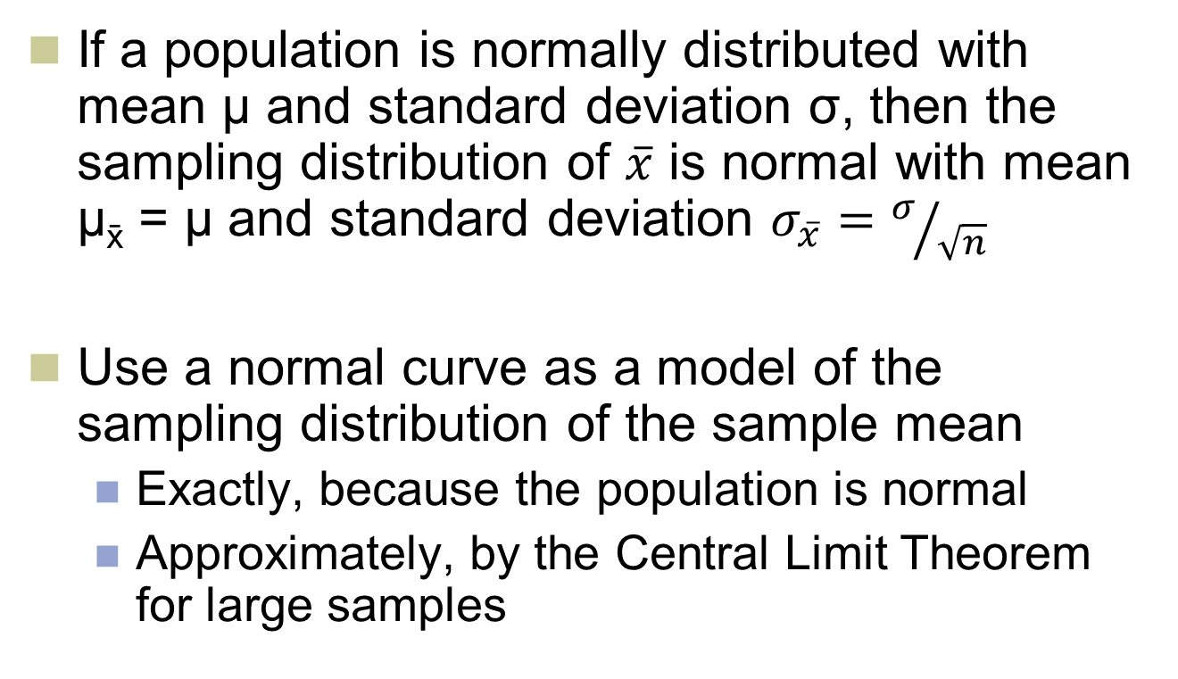
8.1 z-Based Confidence Intervals for a Mean: σ Known
LO 8-1: Calculate and interpret a z-based confidence interval for a population mean where σ is known.
If a population is normally distributed with mean μ and standard deviation σ, then the sampling distribution of $\overline{x}$ is normal with mean μ_{x} = μ and standard deviation $σ_{\overline{x}}=σ/{\sqrt{n}}$
Use a normal curve as a model of the sampling distribution of the sample mean
Exactly, because the population is normal
Approximately, by the Central Limit Theorem for large samples

Slide 4
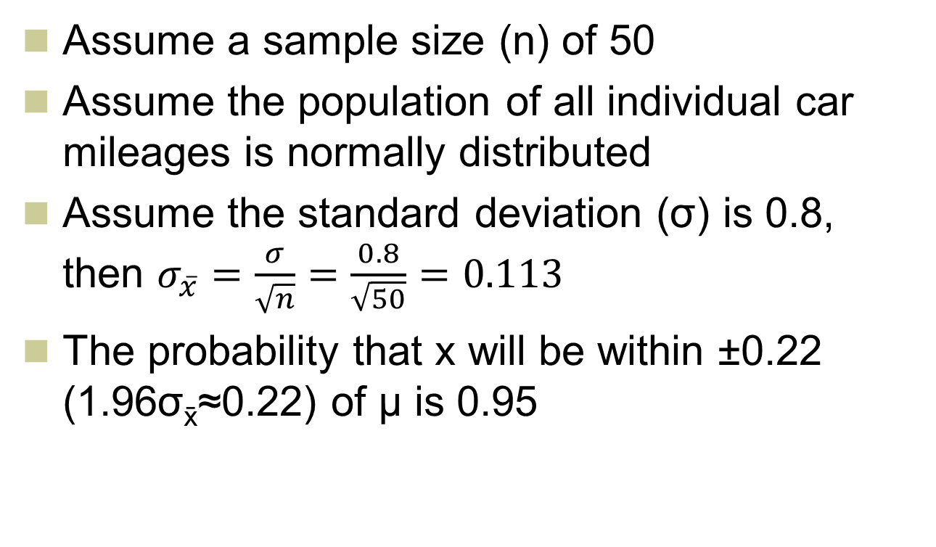
Example: The Car Mileage Case
LO8-1
Assume a sample size (n) of 50
Assume the population of all individual car mileages is normally distributed
Assume the standard deviation (σ) is 0.8, then $σ_{\overline{x}}=\frac{σ}{\sqrt{n}}=\frac{0.8}{\sqrt{50}}=0.113$
The probability that x will be within ±0.22 (1.96σ_{x}≈0.22) of µ is 0.95

Slide 5
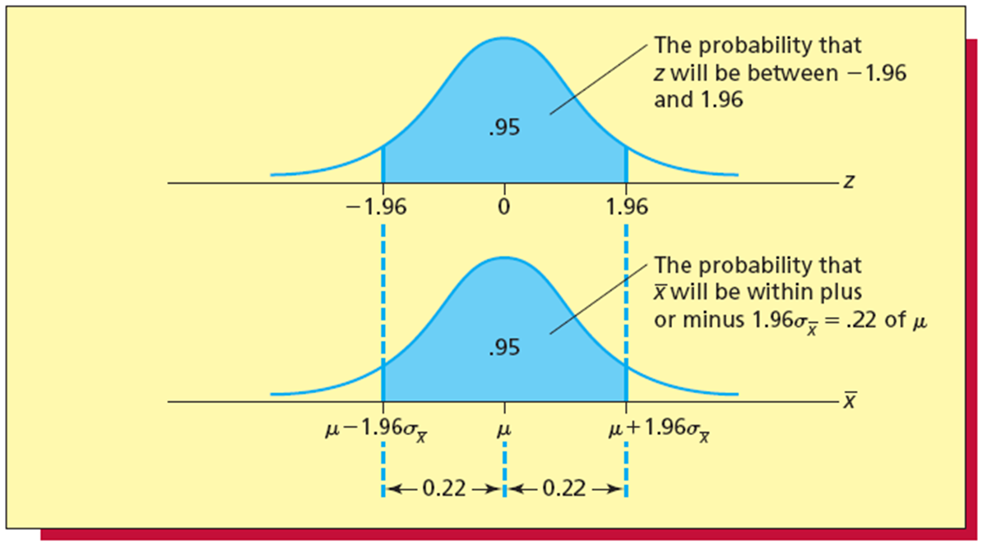
The Sampling Distribution of the Sample Mean
LO8-1
Figure 8.1

Slide 6
The Car Mileage Case Continued
LO8-1
Assume the sample mean is 31.56
That gives us an interval of [31.56 ± 0.22] = [31.34, 31.78]
The probability is 0.95 that the interval [x ± 1.95σ] contains the population mean µ

Slide 7
Generalizing
LO8-1
In the example, we found the probability that μ is contained in an interval of integer multiples of σ_{x}
More usual to specify the (integer) probability and find the corresponding number of σ_{x}
The probability that the confidence interval will not contain the population mean μ is denoted by α
In the mileage example, α = 0.05

Slide 8
Generalizing Continued
LO8-1
The probability that the confidence interval will contain the population mean μ is denoted by 1 - α
1 – α is referred to as the confidence coefficient
(1 – α) × 100% is called the confidence level
Usual to use two decimal point probabilities for 1 – α
Here, focus on 1 – α = 0.95 or 0.99

Slide 9
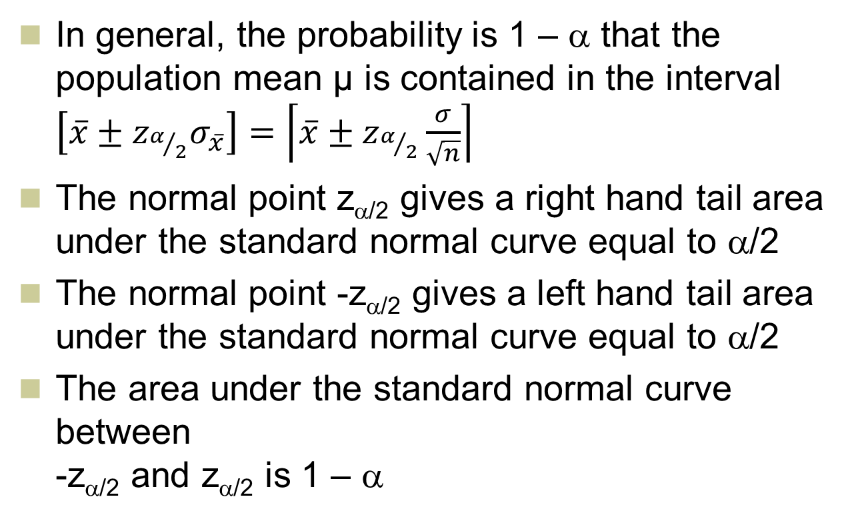
General Confidence Interval
LO8-1
In general, the probability is 1 – α that the population mean μ is contained in the interval $\left[\overline{x}±z_{α/2}σ_{\overline{x}}\right]=\left\lceil \overline{x}±z_{α/2}\frac{σ}{\sqrt{n}}\right\rceil$
The normal point z_{α/2} gives a right hand tail area under the standard normal curve equal to α/2
The normal point -z_{α/2} gives a left hand tail area under the standard normal curve equal to α/2
The area under the standard normal curve between -z_{α/2} and z_{α/2} is 1 – α

Slide 10
z-Based Confidence Intervals for a Mean with σ Known
LO8-1

Slide 11
95% Confidence Interval
LO8-1
Figure 8.3

Slide 12
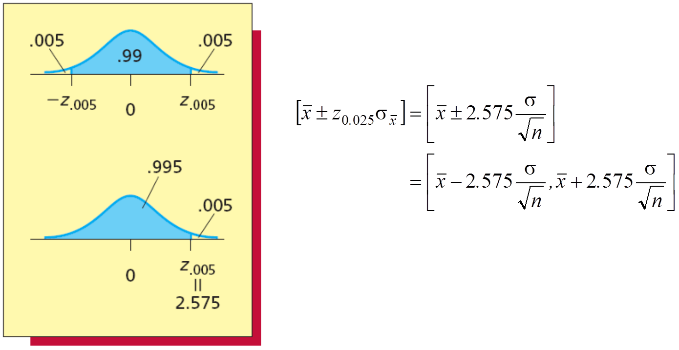
99% Confidence Interval
LO8-1
Figure 8.4

Slide 13
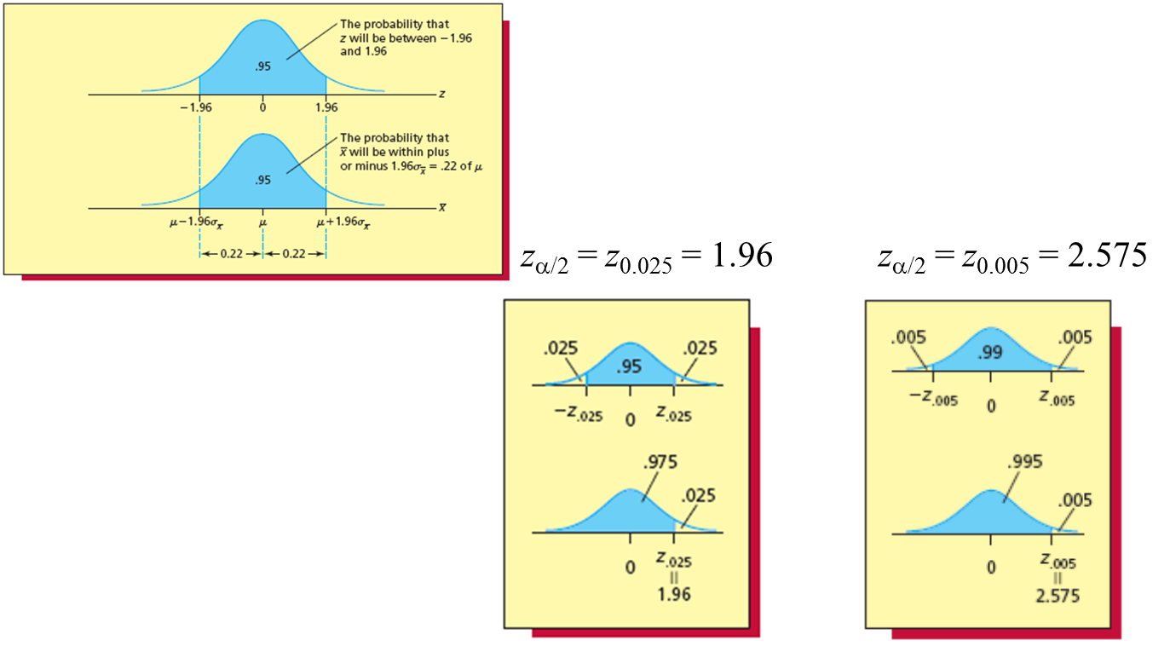
The Effect of a on Confidence Interval Width
LO8-1
Figures 8.1 and 8.3 to 8.4

Slide 14
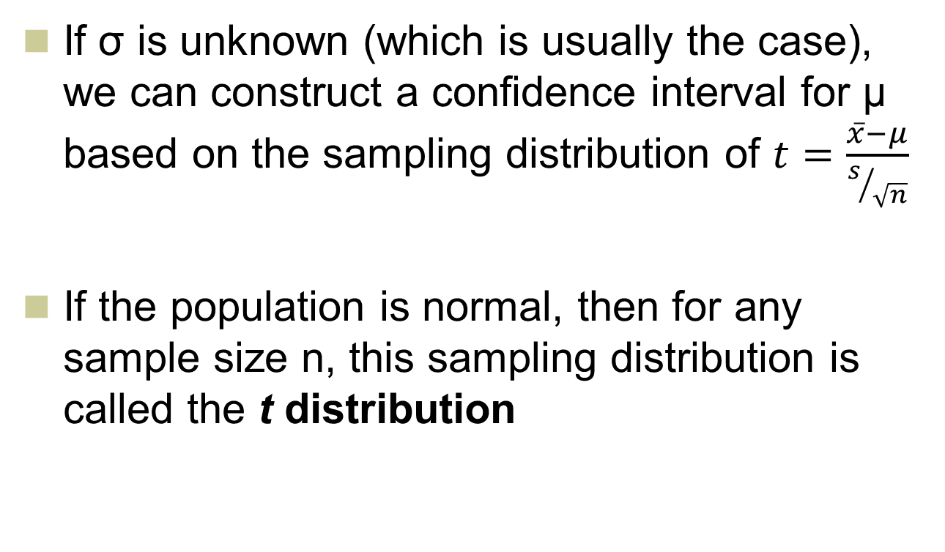
8.2 t-Based Confidence Intervals for a Mean: σ Unknown
LO 8-2: Describe the properties of the t distribution and use a t table.
If σ is unknown (which is usually the case), we can construct a confidence interval for μ based on the sampling distribution of $t=\frac{\overline{x}−μ}{s/{\sqrt{n}}}$
If the population is normal, then for any sample size n, this sampling distribution is called the t distribution

Slide 15
The t Distribution
LO8-2
Symmetrical and bell-shaped
The t distribution is more spread out than the standard normal distribution
The spread of the t is given by the number of degrees of freedom (df)
For a sample of size n, there are one fewer degrees of freedom, that is, df = n – 1

Slide 16
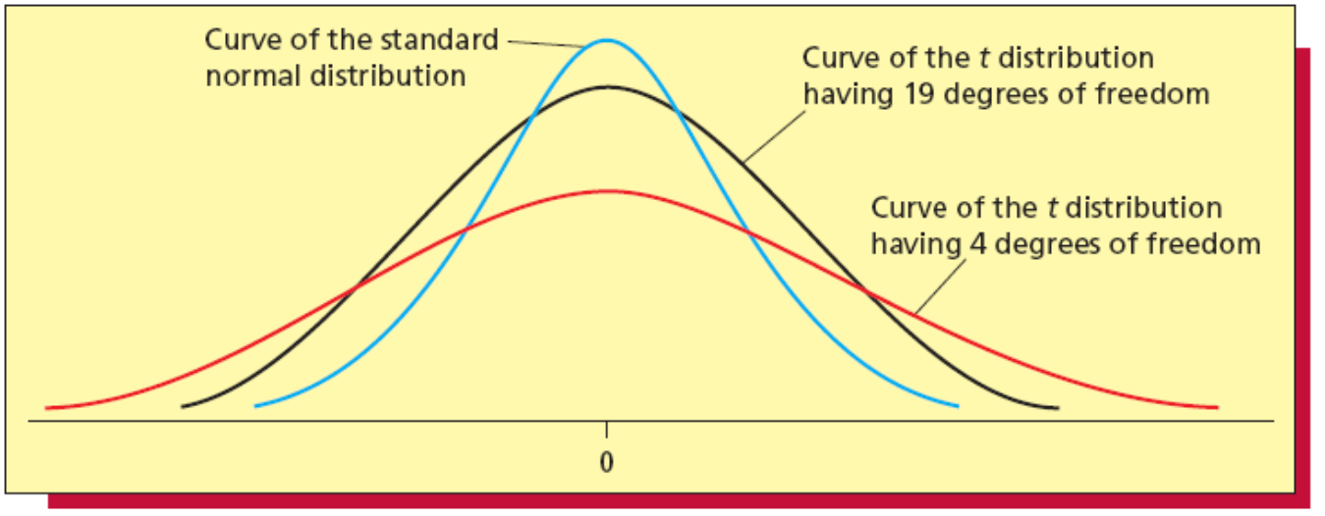
Degrees of Freedom and the t-Distribution
LO8-2
Figure 8.6

Slide 17
The t Distribution and Degrees of Freedom
LO8-2
As the sample size n increases, the degrees of freedom also increases
As the degrees of freedom increase, the spread of the t curve decreases
As the degrees of freedom increases indefinitely, the t curve approaches the standard normal curve
If n ≥ 30, so df = n – 1 ≥ 29, the t curve is very similar to the standard normal curve

Slide 18
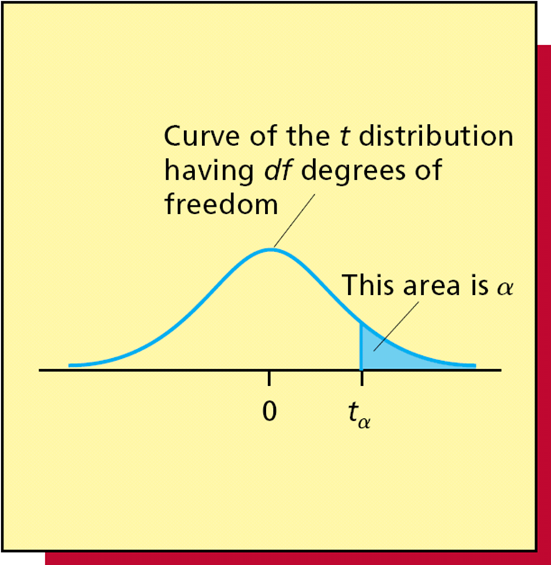
t and Right Hand Tail Areas
LO8-2
t_{α} is the point on the horizontal axis under the t curve that gives a right hand tail equal to α
So the value of t_{α} in a particular situation depends on the right hand tail area α and the number of degrees of freedom
Figure 8.7

Slide 19
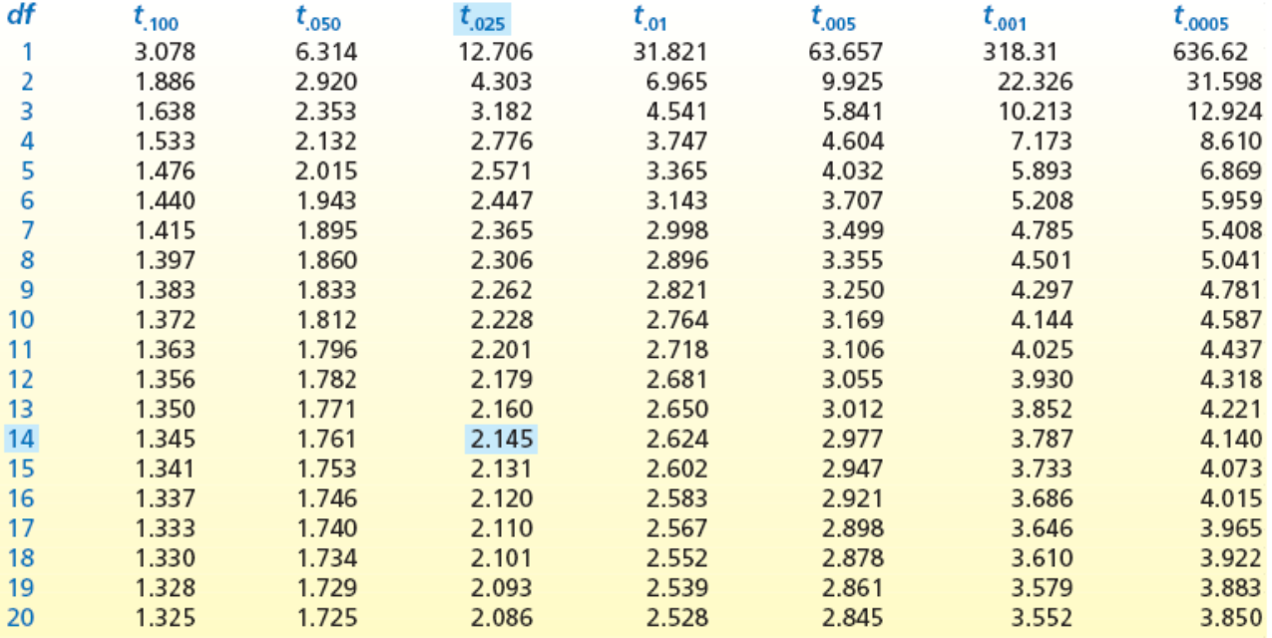
Using the t Distribution Table
LO8-2
Table 8.3 (partial)

Slide 20
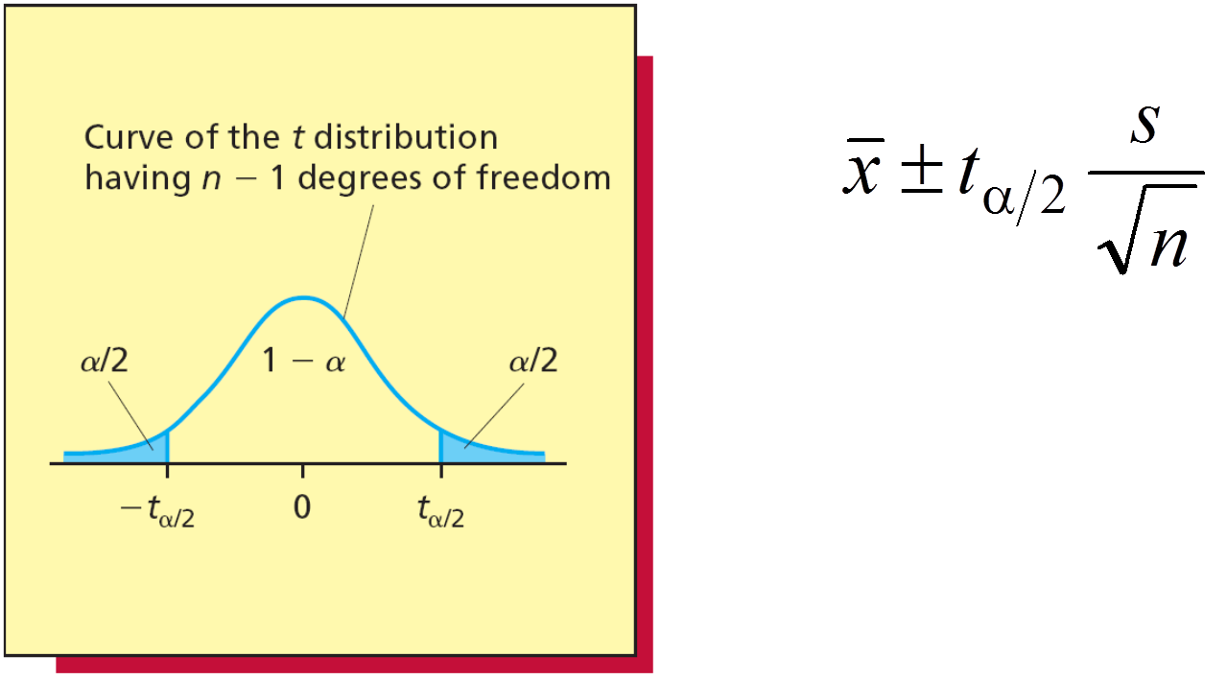
t-Based Confidence Intervals for a Mean: σ Unknown
LO 8-3: Calculate and interpret a t-based confidence interval for a population mean when σ is unknown.
Figure 8.10

Slide 21

8.3 Sample Size Determination
LO 8-4: Determine the appropriate sample size when estimating a population mean.
If σ is known, then a sample of size $n={\left(\frac{z_{α/2}σ}{E}\right)}^{2}$ so that x is within E units of μ, with 100(1-α)% confidence

Slide 22
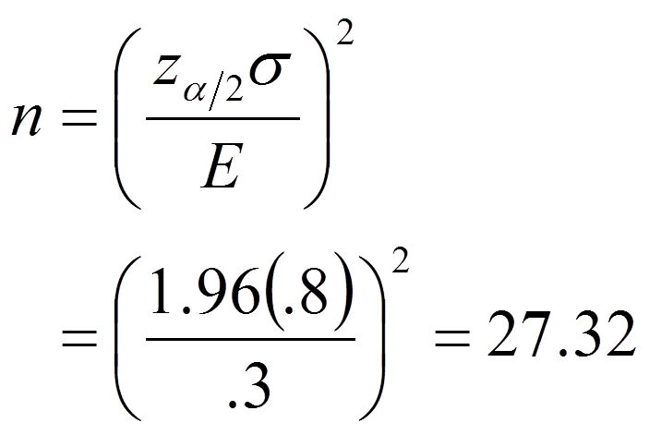
Example (Car Mileage Case)
LO8-4

Slide 23
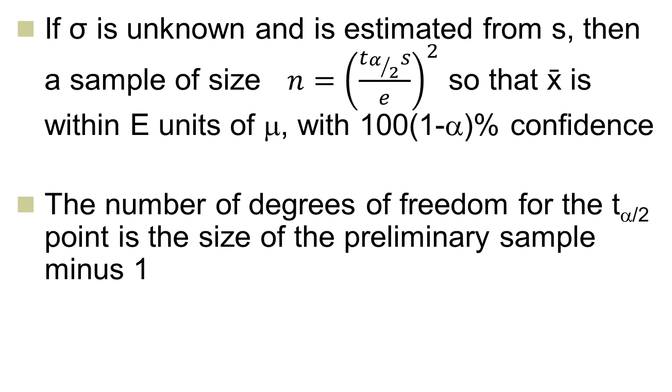
Sample Size Determination (t)
LO8-4
If σ is unknown and is estimated from s, then a sample of size $n={\left(\frac{t_{α/2}s}{e}\right)}^{2}$ so that x is within E units of μ, with 100(1-α)% confidence
The number of degrees of freedom for the t_{α/2} point is the size of the preliminary sample minus 1

Slide 24
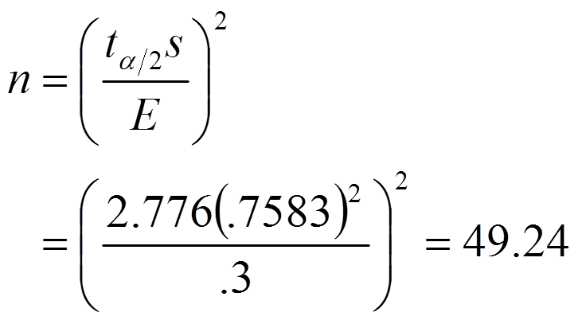
Example 8.4: The Car Mileage Case
LO8-4

Slide 25
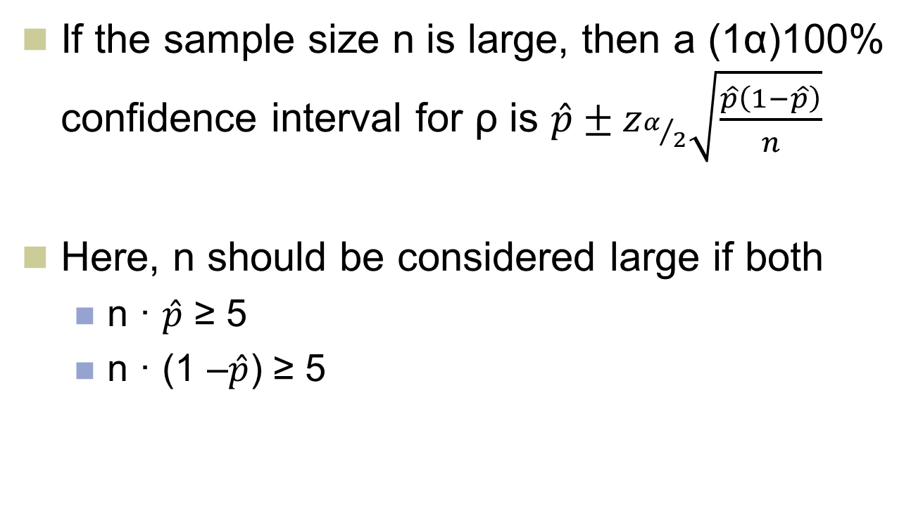
8.4 Confidence Intervals for a Population Proportion
LO 8-5: Calculate and interpret a large sample confidence interval for a population proportion.
If the sample size n is large, then a (1­α)100% confidence interval for ρ is $\hat{p}±z_{α/2}\sqrt{\frac{\hat{p}\left(1−\hat{p}\right)}{n}}$
Here, n should be considered large if both
n · $\hat{p}$ ≥ 5
n · (1 –$\hat{p}$) ≥ 5

Slide 26
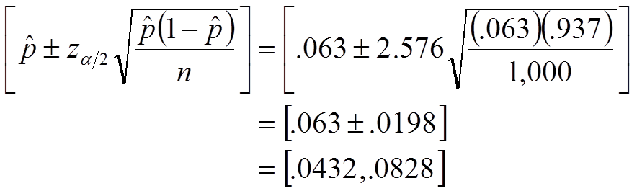
Example 8.6: The Cheese Spread Case
LO8-5

Slide 27
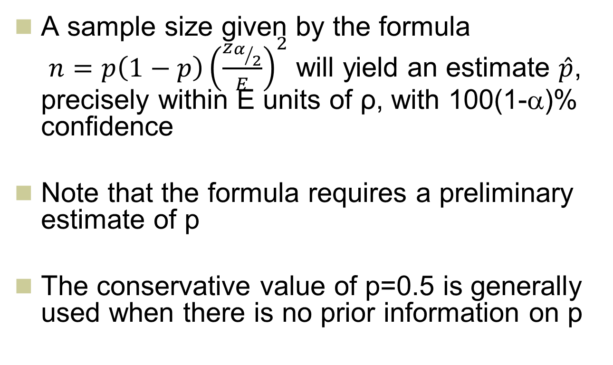
Determining Sample Size for Confidence Interval for ρ
LO 8-6: Determine the appropriate sample size when estimating a population proportion.
A sample size given by the formula $n=p\left(1−p\right){\left(\frac{z_{α/2}}{E}\right)}^{2}$ will yield an estimate $\hat{p}$, precisely within E units of ρ, with 100(1-α)% confidence
Note that the formula requires a preliminary estimate of p
The conservative value of p=0.5 is generally used when there is no prior information on p

Slide 28
Examples: Proportion of Voters
LO8-6
Estimate p near 0.5
Margin of error in 0.95 percent confidence interval of 0.02

Slide 29
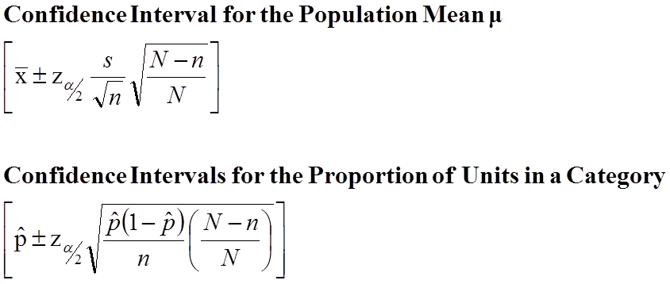
8.5 Confidence Intervals for Parameters of Finite Populations (Optional)
LO 8-7: Find and interpret confidence intervals for parameters of finite populations (Optional).

Slide 30
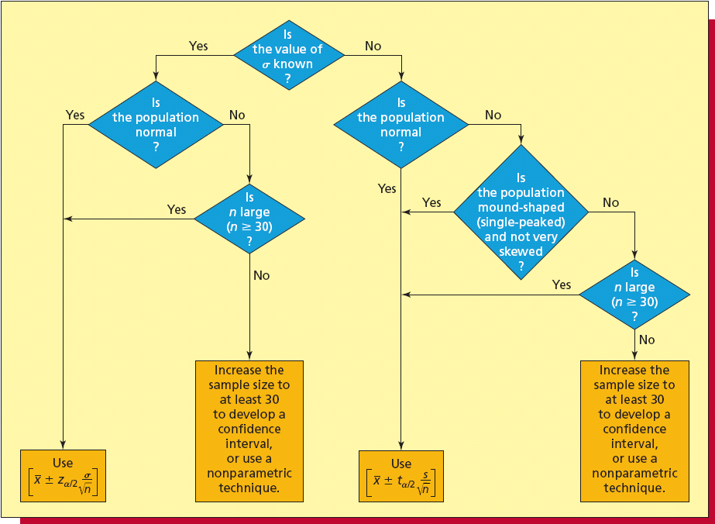
Selecting an Appropriate Confidence Interval for a Population Mean
Figure 8.18

