Slide 1
SQL Report – Hackerrank Demo
第十一組：
組員：A1063312 周君臨 A1063323 覃喆明 A1063330孫子淵
指導教授：楊子賢

Slide 2
題目
Easy：Weather Observation Station 4
Medium：Binary tree codes

Slide 3
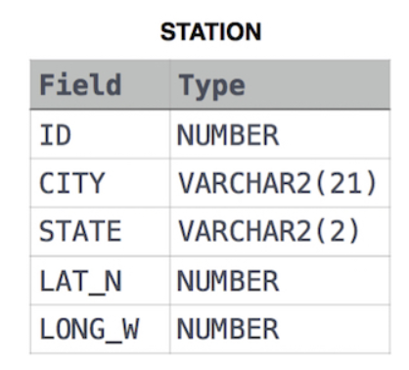
1. Weather Observation Station 4 (Easy)
Query：
Let N be the number of CITY entries in STATION, and let N’ be the number of distinct CITY names in STATION; query the value of N-N’ from STATION. In other words, find the difference between the total number of CITY entries in the table and the number of distinct CITY entries in the table.
>>>>找出N(表格內所有的城市數量)，並減掉N’(表格內不同的城市數量)

Slide 4
2. Binary tree codes (Medium)
Query：
You are given a table, BST, containing two columns: N and P, where N represents the value of a node in Binary Tree, and P is the parent of N.
Write a query to find the node type of Binary Tree ordered by the value of the node. Output one of the following for each node:
Root: If node is root node.
Leaf: If node is leaf node.
Inner: If node is neither root nor leaf node.
>>>>>按排序找出各節點的類型並輸出

Slide 5
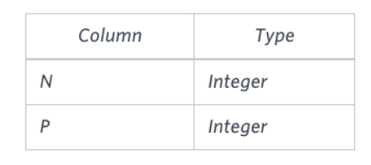
2. Binary tree codes (Medium)
BST表格中有兩個欄位，一是N，代表二元樹的節點；二是P，代表該節點的母節點。
而題目要求輸出每個節點與其類型，並依照節點的ASC方式排序。
以下為節點的類型：
Root：沒有母節點
Leaf：沒有子節點 = 不為其他節點的母節點
Inner：有母節點且也有子節點 = 不為Root或Leaf節點
BST

