Slide 1
Chapter 11
Experimental Design and Analysis of Variance

Slide 2
Experimental Design and Analysis of Variance
11.1 Basic Concepts of Experimental Design
11.2 One-Way Analysis of Variance
11.3 The Randomized Block Design
11.4 Two-Way Analysis of Variance

Slide 3
11.1 Basic Concepts of Experimental Design
LO11-1: Explain the basic terminology and concepts of experimental design.
Up until now, we have considered only two ways of collecting and comparing data:
Using independent random samples
Using paired (or matched) samples
Often data is collected as the result of an experiment
To systematically study how one or more factors (variables) influence the variable that is being studied

Slide 4
Experimental Design #2
LO11-1
In an experiment, there is strict control over the factors contributing to the experiment
The values or levels of the factors are called treatments
For example, in testing a medical drug, the experimenters decide which participants in the test get the drug and which ones get the placebo, instead of leaving the choice to the subjects
The object is to compare and estimate the effects of different treatments on the response variable

Slide 5
Experimental Design #3
LO11-1
The different treatments are assigned to objects (the test subjects) called experimental units
When a treatment is applied to more than one experimental unit, the treatment is being “replicated”
A designed experiment is an experiment where the analyst controls which treatments are used and how they are applied to the experimental units

Slide 6
Experimental Design #4
LO11-1
In a completely randomized experimental design, independent random samples are assigned to each of the treatments
For example, suppose three experimental units are to be assigned to five treatments
For completely randomized experimental design, randomly pick three experimental units for one treatment, randomly pick three different experimental units from those remaining for the next treatment, and so on

Slide 7
Experimental Design #5
LO11-1
Once the experimental units are assigned and the experiment is performed, a value of the response variable is observed for each experimental unit
That is, obtain a sample of values for the response variable for each treatment

Slide 8
Experimental Design #6
LO11-1
In a completely randomized experimental design, it is presumed that each sample is a random sample from the population of all possible values of the response variable
That could possibly be observed when using the specific treatment
The samples are independent of each other
Reasonable because the completely randomized design ensures that each sample results from different measurements being taken on different experimental units
Can also say that an independent samples experiment is being performed

Slide 9
11.2 One-Way Analysis of Variance
LO11-2: Compare several different population means by using a one-way analysis of variance.
Want to study the effects of all p treatments on a response variable
For each treatment, find the mean and standard deviation of all possible values of the response variable when using that treatment
For treatment i, find treatment mean µ_{i}
One-way analysis of variance estimates and compares the effects of the different treatments on the response variable
By estimating and comparing the treatment means µ₁, µ₂, …, µ_{p}
One-way analysis of variance, or one-way ANOVA

Slide 10
ANOVA Notation
LO11-2
n_{i} denotes the size of the sample randomly selected for treatment i
x_{ij} is the j^{th} value of the response variable using treatment i
x_{i} is average of the sample of n_{i} values for treatment i
x_{i} is the point estimate of the treatment mean µ_{i}
s_{i} is the standard deviation of the sample of n_{i} values for treatment i
s_{i} is the point estimate for the treatment (population) standard deviation σ_{i}

Slide 11
One-Way ANOVA Assumptions
LO11-2
Constant variance
The p populations of values of the response variable (associated with the p treatments) all have the same variance
Normality
The p populations of values of the response variable all have normal distributions
Independence
The samples of experimental units are randomly selected, independent samples

Slide 12
Testing for Significant Differences Between Treatment Means
LO11-2
Are there any statistically significant differences between the sample (treatment) means?
The null hypothesis is that the mean of all p treatments are the same
H₀: µ₁ = µ₂ = … = µ_{p}
The alternative is that some (or all, but at least two) of the p treatments have different effects on the mean response
H_{a}: at least two of µ₁, µ₂ , …, µ_{p} differ

Slide 13
Testing for Significant Differences Between Treatment Means Continued
LO11-2
Compare the between-treatment variability to the within-treatment variability
Between-treatment variability is the variability of the sample means from sample to sample
Within-treatment variability is the variability of the treatments (that is, the values) within each sample

Slide 14
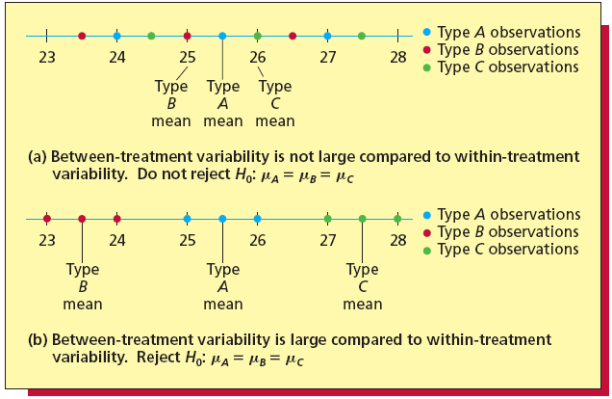
Comparing Between-Treatment Variability and Within-Treatment Variability
LO11-2
Figure 11.1

Slide 15
Partitioning the Total Variability in the Response
LO11-2
Total Variability | = | Between Treatment Variability | + | Within Treatment Variability
Total Sum of Squares | = | Treatment Sum of Squares | + | Error Sum of Squares
SSTO | = | SST | + | SSE

Slide 16

Mean Squares
LO11-2
The treatment mean-squares is $MST=\frac{SST}{p−1}$
The error mean-squares is $MSE=\frac{SSE}{n−p}$

Slide 17
F Test for Difference Between Treatment Means
LO11-2
Suppose that we want to compare p treatment means
The null hypothesis is that all treatment means are the same:
H₀: µ₁ = µ₂ = … = µ_{p}
The alternative hypothesis is that they are not all the same:
H_{a}: at least two of µ₁, µ₂ , …, µ_{p} differ

Slide 18
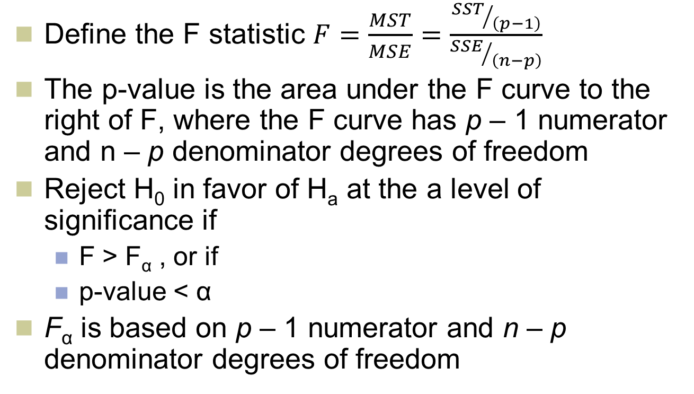
F Test for Difference Between Treatment Means Continued
LO11-2
Define the F statistic $F=\frac{MST}{MSE}=\frac{{SST}/{\left(p−1\right)}}{{SSE}/{\left(n−p\right)}}$
The p-value is the area under the F curve to the right of F, where the F curve has p – 1 numerator and n – p denominator degrees of freedom
Reject H₀ in favor of H_{a} at the a level of significance if
F > F_{α} , or if
p-value < α
F_{α} is based on p – 1 numerator and n – p denominator degrees of freedom

Slide 19
Pairwise Comparisons, Individual Intervals
LO11-2
Individual 100(1 - α)% confidence interval for each pairwise difference
If computing 100(1-α) confidence intervals, we are 100(1- α) percent confident that each difference is contained in its respective interval
However, we are less that 100(1- α) percent confident that all the pairwise differences are simultaneously contained in their intervals

Slide 20
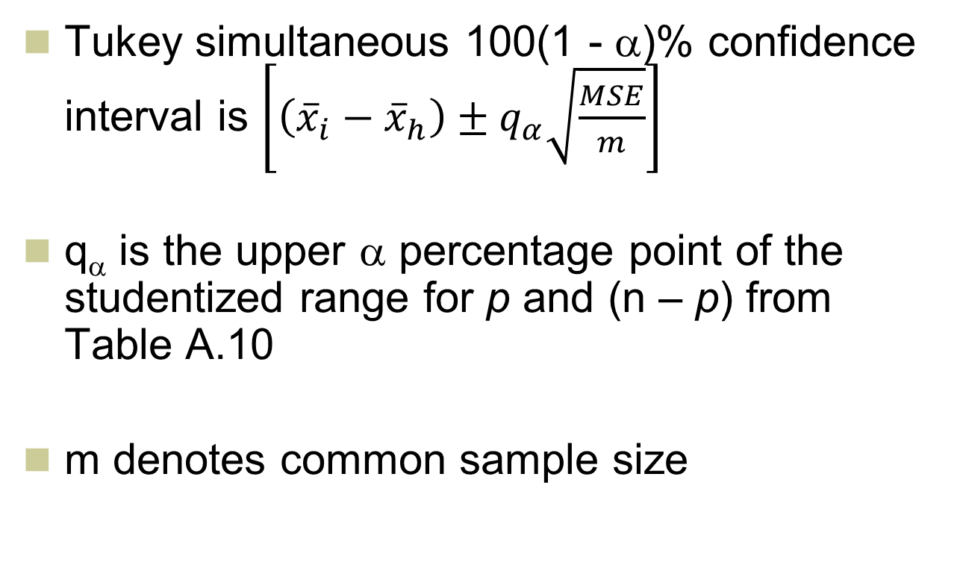
Pairwise Comparisons, Simultaneous Intervals
LO11-2
Tukey simultaneous 100(1 - α)% confidence interval is $\left[\left({\overline{x}}_{i}−{\overline{x}}_{h}\right)±q_{α}\sqrt{\frac{MSE}{m}}\right]$
q_{α} is the upper α percentage point of the studentized range for p and (n – p) from Table A.10
m denotes common sample size

Slide 21
11.3 The Randomized Block Design
LO11-3: Compare treatment effects and block effects by using a
randomized block design.
A randomized block design compares p treatments (for example, production methods) on each of b blocks (or experimental units or sets of units; for example, machine operators)
Each block is used exactly once to measure the effect of each and every treatment
The order in which each treatment is assigned to a block should be random

Slide 22
The Randomized Block Design Continued
LO11-3
A generalization of the paired difference design; this design controls for variability in experimental units by comparing each treatment on the same (not independent) experimental units
Differences in the treatments are not hidden by differences in the experimental units (the blocks)

Slide 23
Randomized Block Design
LO11-3
x_{ij} The value of the response variable when block j uses treatment i
x_{i•} The mean of the b response variable observed when using treatment i (the treatment i mean)
x_{•j} The mean of the p values of the response variable when using block j (the block j mean)
x The mean of all the b•p values of the response variable observed in the experiment (the overall mean)

Slide 24
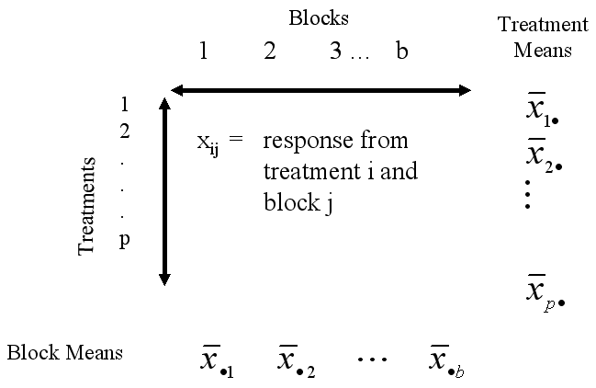
Randomized Block Design Continued
LO11-3

Slide 25
The ANOVA Table, Randomized Blocks
LO11-3

Slide 26
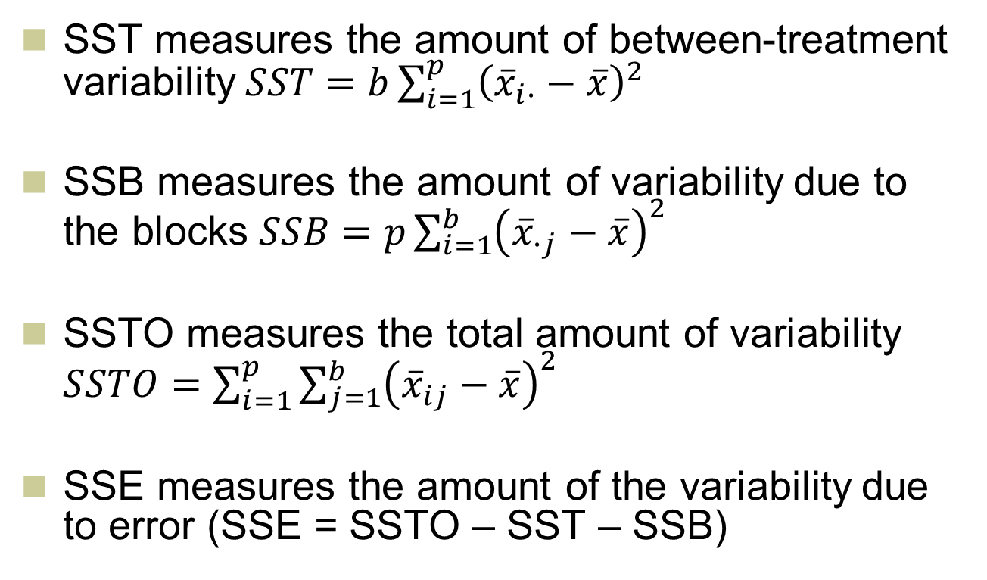
Sum of Squares
LO11-3
SST measures the amount of between-treatment variability $SST=b\sum_{i=1}^{p}{{\left({\overline{x}}_{i∙}−\overline{x}\right)}^{2}}$
SSB measures the amount of variability due to the blocks $SSB=p\sum_{i=1}^{b}{{\left({\overline{x}}_{∙j}−\overline{x}\right)}^{2}}$
SSTO measures the total amount of variability $SSTO=\sum_{i=1}^{p}{\sum_{j=1}^{b}{{\left({\overline{x}}_{ij}−\overline{x}\right)}^{2}}}$
SSE measures the amount of the variability due to error (SSE = SSTO – SST – SSB)

Slide 27
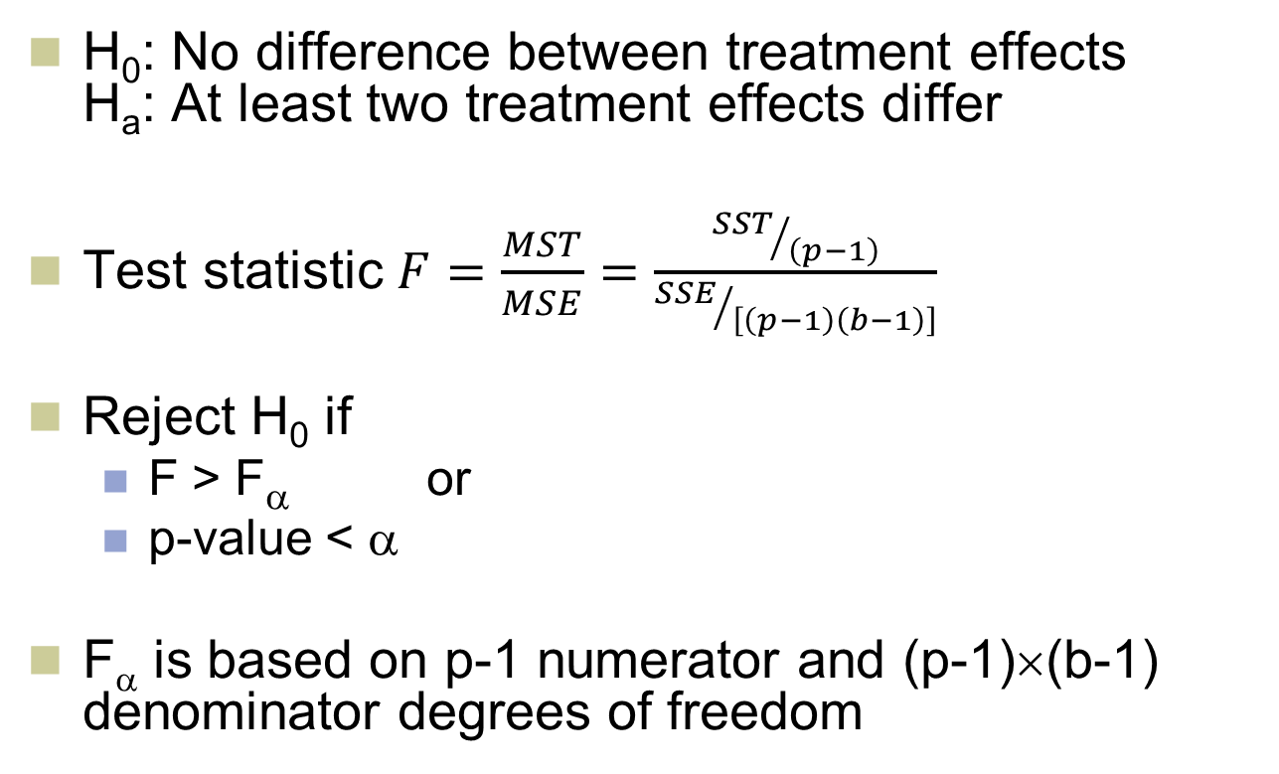
F Test for Treatment Effects
LO11-3
H₀: No difference between treatment effects H_{a}: At least two treatment effects differ
Test statistic $F=\frac{MST}{MSE}=\frac{{SST}/{\left(p−1\right)}}{{SSE}/{\left[\left(p−1\right)\left(b−1\right)\right]}}$
Reject H₀ if
F > F_{α} or
p-value < α
F_{α} is based on p-1 numerator and (p-1)×(b-1) denominator degrees of freedom

Slide 28

F Test for Block Effects
LO11-3
H₀: No difference between block effects H_{a}: At least two block effects differ
Test statistic $F=\frac{MSB}{MSE}=\frac{{SSB}/{\left(p−1\right)}}{{SSE}/{\left[\left(p−1\right)\left(b−1\right)\right]}}$
Reject H₀ if
F > F_{α} or
p-value < α
F_{α} is based on p-1 numerator and (p-1)×(b-1) denominator degrees of freedom

Slide 29
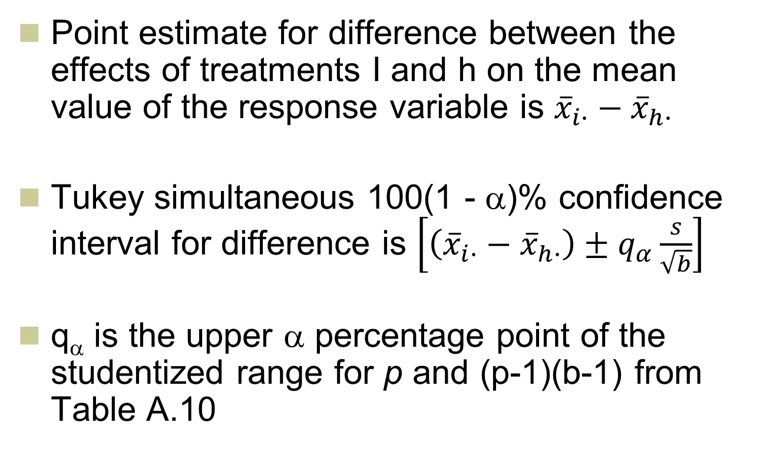
Estimation of Treatment Differences Under Randomized Blocks, Simultaneous Intervals
LO11-3
Point estimate for difference between the effects of treatments I and h on the mean value of the response variable is ${\overline{x}}_{i∙}−{\overline{x}}_{h∙}$
Tukey simultaneous 100(1 - α)% confidence interval for difference is $\left[\left({\overline{x}}_{i∙}−{\overline{x}}_{h∙}\right)±q_{α}\frac{s}{\sqrt{b}}\right]$
q_{α} is the upper α percentage point of the studentized range for p and (p-1)(b-1) from Table A.10

Slide 30
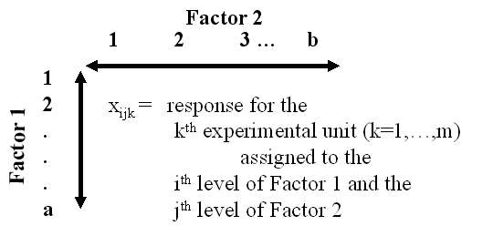
11.4 Two-Way Analysis of Variance
LO11-4: Assess the effects of two factors on a response variable by using a two-way analysis of variance.
A two factor factorial design compares the mean response for a levels of factor 1 (for example, display height) and each of b levels of factor 2 (for example, display width)
A treatment is a combination of a level of factor 1 and a level of factor 2

Slide 31
Two-Way ANOVA Table
LO11-5: Describe what
happens when two factors interact.

Slide 32
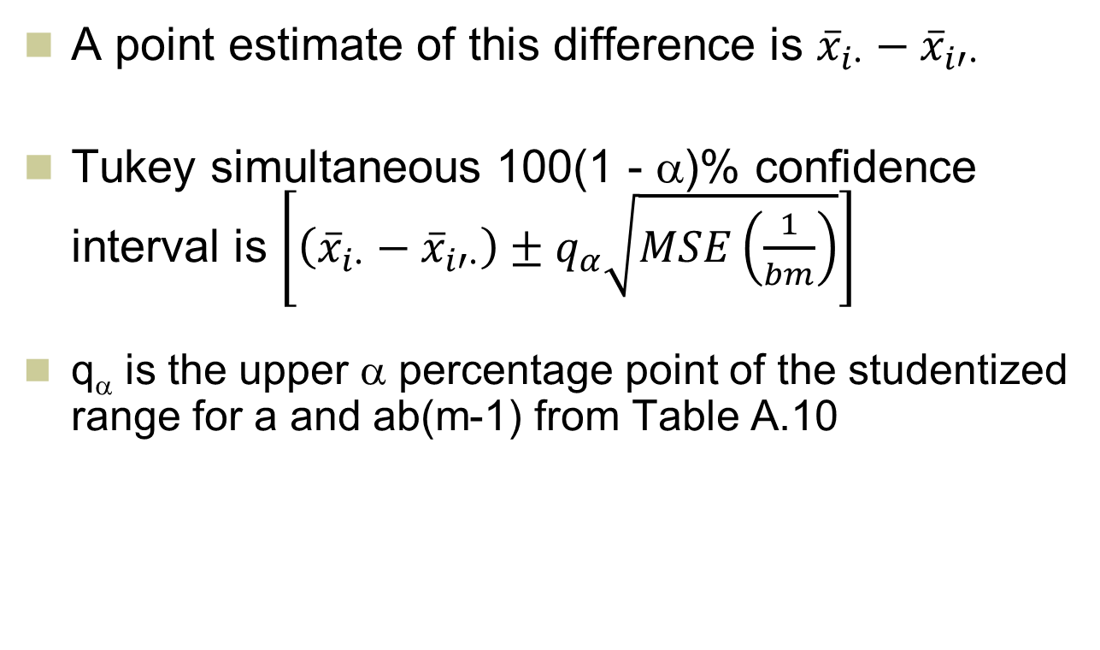
Estimation of Treatment Differences Under Two-Way ANOVA, Factor 1
LO11-5
A point estimate of this difference is ${\overline{x}}_{i∙}−{\overline{x}}_{i′∙}$
Tukey simultaneous 100(1 - α)% confidence interval is $\left[\left({\overline{x}}_{i∙}−{\overline{x}}_{i′∙}\right)±q_{α}\sqrt{MSE\left(\frac{1}{bm}\right)}\right]$
q_{α} is the upper α percentage point of the studentized range for a and ab(m-1) from Table A.10

Slide 33
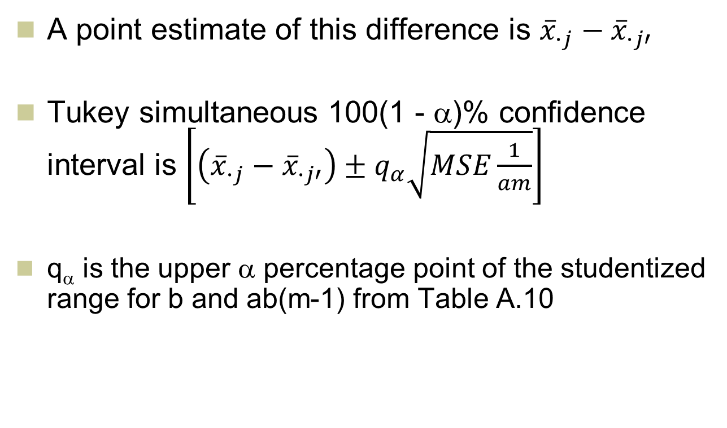
Estimation of Treatment Differences Under Two-Way ANOVA, Factor 2
LO11-5
A point estimate of this difference is ${\overline{x}}_{∙j}−{\overline{x}}_{∙j′}$
Tukey simultaneous 100(1 - α)% confidence interval is $\left[\left({\overline{x}}_{∙j}−{\overline{x}}_{∙j′}\right)±q_{α}\sqrt{MSE\frac{1}{am}}\right]$
q_{α} is the upper α percentage point of the studentized range for b and ab(m-1) from Table A.10

