Slide 1
Chapter 10
Statistical Inferences Based on Two Samples

Slide 2
Statistical Inferences Based on Two Samples
10.1 Comparing Two Population Means by Using Independent Samples
10.2 Paired Difference Experiments
10.3 Comparing Two Population Proportions by Using Large, Independent Samples
10.4 The F Distribution
10.5 Comparing Two Population Variances by Using Independent Samples

Slide 3
10.1 Comparing Two Population Means by Using Independent Samples
LO 10-1: Compare two population means when the samples are independent.
Suppose a random sample has been taken from each of two different populations
Suppose that the populations are independent of each other
Then the random samples are independent of each other
Then the sampling distribution of the difference in sample means is normally distributed

Slide 4
Sampling Distribution of the Difference of Two Sample Means #1
LO10-1
Suppose population 1 has mean µ₁ and variance σ₁²
A random sample of size n₁ is selected which has mean x₁ and variance s₁²
Suppose population 2 has mean µ₂ and variance σ₂²
A random sample of size n₂ is selected which has mean x₂ and variance s₂²
Then the sample distribution of the difference of two sample means…

Slide 5
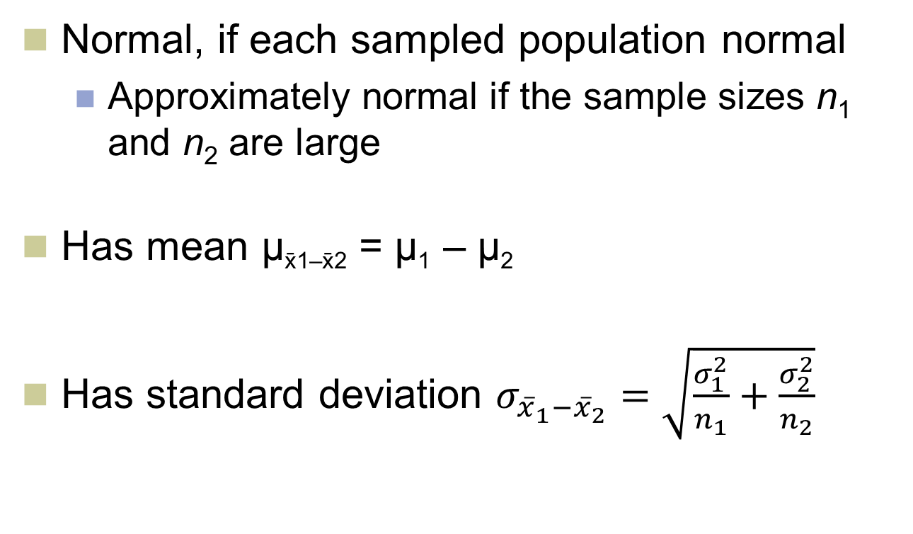
Sampling Distribution of the Difference of Two Sample Means #2
LO10-1
Normal, if each sampled population normal
Approximately normal if the sample sizes n₁ and n₂ are large
Has mean µ_{x1–x2} = µ₁ – µ₂
Has standard deviation $σ_{{\overline{x}}_{1}−{\overline{x}}_{2}}=\sqrt{\frac{σ_{1}^{2}}{n_{1}}+\frac{σ_{2}^{2}}{n_{2}}}$

Slide 6
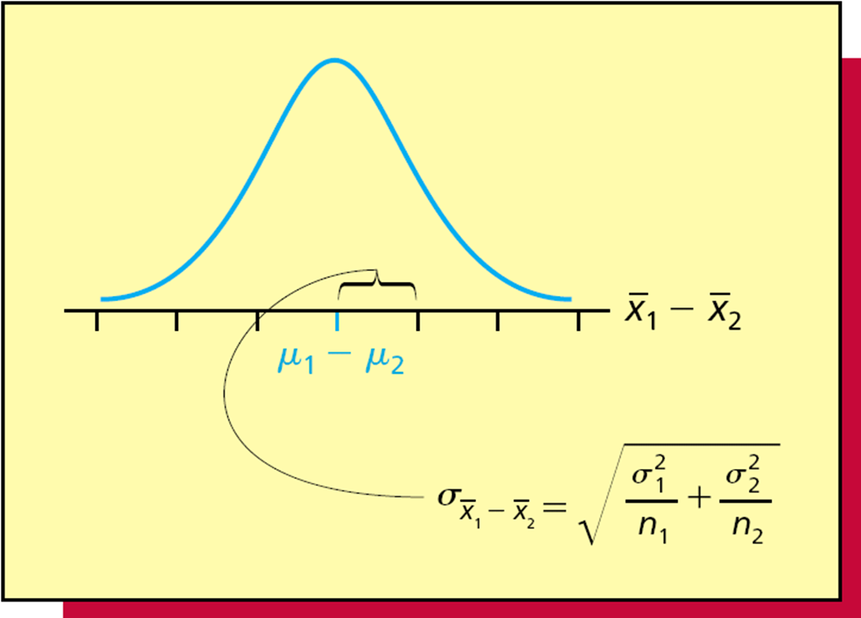
Sampling Distribution of the Difference of Two Sample Means #3
LO10-1
Figure 10.1

Slide 7
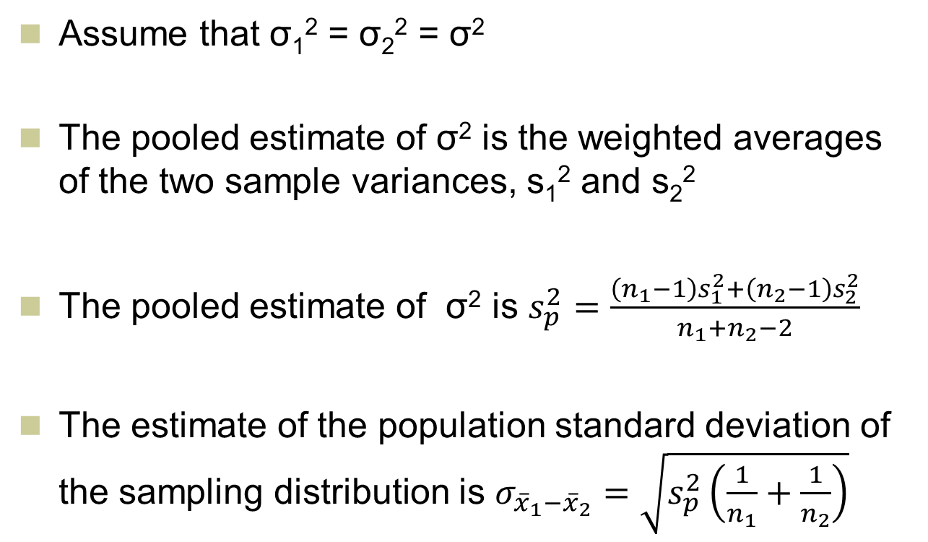
Pooled Estimate of σ²
LO10-1
Assume that σ₁² = σ₂² = σ²
The pooled estimate of σ² is the weighted averages of the two sample variances, s₁² and s₂²
The pooled estimate of σ² is $s_{p}^{2}=\frac{\left(n_{1}−1\right)s_{1}^{2}+\left(n_{2}−1\right)s_{2}^{2}}{n_{1}+n_{2}−2}$
The estimate of the population standard deviation of the sampling distribution is $σ_{{\overline{x}}_{1}−{\overline{x}}_{2}}=\sqrt{s_{p}^{2}\left(\frac{1}{n_{1}}+\frac{1}{n_{2}}\right)}$

Slide 8
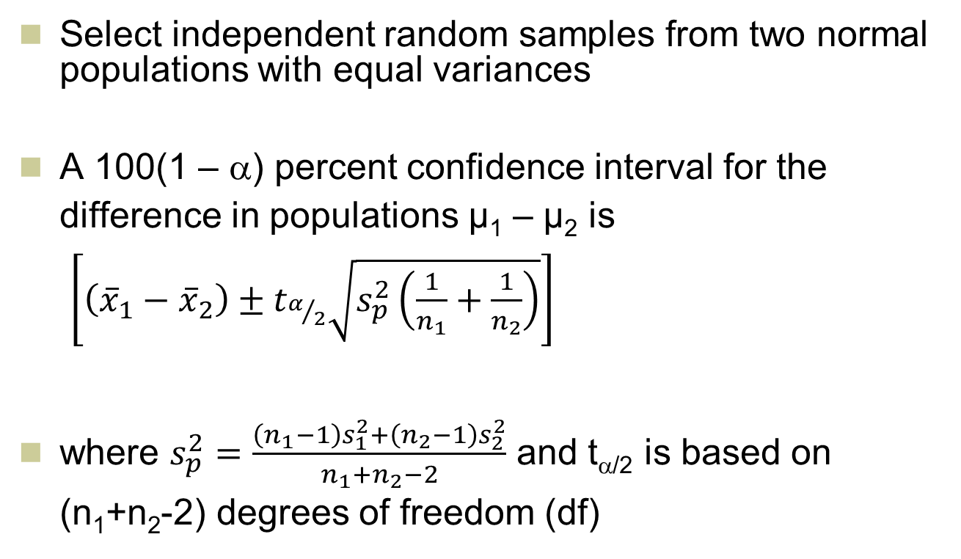
t-Based Confidence Interval for the Difference in Means: Variances Equal
LO10-1
Select independent random samples from two normal populations with equal variances
A 100(1 – α) percent confidence interval for the difference in populations µ₁ – µ₂ is $\left[\left({\overline{x}}_{1}−{\overline{x}}_{2}\right)±t_{α/2}\sqrt{s_{p}^{2}\left(\frac{1}{n_{1}}+\frac{1}{n_{2}}\right)}\right]$
where $s_{p}^{2}=\frac{\left(n_{1}−1\right)s_{1}^{2}+\left(n_{2}−1\right)s_{2}^{2}}{n_{1}+n_{2}−2}$ and t_{α/2} is based on (n₁+n₂-2) degrees of freedom (df)

Slide 9
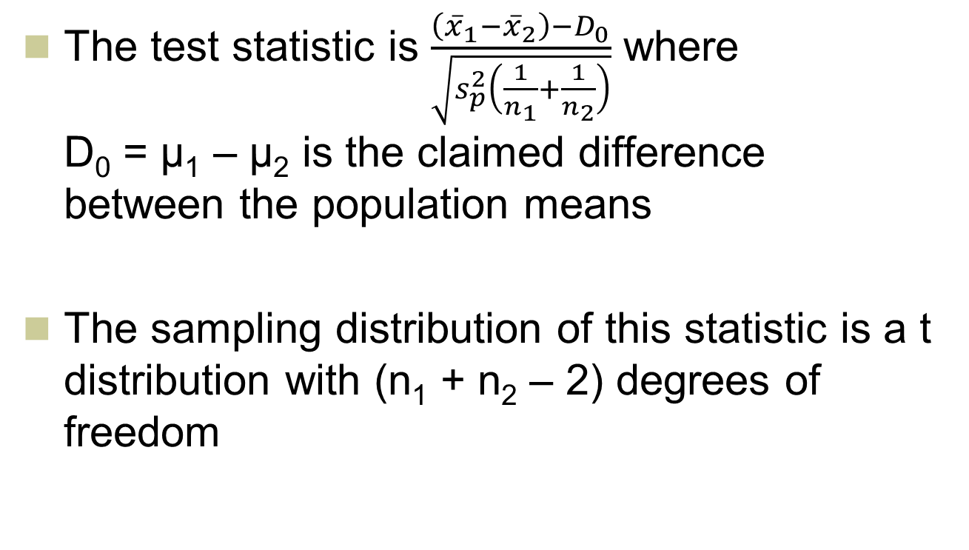
Test Statistic: Variances Equal
L010-1
The test statistic is $\frac{\left({\overline{x}}_{1}−{\overline{x}}_{2}\right)−D_{0}}{\sqrt{s_{p}^{2}\left(\frac{1}{n_{1}}+\frac{1}{n_{2}}\right)}}$ where D₀ = µ₁ – µ₂ is the claimed difference between the population means
The sampling distribution of this statistic is a t distribution with (n₁ + n₂ – 2) degrees of freedom

Slide 10
t-Based Test About the Difference in Means: Equal Variances
LO10-1

Slide 11

t-Based Confidence Intervals and Tests for Differences with Unequal Variances
LO10-1
Confidence interval is $\left({\overline{x}}_{1}−{\overline{x}}_{2}\right)±t_{α/2}\sqrt{\left(\frac{s_{1}^{2}}{n_{1}}+\frac{s_{2}^{2}}{n_{2}}\right)}$
Test statistic is $\frac{\left({\overline{x}}_{1}−{\overline{x}}_{2}\right)−D_{0}}{\sqrt{\left(\frac{s_{1}^{2}}{n_{1}}+\frac{s_{2}^{2}}{n_{2}}\right)}}$

Slide 12
t-Based Confidence Intervals and Tests for Differences with Unequal Variances #2
LO10-1
For both the confidence interval and hypothesis test, the degrees of freedom are equal to…

Slide 13
10.2 Paired Difference Experiments
LO 10-2: Recognize when data come from independent samples and when they are paired.
Before, drew random samples from two different populations
Now, have two different processes (or methods)
Draw one random sample of units and use those units to obtain the results of each process

Slide 14
Paired Difference Experiments Continued
LO10-2
For instance, use the same individuals for the results from one process vs. the results from the other process
E.g., use the same individuals to compare “before” and “after” treatments
Using the same individuals, eliminates any differences in the individuals themselves and just comparing the results from the two processes

Slide 15
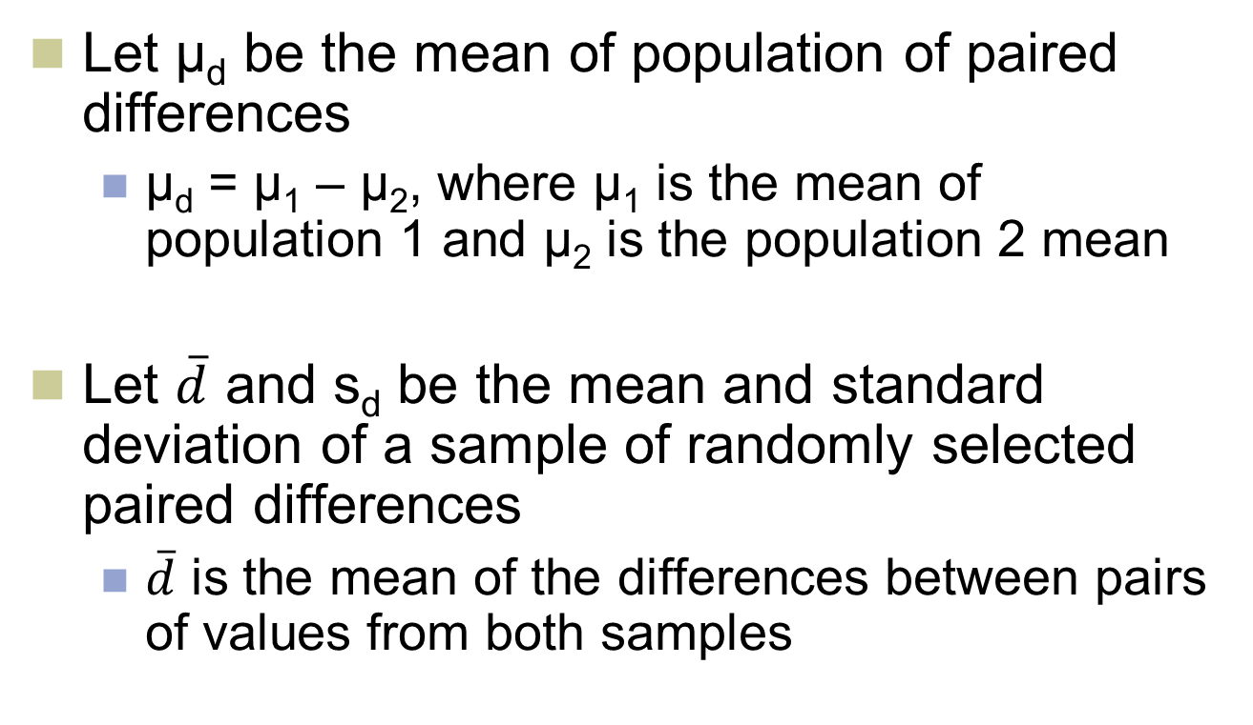
Paired Difference Experiments #3
LO10-2
Let µ_{d} be the mean of population of paired differences
µ_{d} = µ₁ – µ₂, where µ₁ is the mean of population 1 and µ₂ is the population 2 mean
Let $\overline{d}$ and s_{d} be the mean and standard deviation of a sample of randomly selected paired differences
$\overline{d}$ is the mean of the differences between pairs of values from both samples

Slide 16
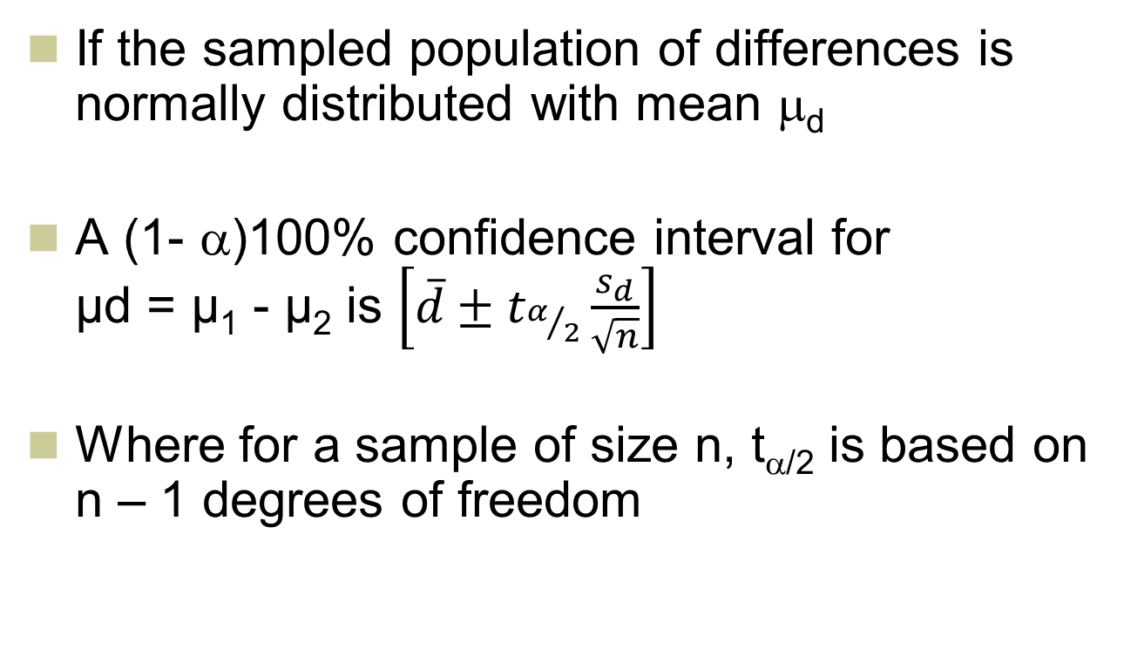
A Confidence Interval for Paired Differences in Means
LO 10-3: Compare two population means when the data are paired.
If the sampled population of differences is normally distributed with mean μ_{d}
A (1- α)100% confidence interval for µd = µ₁ - µ₂ is $\left[\overline{d}±t_{α/2}\frac{s_{d}}{\sqrt{n}}\right]$
Where for a sample of size n, t_{α/2} is based on n – 1 degrees of freedom

Slide 17
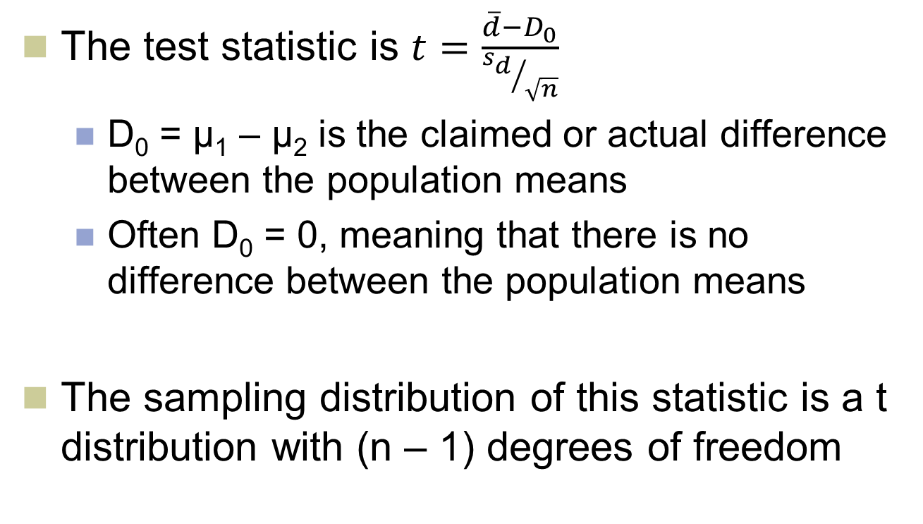
Testing a Hypothesis about the Mean of Paired Differences
LO10-3
The test statistic is $t=\frac{\overline{d}−D_{0}}{{s_{d}}/{\sqrt{n}}}$
D₀ = µ₁ – µ₂ is the claimed or actual difference between the population means
Often D₀ = 0, meaning that there is no difference between the population means
The sampling distribution of this statistic is a t distribution with (n – 1) degrees of freedom

Slide 18
Paired Differences Testing Rules
LO10-3

Slide 19
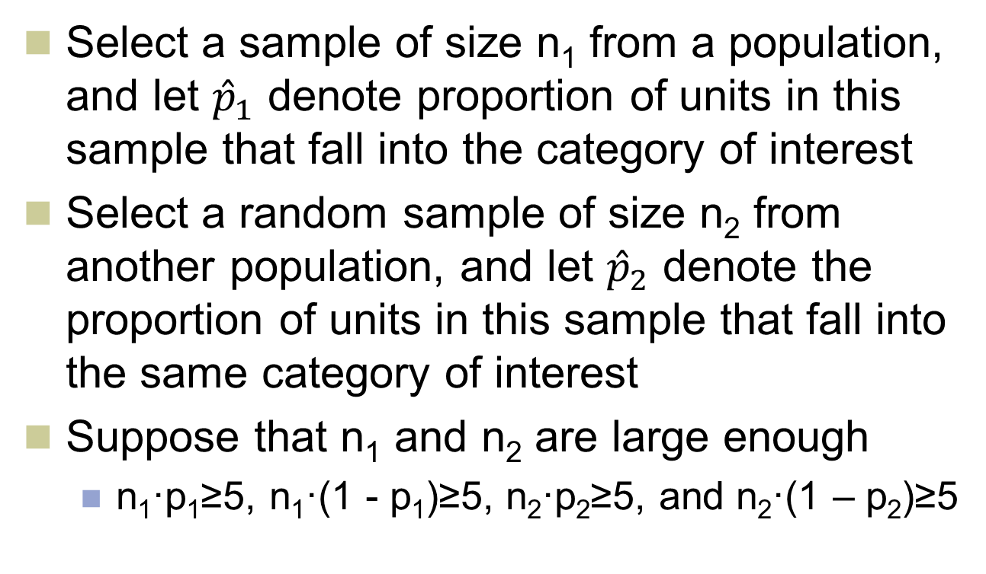
10.3 Comparing Two Population Proportions by Using Large, Independent Samples
LO 10-4: Compare two
population proportions using large independent
samples.
Select a sample of size n₁ from a population, and let ${\hat{p}}_{1}$ denote proportion of units in this sample that fall into the category of interest
Select a random sample of size n₂ from another population, and let ${\hat{p}}_{2}$ denote the proportion of units in this sample that fall into the same category of interest
Suppose that n₁ and n₂ are large enough
n₁·p₁≥5, n₁·(1 - p₁)≥5, n₂·p₂≥5, and n₂·(1 – p₂)≥5

Slide 20
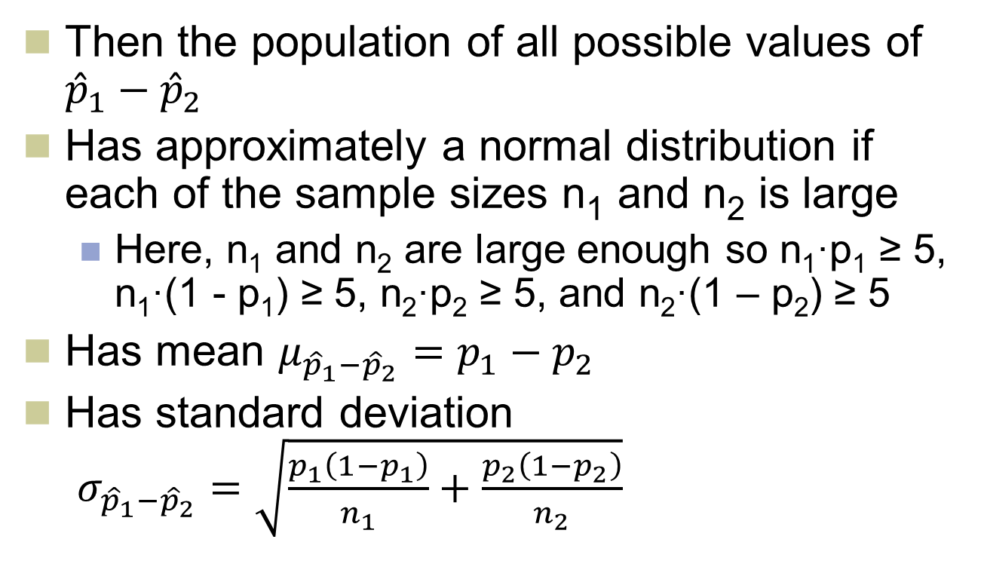
Comparing Two Population Proportions Continued
LO10-4
Then the population of all possible values of ${\hat{p}}_{1}−{\hat{p}}_{2}$
Has approximately a normal distribution if each of the sample sizes n₁ and n₂ is large
Here, n₁ and n₂ are large enough so n₁·p₁ ≥ 5, n₁·(1 - p₁) ≥ 5, n₂·p₂ ≥ 5, and n₂·(1 – p₂) ≥ 5
Has mean $μ_{{\hat{p}}_{1}−{\hat{p}}_{2}}=p_{1}−p_{2}$
Has standard deviation $σ_{{\hat{p}}_{1}−{\hat{p}}_{2}}=\sqrt{\frac{p_{1}\left(1−p_{1}\right)}{n_{1}}+\frac{p_{2}\left(1−p_{2}\right)}{n_{2}}}$

Slide 21

Confidence Interval for the Difference of Two Population Proportions
LO10-4
If the random samples are independent of each other, then the following is a 100(1 – α) percent confidence interval for ${\hat{p}}_{1}−{\hat{p}}_{2}$

Slide 22
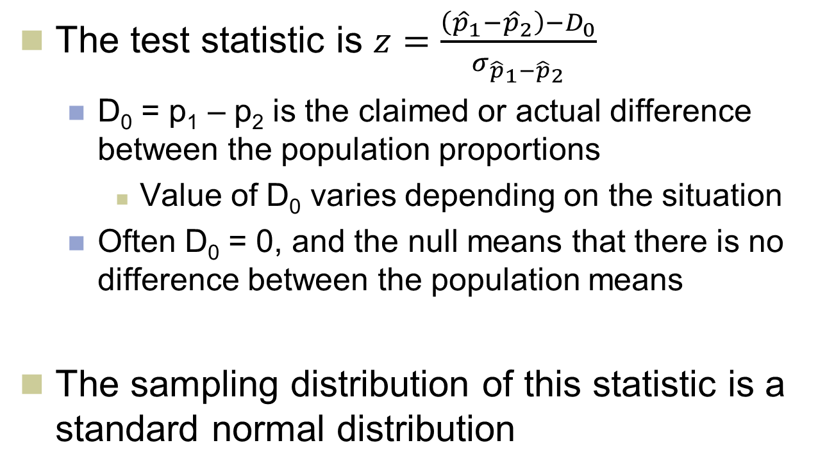
Test Statistic for the Difference of Two Population Proportions
LO10-4
The test statistic is $z=\frac{\left({\hat{p}}_{1}−{\hat{p}}_{2}\right)−D_{0}}{σ_{{\hat{p}}_{1}−{\hat{p}}_{2}}}$
D₀ = p₁ – p₂ is the claimed or actual difference between the population proportions
Value of D₀ varies depending on the situation
Often D₀ = 0, and the null means that there is no difference between the population means
The sampling distribution of this statistic is a standard normal distribution

Slide 23
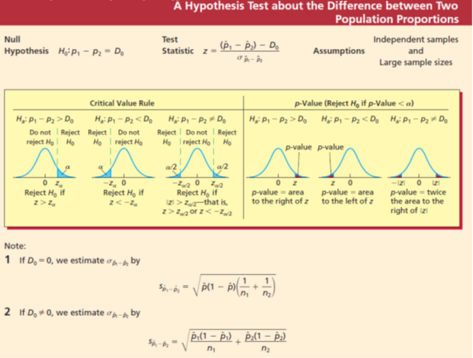
A Hypothesis Test about the Difference between Two Population Proportions
LO10-4

Slide 24
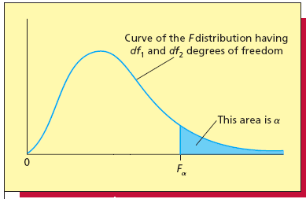
10.4 F Distribution
LO 10-5: Describe the properties of the F distribution and use an F table.
Figure 10.12a
The F is skewed to the right
Shape depends on two parameters: the numerator number of degrees of freedom (df₁) and the denominator number of degrees of freedom (df₂)
Figure 10.12a

Slide 25
F Distribution
LO10-5
The F point F_{α} is the point on the horizontal axis under the curve of the F distribution that gives a right-hand tail area equal to α
The value of F_{α} depends on a (the size of the right-hand tail area) and df₁ and df₂
Different F tables for different values of α

Slide 26
Testing the Equality of Population Variances versus a One-Tailed Alternative
LO10-5

Slide 27
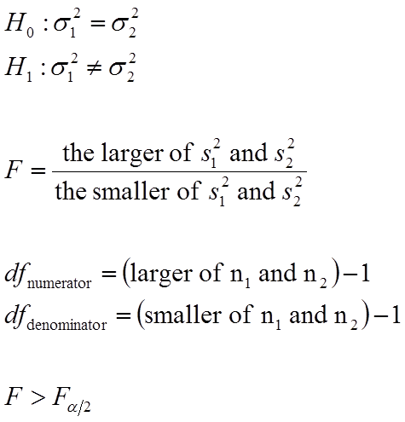
Testing the Equality of Population Variances versus a Two-Tailed Alternative
LO10-5

Slide 28
A Portion of an F Table
LO10-5
Table 10.6

Slide 29
10.5 Comparing Two Population Variances Using Independent Samples
LO 10-6: Compare two population variances when the samples are independent.
Population 1 has variance σ₁² and population 2 has variance σ₂²
The null hypothesis H₀ is that the variances are the same
H₀: σ₁² = σ₂²
The alternative is one is smaller
That population has less variability
Suppose σ₁² > σ₂²
More usual to normalize
Test H₀: σ₁²/σ₂² = 1 vs. σ₁²/σ₂² > 1

Slide 30
Comparing Two Population Variances Using Independent Samples Continued
LO10-6
Reject H₀ in favor of H_{a} if s₁²/s₂² is significantly greater than 1
s₁² is the variance of a random of size n₁ from a population with variance σ₁²
s₂² is the variance of a random of size n₂ from a population with variance σ₂²
To decide how large s₁²/s₂² must be to reject H₀, describe the sampling distribution of s₁²/s₂²
The sampling distribution is the F distribution

