Slide 1
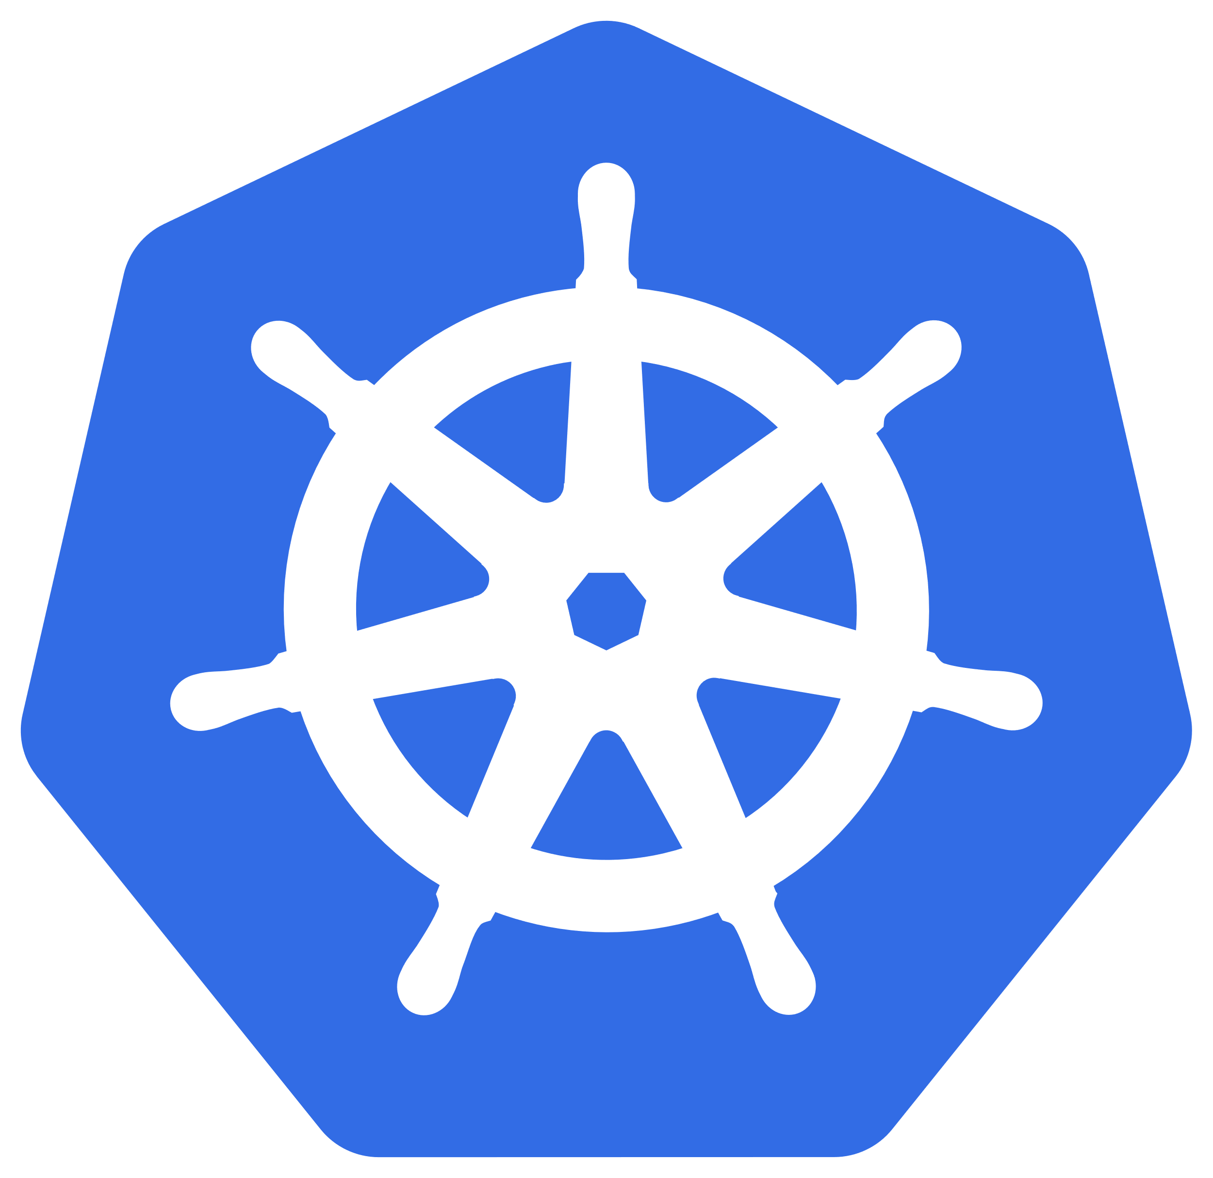
Half the Size, Twice as Awesome
Kubernetes for All of Us
https://github.com/choudeshell/techbash-k3s-workshop

Slide 2
The Plan.
Learn K8s with K3s…
resources
tooling
compute
storage
networking
How?
doing
reading the docs
talking

Slide 3
The Goal.
The primary goal of this workshop is to demonstrate that Kubernetes is approachable and is for all of us.
We will do this through:
Getting your own Kubernetes instance up and running
Understanding the basics of Kubernetes
Kubernetes tooling

Slide 4
Schedule.
50 minutes: Up and Running & Basics
50 minutes: Deployments & Scaling
50 minutes: Kubernetes Networking
50 minutes: Volumes & Secrets

Slide 5

About me
I am a geek.
I love technology.
I am hiring.
https://www.energycap.com/company/careers
Let’s Connect!
Chris Houdeshell
VP of Engineering and Operations EnergyCAP
@choudeshell
choudeshell@gmail.com

Slide 6

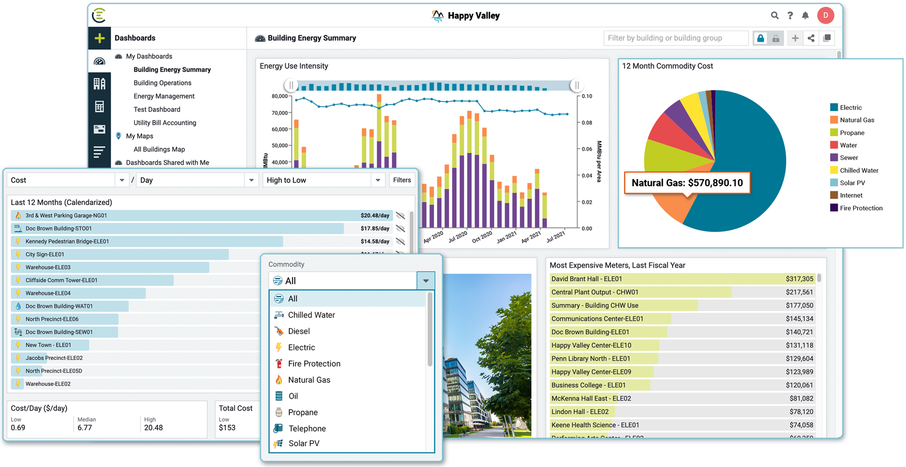
EMPOWER YOUR ENERGY DATA
Say goodbye to spreadsheets, late fees, and inefficiencies. There’s a better way to manage and gain value from your vendor, utility, and facility data.

Slide 7
ENC Clusters
East US
Pittsburgh – k3s.
Pittsburgh – k3s.
State College – k3s.
Azure – aks.
Ireland
AWS– eks.
West US
Azure – aks.

Slide 8
What is Kubernetes?

Slide 9
Kubernetes
is an open source container orchestration platform that automates deploying, managing, and scaling containerized applications.

Slide 10
Kubernetes
is an open source container orchestration platform that automates deploying, managing, and scaling containerized applications.
Apache License 2.0
Commercial use
Modification
Distribution

Slide 11
Kubernetes
is an open source container orchestration platform that automates deploying, managing, and scaling containerized applications.
lightweight packages of your application code together with dependencies

Slide 12
Kubernetes
is an open source container orchestration platform that automates deploying, managing, and scaling containerized applications.
automation of the
operational effort

Slide 13
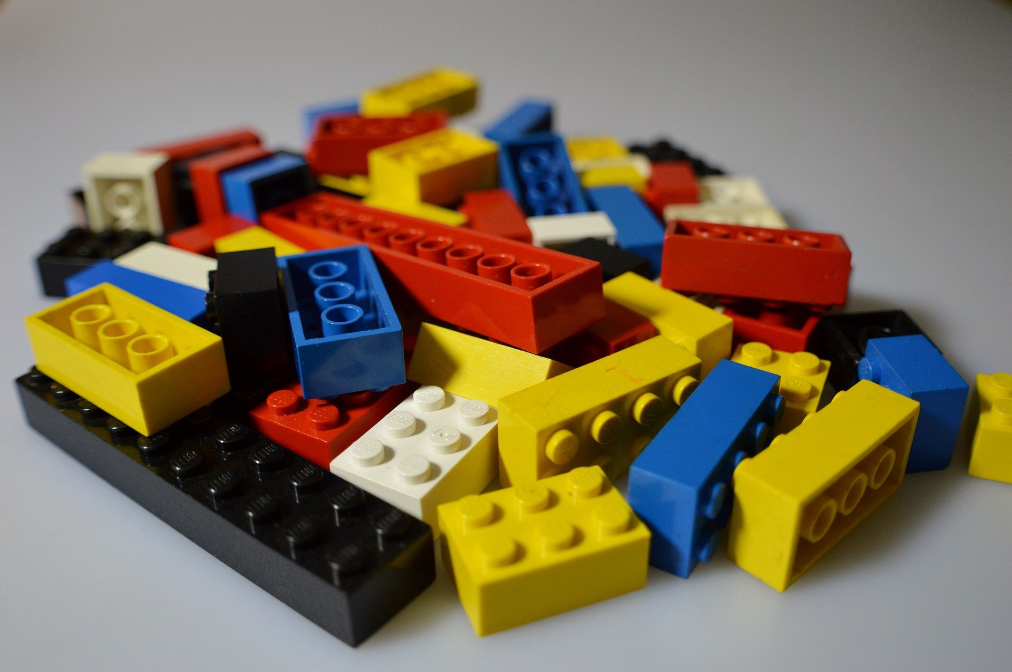

Slide 14
What is K3s?

Slide 15
K3s
is a certified distribution of Kubernetes

Slide 16
K3s
is a certified distribution of Kubernetes
Cloud Native Computing Foundation (CNCF) serves as the vendor-neutral umbrella organization

Slide 17
K3s
Consistency: Users want consistency when interacting with any installation of Kubernetes.
Timely updates: To remain certified, vendors need to provide the latest version of Kubernetes yearly or more frequently, so you can be sure that you’ll always have access to the latest features the community has been working hard to deliver.
Confirmability: Any end user can confirm that their distribution or platform remains conformant by running the identical open source conformance application that was used to certify.
ref: https://www.cncf.io/certification/software-conformance/
is a certified distribution of Kubernetes

Slide 18
Is Kubernetes complex and difficult?

Slide 19
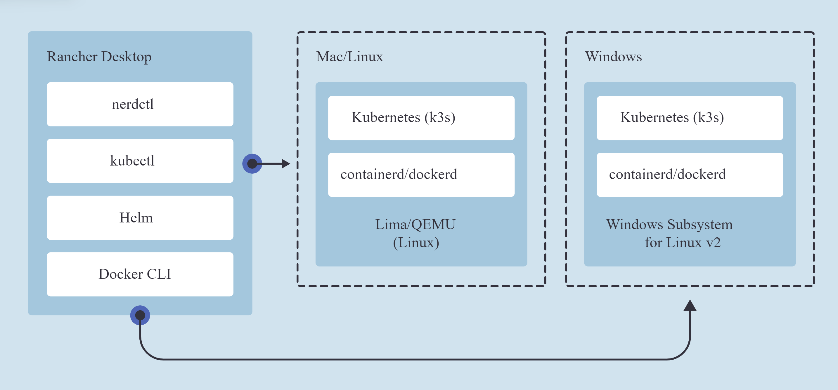

Slide 20
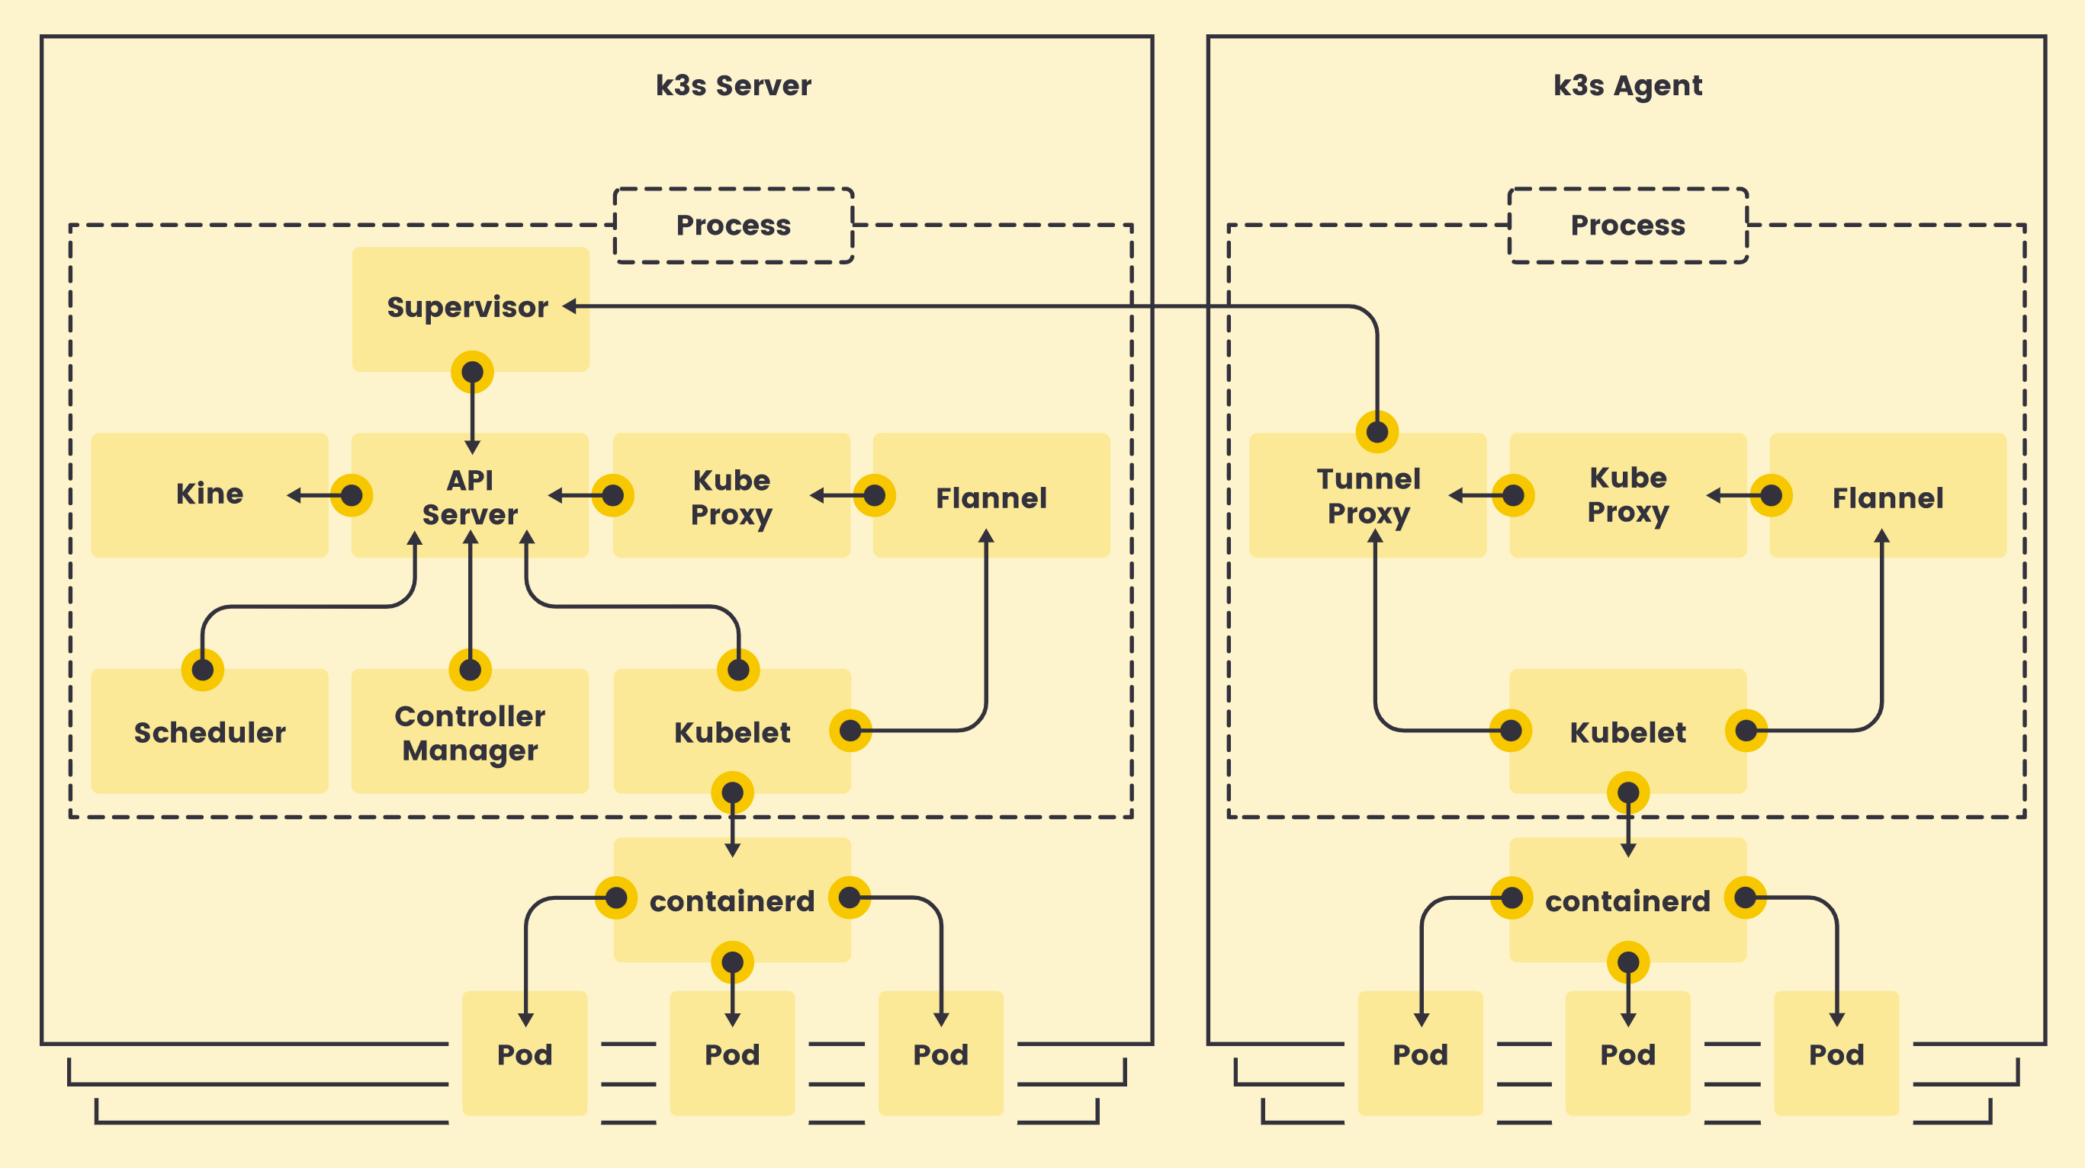

Slide 21
Let’s get started! https://github.com/choudeshell/techbash-k3s-workshop

Slide 22
Quick Feedback
👍
👎

Slide 23
Let’s Connect
@choudeshell
choudeshell@gmail.com

