Slide 1








Credit Risk Analysis using Power BI
Presented by Shubham Choudhari

Slide 2
Introduction
Objective: Analyze financial risk associated with loans and identify patterns in defaults.
Tools Used: Power BI, DAX, Power Query
Dataset Source: Credit Risk dataset with borrower demographics, loan info, and default status
Key Techniques: DAX metrics, What-If analysis, Segmentation, Time analysis, Row-level security

Slide 3
Dataset Overview
Total Records: [Rows : 32581, Columns : 13]
Key Fields:
person_age, person_income, person_home_ownership, person_emp_length
loan_amnt, loan_int_rate, loan_status, loan_grade, loan_intent
cb_person_cred_hist_length, cb_person_default_on_file

Slide 4
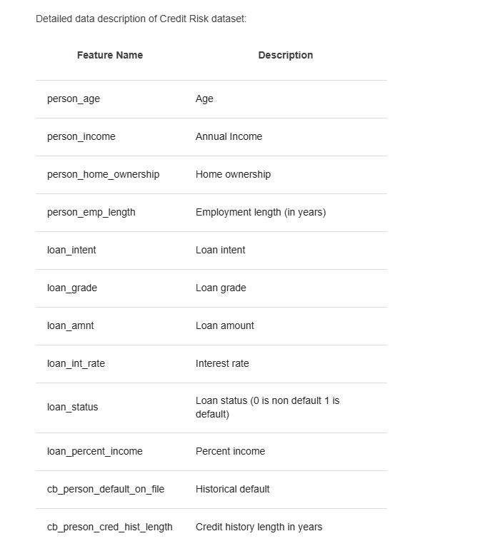
Data Description

Slide 5
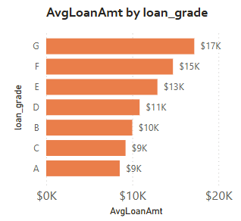
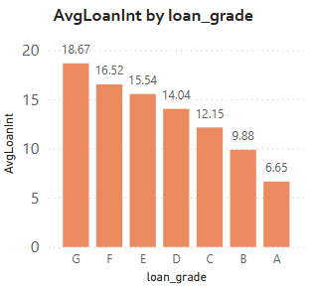
Financial Analysis
Goal: Average loan amount, interest rate, and default rate by loan grade
Key DAX:
AvgLoanAmount
AvgInterestRate
DefaultRate
Key Insights:
Higher grades (A, B) have:
Lower default rates,Lower interest rates,Stable average loan sizes
Lower grades (G, F, E):Associated with higher risk,Require higher interest rates to compensate
Conclusion:
Improved loan grades correlate with lower risk and more favorable terms.
Targeting high-grade borrowers helps reduce defaults and improve overall loan portfolio performance.

Slide 6
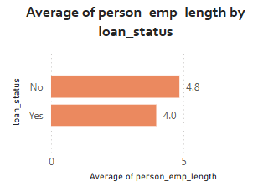
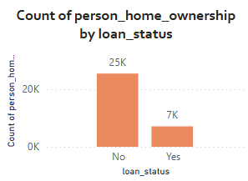
Loan Status by Employment & Ownership
Goal: Analyze loan status distribution across employment length and home ownership
Visuals:Stacked bar chart by person_emp_length vs loan_status
Key Findings:Longer employment correlates with a lower default rate for loans.
The total count of individuals who own homes is lower among those with active loans.
Conclusion: The analysis shows a clear disparity: approximately 25K individuals who are homeowners did not default, while only about 7K homeowners defaulted.
This analysis illustrates that longer employment is associated with better loan performance, while home ownership status varies significantly with loan default rates.

Slide 7
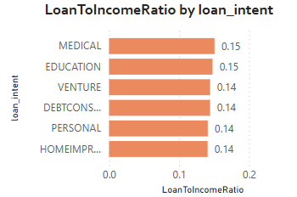
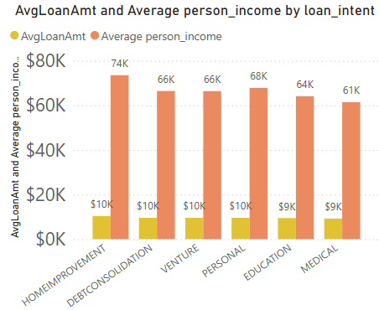
Segmentation Analysis by Loan Intent
Goal: Analyze how loan_intent affects income, loan amount & risk
DAX:
LoanToIncomeRatio = AVERAGE(loan_amnt) / AVERAGE(person_income)
Insight: Medical and Educational loans have higher loan-to-income ratios
Home Improvement and Personal loan have the higher Avg-loan Amount.
Conclusion: Understanding the loan intent is crucial for determining financial planning and risk assessment strategies.

Slide 8
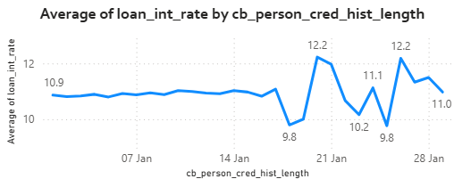
Time Series by Credit History
Goal: Study intrest rate by cb_person_cred_hist_length
Approach: Created bins: 5-10, 11-15,16-20,21-25
Visual: Line chart – Credit History vs Default Intrest Rate
Trend Overview: Fluctuations in average interest rates over time, highlighting changes corresponding to different credit history lengths.
Key Finding: A longer credit history correlates with a reduction in default risk, indicating potentially lower interest rates for those with extensive credit histories.
Conclusion:Understanding the relationship between credit history and interest rates can help lenders make informed decisions and manage risk effectively.

Slide 9
What-If Analysis
Goal: Simulate effect of changing interest rate on defaults
DAX:
Created What-If Parameter: SimilutedInterestRate
Simulated DAX: Default_Rate =
CALCULATE(DIVIDE(COUNTROWS(FILTER(credit_risk_dataset, credit_risk_dataset[loan_status] = 1)), COUNTROWS(credit_risk_dataset)),
ALLEXCEPT(credit_risk_dataset, credit_risk_dataset[loan_grade])
)
Key Findings
Higher interest rates may lead to an increased probability of loan defaults.
Conclusion
The simulation indicates a potential correlation between rising interest rates and increased default rates, emphasizing the need for careful monitoring and risk assessment when setting interest rates for loans.

Slide 10
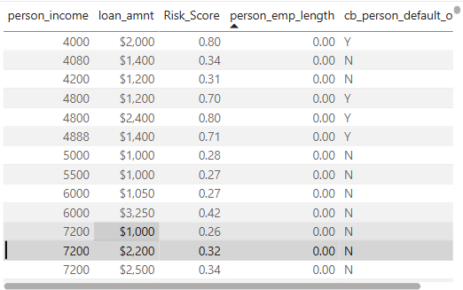
Risk Score Analysis
Formula:
Risk_Score =
VAR LoanRatio = DIVIDE(credit_risk_dataset[loan_amnt], credit_risk_dataset[person_income])
VAR HasDefaulted = IF([cb_person_default_on_file] = "Y", 1, 0)
VAR EmploymentFactor = 1 - DIVIDE(credit_risk_dataset[person_emp_length], 20)
RETURN
ROUND((LoanRatio * 0.4) + (HasDefaulted * 0.4) + (EmploymentFactor * 0.2), 2)
Risk Assessment:
Combining multiple factors gives a comprehensive risk profile.
Decision Making:
Facilitates informed lending decisions based on calculated risk.
This structured content should guide you in creating an informative and engaging slide for your audience.

Slide 11
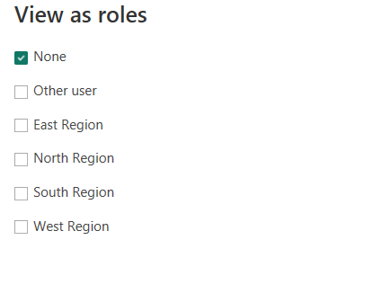
Data Restriction Analysis
Purpose: The primary goal is to restrict data visibility based on user roles, such as geographic regions or departments.
Steps:Defined roles in Power BI using filters
Example: [Region] = "East"
Defined Roles in Power BI: Creating specific roles that correspond with the data access requirements.
Utilization of Filters: Filters are applied to ensure that users only see data relevant to their assigned roles.
Conclusion: Row-Level Security is a powerful feature that, when implemented effectively, can substantially enhance data governance, ensure compliance, and provide a tailored data experience for users.Overall, establishing Row-Level Security in Power BI is critical for organizations seeking to protect their data while allowing appropriate access to users based on their roles.

Slide 12
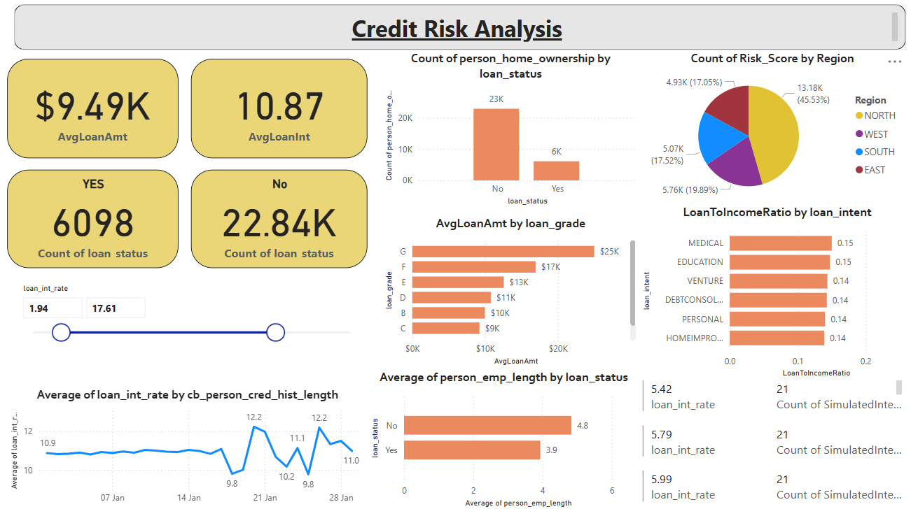
Dashboard Design & Publishing

Slide 13
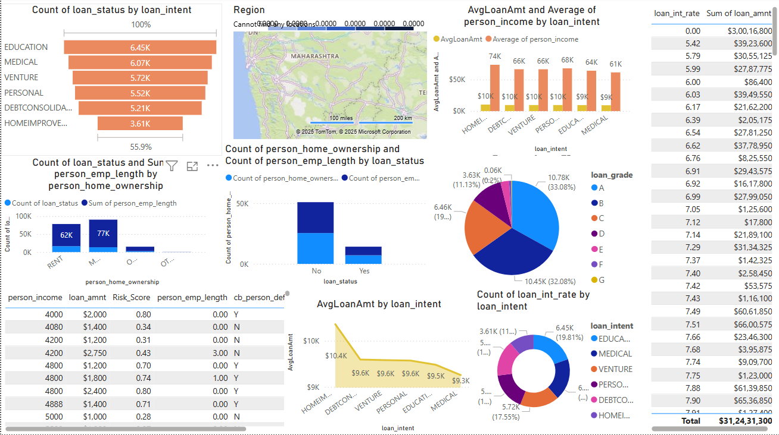
Dashboard Design & Publishing

Slide 14
Summary
Key Findings:
Credit history and employment are key factors
Loan intent and income ratio affect default risk
Risk scoring helps prioritize loan approvals
Impact: Helps financial institutions assess credit risk visually and interactively

Slide 15

Thank
You
Questions?
📩 Email: Choudharishubham28@yahoo.in
🔗 LinkedIn: Choudharishubham28
Youtube :https://www.youtube.com/watch?v=1Ton2yYLHFg

