Slide 1




Madrid Real Estate Market Analysis
Project by Shubham Choudhari | Power BI Dashboard Presentation
KEY INSIGHTS FROM MADRID

Slide 2




Key insights from the Madrid real estate market reveal crucial trends and opportunities for informed investment decisions.
The analysis covers data cleanup results, pricing based on property features, investment opportunities, dashboard observations, and strategic recommendations for potential investors.

Slide 3



Data Cleaning
Removed duplicated listings using id and is_duplicated logic used remove duplicate method for cleaning.
Replace null values and blank space with the 0.
Also some of the columns were unstructured make that in structured.
Retained only the most recent records for accurate reporting with the help of sorting

Slide 4
Price Analysis of Property Features
Recent trends reveal that property attributes significantly impact pricing. Features such as location, size, and amenities have shown varied effects on overall market value.
Key Insight
Properties with balconies also show a higher average price.
Summary Insights
Higher Average Prices: Properties with gardens, pools, and parking show notably higher values.
Lower Average Prices: New developments tend to have a slightly lower average price than established properties.
Balcony Benefits: Having a balcony can also enhance property value.
Conclusion
Investing in properties with sought-after features (like gardens, pools, and parking) can yield higher returns.

Slide 5
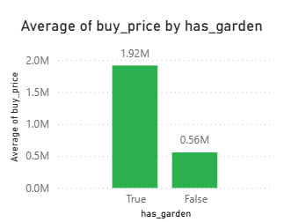
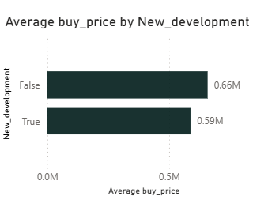
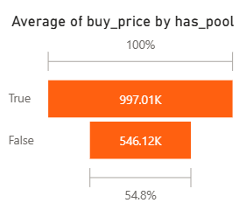
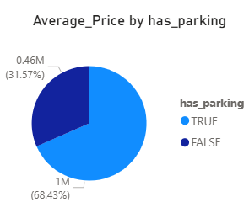
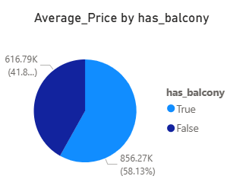
Analysis on Property Features

Slide 6
Promising Investment Analysis
The Madrid real estate market presents unique opportunities for investors, particularly in emerging areas where property values are set to increase significantly over the next few years.
Analysis Summary
Dominance of HouseType 2:HouseType 2 commands the highest average buy price and price per square meter, indicating strong market demand for this property type.
Diverse Price Ranges:The spread in average prices across different house types suggests varying preferences and property values based on characteristics and locations.
Low Value HouseType 1:HouseType 1 (Pisos) has the lowest average price and price per square meter, pointing towards potential opportunities for pricing adjustments or renovations to increase value.
This comprehensive analysis underscores the dynamics of house pricing and can inform future real estate strategies.

Slide 7
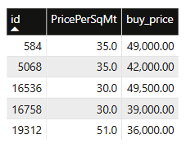
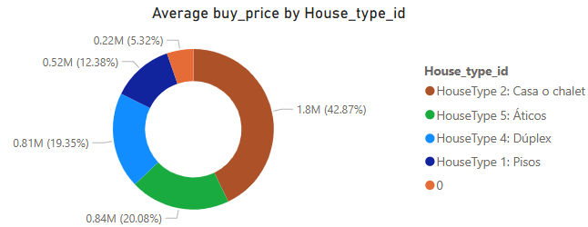
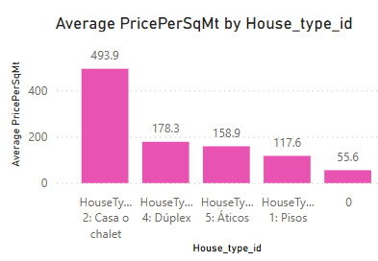
Analysis on Segments
Table Insights:Comparison of individual properties showcasing their Price Per Square Meter and total Buy Price.
Conclusions:Significant variations in average buy prices and prices per square meter among different house types.
Ideal for understanding market segments and making informed investment decisions.
This structured content would help in effectively communicating the analysis on segments.

Slide 8
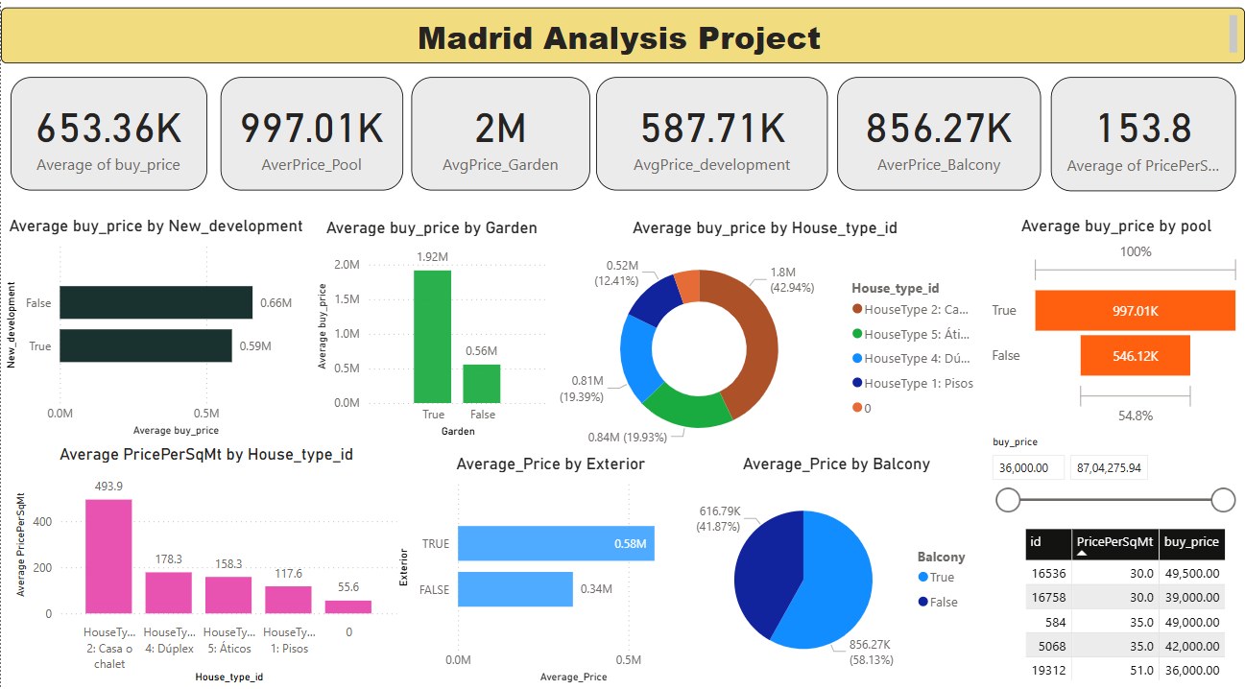
Interactive Dashboard Observations

Slide 9
Strategic Recommendations
Focus marketing on pool/garden properties.
Invest in low-interest, high-space homes in fast-growing regions.
Use dashboard monthly for real-time market tracking.

Slide 10


“In real estate, data integrity is as crucial as oil is to the economy; it fuels informed decisions.”

Slide 11



For more insights, reach out!
Email
choudharishubham28@yahoo.in
Social media
https://www.youtube.com/watch?v=_vKX3qsyaww
Phone
9096047450

