Slide 1



MEDICAL COST DATA ANALYSIS IN EXCEL
Analyzing Healthcare Spending Patterns
by
Shubham R Choudhari
Group Borcelle

Slide 2



CONTENT
Data Overview
Analysis on Age,medical charges & BMI
Gender Analysis
Analysis of Smoking on Costs Dependents Analysis
Dependents vs. Medical Charges Analysis
Geographical Insights: Regional Variation in Medical Costs & BMI
Cost Distribution Analysis
BMI Analysis
Advanced Correlation Analysis
Smoking & Regional Impact on Medical Costs
Dashboard Overview

Slide 3


DATA OVERVIEW
Columns: List the key columns in the dataset:
Age
Sex
BMI
Children
Smoker
Region
Charges
Data Cleaning : Data cleaning was done handling missing values, data type conversions. no cleaning was needed, that the data was clean and ready for analysis.
Objective: Derive insights into medical costs based on demographics and behaviors

Slide 4
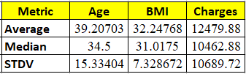
ANALYSIS ON AGE,MEDICAL CHARGES & BMI
Goal: Analysis on Age,medical charges & BMI
Methodology: Calculated the average, median, and standard deviation for each variable using Excel's AVERAGE, MEDIAN, and STDEV functions.
Key Insights:
Medical Charges: High average and large spread.
Right-skewed due to expensive treatments.
BMI : Nearly symmetrical distribution.
Low variation, centered around 30.
Age: Balanced distribution (mean ≈ median).
Moderate spread of values.
Conclusion: Medical costs show high variability, impacting healthcare affordability.BMI and age show consistent patterns, ideal for predictive modeling and deeper analysis.

Slide 5

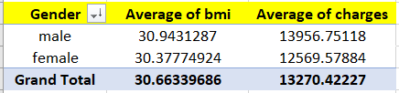
GENDER ANALYSIS
Goal: Compare the average medical charges and BMI by Gender.
Methodology: Used AVERAGEIF or a Pivot Table to calculate the average medical charges and BMI for each gender.
Key Insights: Males have higher average medical charges by approximately $1,387.
Average BMI is also higher for males, suggesting a link to health-related costs.
Both genders fall within the obese range (BMI ≥ 30), indicating potential public health concerns.
Conclusion:Males show slightly higher BMI and healthcare costs, highlighting potential gender differences in health risks and financial burden. Useful for designing gender-specific wellness programs or risk assessments.

Slide 6
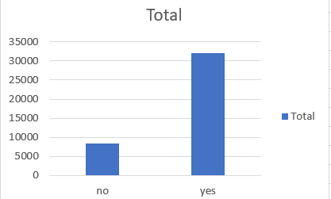

ANALYSIS OF SMOKING ON COSTS
Goal: "How does smoking status affect medical costs?"
Methodology: Used AVERAGEIFS or a Pivot Table to calculate the average medical charges for smokers and non-smokers
.
Insights: Smokers pay 4x more in medical costs than non-smokers.
Indicates a higher burden of disease and medical intervention.
Smoking-related costs place pressure on the healthcare system.
Emphasizes need for preventive health measures and cessation programs.

Slide 7
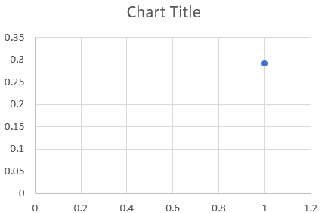
DEPENDENTS VS. MEDICAL CHARGES ANALYSIS
Goal: Relationship between the number of dependents (children) and medical charges.
Methodology: Calculated the correlation coefficient using CORREL.
Correlation Coefficient: 0.067998227
Key Insights: Indicates a weak positive correlation.
Slight upward trend in charges as number of children increases.
The scatter plot shows no strong linear pattern.
Conclusion: The number of dependents has a limited impact on medical costs.
Other variables like age, BMI, or smoking status are more influential in driving medical expenses..

Slide 8
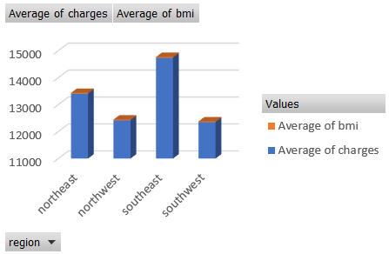
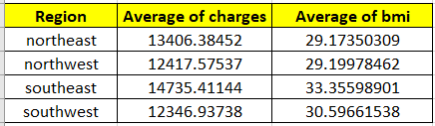
GEOGRAPHICAL INSIGHTS: REGIONAL VARIATION IN MEDICAL COSTS & BMI
Methodology: Used a Pivot Table to calculate the average medical charges and BMI for each region.
Bar chart confirms that the Southeast leads in both cost and BMI.
Key Insights:The Southeast region has the highest average in both medical charges and BMI.
Other regions show lower BMI and costs, particularly the Northwest and Northeast.
Conclusion: There are clear regional disparities in health metrics.
The Southeast’s higher BMI and costs highlight the need for targeted health interventions and policy attention in that region.

Slide 9
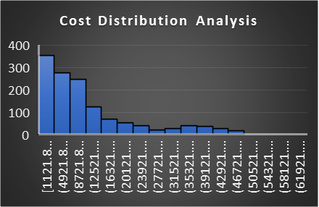
COST DISTRIBUTION ANALYSIS
Methodology: Created a histogram using the Data Analysis Toolpak or the FREQUENCY function.
Results: The histogram shows a right-skewed distribution.
The most frequent medical cost bracket is $250–$275.
Key Insights: Majority of patients have medical charges on the lower end of the scale.
A few patients fall into extremely high-cost brackets, causing a long right tail.
This indicates the presence of outliers that may heavily influence the overall average.
Conclusion: Medical charges are not normally distributed.
Most patients incur lower costs, but high-cost outliers significantly skew the data.

Slide 10
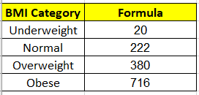
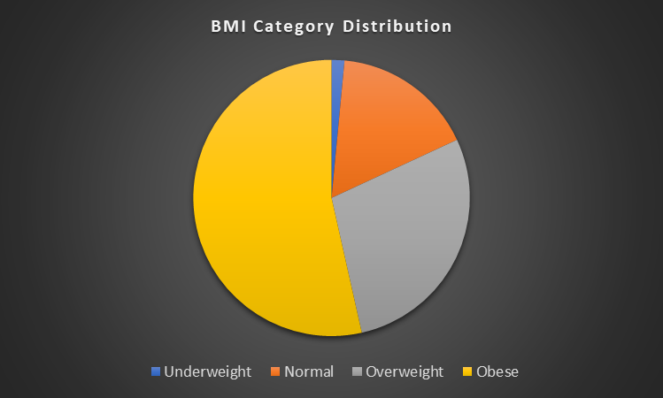
BMI ANALYSIS
Goal: Classify BMI into Underweight (<18.5),Normal (18.5–24.9),Overweight (25–29.9),Obese (30+)
Methodology: Used Excel COUNTIFS to classify each individual into the appropriate BMI category.
Results: Pie chart clearly shows the Obese category dominates the distribution.
Key Insights: Over 50% of the population is obese, indicating a significant health concern.
Underweight individuals are rare, contributing to minimal medical risk from low BMI.
The Normal and Overweight categories form the middle segment and may benefit from preventive care to avoid escalation.
Conclusion:The majority of beneficiaries fall in the Obese BMI range, highlighting the urgent need for targeted interventions, wellness programs, and risk mitigation strategies.

Slide 11
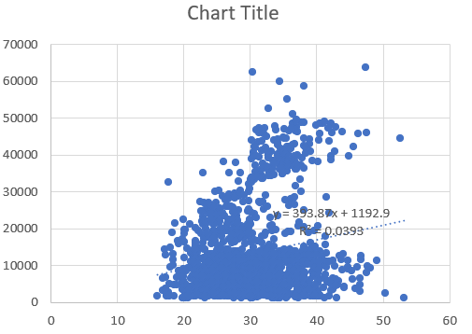
ADVANCED CORRELATION ANALYSIS
Goal : Correlation between BMI and medical charges.
Methodology: Created a scatter plot with a trendline and calculated the correlation coefficient.
Results: Include the scatter plot with the trendline, equation, and R-squared value = 0.1983.
Conclusion:A positive correlation exists between BMI and medical charges.
While the trend is upward, the correlation is moderate, indicating BMI influences charges, but other factors (e.g., smoking, age) are also significant.

Slide 12
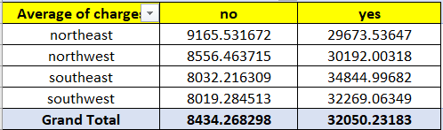
SMOKING & REGIONAL IMPACT ON MEDICAL COSTS
Goal: Region with the highest medical costs for smokers.
Methodology: Used Pivot Table and AVERAGEIFS to calculate the average medical charges for smokers in each region
.
Results: Present a table showing the average costs:
Interpretation: Medical charges for smokers are significantly higher across all regions.
The Southeast stands out with the highest smoker-related costs, highlighting a potential healthcare cost burden in this region.
May indicate need for region-specific smoking cessation programs.

Slide 13

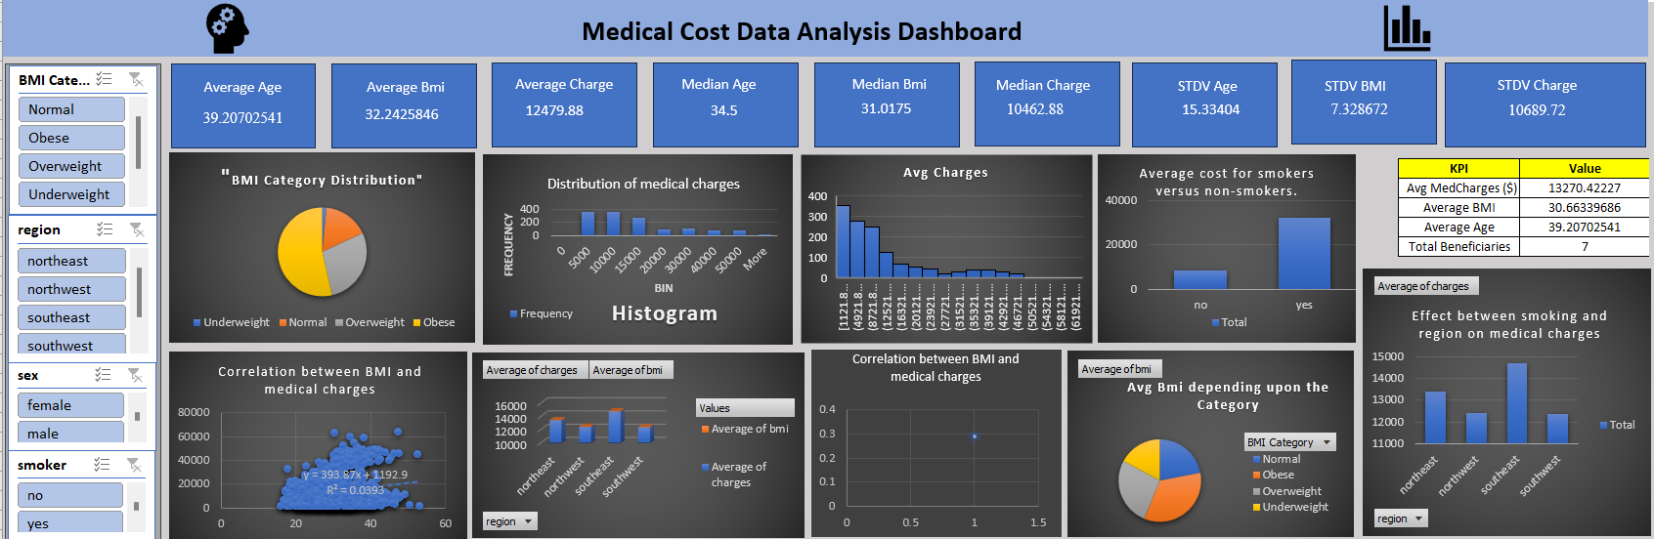

DASHBOARD OVERVIEW

Slide 14




CONTACT SUPPORT
9096047450
choudharishubham28@yahoo.in
https://www.youtube.com/watch?v=DPnagU65IzA

