Slide 1
AED Project Fall 15
Cancer Treatment Assistance Application
By Saurabh Choudhary

Slide 2
About the Problem
Cancer is a fatal disease for which no one if prepared to deal with before hand.
The procedures, tests, precautions and information involved is too overwhelming.
The treatment cures the disease but simultaneously damages the body by leaving the patient vulnerable and weak. In other words its treatment is like killing a poison with another poison.
With so much to handle, main problem is for patient , doctor and associated people to manage and direct the treatment in right direction to improve effectiveness of treatment offered.

Slide 3
Few steps towards solving the problem with an IOT approach.
Integrate several associated environments at one place.
Offer reliable and genuine information at one place.
Offer documentation to keep a proper track of treatment.
To help a patient understand and follow the treatment and keep tabs on everything, this application aims to integrate appointments, tests, medication and information at one place.
Also offers ability to connect with fellow patients for moral strength to deal with the disease in better and positive approach.
This creates a network that could be called as Internet of things(IOT) where one thing connects to another to simplify the problem and tackle it easily

Slide 4
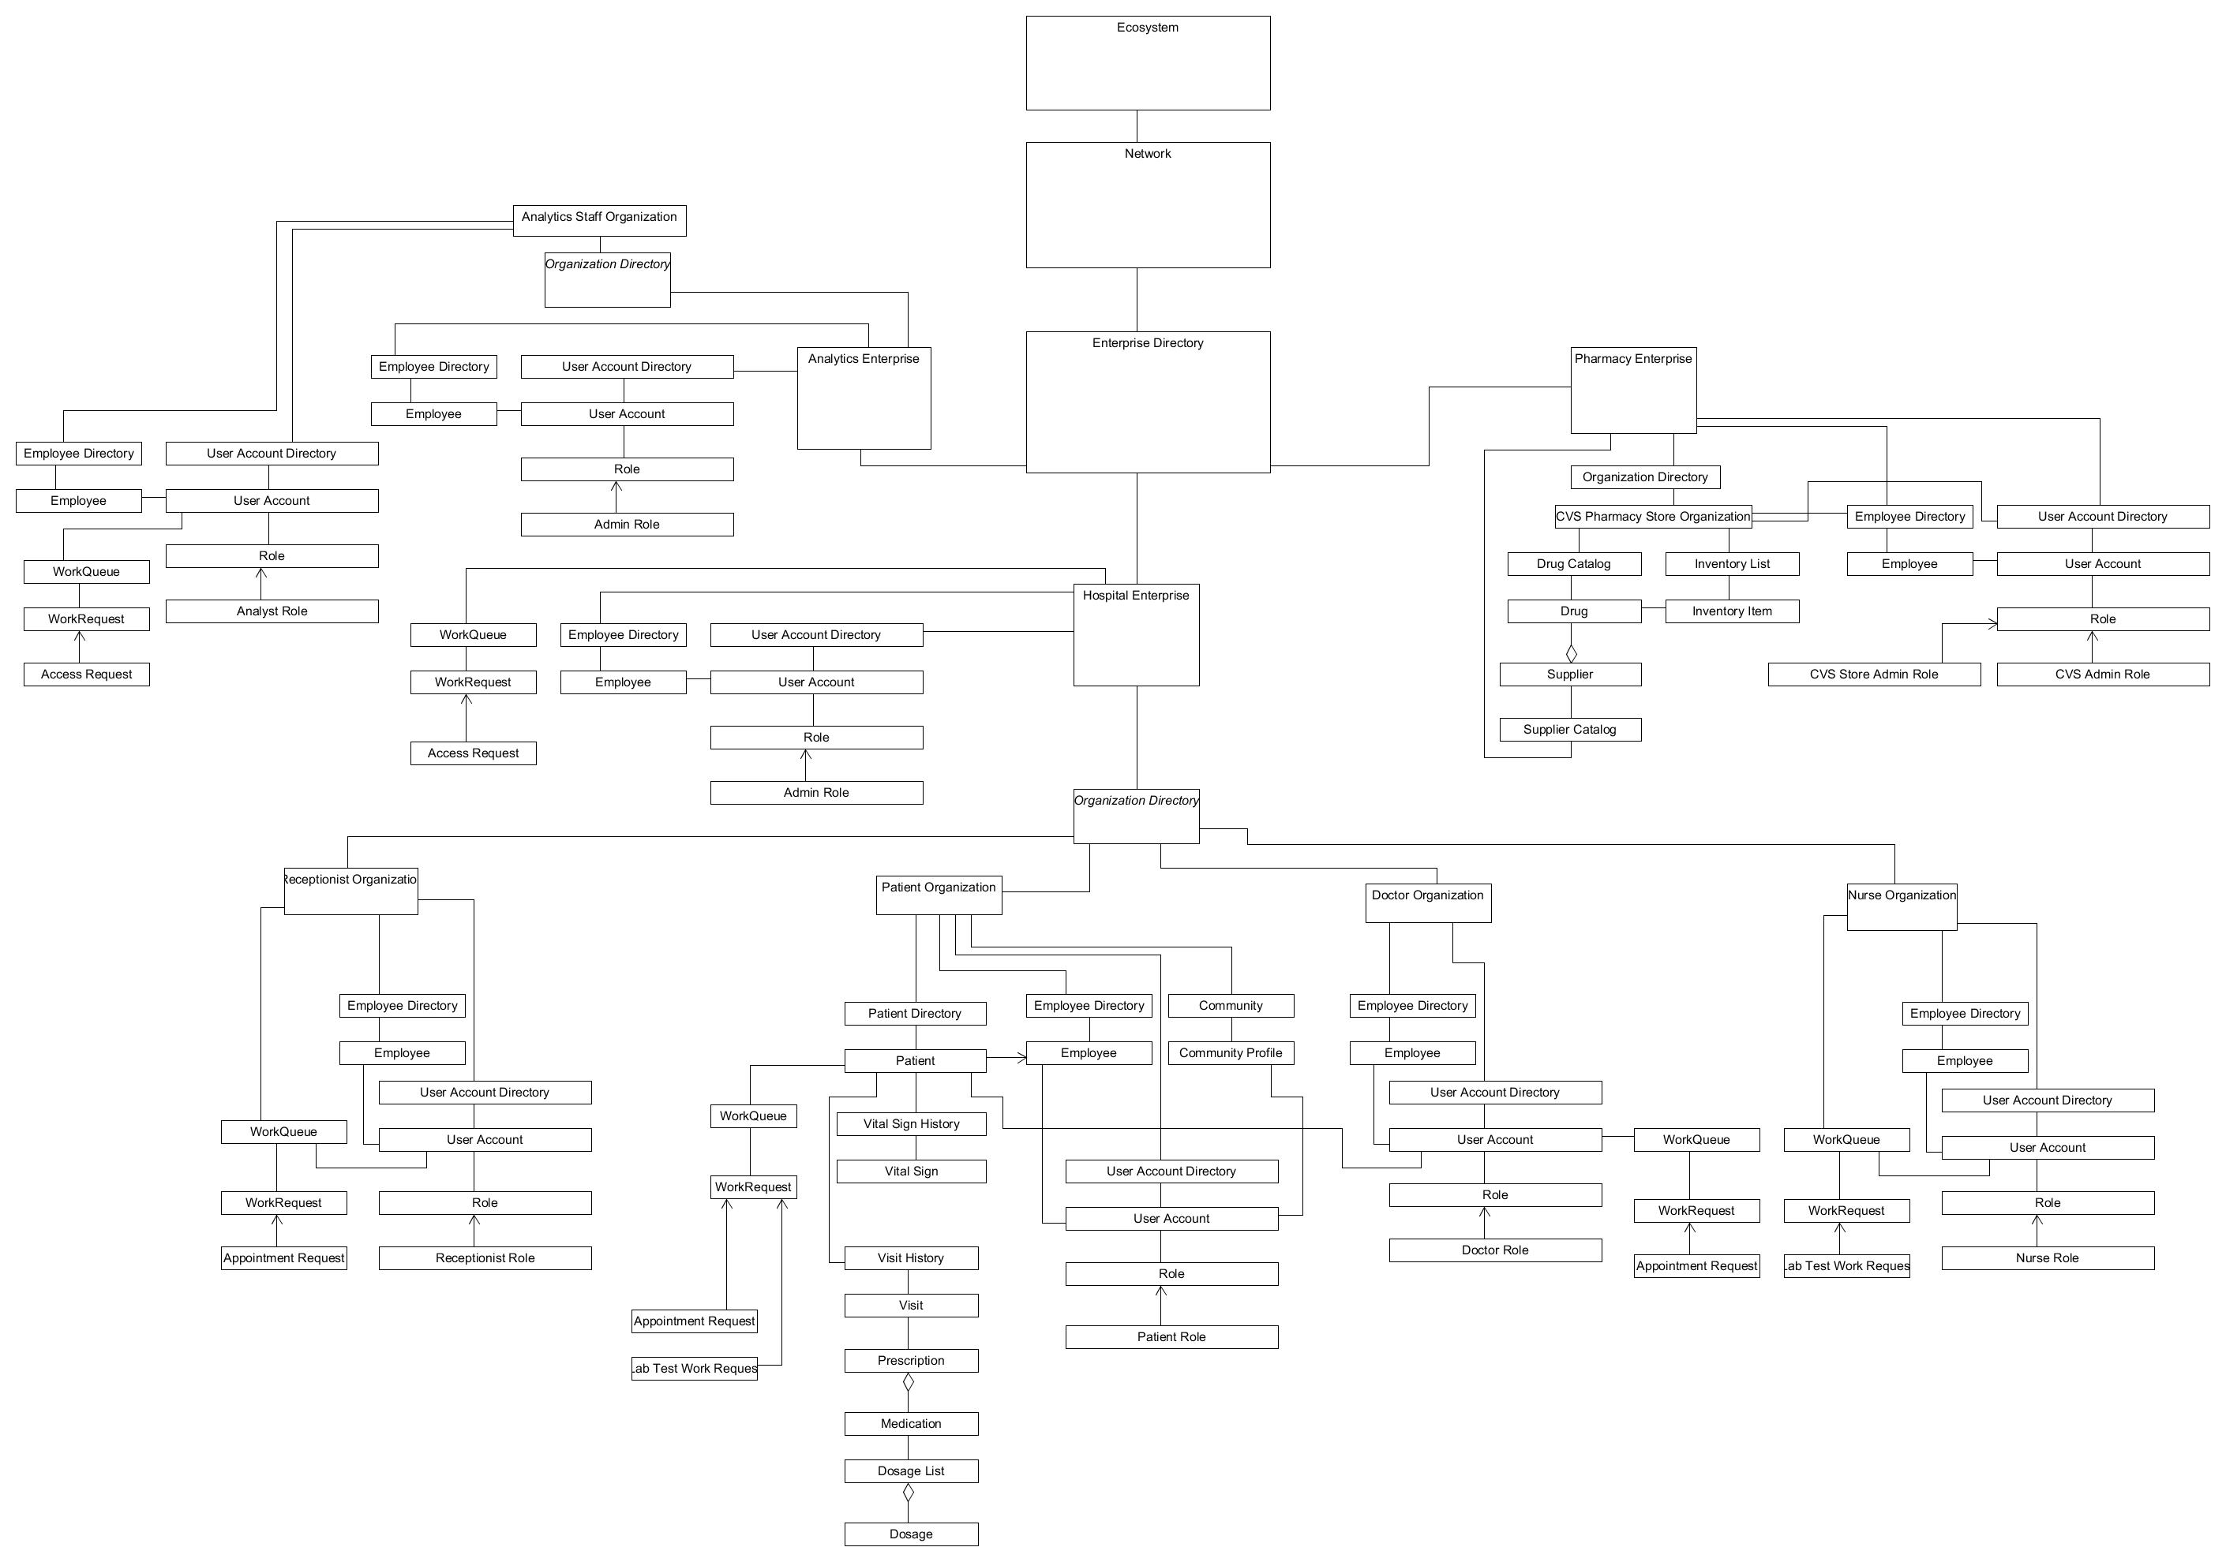
Object Model of the Application
https://drive.google.com/open?id=0B7hpTAuCfb_AQWp2SUZLN1BxbDQ

Slide 5
Object Model
It has been built around the Ecosystem model where all the enterprises are in a network of an ecosystem.
The object model makes use of Singleton pattern in the code.

Slide 6
Roles Included
System Admin
Sets up the entire system at the first login . Creates Network, Enterprises, Enterprise Admins.
Enterprise Admin
Manages the enterprise and associated organizations.
Create employees ,their user accounts.

Slide 7
Enterprise Admins
Hospital Enterprise Admin
Sets up Doctor , Nurse , Patient and Receptionist Organizations.
Creates employees and associated user accounts for Doctor , Receptionist and Nurse organizations.
Manages the access requests from Analytics Enterprises.
Pharmacy Enterprise Admin
Manages the pharmacy store employees and associated user accounts.
Manages setting up of pharmacy stores.

Slide 8
Enterprise Admins
Analytics Enterprise Admin
Manages setting up of Analytics staff organization.
Manages the employee and associated user accounts for analytics staff organization.
Manages the data access requests which are sent to Hospital Enterprise Admins. This data is useful for analyst staff.

Slide 9
Active users/roles
Patient
Doctor
Receptionist
Nurse
Analyst Staff
Pharmacy Store Admin

Slide 10
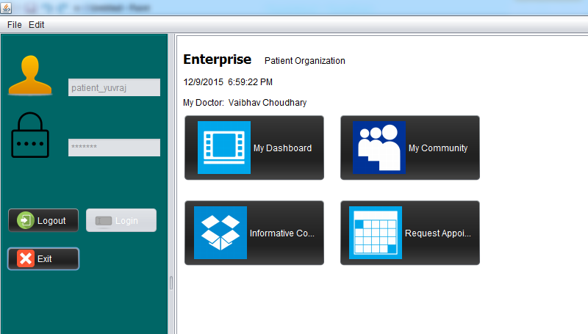
Patient
Patient Login screen looks like this with 4 basic buttons:

Slide 11
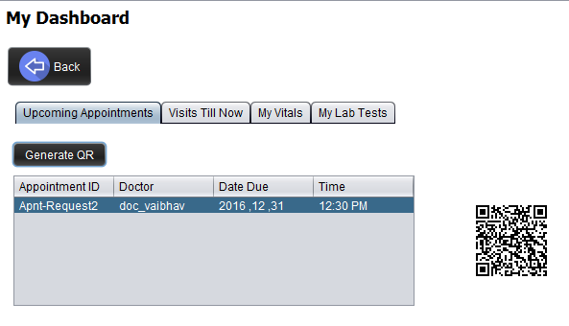
Patient
My Dashboard helps keep track of treatment by giving details of:
Upcoming Appointments, Visits , Vitals and Lab tests.

Slide 12
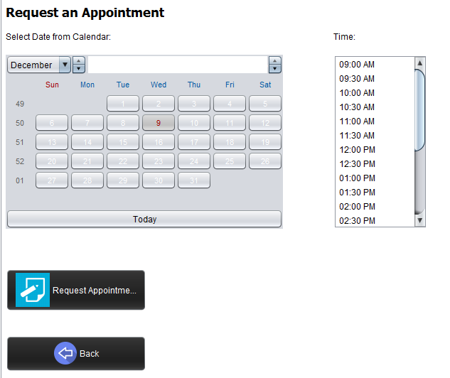
Patient
Request Appointment page helps make appointment request which the receptionist can confirm:

Slide 13
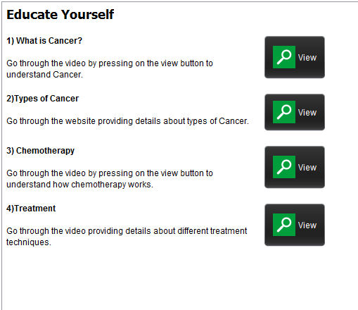
Patient
Informative Content offers a place where user can get genuine and reliable information about cancer . Here user can go through videos and internet pages to educate oneself more about the disease.

Slide 14
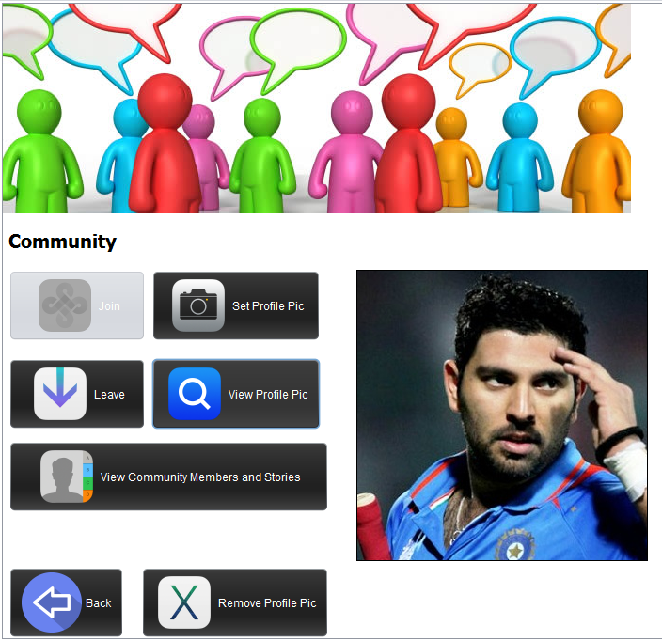
Patient
Community offers a place for connecting to fellow patients and learn from their experiences shared as story. This helps patient understand the prevalence of the disease and that no one was prepared for it. Which in turn gives moral strength to fight the disease.

Slide 15
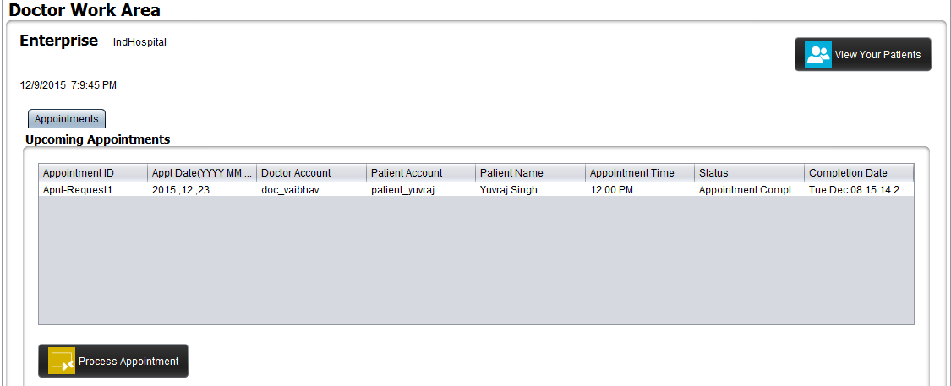
Doctor
Doctor sees the appointment requests in the queue and can process it accordingly .
Also doctor can see the list of his/her patients.

Slide 16
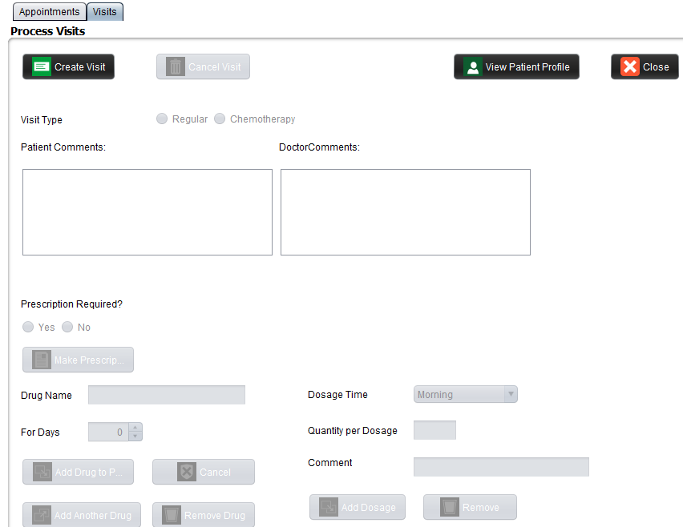
Doctor
Doctor processing the visit and writing prescription as well. Here the Patient’s comment and Doctor’s feedback are
documented which helps in tracking the treatment. Also in future, the entire case can be reviewed as Visit is
recorded in visit history of patient profile.

Slide 17
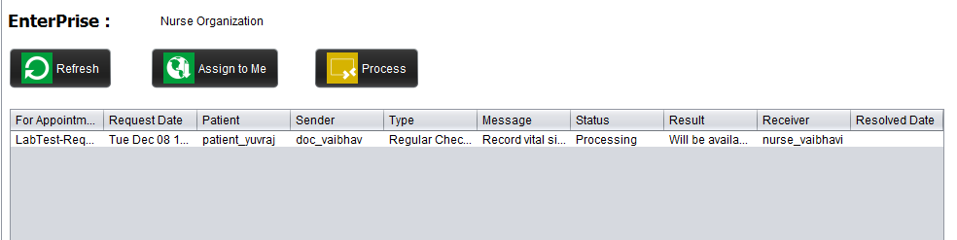
Nurse
Nurse gets the lab test requests from the doctor as the visit gets completed.
Nurse processes the requests depending upon the type of the request.
Processed requests are added to patient profile for his/her reference and future case reviews.

Slide 18
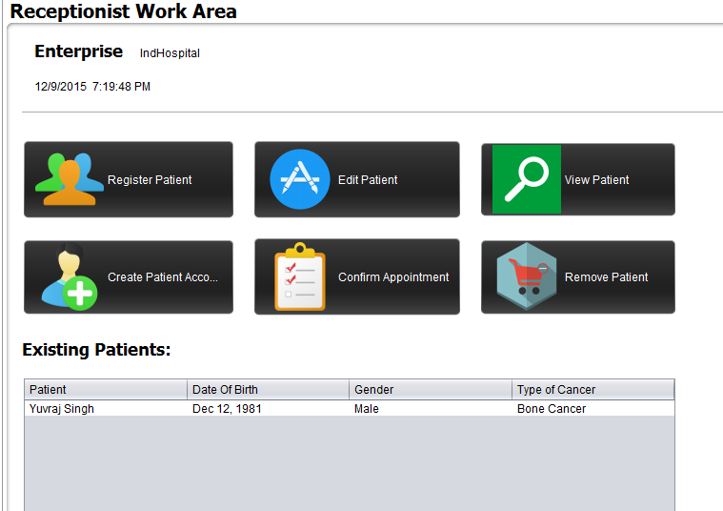
Receptionist
Receptionist can Register Patient, Create Account for Patient, Remove Patient , Edit Patient Profile basic details and can Confirm Appointments:

Slide 19
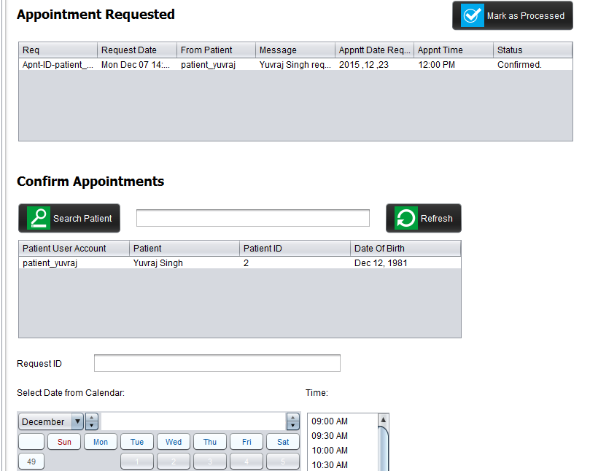
Receptionist
Screen to confirm appointments.

Slide 20
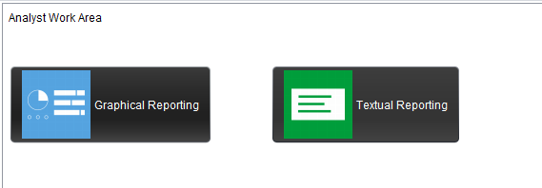
Analyst
Can generate textual and graphical reports:

Slide 21
Some Extra Features
Automatic Email
SMS Triggering
Google Map Access
Community Photo upload
Online Video Tutorials
QR Code generation for user to capture appointment details in cell phone.
Real time data collection of vitals.

Slide 22
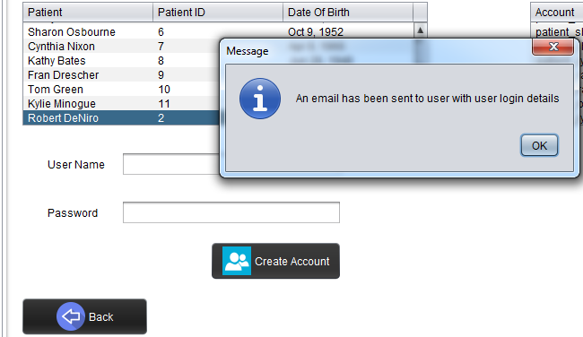
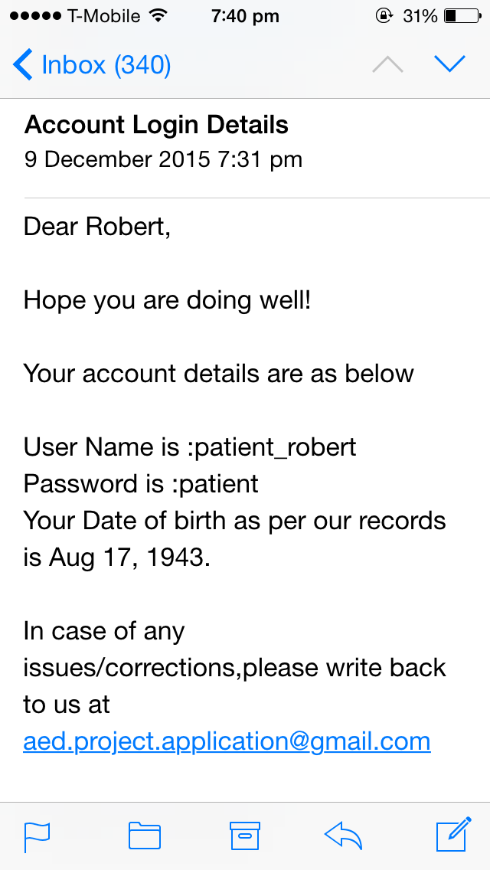
Some Extra Features
When a patient user account is generated in the system by the receptionist, an email alert is triggered to patient at his/her email address with the login details:

Slide 23
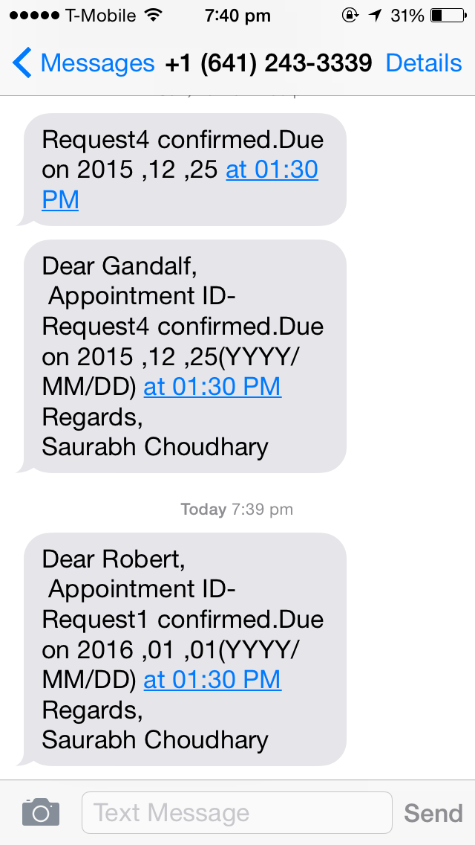
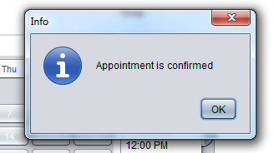
Some Extra Features
On confirming an appointment for a patient, the SMS is triggered automatically from the receptionists id giving the details of appointment to the patient.

Slide 24
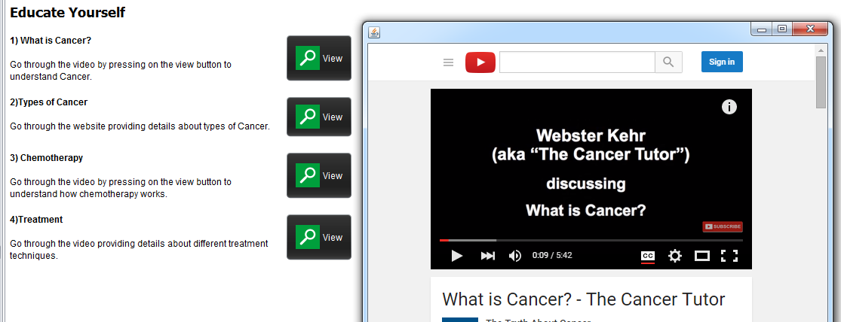
Some Extra Features
Videos:

Slide 25
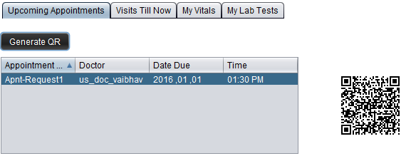
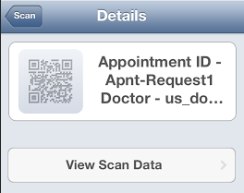
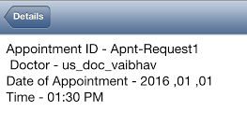
Some Extra Features
QR Code:

Slide 26
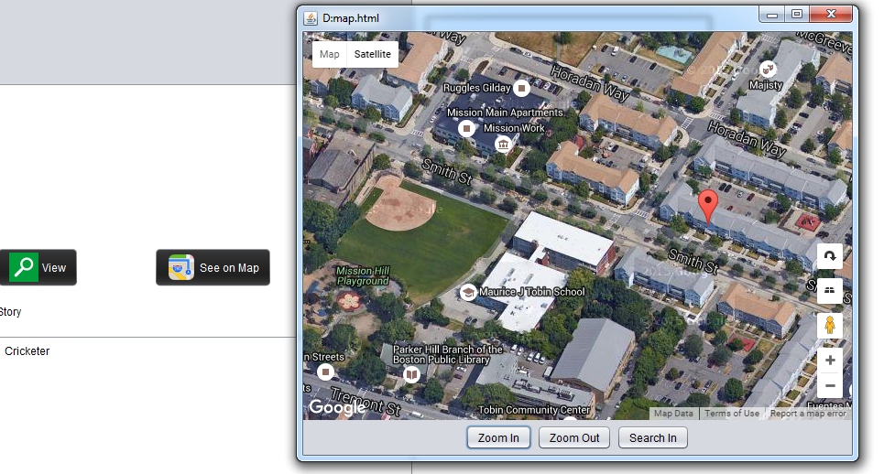
Some Extra Features
Google Map Access

Slide 27
The End!

