Slide 1
Capstone Presentation
Customer Churn Prediction Analysis
Presented By,
Shobha Kumari Choudhary
Date:- 6th April’24

Slide 2
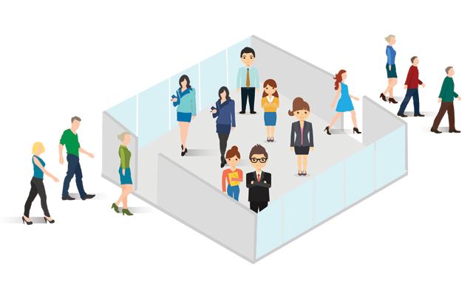
Business Problem Statement
An E Commerce company or DTH (you can choose either of these two domains) provider is facing a lot of competition in the current market and it has become a challenge to retain the existing customers in the current situation. Hence, the company wants to develop a model through which they can do churn prediction of
the accounts and provide segmented offers to
the potential churners. In this company, account churn is a major thing because 1 account can have multiple customers. hence by losing one account the company might be losing more than one customer.
We have been assigned to develop a churn prediction model for this company and provide business recommendations on the campaign.

Slide 3
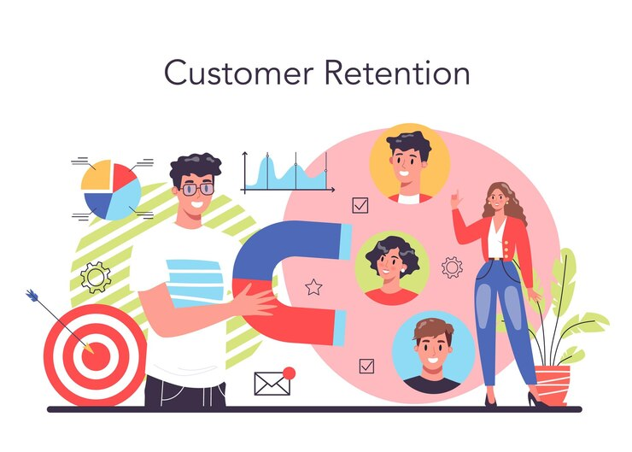
Business Problem Understanding
Customer churn occurs when customers or subscribers stop doing business with a company or service, also known as customer attrition. It is also referred as loss of clients or customers.
Profit is the driving force for every business, and one of the ways businesses can maximize profits is through customer retention. Ensuring customer retention should be a core part of every business because acquiring a new customer can cost businesses 5 to 7 times the amount it requires to keep an old customer.
The Goal of this project is to predict the type of customers that has the potential to churn by identifying various features available that can help in minimizing the customers churn rates and get the right business insights.
It is a Classification Supervised Machine Learning Algorithm.

Slide 4
Data Ingestion
Shape
Datatypes
Dataset contains 11260 Rows & 19 Columns.
Duplicates
No Duplicate Rows present in the Datasets.
Anomalies Present
Special Characters are present in many Features.
Incorrect Datatypes Mapping.
Missing Values
There are Missing Values present In many features.
Outliers
Outliers are Present in the Dataset.
Target Variable
16.8% are churned customers & 83.2% are non-churn customers.
Contains Integer, Float and Categorical type Data.
Columns Gender & Account_segment contains Redundant Categories.
Proportion of the Missing values are less than 30%.
There is Class Imbalance in the Target variable.

Slide 5
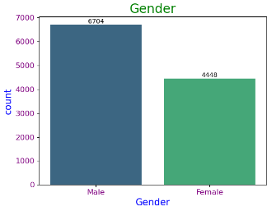
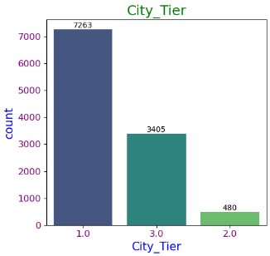
Exploratory Data Analysis
Male Customers are more as compared to Female customers.
Maximum customers belongs to Tier-1 cities followed by Tier-3 cities and very few belongs to Tier-2 cities.

Slide 6
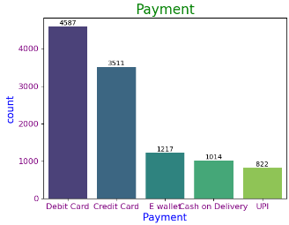
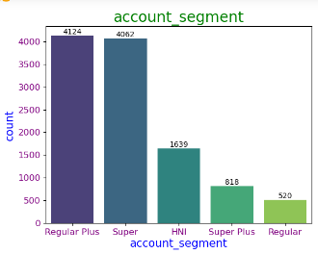
EDA Cont.….
Most Customers Preferred Payment mode are Debit card and Credit Card.
Majority Customers belongs to Regular Plus & Super account_segment.

Slide 7
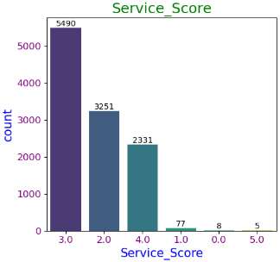
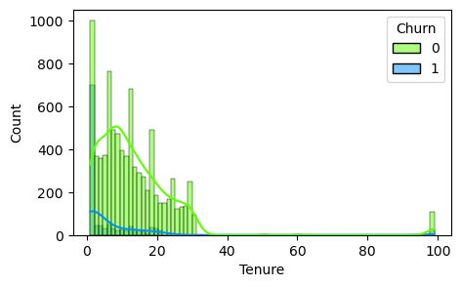
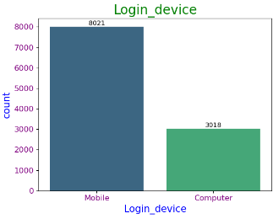
EDA Cont.….
Service score given by Maximum customers is 3,which states that customers are not fully satisfied by the service provided by the company.
Customers having Short-term Tenure churns more.
There are some Loyal customers also having Tenure more than 80 months.
Maximum customers prefers to Login Via Mobile.

Slide 8
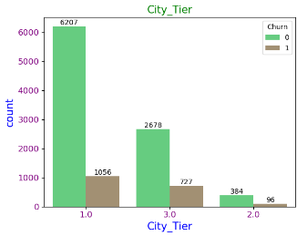
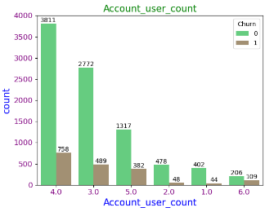
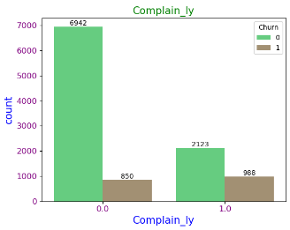
EDA Cont.….
Churning rate of Customers from Tier-2 are very less, seems they are more satisfied, and hence they continue to use the services .
Account tagged with 3,4 and 5 customers have more churning rate.
Very few Churners have raised the complaints in the last 12 months. If they would have raised the complaint, then may be their queries would have been resolved and they would not churn.

Slide 9
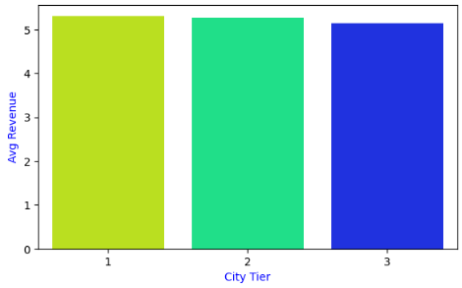
Data Visualization using Segmentation
City - Tier
Though the Customers using the Services in Tier-2 is very less as compared to Tier-1 & 3, But the Avg Revenue generated per month by the account is same across all the Tiers.
It seems Customers are more satisfied in Tier-2 hence they Retain to use the Services, generating greater revenue.

Slide 10
Feature Selection
Variance Inflation Factor is used to Select the Important features using the VIF value.
Dropped the features with VIF > 5.
Following are the features selected having VIF < 5.
Tenure
City_Tier
Account_segment
CC_Agent_Score
Marital_Status
coupon_used_for_payment
Day_Since_CC_connect
Login_device
CC_Contacted_LY
Payment
Gender
rev_per_month
Complain_ly
Churn

Slide 11
Modelling Approach Used & Why
Data Cleaning
Data Encoding
Data Transformation
Train – Test Split
Models Built
Up-Sampling
Data is cleaned for any Anomalies present in the dataset.
Null values, Outlier Treatment, incorrect Datatype mapping were all done using Appropriate methods.
All the Categorical columns were Encoded using Label Encoder.
Model building Algorithm can’t handle Categorical data, so we need to convert into encoded integers.
Features are Transformed (Scaled) using MinMax Scalar.
Train – Test split is done using the 70 : 30 ratio.
Used SMOTE technique for balancing the Data.
Here, synthetically generated data points corresponding to minority class are injected into the datasets.
Built various models and checked Accuracy against the Test data.
Done Hyper-parameter Tuning to get Better Accuracy and Generalized models.

Slide 12
Model Comparison

Slide 13
Model Comparison Cont.…..

Slide 14
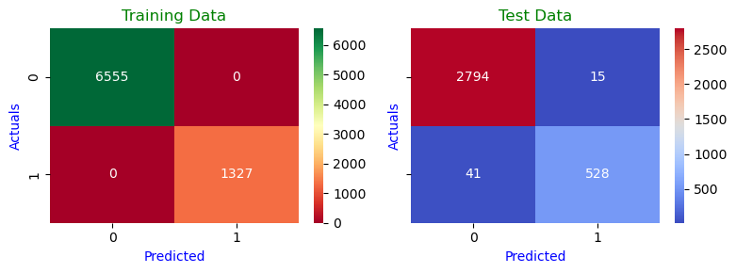
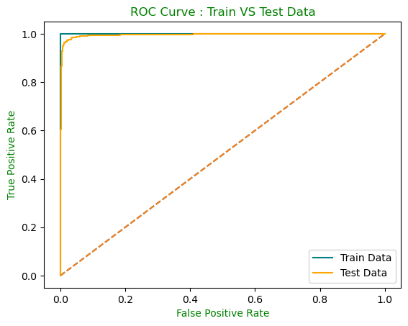
Best Model
Among all the models built, LightGBM model is giving Highest Accuracy of 98% on Test data and Highest AUC score of 99%.
Also, the Recall, Precision & F1 value is Good for LightGBM model.
LightGBM model is the best Optimum model in my case.
The AUC & ROC curve shows that it is covering the same area for Train and Test data. Therefore, this is considered a Generalized good model.
Also, the AUC score is very high and is able to distinguish between Positive and Negative classes vey well.

Slide 15
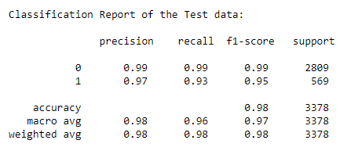
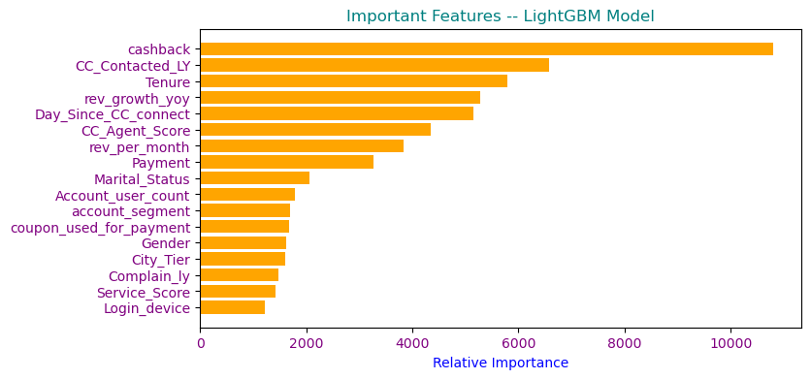
Best Model Cont.….
Recall:
Out of all the Churned customers, 93% of them are identified correctly as Churned.
Out of all the non-churned customers, 99% of them are identified correctly as Not – Churned.
Precision:
97% of the customers predicted are Churned out of all the customers that are predicted as Churned.
99% of the customers predicted are not churned out of all the customers predicted as not Churned.
Feature Importance

Slide 16

Insights from Analysis
Customers having Short-term Tenure churns more.
Tier-1 customers have high churn rate, suggesting some incentives or discounted offer can help in Retaining customers.
Churning rate of Customers from Tier-2 are very less, means customers tends to continue the services seems they are more satisfied.
Maximum of the customers prefers to Login Via Mobile as it is convenient to carry.
Most Customers Preferred Payment mode are Debit card and Credit Card.
There are more customers that belong to account_segment Regular plus and Super.
It is found that Customers who have raised the complaint maximum no of times are mostly non-churners. This shows that raising complaint have solved their issue and hence made them retain the use of service and hence, decreasing churn Rate.
So, we can say Customer Care is also playing an Important role in Retaining Customers.
Account tagged with 3,4 and 5 customers have more churning rate.

Slide 17

Recommendations
It is observed that the newly joined customers having low Tenure Churns most, so more concern should be given to the newly joined customers and their cause of churning should be figured out.
Tenure period should be Maximized to Retain the customers.
UPI and E-wallet payment mode should be encouraged to increase customers.
Customer care services should be improvised so that the customers complaint can be resolved quickly and efficiently.
Customized services should be offered to different account segment customers to retain customers.
Launch tailoring offers to multi-user account holders to retain customers.
The 1st five Important features of LightGBM Model are: cashback, CC_Contacted_LY, Tenure, rev_growth_yoy and Day_Since_CC_connect.
These 5 features are Contributing most towards the Accuracy of theLightGBM Model.
Since these 5 features are contributing most towards the Accuracy, the business should ensure that these features should not contain any Anomalies, Null values or any kind of unwanted characters as a part of these columns in the future.
Also, we should make sure these 5 features are made compulsory for model building and accurate data are captured.
The business can make use of this model to identify customers who may Churn in future.

Slide 18

Thank You

