Slide 1
Knowledge Management Project Demonstration
Project Title : Discussion Portal for colleges
Project Team : Aniket Anand (PES1201700185)
Harsh Choudhary (PES1201700279)
Aditya Manuraj (PES1201700252)
Kumar Abhishek (PES1201700251)

Slide 2
Problem Statement
Interaction between teachers and students is very outdated and time taking. Students and teachers have to invest a lot of important time after college to work out issues and queries.

Slide 3
Proposed Solution
Web based discussion forum for student-student interaction and student-teacher interaction.

Slide 4
Project Abstract and Scope
The idea is to build a website which provides student-student interaction and teacher-teacher interaction.
This website allows various knowledge sharing techniques.
Provides good security and maintains decorum as all functionalities are controlled by admin.
This project can further be extended to build a full fledged college administration website.

Slide 5
Design Approach
There are two different types of login. One for users, and one for admin.
Users can register on the website by filling up a regular form and confirming their e-mail id. If an admin confirms this user, he’s considered active or else he has to wait for the admin to consider him.
User can access all the required functionalities easily. A user can post a question or answer an existing question.
Teacher can answer questions, put up notice and share study material with students.
All the questions, answers and notes are approved by admin. This provides complete security and maintains decorum.
Teachers and students can contact the admin via a message for any assistance.
A non-registered user, can contact the admin for any required details.

Slide 6
Design Constraints, Assumptions & Dependencies
A question posted by a student, is visible to all. Hence, we assume that the students are not hesitant in posting queries.
Any post is visible to all, hence people of different departments can see questions and materials not related to their department.
The database is not populated, it has two admins, two teachers, a few students, a few departments and a few queries for explanation purpose.

Slide 7
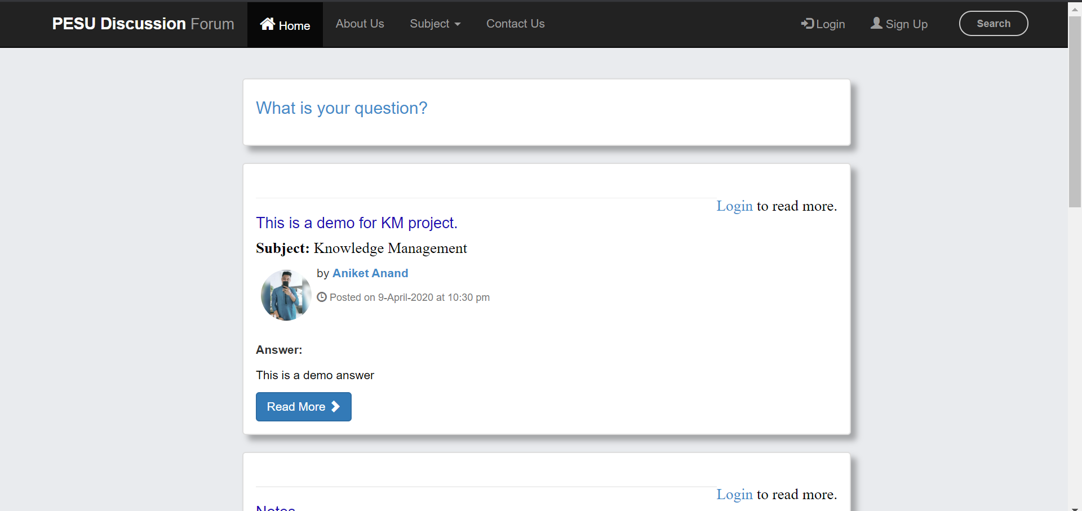
Design Description/UI Design

Slide 8
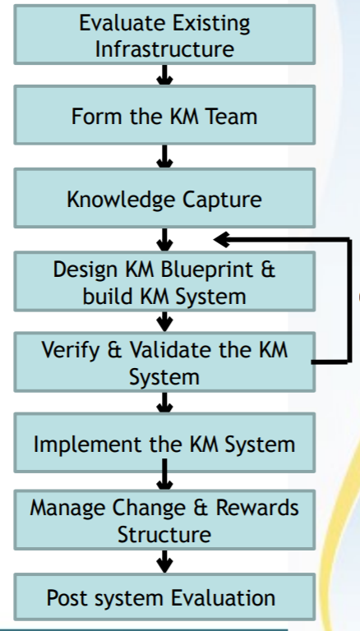
KM system life cycle
Corrections

Slide 9
Different techniques of knowledge transfer used
Tacit to Explicit – A teacher can answer a question.
Explicit to Explicit – Teachers can share books and notes for students.
Explicit to Tacit – Students can learn from responses given by teachers.
Tacit to Tacit – Students can ask for appointments from teachers and plan a classroom lecture.

Slide 10
E-mail and password
User Functionalities
Post/answer query
Share attachments
Upvote/report answers,
Or start a discussion
User Login
Logout
or
Use further
Functionalities
E-mail and password
Admin Functionalities
Approve
Queries
Answers
Users
Etc.
Functionalities
Reply to messages from users or random viewers.
Admin Login
Logout
or
Use further

Slide 11
The homepage displays queries and other options. Viewers can contact the admin using the respected tab.
If a viewer wants to view a full query or response to a query, he must login.
Users and admin share a common login page.
After logging in, you can reply to a query or post a new query. A user can start a discussion on a query or follow up an existing discussion. Users can share study materials with all the other users.
Users can upvote or report a question or response.
Users can see the number of views on a particular question.
Users can contact admin using message feature.
Admin login takes you to the main control panel. Admin can verify users, admins, questions, answers, subjects etc.
Admin can hide a particular subject and other functions.
Admin is responsible for smooth functioning of the model.

Slide 12
Feasibility questions
Doable
Affordable
Appropriate
Practicable
Notes:
12

Slide 13
Technologies Used
Javascript
PHP
HTML
CSS
Bootstrap
MySQL
XAMPP
Notes:
13

Slide 14
Q & A

