Slide 1
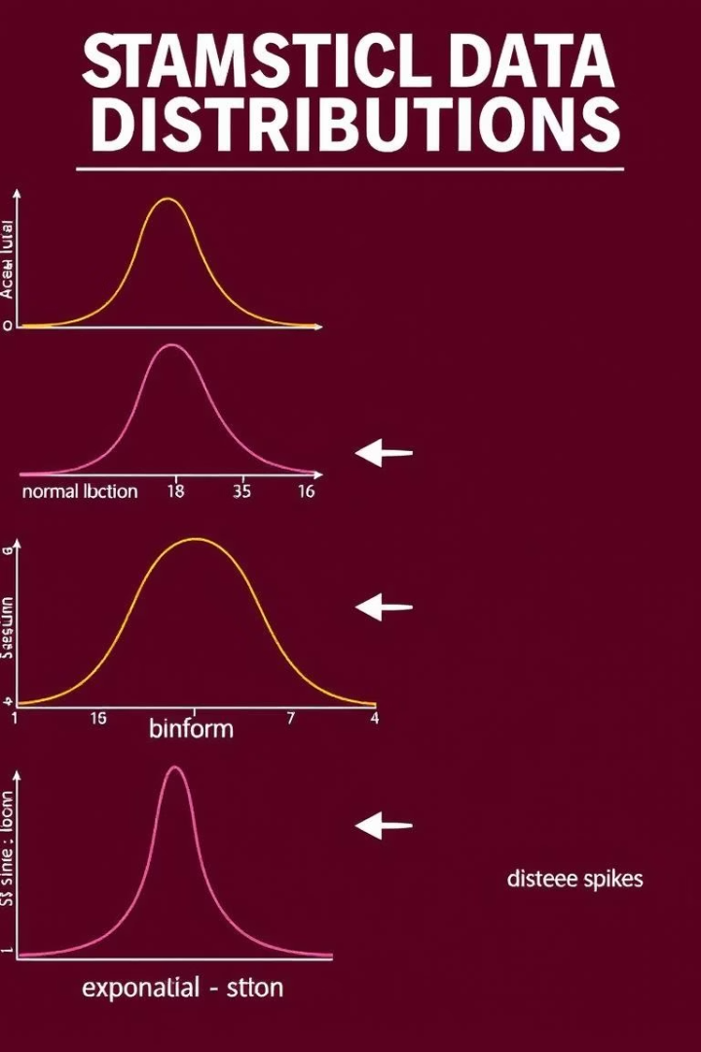

Introduction to Generalized Linear Models (GLMs)
GLMs model data beyond normal distributions. They extend linear regression for diverse responses.
Key parts: random component, systematic component, and link function.
Used for counts, binary outcomes, and skewed data.
Notes:
1

Slide 2
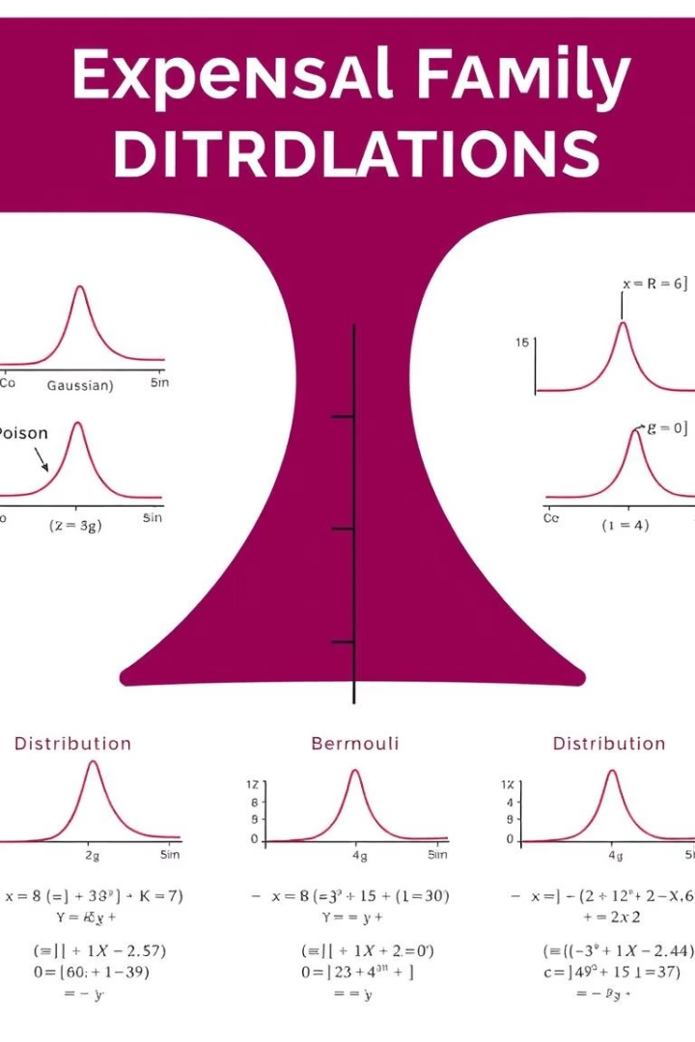
Random Component of GLMs
Specifies the probability distribution of the response variable Y.
Common choices: Normal, Poisson, Binomial, and Gamma.
These belong to the exponential family with unified properties.
Normal
Continuous data with constant variance
Poisson
Modeling count data, variance equals mean
Binomial
Binary or proportion data
Gamma
Skewed continuous data, variance related to mean
Notes:
2

Slide 3
Systematic Component & Link Function
The linear predictor Xβ links covariates to response.
Link function connects the mean response to this predictor.
Popular links include identity, log, logit, and inverse.
Systematic Component
Link Functions
Linear predictor: Xβ
Identity (μ = Xβ)
Log (log(μ) = Xβ)
Logit (logit(μ) = Xβ)
Inverse (1/μ = Xβ)
Notes:
3

Slide 4
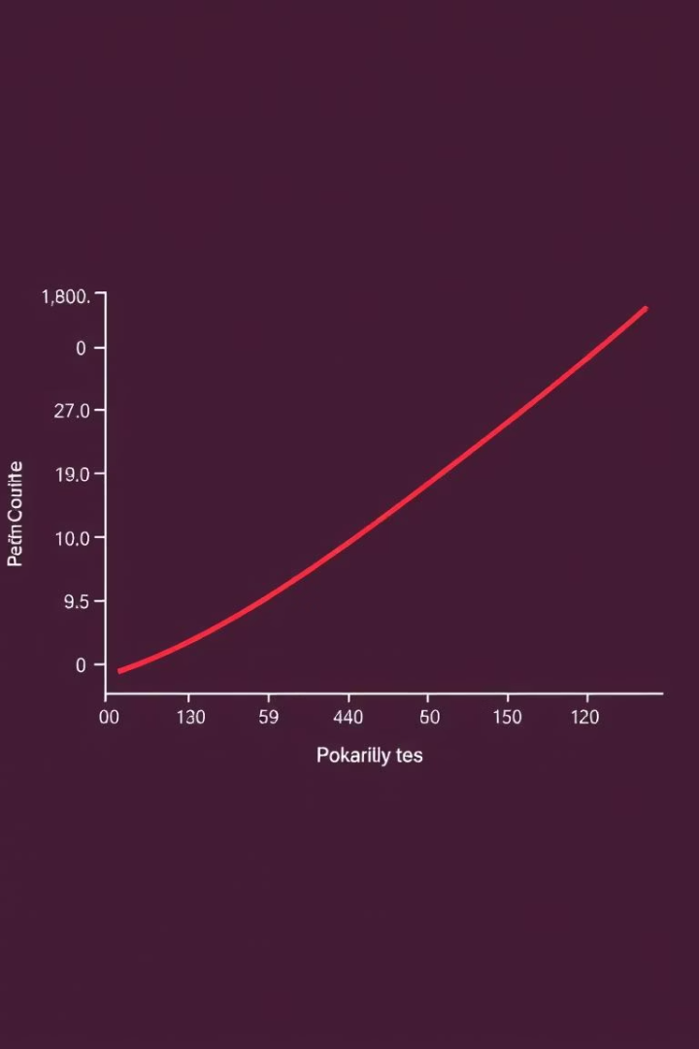
Poisson Regression for Count Data
Models counts assuming independent events with a constant rate.
Uses log link: log(μ) = Xβ, linking predictors to count mean.
Example: Predicting daily customer visits.
Assumptions
Events occur independently, constant event rate
Function
Probability mass: P(Y=y) = (λ^y * e^-λ) / y!
Notes:
4

Slide 5
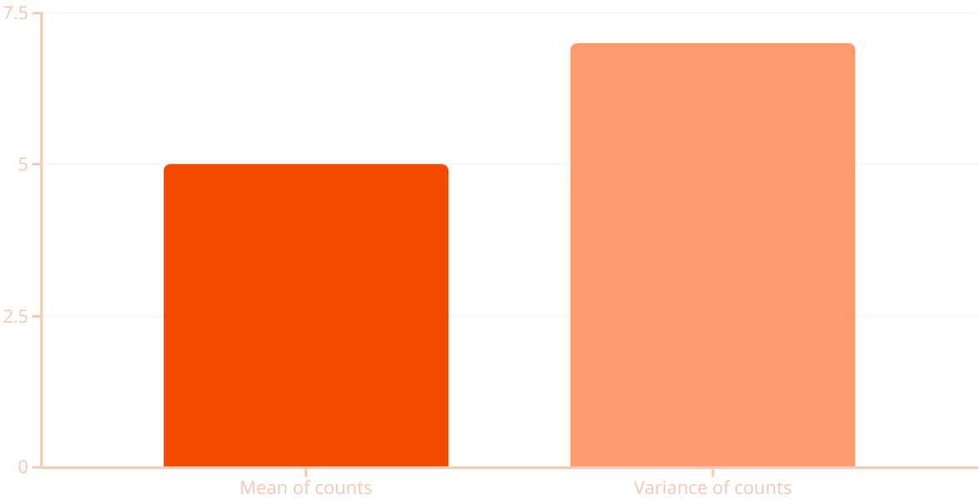
Visualizing Poisson Regression
Compare observed counts to model predictions with scatterplots.
Use histograms to assess residual distributions.
Check overdispersion by comparing mean and variance.
Notes:
5

Slide 6

Negative Binomial Regression
Handles overdispersion where variance exceeds the mean.
Negative binomial distribution adds dispersion parameter k.
Example: Counting defects with heterogeneity in manufacturing.
Why Use It?
Parameters
Models extra variability beyond Poisson assumptions
Mean μ and dispersion k control variance
Notes:
6

Slide 7
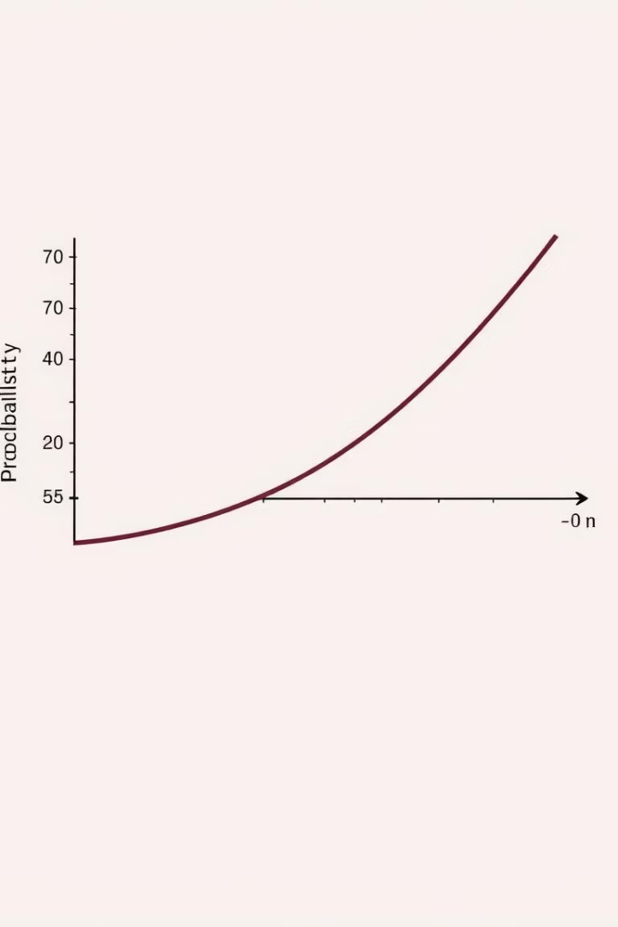
Logistic Regression for Binary Outcomes
Models outcomes with two possible values, like success/failure.
Uses logit link: log(p/(1-p)) = Xβ, relating predictors to probability.
Odds ratio exp(β) measures effect size.
Applications
Medical diagnosis
Customer churn
Spam detection
Key Features
Interpretable odds ratios, probabilistic output
Notes:
7

Slide 8
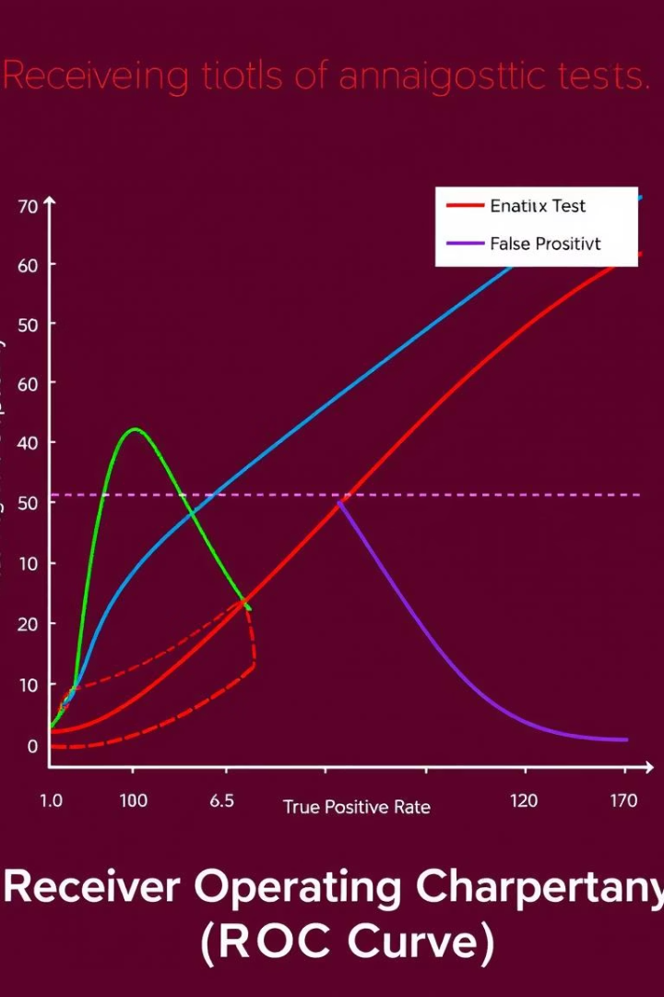
Visualizing Logistic Regression
Plot predicted probabilities against actual outcomes.
Use ROC curves to balance sensitivity and specificity.
Confusion matrix summarizes classification accuracy.
Metric
Value
Accuracy
88%
Precision
85%
Recall
90%
Notes:
8

Slide 9
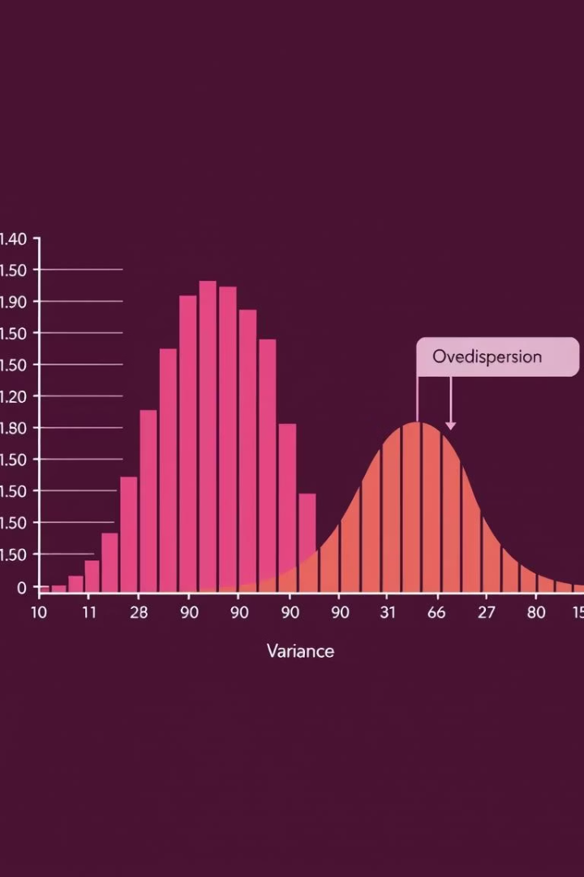
Understanding Overdispersion in GLMs
Occurs when variance exceeds mean, violating Poisson assumptions.
Caused by omitted variables, heterogeneity, or measurement errors.
Leads to underestimated errors and inflated false positives.
Solutions
Quasi-likelihood methods
Negative binomial regression
Notes:
9

Slide 10
Conclusion: GLMs for Diverse Data Types
GLMs provide a flexible way to model many data distributions.
Count data fit Poisson or negative binomial models well.
Logistic regression accurately models binary outcomes.
Addressing overdispersion is crucial for valid results.
Interpret Results
Validate Fit
Make inference based on valid model fit
Choose Model
Check assumptions and diagnose overdispersion
Understand Data
Pick appropriate GLM family and link function
Identify distribution and response type
Notes:
10

