Slide 1
BLOCKCHAIN • SMART CONTRACTS
GradEscrow
Milestone-Based Smart Contracts with Adaptive Dispute Windows
Rudraksh Choudhary
Reg. No. 25BCE1790
Ayush Abhinav
Reg. No. 25BCE5359

Slide 2
1
The Problem With Traditional Escrow
1
2
3
All-or-Nothing Release
No Neutral Middleman
Static Trust Handling
Funds are locked until the ENTIRE job is done. Partial progress cannot be fairly compensated.
Traditional escrow relies on platforms with high fees and slow manual dispute resolution processes.
Every dispute window is treated the same. A freelancer's earned trust over time is completely ignored.

Slide 3
2
Literature Review & Research Gap
Paper / Platform | Limitation Identified
Smart Contract Escrow System (IJCRT, 2023) | Static dispute rules; no mechanism for trust decay.
Crowdfunding Milestone Payments (2020) | Binary release system; lacks proportional logic.
Smart Contracts in Construction (MDPI, 2023) | No adaptive dispute resolution mechanism.
The Research Gap:
No existing academic system mathematically adapts its dispute-resolution timing based on accumulated verified trust within the same smart contract.

Slide 4
3
Methodology: Adaptive Dispute Window
Window(n) = W₀ × (1 - k × n)
Formula Breakdown:
What this implies in practice:
n = Number of successfully verified milestones
k = Decay constant (e.g., 20% or 0.2)
W₀ = Initial dispute window (e.g., 7 days)
As the freelancer successfully completes milestones (n increases), the time the client has to dispute the work automatically shrinks. Trust is explicitly rewarded with exponentially faster payouts.

Slide 5
4
Data: Visualizing Trust Accumulation
Understanding this graph:
This bar chart plots the dispute window over a 5-milestone project utilizing a 20% decay constant.
• Milestone 1 begins at a strict 7-day window.
• By Milestone 3, it shrinks to 4.2 days.
• By Milestone 5, proven trust allows funds to release in just 1.4 days.
Conclusion: The smart contract dynamically adjusts risk based on historical data.

Slide 6
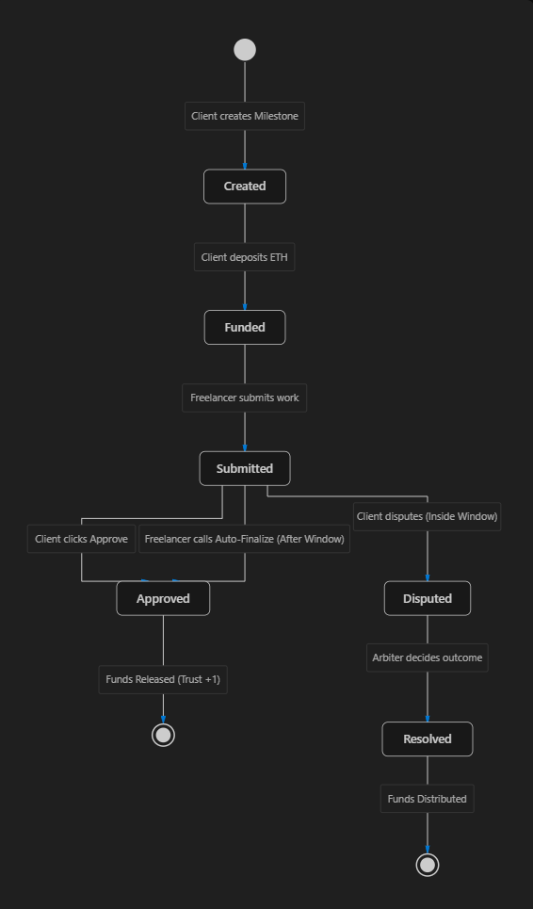
Smart Contract Core Logic (State Machine)

Slide 7
7
Project Status: Review 2 vs Future
70% Completed (Backend & Blockchain)
• Smart Contract fully written in Solidity
• Adaptive trust decay math successfully implemented
• Core workflow tested locally via Hardhat/Ethers.js
• 100% test pass rate for all edge cases
30% Remaining (Frontend & Integration)
• Build React.js Dashboard UI for clients & freelancers
• Integrate MetaMask for seamless Web3 signing
• Deploy to Sepolia Testnet for public interaction
• Prepare Final Interactive Demonstration

