Slide 1
DATA 604 Final Presentation
Tea Packaging Factory
Ahsanul Choudhury

Slide 2
Background and Objective
Background: Tea packaging factory currently producing 1500 boxes of tea everyday utilizing 7 workers and 3 machines.
Objective: Optimize production to reach daily output of 3000 boxes using existing resources and schedule.
Notes:
The objective of this project is to model and simulate operation of a tea packaging factory and optimize its operation. The factory packages 3 grams of loose tea in single use tea bags and sell the in boxes containing 50 tea bags each to a distributor. The factory currently produces 1500 boxes each day and is looking the increase its production. The management wants to produce 3000 boxes per day using existing resources and schedule.

Slide 3
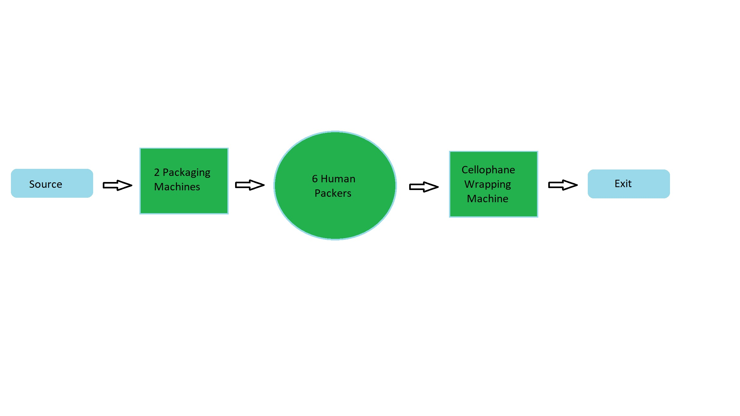
Flowchart
Notes:
The flow chart shows the operation of the factory. Loose tea arrives form the source, loaded into two packaging machines. The machine packs the loose tea in bags, the bags goes to six human packers who put 50 of the bags in box and put them on a conveyor belt. The conveyor belt carries the box to a cellophane wrapping machine. After the boxes are wrapped in cellophane the final product exit the system.

Slide 4
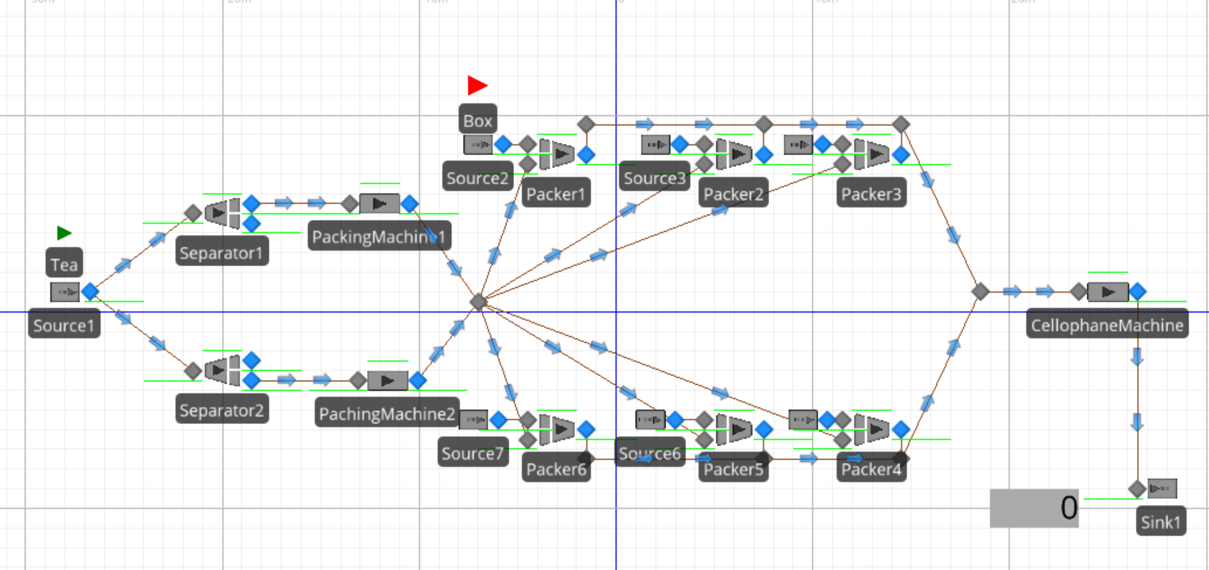
Simulation
Notes:
Simulation model was created in simio.

Slide 5
Status Quo
Entity (tea) arrival rate 2 batches ever 2.5 minutes(600g in each batch)
Packaging machine processing time = 45 bags per minute
Human packer capacity = Uniform (0.367, 0.45)
Cellophane machine capacity = Triangular(0.1, 0.2, 0.3)
Estimated Current output = 1532 Boxes
Notes:
Entity arrival rate and capacity of each sever: Every 2.5 minute 600 grams of loose tea is loaded to the packaging machine. The packing machine packs 45 bags per minute. Packer capacity random.uniform(0.367, 0.45), cellophane machine capacity rando.triangular(0.1,.02,0.3). Estimate output with current setting is 1532 boxes.

Slide 6
Work Schedule
Machine Runs 8am to 5pm continuously
The two packaging machine needs stop and refill tea bag paper after every 6000 bags, the refill process time has a uniform distribution of (8, 10.5) minutes.
The human workers work 8am to 5 pm with an hour lunch between 12pm to 1pm.
Notes:
The factory operates 8am to 5pm every weekday. The machines runs throughout the normal operating hours without any schedule breaks. However the human workers gets an hour long break between 12pm to 1pm and the two packaging machines has to stop operating to refill for random uniform(8, 10.5) minutes after packing every 6000 tea bag.

Slide 7
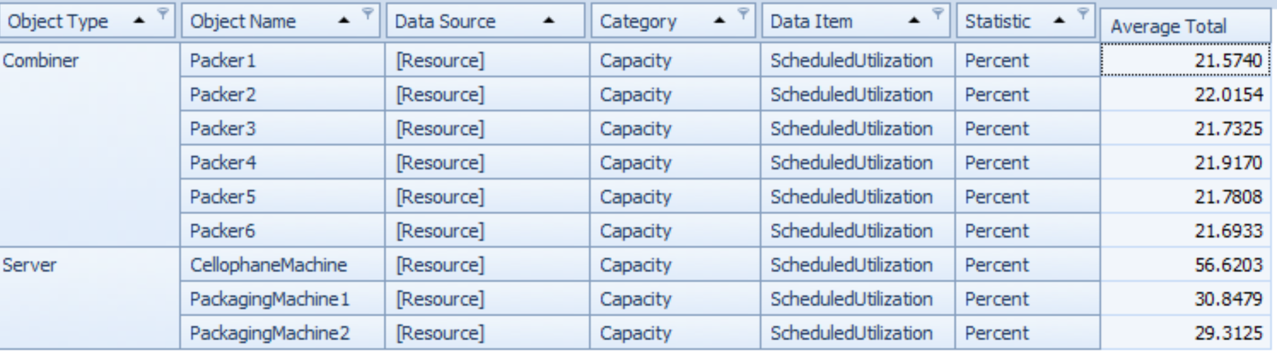
Status Quo Resource Utilization
Notes:
Status quo resource utilization results from simio run.

Slide 8
Status Quo Observation and Opportunities
Both packaging machines have about 70 percent of their capacity unused.
The packers has about 78 percent of their capacity unused.
The cellophane machine has over 43 percent of its capacity unused.
Changing the number of entity per arrival is the opportunity here.
Notes:
At Status quo the resources are severely under utilized and since the management does not want to change in existing resources or schedule; our only opportunity to change is the entity arrival rate for the interventional model.

Slide 9
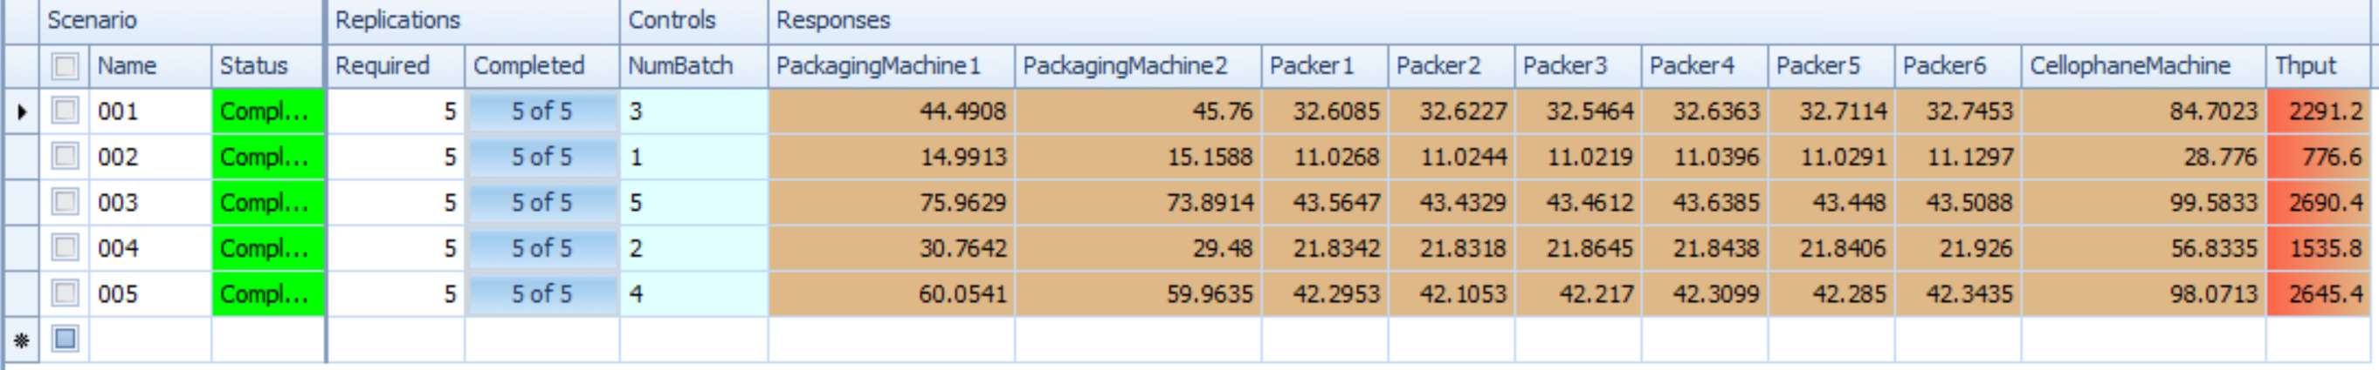
Interventional Models
Notes:
Interventional models generated from existing model using Simio add-in OptQuest. OptQuest generated five different scenarios each time using different number of entities per arrival.

Slide 10
Conclusion
Chosen Interventional model in scenario 003 with entity per arrival of 5.
The estimated output possible with the scenario is 2690 boxes.
It is impossible to reach 3000 boxes per day with the same resources and schedule, the Cellophane machine capacity reached to its maximum.
Notes:
From the five scenarios generated by OptQuest we selected scenario 3 as our Interventional model with 5 entities per arrival. Although the packaging machine have about 25 percent and the packers have over 56 percent capacity unused; this is the best scenario we can achieve without changing the resources as the cellophane machine has reached its capacity. It is not possible to produce 3000 boxes per day using existing resources and schedule.

Slide 11
Challenges faced
Creating the packaging machine model was the biggest challenge, used a “Separator” and a “Server” to replicate the process of each machine.
Had to make sure the packers has a box available all the time, achieved this by assigning an individual source for each of them.

