Slide 1
DATA 609 Final Project Presentation
Ahsanul Choudhury
May 15th 2018

Slide 2
Agenda
Introduction
Problem Description
Data Sources
Model construction
Conclusion

Slide 3
Introduction
According to a report titled “The number of hate crimes rose in 2016” published on CNN.com (https://www.cnn.com/2017/11/13/politics/hate-crimes-fbi-2016-rise/index.html) on November 13, 2017, hate crimes in the United States have increased to a point not seen in recent history. They showed some statistics from Federal Bureau of Investigation and used graphics to back their claim. On a graph the visualized how hate crime spiked around the time of November 2016 election. One of the reason put forward for this is share of proverty in the majority race member of the population and which was blamed on influx of immigrant by some political leaders during campaigning.

Slide 4
Problem Description
My Goal for this project is to collect data form various sources and construct a mathematical model to see the relationship between the share of poverty in white population and Number of reported hate crimes in each state.

Slide 5
DATA Sources
https://ucr.fbi.gov/hate-crime/2016/tables/table-11
https://www.census.gov/data/datasets/2016/demo/popest/state-total.html
https://github.com/fivethirtyeight/data/blob/master/hate-crimes/hate_crimes.csv

Slide 6
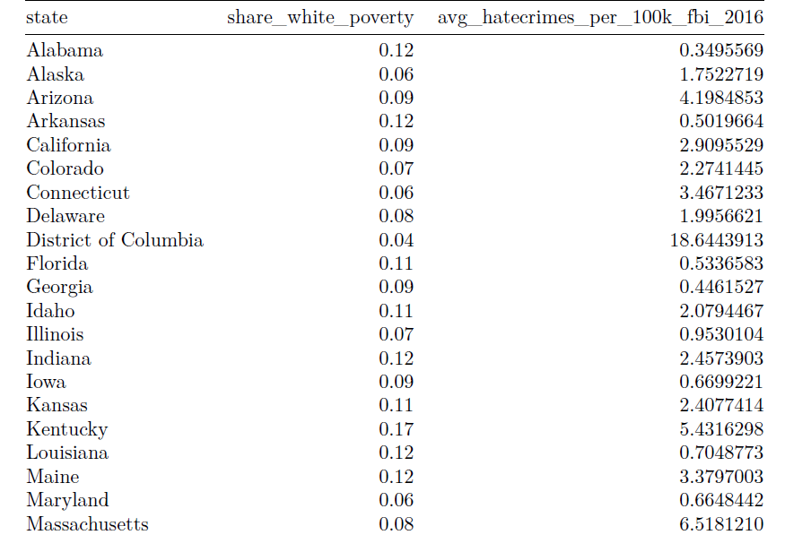
Final DATA

Slide 7




Geometric Similarity Model
We assume that the share of white poverty is proportional to any characteristic dimension cubed.
If we assume a constant share of white poverty, then the share state‘s number of hate crimes reported is proportional to it’s share of white poverty,
Let the characteristic dimension of l be the number of hate crime reported, which is chosen because it is reported as an indicator of share of white poverty.

Slide 8
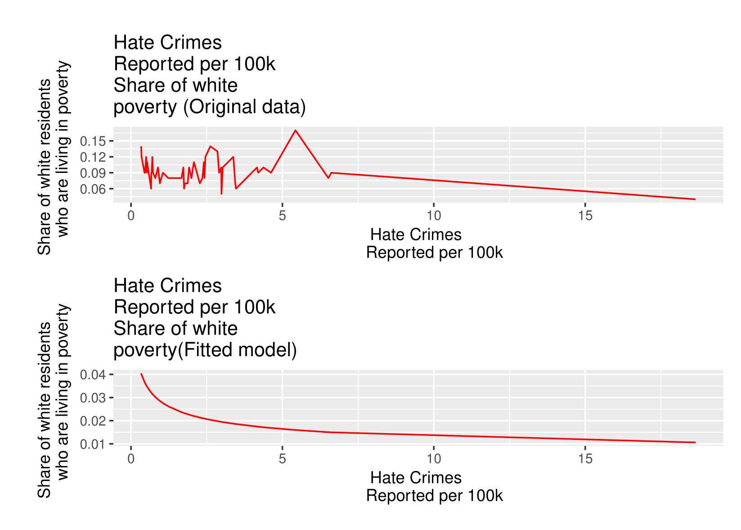
Geometric Similarity Model (original vs Fitted)

Slide 9
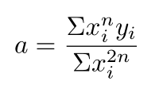
Least-Squares Criterion Model
Our formula for Least-Squares Criterion Model:
Where x = avg_hatecrimes_per_100k_fbi_2016 and y = share_white_poverty
is fixed to given collection of data points

Slide 10
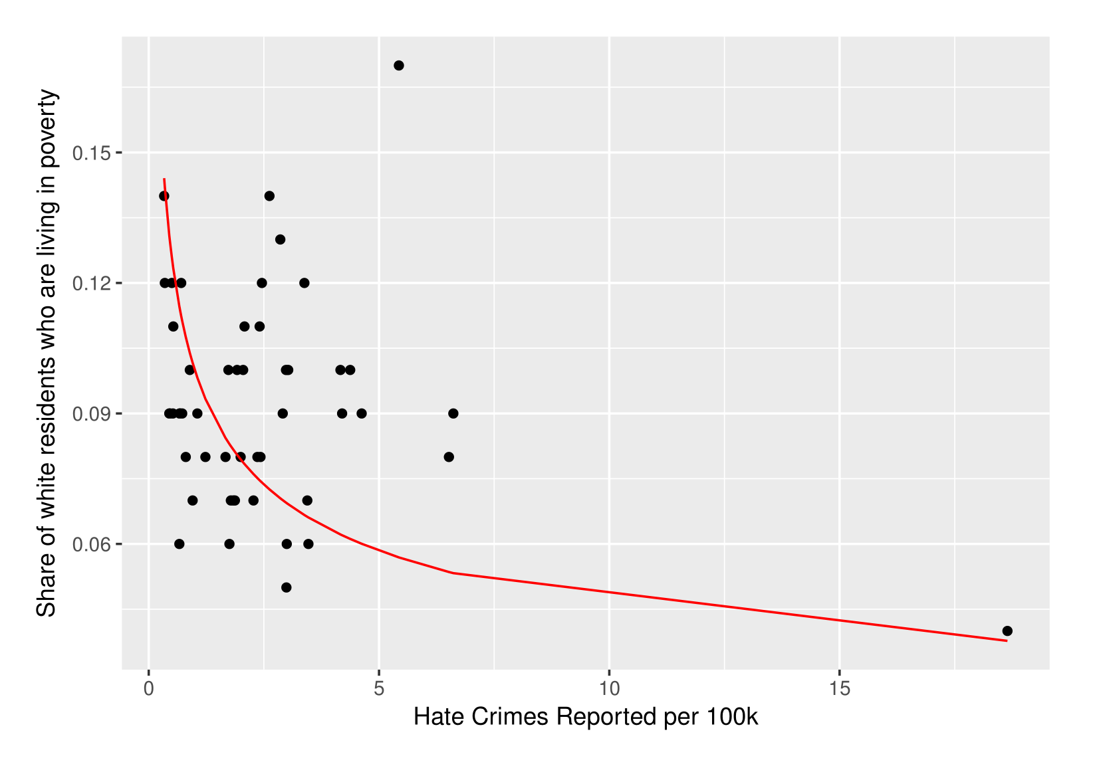
Least-Squares Criterion Fit

Slide 11
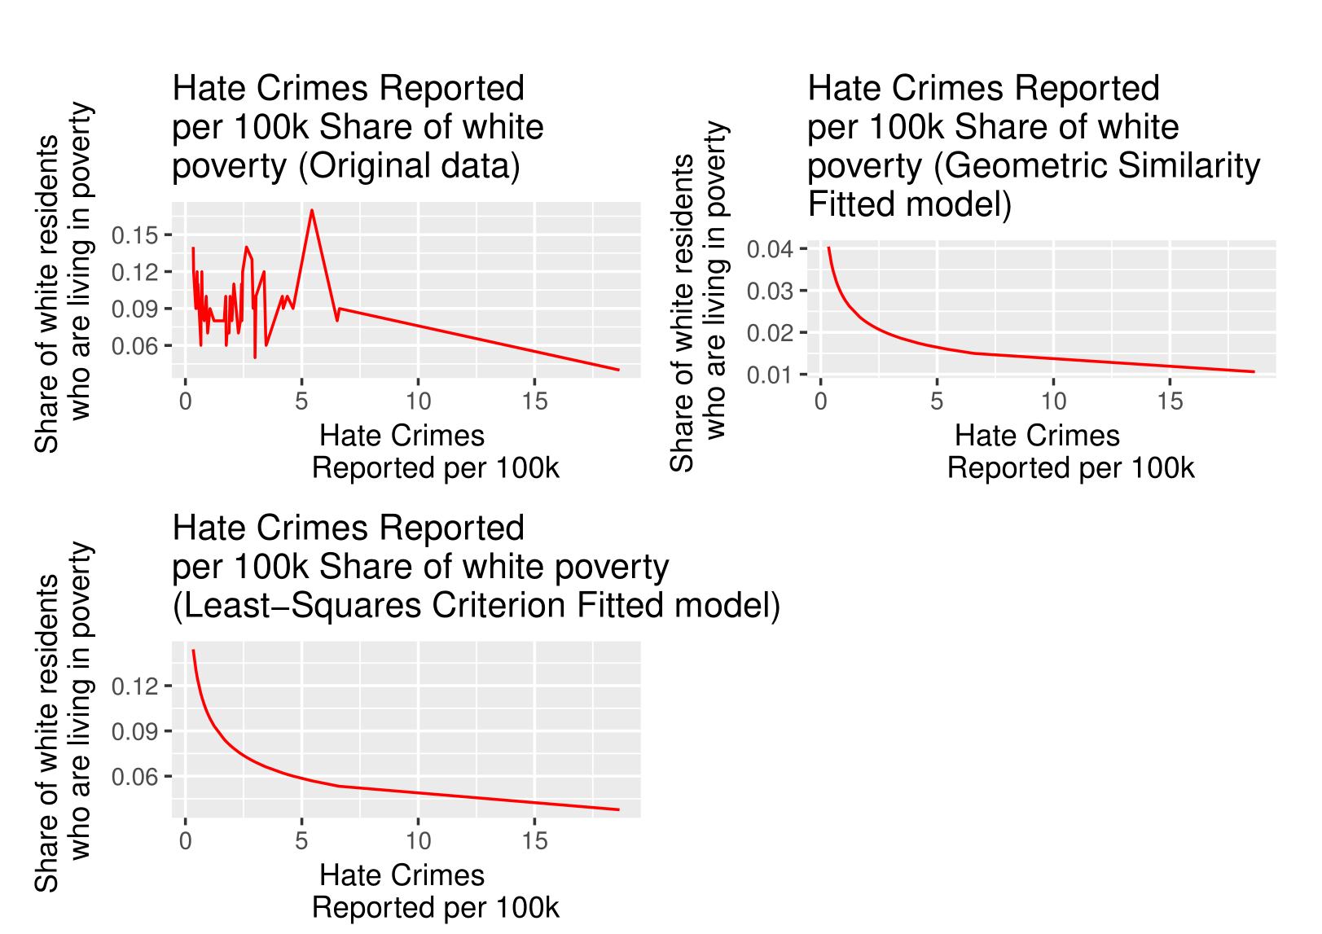
Model Comparison

Slide 12
Conclusion
The models do not fit tightly with our observed data. Hate crimes alone can not be a predictor of poverty in a portion of a state's population and poverty by itself can not be the sole contributing factor to hate crime. Also, our data have some outliers, for example District of Columbia has a large number of hate crimes reported in 2016 and has a relatively low share of poverty compared to other states. There are other socioeconomic factors which may be a better indicator of poverty in a segment of population like level of education or combination of various other factor. We started the project to see the relationship between hate crimes reported in a state and share of poverty in a segment of population and we are concluding this project by saying the relationship is complex and not truly linear.

Slide 13
Reference
Giordano, F. R., Fox, W. P., & Horton, S. B. (2014). A first course in mathematical modeling. Australia: Brooks/Cole, Cengage Learning.
Table 11. (2017, November 03). Retrieved from https://ucr.fbi.gov/hate-crime/2016/tables/table-11
https://www.census.gov/data/datasets/2016/demo/popest/state-total.html
https://github.com/fivethirtyeight/data/blob/master/hate-crimes/hate_crimes.csv

