Slide 1
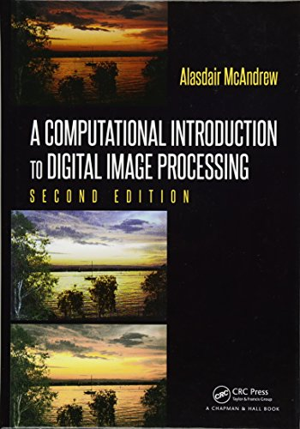
鄰域處理
Neighborhood Processing

Slide 2
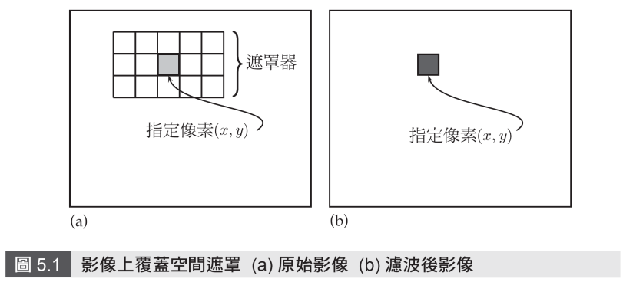
前言
  主要的概念便是將遮罩（邊長通常為奇數的方形或其他形狀）覆蓋到指定影像的每個像素上面。

Slide 3
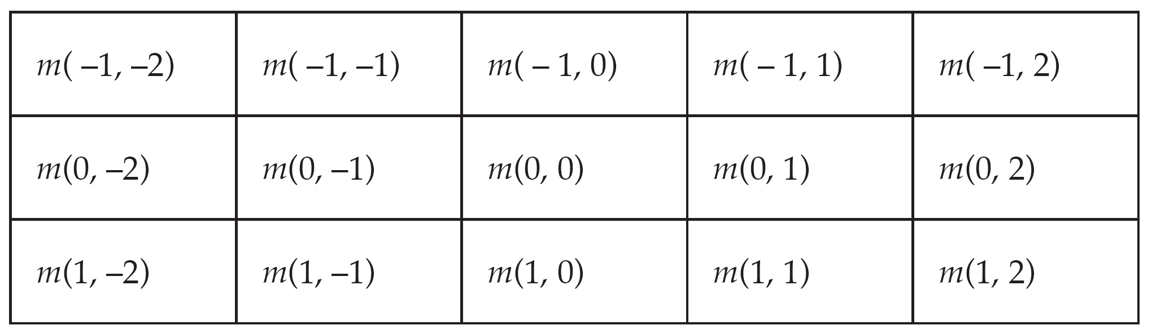
前言
設定遮罩值

Slide 4
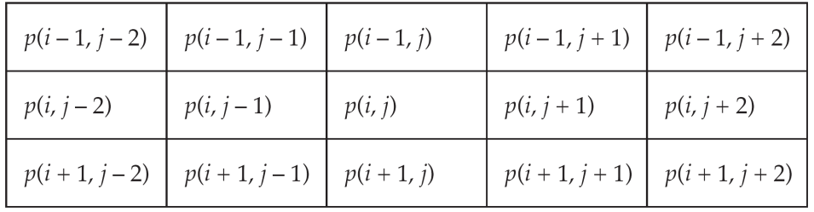
前言
使用遮罩及鄰近像素值，處理相對應的像素值p(i,j)

Slide 5
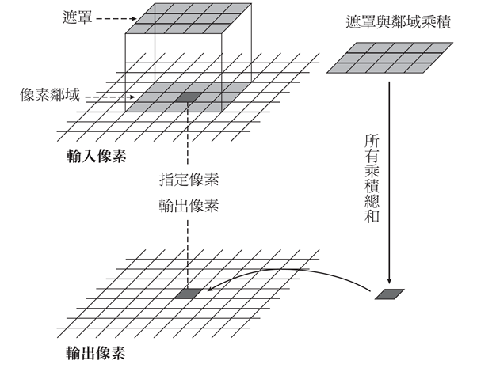

執行空間濾波

Slide 6
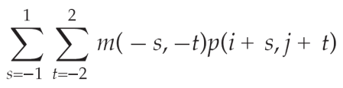
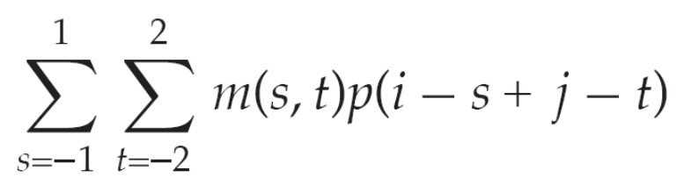
空間旋積（convolution）
空間濾波類似於所謂空間旋積（convolution）
  旋積與濾波的運算方法相同，唯一差異在於濾波器在相乘與相加之前必須旋轉180 度。
  如果遮罩係數沒有做180 度旋轉，則叫就空間相關性(correlation)運算(即空間濾波)

Slide 7
空間旋積（convolution）
如果遮罩係數如下，迴旋後之係數為何?
什麼時候，旋積(convolution) = 相關 (correlation)?
[[ 1 0 -2]
[ 2 0 -2]
[-1 0 1]]
[[ 1 0 -1]
[ -2 0 2]
[-2 0 1]]
[[-1 -2 -1]
[-2 0 2]
[-1 -2 -1]]
[[-1 -2 -1]
[-2 0 2]
[-1 -2 -1]]

Slide 8
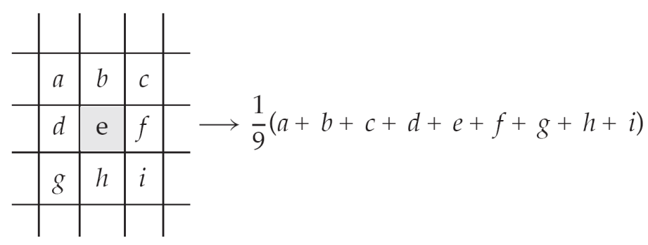
空間濾波範例
線性濾波器是使用3×3 遮罩，並取遮罩中的9 個像素值的平均值。

Slide 9
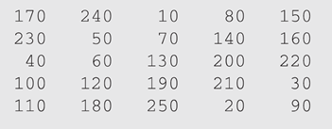
線性濾波器範例
import numpy as np
x = [[170, 240, 10, 80, 150],
[230, 50, 70, 140, 160],
[40, 60, 130, 200, 220],
[100, 200, 190, 210, 30],
[110, 180, 250, 20, 90]]
x = np.array(x, dtype=np.uint8)
>> np.mean(x[0:3,0:3])
>>111.11111111111111

Slide 10
線性濾波器範例
mask = np.ones((3,3)) /9
print(mask)
rows, cols = x.shape
result = np.zeros((rows,cols))
for i in range(1,rows-1):
for j in range(1,cols-1):
result[i,j]= np.sum(x[i-1:i+2,j-1:j+2]*mask)
print(result)
[[0.11111111 0.11111111 0.11111111]
[0.11111111 0.11111111 0.11111111]
[0.11111111 0.11111111 0.11111111]]
x矩陣就是套用3×3 平均濾波器於影像x 的結果
[[ 0. 0. 0. 0. 0. ]
[ 0. 111.11111111 108.88888889 128.88888889 0. ]
[ 0. 118.88888889 138.88888889 150. 0. ]
[ 0. 140. 160. 148.88888889 0. ]
[ 0. 0. 0. 0. 0. ]]

Slide 11
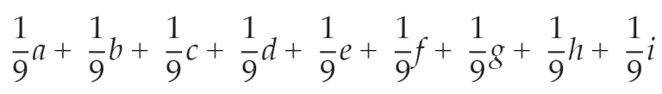
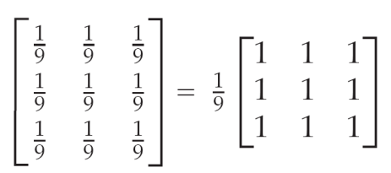
運算符號
線性濾波器運算，我們可以簡單地把它當成遮罩內所有像素灰階值的乘法係數，並可將之寫成一個矩陣。
  平均濾波的運算結果可以寫成：
  該濾波器可用矩陣表示：

Slide 12
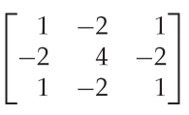
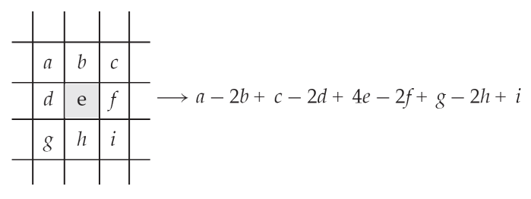
運算符號
範例
  下列濾波器：
  對灰階值進行運算的結果為：

Slide 13
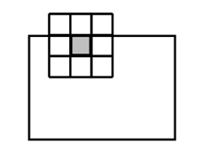
影像邊緣
影像的邊緣，也就是遮罩會有部分超出影像的地方該怎麼辦？
該問題有幾種不同的方法可以解決。

Slide 14
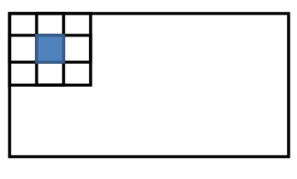
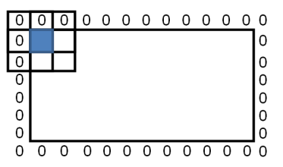
影像邊緣
忽略邊緣（ignore the edges）
補零（pad with zeros）

Slide 15
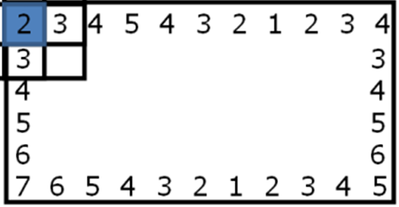
影像邊緣
重複（repeating）
5
7
6
5
4
3
2
1
2
3
4
5
7
4
2
3
3
4
4
4
5
5
6
6
5
7
4
2
3
4
5
4
3
2
1
2
3
4
2

Slide 16
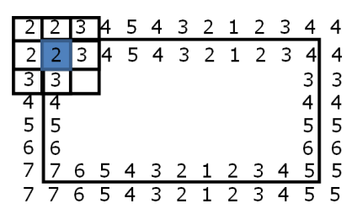
影像邊緣
鏡射（mirroring）

Slide 17
Python中的濾波函數
Ｐython中有許多套件均可執行濾波運算，
  例如scipy套件之ndimage物件提供convolve及correlate函式可供各種濾波運算：
import numpy as np
import scipy.ndimage as ndi
x = [[170, 240, 10, 80, 150],
[230, 50, 70, 140, 160],
[40, 60, 130, 200, 220],
[100, 200, 190, 210, 30],
[110, 180, 250, 20, 90]]
x = np.array(x, dtype=np.uint8)
mask = np.ones((3,3)) /9
result = ndi.convolve(x,mask,mode='constant')
print(result)
mode=‘constant‘代表填入常數值之填補，內定值是0之填補

Slide 18
Python中的濾波函數
結果為一個 整數資料形態的矩陣 ：
[[ 76 85 65 67 58]
[ 87 111 108 128 105]
[ 75 118 138 150 106]
[ 76 140 160 148 85]
[ 65 114 116 87 38]]

Slide 19
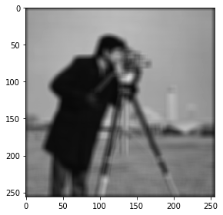
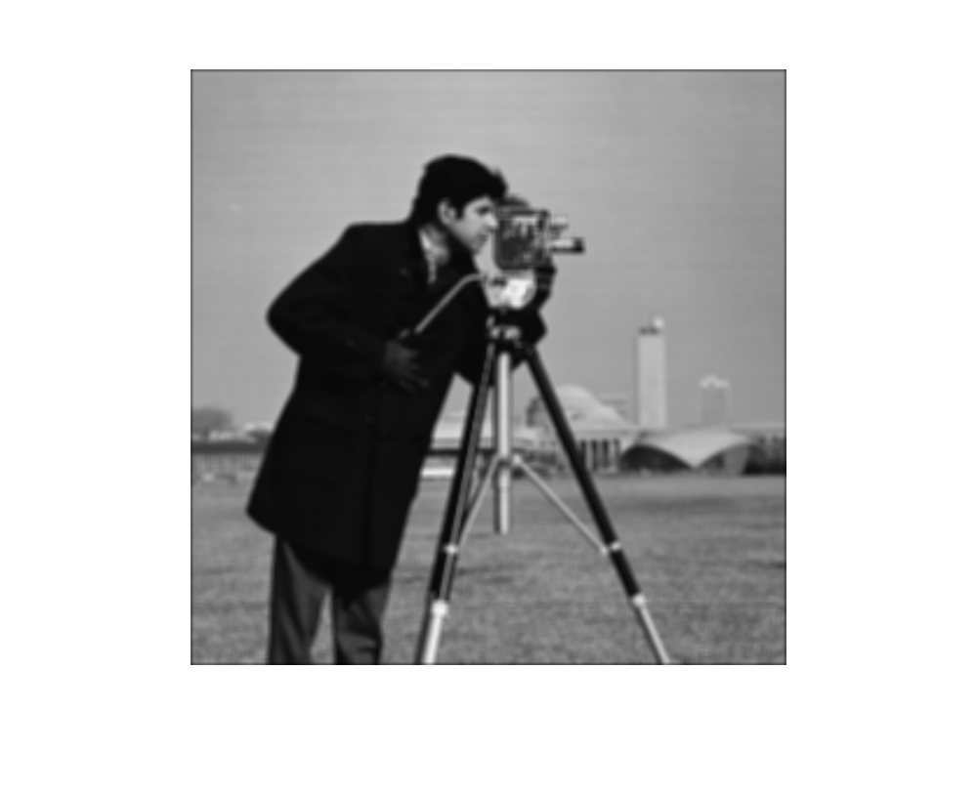
Python中的濾波函數
from skimage import io
import scipy.ndimage as ndi
img = io.imread('cameraman.tif')
mask = np.ones((9,9)) /81
result = ndi.convolve(img,mask,mode='constant')
io.imshow(result)

Slide 20
scipy中的內建濾波函數
from skimage import io
import scipy.ndimage as ndi
img = io.imread('cameraman.tif')
result = ndi.uniform_filter(img,[9,9],mode='constant')
io.imshow(result)

Slide 21
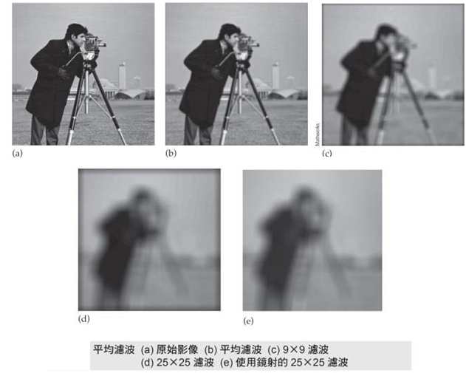
Python中的濾波函數

Slide 22
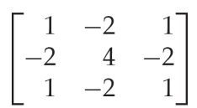
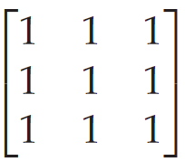
頻率：低通與高通濾波器
影像的頻率是灰階值隨著像素間距離而產生變化程度的一種度量。
  高通濾波器（high-pass filter）
  低通濾波器（low-pass filter）

Slide 23
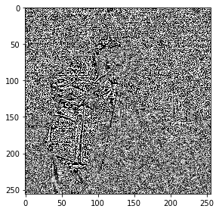
高通濾波器：Laplacian濾波器
from skimage import io
import scipy.ndimage as ndi
import numpy as np
img = io.imread('cameraman.tif')
mask = np.array([[1,4,1],[4,-20,4],[1,4,1]])
result = ndi.convolve(img,mask)
io.imshow(result)

Slide 24
高通濾波器：Laplacian濾波器
from skimage import io
import scipy.ndimage as ndi
import numpy as np
img = io.imread('cameraman.tif')
mask = np.array([[1,4,1],[4,-20,4],[1,4,1]])
result = ndi.convolve(img,mask)
io.imshow(result)

Slide 25
高通濾波器：Laplacian濾波器
from skimage import io
import scipy.ndimage as ndi
import matplotlib.pyplot as plt
img = io.imread('cameraman.tif')
result = ndi.laplace(img)
fig = plt.figure()
plt.gray() # show the filtered result in grayscale
ax1 = fig.add_subplot(121) # left side
ax2 = fig.add_subplot(122) # right side
ax1.imshow(img)
ax2.imshow(result)
plt.show()

Slide 26
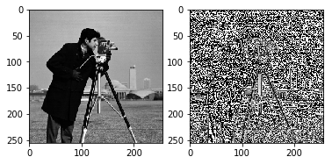
高通濾波器：Laplacian濾波器

Slide 27
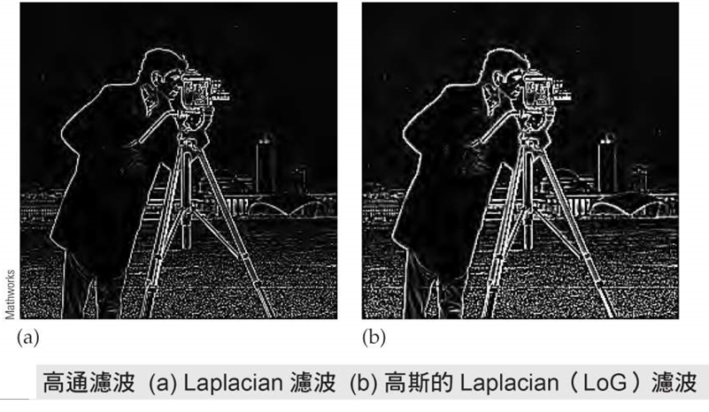
高通濾波器：Laplacian濾波器
加入更複雜的處理（如邊緣點偵測）才能改善效果

Slide 28
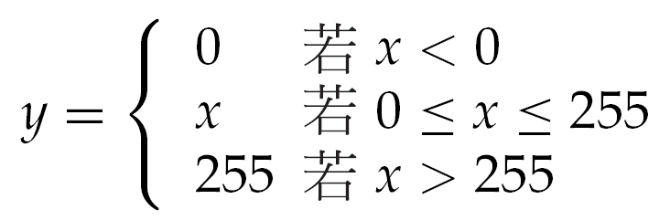
頻率：低通與高通濾波器
數值超出0至255的範圍
  將負值變為正值（make negative values positive ）
  數值裁剪（clip values）

Slide 29
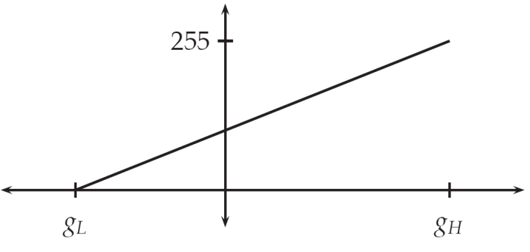
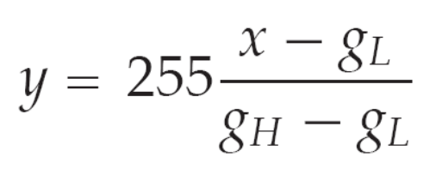
頻率：低通與高通濾波器
  比例轉換（scaling transformation ）

Slide 30
頻率：低通與高通濾波器
from skimage import io,img_as_float
import scipy.ndimage as ndi
import matplotlib.pyplot as plt
import numpy as np
img = io.imread('cameraman.tif')
mask = np.array([[1,4,1],[4,-20,4],[1,4,1]])
img = img_as_float(img)
result = ndi.convolve(img,mask,mode='constant')
maxres = result.max()
minres = result.min()
result = (result-minres) /(maxres-minres)
fig = plt.figure()
plt.gray() # show the filtered result in grayscale
ax1 = fig.add_subplot(121) # left side
ax2 = fig.add_subplot(122) # right side
ax1.imshow(img)
ax2.imshow(result, vmax=1.0,vmin=0.0)
plt.show()
  0至1比例轉換 (float的矩陣)

Slide 31
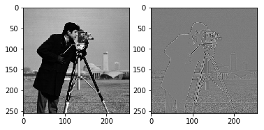
頻率：低通與高通濾波器

Slide 32
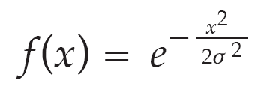
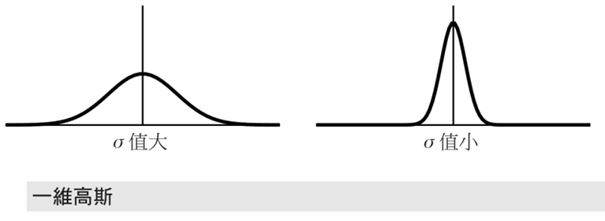
高斯濾波器

Slide 33
Python製作高斯濾波器
import numpy as np
import matplotlib.pyplot as plt
from matplotlib import cm
from mpl_toolkits.mplot3d import Axes3D
# Our 2-dimensional distribution will be over variables X and Y
N = 100
X = np.linspace(-2, 2, N)
Y = np.linspace(-2, 2, N)
X, Y = np.meshgrid(X, Y)
# Mean vector and covariance matrix
mu = np.array([0., 0.])
Sigma = np.array([[ 1. , -0.5], [-0.5, 1.]])
# Pack X and Y into a single 3-dimensional array
pos = np.empty(X.shape + (2,))
pos[:, :, 0] = X
pos[:, :, 1] = Y

Slide 34
Python製作高斯濾波器
def multivariate_gaussian(pos, mu, Sigma):
"""Return the multivariate Gaussian distribution on array pos."""
n = mu.shape[0]
Sigma_det = np.linalg.det(Sigma)
Sigma_inv = np.linalg.inv(Sigma)
N = np.sqrt((2*np.pi)**n * Sigma_det)
# This einsum call calculates (x-mu)T.Sigma-1.(x-mu) in a vectorized
# way across all the input variables.
fac = np.einsum('...k,kl,...l->...', pos-mu, Sigma_inv, pos-mu)
return np.exp(-fac / 2) / N
# The distribution on the variables X, Y packed into pos.
Z = multivariate_gaussian(pos, mu, Sigma)

Slide 35
Python製作高斯濾波器
# plot using subplots
fig = plt.figure()
ax1 = fig.add_subplot(2,1,1,projection='3d')
ax1.plot_surface(X, Y, Z, rstride=3, cstride=3, linewidth=1, antialiased=True, cmap=cm.viridis)
ax1.view_init(55,-70)
ax1.set_xticks([])
ax1.set_yticks([])
ax1.set_zticks([])
ax1.set_xlabel(r'$x_1$')
ax1.set_ylabel(r'$x_2$')
ax2 = fig.add_subplot(2,1,2,projection='3d')
ax2.contourf(X, Y, Z, zdir='z', offset=0, cmap=cm.viridis)
ax2.view_init(90, 270)
ax2.grid(False)
ax2.set_xticks([])
ax2.set_yticks([])
ax2.set_zticks([])
ax2.set_xlabel(r'$x_1$')
ax2.set_ylabel(r'$x_2$')
plt.show()

Slide 36
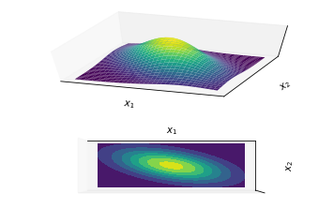
Python製作高斯濾波器

Slide 37
高斯濾波器
from skimage import io
import scipy.ndimage as ndi
import matplotlib.pyplot as plt
img = io.imread('cameraman.tif')
result1 = ndi.gaussian_filter(img,0.5,truncate = 4.5)
result2 = ndi.gaussian_filter(img,2,truncate = 1)
result3 = ndi.gaussian_filter(img,1,truncate = 5)
result4 = ndi.gaussian_filter(img,5,truncate = 1)
fig = plt.figure()
plt.gray() # show the filtered result in grayscale
ax1 = fig.add_subplot(221) # left side
ax2 = fig.add_subplot(222) # right side
ax3 = fig.add_subplot(223) # left side
ax4 = fig.add_subplot(224) # right side
ax1.imshow(result1)
ax2.imshow(result2)
ax3.imshow(result3)
ax4.imshow(result4)
plt.show()

Slide 38
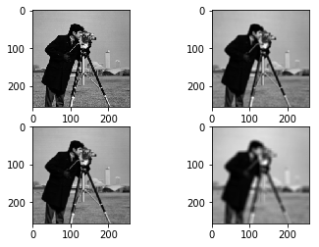
高斯濾波器

Slide 39
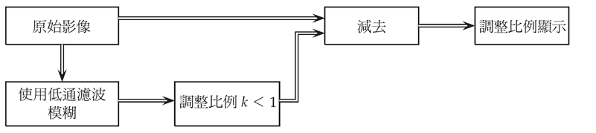
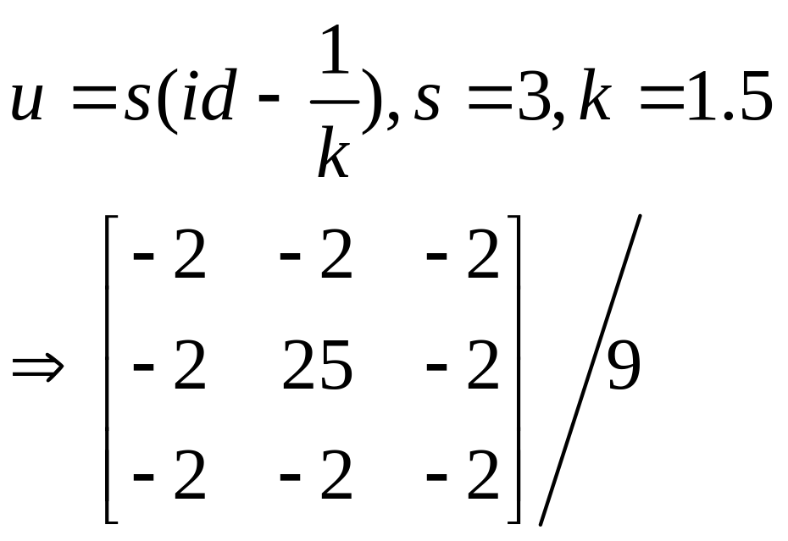
邊緣銳利化
去銳利化遮罩
id=[[ 0 0 0]
[ 0 1 0]
[ 0 0 0]]

Slide 40
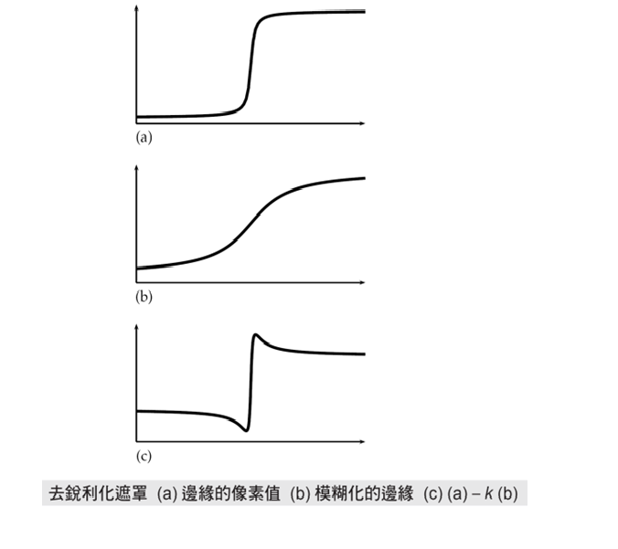
去銳利化遮罩

Slide 41
邊緣銳利化
Python code
from skimage import io
import scipy.ndimage as ndi
import numpy as np
import matplotlib.pyplot as plt
k = io.imread('koala.tif')
u = np.array([[-2.0,-2.0,-2.0],[-2.0,25.0,-2.0],[-2.0,-2.0,-2.0]]) /9
result = ndi.convolve(k.astype(float),u)
fig = plt.figure()
plt.gray() # show the filtered result in grayscale
ax1 = fig.add_subplot(121) # left side
ax2 = fig.add_subplot(122) # right side
ax1.imshow(k)
ax2.imshow(result/255,vmax=1.0,vmin=0.0)
plt.show()

Slide 42
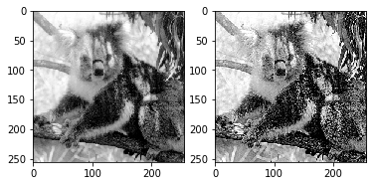
邊緣銳利化

Slide 43
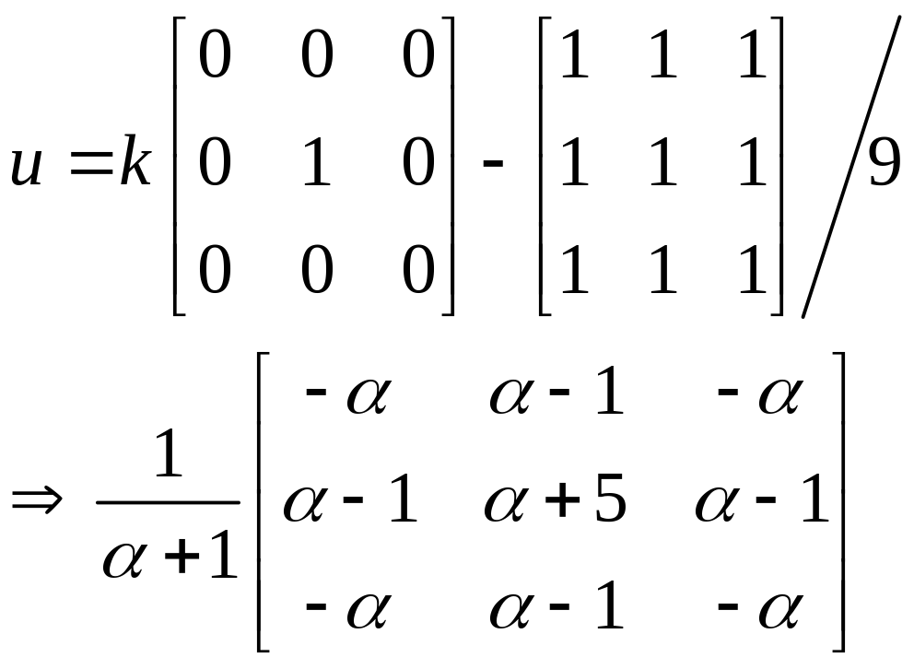
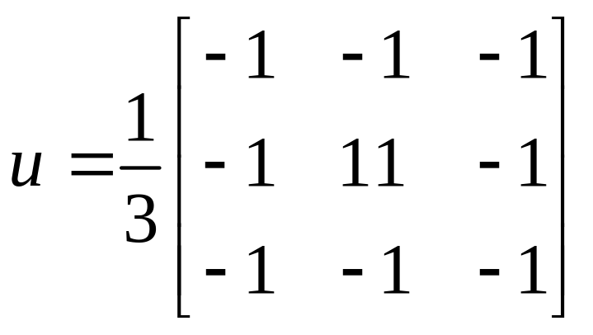
其它形式的去銳利化遮罩
α = 0.5

Slide 44
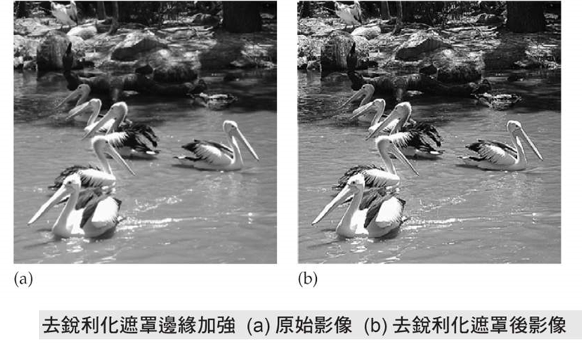
其它形式的去銳利化遮罩

Slide 45
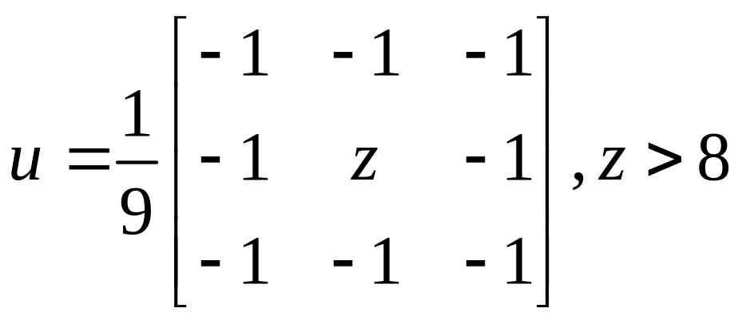
高增幅濾波
與去銳利化遮罩濾波類似的方法是高增幅（high-boost）濾波器
  其中A 是增幅係數。
  若A ＝ 1，則高增幅濾波器就成為典型的高通濾波器。

Slide 46
高增幅濾波
from skimage import io
import scipy.ndimage as ndi
import numpy as np
import matplotlib.pyplot as plt
k = io.imread('koala.tif')
kf=ndi.uniform_filter(k,3)
hb1 = 3.0*k-2.0*kf
hb2 = 1.25*k-0.25*kf
fig = plt.figure()
plt.gray() # show the filtered result in grayscale
ax1 = fig.add_subplot(121) # left side
ax2 = fig.add_subplot(122) # right side
ax1.imshow(hb1/255,vmax=1.0,vmin=0.0)
ax2.imshow(hb2/255,vmax=1.0,vmin=0.0)
plt.show()

Slide 47

高增幅濾波

Slide 48
非線性濾波器
最大濾波器（maximum filter）
最小濾波器（minimum filter）
from skimage import io
import scipy.ndimage as ndi
import numpy as np
import matplotlib.pyplot as plt
c = io.imread('cameraman.tif')
cmax=ndi.generic_filter(c,max,[3,3])
cmin=ndi.generic_filter(c,min,[3,3])

Slide 49
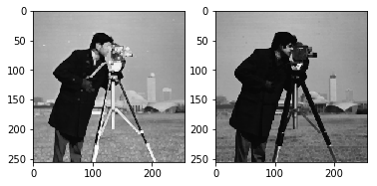
非線性濾波器
Max filter
Min filter

Slide 50
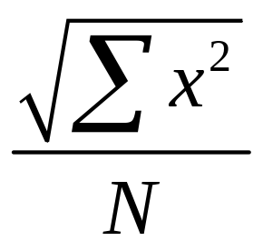
其他常用非線性濾波器
中值濾波器(median filter)
排序濾波器(rank order filter)
均方根濾波器(mean squared filter)

Slide 51
邊緣保持模糊濾波器(Eedg-preserving blurring filter)
中值濾波器(median filter)
from skimage import io
import scipy.ndimage as ndi
import numpy as np
import matplotlib.pyplot as plt
c = io.imread('cameraman.tif')
cm=ndi.median_filter(c,size=[3,3])
cm2=ndi.median_filter(c,size=[5,5])
fig = plt.figure()
plt.gray() # show the filtered result in grayscale
ax1 = fig.add_subplot(121) # left side
ax2 = fig.add_subplot(122) # right side
ax1.imshow(cm/255,vmax=1.0,vmin=0.0)
ax2.imshow(cm2/255,vmax=1.0,vmin=0.0)
plt.show()

Slide 52
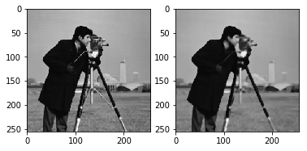
邊緣保持模糊濾波器(Eedg-preserving blurring filter)
中值濾波器(median filter)
3x3
5x5

Slide 53
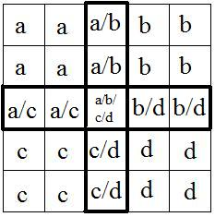
Kawahara 濾波器
針對卷積核内部的所有像素点二次進行分割成四個區域
找出四個區域當中數值最平穩的區域，求出這個區域内的平均值
以這個平均值作為卷積核中心像素点的數值

Slide 54
Kawahara 濾波器
from skimage import io
import scipy.ndimage as ndi
import numpy as np
import matplotlib.pyplot as plt
import numpy as np
from scipy.signal import convolve2d

Slide 55
Kawahara 濾波器
def Kuwahara(original, winsize):
image = original.astype(np.float64)
# make sure window size is correct
if winsize %4 != 1:
raise Exception ("Invalid winsize %s: winsize must follow formula: w = 4*n+1." %winsize)
#Build subwindows
tmpAvgKerRow = np.hstack((np.ones((1,(winsize-1)//2+1)),np.zeros((1,(winsize-1)//2))))
tmpPadder = np.zeros((1,winsize))
tmpavgker = np.tile(tmpAvgKerRow, ((winsize-1)//2+1,1))
tmpavgker = np.vstack((tmpavgker, np.tile(tmpPadder, ((winsize-1)//2,1))))
tmpavgker = tmpavgker/np.sum(tmpavgker)
# tmpavgker is a 'north-west' subwindow (marked as 'a' above)
# we build a vector of convolution kernels for computing average and
# variance
avgker = np.empty((4,winsize,winsize)) # make an empty vector of arrays
avgker[0] = tmpavgker # North-west (a)
avgker[1] = np.fliplr(tmpavgker) # North-east (b)
avgker[2] = np.flipud(tmpavgker) # South-west (c)
avgker[3] = np.fliplr(avgker[2]) # South-east (d)
# Create a pixel-by-pixel square of the image
squaredImg = image**2

Slide 56
Kawahara 濾波器
# preallocate these arrays to make it apparently %15 faster
avgs = np.zeros([4, image.shape[0],image.shape[1]])
stddevs = avgs.copy()
# Calculation of averages and variances on subwindows
for k in range(4):
# mean on subwindow
avgs[k] = convolve2d(image, avgker[k],mode='same')
# mean of squares on subwindow
stddevs[k] = convolve2d(squaredImg, avgker[k],mode='same')
# variance on subwindow
stddevs[k] = stddevs[k]-avgs[k]**2

Slide 57
Kawahara 濾波器
# Choice of index with minimum variance
indices = np.argmin(stddevs,0) # returns index of subwindow with smallest variance
# Building the filtered image (with nested for loops)
filtered = np.zeros(original.shape)
for row in range(original.shape[0]):
for col in range(original.shape[1]):
filtered[row,col] = avgs[indices[row,col], row,col]
#filtered=filtered.astype(np.uint8)
return filtered.astype(np.uint8)

Slide 58
Kawahara 濾波器
c = io.imread('cameraman.tif')
cK=Kuwahara(c,9)
fig = plt.figure()
plt.gray() # show the filtered result in grayscale
ax1 = fig.add_subplot(121) # left side
ax2 = fig.add_subplot(122) # right side
ax1.imshow(c/255,vmax=1.0,vmin=0.0)
ax2.imshow(cK/255,vmax=1.0,vmin=0.0)
plt.show()

Slide 59

Kawahara 濾波器
original
Window size = 9

Slide 60
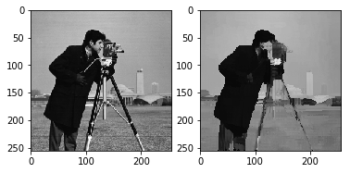
Kawahara 濾波器
original
Window size = 13

Slide 61


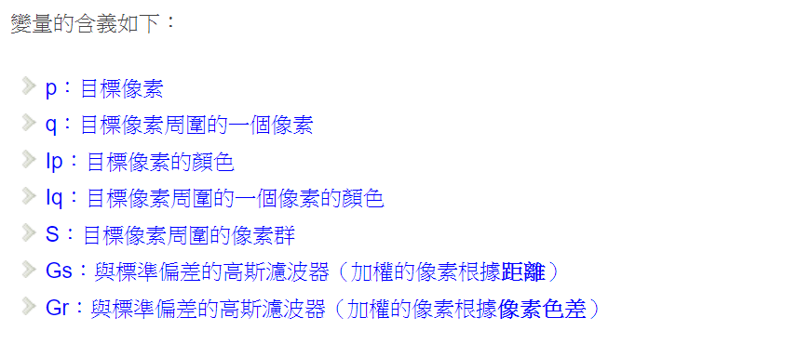
雙邊濾波器(Bilateral filter)
結合兩個函數～一個函數是由幾何空間距離決定濾波器係數，另一個由像素色差決定濾波器係數

Slide 62
雙邊濾波器(Bilateral filter)
結合兩個函數～一個函數是由幾何空間距離決定濾波器係數，另一個由像素色差決定濾波器係數

Slide 63
雙邊濾波器(Bilateral filter)
from skimage import io
import skimage.restoration as re
import matplotlib.pyplot as plt
c = io.imread('cameraman.tif')
cb1 = re.denoise_bilateral(c,win_size =5,sigma_range=0.2,sigma_spatial = 2,multichannel=False)
cb2 = re.denoise_bilateral(c,win_size =7,sigma_range=0.2,sigma_spatial = 10,multichannel=False)
cb3 = re.denoise_bilateral(c,win_size =11,sigma_range=0.1,sigma_spatial = 3,multichannel=False)
cb4 = re.denoise_bilateral(c,win_size =11,sigma_range=0.5,sigma_spatial = 5,multichannel=False)
fig = plt.figure()
plt.gray() # show the filtered result in grayscale
ax1 = fig.add_subplot(221) # left side
ax2 = fig.add_subplot(222) # right side
ax3 = fig.add_subplot(223) # left side
ax4 = fig.add_subplot(224) # right side
ax1.imshow(cb1,vmax=1.0,vmin=0.0)
ax2.imshow(cb2,vmax=1.0,vmin=0.0)
ax3.imshow(cb3,vmax=1.0,vmin=0.0)
ax4.imshow(cb4,vmax=1.0,vmin=0.0)
plt.show()

Slide 64
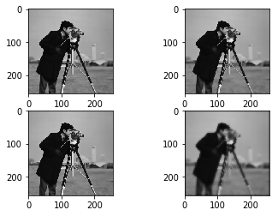
雙邊濾波器(Bilateral filter)

Slide 65
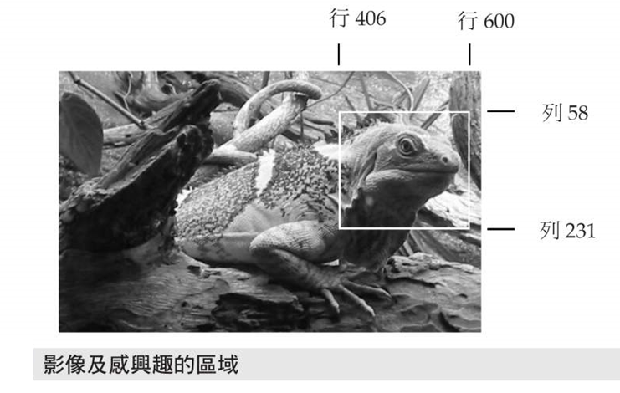
感興趣的區域處理

Slide 66

Python 中的感興趣區域
只對感興趣區域進行濾波處理
M_{f}R + M(1-R)
R

Slide 67
ROI 濾波
from skimage import io
from skimage.draw import polygon
from skimage import filters
from skimage.util import img_as_ubyte
import numpy as np
import matplotlib.pyplot as plt

Slide 68
ROI 濾波
l = io.imread('lizard.tif')
m= l[55:281,220:412]
r,c = m.shape
xi = np.array([60,27,14,78,130,139])
yi= np.array([14,38,127,177,160,69])
roi = np.zeros_like(m)
r,c = polygon(yi,xi)
roi[c,r]=1
lg = img_as_ubyte(filters.gaussian_filter(m, sigma = 0.4))
lr = lg*roi + m*(1-roi)

Slide 69
ROI 濾波
fig = plt.figure()
plt.gray() # show the filtered result in grayscale
ax1 = fig.add_subplot(121) # left side
ax2 = fig.add_subplot(122) # right side
ax1.imshow(lg/255,vmax=1.0,vmin=0.0)
ax2.imshow(l/255,vmax=1.0,vmin=0.0)
plt.show()

Slide 70

ROI 濾波

Slide 71
實驗五Kawahera濾波器實作
Task 1:研讀講義中Kawahera濾波器的程式碼
Task 2: 使用下圖之鄰近區域定義，改寫Kawahera濾波器的程式碼
Task 3: 撰寫實習報告並利用Tronclass繳交報告
The lab sessions focus on the basic image processing using Python
Task 1: Installing Python on your computer
Task 2: Install Pillow and OpenCV on your python
Task 3: Prepare an image in your computer
Task 4: Load the image into Python
Task 5: Display the loaded image using Matplotlib
Task 4: Write a lab report including the results of all tasks
A
D
C
B

Slide 72
Any Questions?

