Slide 1
HTML

Slide 2
Before we begin
This is for BEGINNERS.
Currently we’ll learn HTML with no CSS.
We will focus on HTML 5.
We will learn all the topics in a flow of
WHAT ?
WHY ?
WHERE ?
HOW ?
Be patient

Slide 3
What is HTML ?
Hyper Text Markup Language.
HTML is not a Programming language.
Markup languages is for creating the web pages.
These are the building blocks of the web pages.
HTML elements(tags) tell the browser how to
display the content.

Slide 4
Before Starting
A web Browser
Google Crome
Mozilla firefox
Safari
Edge
A text Editor
Sublime Text
Notepad++
Visual Studio code
Atom.io

Slide 5
Download link
Sublime text : https://www.sublimetext.com/3
Visual studio : https://visualstudio.microsoft.com/
Notepad++ : https://notepad-plus-plus.org/downloads/v7.9.5/

Slide 6
How to create HTML file
Open the text editor.
Open a new file.
Create your customized web page.
Save the file in .html extension.
After saving run your file using any web browser (chrome) .

Slide 7
Structure of html
<!doctype html> // it will always showing the current version of html.
<html> // will represent the root element of a page
<head>
</head> // is known as invisible part. because we are able to
hidden the property.
<body>
</body> // is known as visible part. What all the things we
will write it will be visible for the users.
</html>

Slide 8
Tags
What is tags?
- Inside <> all the predefind keywords in html will be known as tags.
- 2 types are there
1. Single tag :
- If we open one tag it is not required to close the tag.
- For ex:
<img>,<br>,<link> etc.
2. Double tags :
- If we open once it is mandatory to close the tags.
- For ex :
<body></body>,<title></title>,<a></a>,<p></p> etc.

Slide 9
Types of <head> tag
1. <title></title> = If we wants to provide any page name we
have to call it using title tag.
2. <link> = If we wants to link one page to another page we have
to call link tag.
3. <style></style> = To applying css
4. <script></script> = To call javascript
5. <meta></meta> = The subset of head tag. Which will provide to
hide some property from the users.

Slide 10
Attributes
- It will helps to add some extra effects on the html page.
- For each and every tags we are having different attributes.
Body tag attribute :
Attributes Parameter
1. bg color color code/color name
2. background image name
3. text color code/color name
4.Align left(default),right,center

Slide 11
Background color
It is very common to see web pages with their background color set to white or some other colors.
To set your document’s background color, you need to edit the <body> element by adding the bgcolor attribute. The following example will display a document with a background color:
<body bgcolor=“Indigo”></body>

Slide 12
Text color
The TEXT attribute is used to control the color of all the normal text in the document. The default color for text is black. The TEXT attribute would be added as follows:
<body bgcolor=“red” text=“green”></body>
In this example the document’s page
color is red and the text would be green.

Slide 13
Background Image
The BODY element also gives you ability of setting an image as the document’s background.
An example of a background image’s HTML code is as follows:
<body background=“hi.jpg” bgcolor=“blue”></body>

Slide 14
Headings, Paragraphs, Breaks & Horizontal rules
In this chapter you will add headings to your page, insert paragraphs, add some breaks, and add horizontal rules.
Objectives
Upon completing this section, you should be able to
List and describe the different Heading elements.
Use Paragraphs to add text to a document.
Insert breaks where necessary.
Add a Horizontal Rule.

Slide 15
Headings
Heading 1
Heading 2
Heading 3
Heading 4
Heading 5
Heading 6
<html>
<head>
<title> Example Page</title>
</head>
<body>
<h1> Heading 1 </h1>
<h2> Heading 2 </h2>
<h3> Heading 3 </h3>
<h4> Heading 4 </h4>
<h5> Heading 5 </h5>
<h6> Heading 6 </h6>
</body>
</html>

Slide 16
Attributes of heading tag
Align is the only attribute of heading tag.
Align=“left” , “right” , “center”.
Default will be left.
<h1 align=“right”> text </h1>

Slide 17
Paragraphs , <p> </p>
Paragraphs allow you to add text to a document in such a way that it will automatically adjust the end of line to suite the window size of the browser in which it is being displayed. Each line of text will stretch the entire length of the window.
Align is the attribute of paragraph tag.

Slide 18
Paragraphs , <p> </p>
<HTML><HEAD>
<TITLE> Example Page</TITLE>
</HEAD>
<BODY></H1> Heading 1 </H1>
<P> Paragraph 1, ….</P>
<H2> Heading 2 </H2>
<P> Paragraph 2, ….</P>
<H3> Heading 3 </H3>
<P> Paragraph 3, ….</P>
<H4> Heading 4 </H4>
<P> Paragraph 4, ….</P>
<H5> Heading 5 </H5>
<P> Paragraph 5, ….</P>
<H6> Heading 6</H6>
<P> Paragraph 6, ….</P>
</BODY></HTML>
Heading 1
Paragraph 1,….
Heading 2
Paragraph 2,….
Heading 3
Paragraph 3,….
Heading 4
Paragraph 4,….
Heading 5
Paragraph 5,….
Heading 6
Paragraph 6,….

Slide 19
Break Tag , <br>
Line breaks allow you to decide where the text will break on a line or continue to the end of the window.
A <BR> is an empty Element, meaning that it may contain attributes but it does not contain content.
The <BR> element does not have a closing tag.

Slide 20
Horizontal Rule , <hr>
The <hr> element causes the browser to display a horizontal line (rule) in your document.
<HR> does not use a closing tag, </HR>.

Slide 21
Character Formatting
For bold text we have have <b > </b>
For Text to be underlined we have <u> </u>
If we need a italic text , we have <i> </i>
If text needs to be strong , we have <strong></strong>
If my text has to be emphasized <em> </em>

Slide 22
Character Formatting
<big> </big>
<strike> </strike>
<small> </small>
<sub> </sub>
<sup> </sup>

Slide 23
Scrolling Text
<marquee></marquee>
- If we wants to create scrolling data we have to call marquee tag.
-
Attributes Parameter
1. bgcolor color code/name
2. height px,%
3. width px,%
4. direction left(default),right,up,down
5. behavior scroll(default),static, alternate
6. scrollamount number(speed)
7. scrolldelay number (ms)
8. loop any number

Slide 24
Image Tag
<img>:
- The full form is image tag.
- If we wants to create some images inside one page we have to call
<img> tag.
Attributes Parameter
1. src(source) image name/image path
2. height px
3. width px

Slide 25
Hyperlink
- If we want to create the relation between one page to
another page we have to create hyperlink.
- With the help of anchor tag we are able to create the hyperlink.
- Anchor tag we are using to internally connect between one
page to another page.
- <a></a> is known as anchor tag.
Attributes Parameter
1. href page name (where to reach)
2. target parent(default),blank(another tab & destination)

Slide 26
Assignment
Create one gallery page .
Title name should be as GALLERY.
Page should included with 28 images.
Each row it should contain 4 pictures.
Put the horizontal line for each row.

Slide 27
Special characters & Symbols
These Characters are recognized in HTML as they begin with an ampersand and end with a semi-colon e.g. &value; The value will either be an entity name or a standard ASCII character number. They are called escape sequences.
The next table represents some of the more commonly used special characters.

Slide 28
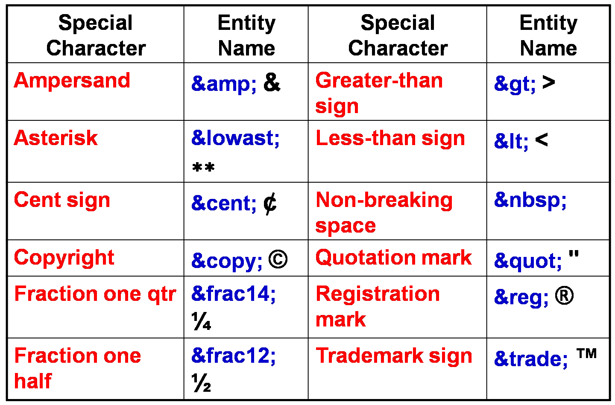
Special characters

Slide 29
List
In this chapter you will learn how to create a variety of lists.
Objectives
Upon completing this section, you should be able to
Create an unordered list.
Create an ordered list.

Slide 30
Order list
1. Order list(<ol></ol>): Items in this list are numbered automatically by the browser.
Default types of order list is number.
Attributes Parameters
1. types Number(default),A-Z,a-z,I,i
2. start any number

Slide 31
Unorder list
Unorder list(<ul></ul>) : Items in this list start with a list mark such as a bullet. Browsers will usually change the list mark in nested lists.
Default types of unorder list is disk.
Attributes Parameters
1. Types circle &
square &
disk(default)

Slide 32
Definition list
DL: Definition List. This kind of list is different from the others. Each item in a DL consists of one or more Definition Terms (DT elements), followed by one or more Definition Description (DD elements).
<dl>
<dt> HTML </dt>
<dd> Hyper Text Markup Language </dd>
<dt> URL</dt>
<dd> Universal Resource locator</dd>
</dl>

Slide 33
Assignment
Food
1.Veg food (put some image)
*idli
*dose
*poori
*chowchow bath
*curd rice
2.Nonveg Food (put some image)
*Biryani
A.chiken biryani
B. mutton biryani
*kabab
*curry
*pepper fry
3. Beverages (put some image)
*coffee
*Tea
i.black tea
ii. Green tea
*soft drink
o.coke
o.pepsi
o.fanta
o.maaza
o.sprite
* Refers to circle type
O refers to square type

Slide 34
Anchors and URL
In this chapter you will learn about Uniform Resource Locator, and how to add them as Anchor or Links inside your web pages.
Objectives
Upon completing this section, you should be able to
Insert links into documents.
Define Link Types.
Define URL.
List some commonly used URLs.

Slide 35
Audio and Video tag
To insert audio or video to our page we have audio tag and video tag
For audio : <audio controls>
<source src="song.mp3">
</audio>
For video : <video controls>
<source src=“video.mp4">
</video>

Slide 36
Table
In this chapter you will learn that tables have many uses in
HTML.
Objectives:
Upon completing this section, you should be able to:
Insert a table.
Explain a table’s attributes.
Edit a table.
Add a table header.

Slide 37
Table
The <table></table> element has four sub-elements:
Table Row<tr></tr>.
Table Header <th></th>.
Table Data <td></td>.
Caption <caption></caption>.
The table row elements usually contain table header elements or table data elements.

Slide 38
Table attribute
BG Color: Some browsers support background colors in a table.
Background: Addition of images
Border: You can choose a numerical value for the border width, which specifies the border in pixels.
Cell spacing: Cell Spacing represents the space between cells and is specified in pixels.
Cell Padding: Cell Padding is the space between the cell border and the cell contents and is specified in pixels.

Slide 39
Table attribute
Align: Tables can have left, right, or center alignment.
Font color : To change the font color inside the table
Border Color: To change the border color.
Table caption : A table caption allows you to specify a line of text that will appear centered above or below the table.
Rowspan: To merge the rows
Colspan:To merge the columns
<caption align=“bottom”> Label For My Table </caption>

Slide 40
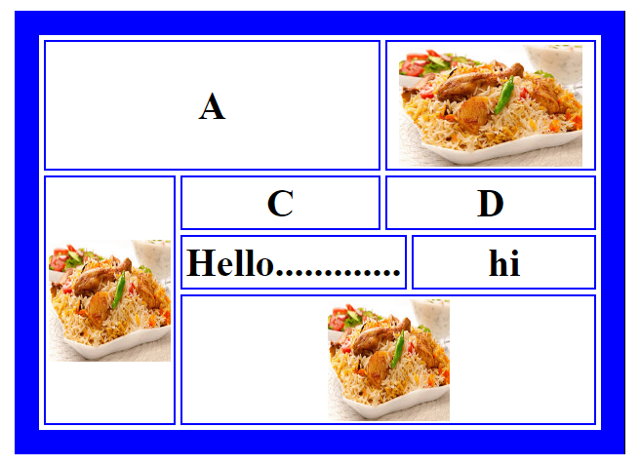
Assignment

Slide 41
Shapes and Co-Ordinates
Types of Shapes
Rectangle🡪 used for squares and ordered shapes.
Circle 🡪 used for circles.
Number of coordination's for each shape:
Rectangle 🡪4 numbers for two corners
Circle 🡪3 numbers for the center & R

Slide 42
Image Mapping
Image maps (USEMAP) use a map file that is part of the HTML document (in an element called MAP), and is linked to the image by the Web browser.
<img src="workplace.jpg" alt="Workplace" usemap="#workmap">
<map name="workmap">
<area shape="rect" coords="34,44,270,350" alt="Computer" href=“list.html">
<area shape="rect" coords="290,172,333,250" alt="Phone" href=“galery.html">
<area shape="circle" coords="337,300,44" alt="Coffee" href=“index.htm">
</map>

Slide 43
Emoji’s in HTML
Emoji’s look like images, or icons, but they are not.
They are letters (characters) from the UTF-8 (Unicode) character set.
UTF-8 covers almost all of the characters and symbols in the world.
<p> First letter in alphabets is A <p>
<p> First letter in alphabets is &#65; <p>

Slide 44
Forms
To insert a form we use the <form></form> tags.
The rest of the form elements must be inserted in
between the form tags.
<html> <head>
<title> Sample Form</title>
</head>
<bodybgcolor=“FFFFFF”>
<formaction = http://www.xnu.com/formtest.asp>
<p> First Name: <input type=“text” name=“fname” maxlength=“50”> </p>
<p> <input type=“submit” name=“fsubmit” value=“Send Info”> </p>
</form>
</body> </html>

Slide 45
End of HTML

Slide 46
CSS
Cascading style sheet

Slide 47
Presentation Summary
What is CSS?
Style Sheet Implementation
Common CSS properties
The Box Model
HTML & DIVs
CSS Rule Structure

Slide 48
Introduction
What do you know about CSS?
What do you hope to do with CSS?
How familiar are you with HTML?

Slide 49
What is CSS?
The full form of CSS is “cascading style sheet”.
We are using CSS to apply design in our web pages.
CSS are case-insensitive.

Slide 54
CSS Selectors
A CSS RULE is made up of a selector and a declaration. A declaration consists of property and value.
selector {property: value;}
declaration

Slide 55
CSS Selectors
A selector, here in green, is often an element of HTML.
body { property: value; }
h1 { property: value; }
em { property: value; }
p { property: value; }

Slide 56
Properties and values
body {background: purple;}
h1 {color: green;}
h2 {font-size: large;}
p {color: #ff0000;}
Properties and values tell an HTML element how to display
body {
background: purple;
color: green;
}

