Slide 1
Computer science department
Data science | Data analysis model

Slide 2
index
:
-
Introduction
Dataset
Code
Visualization
Explanation
Conclusion

Slide 3
introduction
:
-
In this presentation, we'll explore traffic accident dataset to understand patterns and outcomes using stats and visualization.
Our goal is to uncover insights about accidents through data analysis.
We'll use graphs and numbers to see what's happening and why it matters.

Slide 4
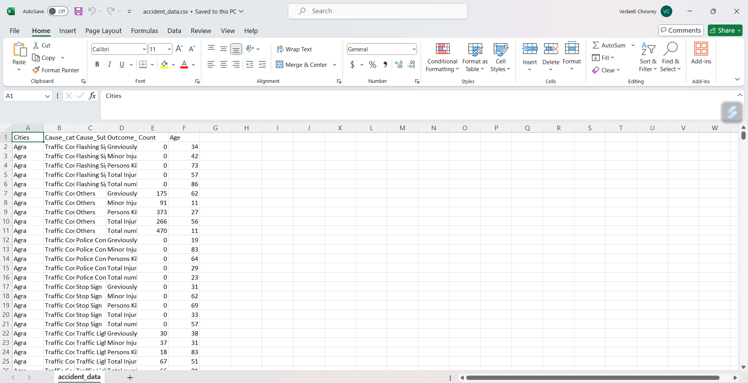
Dataset
:
-

Slide 5
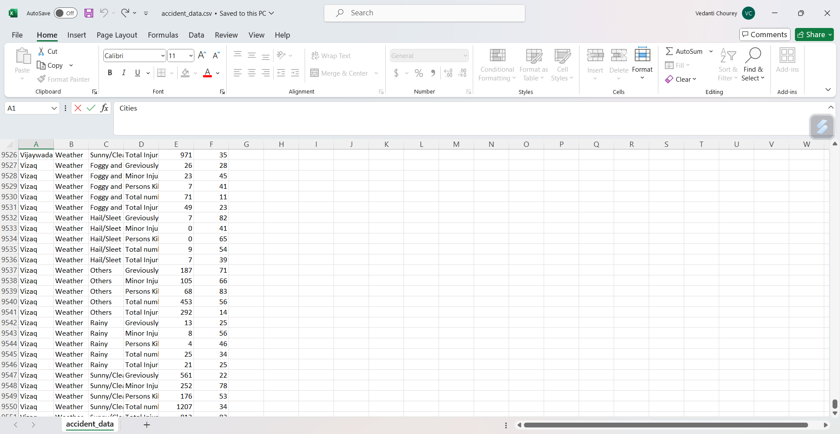

Slide 6
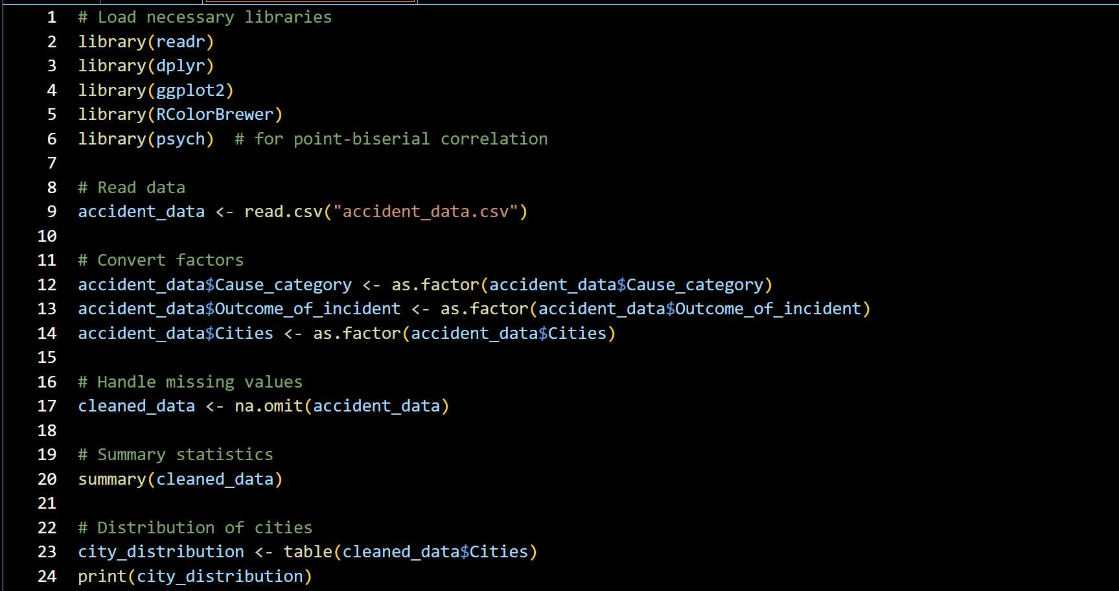
code
:
-

Slide 7
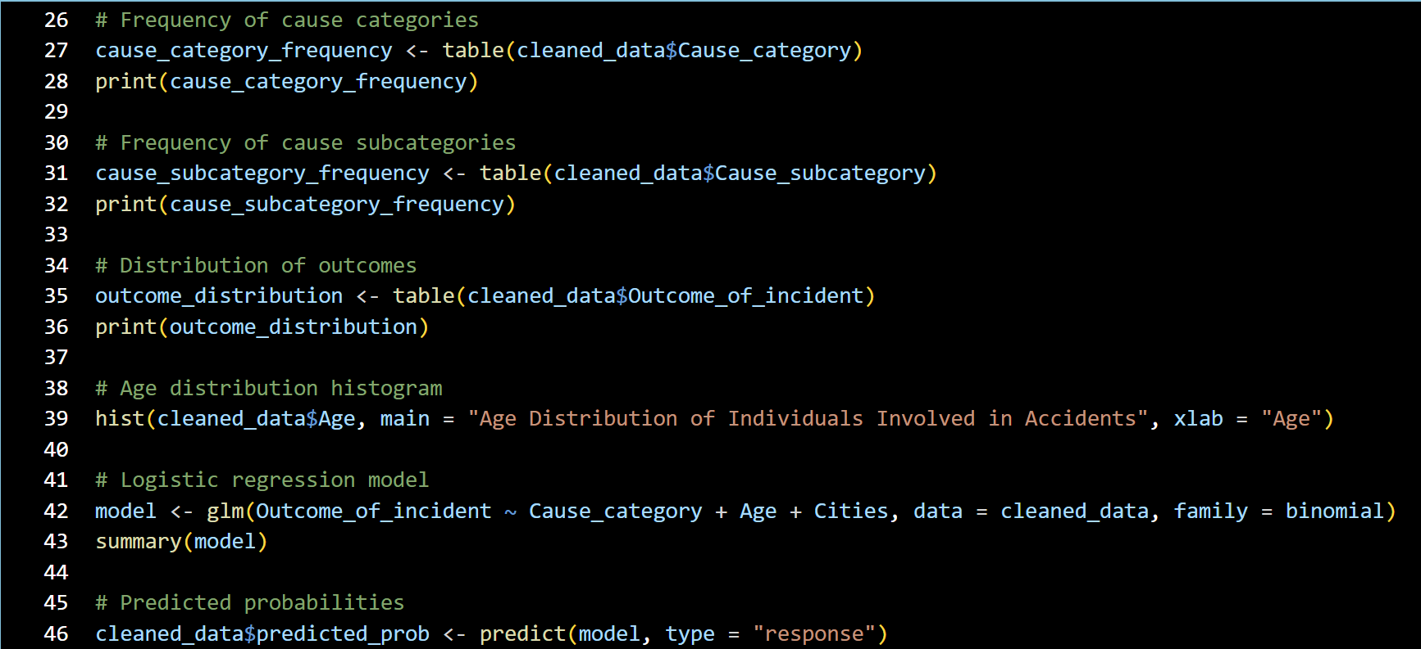

Slide 8
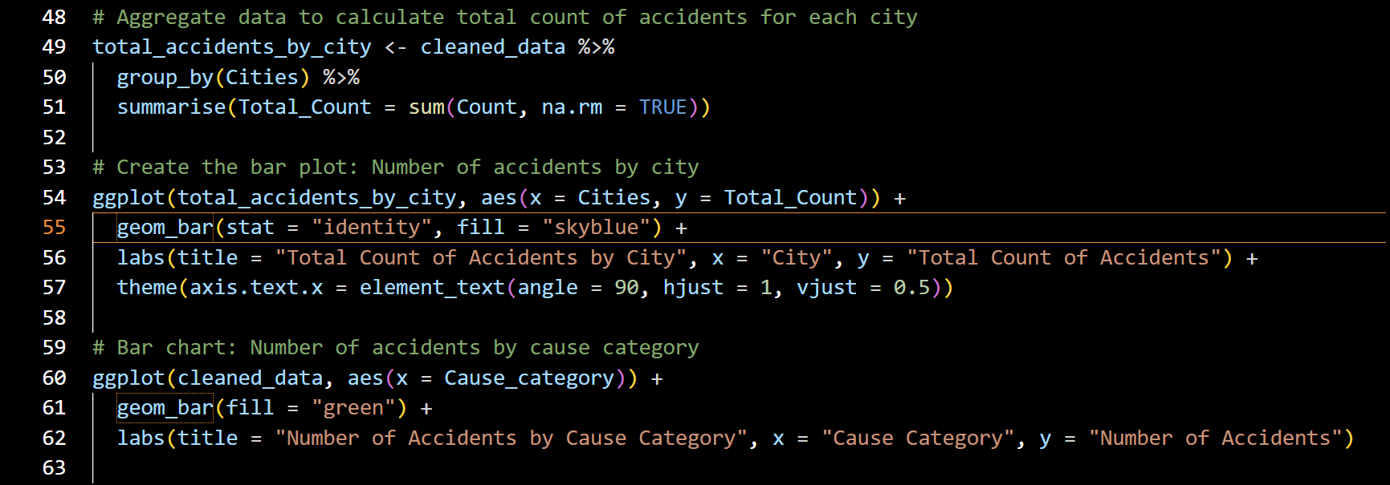
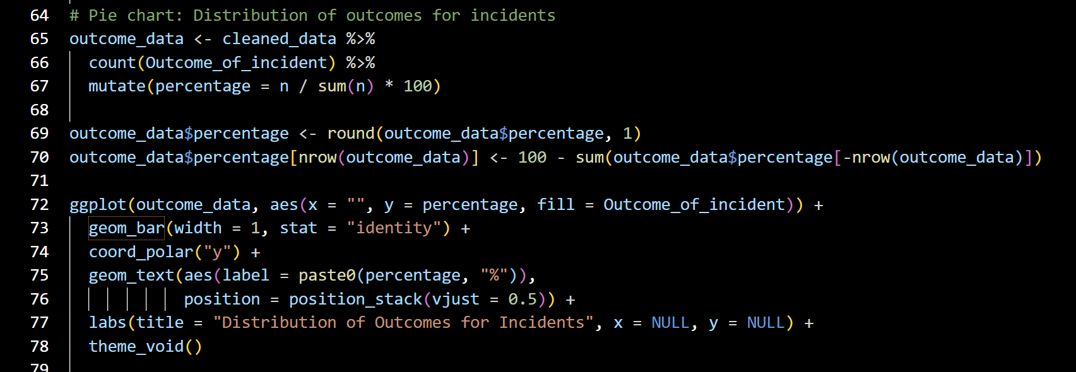

Slide 9
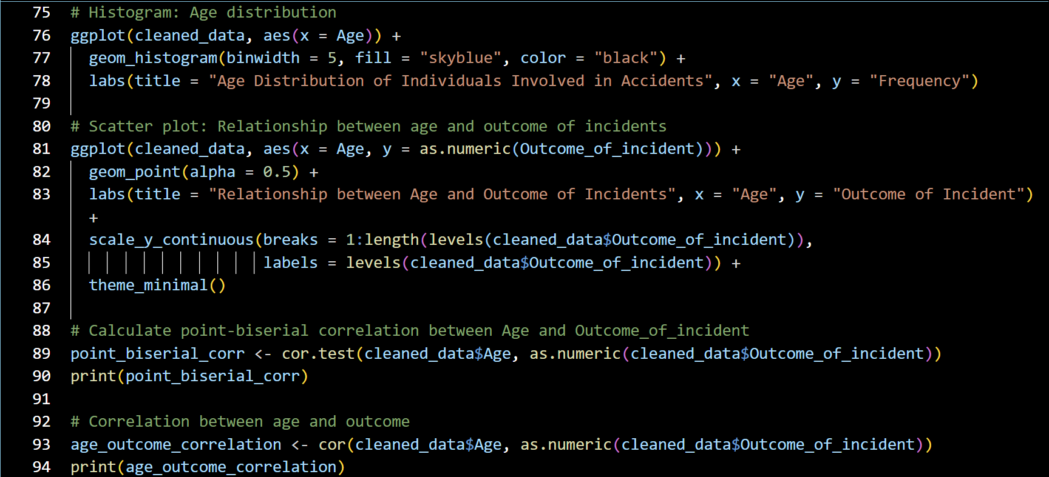

Slide 10
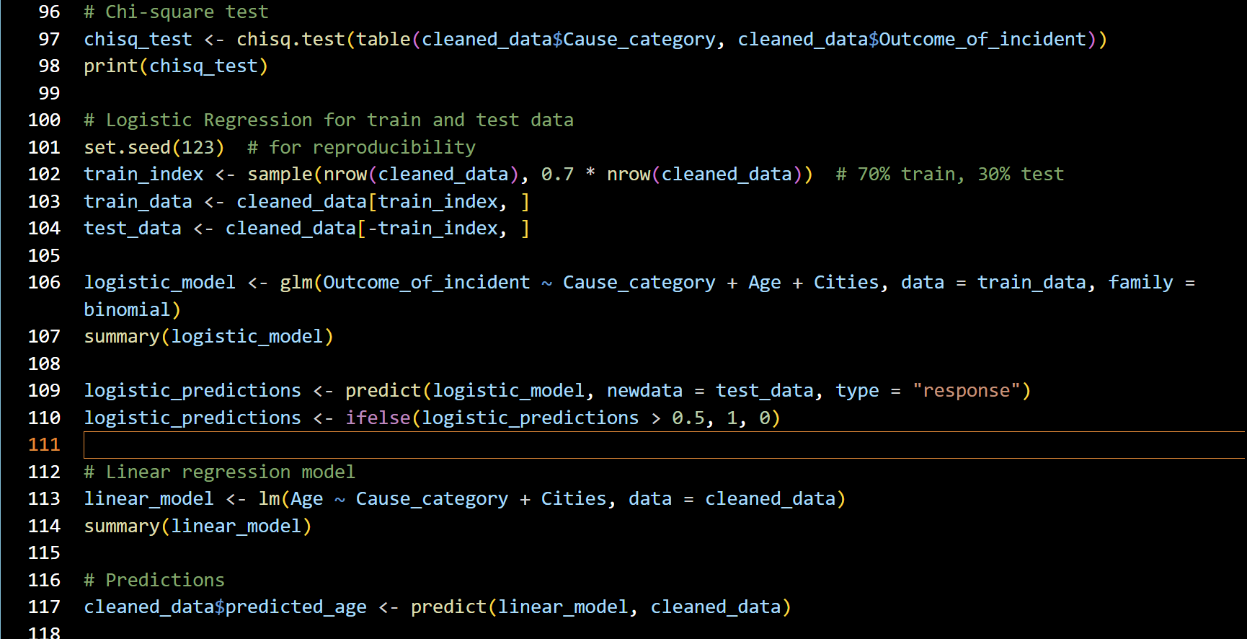

Slide 11
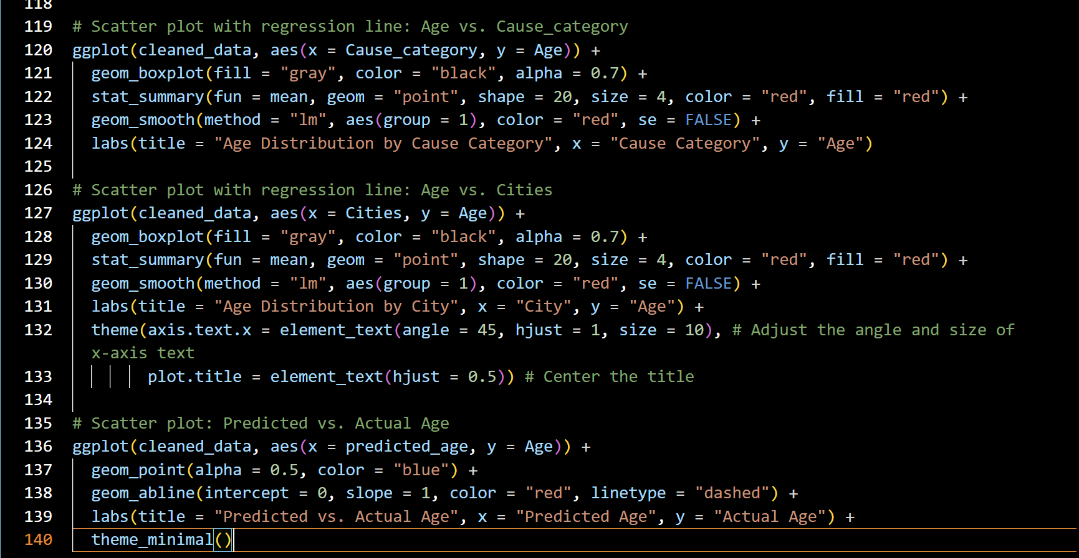

Slide 12
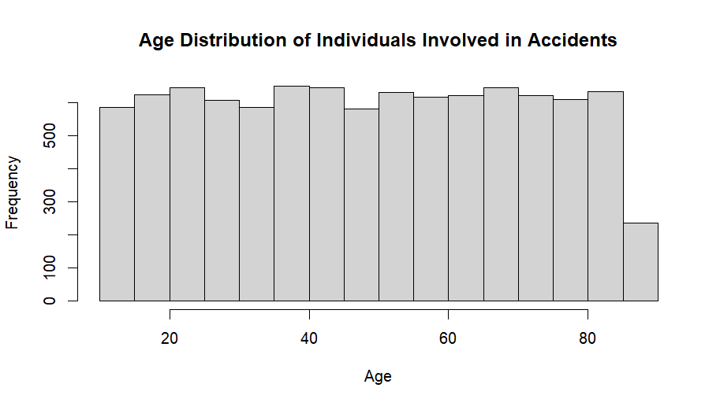
Visualization
:
-
Histogram of the Age variable, showing the distribution of ages for individuals involved in accidents.

Slide 13
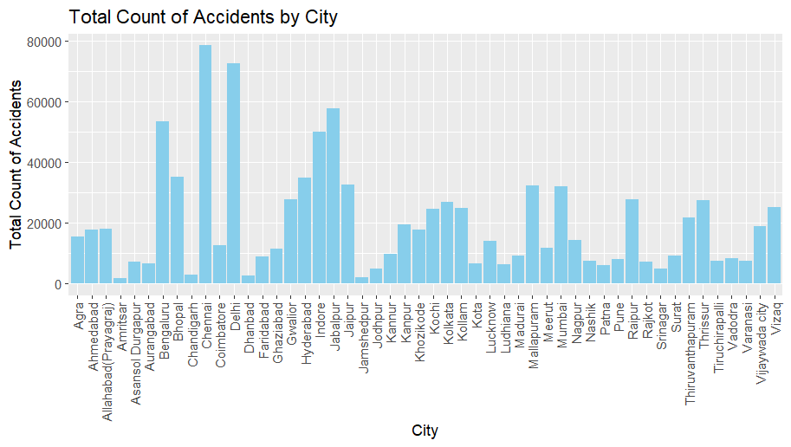
Bar chart showing the number of accidents in each city.

Slide 14
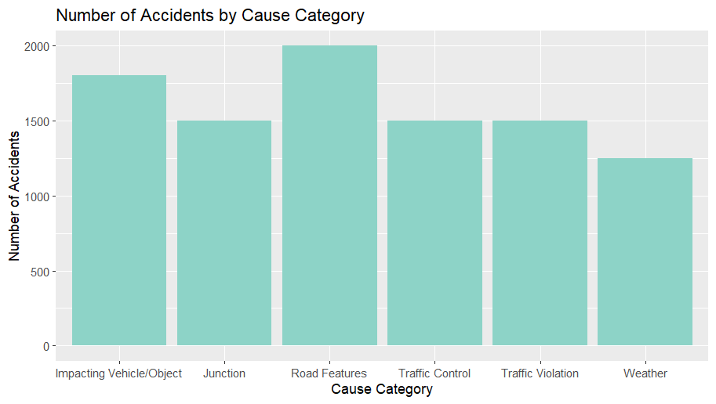
Bar chart showing the number of accidents for each cause category.

Slide 15
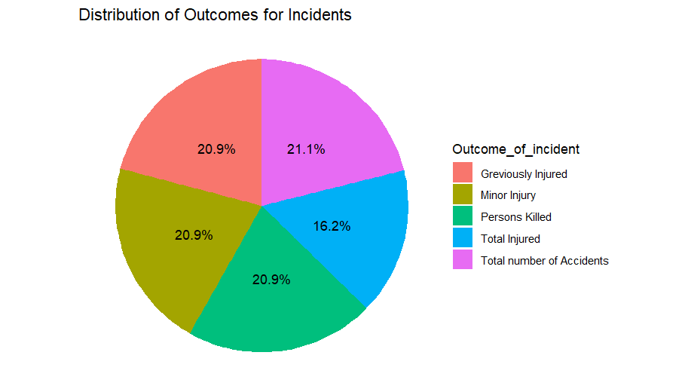
Pie chart showing the distribution of incident outcomes.

Slide 16
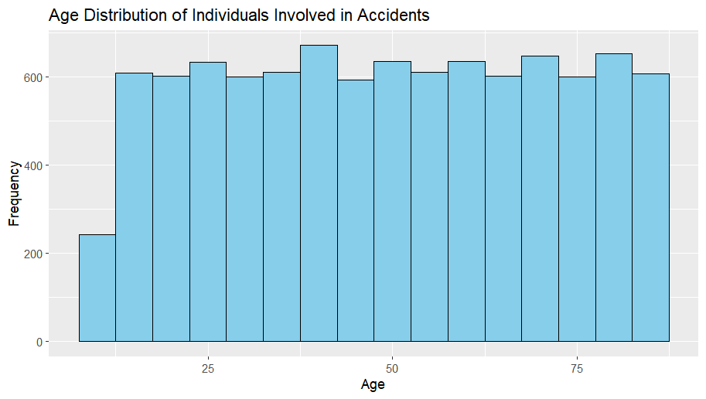
A histogram of the Age variable using ‘ggplot2’ ,the histogram shows the frequency distribution of ages

Slide 17
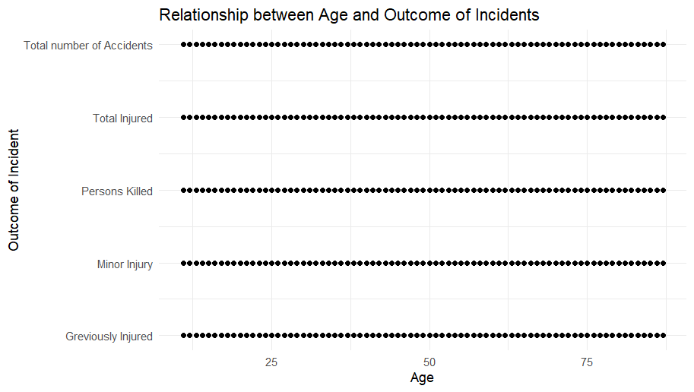
Scatter plot showing the relationship between Age and Outcome_of_incident. The y-axis represents the numeric encoding of the outcomes.

Slide 18
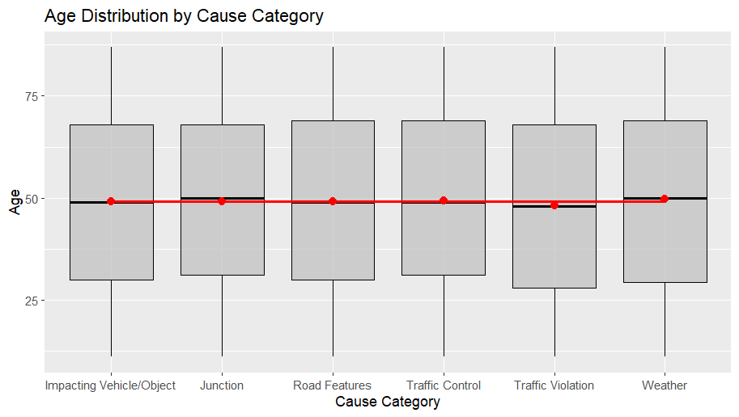
A boxplot showing the distribution of Age for each Cause_category, with gray boxes and black borders.

Slide 19
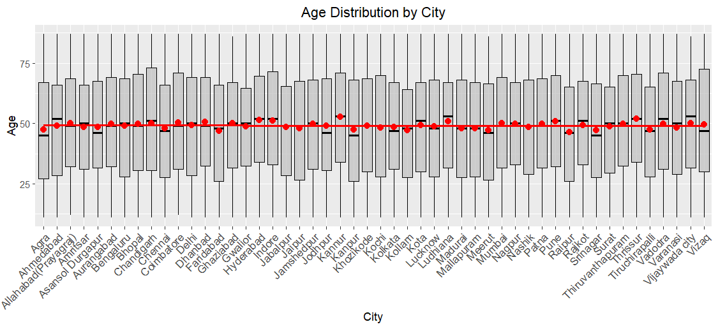
A similar boxplot for the distribution of Age across Cities

Slide 20
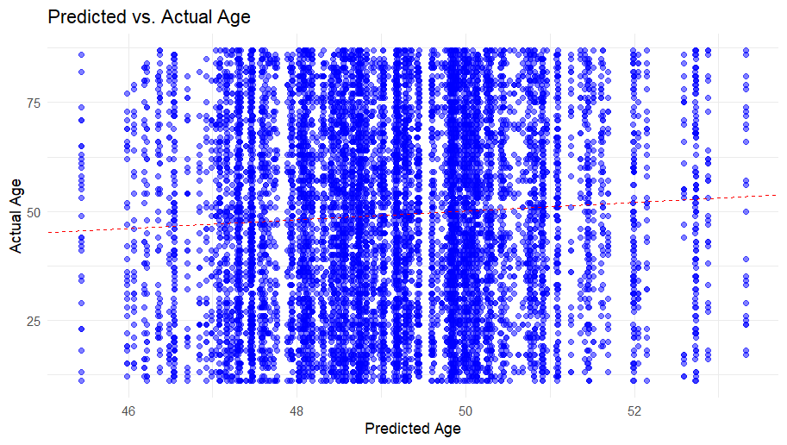
A scatter plot comparing the predicted ages to the actual ages.

Slide 21
Explanation
:
-
We analyzes and visualizes traffic accident data. It starts by loading necessary libraries and reading the dataset. Factors such as `Cause_category`, `Outcome_of_incident`, and `Cities` are converted to factors, and missing values are removed. Summary statistics are generated, and the distributions of cities, cause categories, cause subcategories, and outcomes are printed. Various visualizations are created, including a histogram of age distribution, a bar plot of total accidents by city, a bar plot of accidents by cause category, a pie chart of incident outcomes, and a histogram of age frequency. Statistical analyses include logistic regression to predict incident outcomes, point-biserial correlation to assess the relationship between age and outcome, and a chi-square test to examine the association between cause category and outcome. A linear regression model is used to predict age based on cause category and cities, and a scatter plot compares predicted vs. actual ages. These steps collectively provide insights into the data's structure, distributions, and relationships.

Slide 22
:
conclusion
-
In conclusion, our analysis of the accident data has provided valuable insights into various aspects of accidents, including their causes, outcomes, and demographic patterns. Through statistical methods and visualizations, we've identified significant predictors of accident outcomes and uncovered relationships between variables such as age, cause categories, and cities. These findings can inform targeted safety interventions and policy decisions, helping to improve overall safety measures and resource allocation. By leveraging data-driven insights, we can work towards reducing the occurrence and severity of accidents, ultimately creating safer communities for everyone.

