Slide 1
Pricing a Home Before It Sells
Interpretable linear regression on the Ames housing data
Data Mining HW1 · Group 3 · October 2026
周懷聖 范瀞予 陳湋昱 李宗穎 劉嘉豪 張翊鞍 陳柏淮 陳家祥
Notes:
【W1｜10 秒】
大家好，我們是第 3 組。題目是在房子成交前預測成交價，資料是 Ames Housing，方法是可解釋的線性迴歸。

Slide 2
Sellers need a price estimate at listing time, before any sale data exists
Who uses it
What it decides
Why linear
Sellers and agents setting an asking price
Buyers checking whether a listing is fair
Asking price for sellers
Whether to negotiate or verify for buyers
Each coefficient reads as the value of one house attribute
Users can see why an estimate is high or low
Notes:
【W1｜30 秒】
情境是物件準備上架、還沒成交的時候。賣方和房仲要決定開價，買方要判斷開價合不合理。
選線性模型，是因為每個係數都能解讀成某個房屋條件值多少錢，使用者看得懂估價偏高或偏低的原因。

Slide 3
We predict a home's sale price at listing time, from house attributes only
Item | Definition
Target | SalePrice in USD; training range $34,900 to $745,000, median $165,000
One row | One house sale in Ames, Iowa, 2006 to 2010
Inputs | 73 house attributes (size, quality, rooms, neighborhood) + QualityArea
Known at | Listing time; excluded: sale date, type, condition, age from sale year
Research question: using only pre-sale attributes, can a regularized linear model keep test MAE within $15,000 and do no worse than a Random Forest?
Notes:
【W1｜35 秒】
任務定義：預測 SalePrice（美元），一筆資料是一次成交。輸入是 73 個房屋條件，加上我們設計的 QualityArea。
預測時間點是上架時，所以成交年月、交易類型、交易條件，以及要用成交年份才算得出的屋齡都不用。
研究問題：只用這些資訊，正則化線性模型能不能把 test MAE 控制在 15,000 美元內，而且不輸 Random Forest？

Slide 4
1,460 Ames sales, split once, with the test set sealed until the end
1,460 sales
Train 1,168
Train 1,166
5 folds
Ames, Iowa
2006 to 2010
→
80% split
seed 42
→
2 outliers removed
(Id 524, 1299)
→
232 to 234
homes each
Target: SalePrice (USD), modeled as log1p
Test 292 sales: never used for EDA, tuning or model choice; scored once after all settings were frozen
Inputs: 73 house attributes + QualityArea, one-hot encoded to 214 columns
Source: Kaggle House Prices: Advanced Regression Techniques; De Cock (2011). Outliers: living area > 4,000 sq ft and price < $300,000.
Notes:
【W2｜30 秒】
資料共 1,460 筆，固定切成 1,168 / 292。只在 training 刪掉 2 筆異常值（居住面積超過 4,000 平方英尺、總價卻低於 30 萬美元），剩 1,166 筆，再固定切成 5 折，全組共用。
Test set 封存，只評一次。

Slide 5
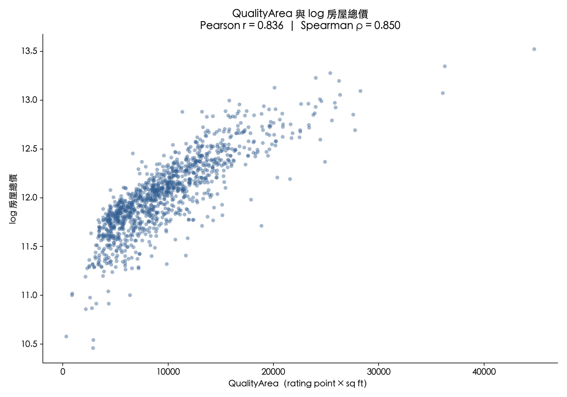
Quality × living area tracks price more closely than either alone
Feature | Pearson r
QualityArea | 0.836
OverallQual | 0.813
GrLivArea | 0.719
Hypotheses from EDA
H1: add QualityArea
H2: log-transform LotArea
H3: merge 3 area columns into TotalSF
Training data only (n = 1,166). QualityArea = OverallQual × GrLivArea. Ablation on slide 10 tests the hypotheses.
Notes:
【W2｜35 秒】
EDA 只用 training。品質 × 居住面積（QualityArea）和 log 房價的 r = 0.836，比單獨的品質 0.813、面積 0.719 都高。
直覺是：同樣一坪，蓋得越好的房子越值錢。由此提出 H1 到 H3，第 10 張用 ablation 驗證。

Slide 6
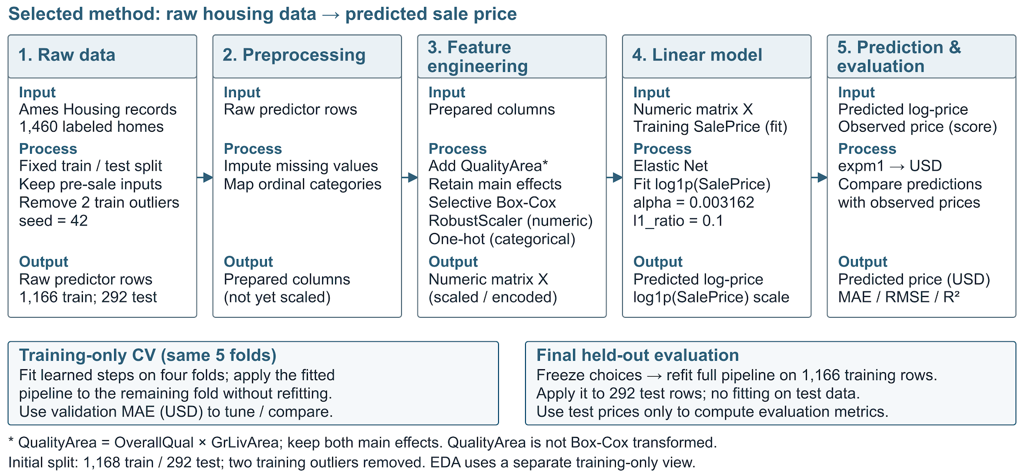
Every learned step is fitted inside the training folds
Model choice: Elastic Net, since the 214 one-hot columns are highly collinear; L1 + L2 shrinks and selects. α = 0.0032 and l1_ratio = 0.1 chosen by 5-fold CV on training data.
Notes:
【W2｜40 秒】
流程：補值、序位編碼 → 加入 QualityArea、Box-Cox、RobustScaler、one-hot → Elastic Net 預測 log 價格 → expm1 轉回美元。所有要從資料學的步驟，都只在 training fold 內 fit。
選 Elastic Net，是因為 214 個欄位共線性強，L1 + L2 能收縮也能挑特徵；α 和 l1_ratio 用 5 折 CV 在 training 上選。

Slide 7
Leakage, collinearity and skewed prices shaped the design
Leakage
Collinearity
Skewed prices
Sale date, type and condition are known only after the sale.
Fix: drop them, and the age computed from the sale year.
214 one-hot columns; area and quality columns overlap (VIF up to 67).
Fix: Elastic Net shrinks and selects instead of plain OLS.
Price skew 1.74; a few expensive homes dominate squared error.
Fix: model log1p(price) (skew 0.12), report errors in USD.
Dead end: keeping only the MI Top-20 features raised CV RMSE by 18%
Surprise: the linear model beat Random Forest on the test set
Notes:
【W2｜35 秒】
我們遇到三個問題。第一是資料洩漏：成交後才知道的欄位要拿掉。第二是共線性：one-hot 後有 214 欄、VIF 最高到 67，所以不用一般 OLS。第三是房價右偏：偏態 1.74，取 log 後降到 0.12，誤差仍用美元報告。
走過的冤枉路：只留 MI 前 20 名特徵，CV RMSE 反而變差 18%。意外的是，線性模型在 test 上贏過 Random Forest。

Slide 8
All models share the same folds, metrics and a $15,000 MAE threshold
Protocol
Fixed 5-fold CV on 1,166 training homes; learned steps fit inside each fold. Test scored once, after all settings were frozen.
$15,000
Metrics
MAE in USD as the primary metric, plus RMSE and R². Predictions are converted back with expm1 first.
test MAE threshold, fixed before the final test
Baselines
Training mean; single-feature OLS on GrLivArea; Random Forest on raw features.
CV mean + 2 SD (14,985), rounded up; about 9% of the median price
Ablation
Same model, folds and tuning; only the feature set changes (slide 10).
Notes:
【W2｜35 秒】
所有模型用同一組 5 折 CV 調參和比較，test 只在設定凍結後評一次。主要指標是美元 MAE，因為它直接對應開價的誤差。
Baseline 由弱到強：平均值、只用居住面積的 OLS、Random Forest。
15,000 美元的門檻是最終模型 CV MAE 的 mean + 2 SD 取整，在跑 test 之前就定好，大約是房價中位數的 9%。

Slide 9
Elastic Net is the only model under the $15,000 threshold
Model | CV MAE | Test MAE | R² | ≤ $15k
Mean | $56,392 | $62,580 | 0.00 | No
Single-feature OLS | $37,160 | $38,474 | 0.57 | No
Random Forest | $16,554 | $16,384 | 0.90 | No
Elastic Net (ours) | $13,366 | $14,423 | 0.93 | Yes
−$1,961
lower MAE per home than Random Forest
95% CI: −$3,847 to −$399
permutation p = 0.017
CV and test agree: $13,366 ± 809 in CV, $14,423 on 292 test homes
Test RMSE $22,340; R² 0.935
Test set evaluated once. Single-feature OLS uses GrLivArea. CI: paired bootstrap; p: paired permutation test on the 292 test homes.
Notes:
【W2｜45 秒】
只有 Elastic Net 通過門檻：test MAE 14,423，R² 0.935；CV 是 13,366 ± 809，兩者一致。三個 baseline 都沒過，Random Forest 是 16,384。
和 Random Forest 比，每筆少 1,961 美元，95% CI 不含 0，permutation test p = 0.017。
補充：Lasso 在 CV 上和 Elastic Net 差不多，所以我們不說 Elastic Net 贏過所有線性模型。

Slide 10
Only the quality × area interaction improved all five folds
Change tested | ΔCV RMSE | Folds | Decision
H1: add QualityArea | −$1,222 (−5.7%) | 5 / 5 | Kept
H2: LotArea → log | −$241 (−1.1%) | 4 / 5 | Dropped: Box-Cox covers it
H3: 3 area columns → TotalSF | −$235 (−1.1%) | 3 / 5 | Dropped: small gain
Keep only MI Top-20 features | +$3,909 (+18%) | n/a | Dropped
Final features: all raw attributes + QualityArea. CV MAE $13,366, vs $13,750 with raw attributes alone.
H1 to H3: Ridge (α = 10), log1p target, same 5 folds. MI Top-20: Elastic Net vs all raw features.
Notes:
【W2｜35 秒】
Ablation 固定用 Ridge 和同樣的 5 折，只換特徵。H1 加入 QualityArea，RMSE 降 5.7%，5 折全部改善，所以採用。
H2、H3 只改善約 1%，沒有放進最終模型。只取 MI 前 20 名反而變差 18%。最終特徵是全部原始欄位加上 QualityArea。

Slide 11
Quality, living area and build year carry the largest coefficients
QualityArea
0.077
All seven have bootstrap 95% CIs that exclude 0
High VIF (GrLivArea 58, QualityArea 33): read as associations, not separate effects
None stays significant after Holm correction
GrLivArea
0.071
YearBuilt
0.070
OverallCond
0.047
LotArea
0.038
OverallQual
0.036
TotalBsmtSF
0.032
Standardized coefficient: change in log1p(price) per training SD. CIs from 1,000 bootstrap resamples.
Notes:
【W2｜25 秒】
標準化係數最大的是 QualityArea、居住面積、建造年份，這 7 個的 bootstrap 95% CI 都不含 0。
但 VIF 很高，所以只解讀成關聯，不是獨立的因果效果；Holm 校正後也沒有係數維持顯著。

Slide 12
Errors double for high-quality homes, which the model under-prices
Test MAE by overall quality
Largest test errors
Quality ≤ 5 (n = 123)
$11,085
Id | Actual | Predicted | Quality
899 | $611,657 | $473,938 | 9
775 | $395,000 | $295,840 | 8
1047 | $556,581 | $459,516 | 9
Quality 6 to 7 (n = 124)
$12,938
Quality ≥ 8 (n = 45)
$27,636
All three are under-predicted; two are in NridgHt
Elastic Net on the 292 test homes. Overall test MAE $14,423; largest error $137,719 (Id 899).
Notes:
【W2｜35 秒】
品質 ≥ 8 的房子 MAE 是 27,636，是其他組的兩倍。誤差最大的三筆都是品質 8 到 9，而且都被低估，其中兩筆在 NridgHt。
可能原因是高品質新屋或特定社區的溢價，訓練資料裡這類房子少。這是推測，不是驗證過的因果。

Slide 13
Prior studies find linear models close to tree ensembles on housing data
Study | Data | Models | Test R²
Sharma et al. 2024 | Ames, 2,930 | LR, RF, SVR, XGB, MLP | XGB 0.930, LR 0.910
Ho et al. 2021 | Hong Kong, ~40,000 | SVM, RF, GBM | GBM 0.904
Limsombunchai 2004 | Christchurch, 200 | Hedonic, ANN | ANN 0.900
This work | Ames (Kaggle), 1,460 | EN, RF | EN 0.935, RF 0.905
What we add: pre-sale inputs only, a sealed test set, and a significance test against a strong baseline
Ames rows are sales; Christchurch rows are listings. R² is on each study's own data and scale, so values are not directly comparable.
Notes:
【W1｜30 秒】
Sharma 2024 同樣用 Ames，XGBoost R² 0.930、線性迴歸 0.910，差距很小。Ho 2021 和 Limsombunchai 2004 用的是其他城市。各篇的資料和尺度不同，R² 不能直接比大小。
我們多做的：只用成交前資訊、test 封存只評一次、和強 baseline 做顯著性檢定。

Slide 14
Team contributions
P1 · Data 李宗穎
P2 · EDA 張翊鞍
Data checks, preprocessing, fixed split
EDA, hypotheses H1 to H3, features
P3 · Model 范瀞予
I1 · Story 劉嘉豪
Models, ablation, final test, statistics
Use case, research question, threshold
I2 · Results 周懷聖
I3 · Slides 陳家祥
Results Master Sheet, figures, tables
Slides, README, repository, submission
W1 · Presenter 陳柏淮
W2 · Presenter 陳湋昱
Intro, related work, conclusion
Data, method, results, analysis
AI tools: Claude for related-work checks and drafting; ChatGPT and Codex for organizing files and tables. The team chose the task, features, models and threshold, ran all experiments and verified every number.
Notes:
【W1｜15 秒】
這是每位組員負責的部分。AI 工具的使用方式寫在下方，所有數字都由組員核對過。

Slide 15
Yes: a linear model stays within $15,000 and beats Random Forest
What we showed
Limitations
Pre-sale setup with no sale date, type or condition
EDA hypotheses tested by ablation: QualityArea cut CV RMSE 5.7%
Elastic Net: test MAE $14,423, $1,961 below Random Forest (p = 0.017)
One city, sales from 2006 to 2010
Under-prices high-end homes (quality ≥ 8: MAE $27,636)
Threshold bounds the average; largest error $137,719
CV slightly optimistic: same folds used for tuning
Next: add a new-construction flag to cut error on high-end homes
Notes:
【W1｜35 秒】
答案是 yes。Elastic Net 的 test MAE 是 14,423 美元，通過 15,000 門檻，而且比 Random Forest 每筆少 1,961。最有幫助的是品質 × 面積的交互作用。
建議：一般住宅可以拿模型當開價起點；高品質或新建住宅誤差較大，要保留議價空間或找正式鑑價。
限制：單一城市、2006 到 2010 年；MAE 是平均值；CV 略為樂觀。下一步是加入新成屋指標。謝謝大家。

