Slide 1
Generative Adversarial Network-(1)
计86-周恩贤

Slide 2
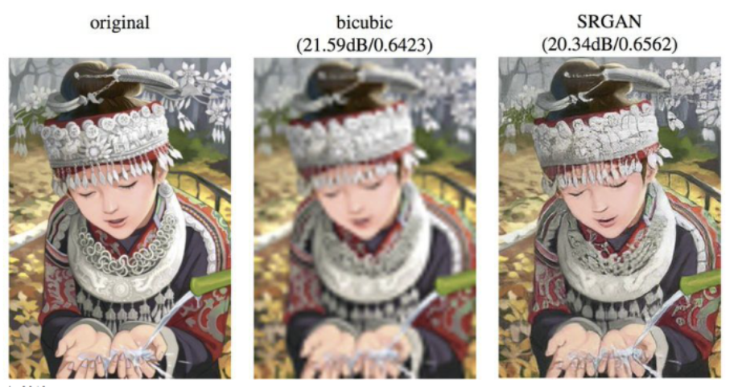
Introduction: GAN
Generative Adversarial Network
Generate new images
A Game between
Generator & Discriminator
A GAN Network with
Generator & Discriminator
GAN can create
high resolution images !

Slide 3
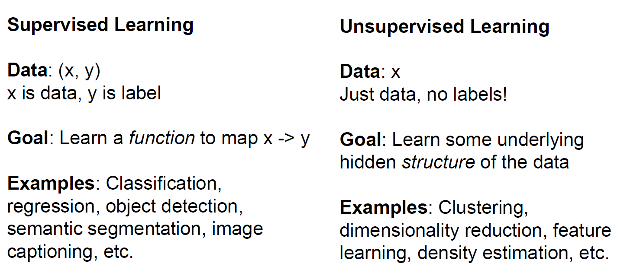
Review : Supervised v.s. Unsupervised
Notes:
Solve unsupervised learning => understand structure of visual world

Slide 4
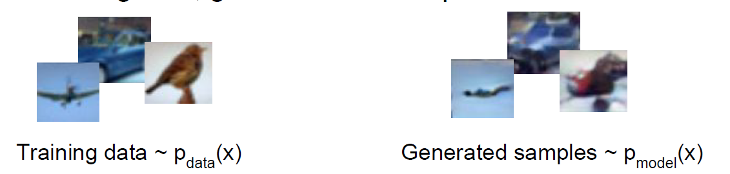
Generative Models
Given training data, generate new samples from same distribution

Slide 5
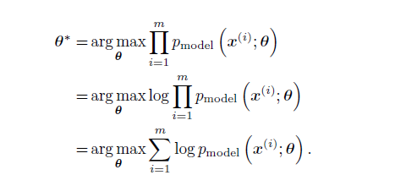

Generative Models using MLE
Choose parameters for model that maximize the likelihood of the training data.
Process of MLE = minimize KL-divergence

Slide 6

KL – divergence ( relative entropy )
KL- divergence = cross entropy - information entropy
KL-divergence represents the difference between p、q
KL-divergence >= 0
Usually, p is a ( correct/real ) distribution, thus its
information entropy can be viewed as a const.

Slide 7
Discriminative v.s. Generative
Discriminative models capture the conditional probability p(Y | X)
Generative models capture the joint probability p(X, Y),
( or just p(X) if there are no labels )
Notes:
判別模型主要的精神是想要學習「判斷目標變數的準則」，因此判別模型是透過觀察大量資料估計後驗分配 P(Y|X) 的機器學習方法。生成模型主要的精神是想要學習「生成資料的機制」，因此生成模型主要是透過觀察大量資料估計聯合分配 ，再透過貝氏定理得出判斷準則。

Slide 8
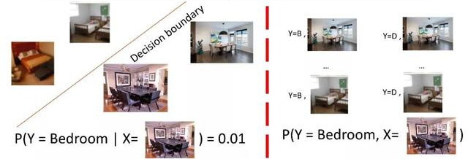
Discriminative v.s. Generative (Supervised)

Slide 9
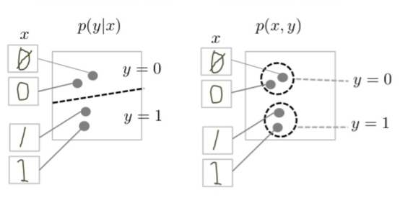
Discriminative v.s. Generative (Supervised)
Notes:
The discriminative model tries to tell the difference between handwritten 0's and 1's by drawing a line in the data space. If it gets the line right, it can distinguish 0's from 1's without ever having to model exactly where the instances are placed in the data space on either side of the line.
In contrast, the generative model tries to produce convincing 1's and 0's by generating digits that fall close to their real counterparts in the data space. It has to model the distribution throughout the data space.

Slide 10
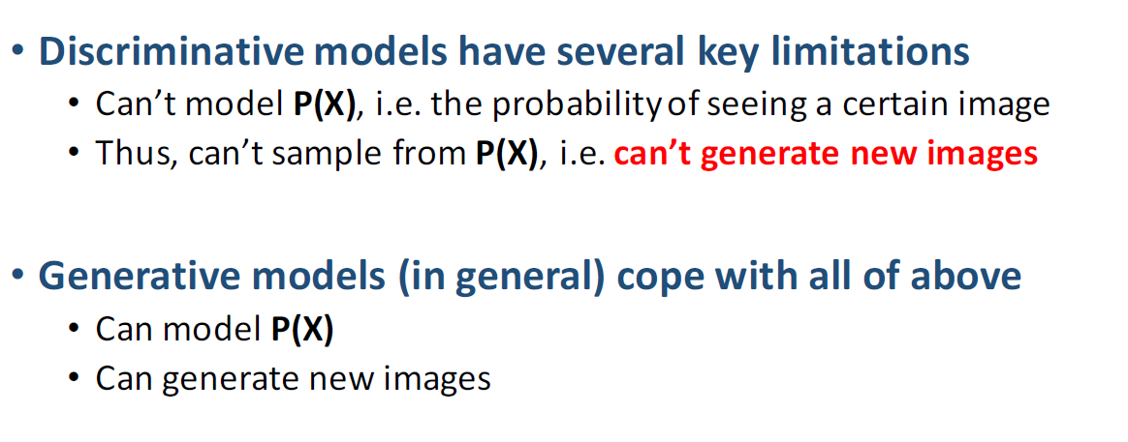
Discriminative v.s. Generative

Slide 11
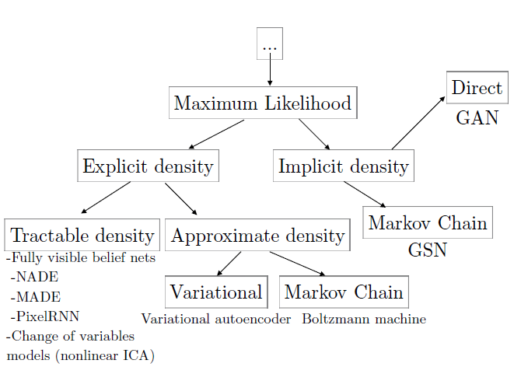
Types of GM

Slide 12
GAN : A two-player game
Generator : Generate fake images to fool the Discriminator
Discriminator : Distinguish between real and fake
Generator = counterfeiters
Discriminator = police
Train them together → get better Generator and Discriminator

Slide 13
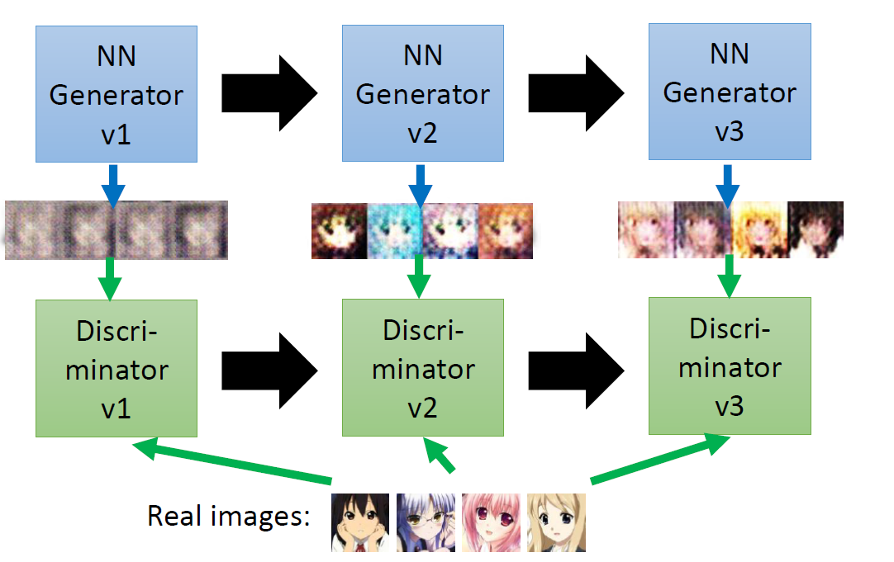
GAN : “evolution” through generation
Notes:
簡報出自李宏毅教授ppt

Slide 14
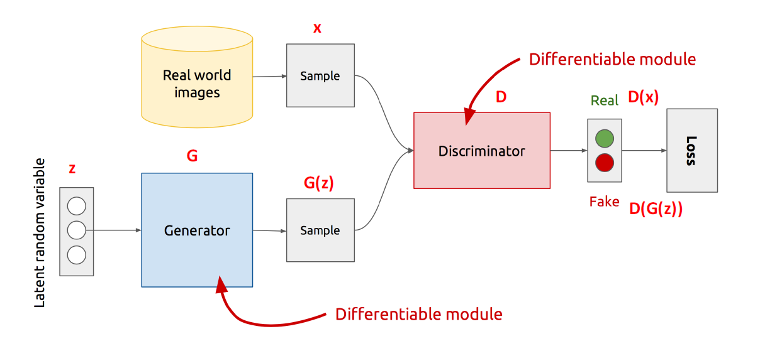
GAN model
• Z is some random noise (Gaussian/Uniform)
• Z can be thought as the latent representation of the image.

Slide 15
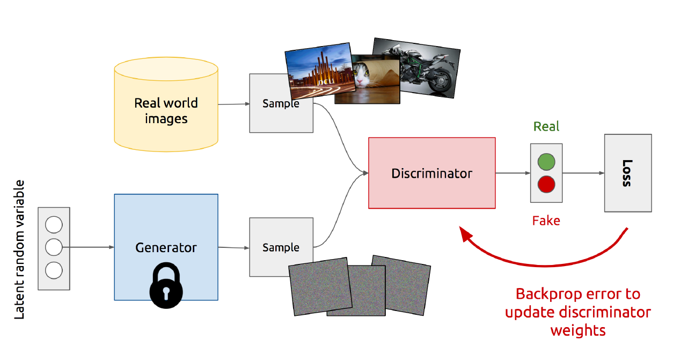
GAN training : Discriminator

Slide 16
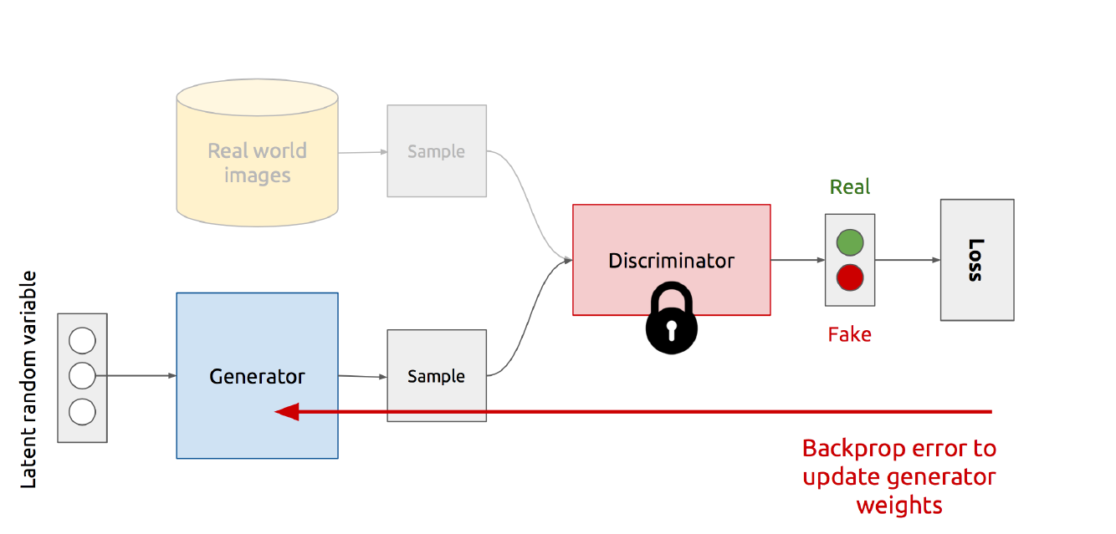
GAN training : Generator

Slide 17
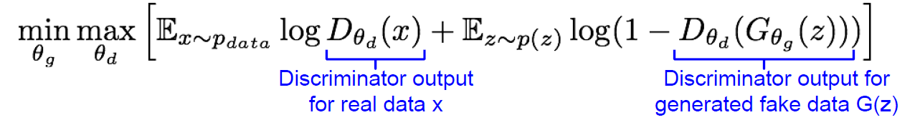
GAN training : min-max game
• The Discriminator is trying to maximize its reward V(G,D)
=> D(x) is close to 1 (real) and D(G(z)) is close to 0 (fake)
• The Generator is trying to minimize Discriminator’s reward
=> D(G(z)) is close to 1 (discriminator is fooled)

Slide 18
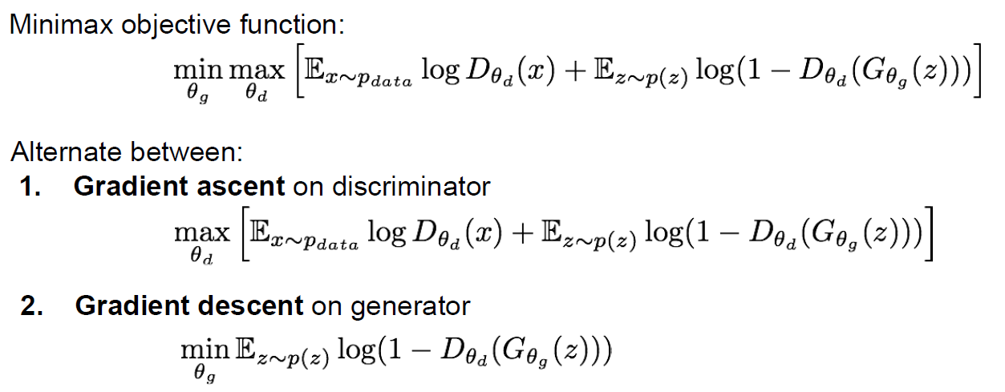
GAN training

Slide 19
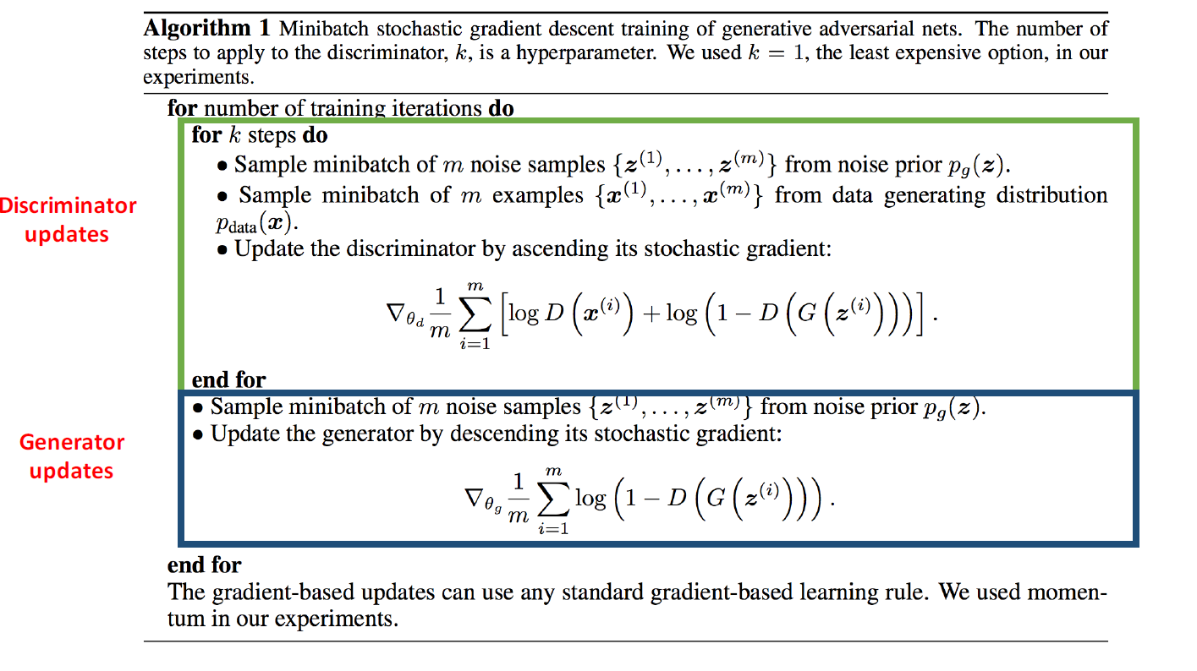

Slide 20
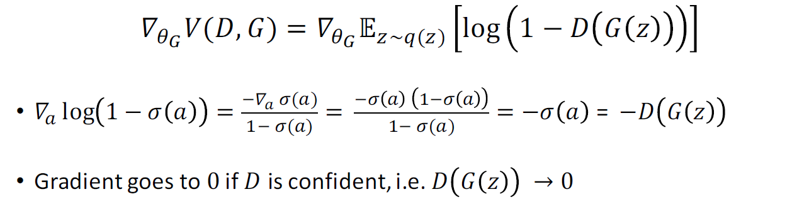
Training generator : Problem

Slide 21
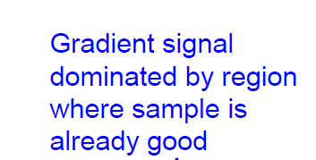
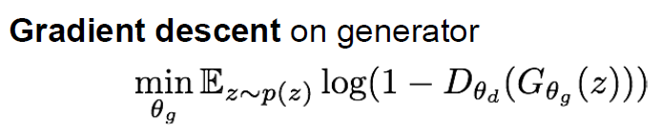
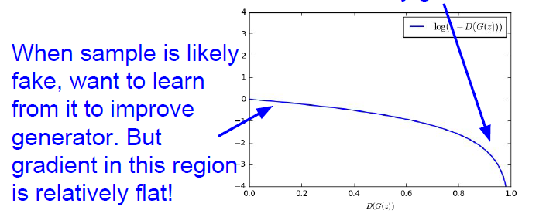
Training generator : Problem

Slide 22
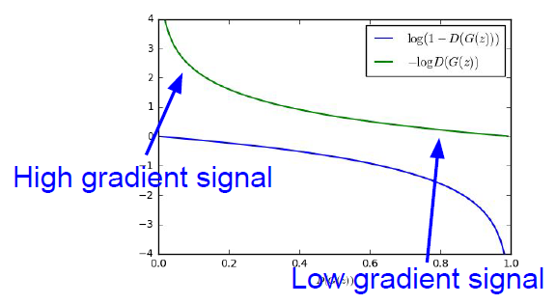

Training generator : trick
minimizing likelihood of discriminator being correct
<=>
maximize likelihood of
discriminator being wrong
Same objective of fooling discriminator,
but now higher gradient signal for bad samples

Slide 23
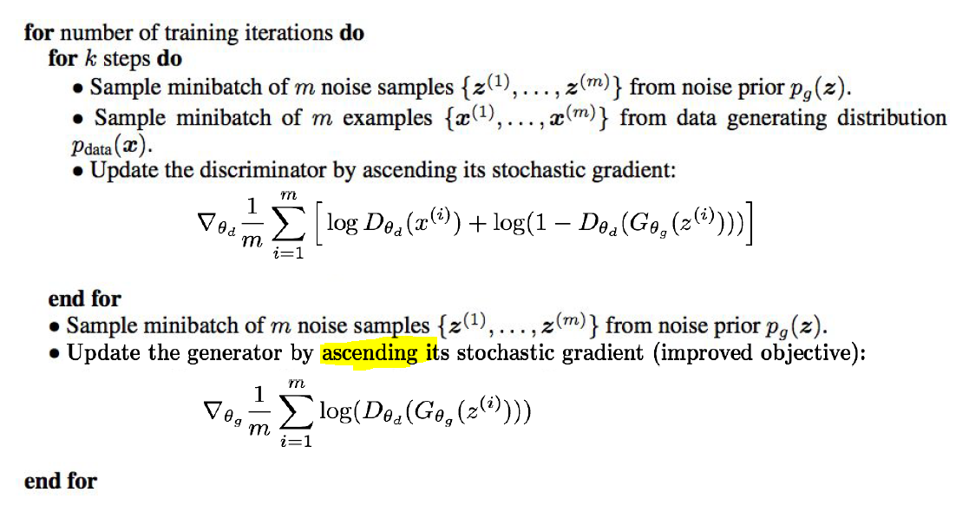
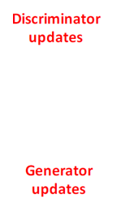

Slide 24
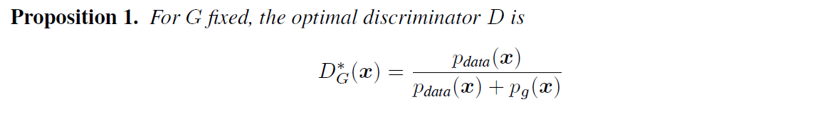
Convergence of GAN
In Game Theory, this is also the point of NASH EQUILIBIUM
(MATH WARNING!!)

Slide 25
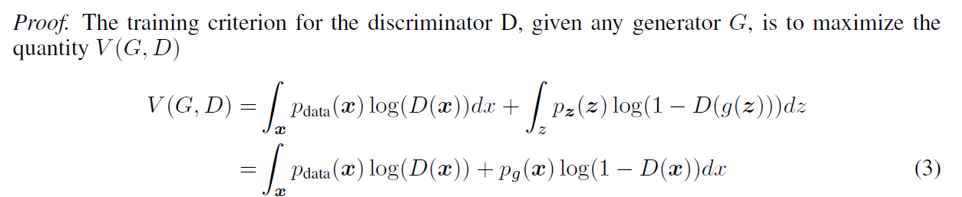
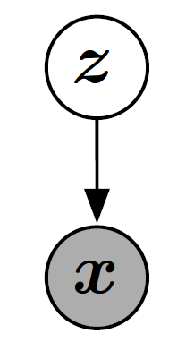
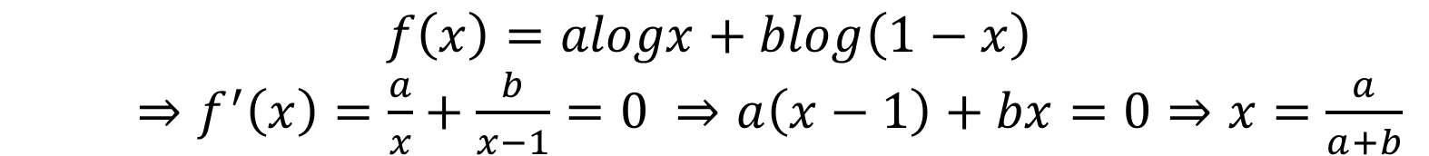
Prop.1 proof:
$$f\left(x\right)=alogx+blog\left(1−x\right)$$
$⇒f^{′}\left(x\right)=\frac{a}{x}+\frac{b}{x−1}=0 ⇒a\left(x−1\right)+bx=0⇒x=\frac{a}{a+b}$
$$a=p_{data}\left(x\right), b=p_{g}\left(x\right), x=D(x) ⇒proved$$
Notes:
G fixed,
x = G(z) ,
for every z, optimize at z ⬄ optimize at x

Slide 26
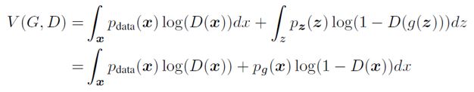
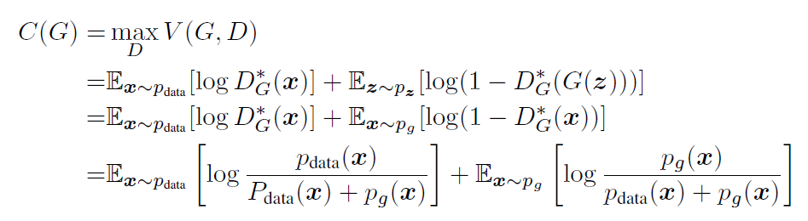
The. 1 proof:
<proof>
Reformulate our training criterion C(G) :
Notes:
Note that the training objective for D can be interpreted as maximizing the log-likelihood for estimating
the conditional probability P(Y = y|x), where Y indicates whether x comes from pdata
(with y = 1) or from pg (with y = 0). The minimax game in Eq. 1 can now be reformulated as:

Slide 27
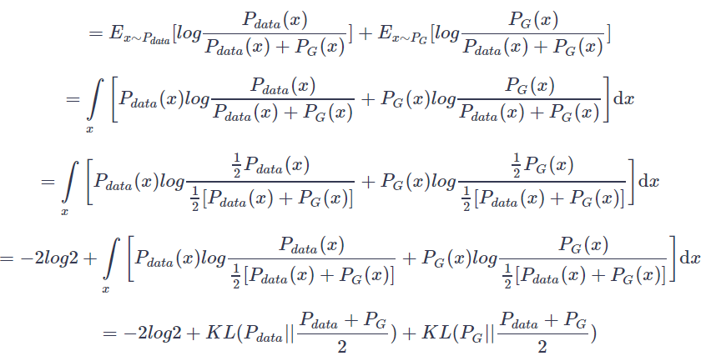
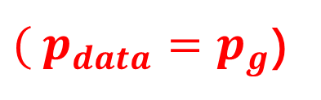

The. 1 proof:
$$C\left(G\right)$$
$( p_{data}=p_{g}$)
Notes:
Note that the training objective for D can be interpreted as maximizing the log-likelihood for estimating
the conditional probability P(Y = y|x), where Y indicates whether x comes from pdata
(with y = 1) or from pg (with y = 0). The minimax game in Eq. 1 can now be reformulated as:

Slide 28

JS-divergence
Since KL-divergence non-negative, so does JS-div.
JS-div. is symmetric

Slide 29

The. 1 proof:
Since JS-div is non-negative, here finishes our proof
The training of GAN is also the process of minimizing
JS-divergence
Notes:
Note that the training objective for D can be interpreted as maximizing the log-likelihood for estimating
the conditional probability P(Y = y|x), where Y indicates whether x comes from pdata
(with y = 1) or from pg (with y = 0). The minimax game in Eq. 1 can now be reformulated as:

Slide 30
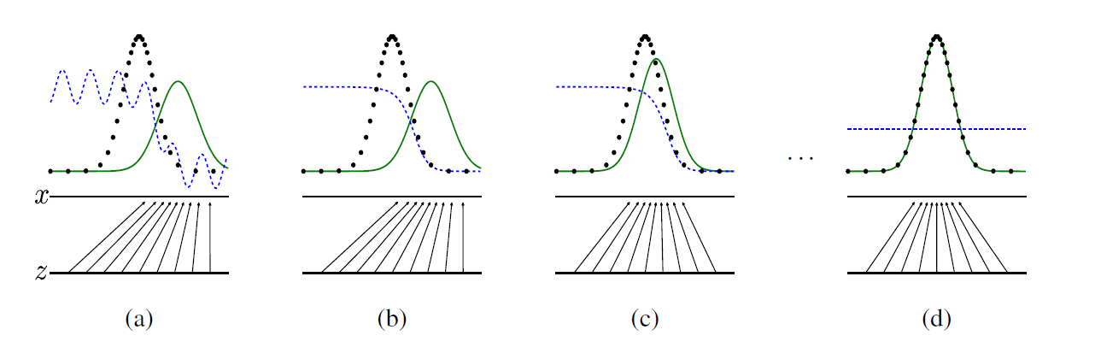
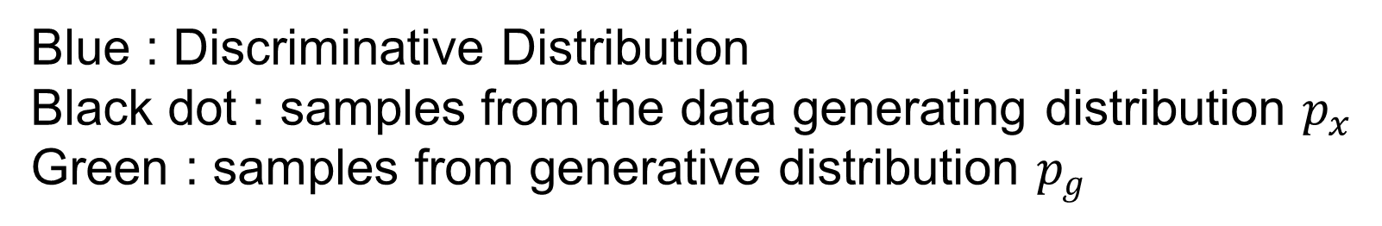
Graph of training GAN
Blue : Discriminative Distribution
Black dot : samples from the data generating distribution $p_{x}$
Green : samples from generative distribution $p_{g}$
Notes:
updating the discriminative distribution (D, blue, dashed line) so that it discriminates between samples from the data generating distribution (black, dotted line) px from those of the generative distribution pg (G) (green, solid line).
The lower horizontal line is the domain from which z is sampled, in this case uniformly.
The horizontal line above is part of the domain of x.
The upward arrows show how the mapping x = G(z) imposes the non-uniform distribution pg on transformed samples.
G contracts in regions of high density and expands in regions of low density of pg.
(a) Consider an adversarial pair near convergence: pg is similar to pdata and D is a partially accurate classifier.
(b) In the inner loop of the algorithm D is trained to discriminate samples from data, converging to D*(x) =pdata(x) / pdata(x)+pg(x) .
(c) After an update to G, gradient of D has guided G(z) to flow to regions that are more likely to be classified as data.
(d) After several steps of training, if G and D have enough capacity, they will reach a point at which both cannot improve because pg = pdata. The discriminator is unable to differentiate between the two distributions, i.e. D(x) = 0.5

Slide 31
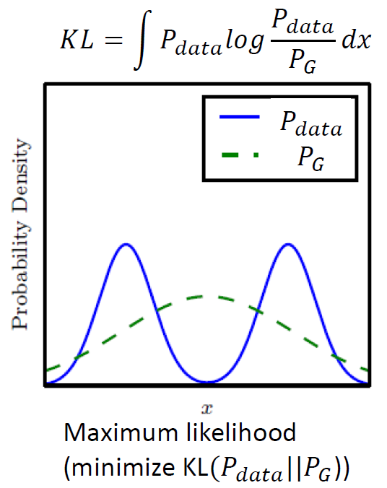
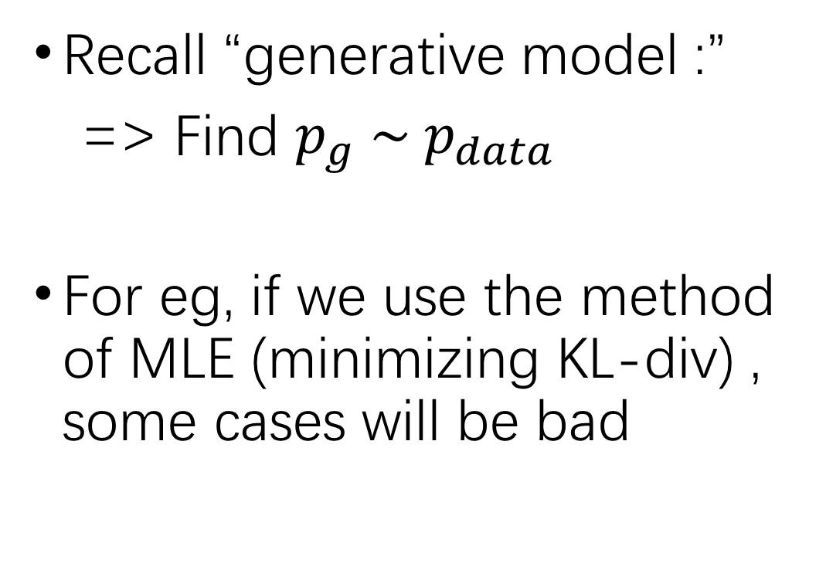
General form of GAN
Recall “generative model :”
=> Find $p_{g} \sim p_{data}$
For eg, if we use the method of MLE (minimizing KL-div) , some cases will be bad
Notes:
用分布PG去拟合分布Pdata，选择KL散度，会将诸多高概率的峰模糊化

Slide 32
fGAN
In fact, we can apply “f-divergence”
f-GAN is a general framework of GAN
( Math Warning！！）
Notes:
用分布PG去拟合分布Pdata，选择KL散度，会将诸多高概率的峰模糊化

Slide 33
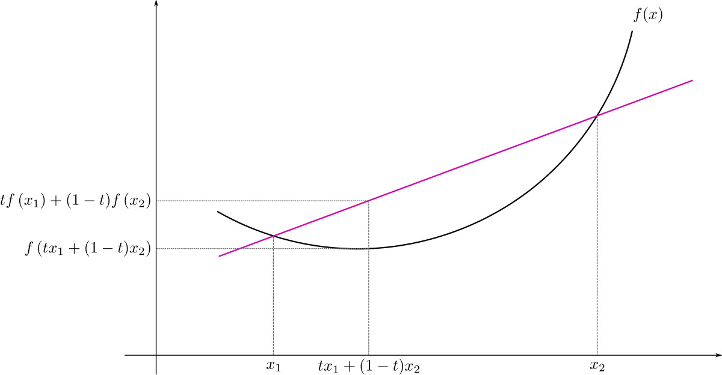

f-divergence
Recall : convex function
f(x) : a convex, f(1) = 0 function
f-divergence is non-negative
f-divergence can quantize difference between p,q using the function f

Slide 34
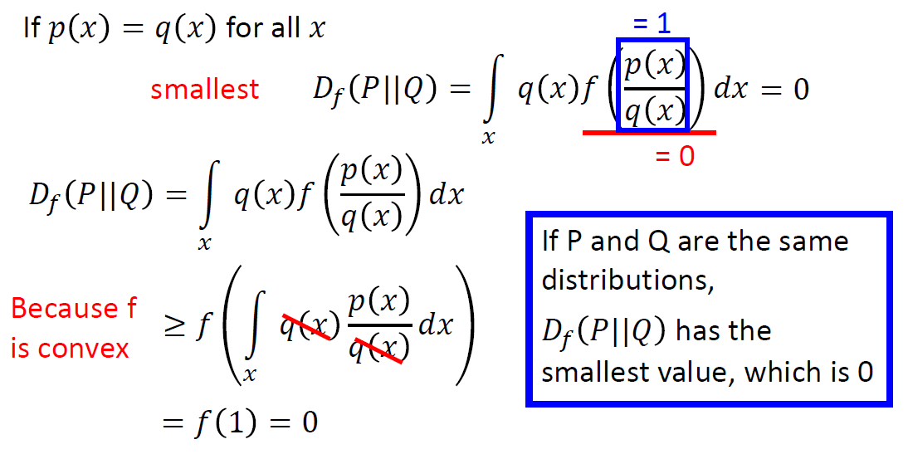
f-divergence is non-negative
Notes:
簡報出自李宏毅教授ppt

Slide 35
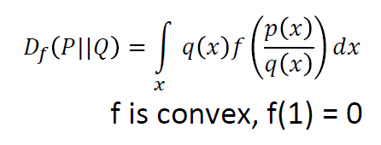
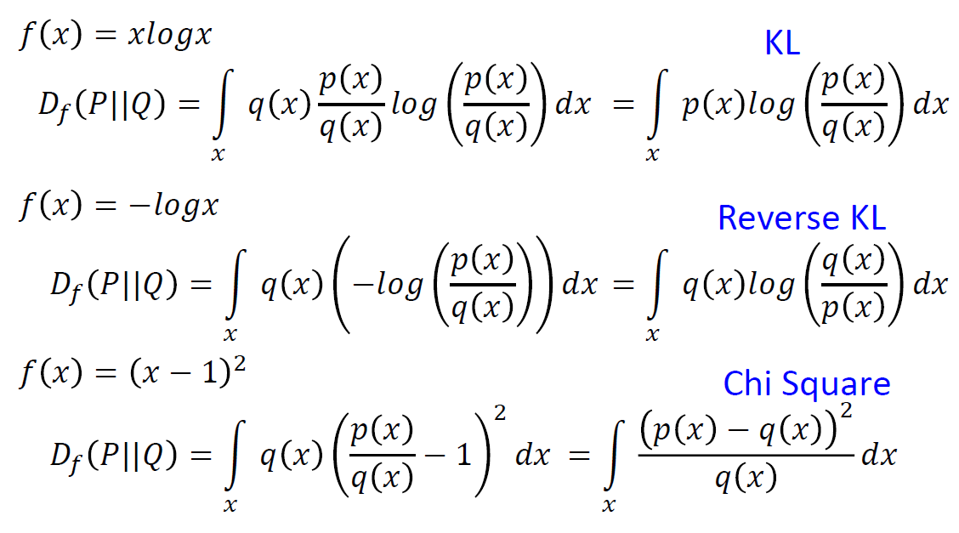
Some common f-divergence

Slide 36

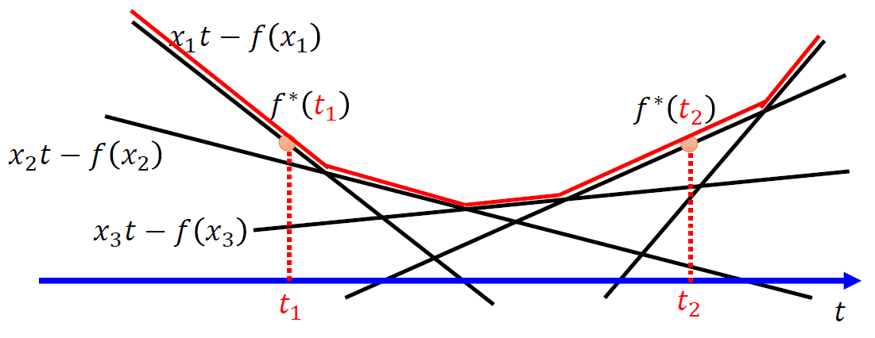
Fenchel Dual (Conjugate)
Every convex function f has its Fenchel Conjugate function f*
Notes:
備註 : 嚴謹的定義應該是上確界 sup , 但為了讓大家更好懂, 用max代替 (李宏毅教授的ppt)

Slide 37
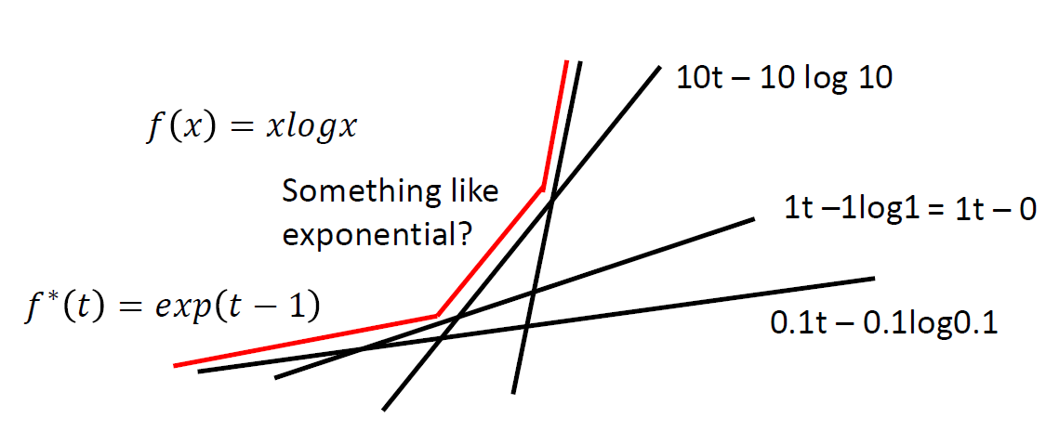
Fenchel Conjugate -- example

Slide 38

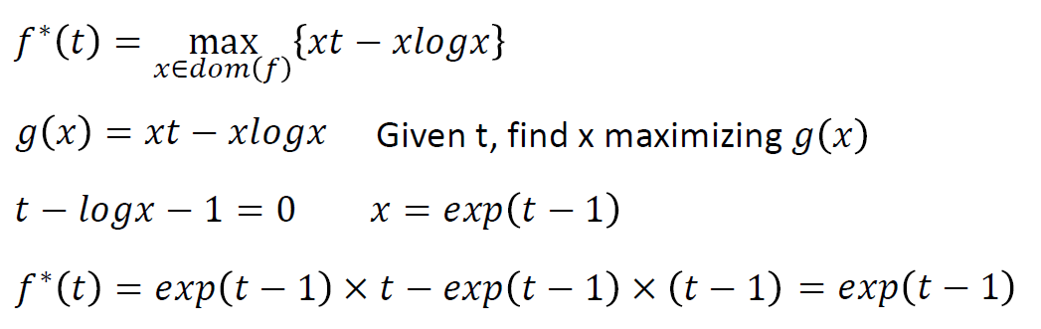
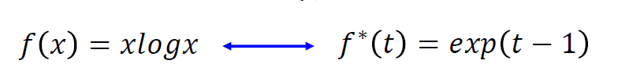
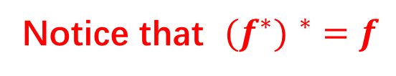
Fenchel Conjugate -- example
for f(x) = xlogx：
Notice that ${{(f}^{∗}) }^{∗}=f$

Slide 39
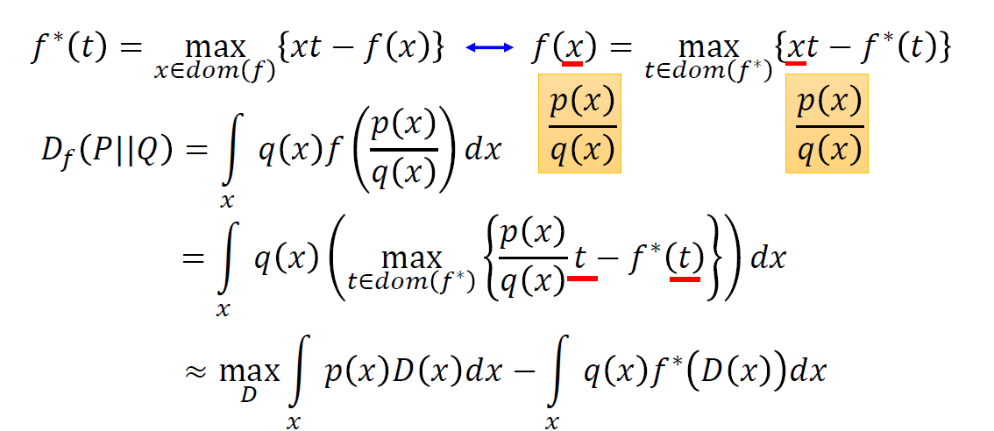
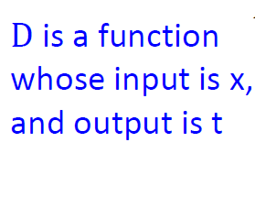
Connection with GAN

Slide 40
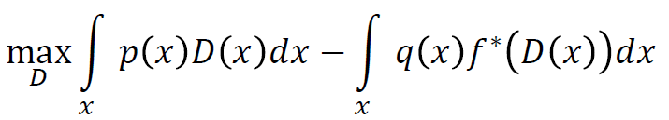
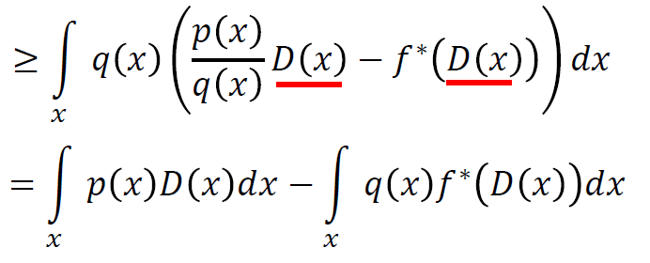



Connection with GAN
$$D_{f}(P|\left|Q\right)≈$$
$=$
sample from P sample from Q

Slide 41


Connection with GAN
Goal of Generator is to let $P_{G}\sim P_{data}$ => minimize f-div
$=$

Slide 42
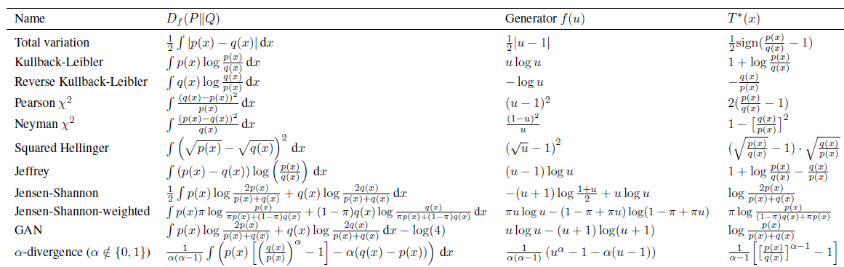
List of f-GANs

Slide 43
f-GAN Summary
GAN can be generalized to minimize f-divergences
The min-max comes from weakening the evaluation of D(P||Q) using the Fenchel dual
Rather than as an adversarial network G/D, can see GAN as a system for simultaneously approximating the divergence and minimizing the divergence

